Slide 1
感恩遇见，相互成就，本课件资料仅供您个人参考、教学使用，严禁自行在网络传播，违者依知识产权法追究法律责任。
更多教学资源请关注
公众号：溯恩高中英语
知识产权声明

Slide 2
B3U3
The Million Pound Bank Note
New Words and Expressions

Slide 3
重点单词
1. ________ n. (戏剧)一场;现场;场面;景色
2. ________ vt. & vi. 许可;允许 n. 通行证;许可证;执照
3. ________ vi. 凝视;盯着看
4. ________ vt. 发现;认出 n. 斑点;污点;地点
5. ________ vi. & vt. 认为;说明;总计有n. 说明;计算;帐目
6. ________ vt. & vi. (_______, _______) 寻找;探索;寻求
7. ________ n. 反面;对立面 adj. 相反的;相违的
8. ________ n. 出生地;故乡
9. ________ n. 小说;长篇故事 adj. 新奇的;异常的
10.________ n. 奇遇;冒险
11. ________ n. 短语;词组;惯用语
12.________ n. 著者;作家
scene
permit
stare
spot
account
seek
sought
sought
contrary
birthplace
novel
adventure
phrase
author

Slide 4
重点单词
wander
13. ________ vi. 漫游;漫步;漂泊
14. ________ n. 过错;缺点;故障
15. ________ n. 船费(包括食宿);通道(一)段
16. ________ n. 耐性;忍耐
17. ________ adj. 难以置信的
18. ________ n. 餐后甜点
19. ________ adj. 粗鲁的;无礼的
20. ________ n. 礼貌;举止;方式
21. ________ vi. 尖声叫 n. 尖叫声;喊叫声
22. ________ adj. 真的;真诚的
23. ________ n. 破布;碎布
24. ________ vi. & n. 鞠躬;弯腰
fault
passage
patience
unbelievable
dessert
rude
manner
scream
genuine
rag
bow

Slide 5
派生单词
1._________ vt. & vi. 许可 n. 通行证 _________ n.许可；批准
2._________ n. 过错;缺点;故障 _________ adj. 有错误的
3._________ v. 说明;总计有 n. 理由;帐目 _________ n. 会计员
4._________ n. 耐性;忍耐 _________ adj. 有耐心的
5._________ adj. 粗鲁的;无礼的 _________ n.粗鲁；原始
6._________ adj. 真的;真诚的 _________ adv. 由衷地；真诚地
7._________ n. 破布;碎布 _________ adj. 破旧的；褴褛的
8._________ n. 奇遇;冒险 _________ adj. 有冒险精神的
9._________ vi. 漫游;漫步;漂泊 _________ n.漫游者；漂泊者
permit
permission
fault
faulty
account
accountant
patience
patient
rude
rudeness
genuine
genuinely
rag
ragged
adventure
adventurous
wander
wanderer

Slide 6
重点短语
1.________________ 抚养;培养;教育;提出
2.________________ 前进;(用于祈使句)可以;往下说
3.________________ 偶然;无意中;不小心
4.________________ 盯着看;凝视
5.________________ 导致;做出解释
6.________________ 与此相反;正相反
7. _______________ 冒险
8. _______________ 衣衫褴褛
9. _______________ 关于;至于
10. _______________ 打赌
bring up
go ahead
by accident
stare at
account for
on the contrary
take a chance
in rags
as for
make a bet

Slide 7
词义释义
____________ a group of officials led by an ambassador who represent their government in a foreign country
____________ a person who writes books or the person who wrote a particular book
____________ a long narrow area with walls on either side that connects one room or place with another
____________ the house or area where a person was born, especially a famous person
____________ something that is wrong or not perfect
____________ the ability to spend a lot of time doing something difficult that needs a lot of attention and effort
____________ a flat part at the side of a road for people to walk on
embassy
author
passage
birthplace
fault
patience
pavement

Slide 8
话题词汇
Profession
businessman, barber, embassy, author
Food
steak, pineapple, dessert,
Words to describe people
penniless, patience, unbelievable, rude, manner, genuine, in rags

Slide 9
美句赏析
Not all those who _______ are lost. ---J. R. R. Tolkien
If you believe, ___________ things can sometimes be possible. ---Tim Tebow
You can be strong and true to yourself without being _____ or loud. ---Paula Radcliffe
The haters always ______ the loudest. ---Tucker Max
A historic defeat cannot ____ our heads forever. ---Neymar
wander
unbelievable
rude
scream
bow

Slide 10
遣词造句
Group 1: author; adventure; bring up
Group 2: pavement; wander; permit
Group 3: fault; by accident; spot
Group 4: seek; patience; rude
Group 5: in rags; genuine; manner
The author loves writing stories about adventure, which probably owes to the way he was brought up.
Pets are not permitted to wander on the pavement.
By accident he spotted the fault, which a lot of people failed to find.
He is seeking help from his friends, who, however, are rude to him and refuse to help him.
Though in rags, he was geuine and behaved in good manners.

Slide 11
核心词汇
1. permit
n. & v.
写出例句中permit的词性和含义
She would not permit herself to look at them.
v. 允许，准许
We have to visit the park, if time permits.
v. 使有可能
He has to apply for a permit, and we have to find him a job.
n. 许可证
派生词
permission n. 允许

Slide 12
Quiz
用permit改写句子
1. Dogs are not allowed inside the shop.
Dogs are not permitted inside the shop.
2. We can see a clear view of the lake with the large window.
The large window permits a clear view of the lake.

Slide 13
核心词汇
2. spot
v. & n.
将例句中spot的含义与右边中文意思匹配。
She was wearing a black skirt with white spots.
His jacket was covered with spots of mud.
He showed me the exact spot where he had asked her to marry him.
I finally spotted my friend in the crowd.
v. 看见；发现
n. 斑点
n. 地点；场所
n. 污渍；脏点

Slide 14
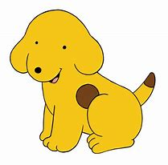
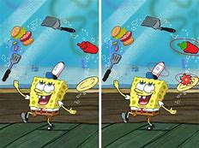
Quiz
根据图片写相关句子
The dog has a brown spot on its body.
Can you spot the difference between these two pictures?

Slide 15
核心词汇
3. account
v. & n.
写出例句中account相关短语的中文意思
He was too shocked to give an account of what had happened?
I've opened an account with Bank of China.
She retired early on account of ill health.
The company takes account of environment issues wherever possible.
The event was accounted a success.
The poor weather may have accounted for the small crowd.
给出...描述
开账户
因为
考虑到；顾及
认为是；视为
解释；导致

Slide 16
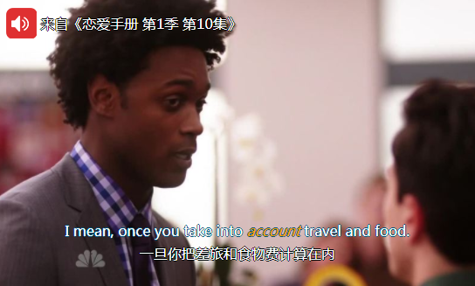
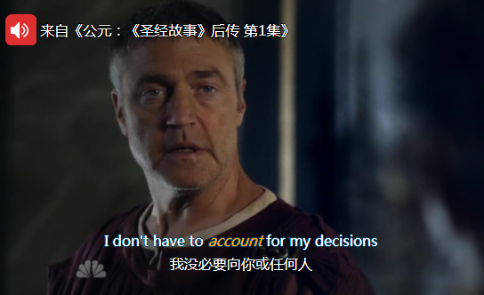
Quiz
台词翻译

Slide 17
核心词汇
4. seek
v.
根据例句写出seek的相关用法
I think it's time we sought legal advice.
Local schools are seeking to reduce the dropout rate.
She managed to calm him down and seek help from a neighbour.
Our mission is to seek out the enemy and destroy them.
seek sth 寻求...
seek to do sth
试图/设法做某事
seek sth from sb （向人）请求，寻求
seek out sth 找出，找到

Slide 18
Quiz
广告翻译
魅力女性，27岁，欲寻25-35岁男子，同玩共乐，发展友情。
Attractive woman, 27, seeks male, 25-35, for fun and friendship.

Slide 19
核心词汇
5. manner
n.
猜测例句中manner的意思
I hope you would behave in a more responsible manner.
She has a calm relaxed manner.
It is bad manners to talk with your mouth full.
It is a book about the life and manners of Victorian London.
方式，方法
态度，举止
礼貌，礼仪
习俗，风俗

Slide 20
Quiz
名言翻译
幸福不是你抵达的车站，而是旅行的方式。
Happiness is not a state to arrive at, but a manner of traveling.
(by Margaret Lee Runbeck)
良好的教养能打开最佳学历所打不开的门。
Good manners will open doors that the best education cannot.
(by Clarence Thomas)

Slide 21
即学即用
Samuel Langhorne Clemens, better known by his pen name Mark Twain, was an American writer. He was _________ in Hannibal, Missouri, which provided ______ of many of his works. His love for the Mississippi River _____________ his pen name. In many people’s eyes, writers are usually poor, and probably ______. _______________, Mark Twain earned a great deal of money from his writings. He also _____________ in investment, though he lost a lot of money in it. The ______ of many famous works such as The Adventures of Tom Sawyer (1876) and The Adventures of Huckleberry Finn (1885), Mark Twain is _______ "the father of American literature".
brought up
scenes
accounted for
in rags
On the contrary
took a chance
author
indeed

Slide 22
溯恩教育感谢一路有你

