Slide 1


感恩遇见，相互成就，本课件资料仅供您个人参考、教学使用，严禁自行在网络传播，违者依知识产权法追究法律责任。
更多教学资源请关注
公众号：溯恩英语
知识产权声明

Slide 2

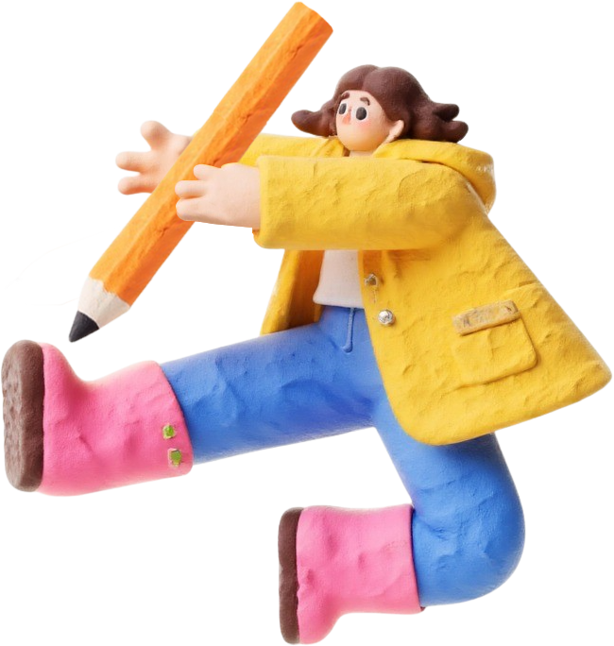


浙江强基联盟英语
2026届高三英语联考客观题解析
F A Y

Slide 3




语篇 | 体裁 | 话题 | 主要内容
A | News report | flooding in central Texas | 报道德克萨斯州中部因暴雨引发危险洪水，瓜达卢佩河泛滥，数百人离家。介绍伤亡与应急响应、救援面临的挑战、政府响应、恢复前景。
B | Narrative | A special fruit - and - vegetable stall in London | 讲述了敦卡姆登小巷特殊果蔬摊，摊主华裔移民 Lena Wong 凭诚信系统经营、低价售物，因年轻人困境决定帮扶，顾客有机会当面致谢并聆听她的植物格言，考查摊位特点与人物等细节 。
C | Expository | TQ (Technology Quotient) | 讨论了TQ（技术商数 ），类比为理解新技术的超能力，说明其是运用、适应技术的量化能力，对比 IQ、EQ，强调对个人发展及融入技术时代的关键作用，考定义、人群判断等 。
D | Expository | Impacts of roads on wildlife | 剖析道路对野生动物的影响，包括道路杀戮、阻碍迁徙、化学污染及 “生态陷阱” 威胁，也提交通减少时动物的适应案例（如白冠麻雀 ）与部分物种的进化应对（如城市狐狸 ），考影响、推理等 。
七 选 五 | Expository | AI Companion | 本文介绍主开发者 Alex Chen 为让交互自然有用，日常优化系统，讲用户（学生、作家 ）对其辅助学习、创作的好评，及团队测试新功能（语音交互等 ），考查语句填充，关联开发目标与用户体验 。
BACKGROUND OVERVIEW

Slide 4

阅读理解详解
01
Reading Comprehension Detailed Analysis

Slide 5

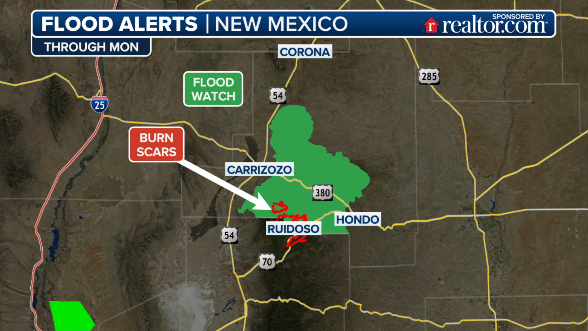
A
Flooding in central Texas

Slide 6
A
Days of heavy rain caused dangerous flooding in central Texas on Friday. The Guadalupe River overflowed, flooding neighborhoods and washing away roads and bridges. Hundreds of people had to leave their homes. Officials say this is the worst flooding the region has seen in years. Below is the breakdown of damages by county.
Below were key updates as of Friday night.
1. Casualties & Emergency Response
The floods have killed 24 people, and 25 campers from Camp Mystic remain missing as searches continue. Emergency crews including the Texas National Guard have rescued 237people using helicopters supported by over 500 personnel from federal agencies (including FEMA and the U. S. Coast Guard) that are currently assisting in affected areas.
2. Challenges
Rescue teams struggled to reach isolated communities as flooded roads and downed power lines blocked access, delaying critical aid. To make matters worse, early weather warnings had underestimated the flood's severity, leaving residents little time to reach safety.
3. Government Response
Governor Greg Abbott issued an emergency disaster declaration for 15 central Texas counties, accelerating state funding for recovery efforts. Lieutenant Governor Dan Patrick noted communication outages likely delayed locating missing campers.
4. Recovery Outlook
The Red Cross has set up 12 shelters, helping more than 1,200 displaced families. Environmental agencies warn that flooded factories could cause pollution. Meanwhile , transportation officials say highway repairs may take weeks.
County | Economic Losses | Buildings Damaged
Hunt | $28 million | 85 (including 12 historic structures)
Kerr | $15 million | 62 (including 3 bridges, 2 historic buildings)
Comal | $5 million | 34(including 2 highways)
Blanco | $2 million | 18(including 1 historic building)
21. Which county was most severely affected in the floods? A
22. How many people have been saved by emergency crews as of Friday night? B
23. What did Governor Greg Abbott do in response to the disaster? D
issue: If you issue a statement or a warning, you make it known formally or publicly.
--- issue a statement
---issue a warning

Slide 7
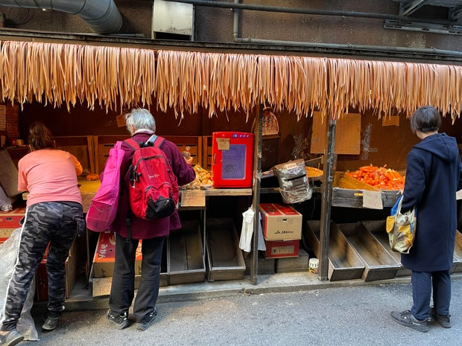
B
A special fruit-and-vegetable stall in London

Slide 8
B
1In a city of wealth, comfort and fine food, there's a quiet alley(小巷) in London’s Camden where passers-by often take several photos. Sharing space with elegant cafes and world-class bars, a tiny fruit and vegetable stand seems to have been transported from a country road far away. But what makes the stall even more remarkable in the heart of Camden is that payment is on the honor system— customers just throw coins into an old mailbox— and most of the items on offer are priced at £ l in a neighborhood where fresh food usually goes for much, much more.
2The greengrocer with a heart of gold——a Chinese immigrant in her 50s who runs this stall alone—— is rarely glimpsed by her grateful customers. Lena Wong rises before dawn to prepare to work in her small plot in Enfield, outside London, Depending on the season, she’ll reap onions, eggplant, green peppers, etc. And she works several overnight shifts every week at a nursing home to supplement her and her husband's modest salaries.
3All this started one day as she was selling produce in Enfield, and a young customer said that he barely earned enough to buy food. “I hate the idea of young people walking around hungry,” Lena Wong said, The seed was planted. “I want young people to feel that they’ re not forgotten, that they are treasured,” she said. “That not everyone is out for himself. I can make money anytime. Right now, I want to give young people a helping hand.”
4Sometimes, when she arrives late in the day, customers get a chance to thank her in person. In return, she's fond of offering botanical sayings that she collected from a life that has had its share of both joy and pain. “Even in a field full of weeds,” Lena Wong likes to say, “you can grow something— if you put in the effort.”
Introduction
—the stall’s Distinctiveness
the stall owner’s Routine
the origin and
the motivation
Interaction & Sayings
thread of the narrative: Stall - centered introduction---Lena’s identity & daily efforts---Origin of goodwill---Kindness in action & life wisdom

Slide 9
B
1In a city of wealth, comfort and fine food, there's a quiet alley(小巷) in London’s Camden where passers-by often take several photos. Sharing space with elegant cafes and world-class bars, a tiny fruit and vegetable stand seems to have been transported from a country road far away. But what makes the stall even more remarkable in the heart of Camden is that payment is on the honor system— customers just throw coins into an old mailbox— and most of the items on offer are priced at £ l in a neighborhood where fresh food usually goes for much, much more.
2The greengrocer with a heart of gold——a Chinese immigrant in her 50s who runs this stall alone—— is rarely glimpsed by her grateful customers. Lena Wong rises before dawn to prepare to work in her small plot in Enfield, outside London, Depending on the season, she’ll reap onions, eggplant, green peppers, etc. And she works several overnight shifts every week at a nursing home to supplement her and her husband's modest salaries.
The honor system: A system based on trust, where people are expected to follow rules (e.g., pay, take exams fairly) without external supervision, relying on their own honesty and sense of responsibility.
24. Why is the stall in the quiet alley special?
A. It is located in an expensive cafe. B. People often take good pictures there.
C. It operates on a trust and credit system. D. The goods sold there come from distant places.
25. What can we learn about Lena Wong's job?
A. It requires her to work long hours. B. It pays well to support her family.
C. It attracts widespread media attention. D. It focuses on organic produce.
Modest salaries: a meager salary; a modest income; a low-paying job; a skimpy salary/pay

Slide 10
B
3All this started one day as she was selling produce in Enfield, and a young customer said that he barely earned enough to buy food. “I hate the idea of young people walking around hungry,” Lena Wong said, The seed was planted. “I want young people to feel that they’ re not forgotten, that they are treasured,” she said. “That not everyone is out for himself. I can make money anytime. Right now, I want to give young people a helping hand.”
4Sometimes, when she arrives late in the day, customers get a chance to thank her in person. In return, she's fond of offering botanical sayings that she collected from a life that has had its share of both joy and pain. “Even in a field full of weeds,” Lena Wong likes to say, “you can grow something— if you put in the effort.”
26. Who inspired Lena Wong to help others?
A. Her grateful customers. B. A hungry youth.
C. Her modest husband. D. Some young people.
27. Which of the following best describes Lena Wong according the text?
A. Kind-hearted. B. Well-educated.
C. Job-centered. D. Strong-willed.

Slide 11

C
TQ (Technology Quotient)

Slide 12
C
1New era requires a new vocabulary. Will we still talk about the “mobile” phone when all phones are mobile, or when they are implanted within us?
2Technology is everywhere nowadays, especially at work. Some people are really good at using all the cool new tools that keep popping up. They have something called a TQ, or technology quotient. Think of it like a superpower for understanding the latest tech stuff that our great-grandparents would have found really impossible. Having a high TQ means you' re awesome at using all the cool new things that not everyone knows about yet.
3The examples are common and becoming more and more frequent. For the parent it might be a home-school video class. For the brand manager it might be search engine boosting. And for the clinician, it might be the role of artificial intelligence in supporting the analysis of a CTscan. TQ attempts to quantify our ability to make sensible use of current technologies and to quickly adapt, embrace and capitalize on future creations. This adoption is critical from a variety of perspectives, from social to business. One trip into the world of ChatGPT and we can see how the dynamics of AI and search are changing for just about everyone.
4Any Mom or Dad can understand the value of IQ and EQ in projecting the potential for a child's success. But what about technology? The ability for the child and the teacher to understand, embrace and assimilate technology will be a defining aspect of their lives as we speed into the future. We are increasingly defined by technology and our active participation in everything from smart phones to Facebook. It might just be time for the basic human needs of food, water and shelter to incorporate technology too. And when that happens, it just might be a good idea to measure it.
5While this shift brings challenges, it's unstoppable. As TQ rises, it will combine with IQ and EQ, reshaping how we live, work, and learn—— turning adaptability with tech into a measurable edge.
Introduction
— the concept of TQ
TQ’s application
TQ’s importance
TQ’s outlook
The main thread: The introduction--- the definition---the application----the value---the future outlook

Slide 13
C
1New era requires a new vocabulary. Will we still talk about the “mobile” phone when all phones are mobile, or when they are implanted within us?
2Technology is everywhere nowadays, especially at work. Some people are really good at using all the cool new tools that keep popping up. They have something called a TQ, or technology quotient. Think of it like a superpower for understanding the latest tech stuff that our great-grandparents would have found really impossible. Having a high TQ means you' re awesome at using all the cool new things that not everyone knows about yet.
3The examples are common and becoming more and more frequent. For the parent it might be a home-school video class. For the brand manager it might be search engine boosting. And for the clinician, it might be the role of artificial intelligence in supporting the analysis of a CTscan. TQ attempts to quantify our ability to make sensible use of current technologies and to quickly adapt, embrace and capitalize on future creations. This adoption is critical from a variety of perspectives, from social to business. One trip into the world of ChatGPT and we can see how the dynamics of AI and search are changing for just about everyone.
28. What is TQ according to the text?
A. Speed of learning new languages. B. Skill of fixing high-tech products.
C. Talent to follow modern changes. D. Ability to apply new technologies.
29. Which of the following people has a high TQ?
A. A manager who often uses modern search engines.
B. A doctor who analyzes CT scans with AI assistance.
C. A grandparent who finds new tech devices awkward.
D. A mom who watches videos of her child's school life.
29. Which of the following people has a high TQ?
A. A manager who often uses modern search engines.
B. A doctor who analyzes CT scans with AI assistance.
C. A grandparent who finds new tech devices awkward.
D. A mom who watches videos of her child's school life.
search engine boosting: the practice of using various techniques to improve a website, webpage, or content's visibility, ranking, or relevance in search engine results pages.

Slide 14
C
4Any Mom or Dad can understand the value of IQ and EQ in projecting the potential for a child's success. But what about technology? The ability for the child and the teacher to understand, embrace and assimilate technology will be a defining aspect of their lives as we speed into the future. We are increasingly defined by technology and our active participation in everything from smart phones to Facebook. It might just be time for the basic human needs of food, water and shelter to incorporate technology too. And when that happens, it just might be a good idea to measure it.
5While this shift brings challenges, it's unstoppable. As TQ rises, it will combine with IQ and EQ, reshaping how we live, work, and learn—— turning adaptability with tech into a measurable edge.
30. What does the underlined word “assimilate” in the fourth paragraph mean?
Rely on. B. Take in. C. Benefit from. D. Learn about.
31. What might be the best title for the passage?
A. Why Are IQ and EQ Important for TQ? B. How Has TQ Changed in the Modern Era?
C. What Makes TQ the New Intelligence? D. Where to Start Adapting to TQ Changes?
Take in: to comprehend information/skills deeply and absorb them into one’s own understanding.
★The best title requires aligning with the text’s core subject, key information, and logical focus—it should neither be too broad (missing critical details) nor too narrow (ignoring the main topic)..
The main thread: The introduction--- the definition---the application----the value---the future outlook

Slide 15
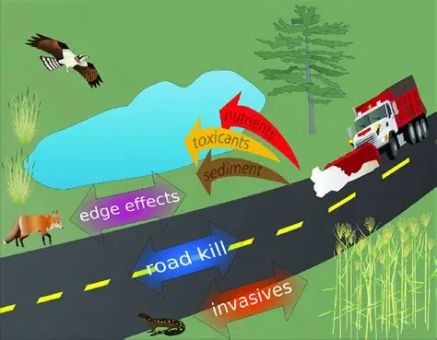
D
Impacts of roads on the wildlife

Slide 16
D
1Through evolution, animals have developed numerous ways to protect themselves from predators(捕食者). Turtles hide in their shells, and skunks(臭鼬) use smelly liquid. But these defenses don't work against cars. Environmental journalist Ben Goldfarb explains, “When facing a car, these defenses are useless—— or even harmful. Staying still is the worst choice. Roadkill is a serious threat to wildlife.”
2Roads also act as barriers, preventing animals from moving freely. The constant traffic on highways creates what scientists call a “moving fence”——a wall of vehicles that animals avoid crossing. While we often see dead animals like deer or squirrels on roads, we don't see the ones that never try to cross. This isolation can harm animal populations more than roadkill itself.
3Chemicals from roads also damage the environment. Every year, the U. S. uses 20 million tons of road salt to melt ice, which pollutes nearby soil and plants. Cars release metals like zinc and copper, and tires leave behind microplastics. These pollutants make roadsides dangerous for creatures like monarch butterflies, even though these areas could otherwise be good habitats.
4Roadsides sometimes attract animals with food like flowers or berries, but this becomes an “ecological trap”. Animals are drawn to these resources, only to face the danger of traffic.
5Interestingly, when traffic decreases, animals quickly adapt. Researchers in the Bay Area found that when cars disappeared for months, white-crowned sparrows— small songbirds——started singing more complex and varied songs. Without traffic noise, they no longer needed to “shout” and could return to their natural behaviors. This shows how much roads affect wildlife—— but also how adaptable animals can be.
6Despite these challenges, Goldfarb says, certain species have made remarkable adaptations. He notes that Chicago's urban foxes are said to look both ways before crossing the street, “We think about roads as these forces that are universally or exclusively harmful to animals, and certainly they' re incredibly destructive,” he says. “But wildlife is also impressively adaptive and clever and animals are finding ways to make a living in our midst.”
The problem
—Roadkill Threat
Movement Barrier
Chemical Pollution
Ecological Trap & Adaptation Case
Adaptive Species
The main thread: the multiple-dimensional harms that roads pose to wildlife, as well as the adaptability displayed by wildlife in response to these impacts

Slide 17
D
1Through evolution, animals have developed numerous ways to protect themselves from predators(捕食者). Turtles hide in their shells, and skunks(臭鼬) use smelly liquid. But these defenses don't work against cars. Environmental journalist Ben Goldfarb explains, “When facing a car, these defenses are useless—— or even harmful. Staying still is the worst choice. Roadkill is a serious threat to wildlife.”
2Roads also act as barriers, preventing animals from moving freely. The constant traffic on highways creates what scientists call a “moving fence”——a wall of vehicles that animals avoid crossing. While we often see dead animals like deer or squirrels on roads, we don't see the ones that never try to cross. This isolation can harm animal populations more than roadkill itself.
roads → blocked movement → population separation (isolation)
32. How does the author start the text in the first paragraph?
A. By stating a reason. B. By providing statistics.
C. By defining a concept. D. By giving examples.
33. What harmful impact do roads have on wildlife?
A. Less food supply. B. Restricted movement.
C. Increased predators. D. Species extinction.
restricted: This means animals on one side of the road can no longer travel to the other side—their movement is directly restricted (they can’t move freely across the road to find food, mates, or new habitats).

Slide 18
D
1Through evolution, animals have developed numerous ways to protect themselves from predators(捕食者). Turtles hide in their shells, and skunks(臭鼬) use smelly liquid. But these defenses don't work against cars. Environmental journalist Ben Goldfarb explains, “When facing a car, these defenses are useless—— or even harmful. Staying still is the worst choice. Roadkill is a serious threat to wildlife.”
2Roads also act as barriers, preventing animals from moving freely. The constant traffic on highways creates what scientists call a “moving fence”——a wall of vehicles that animals avoid crossing. While we often see dead animals like deer or squirrels on roads, we don't see the ones that never try to cross. This isolation can harm animal populations more than roadkill itself.
3Chemicals from roads also damage the environment. Every year, the U. S. uses 20 million tons of road salt to melt ice, which pollutes nearby soil and plants. Cars release metals like zinc and copper, and tires leave behind microplastics. These pollutants make roadsides dangerous for creatures like monarch butterflies, even though these areas could otherwise be good habitats.
4Roadsides sometimes attract animals with food like flowers or berries, but this becomes an “ecological trap”. Animals are drawn to these resources, only to face the danger of traffic.
5Interestingly, when traffic decreases, animals quickly adapt. Researchers in the Bay Area found that when cars disappeared for months, white-crowned sparrows— small songbirds——started singing more complex and varied songs. Without traffic noise, they no longer needed to “shout” and could return to their natural behaviors. This shows how much roads affect wildlife—— but also how adaptable animals can be.
6Despite these challenges, Goldfarb says, certain species have made remarkable adaptations. He notes that Chicago's urban foxes are said to look both ways before crossing the street, “We think about roads as these forces that are universally or exclusively harmful to animals, and certainly they' re incredibly destructive,” he says. “But wildlife is also impressively adaptive and clever and animals are finding ways to make a living in our midst.”
34. What can we infer from Goldfarb's words in the last paragraph?
A. Roads are not truly harmful to wildlife. B. Urban foxes seldom get hit by vehicles.
C. Animals adapt cleverly to dangerous roads. D. Wildlife protection deserves highest attention.
35. What is the author's purpose in writing this passage?
A. To advocate reducing traffic. B. To preserve wildlife diversity.
C. To analyze roads’ effects on wildlife. D. To highlight roadkill danger to animals.

Slide 19

七选五
AI companion

Slide 20
1Need a quick answer or just a smart assistant in your pocket? The AI Companion offers exactly that— and much more.
2Alex Chen, the lead AI developer behind this project, wears his signature hoodie(连帽衫) and glasses as he adjusts the system daily. His goal? 36 The AI processes requests in milliseconds, responding with clear, well-structured answers. When users engage with it, a friendly “How can I assist you today?” sets the tone——a small but meaningful touch that makes the exchange feel personal. Even during peak hours, when thousands of requests flood in all at once, the AI remains reliable, never sacrificing speed or accuracy.
3Chen's day begins at 5:30 a. m., reviewing user feedback and working on the Al's learning models. 37 “I want this technology to feel effortless—— like chatting with a knowledgeable friend,” he explains. His passion for AI arises from years of studying machine learning, but what truly drives him is making complex tech accessible to everyone.
4 38 Lisa Park, a university student majoring in computer science, relies on the AI daily. “It's not just about getting answers—— it's how the AI explains things. Even difficult concepts become easy to grasp,” she says. For her, the AI isn't just a tool. 39 Another user, Mark Reynolds, a freelance writer, adds, “It helps me brainstorm ideas faster than I could alone. The suggestions are creative and actually useful.”
5“I can't imagine working on anything else,” Chen admits. 40 His team is already testing new features, like voice interaction and real-time language translation, to expand its capabilities.
Introduction
AI Performance & Features
Developer’s Work & Motivation
User Feedback
A. It's a study partner that adapts to her learning style.
B. To ensure every interaction feels natural and helpful.
C. He organizes weekly user meetings to collect advice.
D. After five years of refining the AI, he's determined to make it smarter.
E. Some mornings, he logs in early to push updates before users wake up.
F. What Chen might not realize is how much his work impacts daily lives.
G. Not only does it provide instant solutions, it also offers human-like experience.
Developer’s Passion & Future Plans

Slide 21
1Need a quick answer or just a smart assistant in your pocket? The AI Companion offers exactly that— and much more.
2Alex Chen, the lead AI developer behind this project, wears his signature hoodie(连帽衫) and glasses as he adjusts the system daily. His goal? 36 The AI processes requests in milliseconds, responding with clear, well-structured answers. When users engage with it, a friendly “How can I assist you today?” sets the tone——a small but meaningful touch that makes the exchange feel personal. Even during peak hours, when thousands of requests flood in all at once, the AI remains reliable, never sacrificing speed or accuracy.
3Chen's day begins at 5:30 a. m., reviewing user feedback and working on the Al's learning models. 37 “I want this technology to feel effortless—— like chatting with a knowledgeable friend,” he explains. His passion for AI arises from years of studying machine learning, but what truly drives him is making complex tech accessible to everyone.
4 38 Lisa Park, a university student majoring in computer science, relies on the AI daily. “It's not just about getting answers—— it's how the AI explains things. Even difficult concepts become easy to grasp,” she says. For her, the AI isn't just a tool. 39 Another user, Mark Reynolds, a freelance writer, adds, “It helps me brainstorm ideas faster than I could alone. The suggestions are creative and actually useful.”
5“I can't imagine working on anything else,” Chen admits. 40 His team is already testing new features, like voice interaction and real-time language translation, to expand its capabilities.
Introduction
36.回答问题，引出下文。B. To ensure every interaction feels natural and helpful.
AI Performance & Features
Developer’s Work & Motivation
37.主题一致，逻辑连贯。（Chen 清晨工作场景→工作动机）
C. He organizes weekly user meetings to collect advice.
E. Some mornings, he logs in early to push updates before users wake up.
38.段落结构，段落主旨。F. What Chen might not realize is how much his work impacts daily lives.
39.句式，逻辑，语义。A. It's a study partner that adapts to her learning style.
User Feedback
40.逻辑，语义。（当下态度→过往投入→未来计划）
D. After five years of refining the AI, he's determined to make it smarter.
Developer’s Passion & Future Plans

Slide 22
完形填空详解
文章以作者在塞拉利昂邦巴利区的实地观察为切入点，通过 16 岁少年伊萨（Issa）的经历，展现了当地教育的矛盾现状与积极变化
02

Slide 23
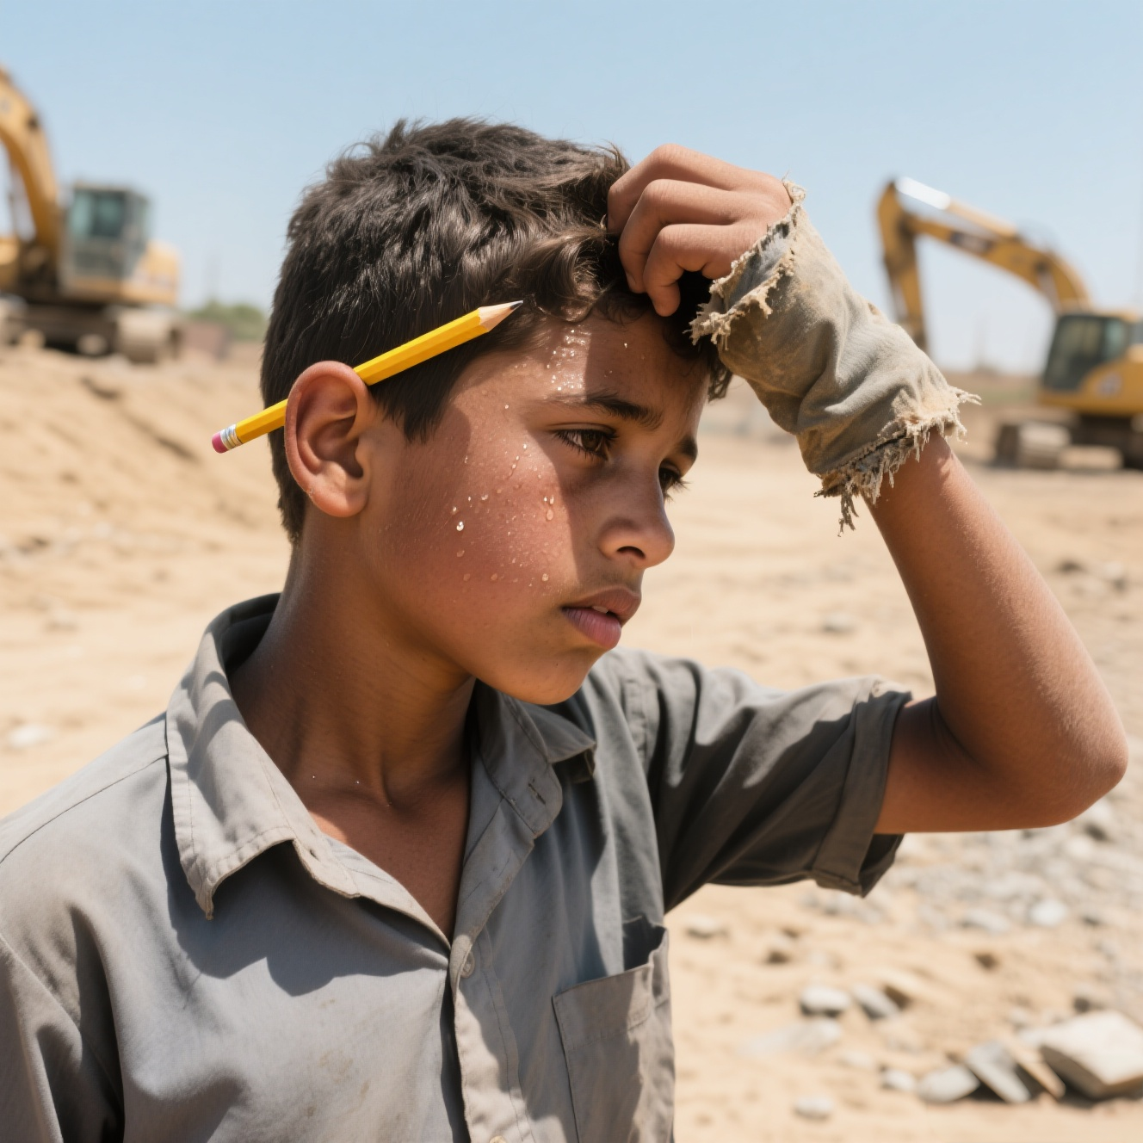
One afternoon in Sierra Leone's Bombali District, my jeep passed fields where children harvested crops. 41 , I approached a tall, thin teenager working hard under the blazing sun.
“Shouldn't you be in class?” I asked, noticing the pencil behind his ear. Issa, 16, 42 his forehead with a worn-out sleeve. “The school building 43 after the rains,” he explained. “Without walls, we take turns 44 under a mango tree when the teacher comes.” His words revealed Sierra Leone's contradiction in 45 . While the government 46 school fees in 2018 and built hundreds of new schools, many still need repairs. About 32% of children here still 47 primary school— though down from 62% a decade ago.
“Last month,” Issa 48 , “they gave us textbooks”, making a 49 to his barefoot sisters. “But no shoes means no school.” Later, at a UNICEF center, I saw 50 in action: solar lamps, shared notebooks, mobile libraries reaching 51 villages.
National enrollment rose from 1.2 million to 2.1 million since 52 began. Girls’ attendance jumped by 37%, with programs like free lunches helping stop kids from leaving school due to 53 .
As I left, Issa's sisters in tire-sandals(凉鞋) were 54 a book bicycle. Their laughter showed the 55 of Sierra Leone's education change: every child's right to learn.
41. A. Worried B. Angry
C. Excited D. Curious
42. A. wiped B. wrapped
C. covered D. patted
43. A. leaked B. collapsed
C. sank D. cracked
44. A. playing B. arguing
C. sleeping D. studying
45. A. economy B. welfare
C. education D. agriculture
46. A. ended B. doubled
C. delayed D. calculated
47. A. miss B. skip
C. finish D. hate
48. A. apologized B. continued
C. whispered D. committed
49. A. promise B. speech
C. change D. gesture
50. A. problems B. solutions
C. debates D. failures
51. A. wealthy B. crowded
C. remote D. dangerous
52. A. challenges B. reforms
C. meetings D. researches
53. A. boredom B. conflicts
C. diseases D. poverty
54. A. fixing up B. looking for
C. running after D. getting on
55. A. truth B. hope
C. secret D. success
取消
无法完成
跳 级
Make a gesture to做手势示意
National enrollment 录取数据

Slide 24
语法填空详解
深圳星云美术馆举办以中国结（2500 多年历史的传统工艺，含中华美学文化）为灵感的艺术展，融合传统与现当代艺术，既展现中国结制作的讲究与魅力，也推动其与多类艺术对话，还据此催生多元参展作品。
核心名词：
handicraft（手工艺）、connotation（内涵）、craftsmanship（工艺）、precision（精准）、symmetry（对称性）
形容词：
delicate（精巧的）、harmonious（和谐的）、masterful（精湛的）
核心动词：
inspire（启发）、initiate（发起）、manipulate（操控）、demonstrate（展现）、motivate（激励），掌握其词性转换（如 inspire → inspired→ inspiration）及固定搭配（如 inspire by, motivate to do）。
03

Slide 25
An exhibition at the Xingyun Art Gallery in Shenzhen is featuring artwork 56 (inspire) by knot-tying, or zhongguojie in Chinese, which originated in China over 2,500years ago.
Knot-tying is one of 57 most traditional handicrafts. The interweaving and looping of the ropes reflect the unique aesthetic and cultural connotations of the Chinese nation, according to Liu Xin, 58 is in charge of the exhibition.
“The exhibition combines knot-tying culture, modern craftsmanship and contemporary art,” says Liu. “We hope to present the rather delicate knot-tying art and its cultural significance in a visual context, 59 initiate dialogues with decorative art, folk art and modernist art.”
“In knot-tying, each step should aim for a 60 (harmony) and complete pattern. You try to 61 (skillful) manipulate the ropes and guide them to form the desired shape until a perfect knot is created,” explains Chen Yue, a knot-tying enthusiast among the visitors to the exhibition.
“The crafter's patience and creativity 62 (demonstrate) during the knot-tying process, and any carelessness might lead to flaws,” she adds. “A masterful crafter always 63 (try) to complete the knot with a sense of precision and elegance as a way of respect 64 the art form.”
Liu says that the symmetry of the knots, the beauty in the strategic arrangement of the ropes, and the flowing lines of the finished work motivated artists 65 (create) oil paintings, pottery sculptures, digitally-designed patterns and embroidery works for the exhibition.
56. inspired 非谓语。artwork 与 inspire 是被动关系（作品 “被” 中国结启发），过去分词 inspired 作后置定语
57. the 冠词。one of + the + 形容词最高级 + 可数名词复数
58. who 定语从句。先行词 Liu Xin 指人，且从句中缺少主语，需用关系代词 who 引导非限制性定语从句
59. and 连词。两个谓语动词 “present” 和 “initiate” 为并列关系，需用并列连词 and 连接，构成 “hope to do A and do B” 的平行结构
60. harmonious词性转换。名词变形容词
61. skillfully词性转换。动词 manipulate 需用副词修饰，skillfully（adv.“熟练地”）
62. are demonstrated 时态语态。“耐心与创造力” 是 “被展现” 的对象，需用被动语态（am/is/are + 过去分词），结合主语为复数.
63. tries主谓一致。主语 A masterful crafter 是第三人称单数，一般现在时中，谓语动词需加 - s/es.
64. for固定搭配。“对…… 的尊重” 常用固定搭配 “respect for...”
65. to create固定搭配。“motivate sb. to do sth.” 是固定结构（激励某人做某事）.

Slide 26
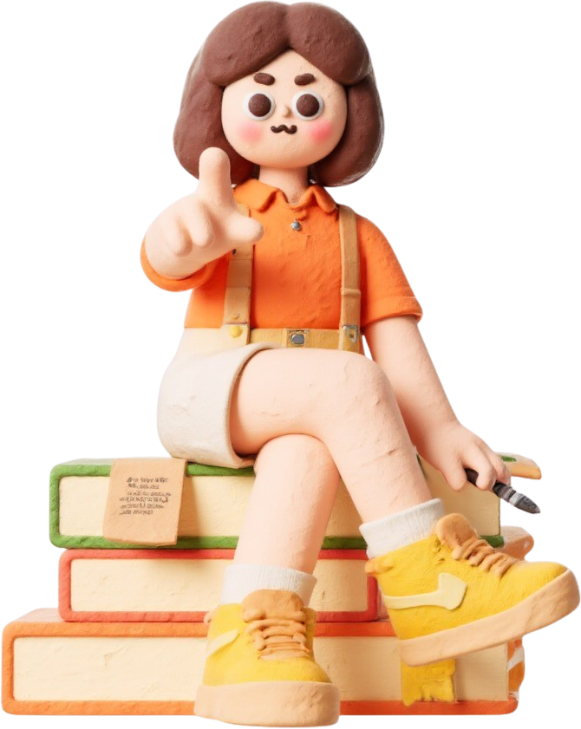
THANK YOU
THANK YOU
THANK YOU
感谢
您的观看

Slide 27
试卷纯享版

Slide 28
A
Days of heavy rain caused dangerous flooding in central Texas on Friday. The Guadalupe River overflowed, flooding neighborhoods and washing away roads and bridges. Hundreds of people had to leave their homes. Officials say this is the worst flooding the region has seen in years. Below is the breakdown of damages by county.
Below were key updates as of Friday night.
1. Casualties & Emergency Response
The floods have killed 24 people, and 25 campers from Camp Mystic remain missing as searches continue. Emergency crews including the Texas National Guard have rescued 237people using helicopters supported by over 500 personnel from federal agencies (including FEMA and the U. S. Coast Guard) that are currently assisting in affected areas.
2. Challenges
Rescue teams struggled to reach isolated communities as flooded roads and downed power lines blocked access, delaying critical aid. To make matters worse, early weather warnings had underestimated the flood's severity, leaving residents little time to reach safety.
3. Government Response
Governor Greg Abbott issued an emergency disaster declaration for 15 central Texas counties, accelerating state funding for recovery efforts. Lieutenant Governor Dan Patrick noted communication outages likely delayed locating missing campers.
4. Recovery Outlook
The Red Cross has set up 12 shelters, helping more than 1,200 displaced families. Environmental agencies warn that flooded factories could cause pollution. Meanwhile , transportation officials say highway repairs may take weeks.
County | Economic Losses | Buildings Damaged
Hunt | $28 million | 85 (including 12 historic structures)
Kerr | $15 million | 62 (including 3 bridges, 2 historic buildings)
Comal | $5 million | 34(including 2 highways)
Blanco | $2 million | 18(including 1 historic building)

Slide 29
B
1In a city of wealth, comfort and fine food, there's a quiet alley(小巷) in London’s Camden where passers-by often take several photos. Sharing space with elegant cafes and world-class bars, a tiny fruit and vegetable stand seems to have been transported from a country road far away. But what makes the stall even more remarkable in the heart of Camden is that payment is on the honor system— customers just throw coins into an old mailbox— and most of the items on offer are priced at £ l in a neighborhood where fresh food usually goes for much, much more.
2The greengrocer with a heart of gold——a Chinese immigrant in her 50s who runs this stall alone—— is rarely glimpsed by her grateful customers. Lena Wong rises before dawn to prepare to work in her small plot in Enfield, outside London, Depending on the season, she’ll reap onions, eggplant, green peppers, etc. And she works several overnight shifts every week at a nursing home to supplement her and her husband's modest salaries.
3All this started one day as she was selling produce in Enfield, and a young customer said that he barely earned enough to buy food. “I hate the idea of young people walking around hungry,” Lena Wong said, The seed was planted. “I want young people to feel that they’ re not forgotten, that they are treasured,” she said. “That not everyone is out for himself. I can make money anytime. Right now, I want to give young people a helping hand.”
4Sometimes, when she arrives late in the day, customers get a chance to thank her in person. In return, she's fond of offering botanical sayings that she collected from a life that has had its share of both joy and pain. “Even in a field full of weeds,” Lena Wong likes to say, “you can grow something— if you put in the effort.”

Slide 30
C
1New era requires a new vocabulary. Will we still talk about the “mobile” phone when all phones are mobile, or when they are implanted within us?
2Technology is everywhere nowadays, especially at work. Some people are really good at using all the cool new tools that keep popping up. They have something called a TQ, or technology quotient. Think of it like a superpower for understanding the latest tech stuff that our great-grandparents would have found really impossible. Having a high TQ means you' re awesome at using all the cool new things that not everyone knows about yet.
3The examples are common and becoming more and more frequent. For the parent it might be a home-school video class. For the brand manager it might be search engine boosting. And for the clinician, it might be the role of artificial intelligence in supporting the analysis of a CTscan. TQ attempts to quantify our ability to make sensible use of current technologies and to quickly adapt, embrace and capitalize on future creations. This adoption is critical from a variety of perspectives, from social to business. One trip into the world of ChatGPT and we can see how the dynamics of AI and search are changing for just about everyone.
4Any Mom or Dad can understand the value of IQ and EQ in projecting the potential for a child's success. But what about technology? The ability for the child and the teacher to understand, embrace and assimilate technology will be a defining aspect of their lives as we speed into the future. We are increasingly defined by technology and our active participation in everything from smart phones to Facebook. It might just be time for the basic human needs of food, water and shelter to incorporate technology too. And when that happens, it just might be a good idea to measure it.
5While this shift brings challenges, it's unstoppable. As TQ rises, it will combine with IQ and EQ, reshaping how we live, work, and learn—— turning adaptability with tech into a measurable edge.

Slide 31
D
1Through evolution, animals have developed numerous ways to protect themselves from predators(捕食者). Turtles hide in their shells, and skunks(臭鼬) use smelly liquid. But these defenses don't work against cars. Environmental journalist Ben Goldfarb explains, “When facing a car, these defenses are useless—— or even harmful. Staying still is the worst choice. Roadkill is a serious threat to wildlife.”
2Roads also act as barriers, preventing animals from moving freely. The constant traffic on highways creates what scientists call a “moving fence”——a wall of vehicles that animals avoid crossing. While we often see dead animals like deer or squirrels on roads, we don't see the ones that never try to cross. This isolation can harm animal populations more than roadkill itself.
3Chemicals from roads also damage the environment. Every year, the U. S. uses 20 million tons of road salt to melt ice, which pollutes nearby soil and plants. Cars release metals like zinc and copper, and tires leave behind microplastics. These pollutants make roadsides dangerous for creatures like monarch butterflies, even though these areas could otherwise be good habitats.
4Roadsides sometimes attract animals with food like flowers or berries, but this becomes an “ecological trap”. Animals are drawn to these resources, only to face the danger of traffic.
5Interestingly, when traffic decreases, animals quickly adapt. Researchers in the Bay Area found that when cars disappeared for months, white-crowned sparrows— small songbirds——started singing more complex and varied songs. Without traffic noise, they no longer needed to “shout” and could return to their natural behaviors. This shows how much roads affect wildlife—— but also how adaptable animals can be.
6Despite these challenges, Goldfarb says, certain species have made remarkable adaptations. He notes that Chicago's urban foxes are said to look both ways before crossing the street, “We think about roads as these forces that are universally or exclusively harmful to animals, and certainly they' re incredibly destructive,” he says. “But wildlife is also impressively adaptive and clever and animals are finding ways to make a living in our midst.”

Slide 32
1Need a quick answer or just a smart assistant in your pocket? The AI Companion offers exactly that— and much more.
2Alex Chen, the lead AI developer behind this project, wears his signature hoodie(连帽衫) and glasses as he adjusts the system daily. His goal? 36 The AI processes requests in milliseconds, responding with clear, well-structured answers. When users engage with it, a friendly “How can I assist you today?” sets the tone——a small but meaningful touch that makes the exchange feel personal. Even during peak hours, when thousands of requests flood in all at once, the AI remains reliable, never sacrificing speed or accuracy.
3Chen's day begins at 5:30 a. m., reviewing user feedback and working on the Al's learning models. 37 “I want this technology to feel effortless—— like chatting with a knowledgeable friend,” he explains. His passion for AI arises from years of studying machine learning, but what truly drives him is making complex tech accessible to everyone.
4 38 Lisa Park, a university student majoring in computer science, relies on the AI daily. “It's not just about getting answers—— it's how the AI explains things. Even difficult concepts become easy to grasp,” she says. For her, the AI isn't just a tool. 39 Another user, Mark Reynolds, a freelance writer, adds, “It helps me brainstorm ideas faster than I could alone. The suggestions are creative and actually useful.”
5“I can't imagine working on anything else,” Chen admits. 40 His team is already testing new features, like voice interaction and real-time language translation, to expand its capabilities.
A. It's a study partner that adapts to her learning style.
B. To ensure every interaction feels natural and helpful.
C. He organizes weekly user meetings to collect advice.
D. After five years of refining the AI, he's determined to make it smarter.
E. Some mornings, he logs in early to push updates before users wake up.
F. What Chen might not realize is how much his work impacts daily lives.
G. Not only does it provide instant solutions, it also offers human-like experience.
七选五

Slide 33
One afternoon in Sierra Leone's Bombali District, my jeep passed fields where children harvested crops. 41 , I approached a tall, thin teenager working hard under the blazing sun.
“Shouldn't you be in class?” I asked, noticing the pencil behind his ear. Issa, 16, 42 his forehead with a worn-out sleeve. “The school building 43 after the rains,” he explained. “Without walls, we take turns 44 under a mango tree when the teacher comes.” His words revealed Sierra Leone's contradiction in 45 . While the government 46 school fees in 2018 and built hundreds of new schools, many still need repairs. About 32% of children here still 47 primary school— though down from 62% a decade ago.
“Last month,” Issa 48 , “they gave us textbooks”, making a 49 to his barefoot sisters. “But no shoes means no school.” Later, at a UNICEF center, I saw 50 in action: solar lamps, shared notebooks, mobile libraries reaching 51 villages.
National enrollment rose from 1.2 million to 2.1 million since 52 began. Girls’ attendance jumped by 37%, with programs like free lunches helping stop kids from leaving school due to 53 .
As I left, Issa's sisters in tire-sandals(凉鞋) were 54 a book bicycle. Their laughter showed the 55 of Sierra Leone's education change: every child's right to learn.
41. A. Worried B. Angry
C. Excited D. Curious
42. A. wiped B. wrapped
C. covered D. patted
43. A. leaked B. collapsed
C. sank D. cracked
44. A. playing B. arguing
C. sleeping D. studying
45. A. economy B. welfare
C. education D. agriculture
46. A. ended B. doubled
C. delayed D. calculated
47. A. miss B. skip
C. finish D. hate
48. A. apologized B. continued
C. whispered D. committed
49. A. promise B. speech
C. change D. gesture
50. A. problems B. solutions
C. debates D. failures
51. A. wealthy B. crowded
C. remote D. dangerous
52. A. challenges B. reforms
C. meetings D. researches
53. A. boredom B. conflicts
C. diseases D. poverty
54. A. fixing up B. looking for
C. running after D. getting on
55. A. truth B. hope
C. secret D. success
完形

Slide 34
An exhibition at the Xingyun Art Gallery in Shenzhen is featuring artwork 56 (inspire) by knot-tying, or zhongguojie in Chinese, which originated in China over 2,500years ago.
Knot-tying is one of 57 most traditional handicrafts. The interweaving and looping of the ropes reflect the unique aesthetic and cultural connotations of the Chinese nation, according to Liu Xin, 58 is in charge of the exhibition.
“The exhibition combines knot-tying culture, modern craftsmanship and contemporary art,” says Liu. “We hope to present the rather delicate knot-tying art and its cultural significance in a visual context, 59 initiate dialogues with decorative art, folk art and modernist art.”
“In knot-tying, each step should aim for a 60 (harmony) and complete pattern. You try to 61 (skillful) manipulate the ropes and guide them to form the desired shape until a perfect knot is created,” explains Chen Yue, a knot-tying enthusiast among the visitors to the exhibition.
“The crafter's patience and creativity 62 (demonstrate) during the knot-tying process, and any carelessness might lead to flaws,” she adds. “A masterful crafter always 63 (try) to complete the knot with a sense of precision and elegance as a way of respect 64 the art form.”
Liu says that the symmetry of the knots, the beauty in the strategic arrangement of the ropes, and the flowing lines of the finished work motivated artists 65 (create) oil paintings, pottery sculptures, digitally-designed patterns and embroidery works for the exhibition.
语法填空

