Slide 1


感恩遇见，相互成就，本课件资料仅供您个人参考、教学使用，严禁自行在网络传播，违者依知识产权法追究法律责任。
更多教学资源请关注
公众号：溯恩高中英语
知识产权声明

Slide 2


Continuation Writing
2020.1浙江卷
上虞区城南中学 陶江英

Slide 3
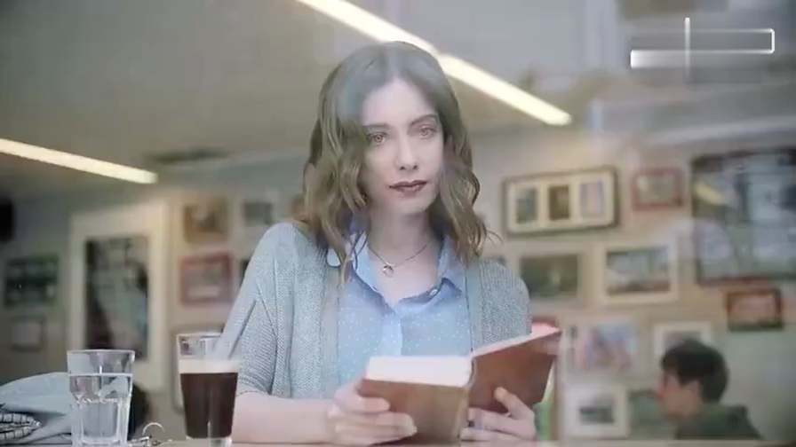

Free talk
Watch the video and discuss what the dog is like.
sad
pitiful
cautious
cute
lovely
faithful
…
How do you know?

Slide 4
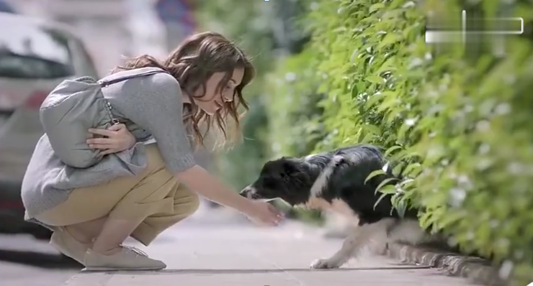
How do you know?
The girl’s action
The dog’s action
sniff…
lick…
wag the tail
stare at…
jump/leap
stand on the back legs
prick ears
trot/rush
…
catch sight of…
crouch
touch…
scratch…
smile/laugh
beam
play with…
hug
…

Slide 5
Reading
①“I’m going to miss you so much, Poppy,” said the tall, thin teenager. He bent down to hug his old friend goodbye. He stood up, hugged his parents, and smiled, trying not to let his emotions (情绪) get the better of him.
②His parents were not quite able to keep theirs under control. They had driven their son several hours out of town to the university where he would soon be living and studying. It was time to say goodbye for now at least. The family hugged and smiled through misty eyes and then laughed.
③The boy lifted the last bag onto his shoulder, and flashed a bright smile. “I guess this is it,” he said. “I’ll see you back home in a month, okay?” His parents nodded, and they watched as he walked out of sight into the crowds of hundreds of students and parents. The boy’s mother turned to the dog, “Okay, Poppy, time to go back home.”
④The house seemed quiet as a tomb without the boy living there. All that week, Poppy didn’t seem interested in her dinner, her favorite toy, or even in her daily walk. Her owners were sad too, but they knew their son would be back to visit. Poppy didn’t.
⑤They offered the dog some of her favorite peanut butter treats. They even let her sit on the sofa, but the old girl just wasn’t her usual cheerful self. Her owners started to get worried. “What should we do to cheer Poppy up?” asked Dad. “We’ve tried everything.”
⑥“I have an idea, but it might be a little crazy.” smiled Mom. “Without anybody left in the house but us, this place could use a bit of fun. Let’s get a little dog for Poppy.”
⑦It didn’t take long before they walked through the front door carrying a big box. Poppy welcomed them home as usual, but when she saw the box, she stopped. She put her nose on it. Her tail began wagging (摆动) ever so slowly, then faster as she caught the smell.

Slide 6
Reading for basic information
Who
What
When
Where
Why
How
Parents, the boy, Poppy, a little dog
Parents and Poppy felt sad.
After the boy went to university
At home
The boy left for the university.
?

Slide 7
Reading for plot
①“I’m going to miss you so much, Poppy,” said the tall, thin teenager. He bent down to hug his old friend goodbye. He stood up, hugged his parents, and smiled, trying not to let his emotions (情绪) get the better of him.
②His parents were not quite able to keep theirs under control. They had driven their son several hours out of town to the university where he would soon be living and studying. It was time to say goodbye for now at least. The family hugged and smiled through misty eyes and then laughed.
③The boy lifted the last bag onto his shoulder, and flashed a bright smile. “I guess this is it,” he said. “I’ll see you back home in a month, okay?” His parents nodded, and they watched as he walked out of sight into the crowds of hundreds of students and parents. The boy’s mother turned to the dog, “Okay, Poppy, time to go back home.”
④The house seemed quiet as a tomb without the boy living there. All that week, Poppy didn’t seem interested in her dinner, her favorite toy, or even in her daily walk. Her owners were sad too, but they knew their son would be back to visit. Poppy didn’t.
⑤They offered the dog some of her favorite peanut butter treats. They even let her sit on the sofa, but the old girl just wasn’t her usual cheerful self. Her owners started to get worried. “What should we do to cheer Poppy up?” asked Dad. “We’ve tried everything.”
⑥“I have an idea, but it might be a little crazy.” smiled Mom. “Without anybody left in the house but us, this place could use a bit of fun. Let’s get a little dog for Poppy.”
⑦It didn’t take long before they walked through the front door carrying a big box. Poppy welcomed them home as usual, but when she saw the box, she stopped. She put her nose on it. Her tail began wagging (摆动) ever so slowly, then faster as she caught the smell.
Sad departure
Bad mood
New idea
?

Slide 8

The development of the story
?
New idea
happy
Bad mood
Sad departure
sad

Slide 9

Reading for language
Tip1: Show a vivid scene of departure through subtle description of action.
unwilling/reluctant to separate
How do you know they felt sad at the boy’s departure?
①“I’m going to miss you so much, Poppy,” said the tall, thin teenager. He bent down to hug his old friend goodbye. He stood up, hugged his parents, and smiled, trying not to let his emotions (情绪) get the better of him.
②His parents were not quite able to keep theirs under control. They had driven their son several hours out of town to the university where he would soon be living and studying. It was time to say goodbye for now at least. The family hugged and smiled through misty eyes and then laughed.
③The boy lifted the last bag onto his shoulder, and flashed a bright smile. “I guess this is it,” he said. “I’ll see you back home in a month, okay?” His parents nodded, and they watched as he walked out of sight into the crowds of hundreds of students and parents. The boy’s mother turned to the dog, “Okay, Poppy, time to go back home.”
①“I’m going to miss you so much, Poppy,” said the tall, thin teenager. He bent down to hug his old friend goodbye. He stood up, hugged his parents, and smiled, trying not to let his emotions (情绪) get the better of him.
②His parents were not quite able to keep theirs under control. They had driven their son several hours out of town to the university where he would soon be living and studying. It was time to say goodbye for now at least. The family hugged and smiled through misty eyes and then laughed.
③The boy lifted the last bag onto his shoulder, and flashed a bright smile. “I guess this is it,” he said. “I’ll see you back home in a month, okay?” His parents nodded, and they watched as he walked out of sight into the crowds of hundreds of students and parents. The boy’s mother turned to the dog, “Okay, Poppy, time to go back home.”

Slide 10
Reading for language
Tip1: Show a vivid scene of sadness through subtle description of action.
How do you know they were in a bad mood?
in low spirits
④The house seemed quiet as a tomb without the boy living there. All that week, Poppy didn’t seem interested in her dinner, her favorite toy, or even in her daily walk. Her owners were sad too, but they knew their son would be back to visit. Poppy didn’t.
⑤They offered the dog some of her favorite peanut butter treats. They even let her sit on the sofa, but the old girl just wasn’t her usual cheerful self. Her owners started to get worried. “What should we do to cheer Poppy up?” asked Dad. “We’ve tried everything.”
④The house seemed quiet as a tomb without the boy living there. All that week, Poppy didn’t seem interested in her dinner, her favorite toy, or even in her daily walk. Her owners were sad too, but they knew their son would be back to visit. Poppy didn’t.
⑤They offered the dog some of her favorite peanut butter treats. They even let her sit on the sofa, but the old girl just wasn’t her usual cheerful self. Her owners started to get worried. “What should we do to cheer Poppy up?” asked Dad. “We’ve tried everything.”

Slide 11
Reading for characters
Tip2: Understand the characters before writing.
The boy: grown-up/considerate
love
①“I’m going to miss you so much, Poppy,” said the tall, thin teenager. He bent down to hug his old friend goodbye. He stood up, hugged his parents, and smiled, trying not to let his emotions (情绪) get the better of him.
②His parents were not quite able to keep theirs under control. They had driven their son several hours out of town to the university where he would soon be living and studying. It was time to say goodbye for now at least. The family hugged and smiled through misty eyes and then laughed.
③The boy lifted the last bag onto his shoulder, and flashed a bright smile. “I guess this is it,” he said. “I’ll see you back home in a month, okay?” His parents nodded, and they watched as he walked out of sight into the crowds of hundreds of students and parents. The boy’s mother turned to the dog, “Okay, Poppy, time to go back home.”
defeat
Parents: care for…/depend on…
love

Slide 12
Reading for theme
Tip3: Understand the theme before writing.
④The house seemed quiet as a tomb without the boy living there. All that week, Poppy didn’t seem interested in her dinner, her favorite toy, or even in her daily walk. Her owners were sad too, but they knew their son would be back to visit. Poppy didn’t.
⑤They offered the dog some of her favorite peanut butter treats. They even let her sit on the sofa, but the old girl just wasn’t her usual cheerful self. Her owners started to get worried. “What should we do to cheer Poppy up?” asked Dad. “We’ve tried everything.”
Poppy: miss the boy/depend on the boy
love
Parents: got worried about Poppy

Slide 13
Reading the given sentences
⑥It didn’t take long before they walked through the front door carrying a big box. Poppy welcomed them home as usual, but when she saw the box. she stopped. She put her nose on it. Her tail began wagging (摆动) ever so slowly, then faster as she caught the smell.
Tip4: Catch hints from the given sentences.
Para.1 Dad opened the box and a sweet little dog appeared.
Para.2 A few weeks later, the boy arrived home from the university.
a sweet little dog
the boy

Slide 14
Reading the given sentences
Tip4: Catch hints from the given sentences.
Para.1 Dad opened the box and a sweet little dog appeared.
Para.2 A few weeks later, the boy arrived home from the university.
Parents
What was Poppy’s reaction? How did Poppy feel?
What about the little dog?
What would the two dogs do?
How did parents feel?
…
love
Poppy
Puppy
Did Poppy still love the boy?
What did the boy do when meeting Poppy?
What was the boy’s reaction to the puppy?
What might parents do/say?
…
The boy
Puppy
love
Poppy
Parents

Slide 15
Writing
When writing, keep the following tips in mind.
description of action.
Tip1: Try to show a vivid scene through subtle description of the characters’ action or words.
Tip2: Try to understand the characters.
Tip3: Try to catch the theme before writing.
Tip4: Try to find as many hints as possible from the text.
Tip5: Read the last paragraph and the given sentences more carefully.

Slide 16
One possible version
Para.1 Dad opened the box and a sweet little dog appeared. Poppy stared at the puppy, surprised and excited. She approached cautiously, barked and then started to lick his face. The little dog jumped out of the box, wagged his tail and barked in a friendly way. He sniffed every corner of the new home, and then ran around Poppy, which brought great joy to the old girl. Watching the happy scene, Dad and Mom looked at each other, beaming proudly.
Para.2 A few weeks later, the boy arrived home from the university. As he entered the doorstep, Poppy trotted to him and got up on his back legs, trying to lick her old friend. The boy crouched, put his arms round Poppy’s neck and scratched her behind the ears. Suddenly, he noticed a little head poke out of the kennel. He felt so puzzled that he turned to his parents. “We’ve got the puppy for Poppy. Now she is as cheerful as before.” Mom chuckled with delight. “What a good idea!” The boy hugged both dogs, smiling.
—By Daisy
Plot
Theme
Language

Slide 17
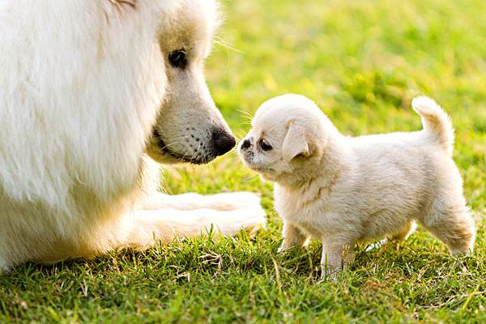
Thank you!

