Slide 1
感恩遇见，相互成就，本课件资料仅供您个人参考、教学使用，严禁自行在网络传播，违者依知识产权法追究法律责任。
更多教学资源请关注
公众号：溯恩高中英语
知识产权声明

Slide 2
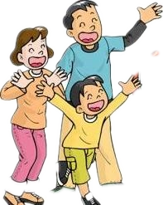
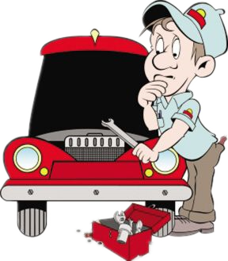
2021.1 八省联考英语读后续写：爱心修车
余杭区杭州二中树兰高级中学 郭合英

Slide 4
阅读下面材料，根据其内容和所给段落开头语续写两段，使之构成一篇完整的短文。
During this past year, I've had three instances of car trouble. Each time these things happened, I was sick of the way most people hadn’t bothered to help. One of those times, I was on the side of the road for close to three hours with my big Jeep. I put signs in the windows, big signs that said NEED A JACK （千斤顶），and offered money. Nothing. Right as I was about to give up, a Mexican family in a small truck pulled over, and the father bounded out.
He sized up the situation and called for his daughter, who spoke English. He conveyed through her that he had a jack but that it was too small for the Jeep, so we would need something to support it. Then he got a saw （锯子）from the truck and cut a section out of a big log on the side of the road. We rolled it over and put his jack on top, and we were in business.
I started taking the wheel off, and then, if you can believe it, I broke his tire iron. No worries: He handed it to his wife, and she was gone in a flash down the road to buy a new tire iron. She was back in 15 minutes. We finished the job, and I was a very happy man.

Slide 5
The two of us were dirty and sweaty. His wife prepared a pot of water for us to wash our hands. I tried to put a $20 bill in the man's hand, but he wouldn't take it, so instead I went up to the truck and gave it to his wife as quietly as I could. I asked the little girl where they lived. Mexico, she said. They were in Oregon so Mommy and Daddy could work on a fruit farm for the next few weeks. Then they would go home.
注意：
1. 续写词数应为150左右；
2. 请按如下格式在答题卡的相应位置作答。
When I was about to say goodbye, the girl asked if I'd had lunch.______________________
__________________________________________________________________________
__________________________________________________________________________
After they left, I got into my Jeep and opened the paper bag.__________________________
__________________________________________________________________________
__________________________________________________________________________

Slide 6
1. 读透文本
Vocabulary: 找出与画线词相同的意思。
1. I've had three instances of car trouble.
A. moments B. examples C. request D. advice
2. I was sick of the way most people hadn’t bothered to help.
A. was ill B. got tired from C. was disgusted with D. was free of
3. A Mexican family in a small truck ① pulled over, and the father ② bounded out.
① A. put out B. push over C. put up D. stop on the roadside
② A. jumped out B. beat out C. tried out D. wear out
4. He sized up the situation and called for his daughter.
A. matched B. visited C. considered D. practiced
5. We were in business.
A. 准备就绪 B. 出差 C. 忙着 D. 做生意
6. I broke his tire iron.
A. 扁扁的铁 B. 铁链条 C. 铁熨斗 D. 撬胎棒

Slide 7
阅读理解
1. which of the following best describes the author’s feeling after a long wait for help?
A. Embarrassed. B. Disappointed. C. Shamefu1. D. Doubtful.
2. why did the father take the trouble to cut a section of a big log?
A. He needed to support the jack with it.
B. He planned to do business with the writer.
C. He intended to remove the log in the way.
D. He attempted to ro1l it over to the roadside.
3. Which of the following statements is true according to the passage?
A. The father told directly that he had a jack.
B. It was the mother that got a new tire iron.
C. I put the signs “NEED A JACK” in the front of the car.
D. A Mexican family came to stop and only the father gave me a hand.

Slide 8
2 理清脉络
How did the Mexican family help me repair the car?
a Mexican family and I
how
who
Noticing me need a jack, a Mexican man puller over.
Elements of
the story
why
where
on the side of the road
one noon during this past year
My car broke down, and the Mexican family gave me a hand.
when
what

Slide 9
3 性格分析
We can learn about the traits of each character according to what he/she says and does, using some adjectives to describe.
故事的后续发展要符合人设，因此，人物性格特点的分析很重要，可以为故事后续发展作铺垫。
persons |  | traits
I
a Mexican family | Mom
 | Dad
 | Daughter
I was sick of the way most people hadn’t bothered to help.
enthusiastic, positive,
Enthusiastic, kind, considerate
She was gone in a flash down the road to buy a new tire iron. His wife prepared a pot of water for us to wash our hands.
enthusiastic, considerate, justic, clever, generous
He sized up the situation and bounded out, saying that he had a jack through his daughter. Then he got a saw from the truck and cut a section out of a big log and we rolled it together and put his jack on it. I put a $20 bill in his hand, but he wouldn't take it.
clever, warm-hearted, thoughtful
He conveyed through her that he had a jack ; The girl asked if I'd had lunch.

Slide 10
4 Story Mountain
A
Climax
Events
The Mexican family offered to help me repair the car .
My car broke down on the side of the road. I turned to someone, but nothing came of it.
After repairing the car, the girl asked if I’d had lunch.
Noticing my car broke down, a Mexican family pulled over .
I opened the paper bag ┅
This is when the problem reaches a high point.
Rising Action
Falling Action
c
D
This is when the characters work to solve the problem or conflict.
This includes the events leading up to the main problem or conflict.
E
B
Background
This is how things end up in the story.
This includes the introduction of characters and setting.
Resolution

Slide 11
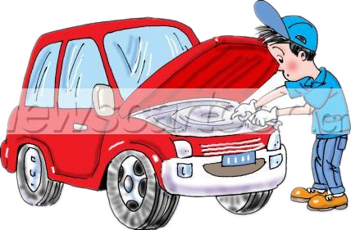
5 情感变化
I put signs in the windows, big signs that said NEED A JACK ，and offered money，but nothing happened.
Right as I was about to give up, a Mexican family in a small truck pulled over, and the father bounded out.
disappointed
hopeful
happy
We finished the job, and I was a very happy man.
?
After opening the paper bag┅
When I was about to say goodbye, the girl asked if I'd had lunch.
curious
surprised
I got into my Jeep and opened the paper bag.

Slide 12
6 情节推理
Para 1
When I was about to say goodbye, the girl asked if I’d had lunch.
Para 2
After they left, I got into my Jeep and opened the paper bag.
Why did the girl ask if I’d had lunch?
What was my reaction?
What did the girl and the family do ?
Who and why gave me the paper bag?
What was in the paper bag?
What was my reaction?
What lesson did I gain form the experience?

Slide 13
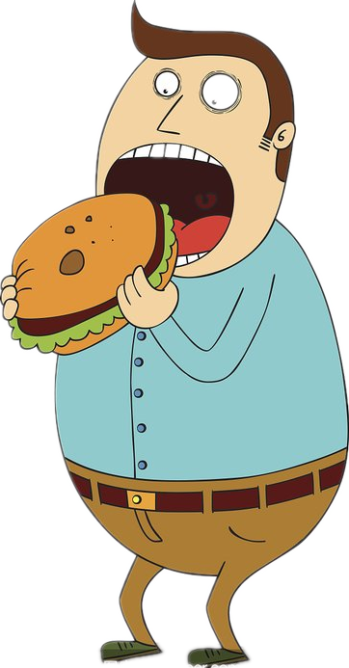
7 词汇积累
“进餐”词汇积累
1. 出去吃饭 eat out ; go out to dinners ; go out for dinner
2. 坐下吃饭 sit down to table ; sit at table
3. 在吃饭 at table ; at meals ; at dinner ;
4. wolf down 用来形容人吃饭速度快，吃得也多，也就是汉语常说的 “狼吞虎咽”。
还可以说 “wolf down the meal” 或 “wolf the meal down”。
E.g. I wolfed my breakfast down as fast as I could and then quickly ran to school.
我三下五除二地吃完早餐，然后飞快地向学校跑去。
5. My stomach was growling from hunger. 肚子饿得咕咕叫。
6. My stomach is making noises from hunger. 肚子饿得咕咕叫。
7. My stomach is rumbling from hunger. 肚子饿得咕咕叫。
8. He was hungry enough to eat up an elephant. 他饿的能吞下一头大象。

Slide 14
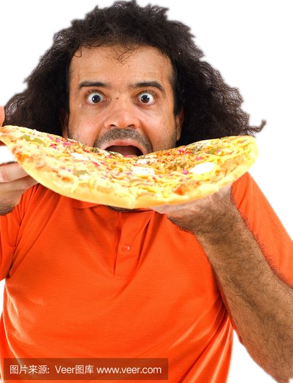
7 词汇积累
吃相表达
devour the food 狼吞虎咽/大口大口地吃
eat like mad 狂吃
gobble up the food 狼吞虎咽地吃
gorge oneself with food 大吃一顿
lick a saucer clean 添个干净
scoff without stop 狼吞虎咽地吃个不停
stoke oneself to belch 狼吞虎咽撑的打嗝
swallow sth. without chewing 嚼都不嚼一口吞下
guttle the food and drink 贪婪地吃着喝着
guzzle away 大吃大喝

Slide 15
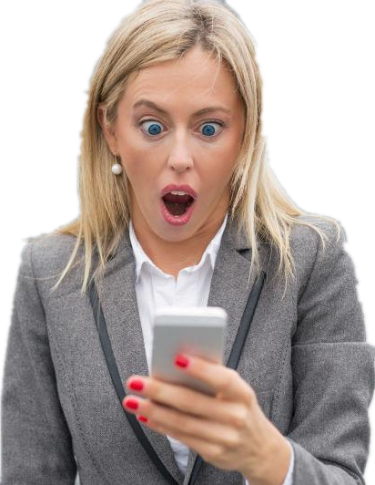
7 词汇积累
“ surprised ” 语言积累
The result is quite startling– a 77% increase in six months.
结果非常令人吃惊——六个月增长百分之七十七。
2. flabbergast ['flæbəgɑːst] v.使大吃一惊
Eg. He was flabbergasted when he heard that his friend had been
accused of murder.
3. open-mouthed adj 张大嘴的；瞠目结舌的；目瞪口呆的
Eg. The finale had 50,000 adults standing in
open-mouthed wonderment.
终场一幕让五万名成年观众全场起立，惊得目瞪口呆。
4. jaw drop (俚语)
Eg. My jaw dropped at the news.
相关短语：
be taken aback
get/ have a fright

Slide 16
7 词汇积累
“ glad ” 语言积累
1. have the time of one's life 度过愉快的经历，异常高兴
Eg. My friends and I had the time of our lives in Disneyland.
我的朋友们和我在迪士尼乐园玩得很开心。
2. be full of the joys of spring
Eg. He bounced into the office, full of the joys of spring.
他兴高采烈地蹦跳着进了办公室。
3. Delight took possession of her.
4. He looked at me, jumping and dancing.
相关短语：
on/at the top of the world 非常幸福、心满意足
over the moon 欣喜若狂
be walking/floating on air 欣喜若狂

Slide 17
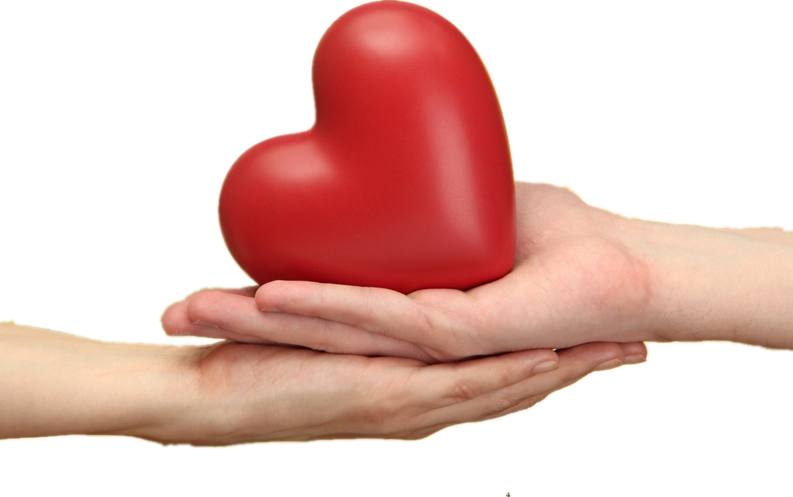
7 词汇积累
“ 感动 ” 语言积累
move; touch; impress; affect
1.be moved/touched; be impressed/affected
感动得不知说什么好
2. be touched beyond words
感动得无语言表/感动得不知说什么好
3. be moved/affected/softened to tears
感动到哭
4. be moved/affected by his devotion
被其献身精神所感动

Slide 18
7 词汇积累
“ 感悟 ” 语言积累
1. Gifts of roses, hand there are lingering fragrance.
赠人玫瑰手有余香。
2. It is better to give than to take.施比受更有福.
3. Find in helping others is a virtue.助人为乐是一种美德.
4. The grace of dripping water should be reciprocated by a gushing spring.
滴水恩涌泉报
5. Being happy by helping is the Chinese traditional virtue.
帮助别人是传统美德。
6. Let’s hand in hand, let love pass through our fingertips.
让我们手拉手，让爱心从指尖穿过。
7. As long as everyone gives love, the world will become a beautiful world.
只要人人都有爱，世界将变成美好的人间。
8. Light a lamp and warm a heart. 点亮一盏灯，温暖一颗心。

Slide 19
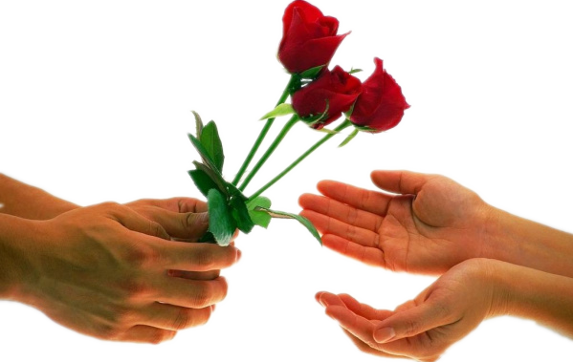
8 下水文欣赏1：原创
夸张
When I was about to say goodbye, the girl asked if I’d had lunch.Shaking my head with my hands stretching in the air, I had no mood to eat anything before my car was repaired . With smile she led me into their car, treating me to a variety of foods. I thanked them a million . I was hungry enough to eat up an elephant. I bet it was the most delicious food that I had had. Watching me wolfing them down, the family grinned from ear to ear, so did I. We chatted freely as if we were friends for many years. After exchanging telephone numbers, expanding my thanks again, I got off the car, when the girl passed a paper bag to me.
After they left, I got into my Jeep and opened the paper bag. The sight of the money filled me with surprise. It was the money that I handed to her mother. Inside was also a note, reading, “Dear friend, may you have a good trip! Please pass it to those
in need.” In a flash, with tears welling up in my eyes, I was touched
beyond words. I felt so warm as if there were nine suns in my chest.
I made up my mind to pass on “love” to others. Just as a saying
goes : “ Gifts of roses, hand there are lingering fragrance. ”
夸张
比喻
夸张
倒装
虚拟
非谓语
无灵主语
强调句
倒装
倒装
with的复合结构
夸张
升华主题

Slide 20
8 下水文欣赏2：原创
倒装
非谓语
非谓语
When I was about to say goodbye, the girl asked if I‘d had lunch. Not until then did I feel my stomach is making noises from hunger. I chuckled, shrugging awkwardly. Reading my mind, the girl suddenly darted toward her truck. In a split second, she came back breathlessly with a paper bag held tightly in her hand and handed it to me mysteriously. Thanking her a thousand and one, I waved to their family, watching them out of my sight. I felt the slightest feeling of being touched and a hint of warmth in my heart.
After they left, I got into my Jeep and opened the paper bag. Seeing the things, astonishment deprived me of my power of speech. Inside were a hamburger and two pieces of ham as well as a 20-dollar bill to which a note was attached, reading, “ Good luck to you！” I was touched beyond words with tears welling up in my eyes, gobbling up the food . The words like a ray of sunshine warmed my heart. It was the first time that I had not been bored with my car trouble but lucky for a beautiful encounter. It dawned on me that as long as everyone gives love, the world will become a beautiful world.
with的复合结构
夸张
非谓语
非谓语
无灵主语
倒装
定从
with的复合结构
非谓语
比喻
升华主题

Slide 21
9 Homework 1
A year ago, my friend and I went to a nearby town to attend a wedding. After the reception, we were waiting for a public transport bus to go back home. It was nine o‘clock at night，and although many buses passed, none stopped．
We had waited for an hour and were getting desperate. We wouldn‘t be able to stay overnight because it was a weekday, and we both needed to work the next day. It was almost 10pm when a family who had attended the same wedding passed by in their car. Probably sensing that we were waiting for some means of transport, they stopped and gave us a lift．
I was so moved by their kindness, and I expressed my gratitude to them．
When we reached my hometown, the family dropped us at the nearest point from where we could catch a shared rickshaw（人力车） to get back to the spot where we had parked our bikes. On the way, a laborer stopped the rickshaw. The driver saw his clothes and asked him whether he had any money to pay the fare．
The laborer shook his head and said，“No．”On hearing this, the driver refused to take him. I remembered my own plight （困境） a few minutes earlier, and I told the driver to allow the laborer to sit with us, as I would pay his fare.

Slide 22
What an immediate opportunity to pass on the family’s act of kindness! That night, I felt lightness in my heart, and I went to sleep happily and filled with joy about what I had done. May this chain of kindness continue．
21. The underlined word shows that the author feels about the situation．
A．hopeless B．angry C．satisfied D. nervous
22. The author and his friend had to go home because ．
A．it was very late at night B．there was no room for them to stay
C．they had to go to work the next day D．they couldn't refuse the family's help
23．We can learn that the laborer ．
A．was coming back from the same wedding ceremony
B．got on the rickshaw and sat with the author
C．refused the author's help
D．had enough money to pay the fare
24．What would be the best title for the text？
A．A Poor Laborer on His Way Home B．A Meaningful Wedding Ceremony
C．A Story at Midnight D．The Delivery of Kindness．

Slide 23
9 Homework 2
An Act of Kindness
Mother was making a dish for Mrs. Smith next door, 1 six-year-old Susie came up and 2 why Mommy was doing so .
“Because Mrs. Smith is very sad: she lost her daughter and she has a broken heart. We need to take care of her 3 . And when someone is very , very sad , they have trouble doing the 4 things like making dinner or other housework . Because we’re part of a 5 and Mrs. Smith is our neighbor , we need to do some thing to help her. Mrs. Smith won’t
6 be able to talk with or hug her daughter or do all those wonderful things that mommies and daughters do together. You’re a very smart girl , Susie ; maybe you’11 think of some way to help take care of Mrs. Smith.”
Susie thought seriously about this 7 and how she could do her part in 8 Mrs. Smith. A few minutes later , Susie knocked on her door. After a few moments , Mrs. Smith 9 the knock with a “Hi , Susie”.
Susie noticed that Mrs. Smith didn’t have that 10 musical quality about her voice when she greeted someone, and she also looked as though having been 11 because her eyes were weary and swollen(肿胀). “What can I do for you , Susie ?” asked Mrs. Smith.
“My mommy says that you lost your daughter and you’re very , very sad with a broken heart.” Susie 12 her hand out shyly. In it was a 13 . “This is for your 14 . Mrs. Smith knelt down and hugged Susie , choking back her tears. 15 her tears she said ,”thank you , darling girl, this will help a lot.”
Mrs. Smith accepted Susie’s act of kindness and took it one step 16 . She bought a small key ring with a picture frame ---- 17 designed to carry keys and proudly display a family portrait at the same time. Mrs. Smith placed Susie’s Band –Aid in the frame to 18 herself to heal a little every time she sees it. She wisely knows that healing takes time and support . It has become her 19 for healing , 20 forgetting the joy and love she experienced with her laughter.

Slide 24
A. when B. then C.as D. while
A. stated B. wandered C. claimed D. wondered
A. after all B. at present C. from now on D. for a little while
A. little B. few C. hard D. tough
A. family B. community C. world D. race
A. even B. nearly C. ever D. barely
A. challenge B. chance C. incident D. risk
A. attending to B. stocking with C. dealing with D. getting on with
A. reacted B. responded C. answered D. received
A. desperate B. familiar C. annoying D. anxious
A. sleeping B. reflecting C. weeping D. praying
A. brought B. took C. held D. pulled
A. Band-Aid B. key C. picture D. frame
A. daughter B. eyes C. hands D. broken heart
A. Upon B. Through C. At D. By
A. further B. as well C.in detail D. once again
A. that B. which C. what D.one
A. recover B. remind C. reward D. repay
A. symbol B. burden C. pressure D. ambition
A. rather than B. in case of C. yet not D. regardless of

Slide 25
As long as everyone gives a little love, the world will become a beautiful spring.

