Slide 1
感恩遇见，相互成就，本课件资料仅供您个人参考、教学使用，严禁自行在网络传播，违者依知识产权法追究法律责任。
更多教学资源请关注
公众号：溯恩英语
知识产权声明

Slide 2
202506新高考全国I卷应用文
DAILY NEWS
2025年06月
09
星期一
Adding a new newspaper column

Slide 3
目 录
CONTENTS
01
02
审题
Analyzing
写作结构
Organizing the structure
03
04
要点拓展
Expansion of key points
参考范文
Example essay

Slide 4
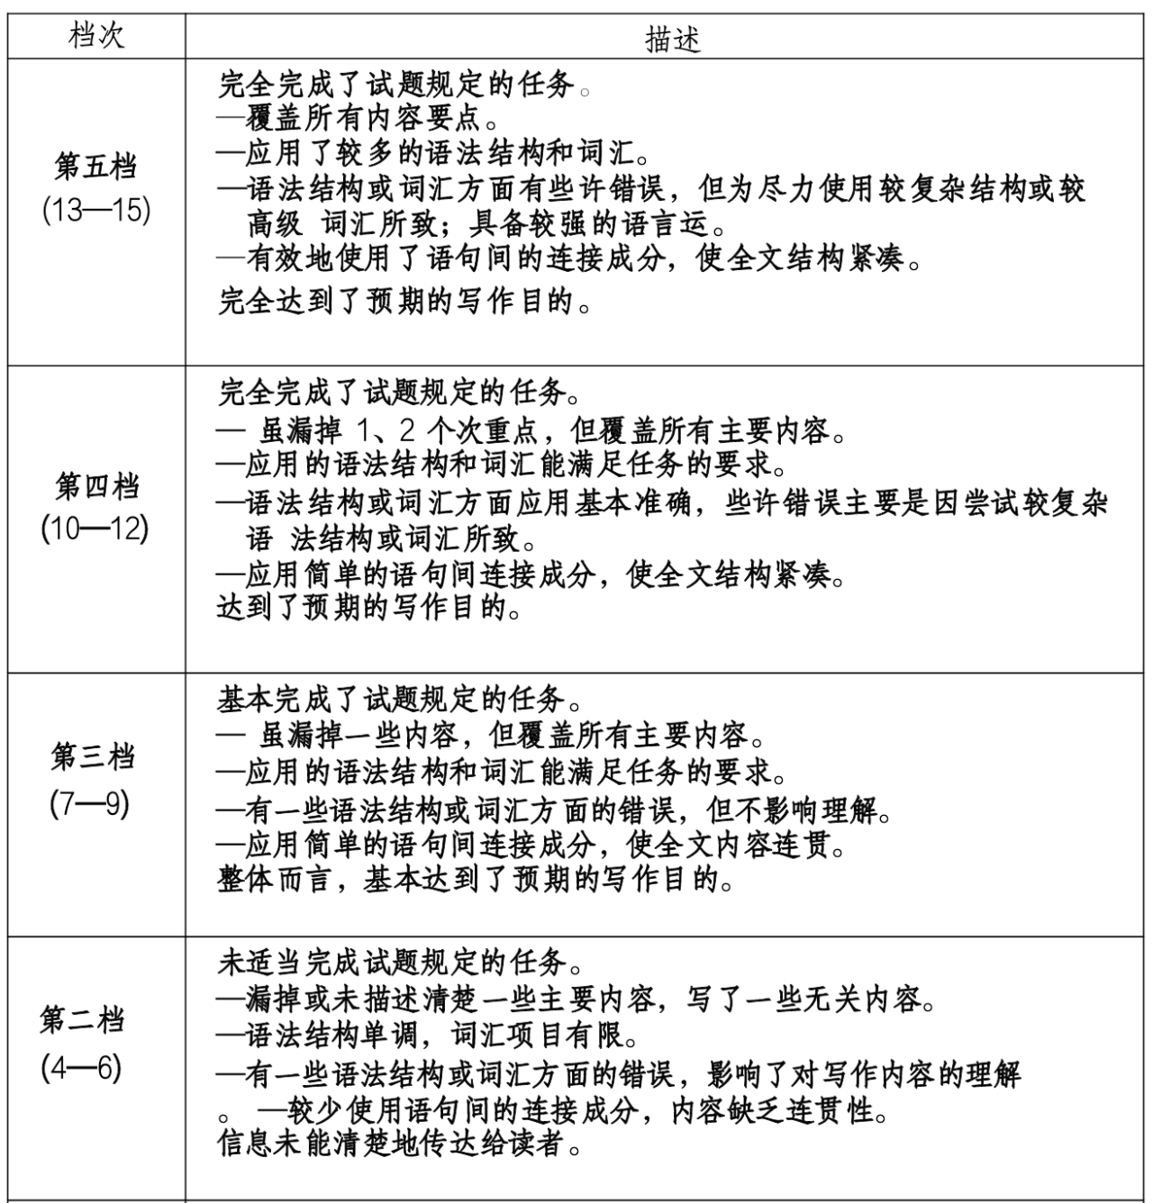
PART 01
应用文评分标准
NEWS
Daily Updates
评分原则：
①考查语言应用和创新能力
综合考虑3个方面：内容、词汇、语法结构；语言错误要结合性质和量一并考虑；
② 评分先定档；
③ 字数：词数过少扣分；应用文强调应用和是否达到交际目的，不要侃侃而谈；
④ 标点符号是体现英语水平的重要衡量标准，注意使用的规范性和准确性。
Notes:
brainstorm

Slide 5
PART 01
题目（考生回忆版）+审题
NEWS
Daily Updates
一、审题：
写作对象/语气
时态/社交场合
主要内容
选择：在Fun at my school和Guess who I am中选择一个栏目。
理由：说明为什么选择该栏目。
假定你是李华，你班的英语报要增设一个栏目。外教Jenny 提出“Fun at my school”和“Guess who I am”两个选项供大家选择。请给Jenny 写一封邮件，内容包括:
(1)你的选择;
(2)说明理由。
注意:
(1)写作词数应为80个左右;
(2)请按如下格式在答题纸的相应位置作答
Dear Jenny,
I really like the idea of adding a new column to our Englishnewspaper.
Yours,
Li Hua
整体语气：友好礼貌、正式但不过于严肃
✅ Polite→ 使用“Dear Jenny,”等正式称呼和结尾
✅ Friendly→ 表达个人观点时自然
✅ Respectful→ 避免命令式语气，多用建议性表达（如 “I believe...”）

Slide 6
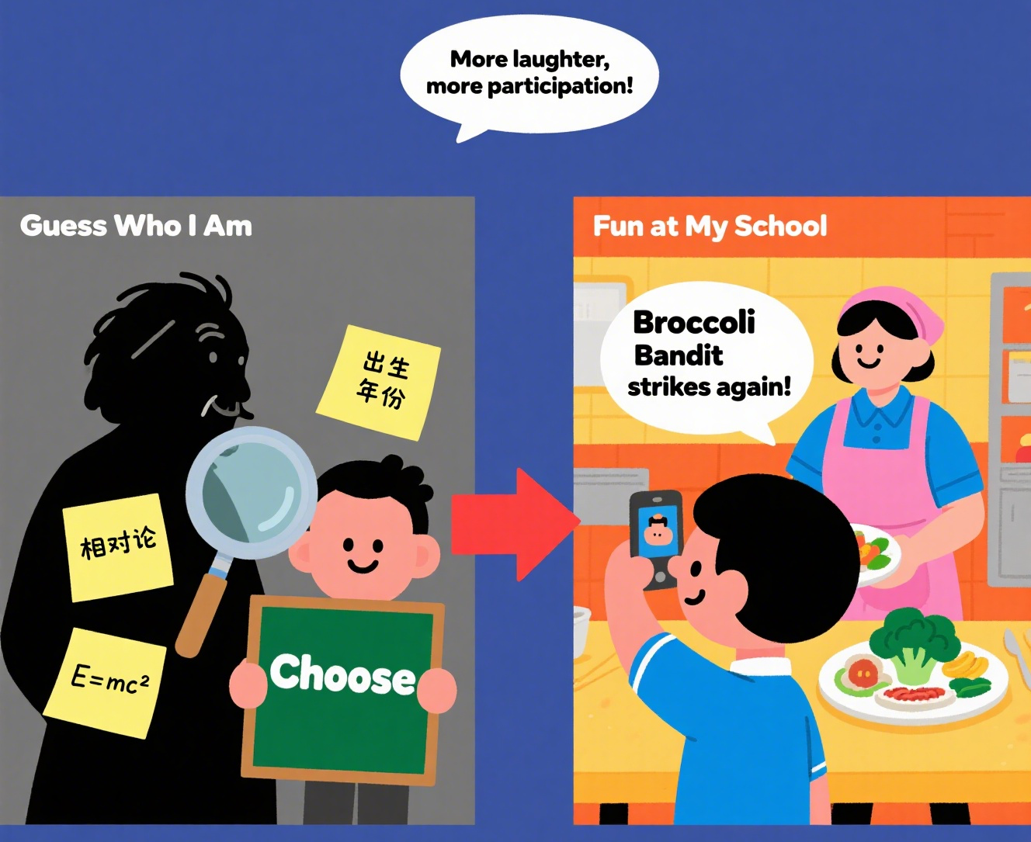
PART 02
二、写作结构
NEWS
Daily Updates
E.G.
After careful consideration, I prefer/strongly support “Fun at My School”.
From my perspective, “Guess who I am” is more engaging/compelling/captivating/attractive.
开头 Para1
主体 Para2
结尾 Para3
明确选择
2-3个具体理由
（如趣味性、学习价值、参与度等）
E.G. I prefer... because.../ In this column, classmates are able to...
E.G. I believe “Fun at My School” will become a hit! Thank you for your creative suggestions, and I’m excited to see this new column come to life.
总结+期待回复
感谢提议+表达期待

Slide 7
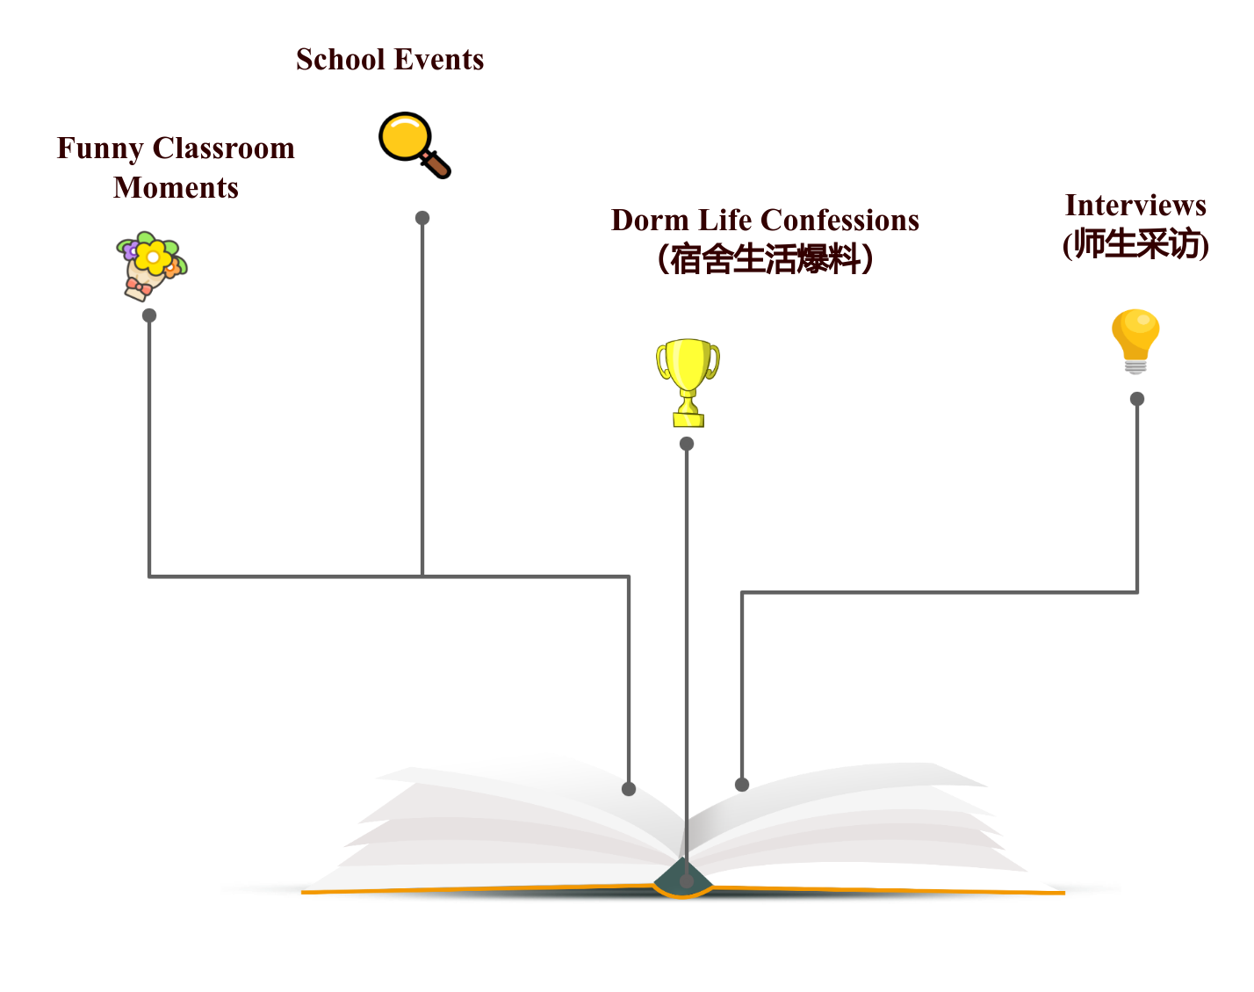
PART 03
三、Column---Fun at my school
NEWS
Daily Updates
What can you read in the column of “Fun at my school”?

Slide 8
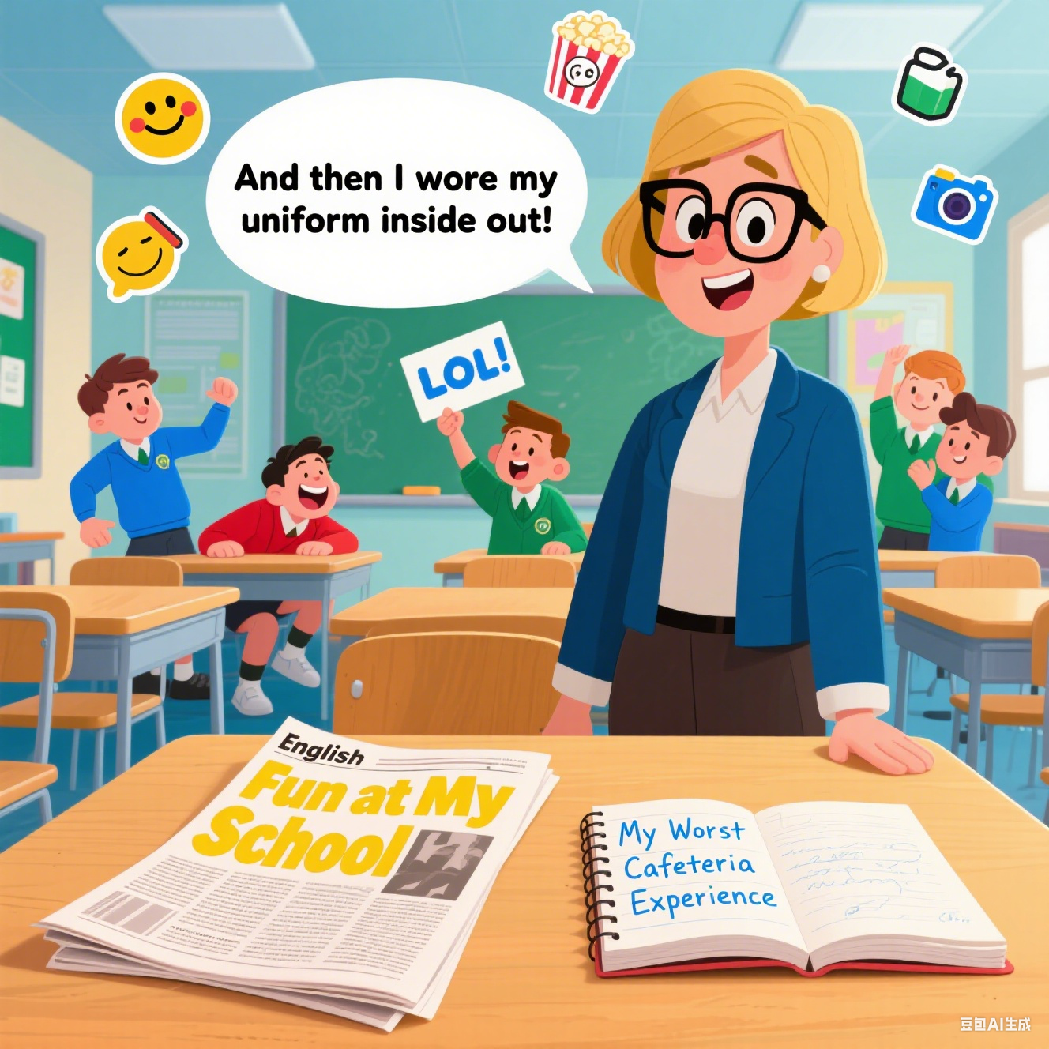
PART 03
三、Column---Fun at my school
NEWS
Daily Updates
School Events
1. Academic Events
开学/毕业典礼 (Opening/Graduation Ceremony)
学科竞赛 (Academic Competitions)
辩论赛 (Debate Competition)
科学展览 (Science Fair)
2. Cultural & Artistic Events
校园音乐节 (School Music Festival)
戏剧表演 (Drama Performances)
艺术展 (Art Exhibition)
诗歌朗诵会 (Poetry Recitation)
国际文化节 (International Culture Day)
3. Sports Events
运动会 (Sports Day)篮球/足球联赛 (Basketball/Soccer Tournament)
马拉松/趣味跑 (Marathon/Fun Run)
4. Community & Charity Events
志愿者活动 (Volunteer Work)
慈善义卖 (Charity Bazaar)
环保倡议 (Environmental Campaigns)
其他：
校园开放日 (Campus Open Day)

Slide 9
PART 03
三、Column---Fun at my school
NEWS
Daily Updates
你的理由：
There are two compelling reasons for my choice.
This column would perfectly capture the vibrant daily life of our school, from amusing classroom moments to exciting school events. (简要介绍板块内容)
Learning Effectiveness：
Such authentic content would make English learning more engaging and relatable for all students.
Students are immersed in real-life language contexts, enabling them to absorb vocabulary in a way that feels effortless and memorable.
Students will subconsciously improve their descriptive writing skills while sharing amusing anecdotes.

Slide 10
PART 03
三、Column---Fun at my school
NEWS
Daily Updates
你的理由：
Student Engagement：
It encourages active participation, as everyone can contribute funny stories or interesting observations, fostering a stronger sense of community.
The peer-to-peer sharing mode keeps everyone actively engaged.
School Culture
It serves as a digital time capsule preserving precious school memories.
By sharing funny or heartwarming moments, we create a collective memory that defines our school identity./Through sharing amusing cultural misunderstandings, we learn to appreciate diverse cultures.
A school that laughs together stays together—this column could be the glue that unites different grades and clubs.
Notes:
能一起欢笑的学校更有凝聚力，该栏目可能成为连接不同年级和社团的纽带。

Slide 11
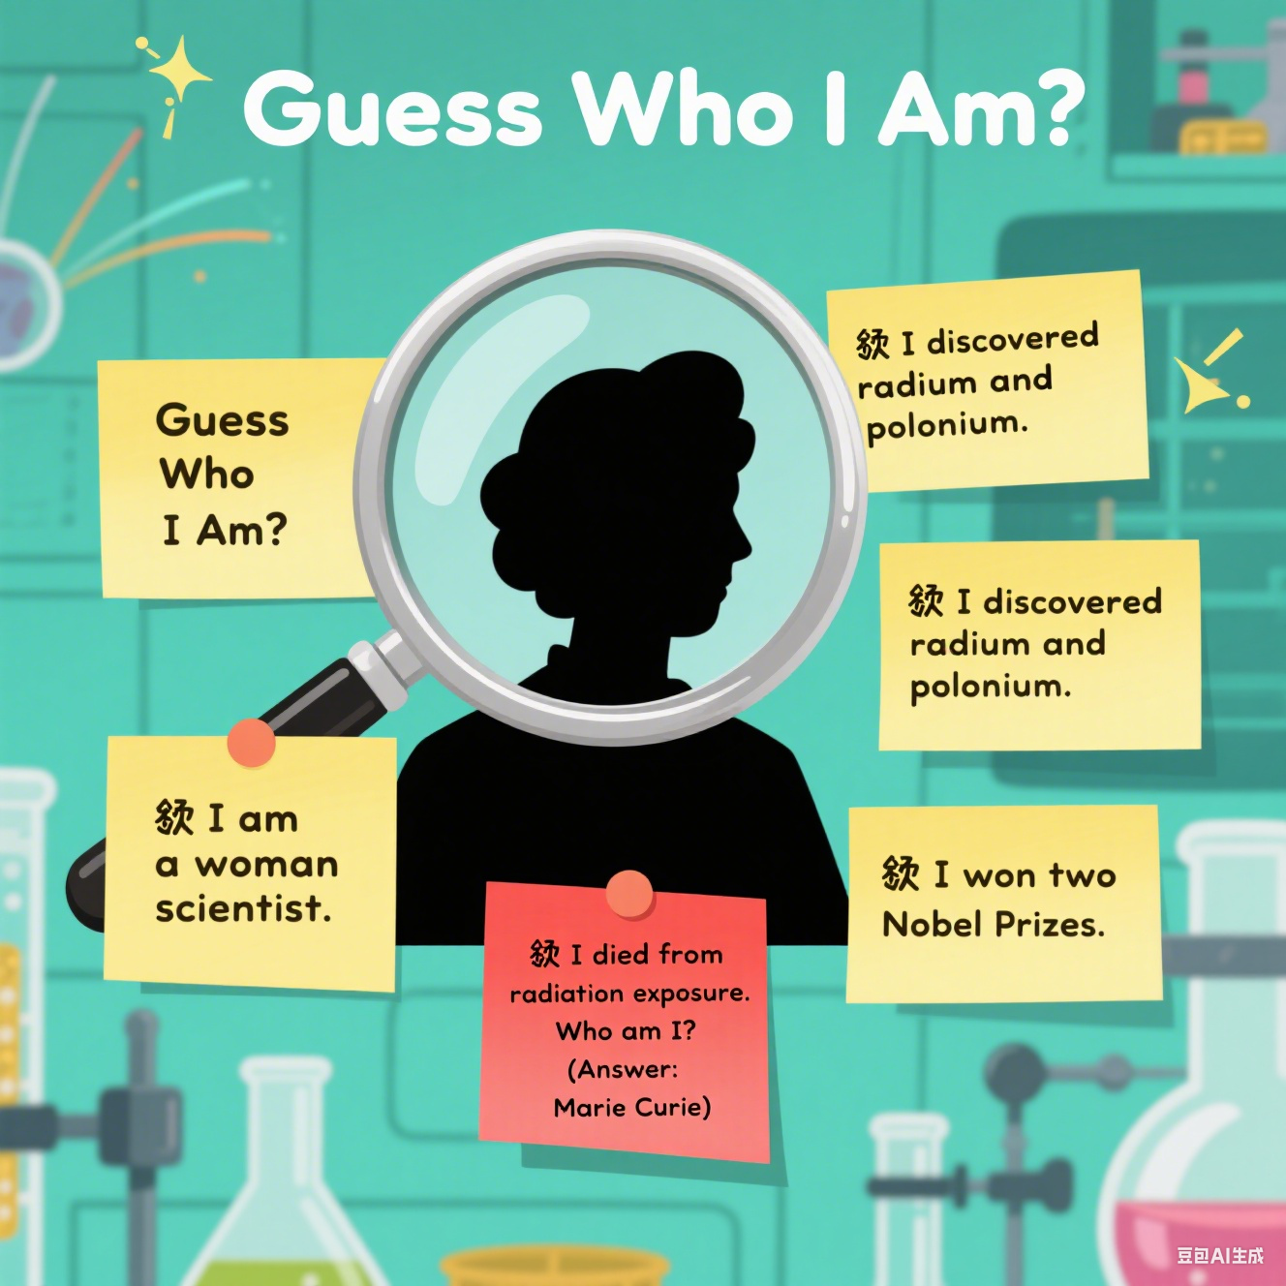
PART 03
三、Column---Guess Who I Am
NEWS
Daily Updates
🔹 I am a woman scientist.
🔹 I discovered radium and polonium.
🔹 I won two Nobel Prizes.
🔹 I died from radiation exposure.
Who am I?
Marie Curie
Notes:
brainstorm

Slide 12
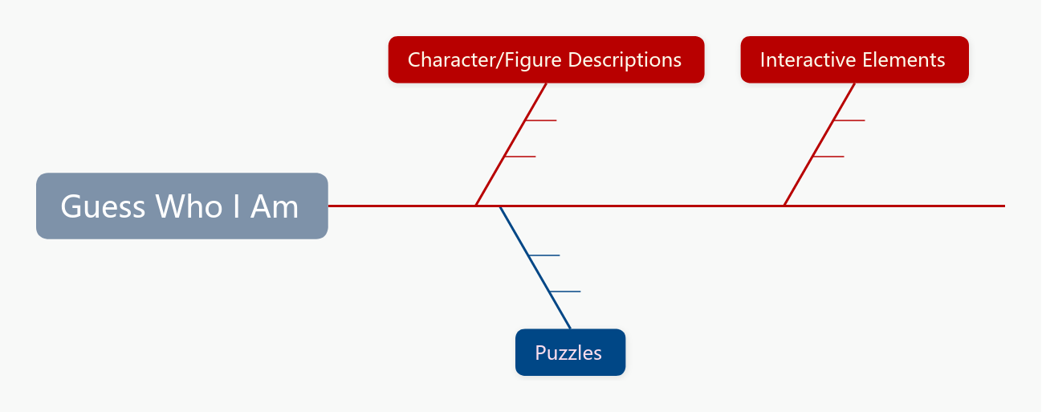
PART 03
三、Column---Guess Who I Am
NEWS
Daily Updates
This section is typically an interactive and entertaining feature, engaging students in guessing the identity of a specific person, character, celebrity, or fictional figure through provided descriptions or clues.
School figures – teachers or students
Historical figures
Hidden answers
Reader submissions
Fictional characters from textbooks or movies
1. Presents progressively challenging clues (Third-person)
2. First-person narration
3. Images or silhouettes
Notes:
brainstorm

Slide 13
PART 03
三、Column---Guess Who I Am
NEWS
Daily Updates
你的理由：
The guessing game format naturally develops our critical thinking and deductive reasoning skills as we analyze clues about historical figures or fictional characters.
The clue-solving process enhances reading comprehension as we analyze descriptive passages for key details.
It serves as an engaging way to expand our cultural knowledge, whether learning about scientists like Marie Curie or literary characters like Hamlet.
It provides an engaging platform where we can learn about Western cultural icons like Shakespeare and Einstein, bridging our cultural knowledge gap.
It makes acquiring new vocabulary and facts much more enjoyable than traditional methods./transforms passive readers into active participants.

Slide 14
PART 04
四、参考范文
NEWS
Daily Updates
Dear Jenny,
I really like the idea of adding a new column to our English newspaper. From my perspective, “Fun at My School” does more than entertain—it strengthens our community.
There are two main reasons for my preference. Firstly, this column will capture the most interesting moments of our daily school life, from funny classroom incidents to exciting sports events, making English learning more relatable and enjoyable. Secondly, it encourages participation from all students as everyone can contribute their own stories, which will help build a stronger sense of community in our class.
I believe “Fun at My School” will become the most popular section of our newspaper while improving our writing skills in a natural way. Thank you for this wonderful opportunity to make our English learning more lively and engaging!
Yours,
Li Hua
Notes:
brainstorm

Slide 15
PART 04
四、参考范文
NEWS
Daily Updates
Dear Jenny,
I really like the idea of adding a new column to our English newspaper. After careful consideration, I strongly recommend choosing “Guess Who I Am” as our new feature.
There are two compelling reasons for this choice. First, this interactive format will significantly enhance our critical thinking skills as we analyze clues and make logical deductions. Second, it provides a fun way to expand our cultural knowledge about historical figures, literary characters, and contemporary icons while learning descriptive vocabulary naturally.
I believe this column will not only make our newspaper more engaging but also create a stimulating learning environment. Thank you for bringing this creative idea to us, and I’m excited to see how it develops!
Yours,
Li Hua
Notes:
brainstorm

Slide 16
THANK YOU FOR LISTENING
XX年XX月
X
星期X
No.00001

