Slide 1
感恩遇见，相互成就，本课件资料仅供您个人参考、教学使用，严禁自行在网络传播，违者依知识产权法追究法律责任。
更多教学资源请关注
公众号：溯恩高中英语
知识产权声明

Slide 2
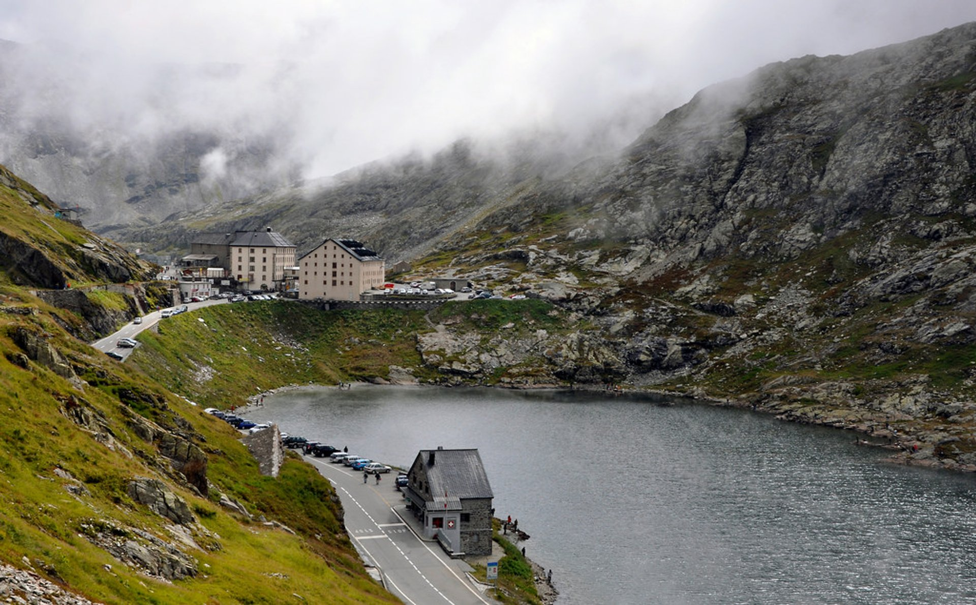
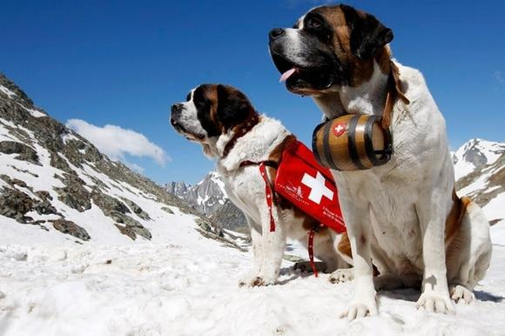
Lesson 8
A famous monastery

Slide 3
Target vocabulary
1

Slide 4
Match each word with the best meaning.
1. _____ monastery A. a person who participates in skiing
2. _____ rashly B. a man devoted to a religious life in a monastery
3. _____ watchdog C. a bounded area surrounded by a fence or walls
4. _____ pass D. the state of being secluded or free from intrusion
5. _____ monk E. acting hastily or impulsively without careful thought
6. _____ Easter F. an underground passage for transportation or passage
7. _____ tunnel G. Christian holiday celebrating the resurrection of Jesus Christ
8. _____ privacy H. a narrow opening or pathway for people or vehicles to go
through
9. _____ enclosure I. a guard dog or a person/organization that monitors and enforces
rules
10. ____ skier J. a religious community where monks or nuns live and practice
their faith
J
E
I
H
B
G
F
D
C
A

Slide 5
Reading the passage
2

Slide 6
Reading the passage
The Great St. Bernard Pass connects Switzerland to Italy. At 2, 473 meters, it is the highest mountain pass in Europe. The famous monastery of St. Bernard, which was founded in the eleventh century, lies about a mile away. For hundreds of years, St. Bernard dogs have saved the lives of travelers crossing the dangerous Pass. These friendly dogs, which were first brought from Asia, were used as watchdogs even in Roman times. Now that a tunnel has been built through the mountains, the Pass is less dangerous, but each year, the dogs are still sent out into the snow whenever a traveler is in difficulty. Despite the new tunnel, there are still a few people who rashly attempt to cross the Pass on foot.
During the summer months, the monastery is very busy, for it is visited by thousands of people who cross the Pass in cars. As there are so many people about, the dogs have to be kept in a special enclosure. In winter, however, life at the monastery is quite different. The temperature drops to -30°and very few people attempt to cross the Pass. The monks prefer winter to summer for they have more privacy. The dogs have greater freedom, too, for they are allowed to wander outside their enclosure. The only regular visitors to the monastery in winter are parties of skiers who go there at Christmas and Easter. These young people, who love the peace of the mountains, always receive a warm welcome at St. Bernard's monastery.

Slide 7
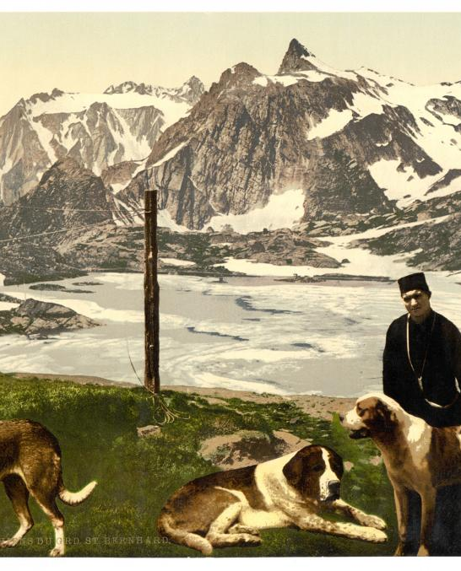
Question:
What are the St. Bernard dogs used for?
They are used to rescue travelers who got into difficulties in the mountains.

Slide 8
Reading comprehesion
3

Slide 9
Reading comprehension
1. St. Bernard dogs are best known for _______.
A. being a great summer tourist attraction
B. having saved people's lives before the new tunnel was built
C. being able to search people out who have been trapped in
the snow
D. the freedom they have to wander about in the winter

Slide 10
Reading comprehension
2. What is the main advantage of the new tunnel?
A. It prevents people from endangering their lives by climbing
the Pass.
B. It brings thousands of tourists to the monastery each summer.
C. It provides a fast and safe communication across the Swiss-
Italian border.
D. It brings the St. Bernard monks into greater contact with the
world.

Slide 11
Reading comprehension
3. In what way does life at the St. Bernard monastery differ in
winter?
A. The great number of visitors must come to the monastery on
skis.
B. The dogs are free to save the lives of people lost in the snow.
C. The monks are more welcoming to their visitors.
D. The monks can pursue their occupation relatively undisturbed.

Slide 12
Structure imitation
4

Slide 13
Structure imitation
1. The (famous) …, which …, (lies/stands) …
The famous Great Wall of China, which stretches across vast landscapes, stands as a testament to human ingenuity and perseverance throughout history.
The famous Eiffel Tower, which stands tall in the heart of Paris, mesmerizes visitors with its elegant design and breathtaking views.
The Mona Lisa, which is famous for its enigmatic smile and artistic brilliance, lies on display in the Louvre Museum, Paris.

Slide 14
The old book I found buried in my grandmother’s attic at one time must have been a treasured possession, for it was adorned with a delicate cover of gold and precious jewels that shone brilliantly in the dim light.
Structure imitation
2. Now that …, …
Now that the pandemic has receded and restrictions have been lifted, people can finally gather and enjoy social events and activities with their friends and loved ones.
Now that the world has become more interconnected than ever before, thanks to advancements in technology and communication, people can easily connect with one another regardless of their geographic locations.
Now that education is becoming more accessible through online platforms and digital resources, individuals from all walks of life can pursue knowledge and acquire new skills at their own pace and convenience.

Slide 15
Structure imitation
3. Despite …, there are still a few people who ….
Despite the advancements in technology and access to information, there are still a few people who prefer to rely on traditional methods and resist embracing modern innovations.
Despite the global efforts to combat climate change, there are still a few people who deny the scientific consensus and refuse to acknowledge the urgency of taking action to protect the environment.
Despite the awareness and campaigns against animal cruelty, there are still a few people who engage in activities that harm or exploit animals for their own gain.

Slide 16
Story telling
5

Slide 17
Story-telling
1. summer months ----monastery very busy ---- thousands of people----Pass----cars 2. so many people about----dogs----special enclosure 3. winter----life----monastery----quite different 4. temperature-30°----few people
5. monks prefer winter----more privacy
6. dogs greater freedom, too---- wander outside enclosure
7. only regular visitors----skiers----Christmas, Easter
8. young people ----peace of the mountains ----receive warm welcome

Slide 18
Summary writing
6

Slide 19
Answer the following questions with complete sentences.
1. When is St. Bernard's monastery visited by thousands of people?
2. How do these people cross the Pass?
3. Why are the dogs kept in a special enclosure?
4. How low does the temperature drop in winter?
5. Are there few visitors then, or are there a great many?
6. Do the monks prefer the winter season or not?
7. What are the dogs free to do in winter?
8. What sort of people regularly visit the monastery in winter?
9. Do they stay there the whole winter, or do they stay only at certain times?
10. Are they warmly welcomed or not?

Slide 20
1. When is St. Bernard’s monastery visited by thousands of people?
St. Bernard’s monastery is visited by thousands of people in summer.
2. How do these people cross the pass?
They cross the pass in cars.
1+2:
The St. Bernard’s monastery is visited by thousands of people in
summer, who cross the Pass in cars.

Slide 21
3. Why are the dogs kept in a special enclosure?
Because there are so many people about, the dogs are kept in a special enclosure.
4. How low does the temperature drop in winter?
The temperature in winter falls to -30℃.
5. Are there few visitors then, or are there a great many?
There are very few visitors then.
6. Do the monks prefer the winter season or not?
The monks prefer the winter season.
4+5+6:
As the temperature in winter falls to -30C, there are few visitors, so the monks prefer this season.

Slide 22
7. What are the dogs free to do in winter?
The dogs are free to wander outside their enclosure.
8. What sort of people regularly visit the monastery in winter?
Parties of young skiers visit the monastery in winter.
9. Do they stay there the whole winter, or do they stay only
at certain times?
They visit there at Christmas and Easter.
10. Are they warmly welcomed or not?
They are warmly welcomed.
8+9+10:
Parties of young skiers regularly visit the monastery in winter, during Christmas and Easter when they are warmly welcomed.

Slide 23
A possible version:
The St. Bernard’s monastery is visited by thousands of people in summer, who cross the Pass in cars. Because there are so many people about, the dogs are kept in a special enclosure. As the temperature in winter falls to -30C, there are few visitors, so the monks prefer this season. The dogs are also free to wander outside their enclosure. Parties of young skiers regularly visit the monastery in winter, during Christmas and Easter when they are warmly welcomed.

Slide 24
Occasion describing
7

Slide 25
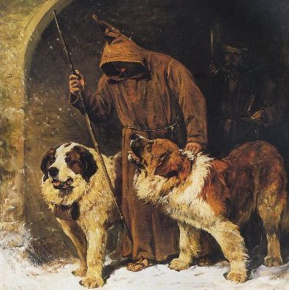
Occasion describing
Introduction:
A monk took two dogs out for exercise ---- the dogs were restless ---- a search party was organized.
Development:
The dogs led the monks through the snow ---- high winds the previous night ---- now heavy fog ---- temperature 20°below ---- they got near ---- heard cries ---- a man was trapped under the snow ---- the dogs dragged him out ---- he was taken to the monastery on a sledge.
Conclusion:
The man was unconscious ---- recovered later ---- told them what had happened the previous night.

Slide 26
Occasion describing
Introduction:
A monk took two dogs out for exercise ---- the dogs were restless ---- a search party was organized.
One very cold morning, a monk took two St. Bernard's dogs out for exercise. He immediately noticed that the dogs were very restless. Suspecting a traveler might be in difficulty, the monk returned to the monastery to organize a search party.

Slide 27
Occasion describing
Development:
The dogs led the monks through the snow ---- high winds the previous night ---- now heavy fog ---- temperature 20°below ---- they got near ---- heard cries ---- a man was trapped under the snow ---- the dogs dragged him out ---- he was taken to the monastery on a sledge.
The two dogs led four monks through the snow. Two of the monks pulled a sledge behind them, in case they needed it. There had been very high winds the previous night, but now everything was still and visibility was bad because there was a heavy fog. Moreover, the temperature had fallen to -20°.The dogs led the monks towards the Pass and as the monks got near, they heard cries in the distance. The dogs soon found a man who was trapped under the snow and immediately dragged him out. The man was alive, but frozen stiff. The monks strapped him to the sledge and took him back to the monastery.

Slide 28
Occasion describing
Conclusion:
The man was unconscious ---- recovered later ---- told them what had happened the previous night.
The man was unconscious, but he soon recovered in the warm atmosphere of the monastery where he was given plenty of hot drinks and food. When the traveler was able to speak, the monks listened with interest as he told them what had happened the previous night.

Slide 29
Story development
8

Slide 30
Reading the passage
The Great St. Bernard Pass connects Switzerland to Italy. At 2, 473 meters, it is the highest mountain pass in Europe. The famous monastery of St. Bernard, which was founded in the eleventh century, lies about a mile away. For hundreds of years, St. Bernard dogs have saved the lives of travelers crossing the dangerous Pass. These friendly dogs, which were first brought from Asia, were used as watchdogs even in Roman times. Now that a tunnel has been built through the mountains, the Pass is less dangerous, but each year, the dogs are still sent out into the snow whenever a traveler is in difficulty. Despite the new tunnel, there are still a few people who rashly attempt to cross the Pass on foot.
During the summer months, the monastery is very busy, for it is visited by thousands of people who cross the Pass in cars. As there are so many people about, the dogs have to be kept in a special enclosure. In winter, however, life at the monastery is quite different. The temperature drops to -30°and very few people attempt to cross the Pass. The monks prefer winter to summer for they have more privacy. The dogs have greater freedom, too, for they are allowed to wander outside their enclosure. The only regular visitors to the monastery in winter are parties of skiers who go there at Christmas and Easter. These young people, who love the peace of the mountains, always receive a warm welcome at St. Bernard's monastery.

Slide 31
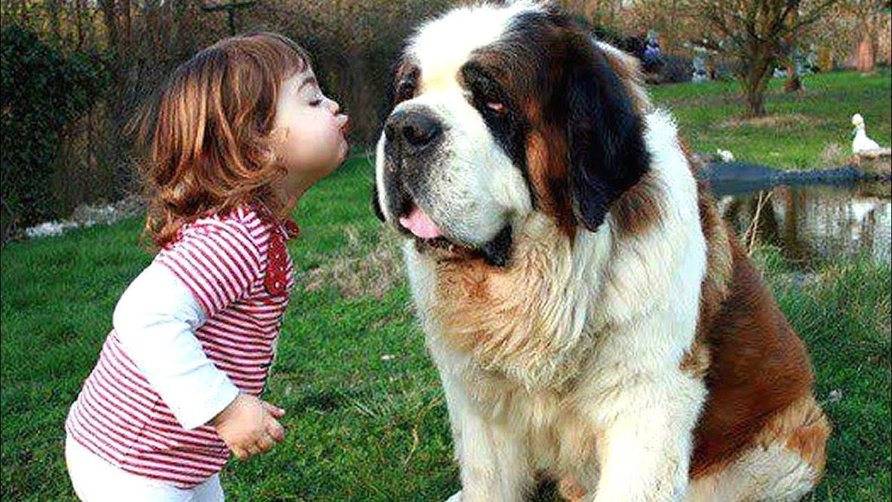
Para 1：
Dogs are our best friends, but not all of them are as calm as St. Bernard dogs.
Para 2：
Even today, many people choose to have a guard dog.

Slide 32
Possible version 1:
Dogs are our best friends, but not all of them are as calm as St. Bernard dogs. Some breeds, like guard dogs, are more protective and alert. These dogs show strong loyalty and work hard to keep their owners' homes and properties safe. They are always watchful and ready to defend. While St. Bernards bring comfort and help, guard dogs have a different role. They show loyalty by ensuring their human companions stay secure and protected from any potential dangers.
Even today, many people choose to have a guard dog. These loyal and vigilant companions provide a sense of security and peace of mind. Breeds such as German Shepherds, Rottweilers, and Doberman Pinschers are trained to protect their families. With their strong presence and natural instincts, they deter potential threats and make sure their owners are safe. While St. Bernards rescue people in need, guard dogs continue to play a vital role in keeping lives and property secure, offering unconditional loyalty and companionship to those they protect.

Slide 33
Possible version 2:
Dogs are our best friends, but not all of them are as calm as St. Bernard dogs. They are well-known for their friendly and gentle nature. These dogs, with their large size and impressive strength, have been a symbol of rescue and salvation for centuries. Their calm and affectionate temperament allows them to provide comfort and assistance to travelers in need, especially during the harsh winters when the Pass becomes treacherous. The St. Bernard dogs have become legendary figures, showcasing the incredible bond between humans and animals, and reminding us of the importance of companionship and protection.
Even today, many people choose to have a guard dog. While the St. Bernard dogs have a long history of being watchdogs, their role has evolved over time. In modern society, guard dogs are desired for their protective instincts and abilities to deter potential threats. With their keen senses and loyalty, these dogs serve as reliable companions and guardians of their owners' homes and properties. Whether it is for personal safety or security measures, the presence of a guard dog brings a sense of reassurance and peace of mind. Despite advancements in technology, the role of dogs as guard animals remains valued and appreciated by those who seek their loyal companionship and protection.

Slide 34
Vocabulary reiforcement
9

Slide 35
A. Word spelling
The Great St. Bernard Pass, the highest mountain pass in Europe at 2,473 meters, c______ Switzerland to Italy. The famous St. Bernard monastery, f______ in the eleventh century, is located nearby. St. Bernard dogs, originally from Asia and used as w________ since Roman times, have s____ countless lives of travelers crossing the dangerous Pass. Despite the construction of a t____, some people still attempt to cross the Pass on foot. During summer, the monastery r______ thousands of visitors who cross the Pass by car, requiring the dogs to be kept in an e_______. In winter, with temperatures d______ to -30°C, few people attempt the Pass, providing the monks and dogs with more p_____ and freedom. The monastery welcomes skiers during Christmas and E____, who appreciate the tranquility of the mountains.
onnects
ounded
atchdogs
aved
unnel
eceives
nclosure
ropping
rivacy
aster

Slide 36
B. Gap filling
In a serene mountain valley stood the Jade Lotus Temple, 1. ______ served as the home for the wise monk Kuan Yin. One fateful day, as he roamed the temple grounds, Kuan Yin came 2. ______ Mei Li, 3. ___ loyal dog in need of shelter, whom he welcomed into his care.
During a violent storm, a landslide 4. _________ (occur), burying villagers beneath the debris. Without hesitation, Kuan Yin and Mei Li 5 . ______ (spring) into action, rushing to rescue those trapped.
Facing treacherous conditions, they 6. _________ (tireless) dug through the rubble, their determination unwavering despite the flickering hope. Together, they saved the trapped villagers one by one.
The grateful villagers hailed Kuan Yin and Mei Li as 7. _______ (hero), forever remembering their 8. _______ (brave). The temple, once again, became a beacon of hope, as Kuan Yin's teachings of compassion resonated through the valley, inspiring others.
Kuan Yin and Mei Li, the compassionate monk 9. ____ his faithful dog, brought salvation and renewed faith to the Jade Lotus Temple, 10. _______ (leave) a lasting legacy of bravery and unwavering dedication.
which
across
a
occurred
sprang
tirelessly
heroes
bravery
and
leaving

