Slide 1

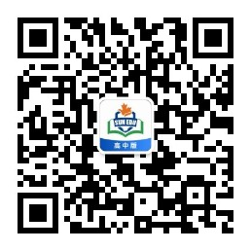
感恩遇见，相互成就，本课件资料仅供您个人参考、教学使用，严禁自行在网络传播，违者依知识产权法追究法律责任。
更多教学资源请关注
公众号：溯恩高中英语
知识产权声明

Slide 2




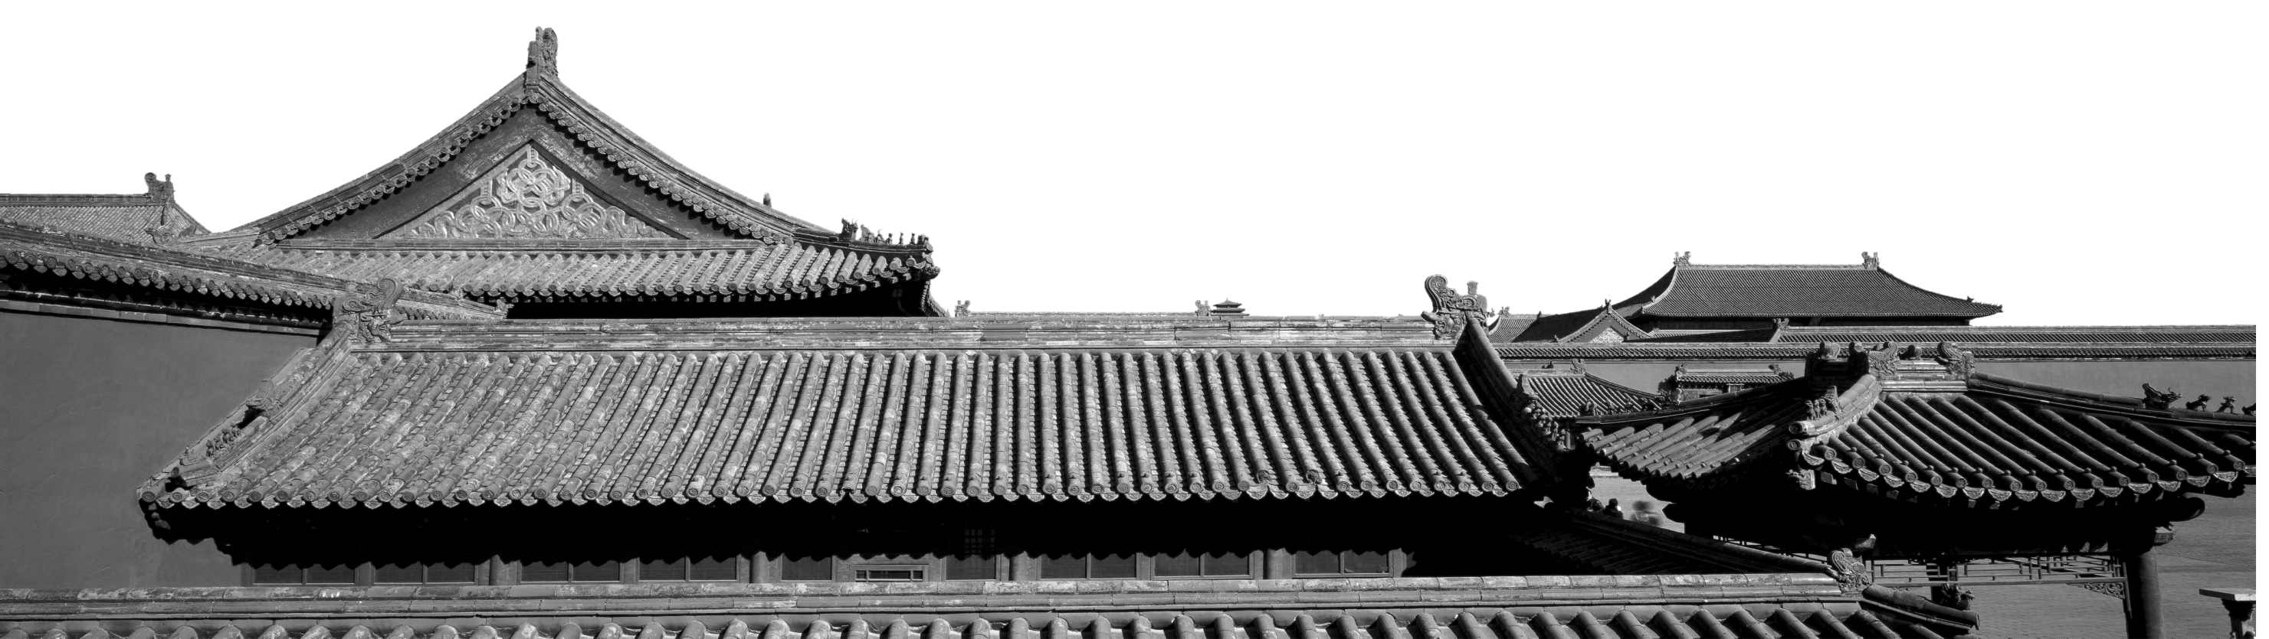
A travel plan to Xi'an
溯恩英语
二零二零
张钊

Slide 3



to
xl@youthlife.com
Subject
A travel plan to Xi'an

Slide 4



Match the key words
with proper parts
Dear Xiao Li,
My time here in China is going well. I love my new school and classmates. Over the October holiday, my parents and I are planning to go to Xi'an to see the Terracotta Army. I've heard that it is an amazing sight, and I can't wait to go. To me, the story of the Terracotta Army is almost unbelievable. It's amazing that there are more than 8,000 statues, and no one in modern times knew about them until the 1970s.
We're also planning to visit several other places in Xi'an. My dad and I are both looking forward to going to the Shanxi History Museum, because my dad loves history and I have heard that this museum is known as a “Chinese treasure house”! We're also going to the Xi'an City Wall and a few other famous sights.
We're taking the train, leaving the day before the October holiday begins. We're arriving at 9: 30 a.m. and will start sightseeing right away, so I hope we sleep well on the train!
I guess that's all for now! I'll write again soon and send photos! Do you have any plans for the coming holiday? Hope to hear from you soon.
Your friend,
Richard
ending & hope
other plans
main purpose
transport

Slide 5
Part One
My time here in China is going well. I love my new school and classmates.
Over the October holiday, my parents and I are planning to go to Xi'an to see the Terracotta Army.
I've heard that it is an amazing sight, and I can't wait to go. To me, the story of the Terracotta Army is almost unbelievable. It's amazing that there are more than 8,000 statues, and no one in modern times knew about them until the 1970s.
How: My present state
What: My destination
Why: Why I choose it

Slide 6
Part One
My time here in ______ is going well. I love ______________ and __________.
Over the _______ holiday, my parents and I are planning to go to _____ to see the ________ ______.
I've heard that it is an amazing sight, and I can't wait to go. To me, the story of the ______________ is almost unbelievable. It's amazing that ___________________________
and __________________________________
____________.
China
my new school
classmates
How: My present state
October
Xi'an
Terracotta
What: My destination
Army
Terracotta Army
Why: Why I choose it
there are more than 8,000 statues
no one in modern times knew about them
until the 1970s

Slide 7
Part Two
We're also planning to visit several other places in Xi'an. My dad and I are both looking forward to going to the Shanxi History Museum,
because my dad loves history and I have heard that this museum is known as a “Chinese treasure house”!
We're also going to the Xi'an City Wall and a few other famous sights.
What: Another destination
Why: Why we choose it
What: Other sights

Slide 8
Part Two
We're also planning to visit several other places in _____. My dad and I are both looking forward to going to the ___________________,
because _________________ and __________ ______________________________________
_____.
We're also going to the _____________ and a few other famous sights.
Xi'an
What: Another destination
Shanxi History Museum
my dad loves history
I have heard
that this museum is known as a “Chinese treasure house
Why: Why we choose it
Xi'an City Wall
What: other sights

Slide 9
Part Three
We're taking the train, leaving the day before the October holiday begins. We're arriving at 9: 30 a.m. and will start sightseeing right away, so I hope we sleep well on the train!
How: by train
when: the day before October holiday
Part Four
I guess that's all for now! I'll write again soon and send photos! Do you have any plans for the coming holiday? Hope to hear from you soon.
Ending
Hopes or Wishes

Slide 10
Part Three
train
We're taking the ______, __________________ __________________. We're arriving ____________ and will start sightseeing right away, so I hope we sleep well on the train!
the day before the
October holiday begins
How: by train
at 9: 30 a.m.
when: the day before October holiday
Part Four
I guess that's all for now! I'll write again soon and send photos! Do you have any plans for the coming holiday? Hope to hear from you soon.
Ending
Hopes or Wishes

Slide 11


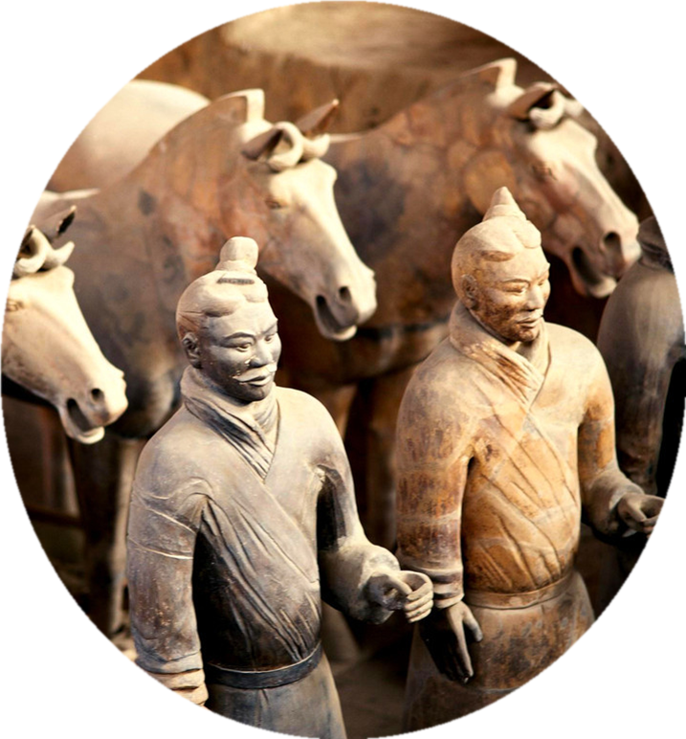
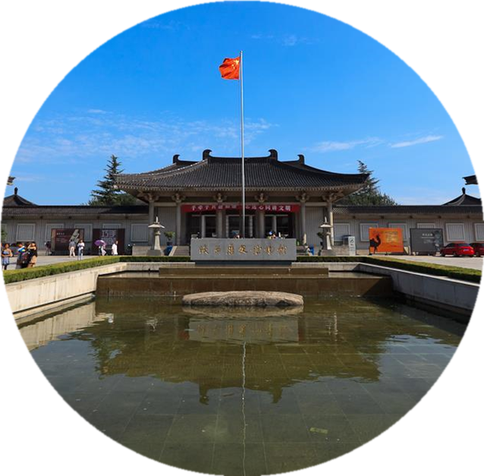
Richard's Plan
Shanxi History Museum
Xi'an City Wall
the Terracotta Army

Slide 12

Outline
P1
present state
P2
another destination
P4
ending
P1
destination
P2
reasons
P3
transport & time
P1
P2
reasons
other sights
P4
hopes or wishes

Slide 13
Underline the words and phrases used to express emotion
Dear Xiao Li,
My time here in China is going well. I love my new school and classmates. Over the October holiday, my parents and I are planning to go to Xi'an to see the Terracotta Army. I've heard that it is an amazing sight, and I can't wait to go. To me, the story of the Terracotta Army is almost unbelievable. It's amazing that there are more than 8,000 statues, and no one in modern times knew about them until the 1970s.
We're also planning to visit several other places in Xi'an. My dad and I are both looking forward to going to the Shanxi History Museum, because my dad loves history and I have heard that this museum is known as a “Chinese treasure house”! We're also going to the Xi'an City Wall and a few other famous sights.
We're taking the train, leaving the day before the October holiday begins. We're arriving at 9: 30 a.m. and will start sightseeing right away, so I hope we sleep well on the train!
I guess that's all for now! I'll write again soon and send photos! Do you have any plans for the coming holiday? Hope to hear from you soon.
Your friend,
Richard

Slide 14


Vary the sentences below
amazing
unbelievable
It is an amazing sight.
It's almost unbelievable.
The sight is ___________.
amazing
I almost can't ________ it.
believe
What an _______________ it is!
amazing sight
It's almost beyond________.
belief
What _________me is its sight.
amazes
What's almost_____________is ...
unbelievable

Slide 15
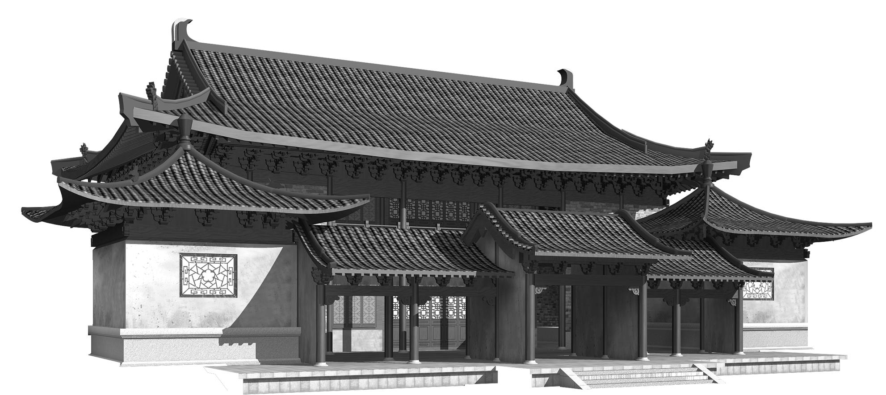
Dear __________,
My time here in ______ is going well. I love ___________ and _________. Over the _________ holiday, my parents and I are planning to go to ______ to see ___________________. I've heard that it is an amazing sight, and I can't wait to go. To me, the story of _______________________ is almost unbelievable. It's amazing that ________________________________, and _______________________________________________.
We're also planning to visit several other places in ________. My dad and I are both looking forward to going to _____________________________, because ______________________________________________________
_____________! We're also going to ______________________________ and a few other famous sights.
We're taking ___________, leaving ____________________________. We're arriving at ____________ and will start sightseeing right away, so I hope we sleep well on the _________!
I guess that's all for now! I'll write again soon and send photos! Do you have any plans for the coming holiday? Hope to hear from you soon.
Your friend,
Richard
Your travel plan

Slide 16
A Reply to Richard's Mail
Dear Richard,
I'm glad to hear that you are getting along well in China. My everything is going on well, too. My family and I are also planning to go on a tour during the October holiday. We are going to________ to see________________________________. I've heard that ____________________________________________________. And it attracts me to____________________ .
Part 1
We're planning to see some other places in_________.My family and I are looking forward to going to __________________________________, because _________
________________! We're also going to __________________________________ ___________________and a few other famous sights.
Part 2
We're taking ________, leaving on____________. We're arriving ________ and will start sightseeing ______________. I hope we will ________________!
Part 3
Well, that's all for now! I'll write again soon and send photos! Please send me a mail and tell me what happens during the tour after your journey. I'm eager to share your experience. Have fun!
Your friend,
Richard
Part 4

Slide 17
A Possible Version
Dear Richard,
I'm glad to hear that you are getting along well in China. My everything is going on well, too. My family and I are also planning to go on a tour during the October holiday. We are going to________ to see________________________________. I've heard that ____________________________________________________. And it attracts me to____________________ .
Part 1
Sichuan
the beautiful mountains and waters there
the streams and ponds of Jiuzhaigou are as beautiful as green jade
enjoy the fresh air there
Sichuan
We're planning to see some other places in_________.My family and I are looking forward to going to __________________________________, because _________
________________! We're also going to __________________________________ ___________________and a few other famous sights.
Part 2
Chendu Research Base of Giant Pandas
pandas
are so cute animals
Leshan to see the famous Giant Buddha
carved on the moutain
the plane
October 1st
at noon
Part 3
We're taking ________, leaving on____________. We're arriving ________ and will start sightseeing ______________. I hope we will ________________!
in the afternoon
have a great lunch
Well, that's all for now! I'll write again soon and send photos! Please send me a mail and tell me what happens during the tour after your journey. I'm eager to share your experience. Have fun!
Your friend,
Richard
Part 4

Slide 18
Have Fun on your travel
溯恩英语
二零二零
张钊

