Slide 1


感恩遇见，相互成就，本课件资料仅供您个人参考、教学使用，严禁自行在网络传播，违者依知识产权法追究法律责任。
更多教学资源请关注
公众号：溯恩高中英语
知识产权声明

Slide 2
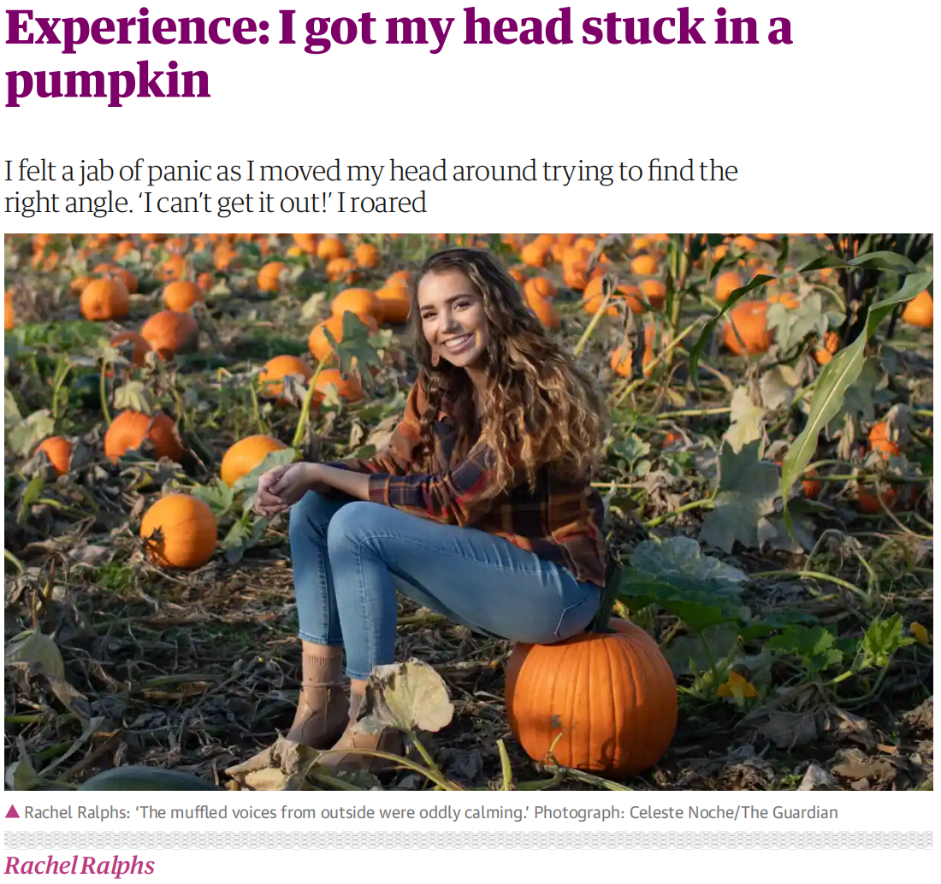
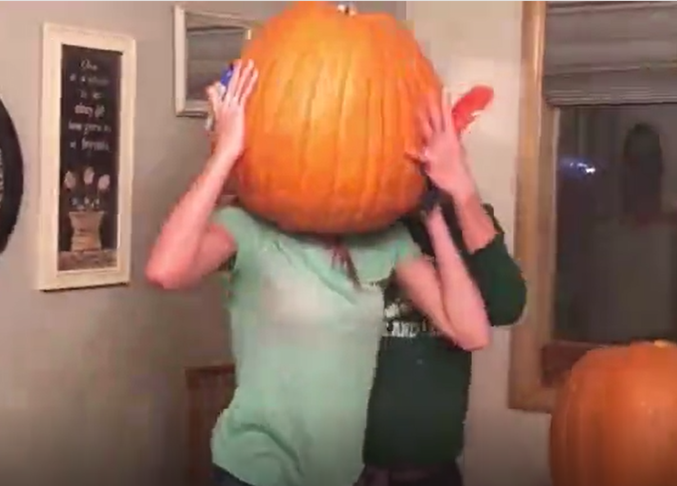

“CK251法”为读后续写助力
——2021年1月浙江省英语高考读后续写 写作讲评
浙江永嘉中学 朱迁苗Carol

Slide 3
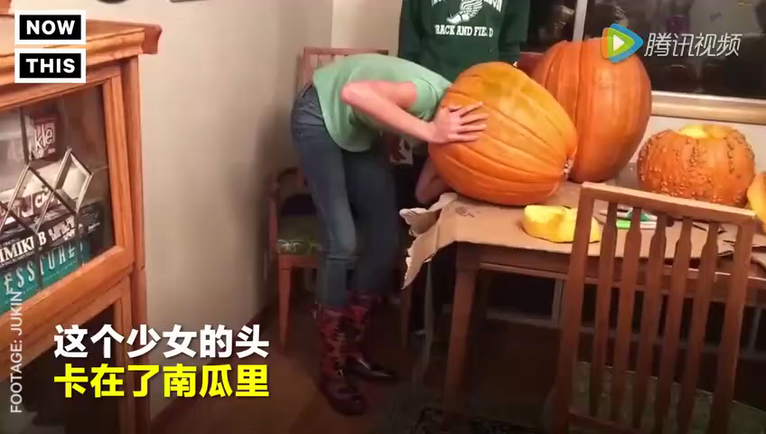

Slide 4
2021年1月高考续写 阅读下面短文，根据所给情节进行续写，使之构成一个完整的故事。
Pumpkin (南瓜) carving at Halloween is a family tradition. We visit a local farm every October. In the pumpkin field, I compete with my three brothers and sister to seek out the biggest pumpkin. My dad has a rule that we have to carry our pumpkins back home, and as the eldest child I have an advantage — I carried an 85-pounder back last year.
This year, it was hard to tell whether my prize or the one chosen by my 14-year-old brother, Jason, was the winner. Unfortunately we forgot to weigh them before taking out their insides, but I was determined to prove my point. All of us were hard at work at the kitchen table, with my mom filming the annual event. I’m unsure now why I thought forcing my head inside the pumpkin would settle the matter, but it seemed to make perfect sense at the time.
With the pumpkin resting on the table, hole uppermost, I bent over and pressed my head against the opening. At first I got jammed just above my eyes and then, as I went on with my task, unwilling to quit, my nose briefly prevented entry. Finally I managed to put my whole head into it, like a cork (软木塞) forced into a bottle. I was able to straighten up with the huge pumpkin resting on my shoulders.
My excitement was short-lived. The pumpkin was heavy. “I’m going to set it down, now,” I said, and with Jason helping to support its weight, I bent back over the table to give it somewhere to rest. It was only when I tried to remove my head that I realized getting out was going to be less straightforward than getting in. When I pulled hard, my nose got in the way. I got into a panic as I pressed firmly against the table and moved my head around trying to find the right angle, but it was no use. “I can’t get it out!” I shouted, my voice sounding unnaturally loud in the enclosed space.
Para1：I was stuck for five or six minutes though it felt much longer.____________________
Para 2：That video was posted the Monday before Halloween.____________________________

Slide 5

CK251 Approach
2021年1月高考 读后续写
评分细则
是否与所给短文故事情节衔接
是否与段落开头语衔接
是否覆盖5个及以上关键词
词汇的准确性和丰富性
语法结构和句式多样化
Continuation 承上启下（段首句 续写协同效应）
Key words 关键词（编情节 契诃夫原则 ）
2 = theme+conflict （故事要素：读+写）
5 = five points (150词数 卷面意识)
1 = one good ending （呼应主题：正能量 ）

Slide 6
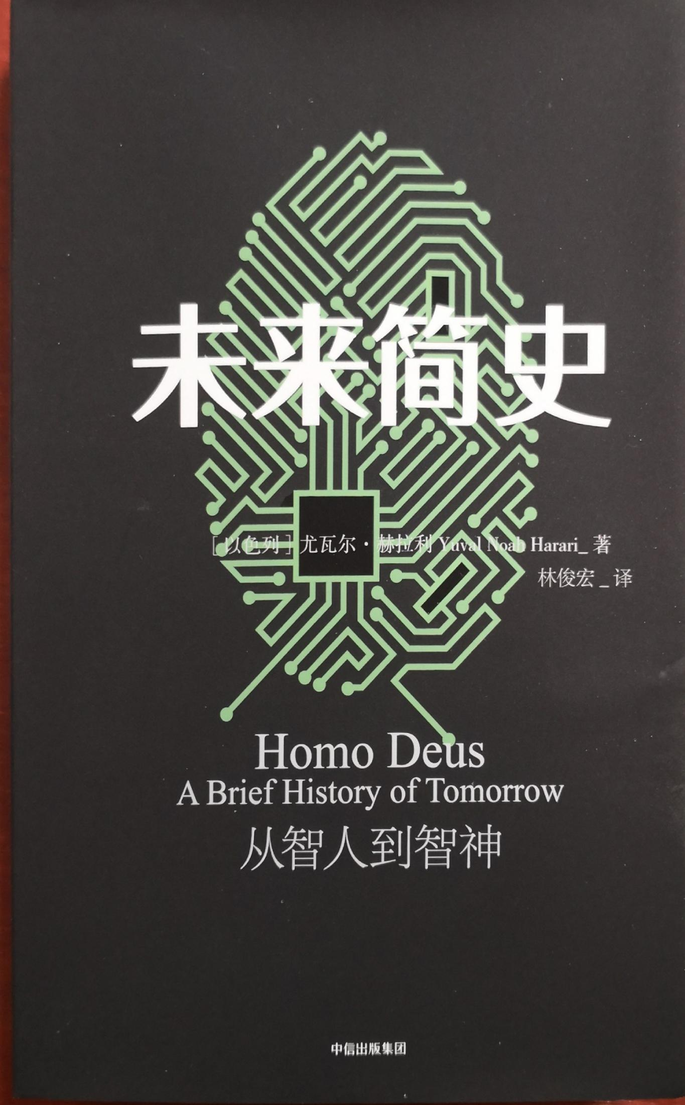
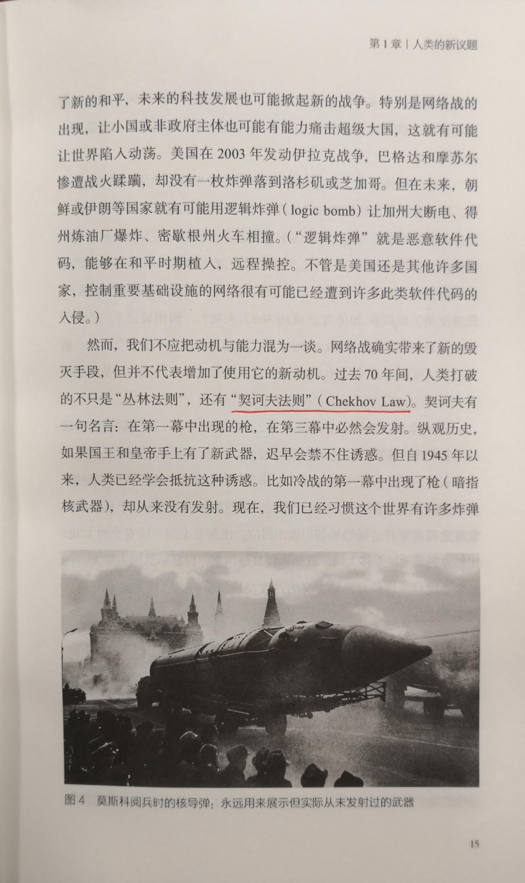

Slide 7
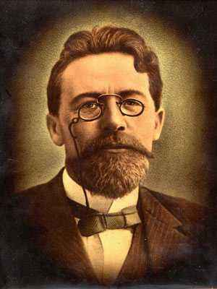
契诃夫法则 Chekhov's Law
Remove everything that has no relevance to the story. If you say in the first chapter that there is a rifle hanging on the wall, in the second or third chapter it absolutely must go off. If it's not going to be fired, it shouldn't be hanging there.
- Anton Chekhov
第二节 读后续写（满分25分）
阅读下面短文，根据所给情节进行续写，使之构成一个完整的故事。
注意:1. 所续写短文的词数应为150左右；
2. 应使用5个以上短文中标有下划线的关键词语；
3. 续写部分分为两段，每段的开头语已为你写好；
4. 续写完成后，请用下划线标出你所使用的关键词语。
契诃夫法则 (Chekhov's Law)是一种文学技巧，在故事早期出现的某一元素，直至最后才显现出它的重要性。换言之，在故事开头出现过的物品一定要在后来用到，否则，它压根就不应该出现。
在一部影片的开头，镜头扫过墙上的一把收藏用的古董枪，到影片结束的时候，它应该发挥作用 (比如， 出其不意地用它干掉手持火箭筒的大坏蛋) ; 否则，这杆枪压根就不应该出现在镜头中。

Slide 8
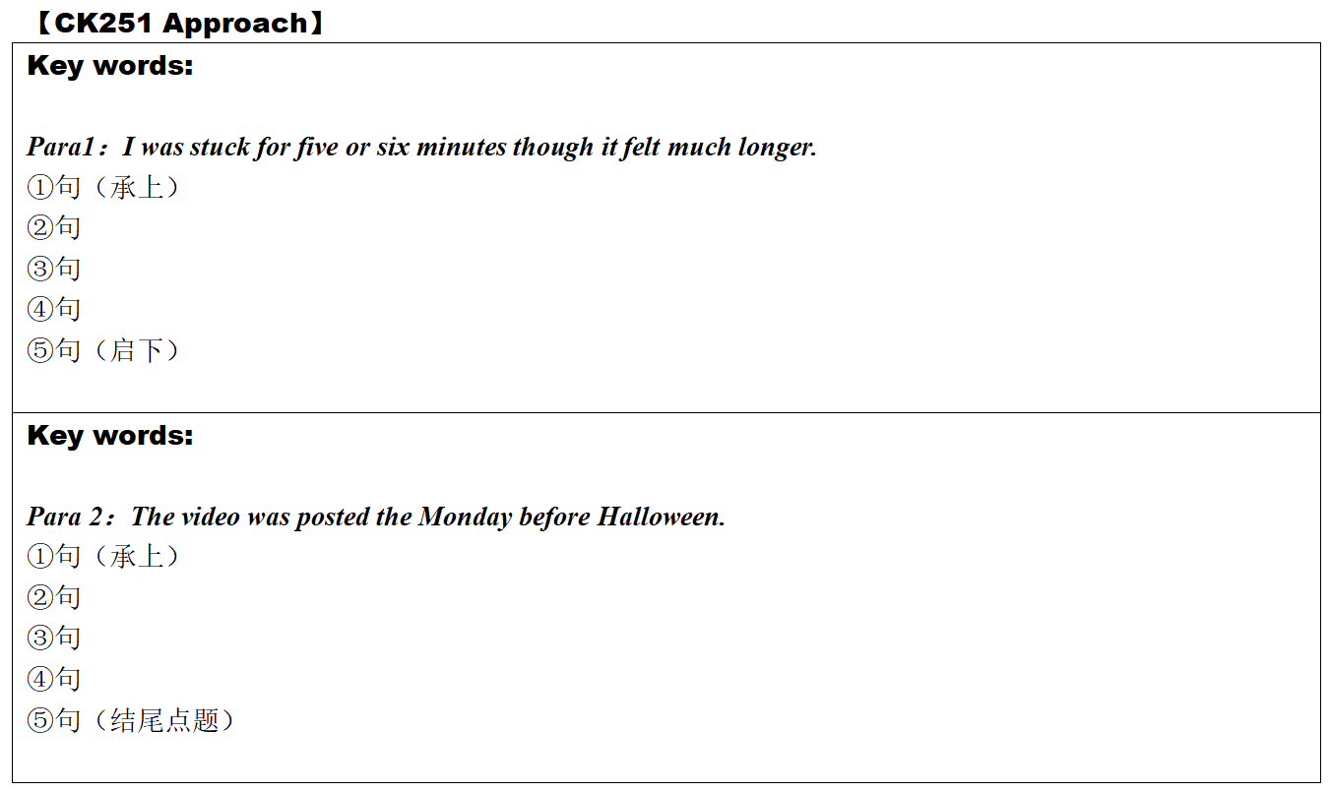
CK251 Approach
2021年1月高考 读后续写
构思草稿
First draft
Notes:
“

Slide 9
CK251 Approach
2021年1月高考 读后续写
2 = theme+conflict （故事要素：读+写）
What is the theme?
What is the conflict?
Notes:
“

Slide 10
Read for the theme and the conflict(s)
CK251 Approach
Pumpkin (南瓜) carving at Halloween is a family tradition. We visit a local farm every October. In the pumpkin field, I compete with my three brothers and sister to seek out the biggest pumpkin(找出最大的南瓜). My dad has a rule that(有一条规定) we have to carry our pumpkins back home, and as the eldest child I have an advantage(有优势) — I carried an 85-pounder back last year.
This year, it was hard to tell whether my prize or the one chosen by my 14-year-old brother, Jason, was the winner. Unfortunately we forgot to weigh them before taking out their insides(取出瓜瓤前称重), but I was determined to prove my point(证明我的观点). All of us were hard at work at the kitchen table, with my mom filming the annual event(拍摄年度活动). I’m unsure now why I thought forcing my head inside the pumpkin would settle the matter, but it seemed to make perfect sense at the time.(我现在不知道为什么我认为把我的头塞进南瓜里就能解决问题，但这在当时似乎很有意义。)
With the pumpkin resting on the table(放在桌上), hole uppermost(开口朝上), I bent over and pressed my head against the opening(把我的头压在开口上). At first I got jammed(卡住) just above my eyes and then, as I went on with my task, unwilling to quit, my nose briefly prevented entry(我的鼻子暂时阻止了我的进入). Finally I managed to put my whole head into it, like a cork (软木塞) forced into a bottle. I was able to straighten up with the huge pumpkin resting on my shoulders(站直，把大南瓜搁在我肩膀上).
My excitement was short-lived(短暂的). The pumpkin was heavy. “I’m going to set it down(放下), now,” I said, and with Jason helping to support its weight, I bent back over the table to give it somewhere to rest(找个位置放下). It was only when I tried to remove my head(挪出脑袋) that I realized getting out was going to be less straightforward than getting in(不会像进去那样直截了当). When I pulled hard, my nose got in the way(挡住). I got into a panic(陷入恐慌) as I pressed firmly against the table(紧紧按住桌子) and moved my head around trying to find the right angle(转来转去，想找到合适的角度), but it was no use. “I can’t get it out!” I shouted, my voice sounding unnaturally loud in the enclosed space(我的声音在这封闭空间里听起来很不自然地响).

Slide 11
2021年1月高考 南瓜
dad; Jason; mom
theme: family love,youth
conflict:
[1] Who was the winner?(次要矛盾)
[2] I got my head stuck in the pumkin. How to get out?Who helps? (主要矛盾)
人物
事物
动作
2
K
pumpkin; head; nose
managed; support; rest; pulled
Climax(conflict最大化/turning point转折点)
Unexpectedly, I got my head stuck in he pumpkin. I attempted several times to get out, but in vain and got into a pacnic.
support; rest; pulled
Para1：It was five or six minutes though it felt much longer.
dad; Jason; mom; pumpkin; head; nose; pulled; managed...（more than 5 key words）
To prove that the winner was Me not Jason, I managed to put my head into my pumpkin feeling excited, with my mom was filming.
Jason; mom; head;
nose; managed
Falling action(conflict缓延)
Rising action
(conflict激化)
Para 2：The video was posted the Monday before Halloween.
Because of Dad's rule, we competed to seek out the biggest pumpkins and carries them by ourselves.
pumpkin ;Dad
dad; mom; pumpkin;head; support; rest ...（or none）
Exposition
(情节交代)
Resolution(conflict解开)
Denouement(结尾)

Slide 12
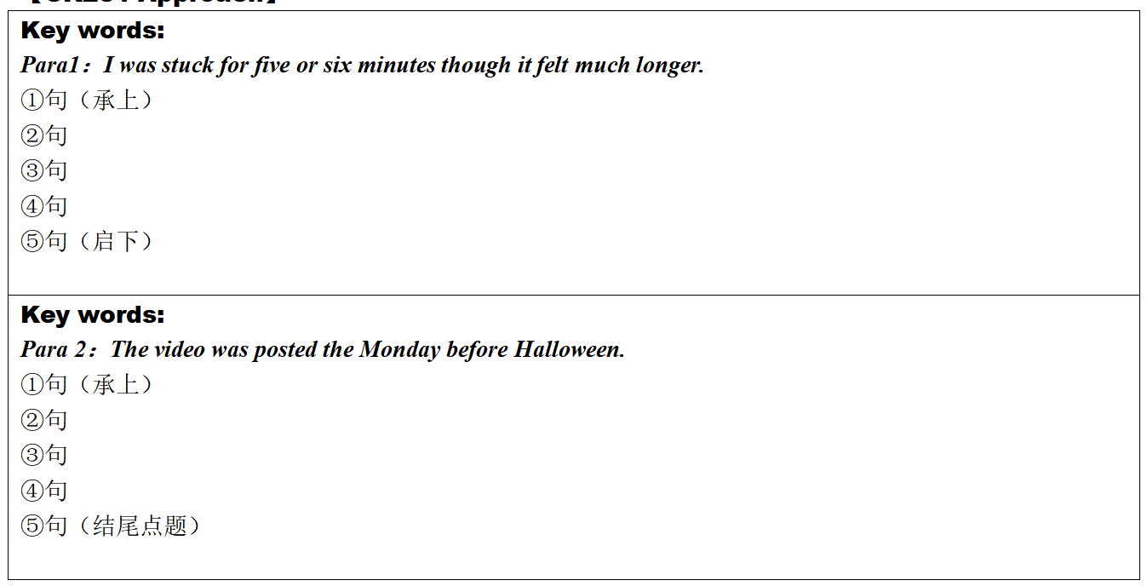
CK251 Approach
2021年1月高考 读后续写
My feelings?reactions? panic, be regretful，shameful
My family's feeling? reactions? worried, hilarious
Who helped me?
How to help?
What was the result( conflict[2] )?
My reaction?(video)
dialogue,action
What was the netizen's response? support, be favourable
My feelings accordingly? be embarrassed, delighted
How about the competition( conflict[1] )?
What was the result?(eg. dress up as pumpkin head for trick-or-treat)
My reflection?(theme)

Slide 13
Brainstorm useful expressions
To show, not to tell!
The solutions to Conflict [1] Who was the winner?(矛盾一的解决)
eg1: （para1）I saw Jason holding his phone at me: “I am going to post this online and you are going to be famous!” Finally, we came to an agreement that he may post the video, but I am the winner of this year’s pumpkin contest.
eg2: （Para2）At the cafeteria during lunch, my friend Nathan greeted me smirkingly, “I heard someone had a little too much pumpkin over the weekend.” I ignored his mocking tone and responded proudly: “Someone might have, but someone also won the pumpkin contest!”

Slide 14
Brainstorm useful expressions
To show, not to tell!
The solutions to Conflict [2] I got stuck in the pumkin.Who helps?
(矛盾二的解决：如何把头从南瓜中弄出来)
我的痛苦感受和徒劳努力：
seized
overcome
occupied
horror
fright
panic
eg1: At the thought of being trapped in the pumpkin, I was by a strong sense of
and my palms were sweating. All efforts to my head from the pumpkin
were , but in vain. As time , I felt //my head was
spinning a lack of oxygen and onto the floor.
free
disconnect
seperate
breathless
dizzy/ giddy
suffocated
tried
attempted
ticked by
dragged on
due to
owing to
as a result of
fell
heaped
slumped
tumbled

Slide 15
Brainstorm useful expressions
To show, not to tell!
我的痛苦感受和徒劳努力：
eg2: Unable to get out of the pumkin, I felt so scared that my throat tightened and my knees felt weak. The hard pumpkin weighed stubbornly upon my shoulder, not wanting to budge at all. Total darkness disorientating me(独立主格), I rotated on the spot and finally spun myself onto the floor.
eg3: Trapped in the pumpkin, I gulped for air, my throat dry and face burning up(独立主格). It was a torment for me. I wrestled with the problem, attempting to squeeze my head out of it(非谓语作状语) , but in vain. So frightened was I that I pulled, and banged the pumpkin frantically.
eg4: [humorous] I attempted the artful removal of pumpkin head calling out all of my hidden gymnastic abilities in ways that I knew I never could have moved. To put it simply, my body was like an octopus crawling out of a borrowed conch shell.(修辞:明喻simile)

Slide 16
Brainstorm useful expressions
To show, not to tell!
The solutions to Conflict [2] I got stuck in the pumkin.Who helps?
(矛盾二的解决：如何把头从南瓜中弄出来)
家人的帮忙：
eg1: Dad held onto pumpkin steadily and mom pulled my body. In the meantime, Jason burst into laughter and joked: “Sticking your head into the pumpkin would not count for extra weight!”
Down dashed my dad who got me to push my head farther into the pumpkin so that mom's hand could reach in and loosen my ponytail.
eg2: Seeing my repeated efforts but in vain, Jason darted out of the room and turned to Dad for help. He tried many approaches, and eventually managed to get my head out by carefully cutting the pumpkin open with a knife.
eg3: “Hey, someone's dying in here!” I feebly protested, my voice muffled. It was then that they wriggled closer to help me unplug. Jason sat on my lap while dad pulled with all his might. The pumpkin eased past my mouth and then climbed, inch by inch, over the most difficult organ--my nose.
eg4: Dad got me to push my head farther into the pumpkin so Mom could reach in and undo the rubber band round my ponytail! l emerged with squash-conditioned hair, a sore chin and my nose plugged with pulp.

Slide 17
Brainstorm useful expressions
To show, not to tell!
家人想帮又想笑的复杂情绪和行为
eg1: While mom and dad worked hard to help calm me down in between fits of laughter, Jason recorded the whole ordeal.
eg2: Through the thick wall of the pumpkin’s meaty shell, I could hear my mom and Jason
struggling to hold back their laughter while supporting me to pull my oversized orange astronaut helmet off.
eg3: Seeing me caught in such a situation, Dad was unexpectedly surprised, but soon surprise transformed into laughter.
eg4: “Dad! Emergency! Help needed!” Jason roared, laughing himself under the table. Dad rushed out and immediately joined his second son in rolling on the ground. Jason, still trembling with laughter in the seat, finally had a pang of conscience and called dad for help.
eg5: Upon seeing the pumpkin-headed “monster”, dad participated in the chorus of jeers but soon snatched a knife, gently poked it through the top of the vegetable and then tore it open.
eg6: Although I was panicking, my family found my foolish display more comical than dangerous.

Slide 18
Brainstorm useful expressions
To show, not to tell!
关于视频拍摄和上传
视频 n. (short) video
拍摄 v. shoot ( shot shot) / film
发送上传 v. post/upload sth. → sth. be posted online 分享v. share...with...
走红 go viral /immediately become a hit 关注v. follow sb. 转发v. repost / retweet
点赞 n. like(s)/thumb-up(s) →give/receive ~ 浏览消息 browse one's messages
评论 n. comment(s) →leave ~ / v. comment (on)
浏览量 n. view(s) / 浏览最多的adj. most-viewed
社交工具 Facebook/TuTube

Slide 19
Brainstorm useful expressions
To show, not to tell!
承上启下句的衔接
[第1段启下句]
eg1:Just when I felt relieved to be freed from the pumpkin, I suddenly found that mom should be shooting all that happened to me and would upload it online.
eg2:My head was finally released and it was then that I realized my mom had been filming the whole time.
eg3:I lifted my pumpkin-pulp-coveredeyelids, scanned the room and saw three faces contorted by guffaw and mum still holding the camera, which, unfortunately, had recorded everything.
[第2段承上句]
eg1:When I logged in my Facebook I found myself dumbfounded by the abundant likes I received from those who had seen my video. Browsing their messages, I felt a wave of warmth.
eg2:It went viral instantly. Just within hours, hundreds of likes and funny comments appeared, showing their enthusiasm. Constants streams of curious people even came by to take photos with us and my prized pumpkin.
eg3:Not long after it was uploaded, it soared to the top of “most-watched” short videos. Thousands left comments, sharing their own stories of their body parts being caught in small undesired places. The next day, when I was walking around the campus, I was soon recognized and asked to take selfies.

Slide 20
Brainstorm useful expressions
To show, not to tell!
我的视频被传到网上的尴尬、懊恼等复杂心情
eg1:I was too embarrassed to see watch the video, let alone seeing my friends' comments!
eg2:So embarrassed was she that I sat there restlessly, feeling the blood rush to her face.(部分倒装句)
eg3:My face flushed/burned scarlet with embarrassment/shame.
eg4:How I wished I had not acted so foolishly, making myself a laughing stock of my family!(虚拟语气)
eg4:While stuck in the pumpkin, I could well imagine how they would look when my head came out.
eg5:Never had I ever felt so embarrassed but never had I ever been so famous! (部分倒装句)My emotions were so conflicted between whether I should be happy or sad.

Slide 21
Brainstorm useful expressions
To show, not to tell!
点题收尾句
eg1:叙事式 I went around my community with my friends, trick-or-treating with my head in another pumpkin that mom and dad had found for me. This time, I made sure to cut a big enough hole.
eg2:感悟式 Though feeling a bit embarrassed, I felt a stronger family bond - a family surrounded by love and fun.
eg3:感悟式 Until today, I am still unsure what to make of that unforgettable Halloween and super thankful for my dad's rescue.
eg4:评价式 Thanks to mom, the video turned out to be a reminder, a captured memorable moment, a recollection of festival happiness, colored by hearty human interactions.
eg5:评价式 The next day, when I walked aroundthe campus, I could feel fingers pointed at my direction, giggles behind sleeves and whispers in small groups. It's like I suddenly shot to stardom! If this incident was a TRICK God played on me, I might as well regard it as my TREAT for everyone to have an unforgettable Halloween.
eg4:多元化（感悟+叙事+评价） Bathed in the festive atmosphere, I totally forgot the “unforgettable” incident and set out for the trick-or-treating. I would take it as a treat to add joy and fun to this festive Halloween for everyone.

Slide 22
Sample 1
2021年1月高考 读后续写
I was stuck for five or six minutes though it felt much longer. Although I was panicking, my family found my foolish display more comical than dangerous. To my dismay, instead of trying to help, Jason reached for his phone. While mom and dad worked hard to help calm me down in between fits of laughter, Jason recorded the whole ordeal. He was determined to keep a video record of the events in its full entirety, surely to tease me with it for a long time to come. Pull as I might, my head couldn’t budge. Finally, after some olive oil to help ease the friction and a final pull with all my might, I stumbled back to the ground - my head free and the pumpkin firmly grasped by mom and dad.
That video was posted online the Monday before Halloween. If I didn’t feel humiliated enough at home, now I get to live with my foolishness in school as well. It was not long before I was given the nickname “Pumpkin Head”, and it stuck. The nickname could not come at a better time; my friends begged me to seriously consider putting my head back in the pumpkin for our annual trick-or-treating adventures tomorrow night. At this point, I could not do anything but smile and chuckle along with the rest of my friends. Acts of foolishness can happen to anybody. After all, I would have done the same to Jason or my friends if they were the ones stuck in the pumpkin. Come Halloween night, I figured might as well be a good sport and play along with the joke. I went around my community with my friends, trick-or-treating with my head in another pumpkin that mom and dad had found for me. This time, I made sure to cut a big enough hole.
注： 参考范文选自溯恩英语外教下水作文

Slide 23
Sample 2
2021年1月高考 读后续写
I was stuck for five or six minutes though it feltmuch longer. How I wished I had not acted so foolishly, making myself a laughing stock of my family! I could well imagine how they would look when my head came out. Seeing my repeated efforts but in vain, Jason darted out of the room and turned to Dad for help. Seeing me caught in such a situation, Dad was unexpectedly surprised, but soon surprise transformed into laughter. He tried many approaches, and eventually managed to get my head out by carefully cutting the pumpkin open with a knife. Just when I felt relieved to be freed from the pumpkin, I suddenly found that mom should be shooting all that happened to me and would upload it online
That video was posted online the Monday beforeHalloween. It went viral immediately. Just within hours, hundreds of likes and funny comments appeared, showing their enthusiasm. Constants streams of curious people even came by to take photos with us and my prized pumpkin. Jason was really excited and Mom was glad that her video should become such a hit and thus grew even crazier about shooting videos. But for me, though a little embarrassed, I soon totally forgot the unforgettable" incident and set outfor the trick-or-treating. I would like to take it as a treat to add joy andfun to this festive Halloween for everyone.
注： 参考范文选自溯恩英语外教下水作文

Slide 24
Thank you!
2021年1月高考 读后续写
Notes:
“一、如何利用语料库进行写作？
何为“语料库”？严格意义上讲，语料库（corpus，复数corpora）指经科学取样和加工的大规模电子文本库。借助计算机分析工具，研究者可开展相关的语言理论及应用研究。语料库是语料库语言学研究的基础资源，也是经验主义语言研究方法的主要资源。应用于词典编纂，语言教学，传统语言研究，自然语言处理中基于统计或实例的研究等方面。
显然，本文所梳理的语料库，是狭义的，是基于“以读促写，读写结合”的理念，通过典范英语小说文学阅读，对文本和语言进行归纳梳理，使学生更加直观地认知原滋原味的语言，积累语言，模仿和运用语言。因此，这里的语料库具有真实性、归纳性、工具性的特点，便于学生查阅和模仿。值得一提的是，高中英语3500的考纲词汇已经远远满足不了学生的阅读和写作需求，因此，在语料库中对超纲词汇、一词多义、熟词新义、文学高频词汇、文学修辞等方面都尽可能做到解析，以供学习。

