Slide 1
感恩遇见，相互成就，本课件资料仅供您个人参考、教学使用，严禁自行在网络传播，违者依知识产权法追究法律责任。
更多教学资源请关注
公众号：溯恩高中英语
知识产权声明

Slide 2
让环境在你的笔端鲜活
环境描写

Slide 3
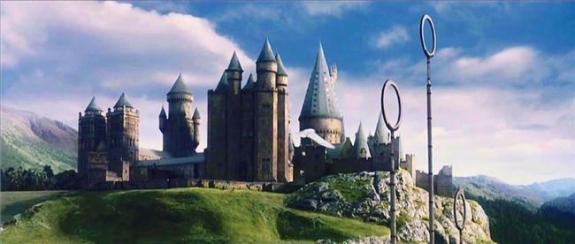
环境描写
“一切景语皆情语”——王国维。
续写中的环境描写并非可有可无的。环境描写是服务于文章的主题并侧面推进对于人物的刻画。

Slide 4
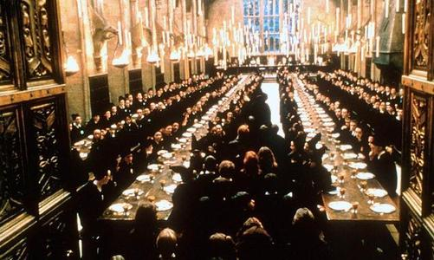
splendid
取胜第一招：环境描写交代故事背景
素材摘录1：Harry had never even imagined such a strange and splendid place. It was lit by thousands and thousands of candles that were floating in midair over four long tables, where the rest of the students were sitting.
哈利从未见过有哪个地方如此奇怪且辉煌。其他高年级的学生都坐在四张长桌子前，他们头顶上方竟有数以千计的蜡烛在半空中飘浮，将整个大会堂照得灯火通明。
never even: 从未（语气夸张）
was lit by: 被…点亮了

Slide 5
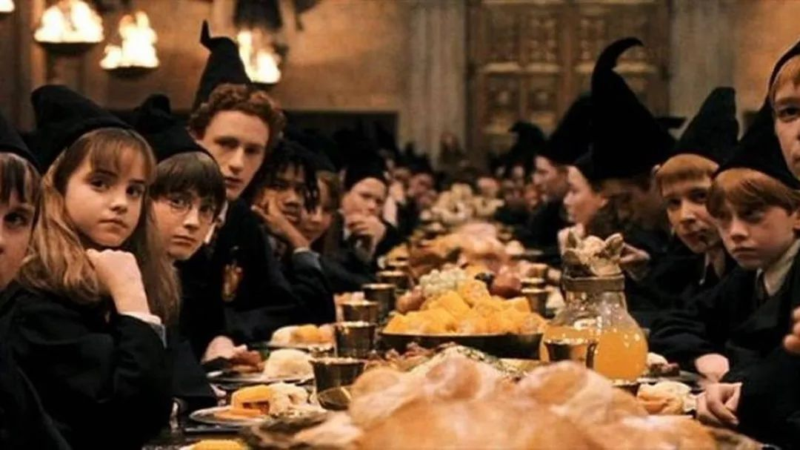
素材背景：After Harry finally arrives at Hogwarts with other first years, they are led into the Great Hall, waiting to be sorted into different houses by the sorting hat. Harry is so amazed at what he sees.
素材解读：The description of the environment not only gives the readers the background of the story, but also moves the story along.

Slide 6
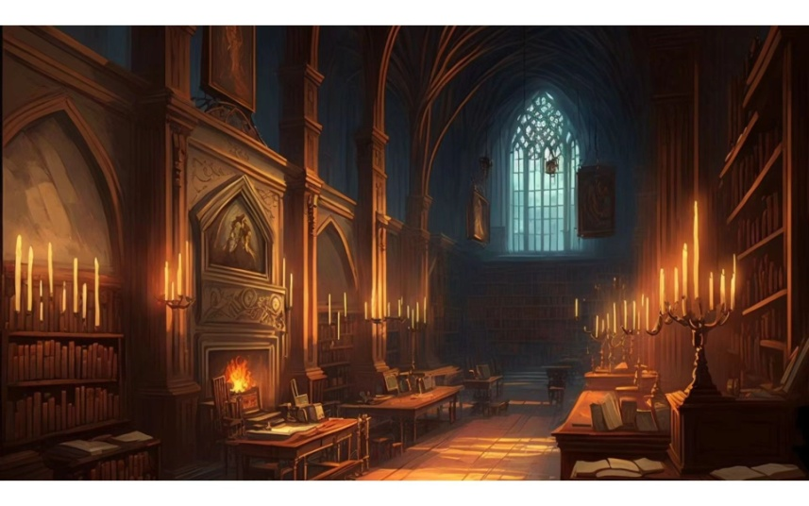
素材摘录2：The entrance hall was so big you could have fit the whole of the Dursleys' house in it. The stone walls were lit with flaming torches like the ones at Gringotts, the ceiling was too high to make out, and a magnificent marble staircase facing them led to the upper floors.
门厅大得能把德思礼家整栋房子搬进去。像古灵阁一样,石墙周围都是熊熊燃烧的火把。天花板高得几乎看不到顶。正面是一段豪华的大理石楼梯, 直通楼上。
flaming /ˈfleɪmɪŋ/ adj.火焰似的;热情的;
torch /tɔrtʃ/ n. 火把，火炬
magnificent /mæg’nɪfəsnt/壮丽的；华丽的
staircase楼梯
Notes:
llo

Slide 7
素材背景：Harry finally arrive at Hogwarts with other first years, with Hagrid leading the way. Professor McGonagall welcomes them into the school. Harry observes it carefully with great curiosity.
素材解读：The writer uses the environment description to show the story setting has changed and Harry has escaped from his old life and come into a new stage of his life.

Slide 8
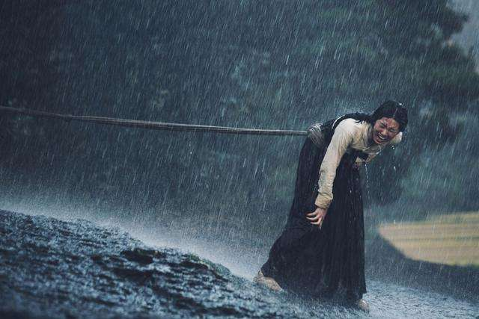
取胜第二招：环境描写体现人物内心
素材摘录1：It was freezing in the boat. Icy sea spray and rain crept down their necks and a chilly wind whipped their faces. After what seemed like hours they reached the rock, where Uncle Vernon, slipping and sliding, led the way to the broken-down house.
船上寒冷至极。冰冷的海水掀起的浪花夹着雨水顺着他们的脖子往下流，刺骨的寒风抽打着他们的面孔。仿佛过了好几个小时，他们才来到那块礁石边。弗农姨夫脚下打着滑，领着他们朝破旧的小屋走去。
spray: n.浪花
creep: v.缓慢行进
freezing
whip: v.鞭打
icy
chilly
slip and slide: v.打滑
and the
Sorcerer’s Stone

Slide 9
素材背景：To avoid being found by Hagrid, Uncle Vernon brings Harry and his family to an island on a stormy night.
素材解读：The first sentence of this paragraph is a generalized statement and the rest sentences are detailed support. The writer uses verbs “creep”, “whip” “slip” and “slide” to indicate the situation for Uncle Vernon is terrible. It is in vain for him to get away.
The adjectives “freezing”, “icy” and “chilly” both show the weather and the traveler’s feelings. And they are totally broken down just like the house they reach.

Slide 10
素材摘录2： Potions lessons took place down in one of the dungeons. It was colder here than up in the main castle, and would have been quite creepy enough without the pickled animals floating in glass jars all around the walls.
creepy
药剂课是在其中一个地牢里进行的。里边比主城堡里冷多了。四周的墙上还摆满了玻璃瓶子，瓶里面漂着的都是腌制动物的尸体，真让人毛骨悚然。
potion /ˈpəʊʃən/ n. 药水;药剂;魔药
dungeon /ˈdʌndʒən/ n. (尤指城堡中的)地牢
creepy/ˈkriːpi/ adj.令人毛骨悚然
pickled/ˈpɪkld/ adj.腌渍的;醉醺醺的
and the
Sorcerer’s Stone

Slide 11
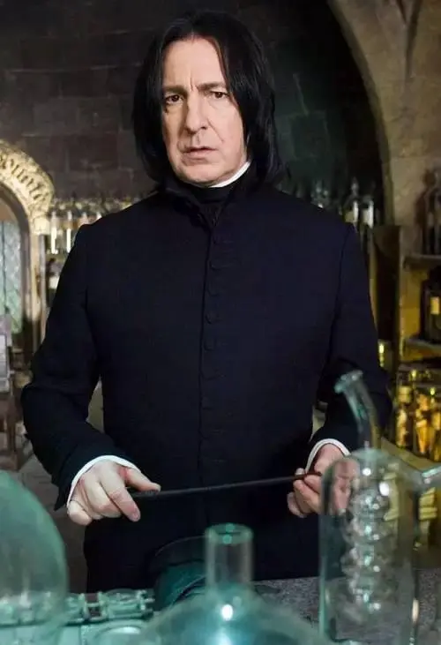
素材背景：Harry gets a feeling that Professor Snape doesn’t like him the moment they meet for the first time.
素材解读：Harry’s feelings towards the classroom is actually his feelings towards Professor Snape, “creepy”.
and the
Sorcerer’s Stone

Slide 12
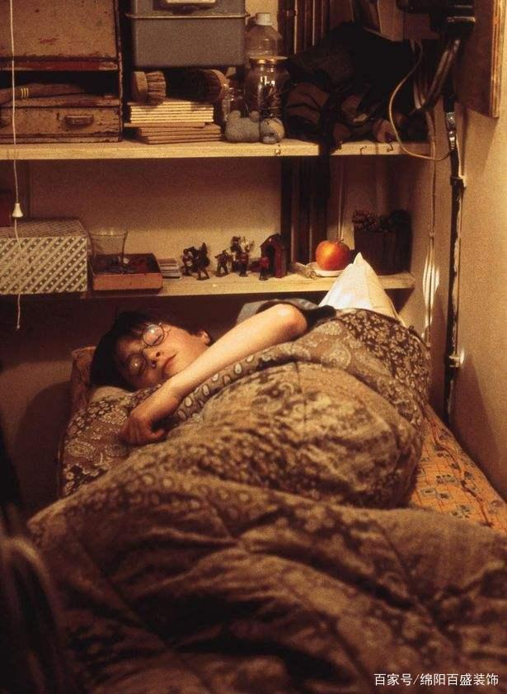
取胜第三招：环境描写揭示人物性格
素材摘录1：Harry got slowly out of bed and started looking for socks. He found a pair under his bed and, after pulling a spider off one of them, put them on. Harry was used to spiders, because the cupboard under the stairs was full of them, and that was where he slept.
calm
strong
哈利慢慢地起床，开始找袜子。他在床下找到一双袜子。把其中一只袜子上的蜘蛛扔了后，就穿上了。哈利已经习惯了蜘蛛，因为他睡觉的楼梯下的橱柜里满是蜘蛛。

Slide 13
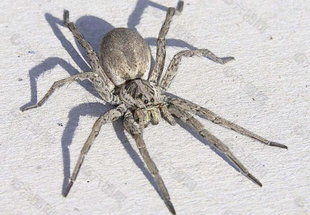
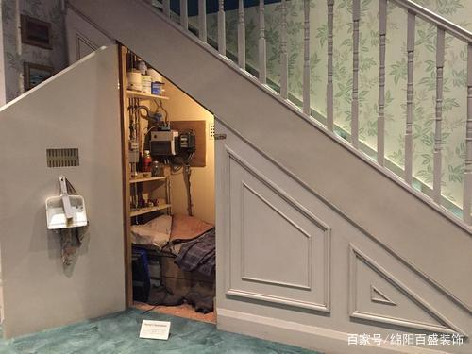
素材背景：It describes the scene when Harry gets up in the cupboard under the stairs, where Harry sleeps and spends most of his time to be left alone.
素材解读：The writer uses the specific thing “spider” on his sock to show the readers the poor living condition of Harry’s. Meanwhile, through Harry’s calm reaction, his calmness and strength are clearly presented in front of the readers, playing an important part of foreshadowing below.

Slide 14
素材摘录2： Hagrid lived in a small wooden house on the edge of the forbidden forest. A crossbow and a pair of galoshes were outside the front door.
simple
海格住在禁林边上的一间小木屋里。他的房子门前放着一把弩和一双橡胶雨鞋。
on the edge of adv.在…的边缘
crossbow /ˈkrɒsbəʊ/ n.弩;弩弓
galoshes /ɡəˈlɒʃɪz/ n. 橡胶套鞋
and the
Sorcerer’s Stone

Slide 15
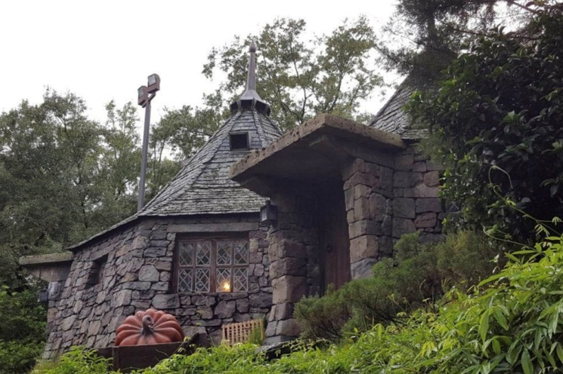
素材背景：Hagrid invites Harry to have tea with him after class on Friday. Harry goes there with Ron.
素材解读：Hagrid is a simple, honest and unsophisticated person. The readers can clearly see that from the place he lives in and the goods that he owns and displays in front of his house.
and the
Sorcerer’s Stone

Slide 16
取胜第四招：环境描写衬托人物行为
素材摘录1：They walked for nearly half an hour, deeper and deeper into the forest, until the path became almost impossible to follow because the trees were so thick.
他们走了将近半个小时，越来越深入森林内部。后来树木变得极为茂密，小路几乎走不通了。
素材背景： Harry, Hermione, Neville, and Malfoy are punished to go into the forbidden forest in the midnight for breaking the school rules. The description of the environment carries the plot forward and show brave actions of Harry.

Slide 17
素材摘录2： At first they just hurtled through a maze of twisting passages. Harry tried to remember, left, right, right, left, middle fork, right, left, but it was impossible. Harry's eyes stung as the cold air rushed past them, but he kept them wide open.
一开始，他们只是匆匆穿过一些弯弯曲曲的迷宫似的通道。哈利想尽力记住，左转、右转、右转、左转、交叉，再右转、再右转，但这几乎是不可能的。冷空气呼呼地吹过，刺痛了哈利的眼睛，但他还是尽力睁大眼。
hurtle /ˈhɜːtl/ v.飞驰，猛冲
twist /ˈtwɪstɪŋ/ v.使弯曲;扭转
sting /stɪŋ/ v.刺;蜇;叮

Slide 18
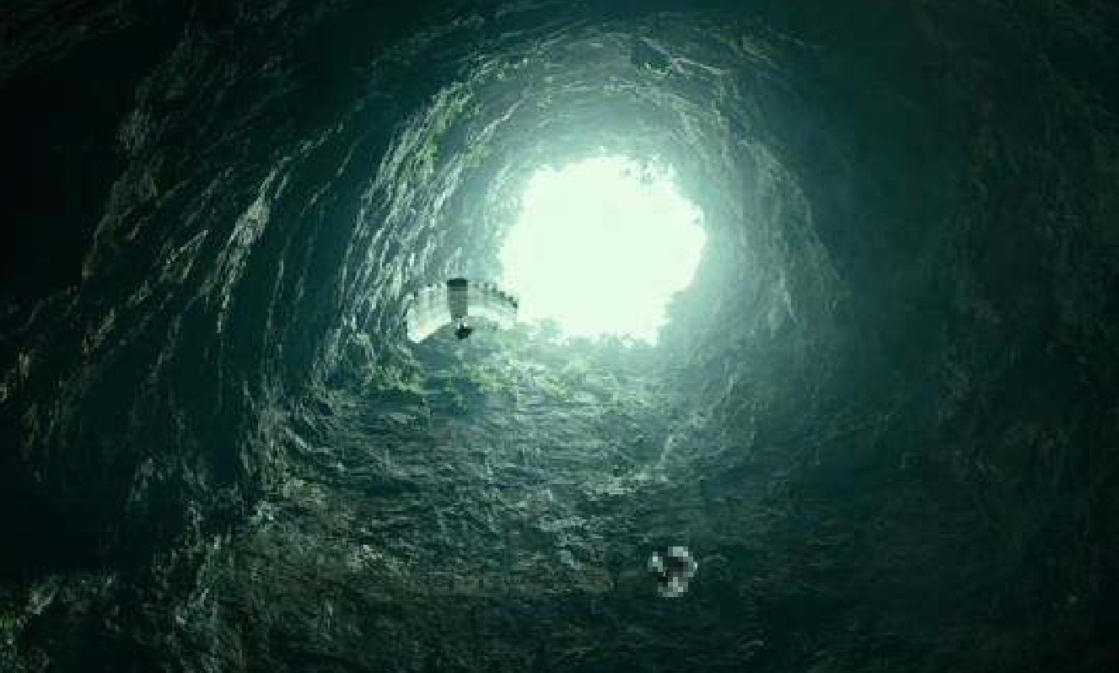
素材背景：Hagrid brings Harry to the deep underground to take some money from Harry’s safe for the future expense at Hogwarts.
素材解读：Though the cart is running deeper and deeper underground, Harry isn’t afraid of that. Instead, he tried to remember the route and open his eyes wide open to observe his surroundings despite the freezing wind. The environment emphasizes Harry’s brave and curious deeds.

Slide 19
取胜第五招：环境描写渲染氛围
素材摘录1：It was a clear, breezy day, and the grass rippled under their feet as they marched down the sloping lawns toward a smooth, flat lawn on the opposite side of the grounds to the forbidden forest, whose trees were swaying darkly in the distance.
breezy /ˈbriːzi/ adj.微风的;轻松愉快的
marched /mɑːtʃt/ v.前进；行军
ripple /ˈrɪpld/v. 如波浪般起伏
sway /ˈsweɪ/ v. 摇动
这是一个晴朗的、微风习习的日子。当他们快步走下倾斜的草地，向场地对面一处平坦的草坪走去时，小草在他们脚下起伏。远处黑魆魆的禁林的树木在风中摇曳。
and the
Sorcerer’s Stone

Slide 20
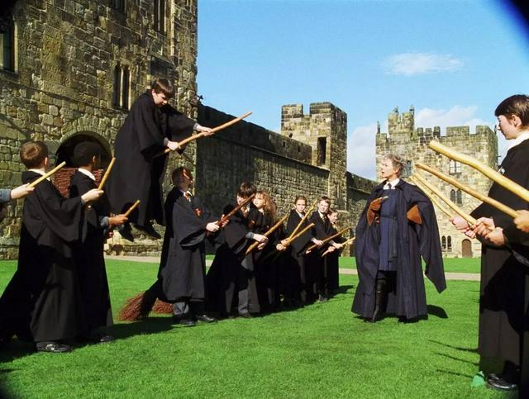
素材背景：At three-thirty that afternoon, Harry, Ron, and the other Gryffindors hurried down the front steps onto the grounds for their first flying lesson.
素材解读：Harry has been looking forward to learning to fly more than anything else. But Gryffindor and Slytherin would be learning flying together, which makes him unhappy. So here the weather and the forest are used for atmospheric purpose and at the same time indicate his inner feelings.
and the
Sorcerer’s Stone

Slide 21
素材摘录2：The moon was bright, but clouds scudding across it kept throwing them into darkness. Ahead, Harry could see the lighted windows of Hagrid's hut.
月光很皎洁, 但不断有云飘过来遮住月亮, 使他们陷入一片黑暗。哈利可以看见海格小屋里亮着灯光。
素材背景：Harry, Hermione, Neville, and Malfoy are punished to go into the forbidden forest in the midnight for breaking the school rules.
素材解读：The description of the environment foretells the danger that they may meet in the forest soon.
scud /skʌd/ vi.飞掠;疾飞
and the
Sorcerer’s Stone

Slide 22
取胜第六招：环境描写推动情节发展
素材摘录1：The countryside now flying past the window was becoming wilder. The neat fields had gone. Now there were woods, twisting rivers, and dark green hills.
窗外掠过的乡野，渐渐变得越来越荒凉。平整的田野已经消失，取而代之的是茂密的树林，蜿蜒的河流和深绿色的山丘。
素材背景：Harry is on the train to Hogwarts.
素材解读：The description of the environment moves the story along.
and the
Sorcerer’s Stone

Slide 23
素材摘录2：As they entered November, the weather turned very cold. The mountains around the school became icy gray and the lake like chilled steel. Every morning the ground was covered in frost.
进入十一月后，天气变得非常寒冷。校周围的大山上灰蒙蒙的，覆盖着冰雪，湖面像淬火钢一样又冷又硬。每天早晨, 地上都结满了霜。
素材背景： The Quidditch season, the biggest event, has begun.
素材解读：Time flies and the winter has come. The Quidditch season has begun and Harry is strong and skilled enough to face the challenge.
and the
Sorcerer’s Stone

Slide 24
Have a practice 1
Fill in the blanks, using the proper words to describe the environment and other details.
Christmas was coming. One morning in mid-December, Hogwarts woke ________________________________________ (发现它覆盖着好几尺厚的积雪). The lake ________________ (结得硬邦邦) and the Weasley twins were punished for bewitching several snowballs so that they followed Quirrell around, _______________ (弹跳) the back of his turban. The few owls that managed _________________ (经历了千辛万苦) _____________________ (飞过风雨交加的天空) to deliver mail had to be nursed back to health by Hagrid before they could fly off again.
to find itself covered in several feet of snow
froze solid
bouncing off
to battle their way
through the stormy sky

Slide 25
Have a practice 2
Fill in the blanks, using the proper words to describe the environment and other details.
Harry suspects Professor is an evil man and plotting to steal the sorcerer’s stone. So one day he followed him into the forbidden forest. ___________________________ (树木如此浓密) he couldn’t see where Snape had gone. He flew in circles, _______________ (越来越低), _____________________________ (擦着树梢) until he heard voices. He glided toward them and __________________________________ (静悄悄地落在一棵高耸的树上).
The trees were so thick that
lower and lower
brushing the top branches of trees
landed noiselessly in a towering tree

Slide 26
Have a practice 3
Fill in the blanks, using the proper words to describe the environment and other details.
Nearly ten years had passed since the Dursleys had woken up to find their nephew on the front step, but Privet Drive ________________________ (几乎一点都没变). The sun rose on the same __________________ (整洁的前院) and ____________ (照亮) the brass number four on the Dursleys’ front door; it _____________________________ (照进他们的起居室), which was almost exactly the same as it had been ten years ago.
had hardly changed at all
lit up
tidy front gardens
crept into their living room

Slide 27
Thanks!

