Slide 1
感恩遇见，相互成就，本课件资料仅供您个人参考、教学使用，严禁自行在网络传播，违者依知识产权法追究法律责任。
更多教学资源请关注
公众号：溯恩高中英语
知识产权声明

Slide 2
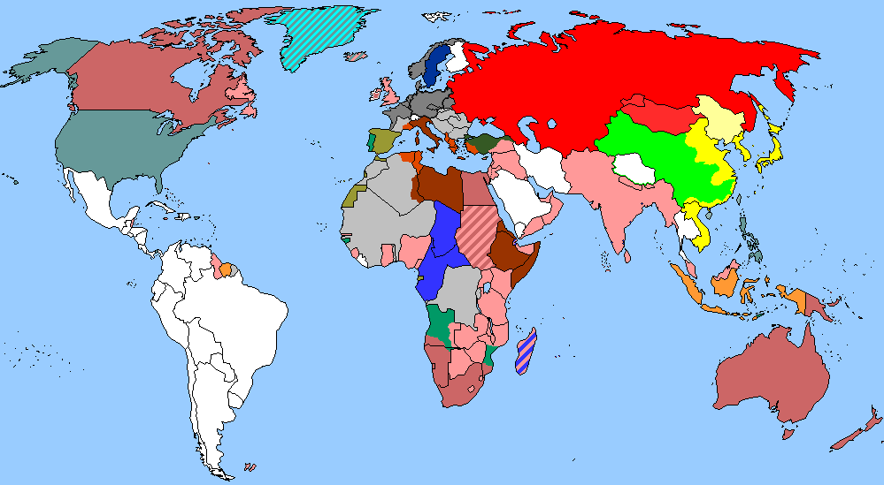
The World
April 16th-30th, 2023

Slide 3
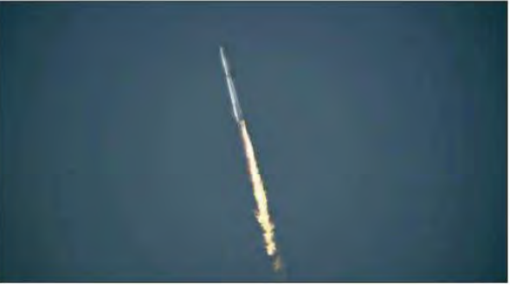
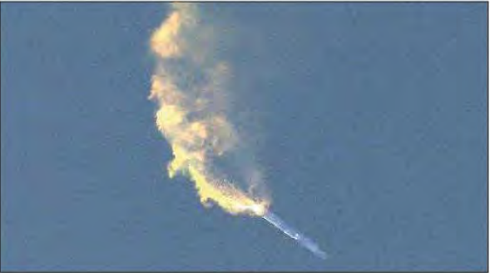
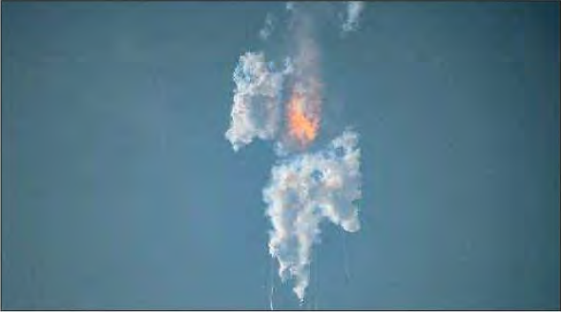
1. SpaceX’s Starship rocket explodes in first test flight
美“星舟”火箭爆炸

Slide 4
语篇填空
（《洛杉矶时报》2023年4月21日 A1&A9版面）
On its first test flight ____ Thursday morning, SpaceX’s massive, uncrewed Starship rocket —
considered key to the future of U.S. human space exploration — roared off the launch pad and ______ (soar) into the south Texas sky for a few minutes but ultimately exploded into a trail of smoke.
The company had been careful to set ___________ (expectation) low for this flight. SpaceX Chief Executive Elon Musk told an audience at a Morgan Stanley conference last month that the rocket’s debut had a 50% chance of success.
The Starship rocket lifted off from the company’s launch site near Boca Chica, Texas, around 6:33 a.m. Pacific time. After ________ (pass) through the moment of peak mechanical stress on the rocket and ascending about 24 miles above the Gulf of Mexico, the Starship spacecraft was set __________ (separate) from the Super Heavy first-stage booster. ____ instead of separating, the still-conjoined rocket tumbled head over tail before it exploded. In typical SpaceX parlance, the company called ___ a “rapid unscheduled disassembly.”
SpaceX later confirmed that the explosion was due to Starship’s autonomous flight termination system, ___ safety measure embedded in the rocket’s software _____ destroys the launch vehicle if it senses that its course or performance is awry or _______(safe). The company also said the rocket experienced multiple engines out during the flight and lost altitude.
on
soared
expectations
passing
to separate
But
it
a
that
unsafe

Slide 5
词汇讲解
1. debut: the first public appearance of a performer or sports player
首次亮相；初次登台（或上场）
He will make his debut for the first team this week.
本周他将在第一支出场的队伍中首次亮相。
2. ascend: to rise; to go up; to climb up
上升；升高；登高
The path started to ascend more steeply. 小径开始陡峭而上。
翻译句子
他的首张专辑在美国获得了巨大成功。
His debut album was hugely successful in the USA.
翻译句子
随着我们往上攀登，空气就寒冷起来。
The air became colder as we ascended.

Slide 6
句子翻译
On its first test flight on Thursday morning, SpaceX’s massive, uncrewed Starship rocket —considered key to the future of U.S. human space exploration — roared off the launch pad and soared into the south Texas sky for a few minutes but ultimately exploded into a trail of smoke.
在周四上午的首次试飞中，被认为是美国人类太空探索未来的关键的SpaceX公司的大型无人飞船火箭轰鸣着离开发射台，飞向德克萨斯州南部的天空几分钟，但最终爆炸成一缕烟雾。
翻译
SpaceX later confirmed that the explosion was due to Starship’s autonomous flight termination system, a safety measure embedded in the rocket’s software that destroys the launch vehicle if it senses that its course or performance is awry or unsafe.
SpaceX后来证实，爆炸是由于“星际飞船”的自主飞行终止系统造成的，这是一种嵌入在火箭软件中的安全措施，如果它感觉到它的路线或性能出错或不安全，就会摧毁运载火箭。
翻译

Slide 7
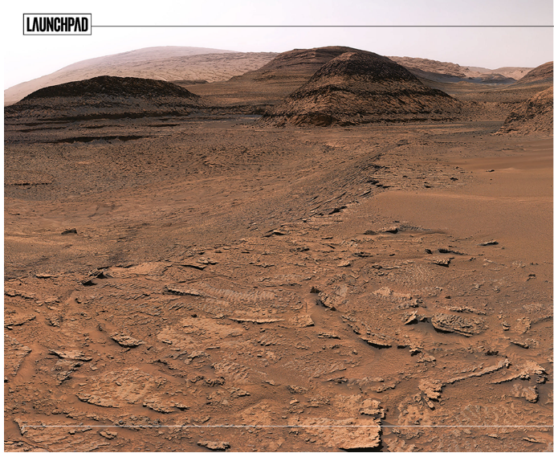
2. Curiosity finds clues to Mars watery past
“好奇号”发现火星过去有水的线索!

Slide 8
语篇填空
（All About Space 2023年4月20日刊 7页）
with
NASA’s Curiosity rover has found rocks imprinted _____ tiny ripples from an ancient lake. They’re __________ (clear) evidence yet that water once existed on Mars. The ripple marks ______________ (discover) frozen in Martian rock on the slopes of Mount Sharp. Though Curiosity has traversed many rock deposits ____ (lay) down in ancient lakes, scientists hadn’t seen such vivid marks in the rocks before. “This is the best evidence of water and waves ____ we’ve seen in the entire mission,” Ashwin Vasavada, Curiosity’s project scientist at NASA’s Jet Propulsion Laboratory, said. “We climbed through thousands of feet of lake deposits and never saw evidence like this, and now we’ve found it in a place we expected to be dry.
Since last autumn the rover ________________ (explore) a region of what scientists call “sulphate-bearing” rock. Scientists believe this salt-rich area was deposited when an ancient lake was nearly dry. But the ripples were created on ____ bottom of a shallow lake as winds created waves on the lake’s surface, _________ (disturb) the sediments below. The ripple marks are about 0.8 kilometres (0.5 miles) up Mount Sharp, a mountain made up of ______ (layer) of rock that record Martian history. The five-kilometre (three-mile) mountain was once dotted with lakes and streams, making ___ an intriguing area to search for signs of ancient Martian life.
the clearest
were discovered
laid
that
has been exploring
the
disturbing
layers
it

Slide 9
词汇讲解
1. traverse: to cross an area of land or water 横过；横越；穿过；横渡
I traversed the narrow pedestrian bridge. 我走过了那座狭窄的步行桥。
2. intriguing: very interesting because of being unusual or not having an obvious answer 非常有趣的；引人入胜的；神秘的
This intriguing book is both thoughtful and informative. 这本引人入胜的书既有思想性又有知识性。
翻译句子
我们乘卡车横穿沙漠。
We traverse the desert by truck.
翻译句子
这些发现带来了非常有趣的问题。
These discoveries raise intriguing questions.

Slide 10
词汇讲解
3. deposit:
① to use sth effectively a layer of a substance that has been left somewhere, especially by a river, flood, etc., or is found at the bottom of a liquid （尤指河流、洪水、液体等的）沉积物，淤积物
The rain left a deposit of mud on the windows. 雨水在窗上留下一层泥。
② to leave a layer of sth on the surface of sth, especially gradually and over a period of time 使沉积；使沉淀；使淤积
Sand was deposited which hardened into sandstone. 沙经沉积固结形成沙岩。
翻译句子
洪水在整个地面上留下了一层厚厚的泥土。
The flood left a thick deposit of mud over the entire ground floor.

Slide 11
句子翻译
NASA’s Curiosity rover has found rocks imprinted with tiny ripples from an ancient lake. They’re the clearest evidence yet that water once existed on Mars. The ripple marks were discovered frozen in Martian rock on the slopes of Mount Sharp.
美国国家航空航天局的好奇号探测车在一个古老的湖泊上发现了带有微小涟漪的岩石。它们是迄今为止火星上曾经存在水的最清晰证据。这些波纹痕迹是在夏普山斜坡上的火星岩石中发现的。
翻译
Scientists believe this salt-rich area was deposited when an ancient lake was nearly dry. But the ripples were created on the bottom of a shallow lake as winds created waves on the lake’s surface, disturbing the sediments below.
科学家们认为，这片富含盐分的地区是在一个古老的湖泊接近干涸时沉积的。但这些涟漪是在一个浅湖的底部产生的，因为风在湖面上掀起了波浪，扰乱了下面的沉积物。
翻译

Slide 12
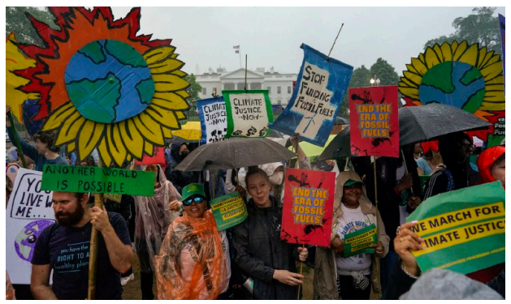
3. Public aware of extreme weather in US, poll finds
民意调查显示，美国公众意识到极端天气
Climate activists protest the use of fossil fuels Saturday in front of the White House. Americans concerned about the environment observed the first Earth Day in1970.

Slide 13
语篇填空
（《芝加哥论坛报 》2023年4月23日 Section 2版块 1页）
majority
An overwhelming ________ (major) of people in the country say they have recently experienced an extreme weather event, a new poll shows, and most of them attribute that ___ climate change.
But even as many across the country marked Earth Day on Saturday, the poll shows _________ (relative) few say they feel motivated when they talk about the issue. The findings from Associated Press-NORC Center for Public Affairs Research poll echo growing evidence many __________ (individual) question their own role in combating climate change. Still, ____ poll suggests people are paying attention. About half of U.S. adults say they ___________ (grow) more concerned about the changing climate in the past year, and a growing number say they are talking about __ .
Adriana Moreno said she feels like she’s been talking about climate change ____ years, but it’s only recently that the high school teacher has noticed her _____ (old) family members ________ (bring) up the issue more and more “almost every time I see them,” said Moreno, 22, a Democrat in New York.
to
relatively
individuals
the
have grown
it
for
older
bringing

Slide 14
词汇讲解
1. attribute: to say or believe that sth is the result of a particular thing 把…归因于；认为…是由于
I wouldn’t dream of attributing such a lack of judgment to you. 我做梦都想不到你会如此缺乏判断力。
2. combat: to stop sth unpleasant or harmful from happening or from getting worse 防止；减轻
The government is taking action to combat drug abuse. 政府正在采取措施，打击滥用毒品。
翻译句子
她认为她的成功来自勤劳和一点运气。
She attributes her success to hard work and a little luck.
翻译句子
国会批评了新政府防止犯罪的措施。
Congress has criticized new government measures to combat crime.

Slide 15
句子翻译
An overwhelming majority of people in the country say they have recently experienced an extreme weather event, a new poll shows, and most of them attribute that to climate change.
一项新的民意调查显示，该国绝大多数人表示他们最近经历了极端天气事件，其中大多数人将其归因于气候变化。
翻译
Still, the poll suggests people are paying attention. About half of U.S. adults say they have grown more concerned about the changing climate in the past year, and a growing number say they are talking about it.
尽管如此，民意调查显示人们正在关注。大约一半的美国成年人说，他们在过去一年里越来越担心气候变化，越来越多的人说他们正在谈论这个问题。
翻译

Slide 16
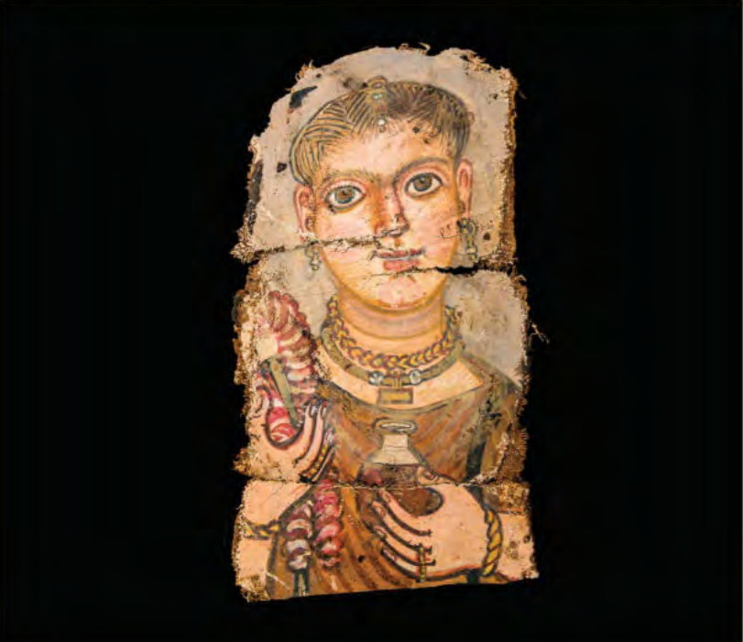
4. Picture the Deceased 考古发现：木乃伊旁的肖像画

Slide 17
语篇填空
（《国家地理》2023年4月刊 BREAKTHROUGHS版面）
During three millennia in Egypt, tens of millions of people and animals are thought ___________ (be) mummified. Far _____ (rare) are mummy portraits—detailed paintings of the living, ______ (bury) with their mummies when they died. Several mummy portraits discovered since 2019 at the burial site of the ancient Egyptian city of Philadelphia were ___ first to be found there in more than a century. Egyptians _____ (go) to great expense—often a ______ (year) wages—to arrange funeral ceremonies and goods, including portraits, says Lorelei Corcoran, director of the Institute of Egyptian Art and Archaeology at the University of Memphis, in Tennessee. Painted with natural pigments mixed with beeswax or animal glue, the portraits are prized ___ their lifelike qualities, though some subjects may have been embellished—for example, _______ (wear) jewelry they didn’t own. ________ (rough) 1,300 mummy portraits are known to exist, though less than one in 10 is still attached to a mummy. Many more may be waiting to be discovered, perhaps with other ______ (item) the deceased would have hoped to possess in the afterlife.
to have been
rarer
buried
the
went
year’s
for
wearing
Roughly
items

Slide 18
词汇讲解
1. go to great expense: to spend a lot of money on sth 把钱用在……上
Why go to the expense of buying an electric saw when you can hire one?
既然可以租电锯，为什么要花大价钱买一个呢？
2. embellish: to make sth more beautiful by adding decorations to it
美化；装饰；布置
The wall was embellished with carvings in red and blue.
墙上装饰有红色和蓝色的雕刻图案。
翻译句子
据说他花费巨资在大楼里安装了一台电梯。
It was said that he went to great expense to install a lift in the building.
翻译句子
天花板上装饰着鲜花和树叶。
The ceiling is embellished with flowers and leaves.

Slide 19
句子翻译
Painted with natural pigments mixed with beeswax or animal glue, the portraits are prized for their lifelike qualities, though some subjects may have been embellished—for example, wearing jewelry they didn’t own.
翻译
这些肖像画是用混合了蜂蜡或动物胶的天然颜料绘制的，因其栩栩如生而受到珍视，尽管有些人物可能经过了修饰——例如，戴着他们不曾拥有的珠宝。
Roughly 1,300 mummy portraits are known to exist, though less than one in 10 is still attached to a mummy. Many more may be waiting to be discovered, perhaps with other items the deceased would have hoped to possess in the afterlife.
翻译
已知大约有1300件木乃伊肖像存在，尽管只有不到十分之一的画像还在木乃伊身上。可能还有更多的肖像画等着被发现，一同发现的也许还有死者希望在死后拥有的其他物品。

Slide 20
5. BBC News 04/27/2023

Slide 21
听力填空
A 72-hour ceasefire has come into effect in Sudan following 2 days of __________. The US Secretary of State Anthony Blinken said the Sudanese ___________ and the paramilitary Rapid Support Forces had agreed to the ______ in fighting from midnight.
Barbara Plett Usher is in Washington. “Mr. Blinken has been in touch with Arab countries who have relations longstanding relations with one or both parties ______ them to use their leverage. He’s also been in touch with African organizations that are trying to also bring a stop to the ________. So there has been a full court press from everyone who has any sort of stake in Sudan at all and this is the ________ that Mr. Blinken negotiated. We’ll see if it does any better than previous ceasefires, which have been _____ to say the least.”
__________ of foreigners from Sudan is continuing with many countries using air, land and sea routes to evacuate their ________. Around 9,000 people, mostly from other African countries, have crossed into neighboring South Sudan since the start of the hostilities. More than 1,000 EU citizens have been _______ out on rescue missions.
negotiations
armed forces
pause
urging
violence
outcome
shaky
Evacuation
nationals
airlifted

Slide 22
词汇讲解
1. ceasefire: a time when enemies agree to stop fighting, usually while a way is found to end the fighting permanently （通常指永久性的）停火，停战
UN officials are expressing cautious optimism that the latest ceasefire is holding. 联合国官员对于最近的停火协定是否有效持谨慎的乐观态度。
2. hostility: unfriendly or aggressive behaviour towards people or ideas
敌意；对抗；敌对行为
She looked at Ron with open hostility. 她带着公然的敌意看着罗恩。
翻译句子
经过3年的冲突，他们已经同意停火。
They have agreed to a ceasefire after three years of conflict.
翻译句子
这两家公司公开相互敌对。
There was open hostility between the two companies.

Slide 23
句子翻译
A 72-hour ceasefire has come into effect in Sudan following 2 days of negotiations.
翻译
经过两天的谈判，苏丹72小时停火协议生效。
Evacuation of foreigners from Sudan is continuing with many countries using air, land and sea routes to evacuate their nationals. Around 9,000 people, mostly from other African countries, have crossed into neighboring South Sudan since the start of the hostilities. More than 1,000 EU citizens have been airlifted out on rescue missions.
从苏丹撤离外国人的工作仍在继续，许多国家利用空中、陆地和海上路线撤离其国民。自敌对行动开始以来，大约有9000人，其中大部分来自其他非洲国家，已经越境进入邻国南苏丹。已有1000多名欧盟公民在救援行动中被空运出去。
翻译

