Slide 1
感恩遇见，相互成就，本课件资料仅供您个人参考、教学使用，严禁自行在网络传播，违者依知识产权法追究法律责任。
更多教学资源请关注
公众号：溯恩高中英语
知识产权声明

Slide 2
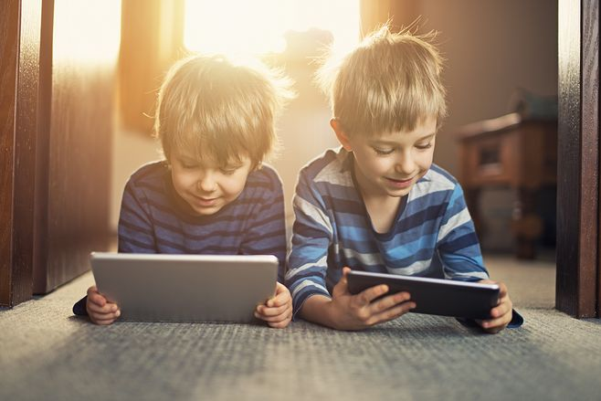
Summary Writing
screen time
——2019年11月绍兴诊断性考试
上虞区城南中学 陶江英

Slide 3
The gist keywords
①If you’re worried that too much “screen time” could badly influence your child’s intelligence, new research suggests you might be right. By analyzing the data gathered from over 4500 U.S. kids aged 8 to 11 between 2016 and 2017, Jeremy Walsh, a postdoctoral fellow with the CHEO Research Institute in Ottawa, found that too much “screen time” could be harming your child’s intelligence. Kids with the sharpest intellects spent less than two hours a day on their cellphones, tablets and computers, coupled with 9 to 11 hours of sleep and at least an hour of physical activity.
②Too much screen time could be affecting kids’ ability to focus, especially if they are switching between apps on a device or between different screens at the same time, Walsh suggested. “One leading hypothesis(假设) is that much time on screens is spent multitasking, using multiple apps or devices at once,” he said. “This can interfere with a child’s ability to focus and keep interest on a task. It can be damaging the building blocks for good cognition(认知).”
③Sleep is important for brain development, since that’s when the brain reorganizes itself and grows ,Walsh added. Besides, exercise has been shown to increase blood flow to the brain and oxygenation of brain tissues, and increase the connectivity of networks in the brain. Too much screen time could lead to a “cascade” effect where kids don’t get enough sleep and then are less active during the day. “You can see how this would have an impact on brain health,” Walsh said.
④What should parents do? Walsh advised setting firm rules regarding the use of screens ,including how long children are using the screens, the kinds of apps they are using and how many screens they are using at once. Concerned parents also should preview games or apps before letting their children play, seek out more interactive (交互的) options that engage the child’s mind, and use parental controls to block or filter content and limit screen time.

Slide 4
The structure
Tip1: Identify the textual pattern.
①If you’re worried that too much “screen time” could badly influence your child’s intelligence, new research suggests you might be right. By analyzing the data gathered from over 4500 U.S. kids aged 8 to 11 between 2016 and 2017, Jeremy Walsh, a postdoctoral fellow with the CHEO Research Institute in Ottawa, found that too much “screen time” could be harming your child’s intelligence. Kids with the sharpest intellects spent less than two hours a day on their cellphones, tablets and computers, coupled with 9 to 11 hours of sleep and at least an hour of physical activity.
②Too much screen time could be affecting kids’ ability to focus, especially if they are switching between apps on a device or between different screens at the same time, Walsh suggested. “One leading hypothesis(假设) is that much time on screens is spent multitasking, using multiple apps or devices at once,” he said. “This can interfere with a child’s ability to focus and keep interest on a task. It can be damaging the building blocks for good cognition(认知).”
③Sleep is important for brain development, since that’s when the brain reorganizes itself and grows ,Walsh added. Besides, exercise has been shown to increase blood flow to the brain and oxygenation of brain tissues, and increase the connectivity of networks in the brain. Too much screen time could lead to a “cascade” effect where kids don’t get enough sleep and then are less active during the day. “You can see how this would have an impact on brain health,” Walsh said.
④What should parents do? Walsh advised setting firm rules regarding the use of screens, including how long children are using the screens, the kinds of apps they are using and how many screens they are using at once. Concerned parents also should preview games or apps before letting their children play, seek out more interactive (交互的) options that engage the child’s mind, and use parental controls to block or filter content and limit screen time.
Problem
Disadvantage1
Disadvantages
Disadvantage2
Suggestion

Slide 5
Para. 1
Tip2: Figure out the relationship between sentences.
①If you’re worried that too much “screen time” could badly influence your child’s intelligence, new research suggests you might be right. ②By analyzing the data gathered from over 4500 U.S. kids aged 8 to 11 between 2016 and 2017, Jeremy Walsh, a postdoctoral fellow with the CHEO Research Institute in Ottawa, found that too much “screen time” could be harming your child’s intelligence. ③ Kids with the sharpest intellects spent less than two hours a day on their cellphones, tablets and computers, coupled with 9 to 11 hours of sleep and at least an hour of physical activity.
Sentence | Function | Keywords
S1
S2
S3
引出要点
badly influence, child’s intelligence
提出要点
harm, child’s intelligence
对比论证
sleep, physical activity

Slide 6
Summary for Para. 1
Too much “screen time” could badly influence your child’s intelligence.
negatively affect/impact
have a bad/negative effect/influence/impact on
damage/harm/impair
do damage/harm to
be harmful to
excessive
New research has found/suggested/showed/revealed that excessive “screen time” may negatively affect children’s intelligence.

Slide 7
Para. 2
Tip2: Figure out the relationship between sentences.
①Too much screen time could be affecting kids’ ability to focus, especially if they are switching between apps on a device or between different screens at the same time, Walsh suggested. ②“One leading hypothesis(假设) is that much time on screens is spent multitasking, using multiple apps or devices at once,” he said. ③“This can interfere with a child’s ability to focus and keep interest on a task. ④It can be damaging the building blocks for good cognition(认知).”
Sentence | Function | Keywords
S1
S2
S3
S4
提出要点
affect, focus
理论论证
much time on screens
强调要点
interfere with, focus, interest
引出后果
damage, cognition

Slide 8
Summary for Para. 2
?
too much screen time
much time on screens is spent multitasking, using multiple apps or devices
This can interfere with a child’s ability to focus and keep interest on a task. It can be damaging the building blocks for good cognition(认知).” It can be damaging the building blocks for good cognition(认知).”
prevent/stop/keep
因果关系
thus, therefore, hence, as a result/consequence
prevent/stop/keep
It can __________ children from focusing and ______ interested, thus ________ their cognition ____________.
staying
impairing
development

Slide 9
Para. 3
Tip2: Figure out the relationship between sentences.
①Sleep is important for brain development, since that’s when the brain reorganizes itself and grows ,Walsh added. ②Besides, exercise has been shown to increase blood flow to the brain and oxygenation of brain tissues, and increase the connectivity of networks in the brain. ③Too much screen time could lead to a “cascade” effect where kids don’t get enough sleep and then are less active during the day. ④“You can see how this would have an impact on brain health,” Walsh said.
Sentence | Function | keywords
S1&S2
S3
S4
推理演绎
sleep, exercise, brain
提出要点
not enough sleep, less active
引用论证
brain health

Slide 10
Summary for Para. 3
Too much screen time could lead to a “cascade” effect where kids don’t get enough sleep and then are less active during the day. “You can see how this would have an impact on brain health,” Walsh said.
屏幕时间过多导致孩子缺少睡眠和运动，这会有损大脑健康。
lack of, inadequate, insufficient
It leads to/results in their lack of sleep and exercise,
which_______________________________________________
has an extremely negative effect on their brain health.
which does harm/damage to the brain health.

Slide 11
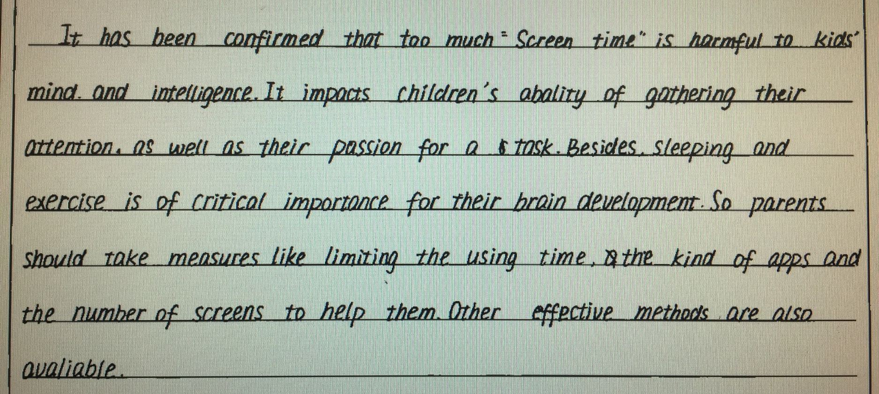
Summary for Para. 3
Tip3: What you write must be closely connected with the theme.
What’s the theme of the ?
What’s the relationship between “sleep and exercise” and “screen time”?

Slide 12
Para. 4
Tip2: Figure out the relationship between sentences.
①What should parents do? ②Walsh advised setting firm rules regarding the use of screens ,including how long children are using the screens, the kinds of apps they are using and how many screens they are using at once. ③Concerned parents also should preview games or apps before letting their children play, seek out more interactive (交互的) options that engage the child’s mind, and use parental controls to block or filter content and limit screen time.
Sentence | Function | keywords
S1
S2
S3
过渡句
提出要点
firm rules, how long, apps, how many
补充要点
filter content, limit screen time

Slide 13
Summary for Para. 4
①What should parents do? ②Walsh advised setting firm rules regarding the use of screens ,including how long children are using the screens, the kinds of apps they are using and how many screens they are using at once. ③Concerned parents also should preview games or apps before letting their children play , seek out more interactive (交互的) options that engage the child’s mind, and use parental controls to block or filter content and limit screen time.
establish strict regulations
Parents are advised to _______________________concerning the use of screens, ________the contents and limit the screen time.
monitor

Slide 14
Coherence
Tip4: Use link words if necessary.
Problem
Disadvantage 1
Link1: also, likewise, besides, furthermore, in addition, etc.
Disadvantage 2
Link2: so, thus, therefore, hence, accordingly, consequently, etc.
Suggestion

Slide 15
One possible version
New research has found that excessive “screen time” may negatively affect children’s intelligence.(要点1) It prevents children from focusing and staying interested, thus restricting their cognitive development.(要点2) Also, it results in inadequate sleep and lack of physical activity, which do harm to the brain health.(要点3) Accordingly, parents are advised to establish strict regulations concerning the use of screens, monitor the contents and limit the screen time. (要点4)

Slide 16
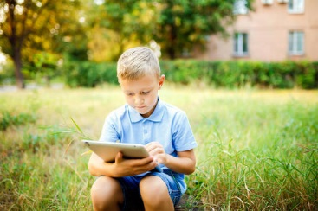
Thanks!

