Slide 1
感恩遇见，相互成就，本课件资料仅供您个人参考、教学使用，严禁自行在网络传播，违者依知识产权法追究法律责任。
更多教学资源请关注
公众号：溯恩高中英语
知识产权声明

Slide 2
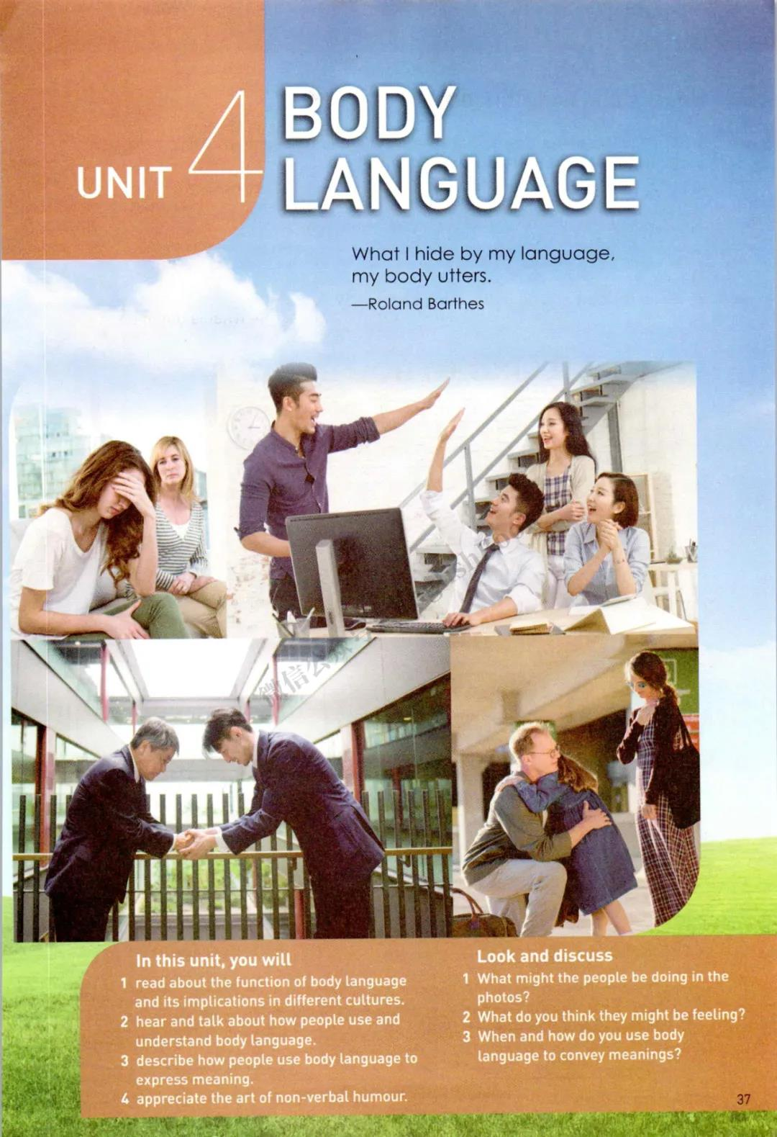
What I hide by my language, my body utters(says).
---Roland Barthes
Notes:
After watching the video, ask the ss “What information can you get from the video?” Body language plays a crucial role when we interact with others. It includes posture, gesture and facial expression and physical distance. Now I'd like to ask someone to act the sentences out without speaking. You can use...

Slide 3
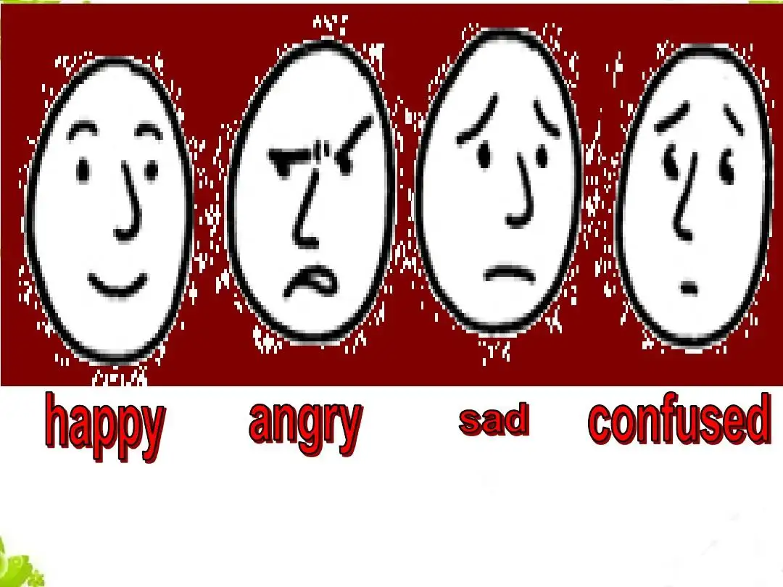
Act and guess
Hello! Goodbye! Come here! Go away! I'm surprised! I'm tired! OK! I'm happy! I'm sad! I forgot! You're great! Good luck!
Too expensive! I'm confused.
Notes:
All of you did a good job. So you see, how important is body language. Now let's read a passage to get more about body language.

Slide 4
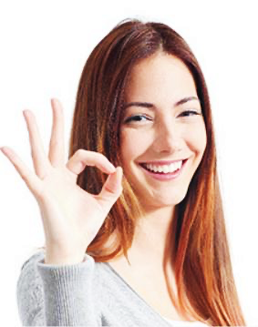
prediction
personification（拟人）
appeal to readers
What may be talked about in this text?
Topic: body language
Notes:
T: Can our bodies really talk? Why does the writer use “talk” in the title? According to the picture and the title, what may be talked about in this text? (body language) What details maybe talked about? ... Now let's check your predictions and underline the topic sentences in each paragraph.

Slide 5
structure
Underline the topic sentences in each paragraph.
Para 1
Para 2
Para 3
Para 4
Para 5
Para 6
Words are important,but the way people stand, hold their arms, and move their hands can also give us information about their feelings.
Just like spoken language,body language varies from culture to culture.The crucial thing is using body language in a way that is appropriate to the culture you are in.
Just like spoken language,body language varies from culture to culture, so the crucial thing is using body language in a way that is appropriate to the culture you are in.
The gesture for “OK” has different meanings in different cultures.
Even the gestures we use for “yes” and “no” differ around the world.
There are also differences in how we touch each other, how close we stand to someone we are talking to, and how we act when we meet.
physical distance
Some gestures seem to have the same meaning everywhere.
Some body language has many different uses.
Notes:
para2&4(difficult) 两个some的区别（定义） According to the topic sentences, can you draw the structure for the passage?

Slide 6
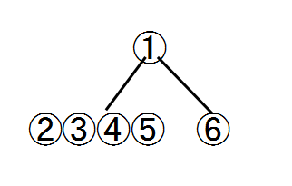
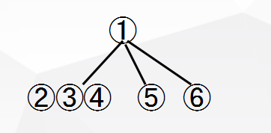
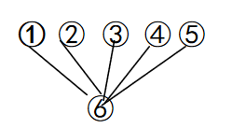
structure
Get the structure of the text.
A
B
①
D
C
②
③
④
⑤
⑥

Slide 7
structure
Para 1 | …but the way people stand, hold their arms, and move their hands can also give us information about their feelings.
Para 2 | … body language varies from culture to culture....
Para 3 | The gesture for “OK” has different meanings in different cultures.
Para 4 | Even the gestures we use for “yes” and “no” differ around the world. There are also differences in...
Para 5 | Some gestures seem to have the same meaning everywhere.
Para 6 | Some body language has many different uses.
introduction
differences
similarities
uses(of the same body language)
Notes:
Can you summarize each part with a noun?

Slide 8
Guided reading
How does the writer introduce the topic?
We use both words and body language to express our thoughts and opinions in our interactions with other people. We can learn a lot about what people are thinking by watching their body language. Words are important, but the way people stand, hold their arms, and move their hands can also give us information about their feelings.
postures
gestures
Notes:
repeat the topic, give specific information about the topic/ examples(postures, gestures)

Slide 9
Guided reading
Just like spoken language, body language varies from culture to culture. The crucial thing is using body language in a way that is appropriate to the culture you are in. For example, making eye contact-looking into someone's eyes-in some countries is a way to display interest. In other countries,
by contrast, eye contact is not always approved of. For example, in many Middle Eastern countries, men and women are not socially permitted to make eye contact. In Japan, it may demonstrate respect to look down when talking to an older person.
What
How
make eye contact
meaning
country
1.display interest
1.some countries
example&contrast
2.not approved of
2.other countries/ many Middle Eastern countries
3. demonstrate
disrespect (oler person)
3.Japan
Notes:
Part 2 is about different body language. What body language is talked about in this paragraph? meaning?(demonstrate猜词） country? How？

Slide 10
Self-guided reading
Part | What |  |  | How
para3 | body language | meaning | country
para4 | body language | meaning | country
para5 | body language | meaning | country
para6 | body language | uses
Notes:
Read the rest of the text and complete the table on the worksheet. (What-body language, meaning, country; how)

Slide 11
Self-guided reading
Part | What |  |  | How
p3
p4
p5
p6
money
zero
impolite
Japan
France
Brazil and Germany
example&contrast
ok
shake one's head
no
no/yes
yes/no
many countries/Bulgaria
and southernAlbania
example&contrast
physical distance
kiss sb on
the cheek
shake, bow, nod
France,Russia
elsewhere
placing,resting
sleep
most places
example
moving...in circles
I'm full
A smile can...We can use a smile to...
Experts suggest...there is nothing better than...
smile
example
Notes:
Why does the writer use so many examples and contrasts?(logical, understandable, support, highlight) make inferences(opposite) Can you think of other uses of smile?

Slide 12
The gesture for “ok” has different meanings in different cultures. In Japan, someone who witnesses another person employing the gesture might think it means money. In France, a person encountering an identical gesture may interpret it as meaning zero. However, you should avoid making this gesture in Brazil and Germany, as it is not considered polite.
Even the gestures we use for “yes” and “no” differ around the world. In many countries, shaking one’s head means “no”, and nodding means “yes”. By comparison, in Bulgaria and southern Albania, the gestures have the opposite meaning. There are also differences in how we touch each other, how close we stand to someone we are talking to, and how we act when we meet or part. In countries like France and Russia, people may kiss their friends on the cheek when they meet. Elsewhere, people favour shaking hands, bowing from the waist, or nodding the head when they meet someone else.
Make inferences
figure out the meaning with the help of clues in the passage

Slide 13
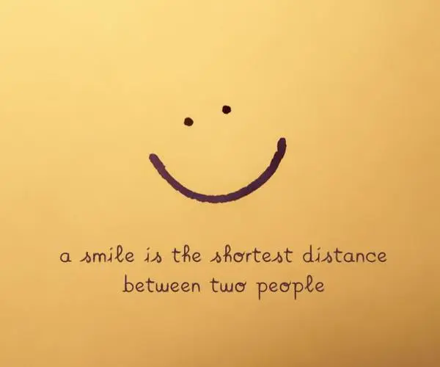
Thinking
Can you think of other uses of smile?(pair work)
〇 A smile can...
〇 A smile can...
〇 We can use a smile to …
〇 Experts suggest smiling
…
There is nothing better than seeing a smile.
show kindness.
make you younger.
hide our embarrassment.
is beneficial to health.

Slide 14
Critical thinking
How do we understand the title?
What should we pay attention to when employing body language in this multicultural world?( group work)
1. Be a global citizen(公民）
2. Observe carefully
3. Do as the romans do.
4. Increase understanding
5. Embrace(accept ) differences
6. Seek common ground
BODIES

Slide 15
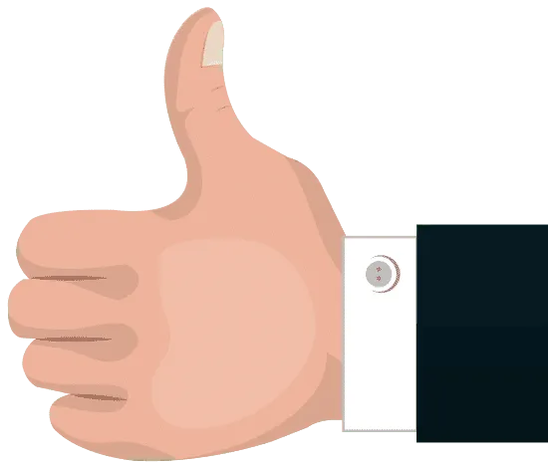
assignment
Search the internet to find out the different meanings of the thumb-up gesture, and then
write a short paragraph based on the structure.
The thumb-up gesture differs around the world. For example, in many countries.... In contrast/By comparison, ....However...
topic
example/contrast

Slide 16
Sample
The thumb-up gesture differs around the world. For example, in many countries it is a sign of approval or support. In contrast/By comparison, in some places such as Nigeria and Middle Eastern countries, it means insult or challenge. However, whatever it is , what matters most is following the golden rule: do as the Romans do.

Slide 17
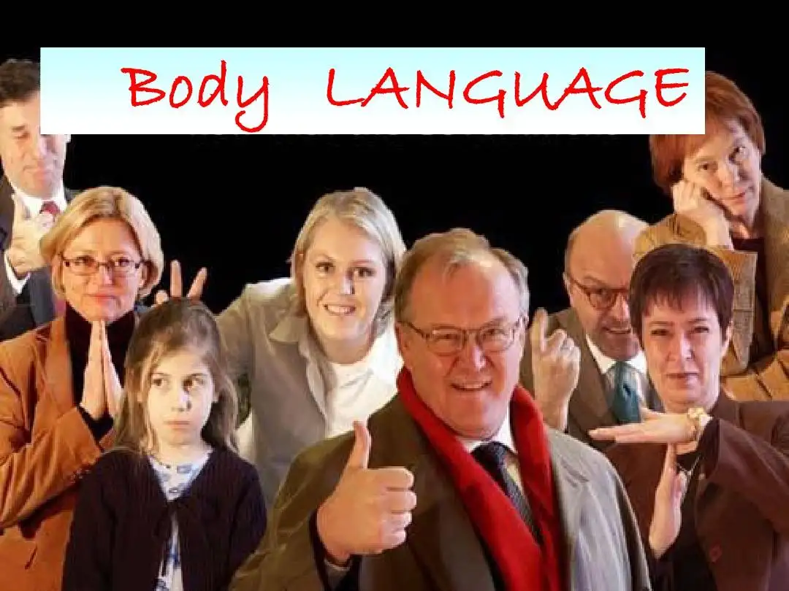
Thanks!

