Slide 1


感恩遇见，相互成就，本课件资料仅供您个人参考、教学使用，严禁自行在网络传播，违者依知识产权法追究法律责任。
更多教学资源请关注
公众号：溯恩高中英语
知识产权声明

Slide 2
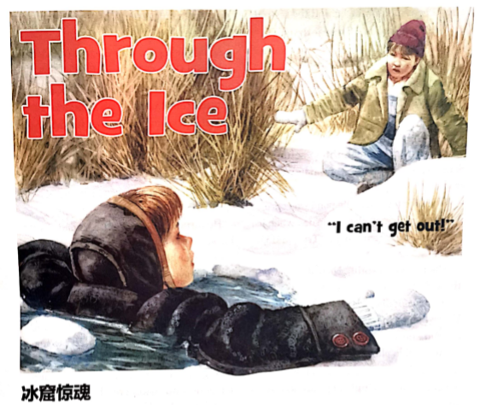
续
写
2020.10月浙江十校联盟
英语试卷
读
后
余杭区树兰高级中学 郭合英

Slide 3
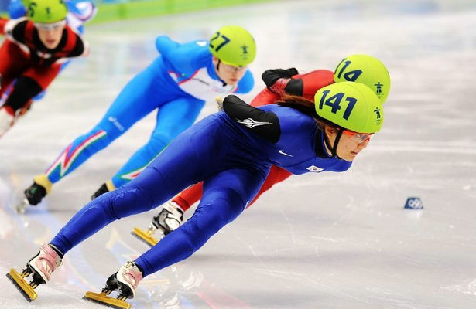
Contents
Step 1
Scenario introduction
情景导入
Step 2
Analyse the article
文本解读
Step 3
Episodic reasoning
情节推理
Step 4
Thematic sublimation
主题升华

Slide 4
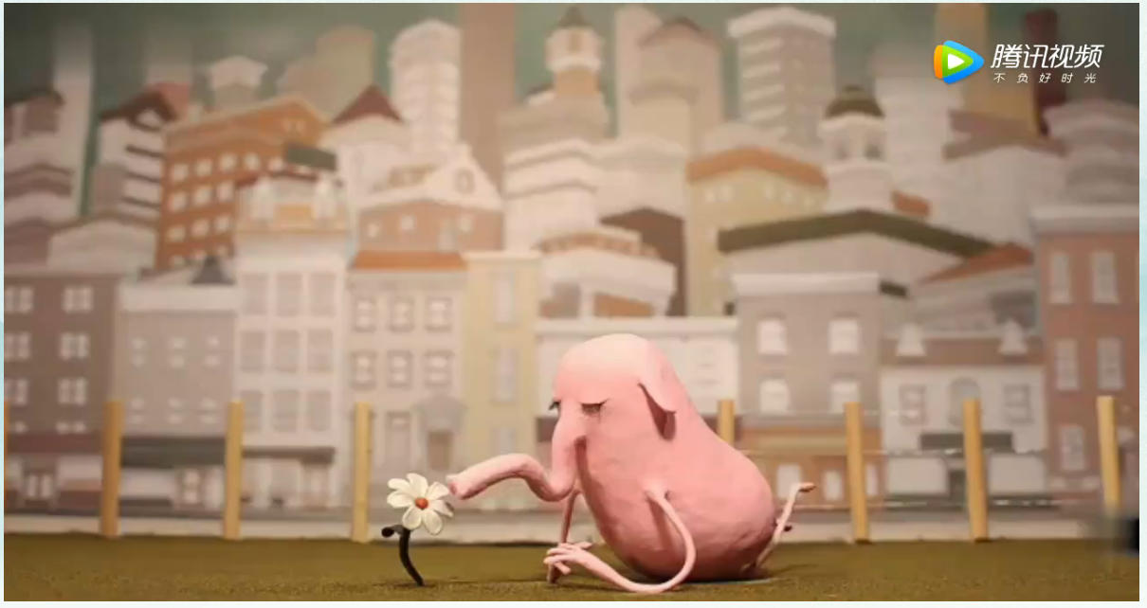
Step 1 Scenario introduction情景导入

Slide 5


Discussion
What's the moral of this video?
Never go out of your way
to please others
and change your original self
永远不要刻意去讨好他人
而改变最初的自己

Slide 6
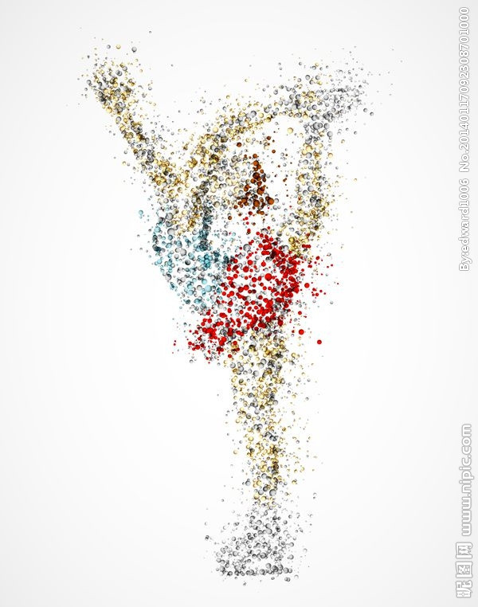
Step 2 Analyse the article 文本解读
读后续写（满分25分）
阅读下面短文，根据所给情节进行续写，使之构成一个完整的故事。
About a half-mile behind our Minnesota farm lay a pond. In summer, my brother Harry and I would run through a stand of oak trees to skip stones there. The pond wore a collar of black mud. It was not a place for swimming.
In late summer, the pond would be covered by a green and bubbly scum(起泡的浮渣). Sometimes a strong, unpleasant smell rose from it. We stayed away.
When winter came, the pond was once again an inviting place. One day when ice covered it, Harry said to me, “Try walking across.”
The ice looked solid. No water showed through it, but I hesitated. “Go ahead.” Harry urged. “Try it. You’re lighter than I am. If the ice holds, we can run and
slide carefully on it. It’ll be fun.” I wanted to please Harry, and I thought
about the fun of a long slide on the ice. I began to slide across the pond.

Slide 7
Step 2 Analyse the article 文本解读
In the middle of the pond, the ice gave way with a sudden crack(裂缝)! I stretched out(伸展) my arms. The next thing I knew I was hanging on to the edge of a hole in the ice by arms outstretched on the ice. From my shoulders down I hung in icy water. I thought of the bottom of the pond. I knew it would be black and awful down there, full of mud and maybe rotting creatures.
I tried to climb out of the hole, but when I got a knee on the ice, it broke like window glass. Again and again I tried to get out. Again and again the ice broke into pieces. The hole widened. I was wearing a coat of heavy material. As it became completely wet, it dragged me down. I was tired of the struggle and rested with my arms stretched out on the ice.
I looked at Harry on shore. He seemed rooted to the spot. “I can’t get out!” I screamed when I caught some breath.

Slide 8
Step 2 Analyse the article 文本解读
注意：
1. 所续写短文的词数应为150左右；
2. 至少使用5个短文中标有下划线的关键词语；
3. 续写部分分为两段，每段的开头语已为你写好；
4. 续写完成后，请用下划线标出你所使用的关键词语。
Paragraph 1:
Harry turned and ran from the pond.
Paragraph 2:
The moment I crashed through the kitchen door, sobbing, mum rushed
over.

Slide 9
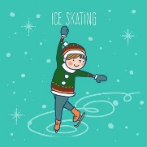
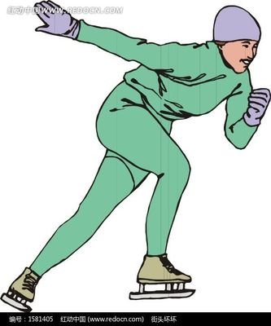
who
Pre-wrting
when
What's the style of the passage?
Narration (记叙文)
B. Exposition (说明文)
C. Argumentation (议论文)
where
what
why
how

Slide 10

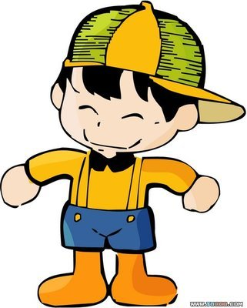

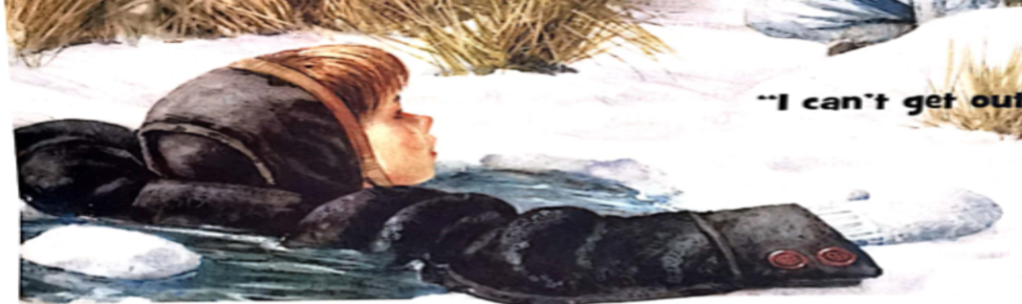
Pre-writing The relationship of the Persons
Harry
brother
I
Topic: How to survive the ice?
an inviting place
fell into the ice
What and why did Harry ask his brother
to do?
the pond
Why did “I” do so?

Slide 11
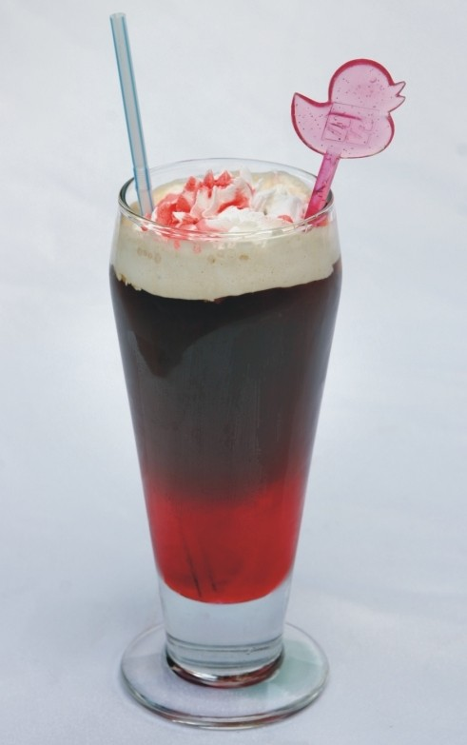
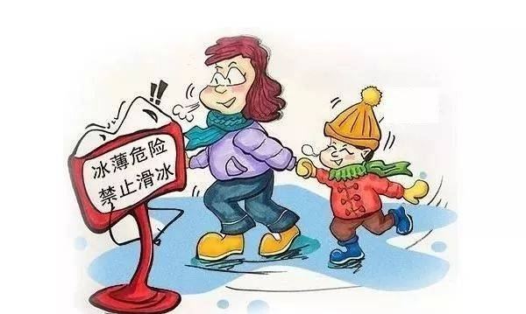

A. It can help to remember the “1-10-1 principle”.
B. However, if you remain calm, it can save your life.
C. Remove any clothing or heavy objects that are weighting you down.
D. Thus you will remain visible for rescue, even if you pass out.
E. Kick hard and use your arms and hands to climb out of the water.
F. Remember that you should always stay off ice that’s only 3 inches.
G. Place your arms over the surface of the ice and remain still.
七选五
How to survive the ice?

Slide 12
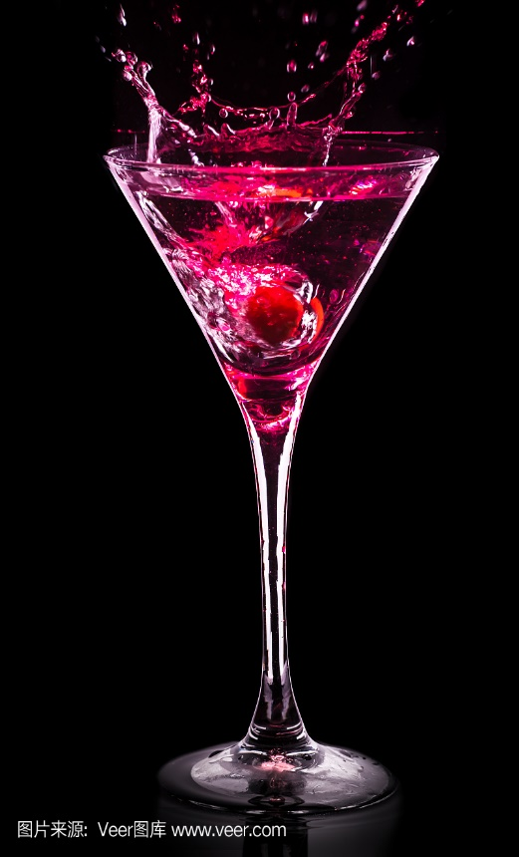
B
It can be truly terrifying to fall through ice on a frozen lake. 1. In fact, there is more time to help you survive than you think.
As you first hit the freezing water, you will almost breathe quickly at once. Remember to get control of your breathing and not to move around. 2.This means that it takes about one minute to gain control of your breathing ,ten minutes to move before you get too cold. The final one is to remind you that it will take one hour before you become unconscious.
Take that first minute and fully focus on your breathing. Slow it down, and then look around to see if you can locate the thickest area of ice. When you locate the ice, stretch your arms over the surface, and then begin to flutter-kick(上下打水)until your body becomes horizontal with the surface. 3..
It is possible that you can live for several hours after passing out. This, however, does require some planning. You only have about 10 minutes before your muscles and nerves become too cold to work. Besides, what if you feel too weal to go on and you cannot get out?4.The point is to encourage your coat to freeze to the ice, so that if you lose consciousness, you will keep your head out of ice. 5.
A
E
七选五
G
How to survive the ice?
D

Slide 13
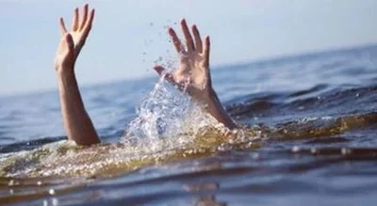
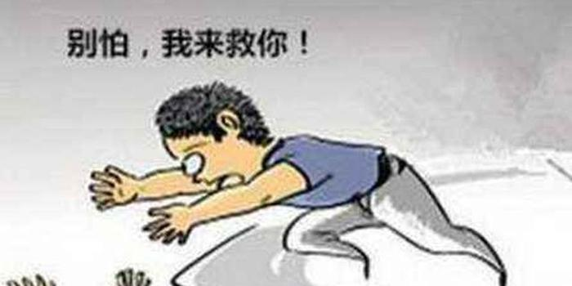
Discussion
How to Survive a Fall Through Ice

Slide 14
语法填空
northern
In 1. (north) climates with lots of lakes and rivers, ice is
2. common sight during the colder months. The formation of ice provides the opportunity to enjoy a 3. (vary) of winter activities, such 4. ice fishing, playing hockey and cross-country skiing. However, unless the ice is thick and can withstand your 5. (weigh), there is a danger of falling through the ice into 6. (extreme) cold water. 7. in the water, panic, hypothermia and drowning are all difficult challenges _____8.______ (overcome). 9. (Survive) a fall through the ice is certainly possible, but it (take) courage and knowledge of some life-saving tips.
a
variety
as
weight
extremely
Once
to overcome
Surviving
takes

Slide 15
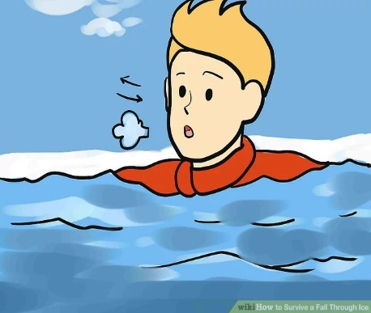
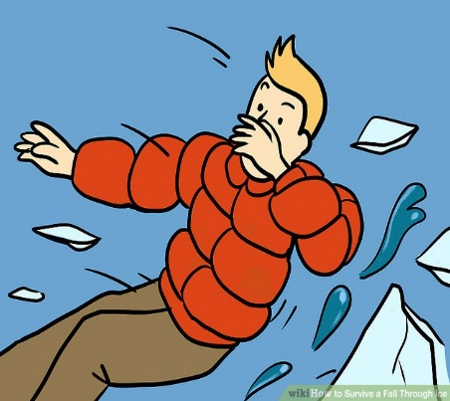
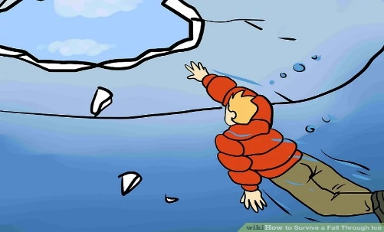
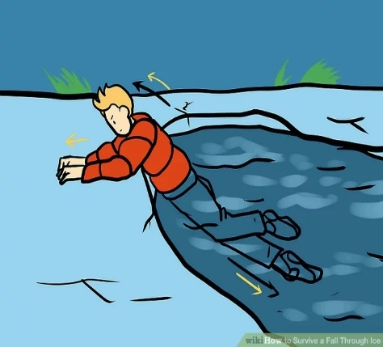
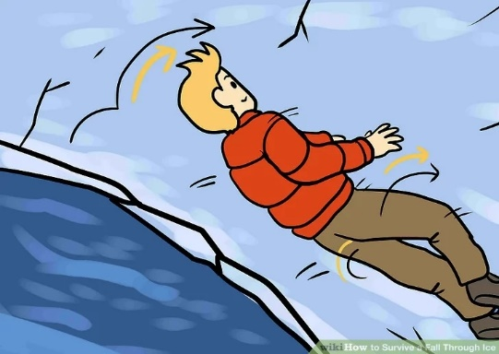
Keep as calm
as possible.
Focus your energy on getting out immediately.
Brace yourself.
2
1
3
How to
Survive
a Fall
Through Ice
Roll your body across the ice once you're out.
Get horizontal
and kick your legs.
5
4

Slide 16
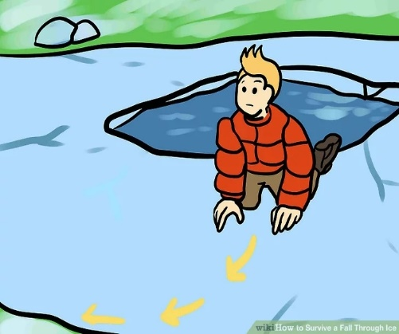
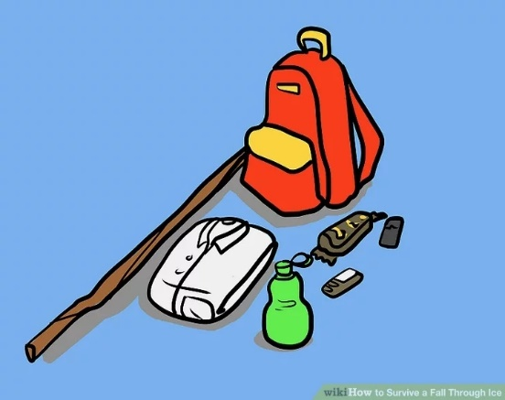
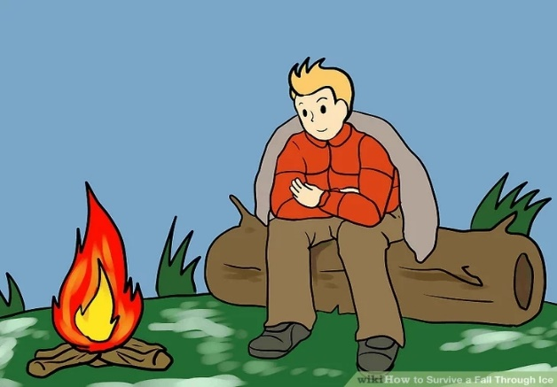
Retrace your footsteps back to safety.
1
What should you do once You're Out?
2
Take off wet clothes.
3
Get warmed up.

Slide 17
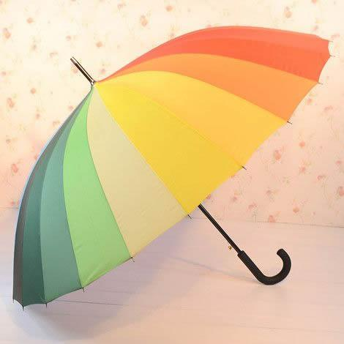
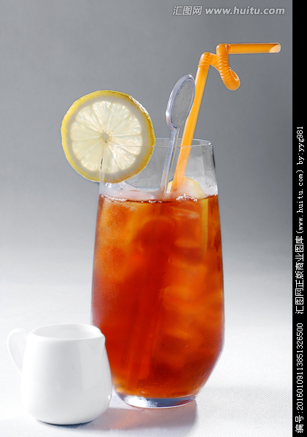
Step 3 Episodic reasoning 情节推理
根据所学的相关知识，结合“逆推法”，对情节做出如下推理：
Paragraph 2:
The moment I crashed through the kitchen door, sobbing, mum rushed over.
Paragraph 1:
Harry turned and ran from the pond.
学以
致用
“I” was rescued.
How was “I” rescued?
可能性1：Harry ran away and asked sb./ sth. for help.
可能性2： Harry ran away and left me alone.

Slide 18
第一段情节的心里活动
心急如焚
Paragraph 1:
Harry turned and ran from the pond.
Harry felt like a cat on hot bricks. He thought，“He is my younger brother, I must turn to someone or something for help. I must save him.”
He thought，“While he is my younger brother, I cannot save him in case I will die, I must leave him alone.”
根据“正能量原则，这种可能性不大存在。”
非常开心
Seeing the scene, I was at the top of the world. I reckoned, “Harry must look for someone or something to give me a hand.”
感到绝望
Seeing the scene, I am feeling blue . In my opinion, he must leave me alone, escaping like an arrow off a string.

Slide 19
第一段情节的心里变化过程
Brother was trapped in the ice
He turned and ran from the pond to look for a way.
worried
calm
After brother was saved.
lesson
不刻意取悦他人，学会说“不”；余生很长，自己最贵！
Emotional change
relieved
glad
despair
hopeful
“I” was rescued.
When “I” saw Harry
run away.
When “I” saw Harry came back again.

Slide 20
“心情”驿站
BrainStorm
1. Keyed Up（俚语）：紧张不安的；焦躁的
Stop pacing the floor. Relax. Why are you so keyed up?
不要来回走了，放松！你为什么如此不安？
2. Harry felt like a cat on hot bricks.
3. Sally said I should try skydiving, but I had cold feet.
赛丽说叫我试试跳伞，但我退缩了。
4. Cross a bridge before one comes to it.(俚语)
事情还没发生就担心起来
讨论并积累
关于“worried”
的表达积累：
关于“despair”
的表达积累：
1. I was thrown into a dark world and sank into hopelessness.
2. She felt seized by a burst of despair and couldn’t help
crying bitterly.
3. A flood of despair took hold of me.
4. My heart ached, tears streaming down my cheeks.
5. I felt blue 感到绝望；感到无精打采
6. I am in a black mood 情绪极差

Slide 21
“心情”驿站
BrainStorm
讨论并积累
My worry gave way to relief.
A feeling of relief slowly crept up on me.
It is gratifying that I survived the ice.
关于“relieved”
的表达积累：
1. His face beamed and his bright smile lit up the room.
2. He danced with joy and sweetness. (欢欣雀跃)
3. I was on the top of the world. 非常幸福、心满意足
4. be on cloud nine 高兴极了；异常兴奋；乐不可支
5. be walking/floating on air 很开心
6. over the moon 欣喜若狂
7.have the time of one's life 度过愉快的经历，异常高兴
8.be full of the joys of spring= be very happy 非常高兴
关于“happy”
的表达积累：

Slide 22
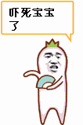
“心情”驿站
BrainStorm
关于“afraid”的表达积累：
讨论并积累
1. I was scared to death with eyes full of horror. 被吓得要死，眼睛里充满了恐惧。
2. I was struck with horror. 我被吓呆了。
3. I was choked by fear. 我被吓得透不过气来。
4. I felt so scared that my throat tightened and my knees felt weak.
(嗓子发紧，膝盖发软)
5. I froze with terror, too scared to move an inch. (吓呆了，不敢动弹)
6. I was seized by a strong sense of horror and my palms were sweating.
(我被深深地恐惧感所控制，手心出汗)
7. The horrible scene made my blood run cold and struck fear into my heart.
那可怕的场面使我毛骨悚然，使我胆战心惊。
8. That made me feel sick and shivery(抖的).
9. All sorts of nightmare pictures came into my mind
10. I shook all over in a cold sweat. 我冒冷汗，直哆嗦。

Slide 23
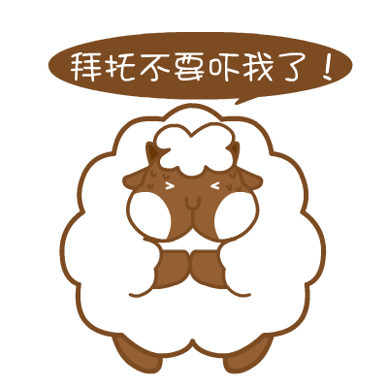
“心情”驿站
BrainStorm
关于“afraid”的表达积累：
讨论并积累
11. A terrible fear took hold of/seized me.
12. Fear slowly( quickly) crept upon me 恐惧爬上我的心头
13. I didn’t have the nerve(没有胆量) to move an inch and I was shaking
like I had rubber bones. (软骨头)
14. My face turned pale and I stood there tongue tied. (舌头打结).
15. A flood of fear welled up in me. / Fear flooded over me.
一阵恐惧涌上我的心头。
16. The horrible scene just made my hair stand on end. (令我头发倒立)
17. I was sick with fear, but the thought of the consequences urged me
on.
我吓得要死，但一想到后果，我就只有往前
18. His mind was a haze of fear and confusion.
由于害怕和困惑，他的脑子一片混沌。

Slide 24
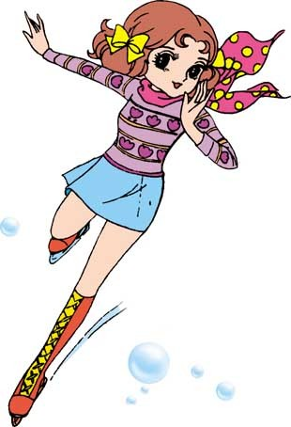
备胎词汇
put one’s ass on the line. 冒险做某事
ring a bell. 回忆起某事
get one’s feet wet. 第一次做某事
4. After he knew what the problem was, his mind began to race,
trying to think of a good solution. (飞速运转)

Slide 25
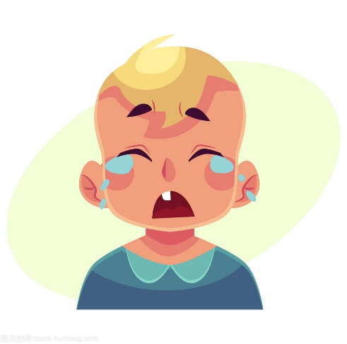
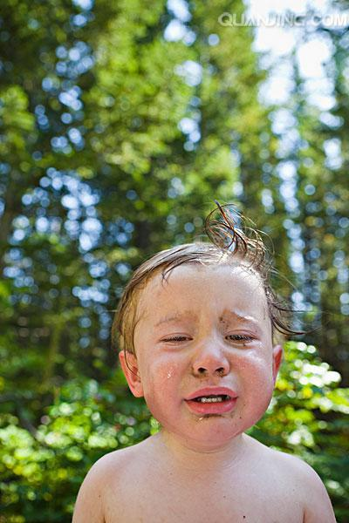
“动词荟萃”+“妙语连珠”
哭
cry, sob, weep, blubber
1. He burst out crying. / He burst into tears
2. There was a lump in my throat (因感动、悲伤而哽咽，喉咙哽住)
3. Harry lifted the lid, tears beginning to blur his vision(眼泪模糊他的双眼)
4. Harry came round later, crying his eyes out, asking me to forgive him
5. I looked up at Harry through red-rimmed eyes.
6. I turned on the waterworks before Mum.
(口语) (撒娇) 哭出来，(故意)哭起来
7. Tears welled up in her eyes.
8. Her eyes were blurry with tears.

Slide 26

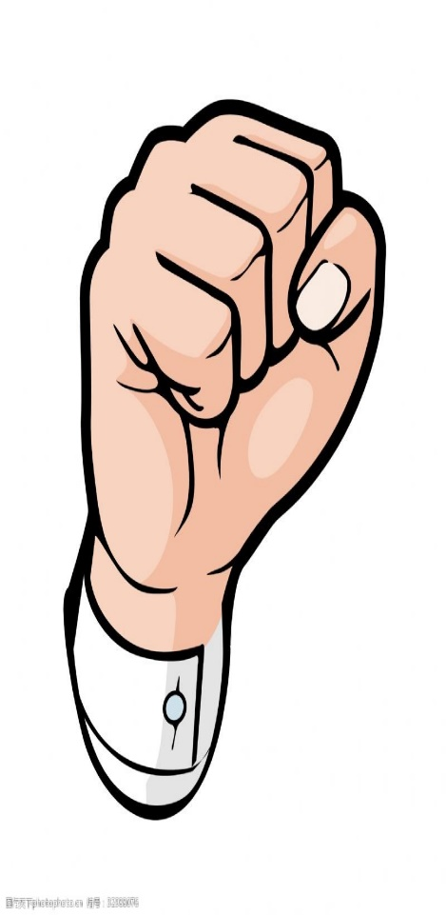
“动词荟萃”+“妙语连珠”
push, pull, pinch, catch, seize, grip, cast, drag,
tear, raise, cast, stretch, wave, snap,
scratch, point, flip, hand , carry, pass…
手部动作
clap one’ s hands 拍手
put one’ s hands on 找到
hold sth. tight in one’ s hand 手里紧紧拽着
slap sb. on the back 拍某人的背
signal/ wave sb. to be quiet 示意某人安静
be on one’ s hands and knees 四肢着地
hug sb. tightly 紧紧抱住某人
fumble for 摸索着找
follow his pointing finger 顺着他指着的方向看过去
He patted my head.
He was squeezing my wrist so hard that it ached.
紧紧地捏着我的手腕，疼得厉害。

Slide 27
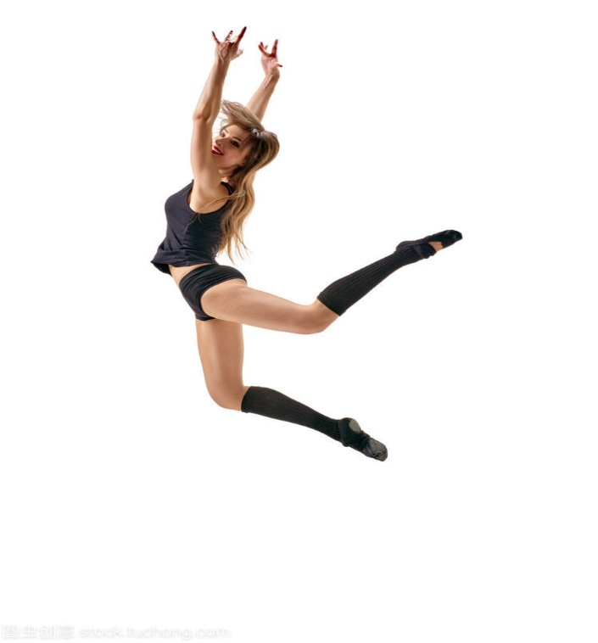
“动词荟萃”+“妙语连珠”
toddel (蹒跚行走), stagger (摇摇晃晃),
trudge (步履艰难)， walk on tiptoe (蹑手蹑脚)，
sit cross-legged (盘腿坐)，squat(蹲着)，
hop(单脚跳)， stand on one leg (单脚站立) , skip, trip, slip, fall ,limp, crawl, kneel, chase, jog, dash, race, parade, jump
脚部动作
stamp one’s feet 跺脚
jump/ bounce/ leap up and down 上蹿下跳
sneak/slip/ steal into 偷偷溜进
stagger/ struggle/rise/ jump to one’s feet 站起来
kneel down 跪下
A hot pain shot through my leg.
一阵剧痛急速穿过我的腿。

Slide 28
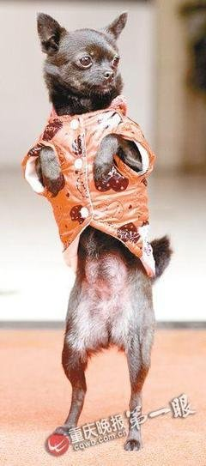
“动词荟萃”+“妙语连珠”
站
stand, be on one’s feet
They all just stood there staring at me, motionless.
(不动地)
2. She planted her feet firmly in front of me.
她坚定地站在我面前。
3. For a moment I just stood there，paralyzed
(呆若木鸡)
4. I stood rooted to the ground, my mind going blank.
我站在那里一动不动，脑子一片空白

Slide 29
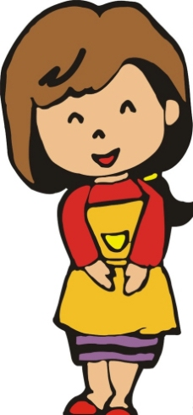
推测第二段情节
Paragraph 2:
The moment I crashed through the kitchen door, sobbing, mum rushed over.
What was Mum’s reaction when she saw me wet
through the body?
2. What did Mum do and say?
3. What was Harry’s reaction?
4. What did that teach “me”?
你若盛开，蝴蝶自来,取悦别人，不如丰富自己；余生很长，自己最贵，从现在开始，学会拒绝！

Slide 30
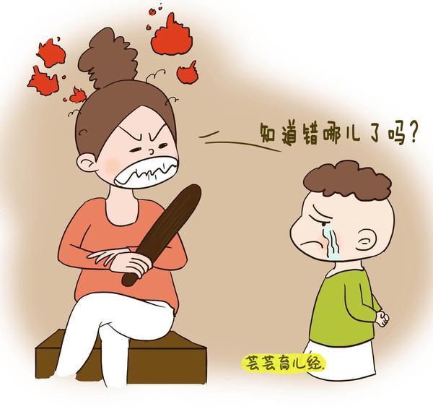
“心情”驿站
BrainStorm
讨论并积累
关于“angry”的表达积累：
He was seized by anger that he stormed out of the room, slamming the door
furiously behind him.(怒气冲冲地冲出房间;狠狠摔门)
2. Boiling/Fuming with rage. he shook his fist at me.(怒火中烧;挥舞拳头)
3. Filled with fury/Flying into a rage, my mother was unable to utter a single word.
(充满愤怒;说不出话)
4. He was breathing fire and fury.他充满着怒火
5. His face clouded with anger.他气得脸色阴沉，
6. All at once a feeling of anger swept through him.
7. His green eyes were shining with irritation/anger, and his voice trembled with anger.
He was sweating and burning with rage.(满头大行，怒火中烧) / He glared at me
with burning eyes.
9. Harry’s reply fueled(激起了) Mother’s anger and she erupted like a volcano.
10. He ran out of the room in a burst of anger.

Slide 31
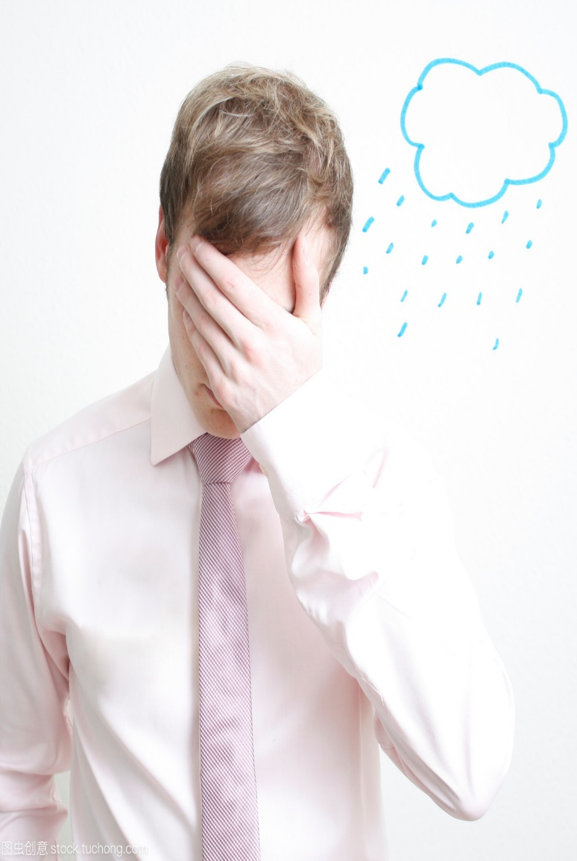
“心情”驿站
BrainStorm
讨论并积累
关于“ashamed” 的表达积累：
She felt so ashamed that she could feel her face burning.
(脸上滚烫)
2. So ashamed was she that she could feel the
blood rush to her face.
(血液涌上脸颊)
3. So ashamed did he feel that she was close to
tears.
(快哭了)

Slide 32
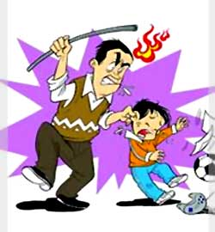
“动词荟萃”+“妙语连珠”
blame, scold, lecture, criticize, accuse,
condemn, consure, denounce, reprimand, rebuke, reprove, chide, tell off, dress down(俚语)
训斥
1. He never listened to us when we told him off.
我们的斥责他从来就听不进去。
2. The headmaster called the boys into his study and administered
a stern rebuke.
校长把男孩子们叫到他的书房进行了严厉斥责。
3. My mother denounced Harry in the face of me.
母亲当着我的面训斥了Harry.
4. The teacher gave John a good dressing down for being tardy to class three days in a row.
Jonn一连三天迟到，那位老师把John责备一通

Slide 33

“动词荟萃”+“妙语连珠”
strike fear into sb, be fear-ridden, be terror-stricken,
be prostrated with fear, tremble with fear, be thrown into panic, chilled with fear, panic-struck, shake/shiver in one's boots, be all of a jump, be thrown into panic, give sb. the jumps, all of a jump, feel alarmed
胆战心惊
The bombing attack struck fear into their hearts.
原子弹的袭击使我万分恐慌。
2. I knew that something was going to happen and I was fear-ridden.
我知道有事情要发生，这是我胆战心惊。
3. Jane’s gone rock climbing with her boyfriend once or twice . she says
that it makes her hair stand on end when she looks down at hundreds of
feet of empty air.
简和她的男朋友作过一两次攀岩。她说当她在数百英尺高处朝下望时，只见脚下
空荡荡的，吓得她胆战心惊。

Slide 34
a possible version
Para. 1
He turned and ran from the pond. At that moment, there was only one belief in his mind that he must save his own brother. He knew if his brother stayed in the water too long, he would die. Harry felt like a cat on hot bricks. He must think of a solution to make his brother climb out of the icy water. To search for objects that could help his brother, he ran to the oak trees like an arrow that left spring. For me, staring at his familiar figure out of sight, my mind went blank. My heart ached, tears streaming down my cheeks. I worked my fingers to the bones to crawl out by myself , but nothing came of it. I was thrown into a black world, crying desperately. It was at this moment that I saw Harry ran towards to me with a large, black, V-shaped oak branch. My worry gave way to relief in no time. He lay on his stomach, pushing the branch before him and wound his way towards me. I grabbed the branch with care and was ultimately dragged out of the icy water by Harry. What a narrow escape! We staggered shiveringly home, with my wet clothes dripping and my shoes squishing and squirting water.

Slide 35
“欧亨利式结尾”小尝试
Para. 1
He turned and ran from the pond. Watching him walk out on me, I was seized by a strong sense of horror, feeling I was thrown into a dark world and sank into hopelessness. The icy water made me shiver with coldness and fear, and I cannot resist crying with my eyes closed, reckoning that I would die . However, survival instinct made me compose myself. Failed as I had many times, my mind began to race, trying to think of a good solution. With my arms still stretching out on the ice, I discreetly fumbled for something that is hard with my foot under the ice. All of a sudden, a hard thing touched my foot, maybe a stone, many tortoise shells (the tortoises died in summer) or something else. A feeling of hope slowly crept up on me. Supported by the hard objects, I moved inch by inch. As if a century had passed, Ultimately, I crawled out of the ice hole. Staying flat on the ice, I rolled on it and survived. My face beamed and my bright smile lit up the whole sky. At this time, Harry came back with a oak limb in his hand. Looking at me rolling on the ice safe and sound, he stood there, rooted to the spot with his mouth open wide.

Slide 36
a possible version
Para. 2:
I crashed through the kitchen door, sobbing, mum rushed over. Looking at me shivering with coldness, She asked me in surprise, “what had happened?” Before I answered, she quickly took off my wet coat and gave me a hot bath. After then, she asked me to rest on the bed. I sobbed out my grievances to her. Fuming with rage, she told Harry off. His head drooping, Harry was fear-ridden, saying nothing. So ashamed was he that he could feel the blood rush to his face. Scolded as he was, he didn’t change himself thoroughly, I changed myself root and branch. After that, the pond put a brand in my heart that I could never erase. It was “the pond” that made me understand at times we should say “No” to others in the first place. I didn't try to please others any more to put my ass on the line. For the rest of my life, I myself am the most expensive.

Slide 37
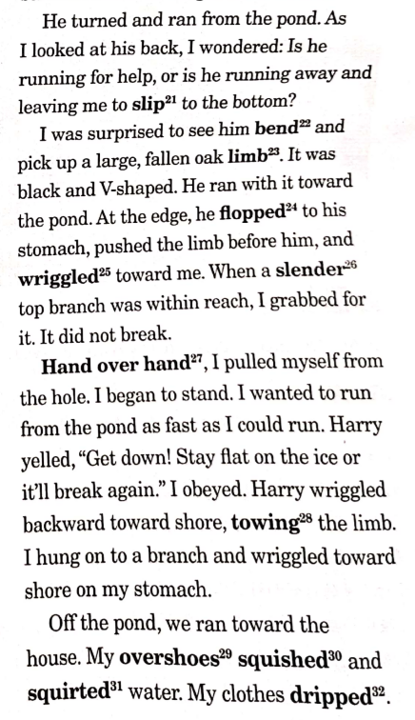

读后续写原文欣赏

Slide 38
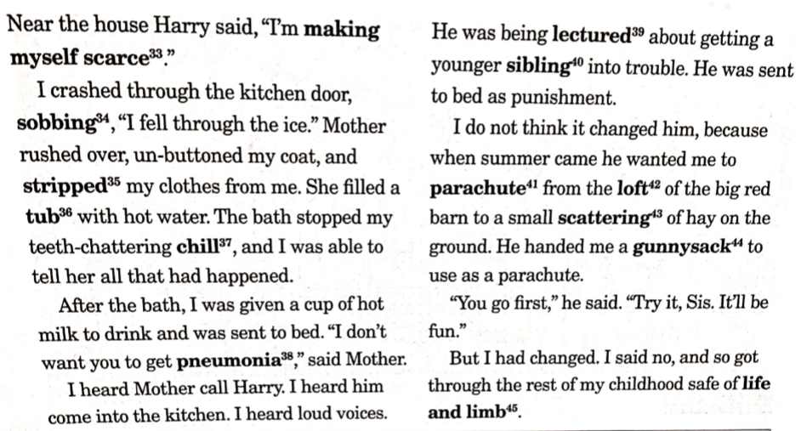
读后续写原文欣赏

Slide 39
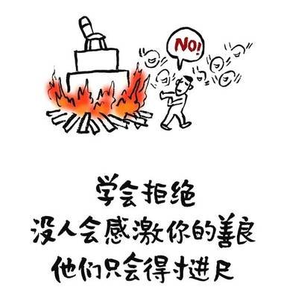
美文欣赏
Step 4 Thematic sublimation主题升华
If you don't want to do something for somebody, you should manage to say "No." in the first place.
The moment you give in, you've given them the impression that they can use your time as long as they try hard enough.
No "Let me see."
No "Maybe."
Just "No." and a "Sorry." if you want to be polite.
Or you can ask "How much?" if it suits you.
Time is the most precious thing that we have.
Once you lose a piece of it, you can never get it back.
And you have the freedom to decide how to use each piece of it.
So if someone want a piece of your time, they have to be worth it, either by being someone you truly care about or by providing enough payment.
Let me say it once again.
Time is the most precious thing that we have. Learn to refuse when people ask for your time.
学会拒绝，你才能走得更远

Slide 40

人生需要学会拒绝，教你一些花式英文拒绝表达公式
1
普通say no：
1. No. = 不。
2. Nope. = 不。
3. No way. = 没门。
4. Not likely. = 不可能。
5. Absolutely not！ = 当然不。
6. Sorry. = 抱歉，不行。
7. Forget it. = 算了吧。
3
文艺式say no：
13. Dream on. = 做梦去吧。
14. You wish. = 想得美。
15. Like hell. = 打死也不。
16. When pigs fly. = 怎么可能。
17. Not a chance. = 休想。
18. Save your breath. = 省省吧。
19. In a pig's eye. = 才不呢。
20. Only in your dreams. = 做梦吧你。
21. Over my dead body. = 除非你从我的尸体上压过去。
22. Not in a million years. = 再等1百万年吧。
23. You couldn't pay me to do it. = 给我钱我也不。
24. You're lying through your teeth.
= 你简直就是睁着眼说瞎话。
2
马景涛式say no：
8. Wrong！ = 错！
9. Lies！ = 骗人！
10. Bull. = 胡扯。
11. Baloney. = 胡说。
12. Horsefeathers！ = 瞎说！

Slide 41
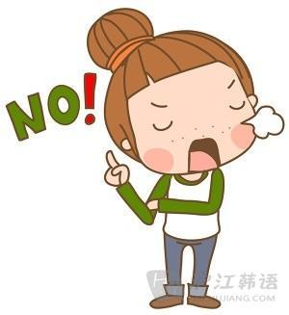
人生需要学会拒绝，教你一些花式英文拒绝表达公式
5
That式say no：
35. That's insane. = 荒唐至极。
36. That's unthinkable. = 难以想象。
37. That's not true. = 假的吧。
38. That's not right. = 不对。
39. That's out of the question. = 绝不可能。
4
程序猿say no：
25. It stinks. = 讨厌死了。
26. It sucks. = 太差劲了。
27. It's awful. = 糟糕之极。
28. It's terrible. = 太可怕了。
29. It's ugly. = 烂透了。
30. It's hideous. = 糟透了。
31. It's dreadful. = 糟透了。
32. It's not my style. = 不是我的菜。
33. It's not for me. = 不适合我。
34. It's hell on earth.
= 简直就是人间地狱啊。
6
“I”式say no：
40. I don't like it. = 我不喜欢。
41. I don't think so. = 我不这么想。
42. I hate it. = 我最讨厌这个了。
43. I disagree completely. = 我完全不同意。
44. I couldn't disagree more. = 真心不同意。
45. I can't stand it. = 我受不了了。
46. I don't care for it. = 我才不管呢。

Slide 42

人生需要学会拒绝，教你一些花式英文拒绝表达公式
7
“You”式say no：
47. You're wrong. = 你错了。
48. You're out of luck. = 你真倒霉。
49. You're way off base. = 大错特错。
50. You don't know what you're talking about. = 你根本不知道自己在说什么。

Slide 43
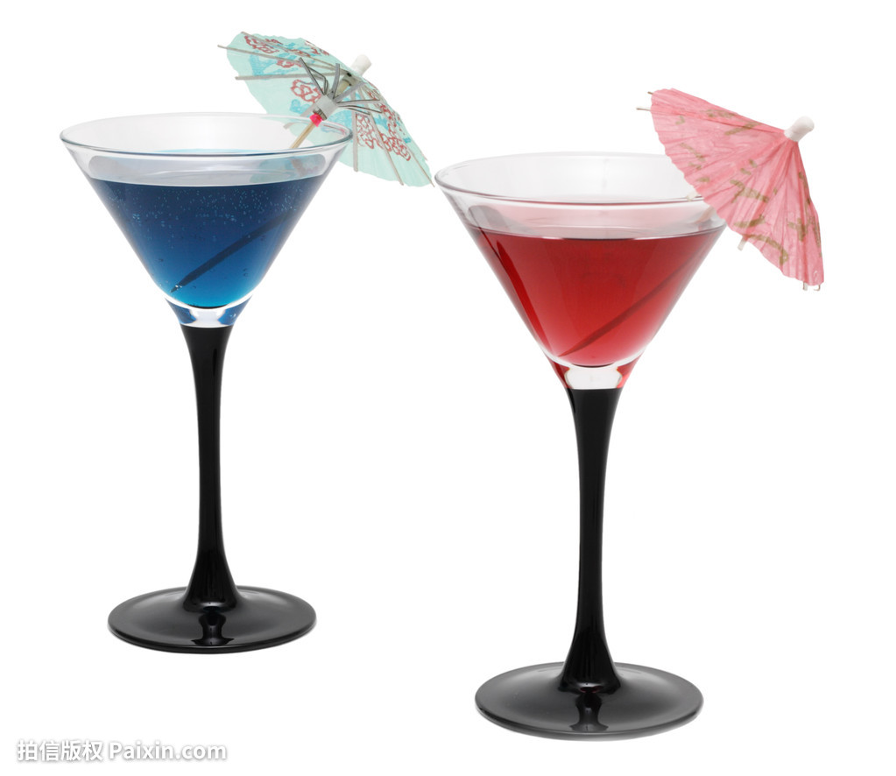
Homework
第一节 完形填空（共20小题；每小题1.5分，满分30分）
阅读下面短文，从短文后各题所给的A、B、C和D四个选项中，选出可以填入空白处的最佳选项。
Cruz Gent, 11, and Anthony Skopick, 10, couldn't agree. Were the ___1___ out on the ice ducks or geese? There was only one way to find out. So on a ___2___ January evening last year, the two friends ___3___ onto the frozen pond near their homes to get a better ___4___.
First they threw a rock onto the ice to test it. Then they stepped on it. Convinced the ice would ___5___ their weight, Anthony took a few steps, then... FOOMP. He crashed through the ___6___ frozen surface. Instantly Cruz rushed to help his ___7___ friend. FOOMP — the pond swallowed him too.
Cruz ___8___ to lift himself out of the icy water and onto a more solid section. He then ___9___ worked his way toward Anthony. But the ice didn't hold, and he fell in again. This time, he couldn't get out.

Slide 44
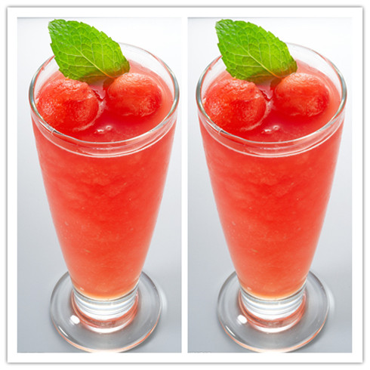
Homework
The boys were up to their necks in the cold water and quickly ___10___ feeling in their arms and legs. Any chance of their freeing themselves was slipping away. Cruz was sure he was going to ___11___.
Anthony's older sister had seen the boys fall through the ice and ___12___ screaming for help. John Lavin, a ___13___ driving nearby on his way to the grocery store, heard her. He quickly ___14___. Seeing the boys, he grabbed a nearby buoy (浮标), ___15___ his shoes, and ran into the icy water, making his way through the ice with his free fist. Finally, Lavin got close to Cruz and Anthony and pulled them back to ___16___. They were taken to the hospital, where ___17___ discovered that their five-minute stay in the water had ___18___ their body temperature nearly ten degrees.___19___, the boys have fully recovered, but they are still impressed by their ___20___ neighbor. "Just think," says Cruz, "if he hadn't been there, I could have died."

Slide 45
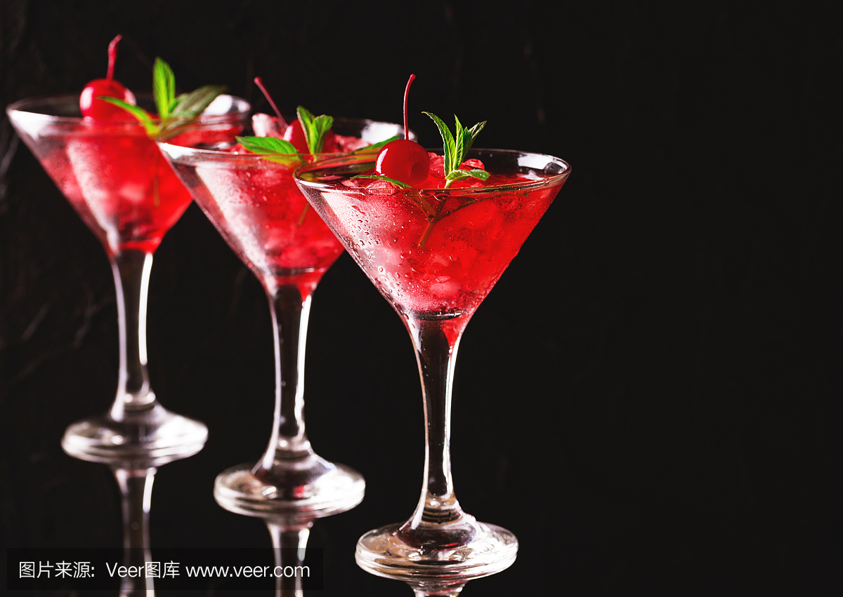
Homework
1. A. birds B. boys C. weeds D. plants
2. A. warm B. cloudy C. freezing D. sunny
3. A. climbed B. fell C. dropped D. stepped
4. A. smell B. look C. taste D. sound
5. A. gain B. keep C. hold D. measure
6. A. firmly B. seemingly C. strongly D. solidly
7. A. panicked B. excited C. annoyed D. surprised
8. A. pretended B. managed C. failed D. happened
9. A. gratefully B. quietly C. cautiously D. lazily
10. A. making B. enjoying C. getting D. losing
11. A. disappear B. float C. die D. survive
12. A. stopped B. started C. avoided D. delayed
13. A. neighbor B. stranger C. relative D. classmate
14. A. gave in B. drove off C. jumped up D. pulled over
15. A. put on B. kicked off C. showed off D. handed on
16. A. land B. earth C. water D. pond
17. A. workers B. assistants C. doctors D. patients
18. A. lowered B. controlled C. recorded D. raised
19. A. Hopefully B. Unforgettably C. Interestingly D. Fortunately
20. A. polite B. fearless C. generous D. innocent

Slide 46
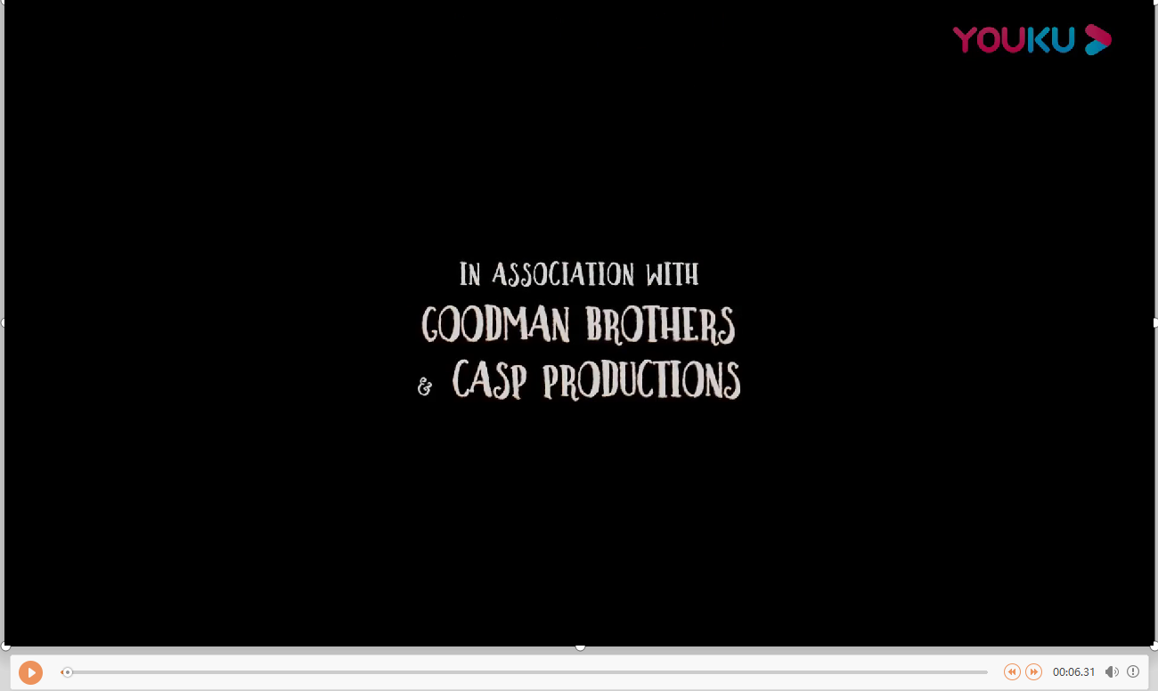

Slide 47
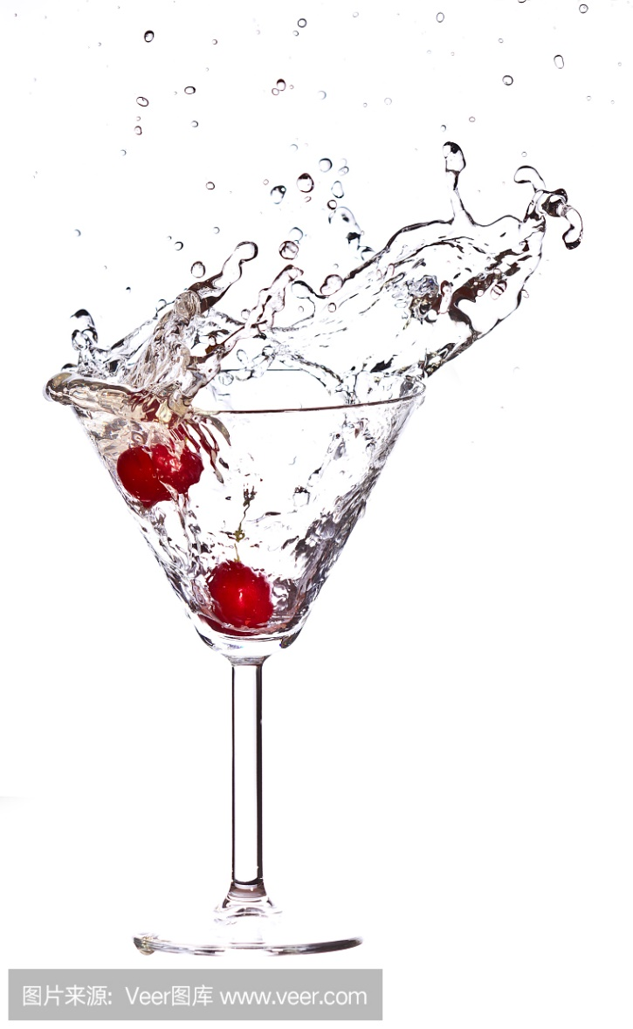
Thank you

