Slide 1
感恩遇见，相互成就，本课件资料仅供您个人参考、教学使用，严禁自行在网络传播，违者依知识产权法追究法律责任。
更多教学资源请关注
公众号：溯恩英语
知识产权声明

Slide 2
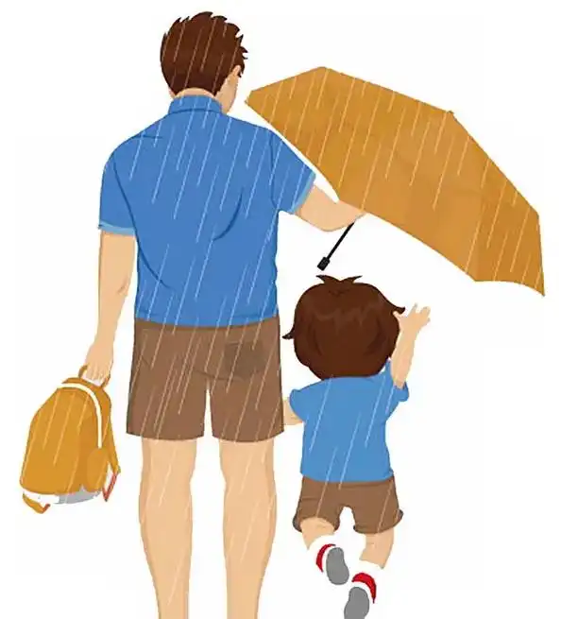
父爱无声
---2025-3 金丽衢联考
人与社会之亲情篇
郑素红

Slide 3
读原文:
It was never a question whether or not my mother loved me—it was a given, the cornerstone of my life that shaped everything about who I was.
However, I’m not sure about my father’s love. There are photographs of us laughing together, with me in diapers when I was a baby. I’ve watched recordings of my older sister and me lining up in turns for my father to hold and toss us into the air—all three of us shrieking(尖叫) with delight.
Did I love him then?
I feel I must have loved him because the film says so—the infant child is laughing, and she is embracing the man beside her. When I turn off the tape to search my own childhood for proof of my father’s love, and proof that we shared something like love, there is one impressive memory I can name.
At some point during my first year of school, I peed(尿湿了) my pants in class. I was sent to the school nurse for a change of clothes, and for the rest of the day, I wore a pair of over-large, bright orange sweat pants. I remember exactly how the teacher looked at me and exactly what the other students said, but they were the least of my worries.

Slide 4
I was in terror at the thought of showing up at home with different pants.
All afternoon I planned how I would enter the house very quietly and run to my room before my father even noticed I was there. During the entire bus ride home I rehearsed(默默练习) again and again the plan I had in mind that would allow me to escape my father’s wrath(盛怒) and his triangle eyes.
Triangle eyes. This was the name my sister Shira and I used to use whenever my father’s eyes would tense up into two hard triangles, with the calm of his face having fled away in a flash of anger. Their appearance was sudden and unpredictable, ignited by a poor exam score from Shira, or when I burnt the bread in the toaster. He’d point out the door and yell, “Get out!”
Who knew what peeing pants in class would get you.
Para 1: So I carefully planned to avoid his notice, but the plan backfired.
Para2: Everything he did told me that HE LOVED ME.

Slide 5
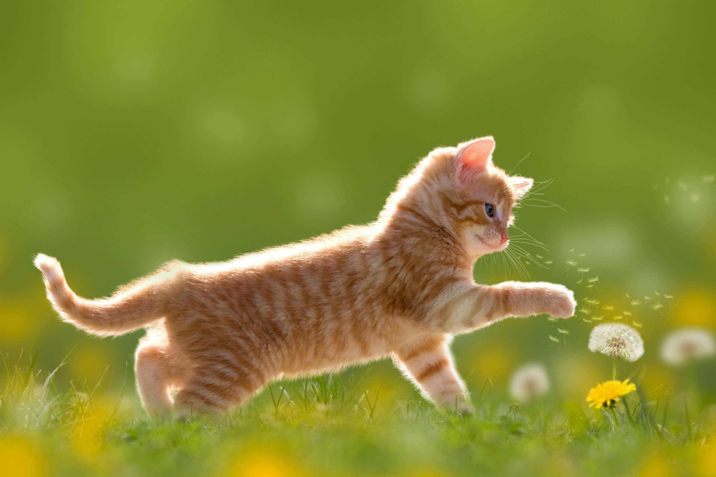
Read for elements
Major roles: I
Minor roles : my father (my sister, my mother)
2. narrative perspective: first-person ( I )
3. time：at some point in my first year of school after school
place： at school at home after school
event: I peed my pants at school and I feared my father would shout at me because he seemed so stern with his triangle eyes.

Slide 6
5.
story
line
Climax
Who knew what peeing pants in class would get you?
Para1: So I carefully planned to avoid his notice, but the plan backfired.
I planned to escape my father’s wrath(盛怒) and his triangle eyes. Their appearance was sudden and unpredictable, ignited by a poor exam score from Shira, or when I burnt the bread in the toaster. He’d point out the door and yell, “Get out!”
Para2: Finally, Callie picked up the scared kitten from the corner of the hayloft.
I peed(尿湿了) my pants in class.I remember exactly how the teacher looked at me and exactly what the other students said, but they were the least of my worries.
It was never a question whether or not my mother loved me—it was a given, the cornerstone of my life that shaped everything about who I was. However, I’m not sure about my father’s love.
background
Ending
Beginning

Slide 7
Read for clues and echoes
hidden clues | echoes
It was never a question whether or not my mother loved me—it was a given, the cornerstone of my life that shaped everything about who I was. | 1. My father’s love, not expressed in words but through gestures, was also a given, a cornerstone of my life, shaping me into the person I am today.

Slide 8
Read for clues and echoes
hidden clues | echoes
However, I’m not sure about my father’s love. There are photographs of us laughing together, with me in diapers when I was a baby. I’ve watched recordings of my older sister and me lining up in turns for my father to hold and toss us into the air—all three of us shrieking(尖叫) with delight. | 2. The bond between my father and me never changed, whether in the infancy photographs or in the childhood recordings.

Slide 9
Read for clues and echoes
hidden clues | echoes
At some point during my first year of school, I peed(尿湿了) my pants in class. I was sent to the school nurse for a change of clothes, and for the rest of the day, I wore a pair of over-large, bright orange sweat pants. I remember exactly how the teacher looked at me and exactly what the other students said, but they were the least of my worries. | 3.His eyes lingering on the over-large orange sweat pants pooled around my ankles, it all clicked to him. 4. Lowering my head, I stammered in a trembling voice, confessing the accident and the resulting embarrassment, tears streaming down my cheeks.

Slide 10
Read for clues and echoes
hidden clues | echoes
All afternoon I planned how I would enter the house very quietly and run to my room before my father even noticed I was there. During the entire bus ride home I rehearsed(默默练习) again and again the plan I had in mind that would allow me to escape my father’s wrath(盛怒) and his triangle eyes. | 5. I froze. What terrified me was that the rehearsed lie was completely on the tip of my tongue. 6. No wrath, no triangle eyes, no shouting—just steady hands fixing what he could do for me.

Slide 11
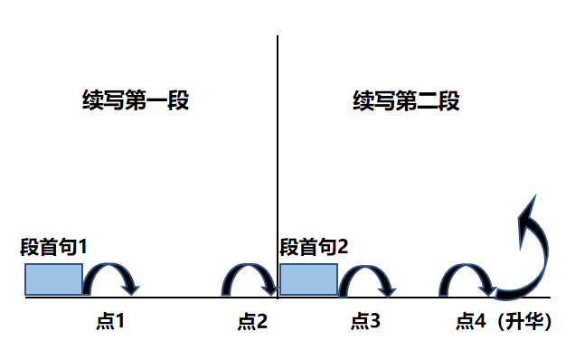
Plot Continuation
点1：位于续写第一段段首，流畅衔接前面的故事（常与原文最后一段呼应）和第一段段首语；
点2：位于续写第一段段尾，流畅衔接第二段段首句；
点3：位于续写第二段段首，续写衔接第二段段首语；
点4：文章结尾升华，给予读者正能量，揭示和强调主题。

Slide 12
Plot the continuation story
Para1: So I carefully planned to avoid his notice, but the plan backfired.
Para2: Everything he did told me that HE LOVED ME.
Link1: How did the plan fail?
Body: How did I explain the embarrassing accident?
Link2: What did my father do? How did I feel?
Link3: What was the difference between father’s love and mother’s?
Body: What things did my father do for me?
What did I think of my father?
Ending: ① How did I interpret my father’s love compared to my mother’s love?
② How did my father’s love influence my growth?

Slide 13
心理描写
神态描写
动作描写
外貌描写
环境描写
对话描写
语言
无灵主语
动作链
分词作状语
With 复合结构
独立主格
从句
倒装句
虚拟语气
强调句
长短句结合
考生构思情节的同时，要考虑合适的语言句式以及修辞

Slide 14
Design link1
Para1: So I carefully planned to avoid his notice, but the plan backfired.
Link1A: (呼应the plan backfired) I tiptoed into the house, my heart racing wildly. But out of the blue, my father’s familiar stern voice boomed, “ What happened? ”
Link1B: （呼应穿着特大的裤子放学回家）After getting off the school bus, I struggled to the doorway in the over-large, bright orange sweat pants, sighing that the unlucky day finally passed.

Slide 15
Design link2
Para1: So I carefully planned to avoid his notice, but the plan backfired.
Para2: Everything he did told me that HE LOVED ME.
Link2 A: (呼应第二段所给句父亲所做所说) Wiping away my tears gently with his calloused hands, he consoled me softly, “ Accident/ Shit happens.” “ Take a shower and tomorrow,” he added after thinking twice, “we’ll pack extra clothes in your bag.” No wrath, no triangle eyes, no shouting—just steady hands fixing what he could do for me.
Link2B: ( 呼应第二段所给句中严父的慈爱) As I tugged off the sweatpants, he passed me clean trousers he had washed and dried, wearing a concerned look.

Slide 16
Design link3
Para2: Everything he did told me that HE LOVED ME.
Link3A：(呼应 原文首段父爱母爱的不同) Time going by, I realized that my father’s love was different from my mother’s—it was less obvious, but no less powerful. He did what he could in silence for me, like staying up into the night to fix my broken bike or waking up early to scrape the frost off my bike seat.
Link3B: (洗澡换裤子后，父亲对我的关心） After I took a shower and got changed, my father looked into my eyes, saying firmly, “Accident happens and it’s not a big deal. So don’t worry your little head about it.”

Slide 17
Design ending
Para2: Everything he did told me that HE LOVED ME.
Ending A: ( 对父爱的解读） My father’s love, not expressed in words but through gestures, was also a given, a cornerstone of my life, shaping me into the person I am today.
Ending B: （被爱的我得以勇敢面对人生的挑战） The affectionate phrase “ I love you” from my stern father might be rarely heard by me, but his intense love was never absent from my life, enabling me to brave challenges in my life.
Ending C: (父爱一直伴我左右） Memories of the time spent with my father in infancy, childhood and adolescence crowding into my mind, it dawned on me that the man in the videos, the one who laughed until his face reddened, was always there on my side, with love disguised in his triangle eyes / with love hidden beneath his stern look.

Slide 18
习作
Para 1: So I carefully planned to avoid his notice, but the plan backfired. I tiptoed into the house, my heart racing wildly. But out of the blue, my father’s familiar stern voice boomed, “ What happened? ” I froze. What terrified me was that the rehearsed lie was completely on the tip of my tongue. His eyes lingering on the oversize orange sweatpants pooled around my ankles, it all clicked to him. Lowering my head, I stammered in a trembling voice, confessing the accident and the resulting embarrassment, tears streaming down my cheeks. Wiping away my tears gently with his calloused hands, he consoled me softly, “ Accident/ Shit happens.” “ Take a shower and tomorrow,” he added after thinking twice, “we’ll pack extra clothes in your bag.” No wrath, no triangle eyes, no shouting—just steady hands fixing what he could do for me. (129)

Slide 19
Para 2: Everything he did told me that HE LOVED ME. Time going by, I came to realize that my father’s love was different from my mother’s—it was less obvious, but no less powerful. He did what he could in silence for me, like staying up into the night to fix my broken bike or waking up early to scrape the frost off my bike seat. Mom’s love was the sun, warm and intense. His was the moon—cool, distant, but guiding, like a beacon of light directing me when I lost my way. The bond between my father and me never changed, whether in the infancy photographs or in the childhood recordings. My father’s love, not expressed in words but through gestures, was also a given, a cornerstone of my life, shaping me into the person I am today.

Slide 20
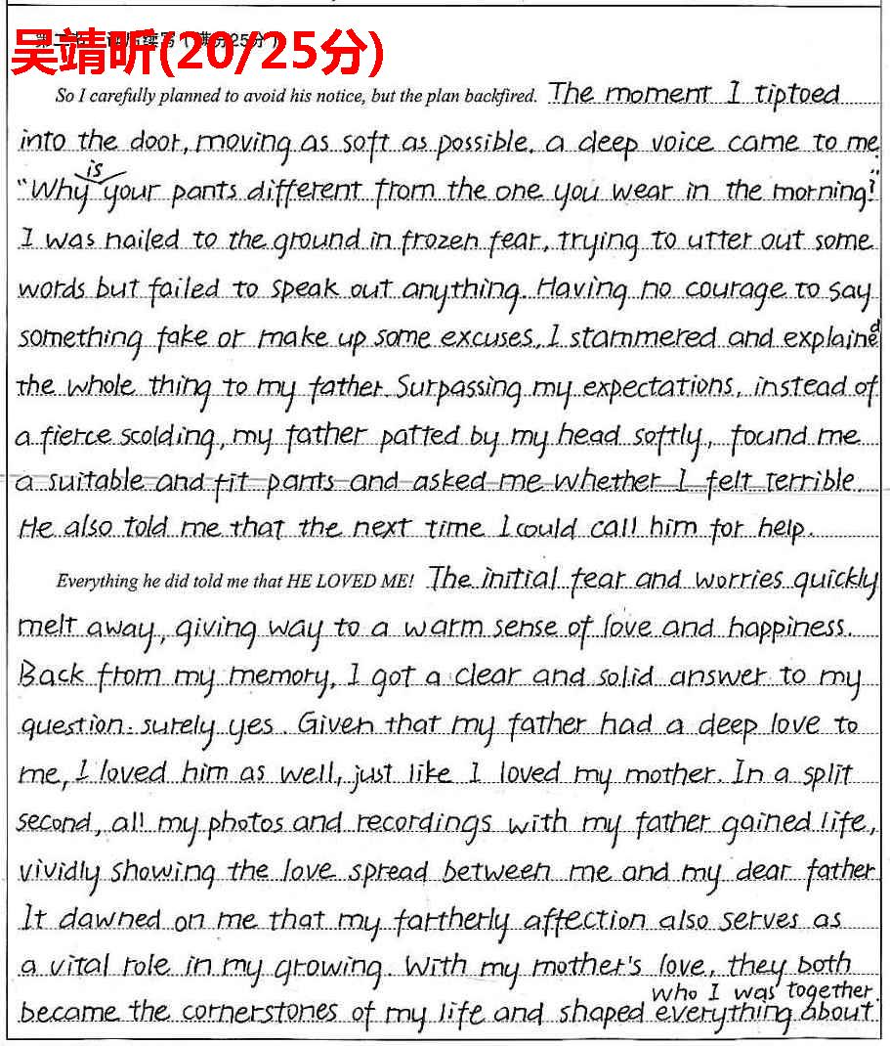
优秀习作点评：
放学—蹑手蹑脚地回家—被父亲发现---坦白---父亲并未责骂，情节处理很好，细节到位；
感受到深沉的父爱，回扣原文的疑问，并得出肯定的答案。父爱和母爱一样是我人生的奠基石，共同造就了现在的我。考生挖掘得非常有深度。
伏笔回扣非常自然妥帖，如照片，录像，奠基石，编借口等。交错编织，融于情节，与原文浑然一体。

Slide 21
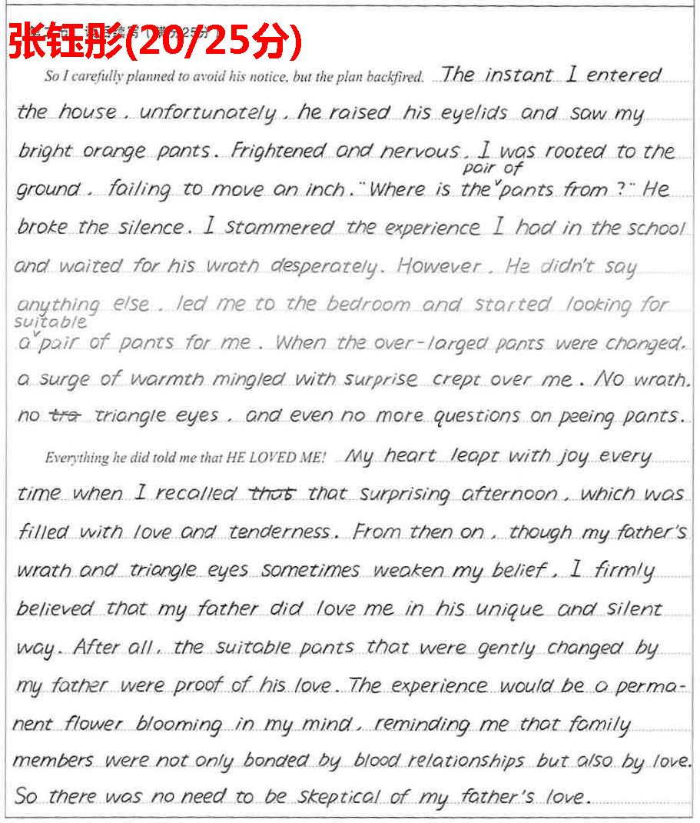
优秀习作点评：
首段情节处理非常自然，符合小学生的心理特点。
my peed pants 证明了了父爱，深入阐述不一样的父爱。语言功底扎实，信手拈来，非常流畅。
细节描写细腻，亦能对 原文有所回应，增加了文章的协同性。

