Slide 1
感恩遇见，相互成就，本课件资料仅供您个人参考、教学使用，严禁自行在网络传播，违者依知识产权法追究法律责任。
更多教学资源请关注
公众号：溯恩高中英语
知识产权声明

Slide 2
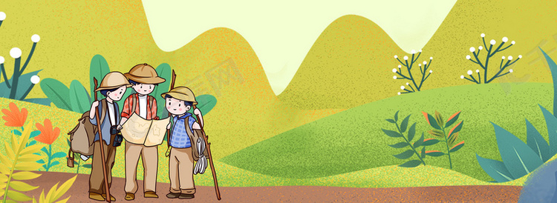
读后续写备考指导
基于语篇“what, how，why”分析的
读后续写合理解读和建构
——以“野外困境中哥俩合作脱险”为例
杭州二中 许丽君
常山一中 吴俊峰

Slide 3
野外父亲眼镜掉水中，兄弟合作脱险
阅读下面短文，根据所给情节进行续写，使之构成一个完整的故事。
Mr. Taylor checked again: water, food, bandage, medicines, a compass, and a map wrapped in plastic… Bingo! He put all that he prepared for the coming hiking into his backpack.
Mr. Taylor was fond of hiking, this time in particular, for it was the first time for him to hike with his two sons, Harry and Joel. Joel liked reading books about explorers and Harry joined the hiking club in his school this term. "It will be an unforgettable experience, definitely.” he whispered to himself, unconsciously a smile spreading over his face.
Harry and Joel, however, argued for the first three miles of their hiking trip. Harry accused Joel of wearing smelly old shoes. Joel blamed Harry for using all of the bug spray(喷雾防虫剂). Harry told Joel he smelled terrible，Joel called Harry a coward(懦夫).
“ Will the two of you just quiet down and enjoy our hike together? ”their father said. “You‘re missing all of the beautiful scenery!”

Slide 4
It was true. Neither Joel nor Harry had taken notice of the bear their father had spied at the start of their trip. They hadn't looked up at the eagle he pointed out overhead. Worst of all, they hadn't paid any attention to the turns and twists along the way while they continued their argument.
“Joel threw a stick at me!" Harry screamed.
“That’s not true! "Joel shouted back.
Mr. Taylor could no longer contain his anger. "And both of you need to stop arguing!" he erupted. As he turned to face them, his left foot caught on a root. He slipped backward and down muddy bank, falling into the river that ran alongside the path. Harry and Joel raced to their father's assistance. They helped him up out of the water, and then dragged his wet backpack up onto land. Fortunately, their wet-through father found himself just slightly injured.

Slide 5
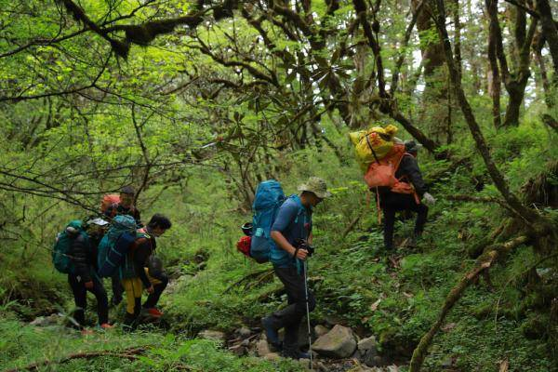
注意：
1.续写词数应为150左右：
2.请按如下格式在答题卡的相应位置作答。
Paragraph 1：
But his glasses came off when he fell in the water.
Paragraph 2:
“Just calm down.” Mr. Taylor shouted, “Without my glasses, we need to work together to find our way.”.

Slide 6
语篇
作者的意图、情感态度或价值取向
语篇的主题和内容
What
Why
读后续写的
解读和建构
How
语篇的文体特征、内容结构和语言特点

Slide 7
Search for “what”:
语篇的主题和内容分析：
通过原文和续写段首语可知：
本文主要讲述了一个小故事：Joel and Harry 和父亲一起野外徒步旅行，途中因为一些琐事两人互相指责，一路争吵，错过了沿途的美景，也未曾看见父亲所指的头顶的鹰，更糟糕的是，未注意沿途的环境。当父亲因为阻止他们的争吵失足落水，丢失眼镜，无法给他们领路时，两人再次争吵。但在父亲的思想工作后，他们从背包中找到了指南针和地图，在两人的通力合作和父亲的指引下，最终找到了回家的路。故事的主题是：吵吵闹闹解决不了问题，只有合作努力才能摆脱困境，走向光明。
续写中的人物塑造、情节发展和环境描写需紧扣故事主题。

Slide 8
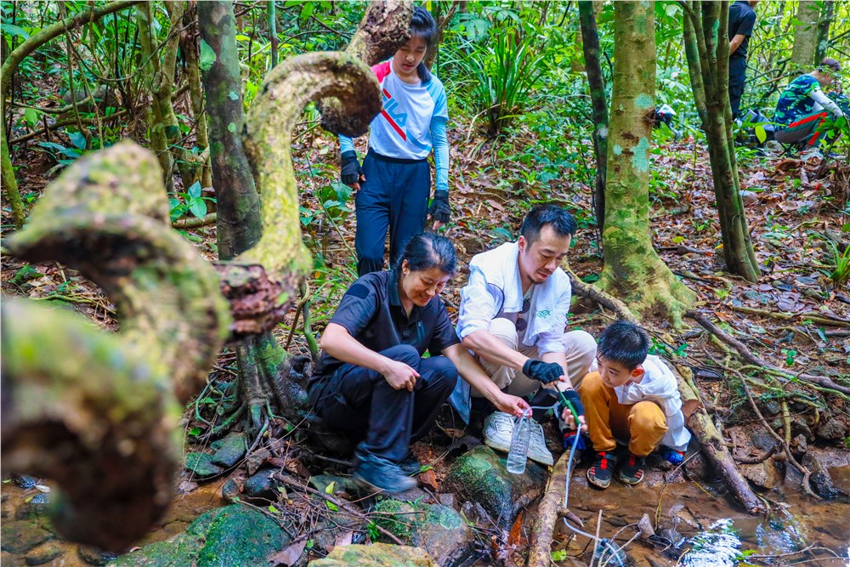
Search for the clue:
线索分析
1. 人物线索
Joe and Harry——爱学习，爱探险，但互不体谅，争吵不断
爸爸Mr. Taylor——为外出徒步旅行做好充分准备，仔细，教育孩子合作才能赢。

Slide 9
Search for “how” :
语篇的文体特征、内容结构分析
按照冲突（conflict）→行动（action）→解决（resolution）的结构模式分析：
1. 冲突（conflict）:
Joe and Harry两人互相指责，一路争吵，父亲因为要阻止兄弟俩争吵，掉进了河中
父亲的眼镜在落水时掉了，父亲全身湿透，先要干衣，处理伤口，还要找回去的路，因为父亲的眼镜不见了，不知回家的路，他俩再次争吵（第一段）
2.行动（action）
3.解决（resolution）
没有了眼镜，他们必须一起努力找到回家的路。

Slide 10
Search for “why” :
探索作者的意图、情感态度或价值取向
情感分析
故事围绕Joel和Harry兄弟争吵导致父亲失足落水，在父亲引导下合作解决困境展开。从争吵到合作是故事的情节线索之一。根据原文，Joel和Harry的互相指责让他们不仅错过了沿途的美景，更让父亲落水，但他们终于意识到争吵解决不了问题，必须运用自己所学的技能和办法，摆脱困境，最终找到回家的路。更重要的是他们懂得了和谐的重要性。

Slide 11
Search for “why” :
探索作者的意图、情感态度或价值取向
Joel and Harry的心理变化是故事的另一个情节线索。从远足开始到旅行结束，他们的心理变化如下：
discouraged（两人沿途指责争吵）
disappointed（错过了沿途的美景）
心理变化
frustrated（父亲意外落水）
hopeless/scared（害怕回不了家）
excited（指南针、地图引领）
delighted/proud（找到了回家的路）

Slide 12
Search for “how” :
根据以上问题，续写第一段的具体情节可以是：
探索语篇的文体特征、内容结构和语言特点
Joel and Harry 帮父亲烘干衣服，处理伤口
情节分析
续写第一段具体情节构思：
展开细节时，可以尝试回答如下问题并考虑多种可能性：
How did Joel and Harry help their father?
What did the two brothers say to blame the other?
How did they feel when facing the great challenge？
因为父亲眼镜不见了，没有人领路
兄弟俩意识到困难，感到害怕
又开始指责对方，争吵不休

Slide 13
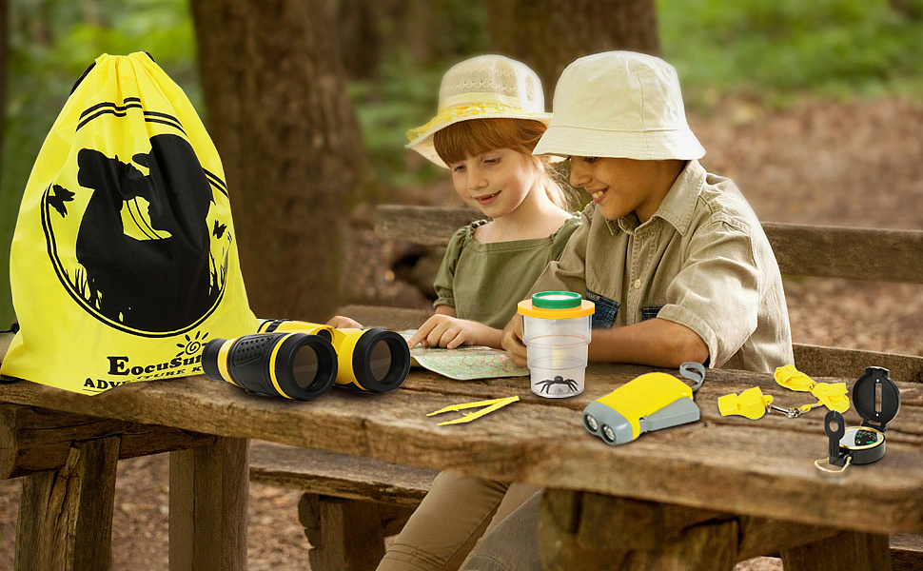
Search for “how” :
探索语篇的文体特征、内容结构和语言特点
情节分析
续写第二段具体情节构思：
展开细节时，可以尝试回答如下问题并考虑多种可能性：
a) What did they think of after their father stopped their quarrel?
b) What did Joel and Harry do with the help of the compass and the map?
c) What did they learn from the experience?

Slide 14
Search for “how” :
探索语篇的文体特征、内容结构和语言特点
根据以上问题，续写第二段的具体情节可以是：
Joel 想到了背包里的指南针和地图（开心）
Harry和Joel一起研究地图找到了所处位置
plot development
在指南针的帮助下→找到了回家的路（兴奋）
爸爸问兄弟俩从中领悟到了什么
Joel回答说，吃一堑，长一智，并总结人生哲理：只要一条心，就一定能克服困难（自豪）。

Slide 15
Search for the clue:
Clue 1：
为后文父亲摔倒掉入河中轻微受伤并丢了眼镜，无法辨别方向，该如何回家作铺垫。
因为出发前父亲准备工作非常充分，背包里准备了野外徒步旅行时所需的一切工具和设备。
Paragraph 1：
Mr. Taylor checked again: water, food, bandage, medicines, a compass, and a map wrapped in plastic… Bingo! He put all that he prepared for the coming hiking into his backpack.
Resolution：
学生运用基本常识：用绷带、药物可以救治受伤的父亲；用指南针、地图可以帮助辨别方向。

Slide 16
Search for the clue:
Paragraph 2：
Mr. Taylor was fond of hiking, this time in particular, for it was the first time for him to hike with his two sons, Harry and Joel. Joel liked reading books about explorers and Harry joined the hiking club in his school this term. "It will be an unforgettable experience, definitely.” he whispered to himself, unconsciously a smile spreading over his face.
Clue 2：
兄弟俩一个喜欢探险类书籍，一个在学校参加过徒步旅行俱乐部，两人都积累了一定的野外生存技能和脱险的方法。
Resolution：
虽然父亲眼镜不见了，但运用父亲在背包里准备的指南针和地图，运用Joe的书本知识和Harry的实际经验，在经验丰富的父亲的指导下，父子三人一定能摆脱困境。

Slide 17
Search the clue:
Paragraph 4：
It was true. Neither Joel nor Harry had taken notice of the bear their father had spied at the start of their trip. They hadn't looked up at the eagle he pointed out overhead. Worst of all, they hadn't paid any attention to the turns and twists along the way while they continued their argument.
Clue 3：
最糟糕的是，兄弟俩一路争吵都未注意途中转了几个弯，拐了几道折。
Resolution：
虽然两人都积累了一定的野外生存技能和脱险的方法。但途中未注意周围环境的变化。现在父亲眼镜也不见了，必须依靠三人共同的力量，运用指南针和地图，在书本知识和实践经验的帮助下，父子三人一定能摆脱困境。

Slide 18
Search the clue:
Paragraph 8-9：
Harry and Joel raced to their father's assistance. They helped him up out of the water, and then dragged his wet backpack up onto land. Fortunately, their wet-through father found himself just slightly injured.
Clue 4：
兄弟俩把父亲救出来，把湿透的背包捞上岸。
Resolution：幸好父亲把地图用塑料袋包好了，背包虽然湿透了，但指南针和地图都能用上。父亲受伤也不重，带着的绷带和药物都能帮上忙。为后文的续写起到了伏笔的作用。

Slide 19
Predict the plot -1
Paragraph 1: But his glasses came off when he fell in the water.
Paragraph 2: “Just calm down. “Mr. Taylor shouted, "Without my glasses, we need to work together to find our way.”
problem
Mr. Taylor: couldn't see clearly
no one guided the way
panicked? Argued again?
Joel & Harry : couldn't calm down
further problem

Slide 20
Predict the plot-2
Paragraph 2: “Just calm down. “Mr. Taylor shouted, "Without my glasses, we need to work together to find our way.”
Using the compass and the map guiding the way and working together, Joel and Harry managed to find their way.
solution
result?
learn to enjoy the hike,
learn to cooperate …

Slide 21
Plot – paragraph 1
Fortunately, their wet-through father found himself just slightly injured. But his glasses came off when he fell in the water.
dried the clothes
dealt with the injury
realized no one guided the way
panicked
blamed/argued again

Slide 22
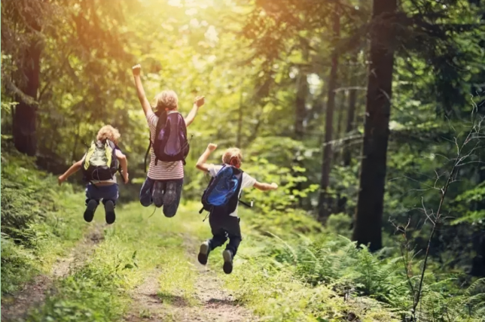
Plot – paragraph 2
“Just calm down. “Mr. Taylor shouted, "Without my glasses, we need to work together to find our way.”
find way with the compass and map
Lesson learned
A fall into the pit, a gain in your wit. (吃一堑，长一智）
learn to cooperate
Enjoyed the hike

Slide 23
Possible version 1 for paragraph 1
But his glasses came off when he fell in the water. Sighing deeply, Mr. Taylor quickly took off his wet clothes and squeezed the water out. While Harry was spreading the clothes on a huge stone, Joel walked their half-naked father to an opening area. Seeing his father wrapping the wound with the bandage, Joel felt that a thought entered his mind like an electric shock. How could they continue hiking if Dad was unable to see clearly? “If only Harry stopped arguing earlier with me!” he murmured, with his heart sinking and his palms sweating. “I hate you!” Harry yelled, glaring at him with burning eyes.

Slide 24
Possible version 1 for paragraph 2
“Just calm down. “Mr. Taylor shouted, "Without my glasses, we need to work together to find our way.” After He mentioned the map and compass, the boys approached reluctantly and fumbled for them in his backpack. It was not long before they located where they were and found out the way. Joel soon found himself an expert at using a compass, while Harry was an excellent map reader. Now and then, pretty birds singing merry songs and flowers blooming with smiles made the kids immersed in the charm of nature. Later that day, they managed to catch sight of some mountain goats and even a grizzly bear and an eagle. This unforgettable hiking will be rooted in the two brother’s minds, because they learn that cooperation matters.

Slide 25
Possible version 2 for paragraph 1
But his glasses came off when he fell in the water. Mr. Taylor was stunned for a moment, wondering what to do next. At the same time, Harry burst out crying with bitter tears rolling down his blank cheek. Immersed in horror, Joel’s body was shivering and his palms were sweating heavily. They were all in a dilemma and felt a kind of sorrow mingled with regret. Afterwards, his two sons began arguing with each other again.

Slide 26
Possible version 2 for paragraph 2
“Just calm down. “Mr. Taylor shouted, "Without my glasses, we need to work together to find our way.” Joel wiped Harry’s tears away and it hit Harry that they had brought a map wrapped in plastic! Joel’s eyes twinkled with merriment and reached the map out instantly. “I love reading books about explorers, so I can definitely use this map to find our way! Joel screamed out, They tried their best to go back home and their anxiety disappeared and then their bravery started to grow. Eventually, they got home successfully. “What an unforgettable experience!” They said.

Slide 27
Thanks for your attention！

