Slide 1

感恩遇见，相互成就，本课件资料仅供您个人参考、教学使用，严禁自行在网络传播，违者依知识产权法追究法律责任。
更多教学资源请关注
公众号：溯恩高中英语
知识产权声明

Slide 2


20220414台州二模应用文讲评
告知信：成人礼
陈星可
浙江省天台中学

Slide 3
〖20220414台州二模-告知信：成人礼〗
假定你是校学生会主席李华，邀请了即将来访的新西兰学生交流团参加你校成人礼。请给领队Mrs. Evans再写一份电子邮件，附上活动具体安排（附件）。你的邮件正文内容包括：
1.成人礼大致安排；
2.希望读完附件,提出建议；
3.期盼到来。
注意：
1.词数80左右；
2.可以适当增加细节，以使行文连贯。
参考词汇：
成人礼 the coming-of-age ceremony; 附件 attachment

Slide 4
审题1:要素 Elements
体裁：
时态：
交际对象：
主题语境：
人称：
an e-mail of information
simple present tense, simple future tense
foreign delegation（friendly, formal）
介绍安排、征求建议、期待到来
the first person, the second person

Slide 5
审题2:试题信息的取舍
假定你是校学生会主席李华，邀请了即将来访的新西兰学生交流团参加你校成人礼。请给领队Mrs. Evans再写一份电子邮件，附上活动具体安排（附件）。
信息点1：你是校学生会主席李华
解读：是第二次的邮件，已经建立联系，自我介绍不用涉及。
信息点2：邀请即将来访的新西兰学生交流团参加你校成人礼
解读：已经确认，“邀请”和“新西兰代表团”的身份信息都不写，只需表达很高兴你要来 。
信息点3： 领队的身份
解读：与自介一样，不必赘诉，以you代之。
信息点4： 附上活动具体安排（附件）
解读：属于具体信息，放到要点2比较合适。

Slide 6
审题3:框架结构要点 Structure+Points
Paragraph 1: background +purpose
Paragraph 2:Body
Paragraph 3:Conclusion
得知你们要来参加成人礼+回信告知大致信息
1.成人礼大致安排；2.希望读完附件,提出建议；
或者：成人礼大致安排
期盼到来；
或者：2.希望读完附件,提出建议；3.期盼到来。

Slide 7
背景话题 coming-of-age ceremony
是在少男少女年龄满18岁时举行的象征迈向成人阶段的仪式。举行成人礼表示一个人已经come of age（成年），在经历了puberty（青春期）之后，完成了从adolescent（青少年）向youth（青年）的转变，即将迈向人生的新阶段。
In Chinese senior schools, a ceremony of Coming-of-age and 100 days countdown to the Entrance Examination of College usually take place on the same day. It aims to stimulating the sense of responsibility and determination.

Slide 8

背景话题 coming-of-age ceremony
主要活动
主持人开场白 opener
领导/校长致辞 address
学生成人宣誓 oath
家长和学生互动 interaction
家长陪伴学生走过成人门 stride through the gate
中间穿插歌舞等互动节目 performances

Slide 9
思维和表达: 首段
1.背景+写信目的：得知你们要来参加成人礼+回信告知大致信息
背景+目的：
1.So excited that we’ll soon meet and join in the coming-of-age ceremony in our school. Here, I’d like to share with you our plan briefly.
2.Glad to know you’ll attend the coming-of-age ceremony to be held in our school next week, I’m writing to inform you of the relevant details.
3.It's our honor to have you here to jointly witness the coming-of-age ceremony. Here, I'm writing cordially to brief you on the arrangement.

Slide 10
思维和表达: 首段
1.背景+写信目的：得知你们要来参加成人礼+回信告知大致信息
背景+目的：
4.Delighted to learn that you will be joining us in the coming-of-age ceremony in our school, I’d like to brief you on the event.
5.With the approach of our coming-of-age ceremony, I’m writing to inform you of some relevant details.
6.I’m writing to brief you on the arrangements of the following coming-of-age ceremony you are to attend.

Slide 11
思维和表达: 中段body
2.成人礼大致安排:
--1.领导/校长致辞 address
1.The ceremony begins with an inspiring speech from our headmaster, guiding students to understand the responsibility of being an adult.
2. The ceremony will kick off with a fabulous lecture delivered by our school headmaster who will congratulate students on entering adulthood and offer practical advice to us.
3. Accompanied by blissful music, the school president will deliver us a congratulatory speech and his anticipations.
4.可以一笔带过。

Slide 12
思维和表达: 中段body
2.成人礼大致安排:
--学生成人宣誓 oath
1.We will witness a unique ritual where we’ll make an oath of being responsible into adulthood.
2.Together, we will make an oath, determined to be responsible adults and devote every effort to the upcoming Gaokao.

Slide 13
思维和表达: 中段body
2.成人礼大致安排:
--家长和学生互动 interaction--students
1.Then we take the chance to show our appreciation to our teachers and parents for their devotion to our growth and development.
2.The ceremony highlights the moment when we express our gratitude to our parents who have been taking care of us and our teachers who have been patiently guiding us.
3.We will express thanks to our parents who have made ever effort to bring us up, and teachers who have devoted all their energy and time to leading us all the way to our dreams.

Slide 14
思维和表达: 中段body
2.成人礼大致安排:
--家长和学生互动 parents
1.Our parents offer their congratulations on our reaching adulthood and best wishes and anticipations about our future on this very sepcial occasion.
2.Our parents offer their best wishes, hoping that we will overcome any obstacle that gets in our way to contribute to our motherland.
3.Our parents present commemorative presents to us, marking this special moment in our life.

Slide 15
思维和表达: 中段body
2.成人礼大致安排:
--家长陪伴学生走过成人门 stride through the gate
1.Together, we will stride through the coming-of-age gate, signalling we have grown up.
2.Finally, we will pass through the arched door, which is the symbol of adulthood.
3.The ceremony ends with our passing through the coming-of-age gate, string towards a promising future.

Slide 16
思维和表达: 中段body
2.成人礼大致安排:
--其他可能的安排/程序
1.We will watch a video which shows memorable plots of school life, our teens’ hard work as well as their youthful spirits.
2.The party will definitely feast your eyes and souls with popular music band and elegant dance.
3.There will also be a Chinese style coming-of-ceremony, enabling you to savor traditions of China while showcasing the way you do in New zealand.

Slide 17
思维和表达: 中段body
2.成人礼大致安排:
--其他可能的安排/程序
4.Possibly, would you kindly offer your congratulations or do some singing or dancing, which will definitely add color to the ceremony.
5.Accompanied by some music and performances during the process, the ceremony will be memorable and dynamic.
6.Showered with deafening cheers, the flying balloons and encouraging words from our teachers and parents, we stride through the coming-of-age gate.

Slide 18
思维和表达: 中段body
2.2.希望读完附件,提出建议:
--逻辑关系：
1.You can find more detailed information in the attachment. And I wonder if you could offer some suggestions so that we can better it. （并列）
2. Attached is our detailed schedule. Please let me know if you have any suggestion. （并列）
3.With the detailed schedule attached, I’d like to have your ideas about it.（伴随，独立主格结构）
4.You can check the attachment to get detailed information and offer us your precious proposals.

Slide 19
思维和表达: 中段body
2.2.希望读完附件,提出建议:
--逻辑关系：
5.For more details, please refer to the attachment attached. Keenly anticipating your constructive and practical suggestions after reading it.
6.Meanwhile, could you please give me you precious suggestions after finishing the detailed arrangement in the attachment?（时间先后）
7.More details can be found in the attachment,and don’t hesitate to share your suggestions.

Slide 20
思维和表达: 末段
3.期盼到来
1.I’m convinced that it will be treasured memory for us all. Anticipating your presence.
2.Looking forward to your arrival/attendance!
3.How expectant that we are to have you with us through these moments. Right here waiting for you all.
4.Looking forward to seeing you.

Slide 21
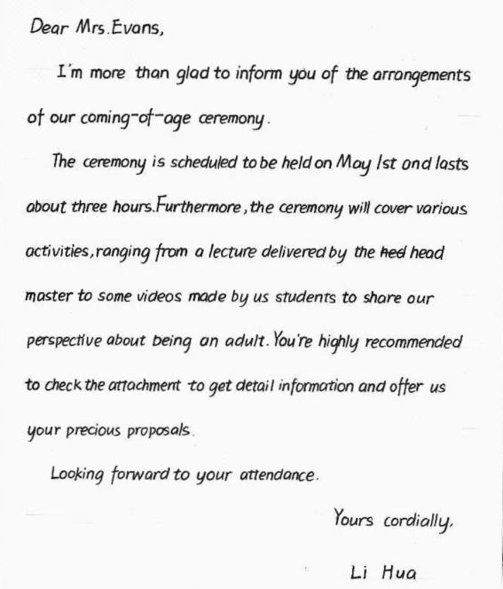
考场作文1：
亮点：
卷面漂亮；
The ceremony will cover various activities,
ranging from a ... videos made by us students to share our perspective about being an adult. 长句驾驭能力不错，思维有高度。
不足点：
遗漏信息点-“得知他们要来” 。
You're highly recommended to check the
attachment to get ...语气不妥，这是建议信的表达。
get detail information 应该是get detailed
information。
furthermore的逻辑表达有误。

Slide 22
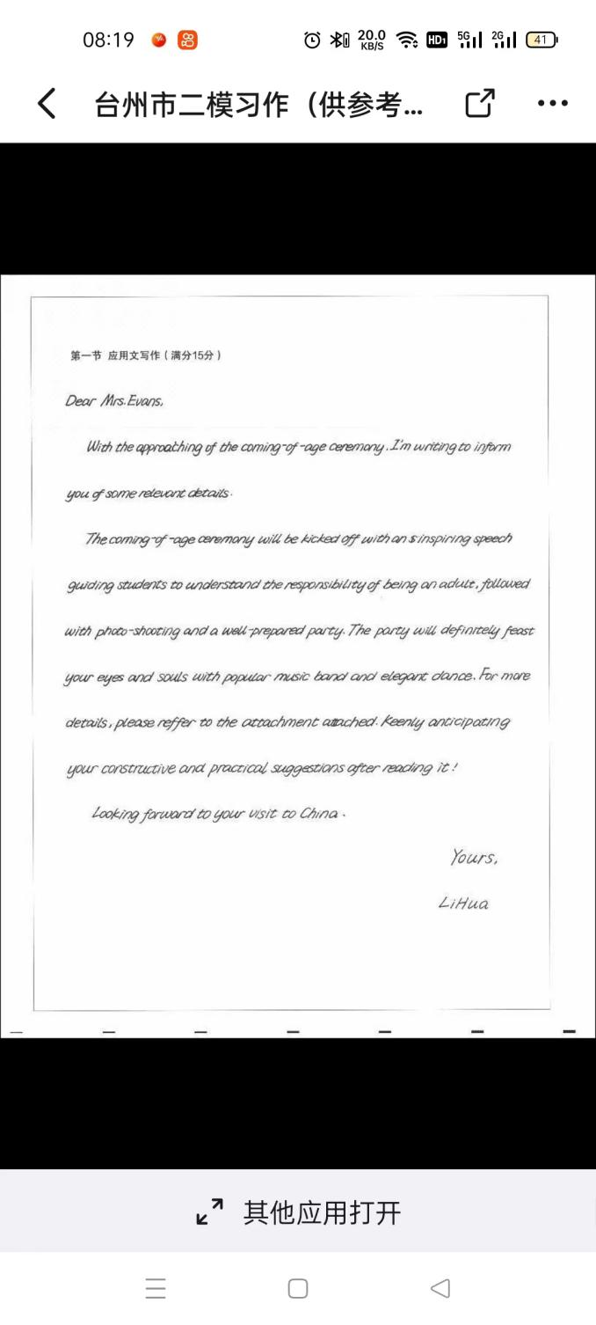
考场作文2：
亮点：
第二段首句体现了考生较强的长句驾驭
能力，不过后面的followed with...显得有点画蛇添足。
高级词汇feast anticipate, constructive
等给人留下印象。
不足点：
遗漏信息点-“得知他们要来” 。
reffer to -- refer to
be kicked off --- kick off
with the approaching of... -- with the approach of...

Slide 23
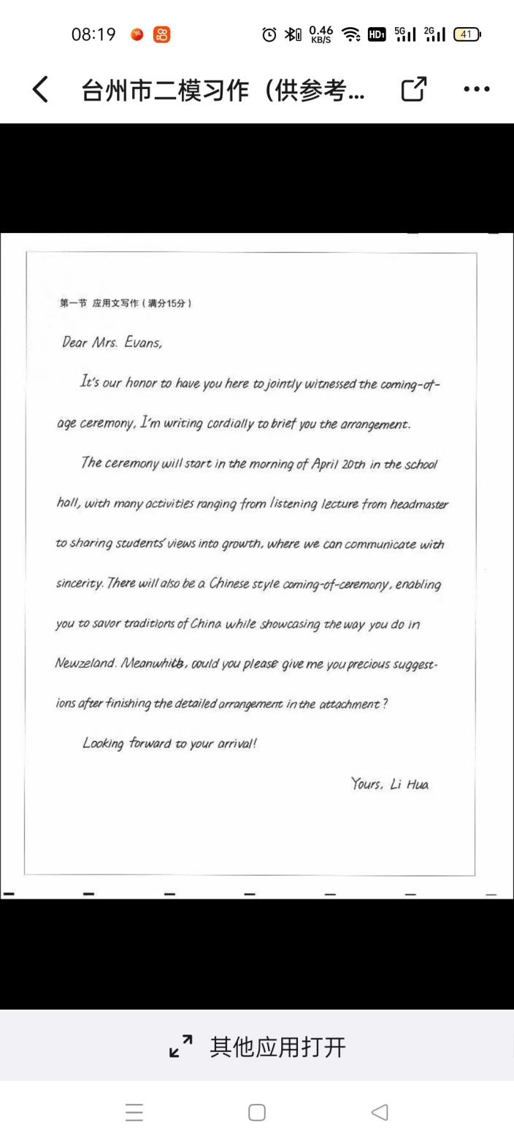
考场作文2：
亮点：
要点完整，语言得体；
表达句式多样，各种句式合理运用，丰富而不堆砌；
能够结合有外宾参与这一信息来安排活动，体现了交际功能和考生严谨的思维态度。
不足点：
语言能力不错，还要在精准方面多做文章；
to jointly witnessed -- witness
in the morning -- on the morning
listening-- listening to

Slide 24
〖参考范文〗
Dear Mrs. Evans,
So excited that we’ll soon meet and join in the coming-of-age ceremony in our school. Here, I’d like to share with you our plan ahead of time briefly. 31
For this most awaited ceremony, we’ve arranged enlightening activities, like an inspiring speech, a video from parents with their best wishes, and best of all, a unique ritual where we’ll make an oath of being responsible into adulthood. Attached is our detailed schedule. Please let me know if you have any suggestion. How expectant that we are to have you with us through these moments. Right here waiting for you all.
Yours,
Li Hua 72

Slide 25
〖下水作文〗
Dear Mrs. Evans,
Delighted to learn that you will be joining us in the coming-of-age ceremony in our school, I’d like to brief you on the event. 27
After an inspiring speech from our president, the ceremony highlights the moment when we express our gratitude to our parents who have been taking care of us and our teachers who have been patiently guiding us. Together, we will stride through the coming-of-age gate, signalling we have grown up. 49
With the detailed schedule attached, I’d like to have your ideas about it. Looking forward to seeing you.
Yours,
Li Hua 23

Slide 26
〖同话题巩固练-成人礼〗
假设你是李越，昨天学校为你们举行18 岁成人仪式。请你写一封信告诉你的朋友Mike，包括以下内容：
1.校友沈恩赐的演讲；
2.你的感受（感谢父母、感谢师长……）；
3.你对未来的期待。
注意：
1.词数80左右
2.可适当增加细节，以使行文连贯。
参考词汇：18 岁成人仪式a growing-up/an adulthood ceremony
校友alumnus

Slide 27
〖参考范文〗
Dear Mike,
I’m very glad to write you an E-mail, telling you that we held a growing-up ceremony for our coming 18-year-old birthday yesterday afternoon.
During the ceremony, Shen Ci’en, one of our outstanding alumnus, shared with us his inspiring story of learning and work. Then we expressed our thanks to our parents who had gone through hardships to bring us up and to our teachers who had been educating us patiently.
I am determined to fulfill my dream so that I can be more competent and better shoulder my responsibility.
Yours sincerely,
Li Yue

Slide 28
Thank you

