Slide 1


感恩遇见，相互成就，本课件资料仅供您个人参考、教学使用，严禁自行在网络传播，违者依知识产权法追究法律责任。
更多教学资源请关注
公众号：溯恩英语
知识产权声明

Slide 2

Game time

Slide 3

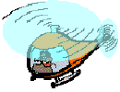
Let’s play a game :
Catch the helicopter
快速说出看到的单词、词性及其中文意思

Slide 4
attractive
frightened
suitable
responsible
annoying
obvious
anxiously
annoyed
luckily
powerful
confident

Slide 5
Grammar adj./adv

Slide 6
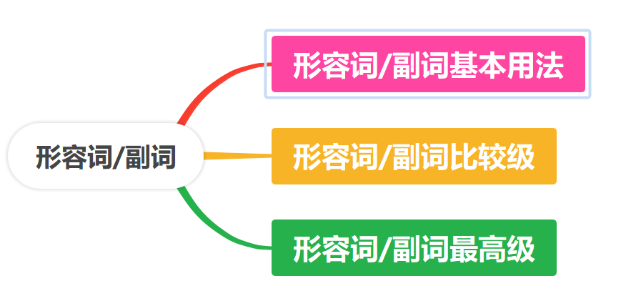
学习目标
本节课我将学会

Slide 7
课前预习 Preview
01

Slide 8

1.常见形容词词缀
例词 | 常见形容词后缀
official / formal/ personal/global | -al
able/ suitable /responsible
powerful/ useful/ helpful/careful
obvious/curious/ anxious/ various
confident /fluent/ different
impressive/ attractive/ creative
cloudy/ noisy /lucky
amazed/confused/annoyed/frightened/ advanced/detailed
amazing/confusing/annoying/frightening
friendly/ elderly daily/weekly/monthly/yearly
-able/ble
-ful
-ous
-ent
-ive
-y
-ed
-ing
-ly

Slide 9
2.形容词/副词比较级和最高级构成(规则变化)
情况 | 变化规则 | 原级 | 比较级 | 最高级
单音节词 | 加-er/est | high
以不发音字母e结尾的词 |  | large | larger | largest
以一个辅音字母结尾的重读闭音节 | 双写末尾辅音字母，再加-er/-est | hot
以“辅音字母+y”结尾的词 |  | lucky | luckier | luckiest
多音节词和部分双音节词 | 词前加more/most | powerful confident attractive
higher highest
在词尾加-r, -st
hotter hottest
将-y变为-i,再加-er, -est
more powerful most powerful
more confident most confident
more attractive most attractive

Slide 10
2.形容词/副词比较级和最高级构成（不规则变化）
形容词原级 | 副词原级 | 比较级 | 最高级
good(好的), well(健康的) | well(好) | better | best
bad, ill | badly | worse | worst
many, much | much | more | most
little(小的, 不严重的) | little(少许, 一点) | less | least
far | far | farther/further | farthest/furthest
old | / | older/elder | oldest/eldest

Slide 11
3.形容词变副词规则
情况 | 变化规则 | 示例
一般情况 |  | careful—— confident——confidently
以-y结尾的词 | 变y为i, 再加ly | lucky——_________________ happy——__________________
以-le结尾的词 | 去e，加-y | simple—— ______________________ comfortable——__________________
以-ue结尾的词 | 去e,再加ly | true-truly
加-ly
carefully
luckily
happily
simply
comfortably

Slide 12
考点讲解 Presentation
02

Slide 13



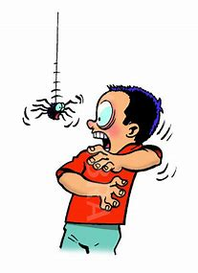


Let’s describe them using proper adjectives.
responsible
confident
annoyed
frightened
helpful
careful

Slide 14


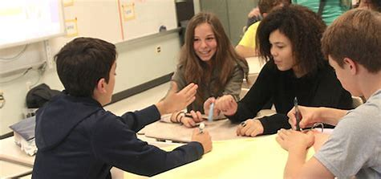
Didcuss with your group members and finish your task.
小组各自完成本组任务，并派一名代表上台讲解。

Slide 15
形容词\副词用法总结
Task 1
词类 | 例句（找出形容词/副词并划线） | 用法
形容词 | ①I’ve heard that it is an amazing sight. ②I have something important to tell you. ③The class was difficult , but the teacher was kind and friendly. ④I feel frightened. ⑤I found most of my classmates and teachers friendly and helpful. | ①形容词修饰________________ ②形容词修饰不定代词且后置 ③④形容词放在____________后 ⑤find/make/keep sb/sth +adj. adj.作宾补
副词 | ⑥I think carefully about my course. /⑦We are studying quietly. ⑧Going from junior high school to senior high school is a really big challenge./ ⑨I know that Chinese is a very difficult language ⑩I think very carefully about my course. ⑪Obviously, I was unhappy, but I won’t quit. | ⑥⑦副词修饰_____________ ⑧⑨副词修饰_____________ ⑩副词修饰_____________ ⑪副词常放在______, 修饰整个句子
名词
系动词
动词
形容词
副词
句首

Slide 16
Task 2
示例：My adviser recommended that I should sign up for advanced(advance) literature. Skill:__adj+n._____
1. I will feel ___________ (annoy) if someone takes my book without asking me. Skill: _________
2. It is _______________(annoy) that he is always making the same mistake again and again.
Skill: ________________________________
3. Hearing the ___________ noise in the library, he felt quite _______________ ．(frighten)
Skills: ①________________②________________
4.I will find ____________ (suit) ways to improve my English.
Skill: _________________________
5.I am waiting _________________(anxious) to see which team will win at last. Skill: _________________
6._______________(lucky), the homeless people got the food handed out by the volunteers. Skill: __________

Slide 17

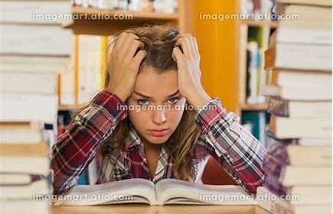

Task 2
示例：My adviser recommended that I should sign up for advanced(advance) literature. Skill:__adj+n._____
1. I will feel ___________ (annoy) if someone takes my book without asking me. Skill: _________
2. It is _______________(annoy) that he is always making the same mistake again and again.
Skill: ________________________________
3. Hearing the ___________ noise in the library, he felt quite _______________ ．(frighten)
Skills: ①__________ ________②________________
annoyed
系动词+形容词，主语为I(指人)
annoying
系动词+形容词，主语为It（指物）
frithtening
frithtened
adj+n.，noise（指物）
系动词+形容词，主语为he（指人）

Slide 18


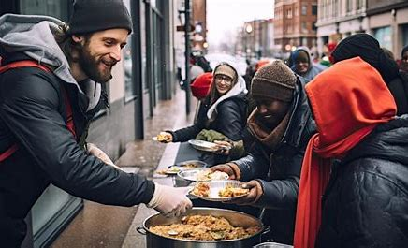
Task 2
4. I will find ____________ (suit) ways to improve my English.
Skill: _________________________
5.I am waiting _________________(anxious) to see which team will win at last. Skill: _________________
6._______________(lucky), the homeless people got the food handed out by the volunteers. Skill: __________
suitable
adj+n.
anxiously
v+adv.
Luckily
adv.位于句首，修饰整个句子，用逗号与句子隔开

Slide 19
比较级常考查的四种情况 Skills （1）如果句中有than就用比较级； （2）题目中有much, far, still, even, a lot, a bit,a great deal等标志性词汇并有“更……”的含义时，需填比较级； （3）有时候比较级结构中并不出现than，而是根据语境判断表“更……”含义时，用比较级； （4）表示“越……就越……”用句型The +比较级……，the +比较级 示例：The more careful you are, the fewer mistakes you will make. 你越细心，你犯的错误就越少。 （5）＂比较级+比较级＂和＂more and more+多音节词原级＂表示＂越来越……＂ 示例：Our school is cleaner and cleaner. 我们的校园越来越干净。 Our city becomes more and more beautiful. 我们的城市变得越来越漂亮。
Task 3 用所给单词的适当形式填空并说出原因。
（1）I feel much_______________(confident) than I felt this morning.
（2）If there are_______(many) trees, the air in our city will be much cleaner.
（3）In order to pass the exam, you need to study much___________( hard) now.
（4）The ________(early) kids learn to be independent（独立的), the better it is for their future.
（5）The ____________(responsible) you are, the greater progress you will make.

Slide 20
Task 3 用所给单词的适当形式填空并说出原因。
（1）I feel much____________________(confident) than I felt this morning.
（2）If there are_______(many) trees, the air in our city will be much cleaner.
skill ____________________________________________________
（3）In order to pass the exam, you need to study much___________( hard) now.
skill
（4）The ________(early) kids learn to be independent（独立的), the better it is for their future.
（5）The _________________(responsible) you are, the greater progress you will make. skill:___________________________
more confident
more
根据语境判断表“更……”含义时，用比较级
harder
有much, far, still, even, a lot, a bit,a great deal等标志性词汇并有“更……”的含义时，需填比较级；
earlier
more responsible
表示“越……就越……”用句型The +比较级……，the +比较级

Slide 21
Task 4
最高级常考查的情况： （1）设空处有表示范围的标志词有in，of , among等时,用最高级。 （2）one of the+最高级+n(复数)，the second/third(等序数词)+最高级+n.…等
（1）He is the __________ (strong) boy in our class and he often helps us carry heavy things. skill___________________________________________________
（2）In my opinion, China is one of the_______________________(powerful) countries in the world. skill____________________________________
（3）Hainan island is the second __________________(large) island in China.
（4）I’ve heard that Lake Titicaca is the________________________(attractive) tourist attraction in Peru. skill________________________________________
strongest
有表示范围的标志词有in
most powerful
one of the+最高级+n(复数)
largest
the second/third(等序数词)+最高级+n.…
most attractive
有表示范围的标志词有in

Slide 22

1.修饰______________
名词和不定代词
形容词的用法：
2.放在________之后
系动词
3.放在find/make/keep等词 +sb/sth. + adj（宾补）
总 结
1.修饰______,放在它的后面。
2.修饰___________,放在它的前面。
3.修饰____________
3.放在__________,修饰整个句子。
动词
形容词
副词的用法：
副词
句首
1.比较级的标志词______________
2.常用来修饰比较级的词_____________________________
3.句型_________________________________
than
形容词/副词
比较级用法
much, far, still, even, a lot, a bit,a great deal
表示“越…就越…”The +比较级…，the +比较级
1.有表示范围的标志词______________
2.句型_________________________________
in，of , among
形容词/副词
最高级级用法
one of the + 最高级+n.(复数)…,
the second/third（等序数词）+最高级+ n.

Slide 23
活学活用 Practice
03

Slide 24
obviously
It’s 1 (obvious)right to say that living in the city is 2 (interest), but the city is3 (dangerous) than the country. There are often many bad things that happen in the city, such as robberies.4 (addition), the city is very noisy. Life in the country is5 (health) in many ways. I always want to escape city life to have a good rest and enjoy the6 (beauty) scenery in the country.
7 , some people think country life is so slow and boring! Life is sometimes not 8 (convenience). As for me, I like the city for its9 (color) and good life, and want the country life for its quiet. When I’m married and have children, I’ll move to the country while working in the city. I’m not so sure, 10 .
interesting
more dangerous
Additionally
healthy
beautiful
However
convenient
colorful
though

Slide 25
一．从下列词汇或短语中任选词或短语，编写一段小故事。
Requirements(要求):1. 至少用到表格中的2个形容词和1个副词2.至少写3句话。
形容词 official / formal/ personal/global able/ suitable /responsible powerful/ useful/ helpful/careful obvious/curious/ anxious/ various confident /fluent/ different impressive/ attractive/ creative cloudy/ noisy /lucky amazed/confused/annoyed/frightened/ advanced/detailed amazing/confusing/annoying/frightening friendly/ elderly daily/weekly/monthly/yearly | 动词及动词词组 explore organize recommend improve focus on be attracted to clean up be addicted to apply for sign up for 副词 carefully obviously luckily happily simply comfortably confidently 名词及名词词组 volunteer freshman partner topic adviser course
示例：Adam is a freshman at senior high school. He is confused about which course to take. Luckily, the school adviser recommended that he should sign up for advanced literature because he likes English and he’s good at it.

Slide 26


Good,better,best;
Never let it rest;
Till good is better;
And better,best.

