Slide 1
感恩遇见，相互成就，本课件资料仅供您个人参考、教学使用，严禁自行在网络传播，违者依知识产权法追究法律责任。
更多教学资源请关注
公众号：溯恩英语
知识产权声明

Slide 2
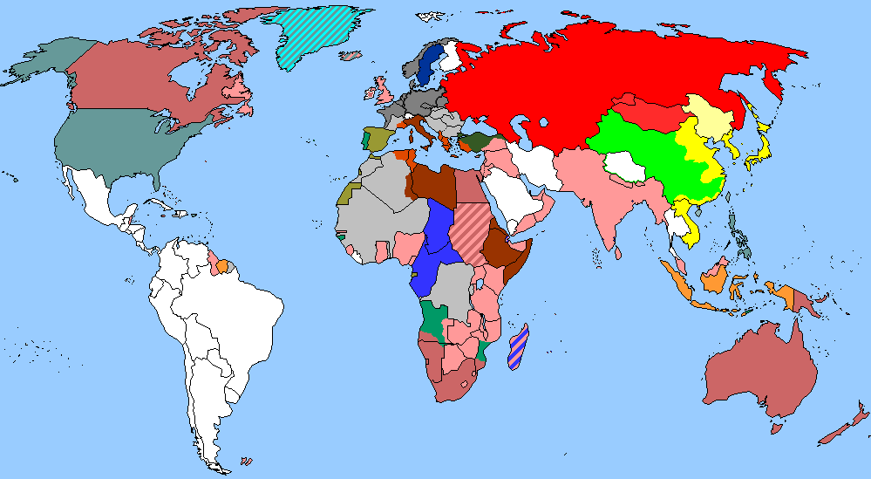
The World
October 1st-15th, 2024

Slide 3
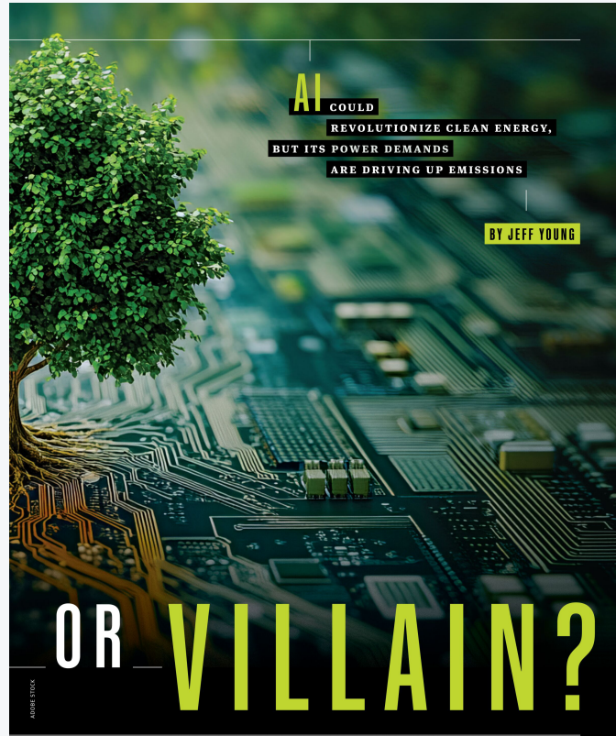
1. Climate Hero or Villain? AI是气变拯救者还是加害者？

Slide 4
Text Completion
Newsweek (October 4, 2024 P20)
With billions of dollars currently _______ (flow) into AI and the technical infrastructure it requires, _____ we decide to both power and then apply the technology could determine if AI proves to be a climate hero or a climate villian.
An Electric Power Research Institute report this year estimated that by the end of the decade, data centers could gobble up 9 percent of all U.S. electricity _________ (generate), up sharply from about 4 percent today. “Based on everything we’re seeing, that’s probably an understated number,” Mawson Infrastructure Group CEO Rahul Mewawalla said. “The demand is much more than _____ most people are envisioning.”
The race is on ________ (secure) all forms of power for the AI boom. In May, Amazon _____ (break) ground on its first industrial-scale solar facility, a 150-megawatt array in Southern California _____ massive batteries to store power for use after dark. In August, Microsoft launched a partnership to build 500 megawatts of community-scale solar power across the country over the next five years. Later that same month, Meta, parent company of Facebook, announced a deal to buy 150 megawatts of geothermal power to supply data centers. That means the AI data center boom is also driving up fossil fuel consumption and greenhouse gas emissions, even at some tech companies with reputations for _________ (ambition) climate goals.
However, AI and machine learning are also being applied to some of the ________ (tough) problems in clean tech and climate science. Researchers are always using these new tools in a wide range of climate-related applications, such as aligning intermittent renewable energy with the power grid’s needs, improving predictions of climate-driven fires and floods and aiding discoveries of materials _____ (use) in clean tech.
flowing
how
generation
what
to secure
broke
with
ambitious
toughest
used

Slide 5
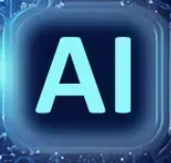
Reading Comprehension
Which of the following statements is correct according to the text?
A. Data centers’ electricity consumption will increase by 4% in ten years.
B. Microsoft will buy 500 megawatts of geothermal power to supply its data centers.
C. Climate-concious tech companies don’t have issues of carbon emissions.
D. AI and machine learning are being employed to deal with climate-related problems.

Slide 6
Vocabulary
1. villian: a person who is morally bad or responsible for causing trouble or harm 恶棍；坏蛋
Industrialized nations are the real environmental villains.
工业化国家是破坏环境的真正元凶。
2. gobble: to make sth more beautiful by adding decorations to it
美化；装饰；布置
Pete gobbled all the beef stew.
皮特狼吞虎咽，把炖牛肉吃了个精光。
Translation
他把这个坏蛋交给了一个警察。
He handed the villain over to a policeman.
Translation
别这么狼吞虎咽地吃东西！
Don’t gobble your food like that!

Slide 7
Translation
With billions of dollars currently flowing into AI and the technical infrastructure it requires, how we decide to both power and then apply the technology could determine if AI proves to be a climate hero or a climate villian.
目前，数十亿美元流入人工智能及其所需的技术基础设施，我们如何决定为这项技术提供动力，然后应用这项技术，可能会决定人工智能是气候英雄还是气候恶棍。
However, AI and machine learning are also being applied to some of the toughest problems in clean tech and climate science. Researchers are always using these new tools in a wide range of climate-related applications, such as aligning intermittent renewable energy with the power grid’s needs, improving predictions of climate-driven fires and floods and aiding discoveries of materials used in clean tech.
然而，人工智能和机器学习也被应用于清洁技术和气候科学中一些最棘手的问题。研究人员一直在广泛的气候相关应用中使用这些新工具，例如将间歇性可再生能源与电网需求相结合，改进对气候驱动的火灾和洪水的预测，以及帮助发现用于清洁技术的材料。

Slide 8
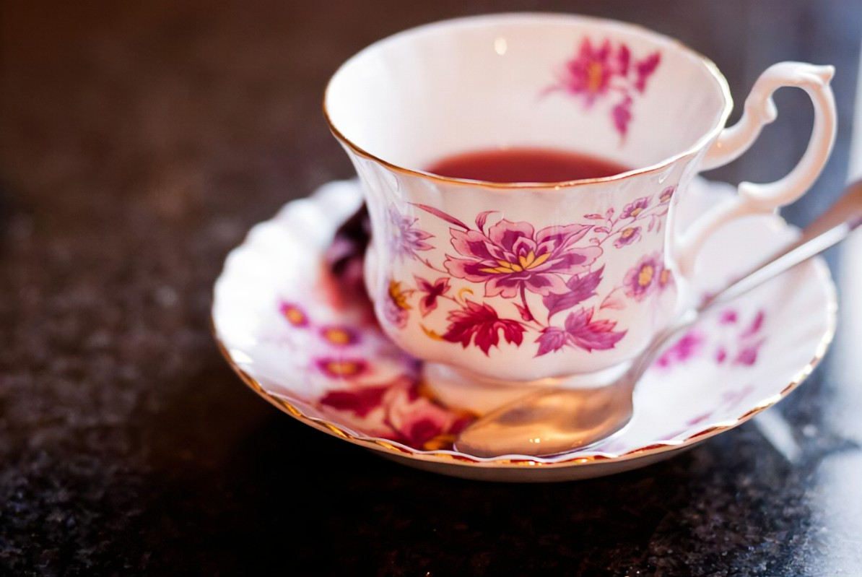
2. To keep your heart healthy, sit down and enjoy a cuppa
为了保持心脏健康，坐下来喝杯茶吧 ！

Slide 9
Text Completion
The Times（October 9, 2024 P1)
solves
It’s often said a cup of tea ______ (solve) everything. Now research suggests it could protect against heart attacks and strokes. Daily tea and coffee drinkers have better heart health, to the anti-inflammatory benefits of caffeine, a study has found. Experts suggested that drinking two to three cups a day could now _________ (add) to traditional recommendations, such as losing weight, _______ (help) prevent heart disease.
The study is the first to “demonstrate a protective role of caffeine” on the function of blood vessels in people with weakened immune systems. It found the more cups of tea or coffee participants drank, the _______ (high) their levels of a type of cell that protects against heart attacks and strokes.
The work builds on evidence __________ (suggest) caffeine can reduce the risk of heart disease in the general population. There has long been _________ (science) debate over the role of caffeine in heart health, amid concerns it could cause heart palpitations and increase blood _________ (press).
_____ there is mounting evidence showing that caffeine is good for overall health. This is due ___ its anti-inflammatory action, as it binds with receptors on immune cells to suppress the production of inflammatory __________ (chemical).
be added
to help
higher
suggesting
scientific
pressure
But
to
chemicals

Slide 10
Vocabulary
1. mounting: increasing, often in a manner that causes or expresses anxiety 上升的；增长的
There is mounting evidence of serious effects on people’s health. 有越来越多的证据表明对人的健康有严重影响。
2. bind: to unite people, organizations, etc. so that they live or work together more happily or effectively（使）联合在一起，结合
She thought that having his child would bind him to her forever. 她以为生了他的孩子就会永远把他留住。
Translation
遗憾的是，费用不断增加，博物馆不得不关门。
Regretfully, mounting costs have forced the museum to close.
Translation
诸如学校、俱乐部等机构使社区成为一个整体。
Organizations such as schools and clubs bind a community together.

Slide 11
Translation
The study is the first to “demonstrate a protective role of caffeine” on the function of blood vessels in people with weakened immune systems. It found the more cups of tea or coffee participants drank, the higher their levels of a type of cell that protects against heart attacks and strokes.
这项研究首次证明了咖啡因对免疫系统较弱的人血管功能的保护作用。研究发现，参与者喝的茶或咖啡越多，他们体内一种防止心脏病发作和中风的细胞的水平就越高。
But there is mounting evidence showing that caffeine is good for overall health. This is due to its anti-inflammatory action, as it binds with receptors on immune cells to suppress the production of inflammatory chemicals.
但越来越多的证据表明，咖啡因对整体健康有益。这是由于它的抗炎作用，因为它与免疫细胞上的受体结合，抑制炎症化学物质的产生。

Slide 12
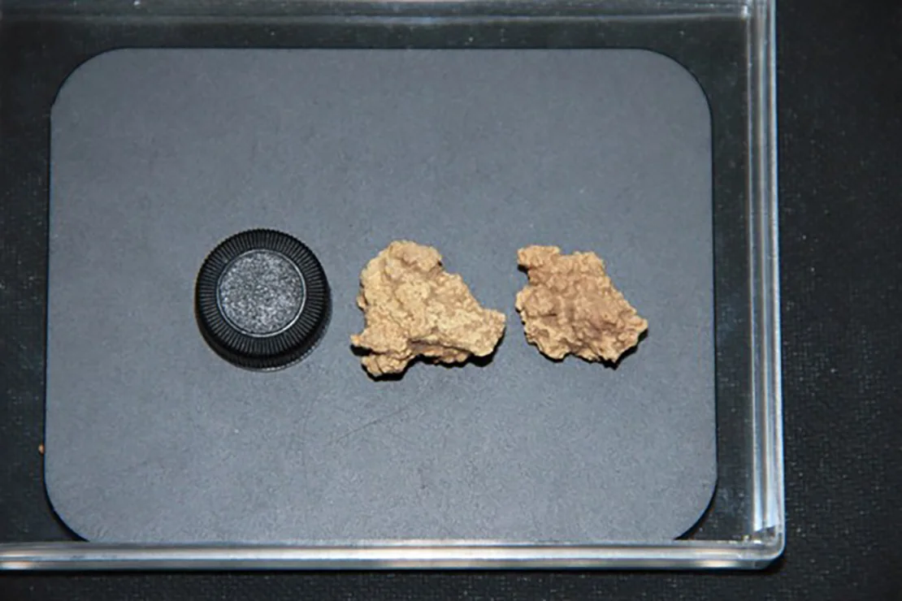
3. World’s oldest cheese found on Chinese mummies
中国木乃伊上发现世界上最古老的奶酪

Slide 13
Text Completion
New Scientist (October 5, 2024 P13)
A ___________ (mystery) white substance found on Bronze Age mummies in China is the world’s oldest cheese. The food remnants were found about two decades ago, smeared on the heads and necks of mummies found in the Xiaohe cemetery in Xinjiang province. These ______ (body) date from around 3500 years ago.
It had been suspected that the substance may have had a fermented dairy origin, but only now have molecular tools been able __________ (confirm) this. Based on the _________ (present) of yeast, lactic acid bacteria and proteins from ruminant milk, Qiaomei Fu at the Chinese Academy of Sciences in Beijing and her colleagues have identified the substance ____ a kind of kefir cheese. Kefir is a traditional drink made by fermenting milk using kefir grains, _______ are pellets of microbial cultures, like a sourdough starter.
________________________ there has been archaeological evidence from pottery of cheese-making from as long as 7000 years ago, no one has ever found such ancient cheese. The team _______ (spot) goat and cow DNA in the samples, but it appears that the milk from each of these animals was kept separate - unlike the mixed cheeses in many Middle Eastern cheese-making traditions. This may have been because goat’s milk is ______ (low) in lactose and so less likely to cause gut problems when __________ (consume).
mysterious
bodies
to confirm
presence
as
which
While / Although / Though
spotted
lower
consumed

Slide 14
Vocabulary
1. smear: to spread an oily or soft substance over a surface in a rough or careless way（用油性或稀软物质）涂抹
The children had smeared mud on the walls. 那几个孩子往墙上抹了泥巴。
2. ferment: to experience a chemical change because of the action of yeast or bacteria, often changing sugar to alcohol（使）发酵
Red wine is fermented at a higher temperature than white. 红葡萄酒发酵的温度比白葡萄酒高。
Translation
他的脸上沾满了泥。
His face was smeared with mud.
Translation
果汁存放过久就会发酵。
Fruit juices ferment if they are kept for too long.

Slide 15
Translation
A mysterious white substance found on Bronze Age mummies in China is the world’s oldest cheese. The food remnants were found about two decades ago, smeared on the heads and necks of mummies found in the Xiaohe cemetery in Xinjiang province.
在中国青铜时代的木乃伊上发现的一种神秘的白色物质是世界上最古老的奶酪。这些食物残渣大约是在20年前被发现的，涂在新疆省小河墓地发现的木乃伊的头部和颈部上。
The team spotted goat and cow DNA in the samples, but it appears that the milk from each of these animals was kept separate - unlike the mixed cheeses in many Middle Eastern cheese-making traditions.
研究小组在样品中发现了山羊和奶牛的DNA，但这两种动物的牛奶似乎是分开的，不像许多中东奶酪制作传统中的混合奶酪。

Slide 16
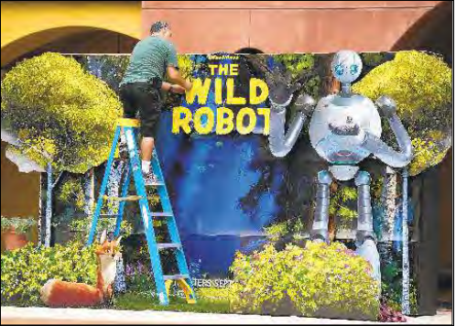
4. Box office success now measured by capturing the zeitgeist 时代精神——衡量票房成功与否的标准

Slide 17
Text Completion
Los Angeles Times (October 7, 2024 A9)
The fall box-office season is ____ odd stew, a real gumbo of opportunistically timed horror movies, Hollywood blockbusters and artsy festival darlings hoping to get mainstream attention and Oscar buzz as “Wicked” and“Gladiator II” prepare ______ (take) over cinemas ahead of Thanksgiving.
Overall domestic revenue numbers in 2024 _____ (be)still down about 11% from last year and ____________ (significant) worse compared with pre-pandemic levels.
As the box office has slowly recovered, it’s become increasingly clear that _____ determines a movie’s success or failure isn’t some microtrend in audience ___________ (preference), as fun as it is to try to identify those. It’s about whether the films in question tap into a current mood in the culture.
The latest film to fail to capture the moment came over the weekend, with Todd Phillips’ “Joker: Folie à Deux” _______ (arrive) in theaters to disappointing ticket sales and crushing audience reviews. The first “Joker” opened with $96 million domestically and _____ (end) up grossing $1 billion worldwide. It was also nominated for best picture at the Oscars _____ won for actor and original score.
But this is a grim franchise, and it’s unclear whether today’s audiences are in the mood, given the grimness Americans are inundated with ____ an everyday basis. And mood, it seems, counts for a lot.
an
to take
are
significantly
what
preferences
arriving
ended
and
on

Slide 18
Vocabulary
1. crushing : used to emphasize how bad or severe sth is
（强调糟糕或严重的程度）惨重的，毁坏性的
The shipyard has been dealt another crushing blow with the failure to win this contract. 由于未能赢得这份合同，造船厂又遭到了一次惨重的打击。
2.grim: looking or sounding very serious 严肃的；坚定的；阴冷的
The house looked grim and dreary in the rain.
这房子在雨中显得阴郁凄凉。
Translation
他觉得沉重的负担从身上落了下来。
He felt as if the most crushing load had fallen off him.
Translation
他们描绘了一个犯罪增长的严酷局面。
They painted a grim picture of growing crime.

Slide 19
Translation
The fall box-office season is an odd stew, a real gumbo of opportunistically timed horror movies, Hollywood blockbusters and artsy festival darlings hoping to get mainstream attention and Oscar buzz as “Wicked” and“Gladiator II” prepare to take over cinemas ahead of Thanksgiving.
秋季票房季是一锅奇怪的大杂烩，由机会主义的恐怖电影、好莱坞大片和文艺节宠儿组成，它们希望获得主流关注和奥斯卡奖的关注，因为《邪恶女巫》（Wicked）和《角斗士2》（Gladiator II）准备在感恩节前占领影院。
As the box office has slowly recovered, it’s become increasingly clear that what determines a movie’s success or failure isn’t some microtrend in audience preferences, as fun as it is to try to identify those.
随着票房的缓慢回升，越来越清楚的是决定一部电影成败的并不是观众偏好的一些微小趋势，尝试识别这些趋势也很有趣。

Slide 20
5. BBC News 10/06/2024

Slide 21
Dictation
This is Daniel Yao of Yatsgar with the BBC News, hello. The U.S. president Joe Biden has said an all out war in the Middle East must be _______ . Speaking to reporters, he said he would be talking to the Israeli Prime Minister Benjamin Netanyahu.
The BBC has found that the fast food chain McDonald’s failed to stop the ___________ of 9 men who’d been trafficked from the Czech Republic into the UK. The men all worked in the same branch of McDonald’s and had their wages ______ by those who’d brought them into Britain. The former British Prime Minister, Theresa May, introduced anti-slavery legislation in 2015. She said the situation was very ________.
I think the case has raised some shocking questions about the ________ being taken by some big companies. They need to look at their supply chains, they need to look at their processes. When people are going into buy that burger at McDonald’s, they want to have __________ that the people working there are not being effectively in slavery through forced labor.
The company and its franchises say they’ve taken action to help detect potential risks in future and are committed to helping every employee spot ____________.
The United Arab Emirates says the residents of its ambassador in Khartoum has been attacked by a Sudanese army aircraft. In a statement on social media, the country’s Ministry of Foreign Affairs said it would file a _______ with various bodies, including the United Nations. The UAE has _________ been accused of supplying arms to the Rapid Support Forces which is fighting Sudan’s army in a brutal civil war. Abu Dhabi has ______ supporting the paramilitary group.
You’re listening to the latest world news from the BBC.
avoided
exploitation
stolen
worrying
approach
confidence
warning signs
protest
previously
denied

Slide 22
Vocabulary
1. traffic: (~ in sth) to buy and sell sth illegally （非法）进行...交易，做...买卖
Those who traffic in illegal drugs should be brought to justice.
非法贩卖毒品的人都应依法受到惩处。
2. franchise: an authority that is given by an organization to someone, allowing them to sell its goods or services or to take part in an activity which the organization controls 特许经营权;专卖权;经销权
The company expanded rapidly during the 1980s by means of franchises.
该公司在20世纪80年代通过特许经营迅速扩张。
Translation
他被指控贩卖赃物。
He was charged with trafficking in stolen goods.
Translation
肯德基是最成功的快餐连锁店之一。
KFC is one of the most successful fast-food franchises.

Slide 23
Translation
The BBC has found that the fast food chain McDonald’s failed to stop the exploitation of 9 men who’d been trafficked from the Czech Republic into the UK. The men all worked in the same branch of McDonald’s and had their wages stolen by those who’d brought them into Britain.
BBC发现快餐连锁店麦当劳未能阻止对9名从捷克共和国被贩卖到英国的男子的剥削。这些人都在麦当劳的同一家分店工作，他们的工资被那些把他们带到英国的人偷走。
The case has raised some shocking questions about the approach being taken by some big companies. They need to look at their supply chains, they need to look at their processes. When people are going into buy that burger at McDonald’s, they want to have confidence that the people working there are not being effectively in slavery through forced labor.
这起案件对一些大公司采取的做法提出了一些令人震惊的疑问。他们需要关注他们的供应链，需要关注他们的流程。当人们去麦当劳买汉堡的时候，他们想要确信在那里工作的人没有被强迫劳动而沦为实际意义上的奴隶。

