Slide 1

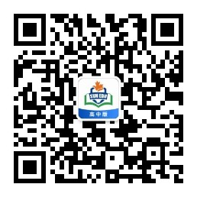
感恩遇见，相互成就，本课件资料仅供您个人参考、教学使用，严禁自行在网络传播，违者依知识产权法追究法律责任。
更多教学资源请关注
公众号：溯恩高中英语
知识产权声明

Slide 2

高中英语应用文写作系列
2.申请信
Rainbow
高中 英语

Slide 3


高中英语应用文写作系列
2.申请信
What is an application letter?
target: to whom you are writing
An application letter is a personal letter that is typically used to apply for a job. In this sense, it is also called a cover letter.
In a more general sense, application letters can be used when applying for anything from
a club membership or admission to a school.
potential employer
to whom it may concern
高中 英语

Slide 4
高中英语应用文写作系列
2.申请信
Application Letter
persuasive/requesting tone
To whom
For what purpose
Your qualifications
hard skills:
soft skills:
land/secure a job
be a member of a club
be admitted to a school
potential employer
to whom it may concern
work-related skills
personality traits such as leadership, communication
高中 英语

Slide 5

高中英语应用文写作系列
2.申请信
假如你是高中生李华，你校有一个由中外学生组成的名为Cross Culture的俱乐部，致力于向外国友人介绍和推广中国传统文化，请你给该俱乐部部长George写一封80词左右的邮件,申请加入。内容包括：
1.自我介绍;
2.写信目的;
3.申请理由。
高中 英语

Slide 6

高中英语应用文写作系列
2.申请信
自我介绍
写信目的
申请理由
Li Hua’s identity
Note:
the relationship between Li Hua and the receiver
apply for the membership of the club
join the club
interested
qualified
高中 英语

Slide 7
高中英语应用文写作系列
2.申请信
I have great interest in…
a keen lover/enthusiast of…
dream of spreading…to…
the club is dedicated to…
a meaningful activity/cause
my interest/dream
interested
be coincident with…
be consistent with…
run parallel to…
club’s purpose
reasons
a good command of …/be equipped with…/be familiar with…
My proficiency and fluency in spoken English enables me to…
My excellent communication skills help to do the job…
qualified
高中 英语

Slide 8

高中英语应用文写作系列
2.申请信
审题误区之
Will this club provide a platform where you can sharpen your English proficiency and improve your knowledge about traditional culture?
Is your great interest in Chinese culture enough for you to be a member of the club?
高中 英语

Slide 9
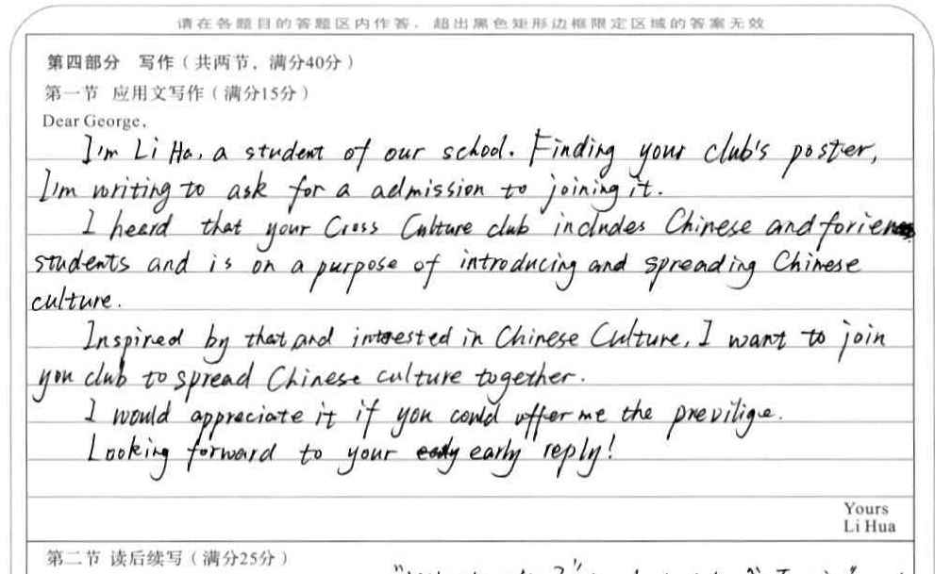
高中英语应用文写作系列
2.申请信
What is your qualification?
Too many paragraphs!
高中 英语

Slide 10


高中英语应用文写作系列
2.申请信
强行使用定语从句
你们自己学校的俱乐部！
apply for the membership of your club
高中 英语

Slide 11
高中英语应用文写作系列
2.申请信
Dear George,
I am Li Hua from Class 3 Grade 2, writing to apply to be a member of your club.
I really appreciate the efforts Cross Culture has made to introduce Chinese culture to the world. As a student with a keen interest in cross-cultural communication, I hope I can have a chance to do my own bit for this significant cause. I have read many books on Chinese traditions and take great pride in my spoken English, which I believe can help me do a good job in the club.
I’d appreciate it if you could consider my application.
Yours,
Li Hua
高中 英语

Slide 12
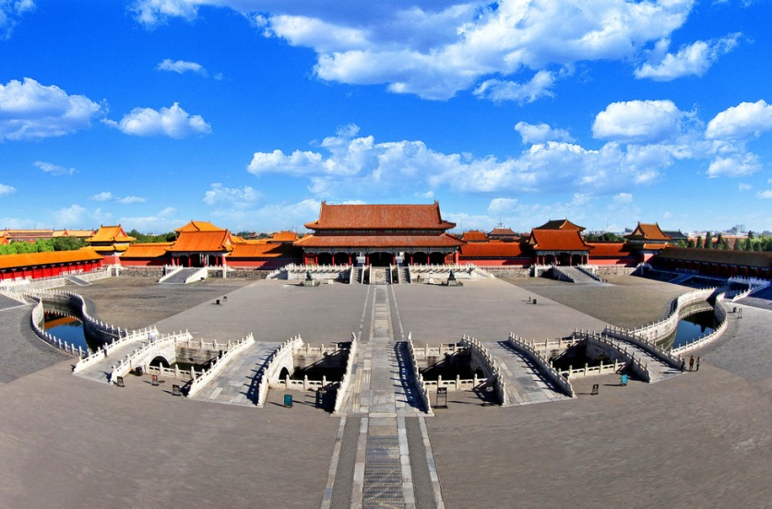
高中英语应用文写作系列
2.申请信
假设你是红星中学学生李华，你得知故宫正在招聘暑期义务英文讲解员，请你给相关部门负责人写一封申请信，内容包括
1. 介绍你的基本信息；
2. 说明你的优势；
3. 表示你希望被录用。
高中 英语

Slide 13
高中英语应用文写作系列
2.申请信
Dear Sir or Madam，
I have learned that English volunteer guides for the Forbidden City are wanted in the summer vacation．I am writing to apply for this position．
I'm a Senior 3 student in Hongxing Middle School，and I believe I am qualified for the position． These years，I have been on several exchange programs in America， so I am confident with my communication skills in English．What's more，as a fan of Chinese ancient history，I am sure my knowledge will prove helpful when I introduce the Forbidden City to foreign guests．
I would be very grateful if you could offer me the opportunity. Thank you for your consideration．
Sincerely yours，
Li Hua
高中 英语

Slide 14
高中英语应用文写作系列
2.申请信
Dear sir or Madam,
I am writing to apply for the position of an English volunteer guide at the Forbidden City in the summer.
Let me tell you something about myself. My name is Li Hua. I am a senior 3 student at Hongxing High School. There are several advantages that I possess. To start with, I am fluent in English, which allows me to explain the glorious history of the Forbidden City to foreign visitors clearly. Besides, I am an enthusiastic learner of the Chinese history and a top student in class, therefore I have a rich knowledge of the history of the Forbidden City, which makes me well-equipped for the job.
I would feel grateful if you could give the golden opportunity to share Chinese culture and history with foreign visitors. Thank you for your time. I am looking forward to your reply.
Yours sincerely,
Li Hua
高中 英语

