Slide 1


感恩遇见，相互成就，本课件资料仅供您个人参考、教学使用，严禁自行在网络传播，违者依知识产权法追究法律责任。
更多教学资源请关注
公众号：溯恩英语
知识产权声明

Slide 2
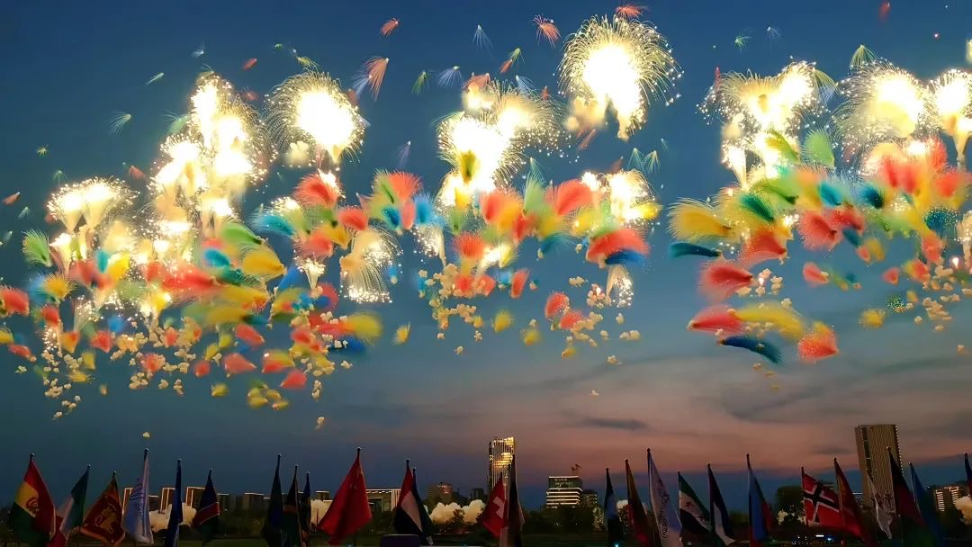
New Term， New Beginning
Characters, Qualities, and Dreams

Slide 3

Lead-in Guessing Game
What does “w” mean ?
We
Win
World

Slide 4
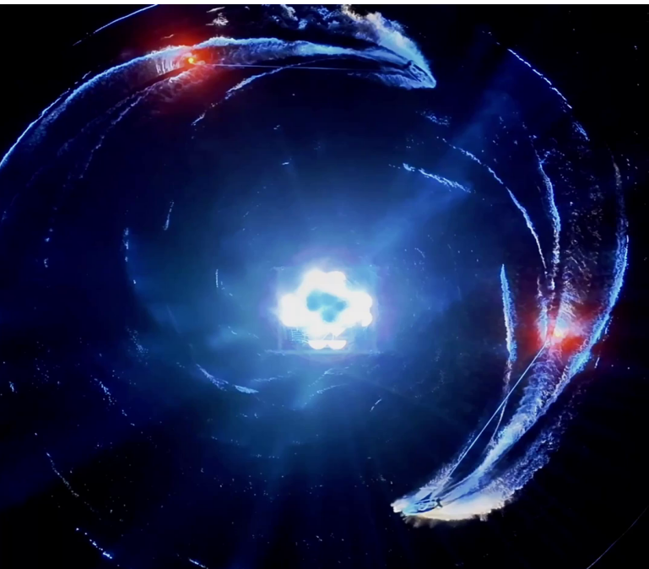
What qualities do you think these athletes show in the World Games?
1. determined /dɪˈtɜːrmɪnd/
2. resilient /rɪˈzɪliənt/
3. perseverant /ˌpɜːrsɪˈvɪərənt/
4. disciplined /ˈdɪsəplɪnd/
5. courageous /kəˈreɪdʒəs/
6. confident /ˈkɑːnfɪdənt/
7. focused /ˈfoʊkəst/
8. dedicated /ˈdedɪkeɪtɪd/
9. ambitious /æmˈbɪʃəs/
10. agile /ˈædʒl/
坚定的
有韧性的
锲而不舍的
自律的
勇敢的
自信的
专注的
投入的
雄心勃勃的
敏捷的
视频1

Slide 5
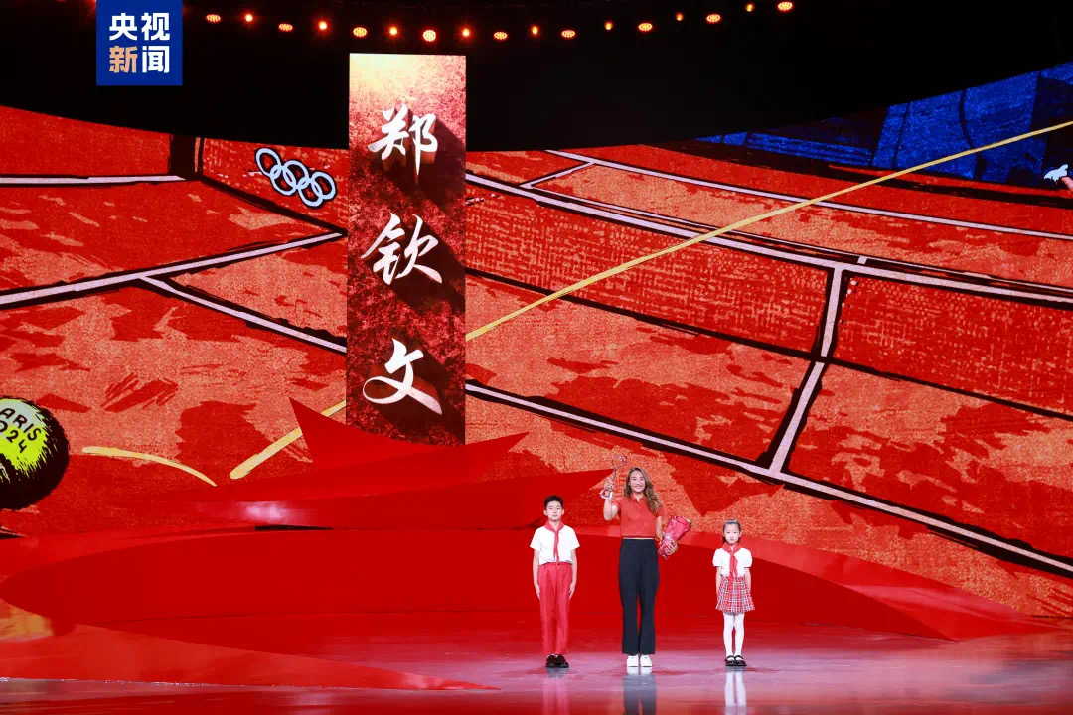
Award citation/ Award speech
颁奖辞
Mountains flatten and seas yield;
the laurel rests already in your hand. You are the flame of attack,
the soaring arrow, the rising wave on red clay,
the champion on Olympic ground. Setting out from where the road ends, you shattered every barrier with confidence,
irrigating your dream with sweat.
With racket in hand, you showed the world the strength of China.
山海可平，桂冠已揽，
你是进攻的火，升腾的箭，
红土上的后浪，奥运场的强者。
在路的尽头出发，
自信冲破壁垒，汗水浇灌梦想，
你用球拍向世界展示中国的力量。

Slide 6

What challenges did Zheng Qinwen face, and how did she overcome them?
Olympic champion Zheng Qinwen __________ (name)one of the 2024 “Touching China” honorees during the annual award ceremony broadcast Saturday evening by China Media Group (CMG). __________（establish) in 2003, the program recognizes ten _________(individual)and groups each year ______have inspired the nation through their tenacity坚韧, bravery and__________(wise).
was named
Established
individuals
who
wisdom
视频2
Mental pressure +Physical injuries
Keep learning+ Keep adjusting

Slide 7

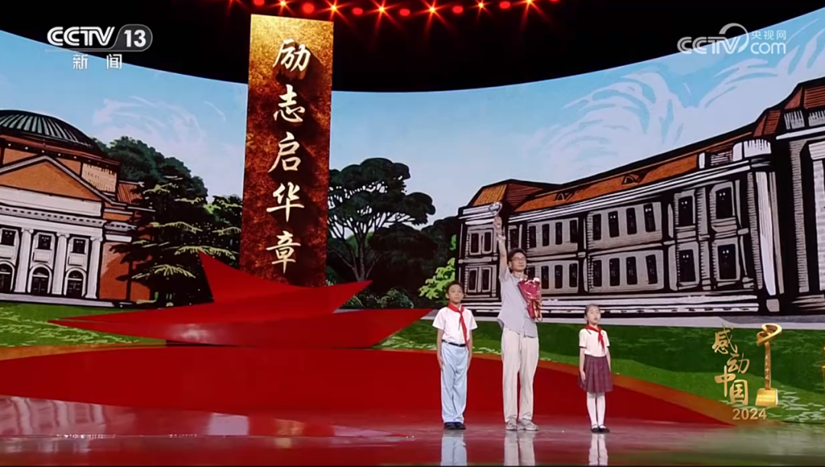
颁奖辞
Award citation/ Award speech
背影留给坎坷，笑容交给阳光，
名字里写着责任，步履中充满力量，
磨砺过的剑，破茧后的蝶。
你一直向前，一直向上，
不辜负妈妈的目光，不辜负时代的期望。
Your back turns away from hardship;
your smile is given to the sunlight.
Responsibility is written in your name,
and every step you take is filled with strength.
You are a sword tempered by trials,
a butterfly freed from its cocoon.
You keep moving forward, keep rising higher—
never failing your mother’s gaze,
never falling short of your era’s hopes.

Slide 8
Born in 1998 in Wuqiao county, Cangzhou city, Hebei province, Pang grew up under difficult circumstances: his father was chronically ill, his mother disabled, and he himself suffered from congenital heart disease. Despite these challenges, he remained optimistic, crediting his mother's encouragement. "She smiled every day — so why should I feel sad?" he recalled.
In 2017, Pang entered Tsinghua University's Department of Precision Instruments. Initially burdened by expectations, he gradually found his passion for research and was later granted direct admission to the university's PhD program. Sadly, his mother passed away before witnessing his achievement.
Pang said he rarely expressed emotions verbally, preferring to honor his mother through action. Inspired by her wish for him to serve the nation, he has dedicated himself to scientific research. "I want to show the resilience of the Chinese people," he said. "No matter the difficulties, I will move forward with determination."
Which word best describes Pang Zhongwang’s attitude toward his family’s difficulties?
A. Resigned
B. Resilient
C. Indifferent
D. Pessimistic
逆来顺受的；听天由命的

Slide 9
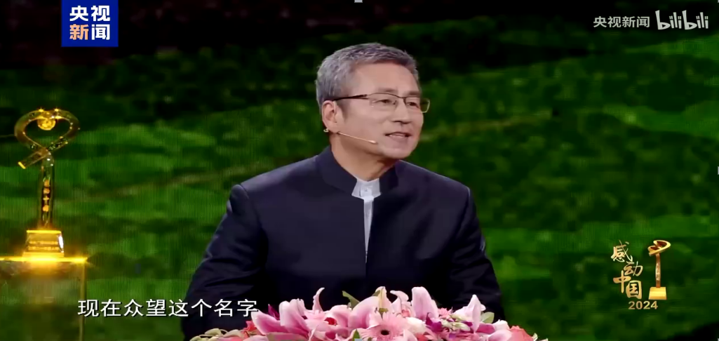
What is Pang Zhongwang’s present dream?
视频3
His dream is to serve the nation through scientific research and inspire more people.

Slide 10
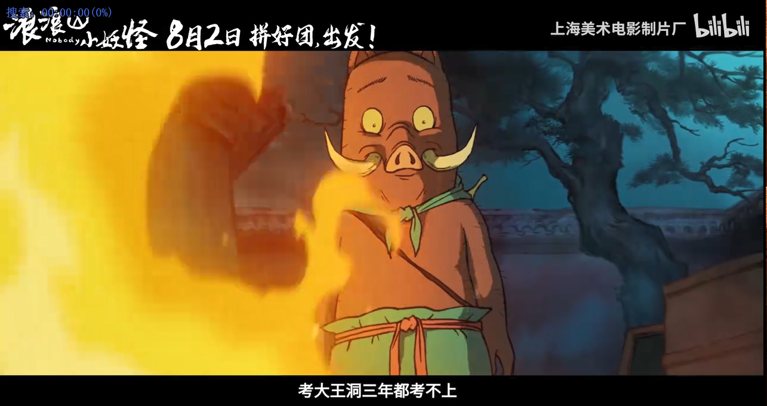
What are main characters in the movie Nobody ?
视频4

Slide 11
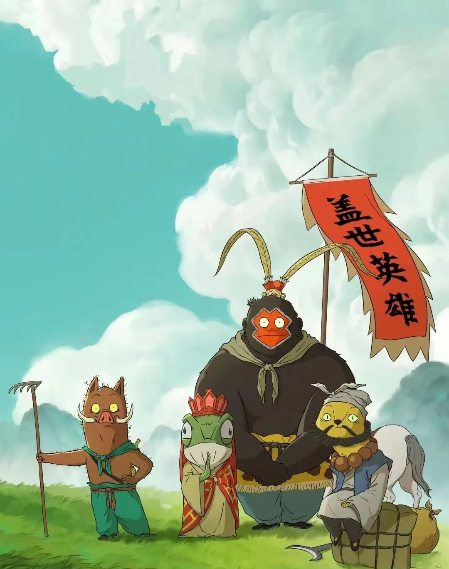
Divide students into groups and discuss the qualities of each character.
chimpanzee
What qualities do you think Pig, Toad, Mink, and chimpanzee have and what are their dreams?
pig
mink
toad

Slide 12
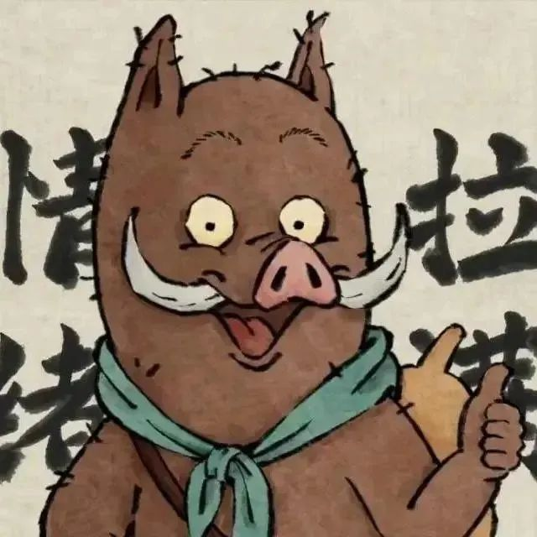
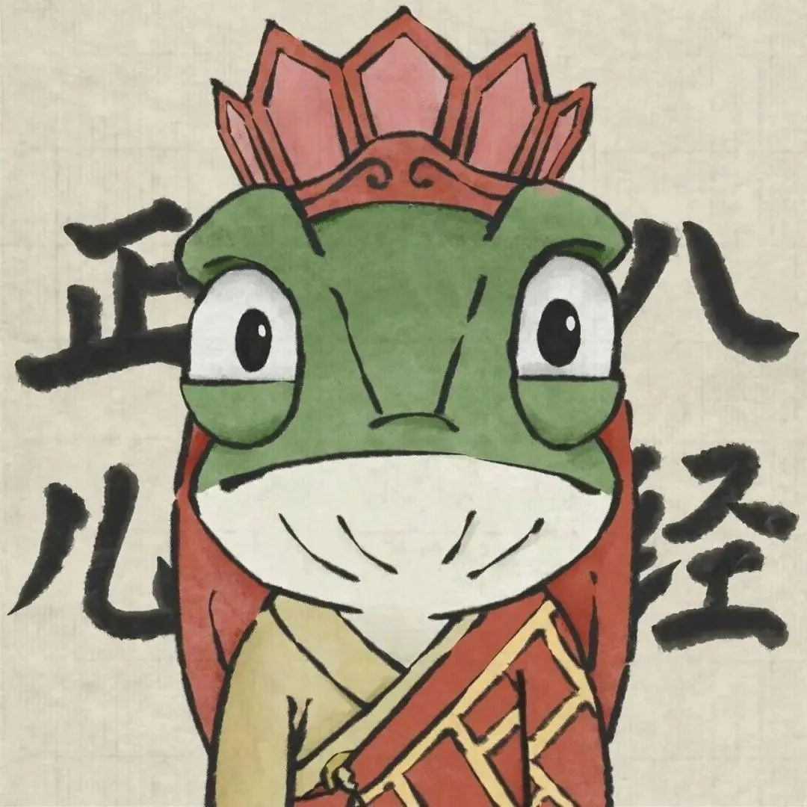
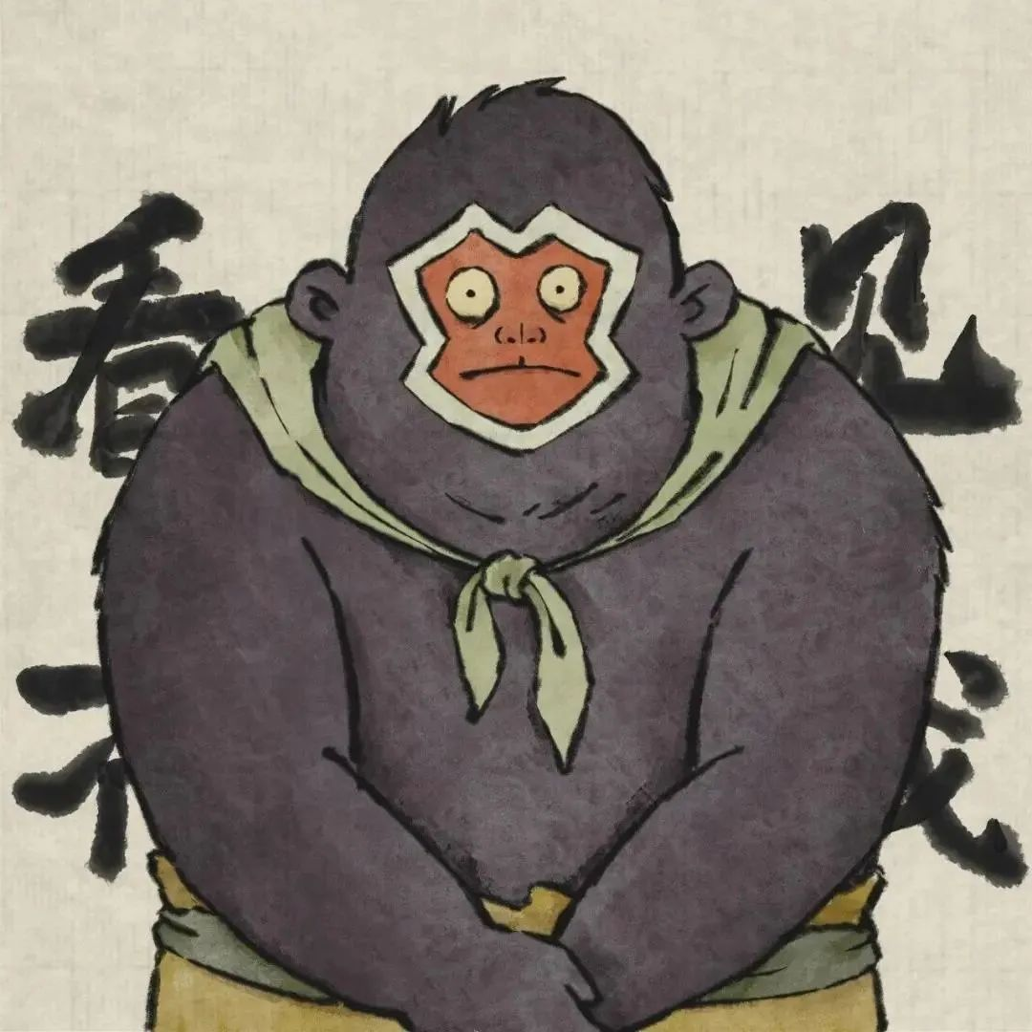
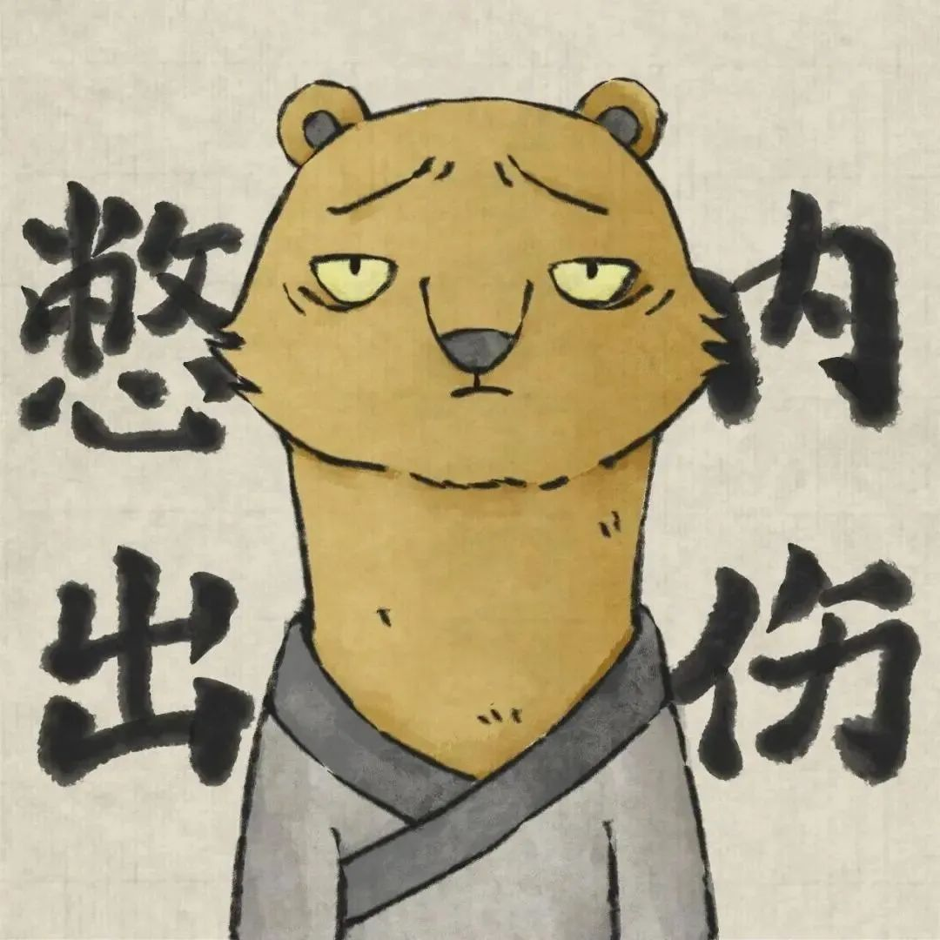
Curious and brave
Opportunistic but loyal
to become a great hero
to find a place where he belongs
Introverted but brave
Talkative and energetic
to prove himself and to be recognized
to travel the world

Slide 13

What are your dreams, and which qualities do you think will help you achieve them?
1. determined /dɪˈtɜːrmɪnd/
2. resilient /rɪˈzɪliənt/
3. perseverant /ˌpɜːrsɪˈvɪərənt/
4. disciplined /ˈdɪsəplɪnd/
5. courageous /kəˈreɪdʒəs/
6. confident /ˈkɑːnfɪdənt/
7. focused /ˈfoʊkəst/
8. dedicated /ˈdedɪkeɪtɪd/
9. ambitious /æmˈbɪʃəs/
10. agile /ˈædʒl/
11. loyal
12. curious

Slide 14
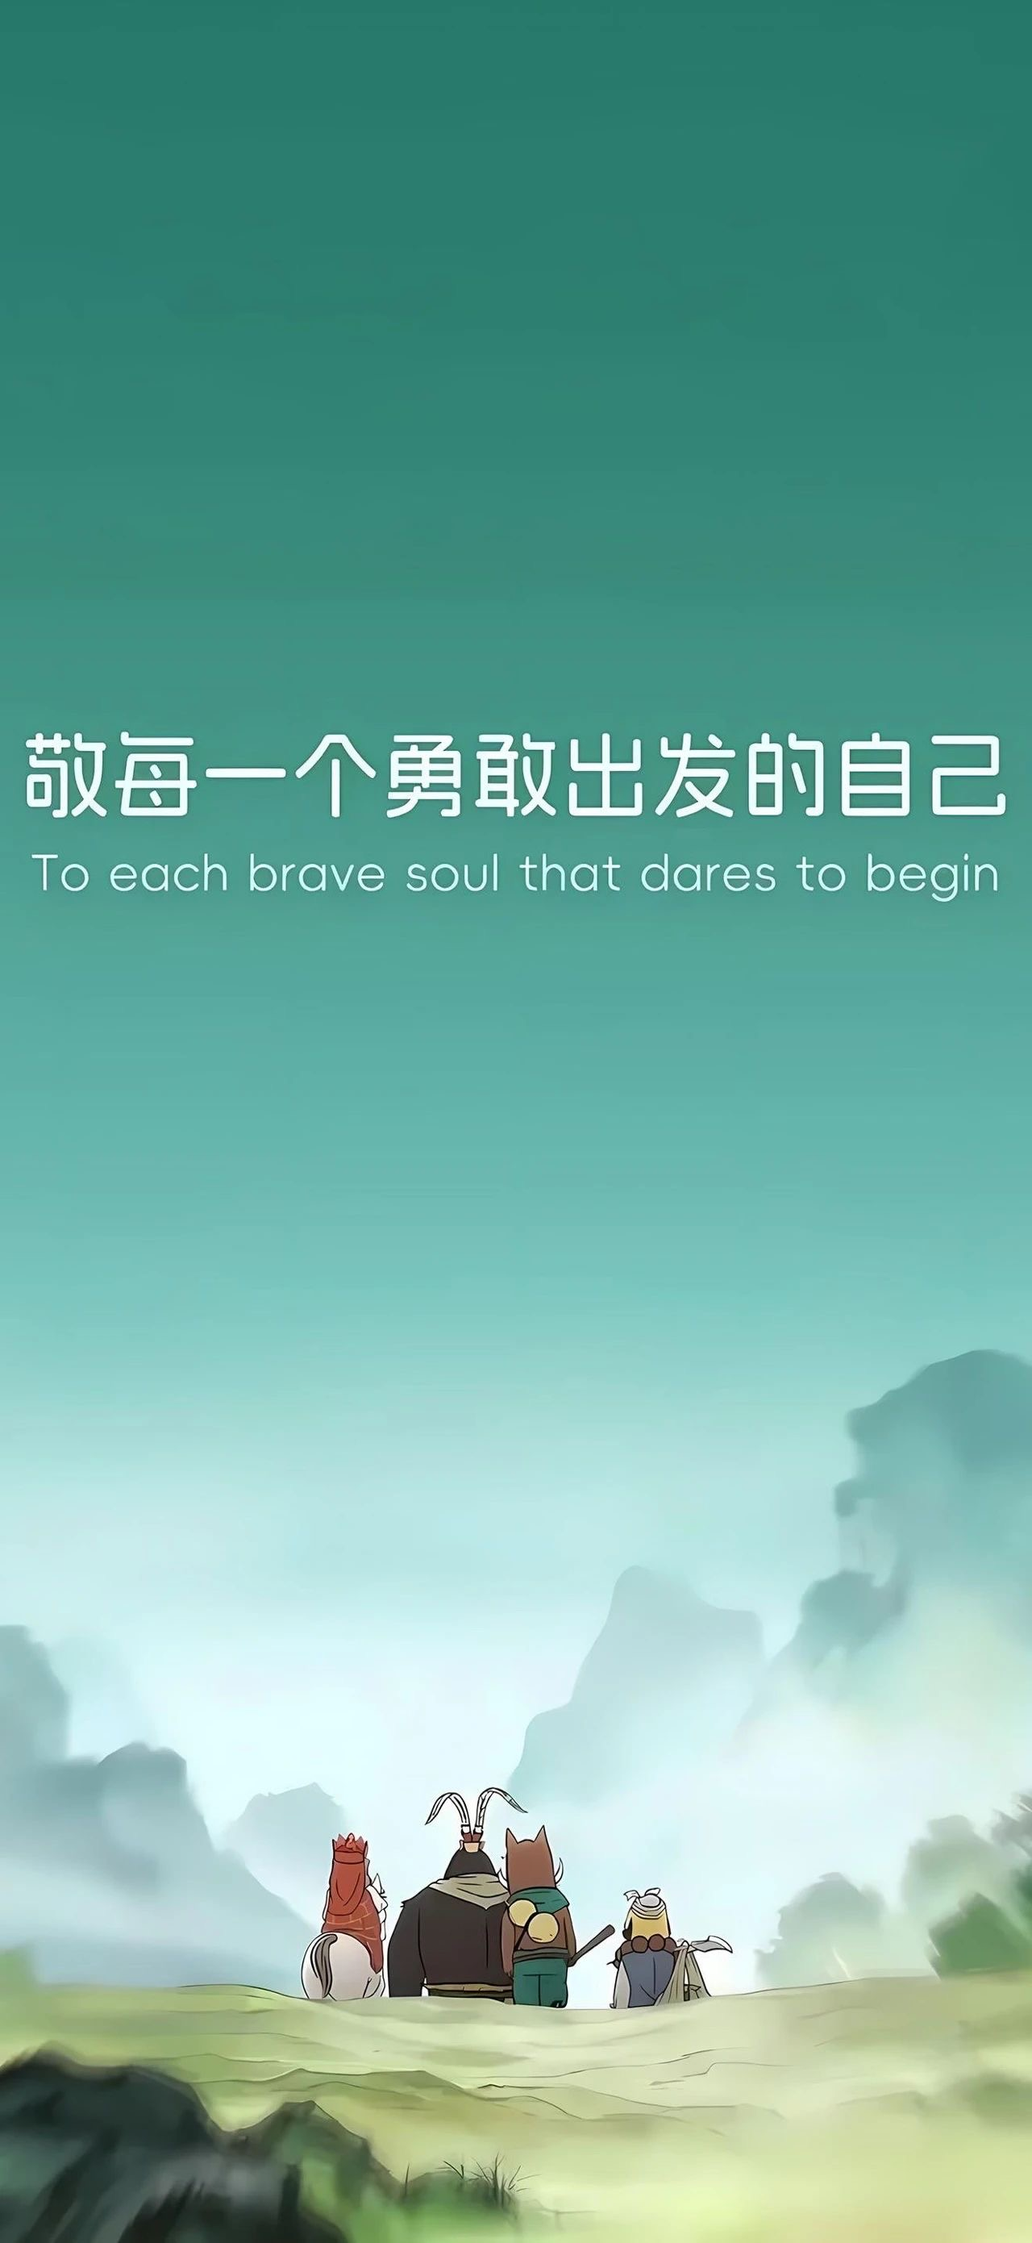
Share&Translation
Which line from the movie impresses you most ?
真正的成长，是敢于翻越浪浪山。敬每一个勇敢出发的自己。
True growth lies in the courage to climb over the waves of challenges. To every brave self who embarks on a journey.
敬每一个勇敢出发的自己，哪怕最后无名。
Honor every self that dares to set out, even if they remain nameless in the end.

Slide 15
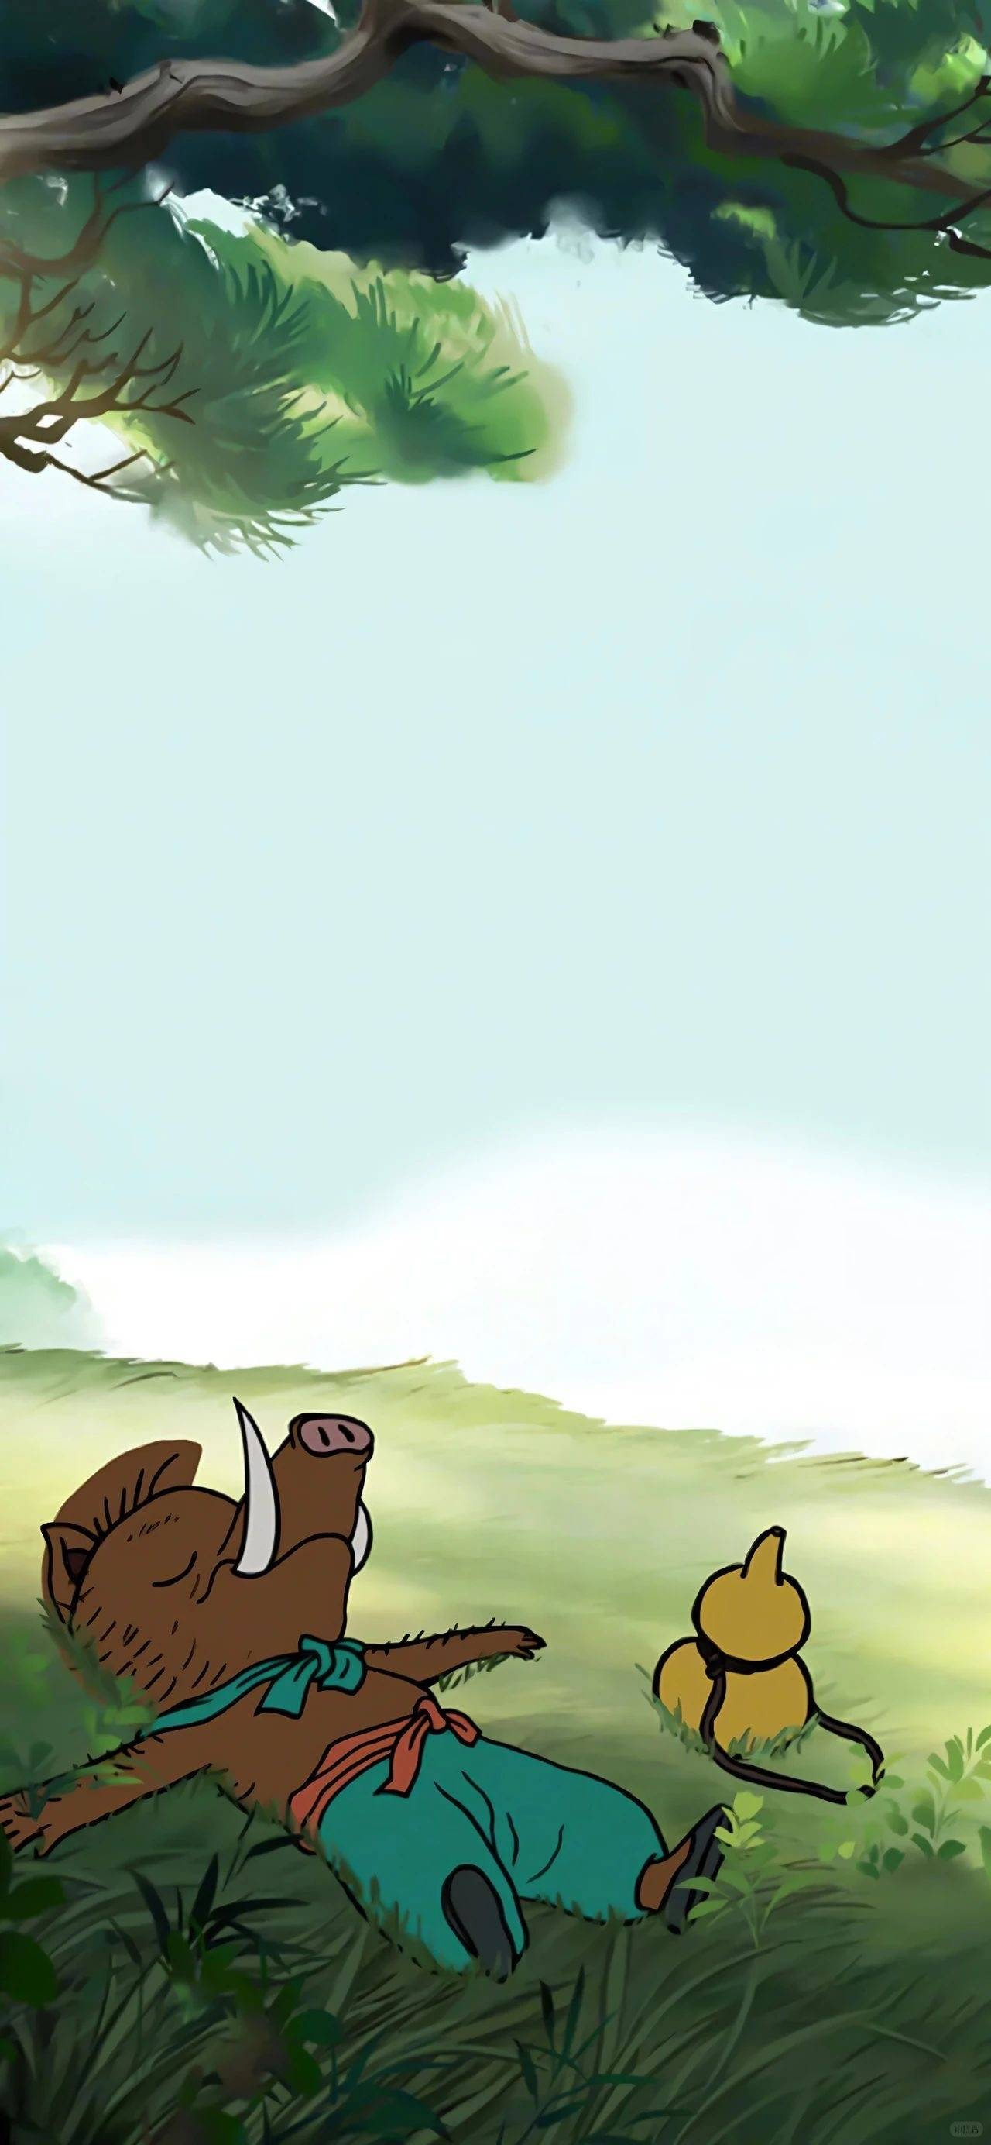

取经路上可以迷路，但不能忘记为什么出发。
It's okay to get lost on the journey for the scriptures, but you must never forget why you set out in the first place.
就算是只小猪妖，也有仰望星空的权利。
Even if you're just a little pig demon, you have the right to gaze at the starry sky .

Slide 16
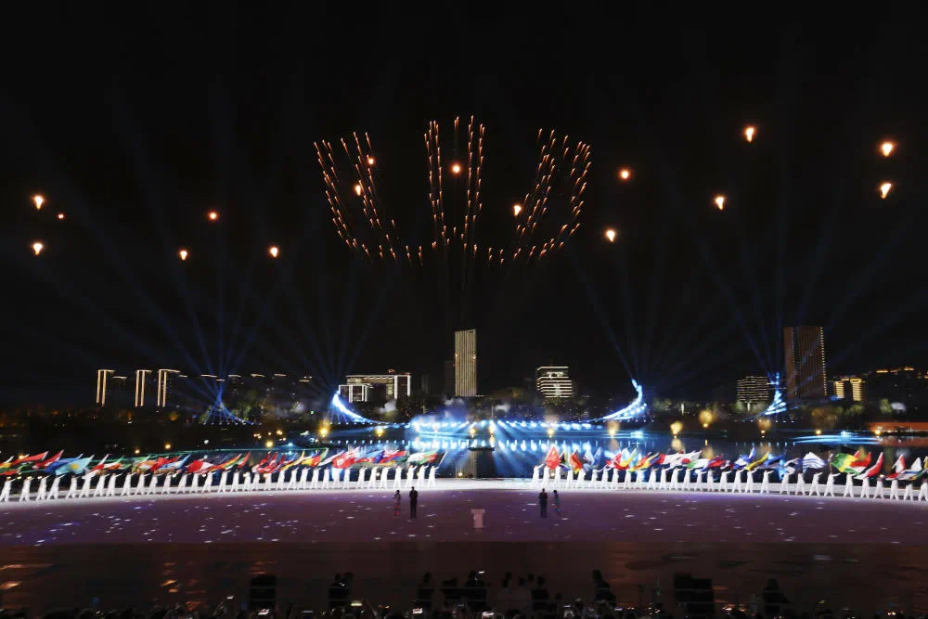
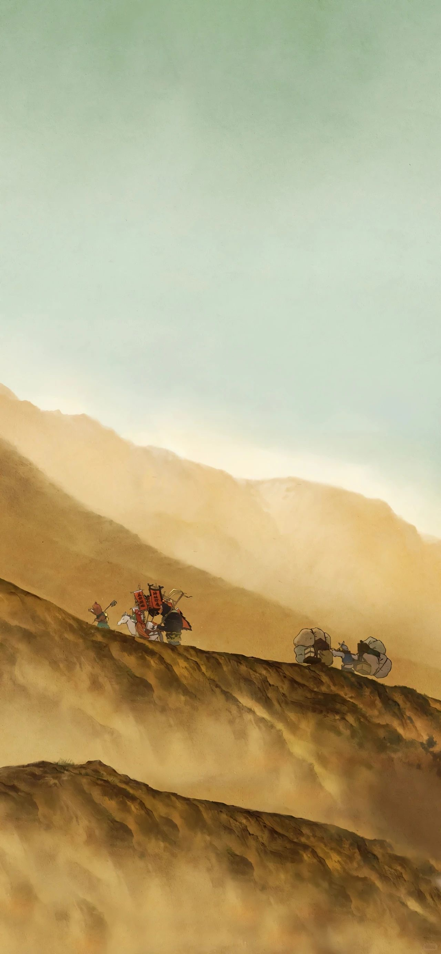
We win the world
—one dream, one quality,
one step at a time.
WE WIN THE WORLD
But ‘we’ does not mean ‘I alone’. It means the resilient, the disciplined, the courageous—inside each of us. When these qualities unite, every dream becomes possible. So, from the new term today, take the word WE, stitch it to your own WIN, and go conquer YOUR world.”

Slide 17
Homework
假定你是李华，你校英文报正在开展主题为 “Characters, Qualities, Dreams” 的征文活动。请你写一篇短文投稿，内容包括：
1.介绍一位你敬佩的人物（可为真实人物或文学形象）；
2.说明他/她的主要品质；
3.阐述该人物的梦想及其对你的启示。
注意：
1. 词数80左右；
2. 可以适当增加细节，以使行文连贯。

Slide 18
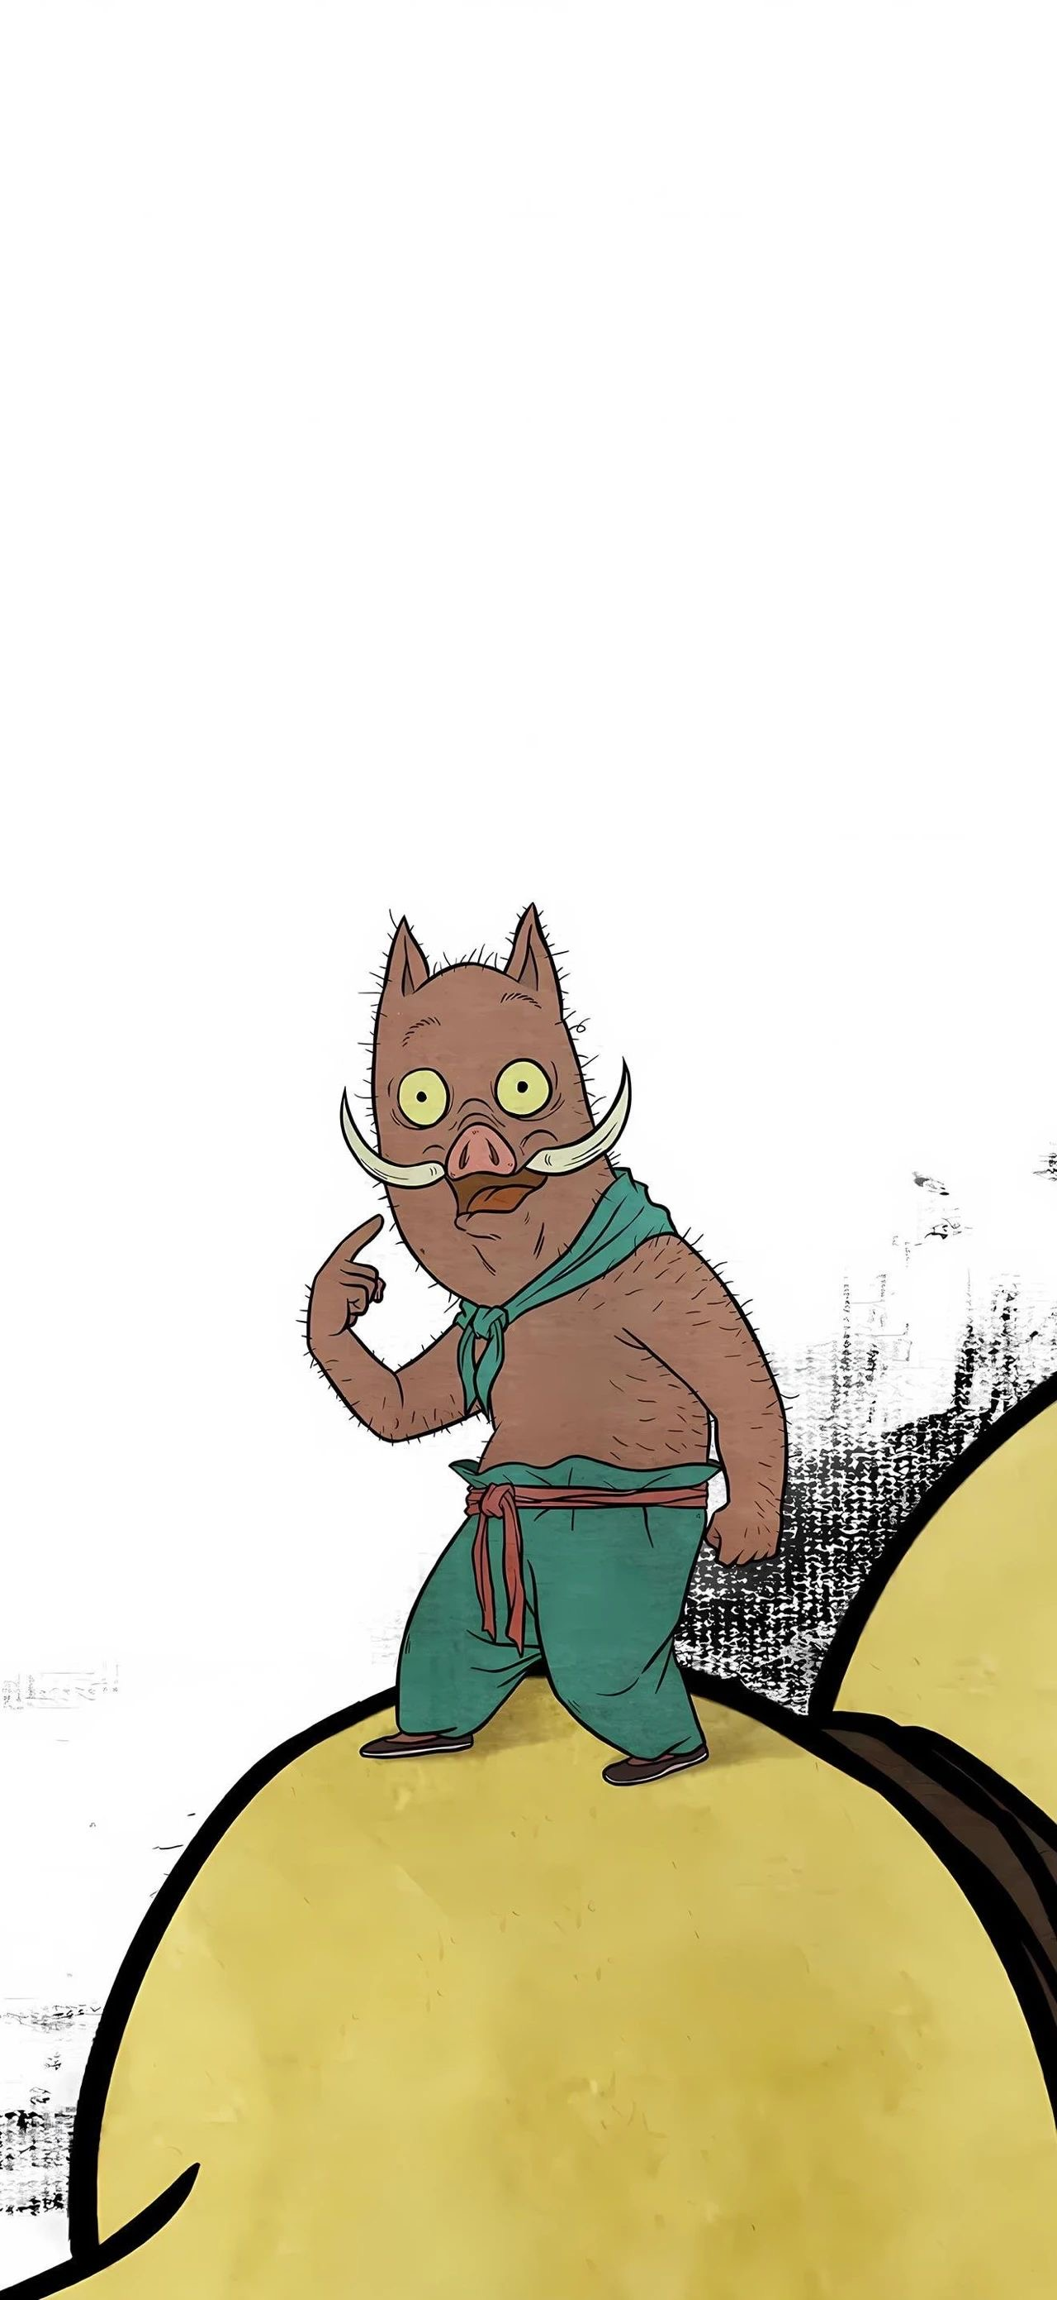
One possible Sample
Characters, Qualities, Dreams
The character I admire is Piglet, the little monster from Little Monsters of Langlang Mountain.
Though born in a forgotten corner of the valley, he overflows with curiosity and courage; when cliffs block the way, he sharpens his tusks into steps, and when storms howl, he uses their wind to leap higher. His dream is simple yet grand: to become a true hero who can protect his friends and light up the darkest paths.
Piglet’s perseverance teaches me that dreams are not handed to us; they are earned by fearless hearts and tireless feet. Whenever I feel discouraged, I picture his tiny silhouette marching forward and I find my own strength again.

Slide 19
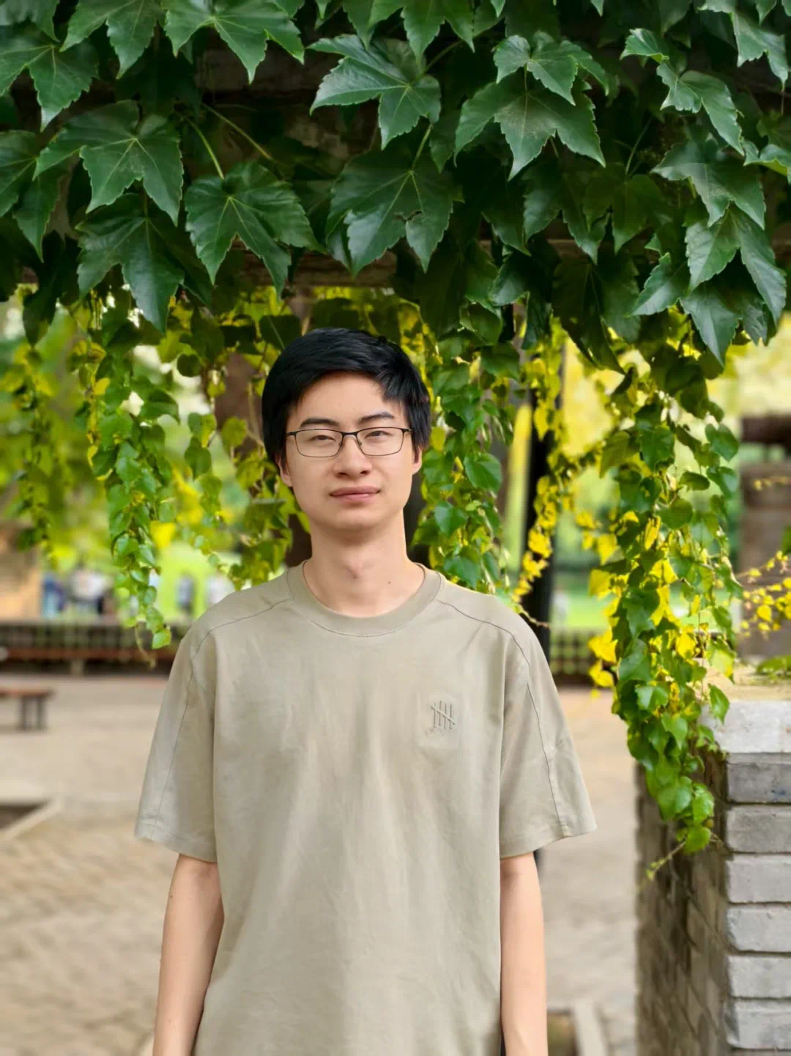
One possible Sample
Characters, Qualities, Dreams
The figure I admire most is Pang Zhongwang. Born in a poor village, he cared for a paralyzed mother and a mentally-ill father while battling his own heart disease .
His resilience, self-discipline and optimism turned nights of study beside a hospital bed into a 744-point triumph and a place at Tsinghua University . Now a PhD student, his dream is to transform personal hardship into scientific progress that serves the nation. Watching him decline outside donations and rely on his own efforts , I realize that circumstances may shape the starting line, but determination draws the finish line.
His journey convinces me that my own goal of becoming a doctor is not a distant star, but a finish line I can reach—step by quiet, determined step.

Slide 20
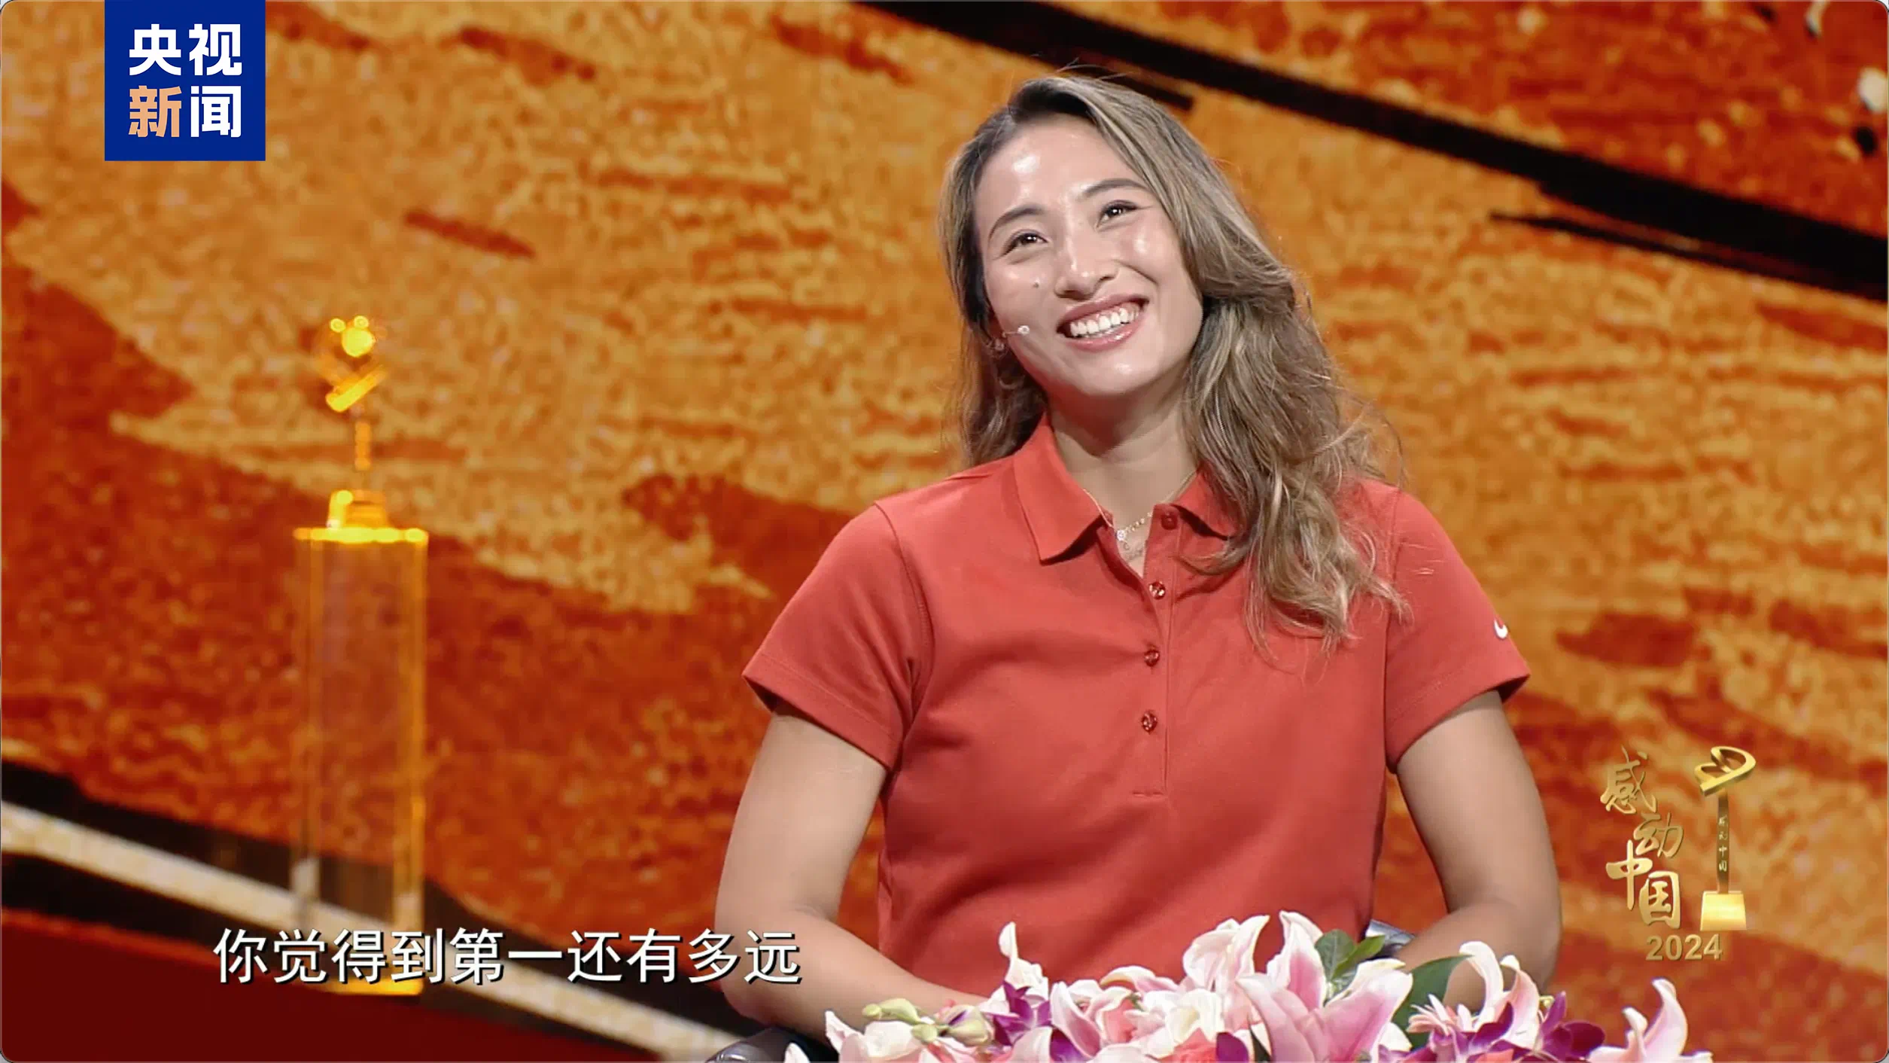
One possible Sample
Characters, Qualities, Dreams
The athlete who lights my way is Zheng Qinwen. At 21 she carved history by winning China’s first Olympic tennis singles gold in Paris 2024, rising from world No. 630 only four years earlier.
Her path reveals three shining qualities: resilience that heals injuries faster than medicine, discipline that turns 5 a.m. drills into routine, and courage that lets her stare down match points without blinking.
Zheng’s dream reaches beyond that medal, proving Asian power on the world stage. Watching her, I’ve learned that rankings measure yesterday, but determination designs tomorrow. My own dream of becoming a doctor now feels like a final I can win—point by fearless point.

