Slide 1

感恩遇见，相互成就，本课件资料仅供您个人参考、教学使用，严禁自行在网络传播，违者依知识产权法追究法律责任。
更多教学资源请关注
公众号：溯恩高中英语
知识产权声明

Slide 2
人教版新教材 词汇导学练
Unit3 Book1

Slide 3
1.exchange/ɪksˈtʃeɪnd ʒ/n.&vt.____;____;_____
an open exchange of ideas and information思想和信息的公开交流
educational exchanges for young people面向年轻人的教育交流
trade and cultural exchanges with China与中国的贸易和文化交流
to exchange ideas/news/information交流思想/ 互通消息/ 交流信息
I’m an __________student from the UK. 我是一名来自英国的交换生。
I'm going to go on an _________ visit to Paris. 我将到巴黎交流参观。
Our school does an _________ with a school in France.
我们学校与法国的一所学校进行交流。
I buy you lunch and you fix my computer. Is that a fair ________ ?
我请你吃午饭，你给我修计算机，这算是公平交易吧？
Everyone in the group __________ email addresses.
所有的组员都相互交换了电子邮件地址。
If the shirt doesn't fit, take it back and the store will _________ it.
如果衬衫不合适就把它拿回来，商店将给你掉换。
交换 交流 交易
exchange
exchange
exchange
exchange
exchanged
exchange

Slide 4
_______________换取
____________________ 与某人交换某物
________________ 把A换成B
They sold eggs _______________ salt and tea.他们把鸡蛋卖掉换取茶叶和盐。
Linda teaches me French _______________Chinese lessons.
琳达教我法语，作为交换我教她汉语。
I _________ learning experience ____ my classmates. 我与同学交流学习经验。
I shook hands and _________ a few words ____ the manager.
我与经理握手，相互交谈了几句。
If you are not satisfied with the car, you can always _________ it ___ another.
如果你对车不满意，可以随时另换一辆。
I am going to America next week, so I have to ________ some RMB ___ dollars.
我下周要去美国，所以得把人民币兑换成美金。
in exchange for
exchange sth. with sb.
exchange A for B
in exchange for
in exchange for
exchange
with
exchanged
with
exchange
for
exchange
for

Slide 5
2.lecture/ˈlektʃə(r)/n. &vt.________ _____ _____ _____
______________给某人的讲座/训斥
______________报告厅
___________________ 关于……的讲座/训斥 ____________________ 因某事指责/ 训斥某人
_______/ˈlektʃərə(r)/ n.授课者,讲师;演讲者
He gives a _______ to first-year students. 他给一年级学生讲课。
Did you ever ______ at Harvard? 你在哈佛大学开过讲座了吗？
I was asked _________ on Chinese literature yesterday.昨天我应邀去讲中国文学。
Smith gives lectures _________ business management. 史密斯教工商管理课。
I know I should stop smoking─don't give me a lecture_________ it.
我知道我该戒烟，别再训斥我了。
(开)讲座; 讲课; 演讲; 训斥
词根词缀：lect-说+-ure(名词后缀)：去说——讲座;讲课;演讲;训斥
a lecture to sb.
the lecture hall
a lecture on/about sth.
lecture sb on/about sth.
lecturer
lecture
lecture
to lecture
on/about
on/about

Slide 6
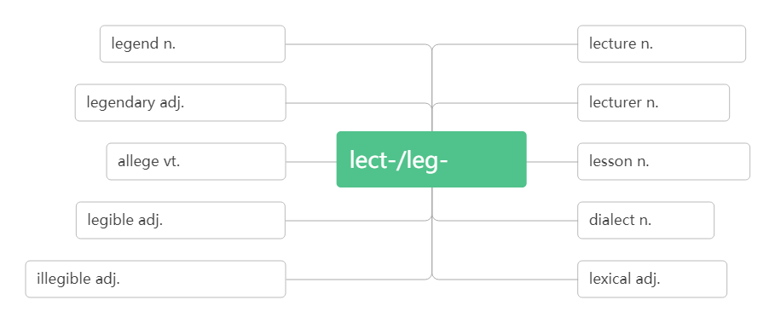
He's always ________ me about the way I dress. 他对我的衣着总是指手画脚的。
He used to lecture me about _________ too much.他以前常唠叨我喝酒太多。
He's a _______ in French at Oxford. 他是牛津大学的法语讲师。
The ________ spoke very clearly so that we could hear every word.
演讲者讲话很清楚,我们每个字都能听清。
lecturing
dringking
lecturer
lecturer
传奇,传说
讲座;课程
传奇般的
演讲者
断言,宣称
说/读
功课;教训
易读的;清晰的
方言
看不清的,字迹模糊的
词汇的

Slide 7
3.register/ˈredʒɪstə(r)/vt.& vi_____;_____
___________为……注册/登记
___________ /ˌredʒɪˈstreɪʃn / n.登记；注册；挂号
Have you come__________ at the school? 你来学校注册了吗？
Check the number of people who have ___________. 核实一下登记注册的人数。
We _________ his birth. 我们给他进行了出生登记。
We have to register ___ classes on Friday.我们必须在星期五去注册课程。
She will register ___ the physics class. 她准备选修物理课.
The___________ of students for the course will begin on Thursday morning.
学生登记上的这门课将于星期四上午开始。
Please write your home address on the ___________ form.
请在这张登记表上写下你的家庭住址。
They charge a small ____________ fee. 他们收一点注册费。
注册 登记
词根词缀：re-(再，又)+gist-(gest-获取)+-er:
再次获取个人信息——登记;注册
register for
registration
to register
to registered
registered
for
for
registration
registration
registration

Slide 8
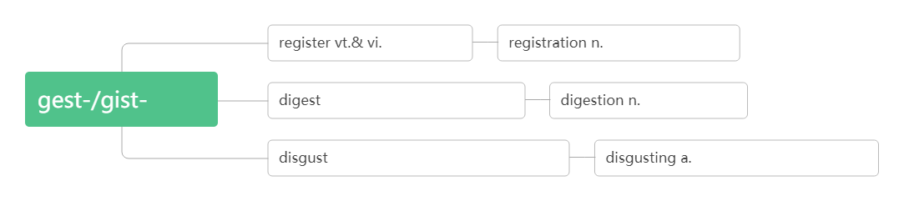
注册;登记
注册;登记
获取
vt.消化,吸收n.文摘,摘要
消化;领悟
vt.使厌恶,使作呕 n.厌恶
恶心的,令人作呕的
4. sex /seks/n.
We don’t allow couples to choose the sex of their baby.
我们不允许夫妇选择婴儿的性别。 Please indicate your sex and date of birth below.
请在下面写明你的性别和出生日期。
性别

Slide 9
5.male /meɪl/ adj._____;_______n._____,____
a male nurse/model 男护士/模特儿
a male flower 雄花
More females than males are employed in the factory.
这家工厂雇用的女性比男性多。
_______/ˈfi:meɪl/adj.女的;雌性的n. 雌株,雌性
She was the greatest female poet in America.
她是美国最伟大的女诗人。
The animal in the picture was a female elephant.
照片上的动物是头母象。
Fifty percent of the workers were female.
50%的工人是女性。
Each female will lay just one egg in April or May.
每个雌体四五月份只产一粒卵。
男的 雄性的 雄株 雄性
female

Slide 10
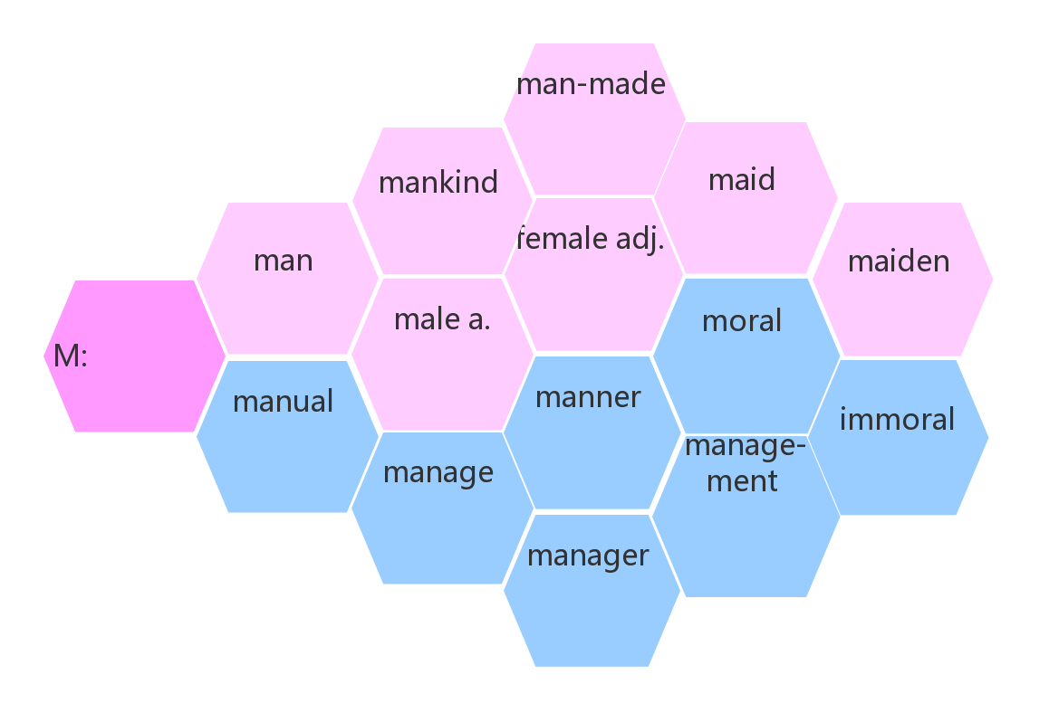
a.人造的
n.人类
n.少女;女仆
女的;雌性的
n.雌性
n.人; 男人
n.少女
人手
男的;雄性的
n.雄性
n. 道德;寓意
a. 道德的
n.手册,指南
a.手工的
n.方式;模式;
风格;做法
a.不道德的
vt.管理;经营;
设法;处理
n. 管理;
管理部门
n.管理人员;
经理

Slide 11
6. nationality /næʃəˈnæləti/ n._________
nation /ˈneɪʃn/n._____ _____
national /ˈnæʃnəl/ adj.______________
When asked his nationality, he said British. 被问及国籍时，他说是英国。
The college attracts students of all nationalities. 这所大学吸引着各国的学生。
The Yi nationality is distributed mainly over Yunnan, Sichuan and Guizhou provinces.
彝族主要分布在云南 、 四川和贵州三省。
It seemed that the nation's health was improving.好像该国的健康状况正在改善。
The British are known as a nation of dog lovers.英国人以爱犬而闻名。
The whole nation were watching the football game. 全国的人都在看这场足球赛。
national and local newspapers全国性的和地方的报纸
national and international news国内和国际新闻
Agriculture plays an important part in the national economy.
农业在国民经济中占重要地位。
Lin Zexu and Yue Fei are our national heroes.林则徐和岳飞是我们的民族英雄。
国籍;民族
民族;国家
民族的; 国家的

Slide 12
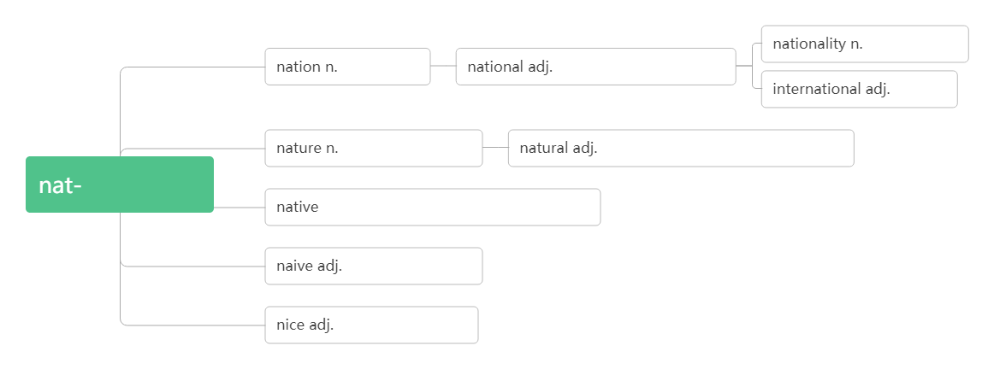
国籍;民族
民族;国家
民族的;国家的
国际的
天性,本性;自然
天然的;自然的;不做作的
出生/天生
a.当地的,本土的 n.当地人,土著
天真的;幼稚的
美好的;和蔼的
7. design /dɪˈzaɪn/n._______________vt.__________
________/dɪˈzaɪnə(r)/n.设计师，设计者
by design= on purpose _______
设计;方案;图案
设计;筹划
词根词缀：de-(向下)+sign(符号)：画下来的符号——设计;方案;图案
designer
故意地

Slide 13
be designed to do sth. ________________ be designed for… _______________ be designed as…_______________
She came to London in 2019 to study fashion ______. 她2019年来到伦敦学习时装设计。
The shoes were ___ good design and good quality.这些鞋样式新颖，质量上乘。
They drew up the design ______ the house in a week. 他们在一周内就画出了房子的图样。
I am sure he did it _________.我肯定他是故意做的。
This bridge ____________ by Scott 这座桥是斯科特设计的。
He has a job _________________ websites. 他得到了一份网站设计工作。
We need ________ a new course for the third year.
我们需要为三年级学生制订一个新的课程。
The programme is designed ______ people who have been out of work for a long time.
这项计划的目的是为长期失业者提供帮助。
These programs are designed __________the economy.
这些项目是为了发展经济而设计的。
专门被用来做……
专为……而设计
被设计为……
design
of
for/of
by design
was designed
designing/to design
to design
to help
to develop

Slide 14
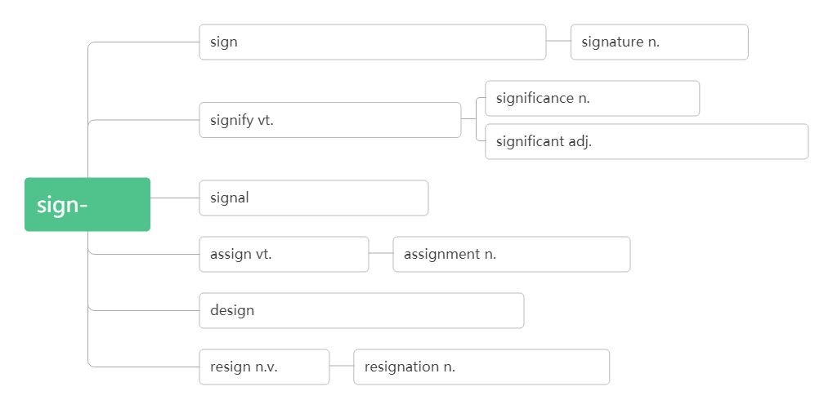
This training is designed ____ teachers. 这项培训是为老师设计的。 It's not designed ____ anyone under age eighteen. 它不是为18岁以下者设计的。 The room is designed ____ a small reception hall for important visitors . 这个房间被设计为用来接待重要来宾的小型会客室。 --What does Amy want to be inthe future? ——艾米将来想做什么？
--A _________.——设计师。 My brother is a fashion _________. 我哥哥是一名时装设计师。
for
for
as
designer
designer
n.符号;迹象;标志 v.签署;签名;示意
署名;签名
意义;重要性
表示;表明;意味着
重大的;有意义的
符号
n.信号vi.发信号;示意
分配;指派
分配;任务;作业
v.设计;计划;构思n.设计;图案
辞职
辞职;放弃;辞职书

Slide 15
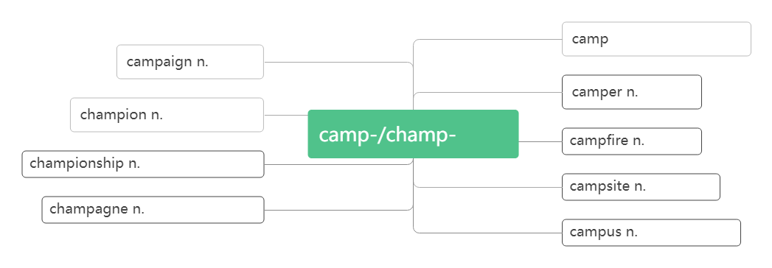
8.campus/ˈkæmpəs/n.__________
An exchange student is talking to a teacher __________.
一个交换生正在校园里和一位老师谈话。
They spoke of the old days _____________.他们谈起昔日的校园生活。
The _______ of Harvard University is very beautiful. 哈佛大学的校园非常漂亮。
The campus ______ an area of twenty square kilometers.
这个校园占地二十平方公里。
校园; 校区
破拆法：camp(营地)+us(我们)：我们的营地——_________
校园; 校区
on campus
on the campus
campus
covers
n.营地 vi.宿营
战役
宿营者
胜利者, 冠军
营地
营火
锦标赛; 冠军称号
宿营地
香槟酒;香槟色
校园;校区

Slide 16
正式的;正规的
9. formal /ˈfɔ:ml/ adj._____________ ________ /'fɔ:m əlɪ/ adv.正式地; 正规地 ________ /ɪnˈfɔ:ml/ adj. 非正式的；非正规的 __________/ɪn'fɔ:məlɪ/adv.非正式地
People speak in a more polite way in ______ situations. 在正式场合人们说话更礼貌。
He wrote a very ______ letter of apology to Mary. 他给玛丽写了一封非常正式的道歉信。
They had a ______ dinner after the play. 演出结束后他们举行了一个正式的晚宴。
He didn't have any ______ dance training.他没受过任何正规的舞蹈训练。
We need to dress ________ for the party. 我们需要穿得正式参加晚会。
Everyone was ________lined up to meet the king.大家正式地列队迎接国王。
The house has an ________ atmosphere. 房间里有一种轻松随意的氛围。
I would like it to be an ________ occasion. 我希望把它办得不那么正式。
They told me _________ that I had got the job. 他们非正式地告诉我我已获得那份工作。
The guests were seated very _________ around the table. 客人们很随意地坐在桌旁。
formally
informal
informally
formal
formal
formal
formal
formally
formally
informal
informal
informally
informally

Slide 17
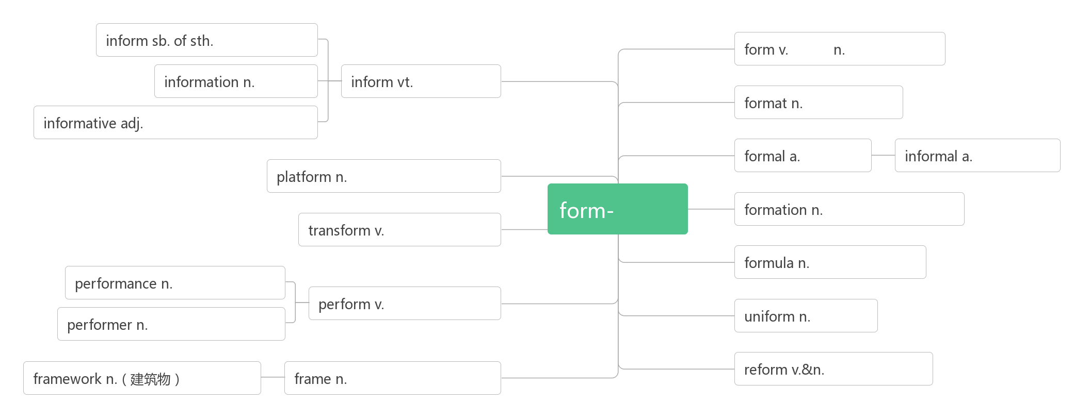
告知某人某事
形成
形式;表格
信息
通知,告知
格式,版式
提供信息的
正式的
非正式的
平台;站台;讲台
形式
构造;形态;队形
转变,变形
公式;配方
表演,表现
表演;执行
制服
表演者,执行者
改革;改良
框架,结构
框架;结构;画框

Slide 18
10. anxious /ˈæŋkʃəs/ adj.____________________
____________________ 为某事焦虑 ________________ 为某人担忧 __________________ 渴望做某事 _________/'æŋkʃə slɪ/ adv.焦急地；担忧地 _______ /æŋˈzaɪəti/n.焦虑；忧虑；渴望
Tom is a very_______ person.汤姆是个非常容易焦虑不安的人。
He seemed anxious______the meeting.他似乎对这次会议忧心忡忡。
Parents are naturally anxious______their children.父母自然为儿女担心。
She was anxious ________(finish) school and get a job.她渴望毕业找一份工作。
He is _________waiting for the result of the medical tests. 他焦急地等待着体检结果。
I hope for her letter__________. 我焦急地盼望着她的回信。
Her voice was full of _______. 她的声音满是焦虑不安。
________is modern man's natural state.焦虑是现代人的自然状态。
He shouted at her with _______.他焦急万分地对着她大喊大叫。
Tom's _______ to succeed led him to work hard.汤姆对成功的渴望使他更加努力。
焦虑的;担忧的;渴望的
be anxious about sth.
be anxious for sb.
be anxious to do sth.
anxiously
anxiety
anxious
about
about
to finish
anxiously
anxiously
anxiety
Anxiety
anxiety
anxiety

Slide 19
11. annoy /əˈnɔɪ/ vt.____________
_________/əˈnɔɪɪŋ/ adj.令人恼怒的，恼人的
________/əˈnɔɪd/ adj.感到恼怒的，生气的
______________________________(因某事)对某人恼火
She sometimes does things on purpose just ________ me.她有时存心做些事来使我生气。 A fly was annoying him. 一只苍蝇搅得他心烦。 It _______ me that I didn't have time to do more reading.腾不出时间多看会儿书让我很烦。 Don't ask lots of _________ questions.不要问许多烦人的问题。 You must have found the children ________.你肯定觉得这些孩子讨人厌烦。 It is _________that there is no hot water.没有热水,真烦人。 Her mother was ________ because she was so late. 她母亲生气了，因为她来晚了。 He was ________to learn that the train would be delayed.他得知火车要晚点,心里感到烦恼。 He was very annoyed _____ me ______ my carelessness. 因为我粗心大意，他对我恼火了。
惹恼, 使恼怒
annoying
annoyed
be annoyed with sb (at/about sth.)
to annoy
annoyed
annoying
annoying
annoying
annoyed
annoyed
with
about

Slide 20
12. fright /fraɪt/ n._________
____________ 惊恐地;被吓得
________/ˈfraɪtn/vt.使惊恐；吓唬 _________ /ˈfraɪtnd/ adj.受惊吓的；感到害怕的 _________________________ 害怕(做)某事 _____________________ 不敢做某事 ___________/ˈfraɪtnɪŋ /adj.令人恐惧的；吓人的
I got the _____ of my life. 我吓得要命。
Pinocchio was beginning to tremble _____________. 皮诺乔开始吓得浑身发抖。
The grandmother jumped up in her ______ and asked him what that meant.
奶奶吓得跳起来，问他这是怎么回事。
Sorry, I didn't mean to ________ you.对不起，我没有吓唬你的意思。
Most children are __________ by the sight of blood. 大多数孩子见到血就害怕。
She was __________ that the plane would crash.她害怕飞机会坠毁。
惊吓,惊骇
with/in fright
frighten
frightened
be frightened of (doing) sth.
be frightened to do sth.
frightening
fright
with/in fright
fright
frighten
frightened
frightened

Slide 21
Her __________ face showed us that something terrible had happened to her family.
她惊恐的神色向我们表明她家出了大事。
She was frightened ____flying. 她害怕坐飞机。
I'm frightened____walking home alone in the dark.
我害怕在黑夜单独走路回家。
She was too frightened______her family what had happened.
她太害怕了，不敢告诉家人发生了什么事。
The idea of death is ___________to most people.
死的想法对于大多数人都是可怕的。
It's ___________to think it could happen again.
想到此事可能再次发生就使人不寒而栗。
frightened
of
of
to tell
frightening
frightening
较高的;年长的
较年长者
13. senior/ˈsi:niə(r)/adj.(级别,地位等)____________n._________ _________________（美国）高中 ___________ 比某人资格高/年长
senior high school
senior to sb.

Slide 22
a senior manager/lecturer 高级经理/高级讲师
a senior post/position 高级职务/职位
So this is it— senior high school at last! 就是这样——终于上了高中！ He is senior to me. 他的职位比我高。 Williams felt himself to be senior to all of them. 威廉斯自认为比他们所有人资格都要老。 My brother is my senior by two years. 我哥哥比我大两岁。
最后;终于
14. at last _________ The rainy season has ended at last. 雨季总算过去了。
At last they won their freedom. 他们终于赢得了自由。 His wish to visit China has at last come true.
他要访华的愿望终于实现了。
At first he was very tense and at last relaxed.
起初，他非常紧张，最后终于放松了下来。

Slide 23
15. outgoing /ˈaʊtgəʊɪŋ/ adj.
I'm not outgoing so I'm a little anxious right now.
我不外向，所以我现在有点焦虑。 He is an outgoing and lively person. 他是个性格开朗而又活泼的人。 She's friendly and outgoing. 她好相处,性格外向。
外向的;开朗的
16. impress/ɪmˈpres/________________________________________
_____________________ 用……给某人留下深刻印象
___________________ 对……印象深刻
_________________把…印在…上; 使铭记
vt. 使钦佩;使印象深刻vi. 留下印象;引人注目
词根词缀：im-(里)+press(按压)：把……按到心里——留下印象
impress sb with/by sth.
be impressed with/by
impress sth on sb.

Slide 24
__________/ɪmˈpreʃn/ n.印象
___________________________给某人留下……的印象
_______________________对……有印象
______________第一印象
__________/ɪm'presɪv/ adj.令人印象深刻的；感人的
impression
leave/make a ... impression on
have/get an impression of
first impression
impressive
It _________ me that she remembered my name.令我佩服的是她记得我的名字。 What __________me most was their brave spirit.给我印象最深的是他们的无畏精神。 She was deeply impressed _______ the scenery in Guilin.
桂林的景色给她留下了深刻的印象。 My father impressed ___ me the importance of hard work.
我父亲要我牢记努力工作的重要性。 The scenery in Guilin never fails__________.
桂林的景色永远让人叹为观止。 There was a general___________ that tomorrow meant a fresh start.
普遍的感觉是明天意味着一个新的开始。
impressed
impressed
by/with
on
to impress
impression

Slide 25
I want to make a good first __________. 我想给人留下好的第一印象。 Her words__________ a lasting impression on me. 她的话给我留下了难忘的印象。 I have a good impression ___him.我对他有很好的印象。
_______________are the most lasting. After all, you never get a second chance to make a first impression.
第一印象是持久的。毕竟，你永远不可能再有一个机会去给别人再留一次第一印象。 While I really don’t like art, I find his work __________.
虽然我不喜欢艺术，但是我发现他的作品令人印象深刻。 This is an __________ book.这是一本感人的书。
impression
left/made
of
First impression
impressive
impressive

Slide 26
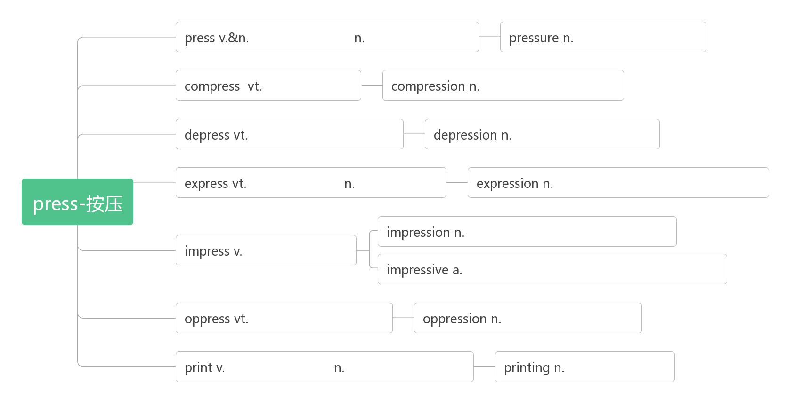
按;压;逼迫
新闻业;出版社
压力;压迫,压强
压缩,压紧
压缩,浓缩;压榨
压抑;使沮丧;使萧条
沮丧;不景气;忧愁
表达;快递
快车;快递
表示,表达;表情;措辞,说法
印象;效果,影响;压痕,印记
盖印;给人印象
感人的;令人钦佩的;令人深刻印象的
压迫,压抑;使烦恼
压抑;沉闷;苦恼
印刷;打印
印刷业;印章;印记
印刷;印刷术

Slide 27
17. what if ________________
what if 用于疑问句句首, 尤用于询问不希望看到的事发生时的结果。
What if no one talks to me? 如果没人跟我说话怎么办？
What if it rains? 要是下雨怎么办 ?
What if anything should happen to the child? 万一这孩子出了差错怎么办？ So what if you make a mistake? 如果你犯了错那又怎样？
如果…会怎么样呢？
18. guy/gaɪ/n._____________
I was working with a guy from Japan.
我与一个来自日本的小伙子一起工作。 Hi, guys. How are you doing? 嗨，伙计们，大家还好吧？
小伙子;家伙

Slide 28
19.concentrate/ˈkɒnsntreɪt/vt.&vi._____________________________
________________________集中注意力于（做）某事
____________________________ 把……集中于（做）某事
_____________/ˌkɒnsnˈtreɪʃn/ n.集中; 专心，全神贯注
集中(注意力);专心于;聚精会神
词根词缀：con-(都)+centr-(中央)+-ate:都集中到中央——
集中(注意力);专心于;聚精会神
concentrate on (doing) sth.
concentrate sth. on (doing) sth.
concentration
I haven't been able to get enough sleep, and I'm too tired _____________ in class.
我睡眠不足，课上精力不集中。 I couldn’t concentrate ____the experiment.我无法集中精力做实验。
You should concentrate ___ food while eating. 吃饭时,你应该把注意力放在食物上。 You should concentrate your energy ___ reading and writing.
你应该集中精力于阅读和写作。 I decided to concentrate all my efforts ___ finding a place to live in.
我决定全力以赴找个住的地方。 This book requires a great deal of ____________.这本书需要全神贯注才能读懂。 With great ____________ she worked out the problem.她聚精会神地解出了这个问题。
to concentrate
on
on
on
on
concentration
concentration

Slide 29
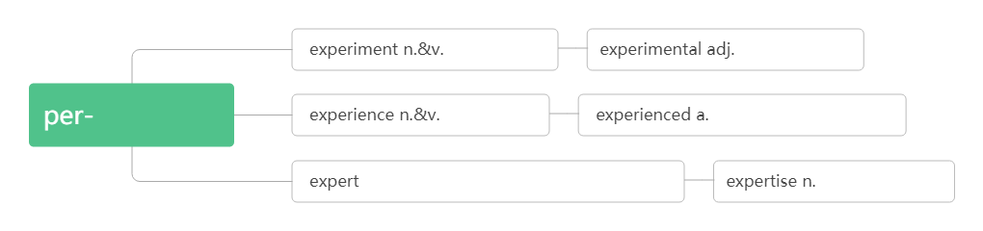
20. experiment /ɪkˈsperɪmənt/ n.___________ _______________________________做实验
实验;试验
do/perform/conduct an experiment
实验;试验
实验的;试验的
体验,尝试
经历;经验
有经验的;熟练的
n.专家; 行家
a.专业的，内行的
专业知识/技能
不打扰..., 不惊动...
21. leave...alone___________________
I really wanted to tell him to please be quiet and leave me alone!
我真想告诉他请安静点，别打扰我。 I've told you before─leave my things alone! 我告诉过你——-别碰我的东西！
Leave the birds' nests alone. 不要去碰鸟巢。

Slide 30
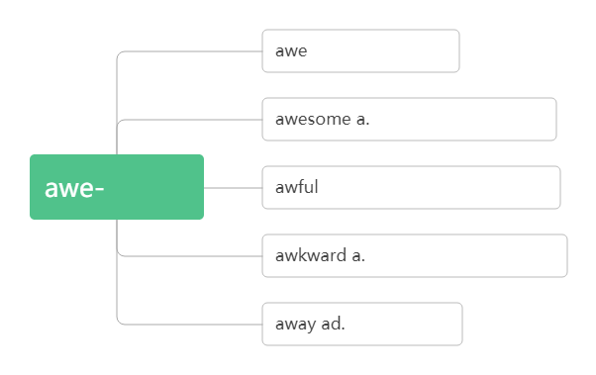
尴尬的;笨拙的;棘手的
22. awkward /ˈɔ:kwəd/ adj._______________________
词根词缀:awk-(away)+-ward(向):令人向远处离开的——令人尴尬的; 棘手的
I didn't feel awkward or frightened at all.我一点也不觉得尴尬或害怕。 They were trying to get out of this awkward situation.他们正设法摆脱困境。 There was an awkward silence in the meeting room. 会议室里一阵令人尴尬的沉默。 She's got to an age where she is being awkward. 她到了难相处的年龄。
n.敬畏 vt.使敬畏
令人惊叹的;极困难的
敬畏
a. 极坏的,极讨厌的 ad.极其
尴尬的;笨拙的;棘手的
离开,远离

Slide 31
23. junior /ˈdʒu:niə(r)/adj.___________________
n._____________________________
___________________（美国）初级中学
____________比某人资格低/年青
______________ 办公室的一般职员
I miss my friends from junior high school, but I believe I will make new friends。 我想念我初中的朋友，但我相信我会结交新朋友。 My daughter is 16 and my boy is already in junior high school.
我女儿16 岁了，我儿子已经上初中了。 We could give the job to somebody junior. 我们可以把这份工作交给职位较低的人. She has coached many leading juniors.她训练过许多名列前茅的青少年运动员。 That teacher's assistant is at least ten years junior to the professor in experience. 那位助教的资历起码比那位教授少十年。
地位/职位/级别低下的
职位较低者;(体育运动中的)青少年
junior high school
junior to sb.
office juniors

Slide 32
24. explore /ɪkˈsplɔ:(r)/vt.& vi._______________ __________ 勘探 ___________/ekspləˈreɪʃn/n.探索；勘探；探险
I believe I will make new friends here, and there's a lot __________at senior high.
我相信我会在这里交到新朋友，而且在高中有很多东西要探索。
As soon as they arrived in the town they went out _________.
他们一到这城镇就外出察看周围环境。
What does the author say about America's aim _________space?
作者对美国探索太空的目标有何评论？
Children who have chances __________natural areas tend to develop a strong love
for science.有机会探索自然区域的儿童往往会培养对科学的强烈热爱。
The companies are allowed to explore____oil and gas.
这些公司被允许勘探石油和天然气。
探索,探测;勘探
词根词缀:ex-(外)+plo-(应用)+re(反复):反复到外面去找有用的东西——探索,探测;勘探
explore for
exploration
to explore
to explore
to explore
to explore
for

Slide 33
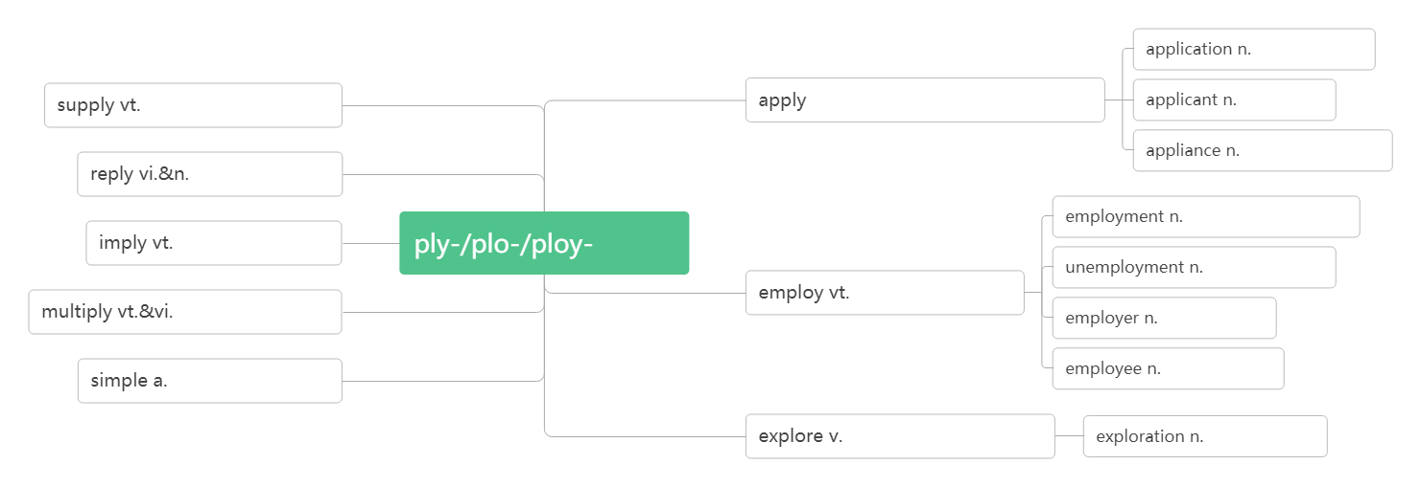
We have made great progress in space __________.我们在探索太空方面取得了很大进展。 The new method saves the cost of oil __________. 这种新方法节省石油勘探成本。 The answer to this question is now ______exploration.该问题的解决办法在探讨中。 This book is about a scientific __________. 这本书是关于科学探险的。
exploration
exploration
under
exploration
申请;应用
供应,提供
vt.应用,涂抹
vi.申请
申请人
器具,装置
回答;回应
雇用;就业
暗示;意味着
应用
失业
雇用;利用
增加;繁殖
雇主
雇员
简单的
探索,探测;勘探
探索;探险

Slide 34
25. confident/ˈkɒnfɪdənt/adj.________________ ____________________________ 对(做)某事有信心 __________________确信…… __________ /'kɒnfədəntlɪ/adv.确信地；肯定地; 自信地 __________ /ˈkɒnfɪdəns/n.信心；信任；自信心 _________________对……有信心/信任 ______________ 自信地；有把握地
自信的,有把握的
词根词缀:con-(强调)+fid-(信)+-ent(形容词后缀):自信的,有把握的
be confident of/about (doing) sth
be confident that…
confidently
confidence
have confidence in
with confidence
I feel much ______________than I felt this morning.
我觉得比今天早上更有信心了。 Mary is a _________ and happy child. 玛丽是个自信、快乐的孩子。 I think you should be a bit ______________. 我认为你应该稍微自信一点儿。 The teacher wants the children to feel _________ about asking questions when they don't understand. 教师要孩子们遇到不懂的问题就大胆提问。
more confident
confident
more confident
confident

Slide 35
Mr. Smith is confident ________ success. 史密斯先生坚信一定会成功。
The team feels confident of ________(win). 这个队觉得有把握取胜。
I'm confident ____ you will get the job. 我肯定你能得到那份工作。
He is confident ____everything will get better. 他坚信一切都会更好。
You must act __________. 你必须表现得自信。
He felt safe now, and he spoke _______________.
他觉得现在安全了, 便更大胆地说起来。
I can __________ promise that this year is going to be very different.
我可以信心十足地保证今年将大不一样。
He expressed his __________that they would win.
他表示了自己的信心：他们必定取胜。
He gained __________when he went to college.他上大学后增强了自信。
I have every confidence ___my students' abilities. 我完全相信我的学生的能力。
We have confidence___our government. 我们对政府充满信心。
He answered the questions _____ confidence . 他自信地回答了那些问题。
I can say _____confidence that the economy will be better soon.
我可以有把握地说经济很快就会好转。
of/about
winning
that
that
confidently
more confidently
confidently
confidence
confidence
in
in
with
with

Slide 36
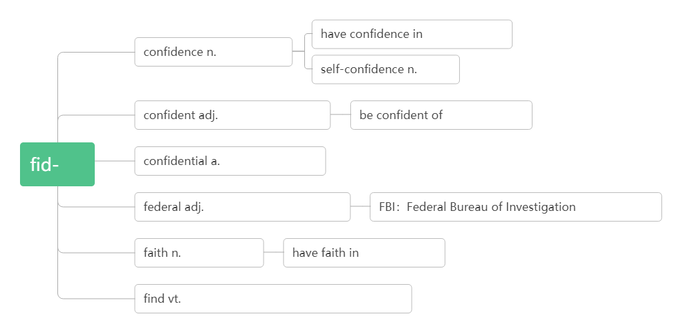
对…有信心
信心;信任
自信
确信的;有信心的
对…有信心
信
机密的,保密的
联邦的;同盟的
联邦调查局
信念;信仰
对…有信心
找到;发现;感到(found, found)

Slide 37
26. forward /ˈfɔ:wəd/adv.(also forwards)_____ adj._______________ (只用于名词前) _________________________ 盼望/期待(做某事)
向前
向前的;前进的
look forward to (doing) sth.
He took two steps forward.他向前走了两步。 They ran forward to welcome her. 他们跑向前去欢迎她。
the forward movement of history 历史的向前发展 the plane's forward door 飞机前舱门 Tom is looking forward to meeting the new exchange student.
汤姆期待着见到新来的交换生。 We are looking forward to the coming of spring.我们正盼望着春天的到来。 I look forward to your reply我期待你的答复。 I look forward to hearing from you in the near future.我盼望着不久收到你的信。

Slide 38
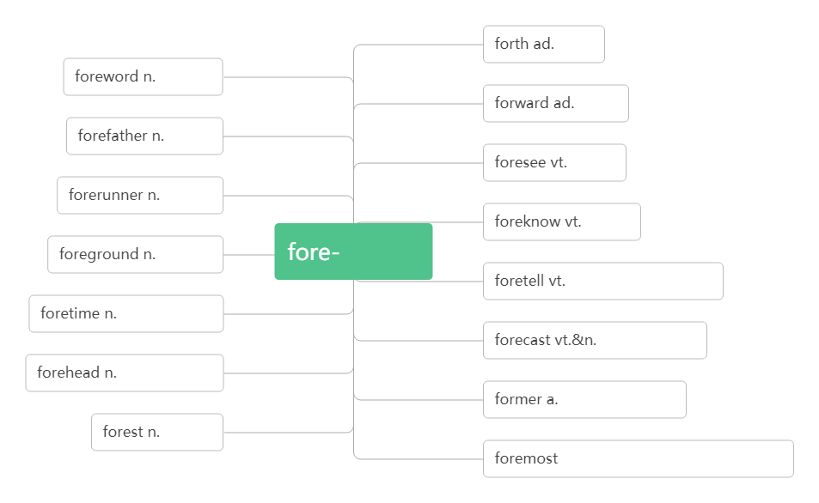

向前
前言
向前
祖先
预见
先驱
预知
前景
先/前
预言;预示;预告
已往,过去
预报,预测
额头,前额
先前的,前者的
森林
a. 最重要的;最先的
ad. 首先

Slide 39
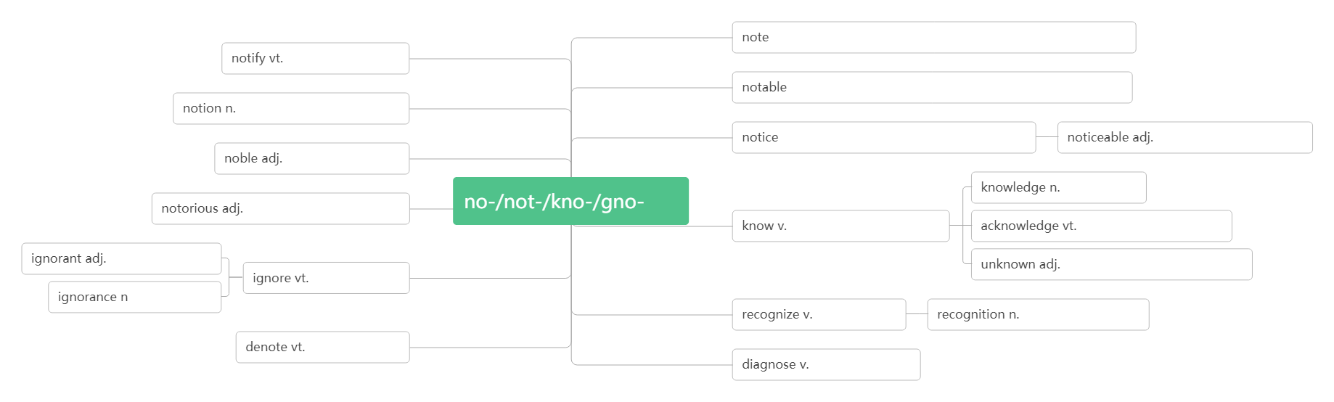
27. take notes_______
Listen to the teacher and take notes.听老师讲课并做记笔记。
I take notes while listening and reading. 我边听边读边做笔记。 Students should take notes in class.学生在课堂上应该记笔记。 She took out her notebook and began to take notes. 她掏出笔记本,开始记笔记 。 Please take notes of the important words while you read. 请边读边把重要的单词记下来。
记笔记
n.笔记;音符;票据;注解;便笺
vt.注意;记录;注解
通告,通知;公布
a.显著的;著名的n. 名人,显要人物
概念;想法;见解;打算
n.通知,布告;公告
vt.注意到,觉察到
显而易见的,
显著的
高尚的;贵族的n.贵族
臭名昭著的;
声名狼藉的
知
知识;知道
知道;认识;
懂得;了解
承认;答谢;报偿
无知的;愚昧的
未知的;陌生的,默默无闻的
忽视;不理睬
无知;愚昧
认出;承认
认出;识别;承认;公认
表示,指示
诊断;判断（dia-彻底）

Slide 40
27. flash/[flæʃ/n._________vt.&vi.______________
_________一瞬间
___________________ 一道闪电
use flash cards 使用识字卡
Children can use flash cards to learn English. 小孩可以使用识字卡来学英语。
Flash card is very useful to students. 教学卡片对学生很有用。
The flash sent the foxes running away. 闪光惊得狐狸逃窜。
The answer had come to him in a flash.他一下子就有了答案。
It was done in a flash. 一眨眼的工夫就完成了。
Lightning flashed in the distance.远处电光闪闪。
There is something wrong with the traffic light because only the red light flashes on and off.
交通灯出故障了，只有红灯一直在闪。
Why is that driver flashing his lights at us?为什么那个司机向我们闪着车灯？
闪光;信号
闪光;发出(信号)
in a flash
a flash of lightning

Slide 41
组织;组建
28. organize (BrE- ise) /'ɔ:(r)gənaɪz/ vt.&vi. __________
_____________(BrE- isation)/ɔ:gənaɪˈzeɪʃn/ .组织; 团体; 机构
the World Health Organization 世界卫生组织
词根词缀：org-(运作)+an-(使)+-ize(动词后缀): 使运作起来——组织
organization
to organize a meeting/party/trip/competition/club组织筹备会议/聚会/旅行/比赛/俱乐部
How does Li Ming ________his thoughts? 李明是如何组织他的想法的？
We'll ________some students into the basketball team.
我们将组织一些学生参加篮球队。 Workers have the right ___________trade unions according to law.
劳动者有权依法组织工会。 His speech is well _________. 他的演讲很有条理。 It's the first time farmers have decided __________. 这是农场主首次决定组织起来。 He has the ability __________. 他很有组织才能。
They set up a charity ___________ last year. 去年他们建立了一个慈善机构。 No ___________ or individual are allowed to use the logo in advertisement or any other business activities. 任何团体或个人不得将标识用于广告或其他商业性活动。
organize
organize
to organize
organized
to organize
to organize
organization
organization

Slide 42
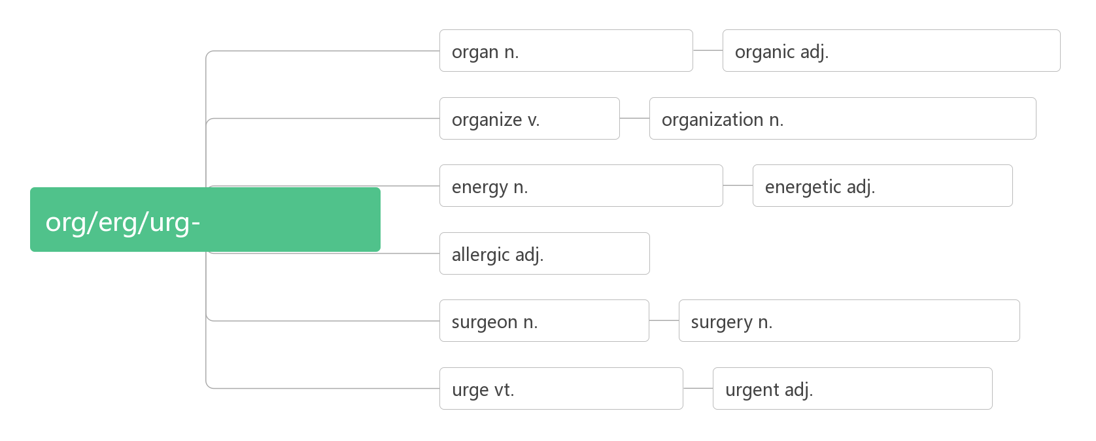
器官;机构;风琴
器官的,组织的;有机的
组织
组织;机构,团体;体制
能量;精力;活力
精力充沛的
运作/活动
过敏的
外科医生
外科;外科手术;手术室
催促;极力要求
紧急的,紧迫的

Slide 43
29. goal /gəʊl / n._______________
I have learning goals and make plans for my English studies.
我有学习目标，并为我的英语学习制定计划。
Our goal is to raise as much money as possible for the project.
我们的目的是为这个项目筹集到尽可能多的资金。 He scored the winning goal.他踢进了制胜的一球。 Liverpool won by three goals to one.利物浦队以三比一获胜。
目标;球门;射门
30. strategy /ˈstrætədʒi/n.__________
What learning strategies do you and your partner share?
你与你的搭档分享什么学习策略？ What is the best strategy for you to learn new words?
对你来说学习生词的最佳策略是什么？ the government's economic strategy. 政府的经济策略 We need to discuss our new strategy. 我们需要商讨一下我们的新策略。 We have reduced air pollution through many strategies.
我们通过许多策略减少了空气污染。
策略;战略
词根词缀：strat-(伸展)+-ety(名词后缀)：展开的计划——策略

Slide 44
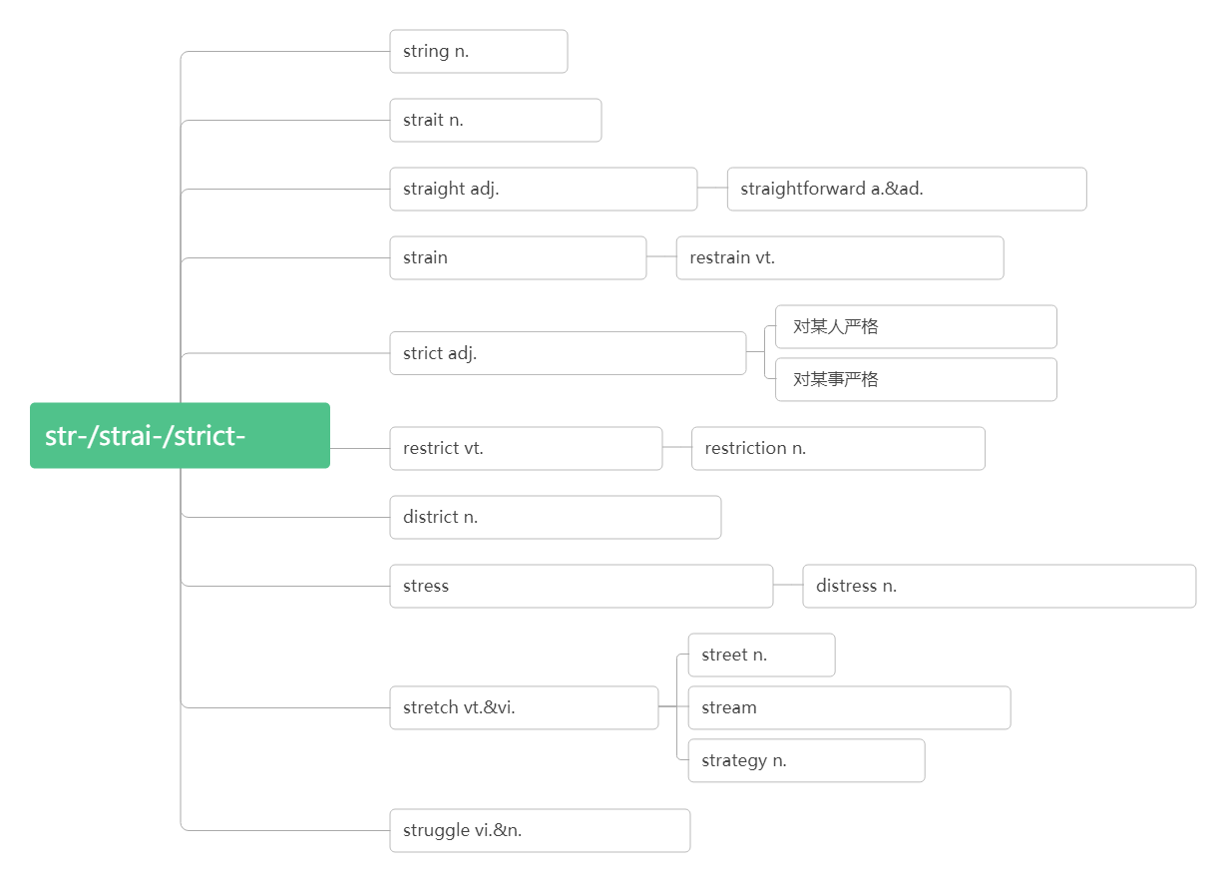
弦,细绳
海峡;困境
直的;正直的
简单的/地;直率的/地
n.张力;拉力v.拉紧
抑制,控制,约束
be strict with sb.
严格的;严密的;精确的
be strict in sth.
拉伸
限制,约束,制约
限制,约束,束缚
限制,约束,制约
n. 压力;强调;紧张 vt. 强调;使紧张
危难;不幸;贫困;悲痛
街道
伸展,展开
vt.流出 vi.流动 n.小河; 溪流
战略,策略
斗 争;搏斗;奋斗

Slide 45
30. partner /ˈpɑ:tnə(r)/ n._______________
a marriage partner 配偶 I have a good partner to practice English with.我有一个好搭档一起练英语。
China and America are now economic partners.中国和美国目前是经济合作伙伴。
“Changing Partners” , a pop song in the 1950s, is now still loved by many people.
“交换舞伴”是二十世纪五十年代的一首流行歌曲，现在仍然被人们所喜爱。
同伴;配偶;搭档
33.curious /ˈkjʊəriəs/adj.______________
_____________对……好奇
________________好奇于做某事
________/ 'kjʊərɪəslɪ/ adv.好奇地；奇怪的是
_______/kjʊəriˈɒsəti/ n.好奇心
好奇的;奇怪的
词根词缀：cur-(心)+-ious(形容词后缀)：用心去探寻的——好奇的
be curious about
be curious to do sth.
curiously
curiosity

Slide 46
Children are naturally _______. 孩子天生好奇。
A _______ child is a teacher's delight. 老师喜欢有求知欲的孩子。 It's the ____________ thing I ever saw in my life!
这是我一生中看到的最奇怪的事情！ I'm curious ______everything.我对一切都很好奇。 She seemed to be curious ______what he was doing.
她似乎对他正在做的感到很好奇。 You must be curious _______(find) out how to decorate the Christmas tree.
你一定很好奇想弄清楚如何装饰你的圣诞树。 He looked _________at the people.他好奇地看着那些人。 _________enough, he had never seen the little girl.
奇怪的是，他竟从未见过那个小女孩。 It is good to be _______about the world around you because I think ________is the best teacher. 对你周围的世界感到新奇是件好事，因为我认为好奇心是最好的老师。
curious
curious
most curious
about
about
to find
curiously
Curiously
curious
curiosity

Slide 47
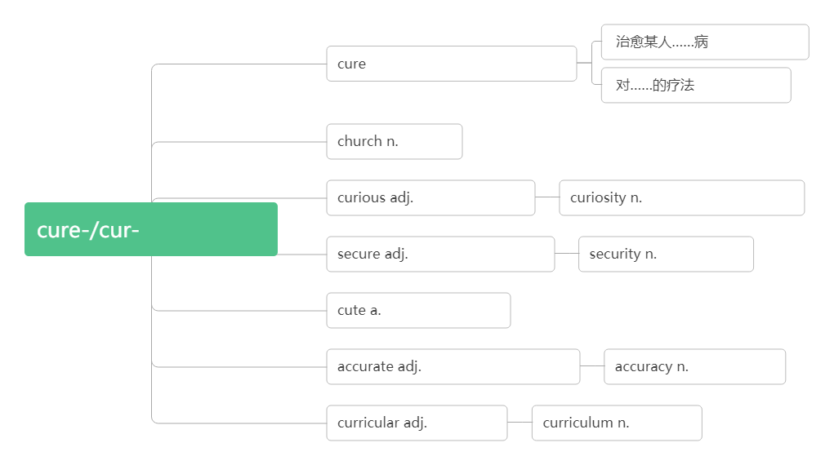
cure sb. of
vt.治疗;治愈 n.治疗;疗法
a cure for
教堂
好奇的;奇怪的
好奇心;求知欲;珍品
关心/用心
安全的vt.使安全
安全;安保
可爱的;伶俐的
精确的, 准确的
准确,精确
课程的
总课程

Slide 48
34. company/ˈkʌmpəni/ n._______________ ____________作为陪伴 _________________与某人交往 __________/ə'kʌmpəni/vt.&vi. 陪伴，伴随；伴奏
__________/kəmˈpænjən/n.同伴,伙伴
同伴;配偶;搭档
破拆法：com-(come来)+pany(陪你)：来陪你
for company
keep company with
accompany
companion
My dream is to start my own IT _________!我的梦想是成立自己的IT公司！
What are your plans for the development of your _________?
你打算怎样来发展壮大自己的公司？
I enjoy her _________. 我喜欢和她在一起。
He went with us to the airport ____________.他陪同我们去机场了。
No one wants to keep company_____ someone who always looks upset.
没有人喜欢和经常很沮丧的人交往。
company
company
company
for company
with

Slide 49
His wife _____________ him on the trip. 那次旅行他由妻子陪同。
The singer _________________on the piano by her sister. 女歌手由她姐姐钢琴伴奏。
He was a good friend, a dependable __________. 他是个好朋友，一个可以信赖的同伴。
She was a charming dinner __________. 与她同桌进餐使人感到十分高兴。
His younger brother is not much of a __________ for him. 他的弟弟和他志趣不太相投。
acccompanied
was acccompanied
companion
companion
companion
35. person/ˈpɜ:sn/n.___
________/ˈpɜ:sənl/ adj.个人的; 私人的
_________/ˈpɜ:sənəli / adv.亲自地; 就个人而言
__________/pɜ:səˈnæ ləti/ n.性格;个性
_________亲自
人
词根词缀：per-(每个)+son(儿子)：每个人都是上帝的子民。
personal
personally
personality
in person
He's just the ______ we need for the job. 他正是我们需要的适合这项工作的人。
At least four _______died in the accident. 至少四个人在事故中死亡。
Of course, this is just a ________opinion. 当然了，这只是个人意见。
The novel is written from ________experience . 这部小说是根据个人亲身经历写成的。
person
persons
personal
personal

Slide 50
She's a ________friend of mine . 她是我的私人朋友。
He is always curious about my _________life .他对我的私生活很好奇。
I handed the letter to him __________________.我亲自把这封信交给了他。
__________, I am very satisfied with his work. 就个人而言，我对他的工作很满意。
How would you describe Yuan Longping's __________? 你如何描述袁隆平的个性呢？
His wife has a strong __________. 他妻子的个性很强。
The children all have very different ___________. 孩子们的性格各不相同。
personal
personal
personally/in person
personally
personality
personality
personalities
36. style /staɪl/n.______________________
_______时髦; 气派
方式; 作风; 样式, 款式
in style
learning style 学习方式
a management style 管理方式 Now on-line shopping has changed people's life style.现在网上购物改变了人们的生活方式。 The story was written in a lively and interesting style.这个故事以一个生动有趣的风格来写作的。 The building was built in the style of a Chinese palace. 这座建筑是仿照中国宫殿形式而建的。 Caution was not her style. 谨小慎微不是她的作风。
She always celebrates her birthday in style. 她的生日总是过得很排场。

Slide 51
37. revise / rɪˈvaɪz/ vt.&vi. ______________
_______/rɪˈvɪʒn/n.修订;复习
Get your draft back and______it. 把草稿拿回来修改一下。
It is necessary ________the original plan. 原计划须加以修改。
We have to ______the dictionary. 我们必须修订这部字典。
I can't come out tonight. I have to ______. 我今晚不能出去。我得复习。
I'm ________Geography today. 我今天要复习地理。
Have you started your ________yet? 你开始复习了吗？
The phase of writing that is actually most important is _______.
写作中真正最重要的阶段是修改。
修改,修订;复习
词根词缀：re-(再,又)+vis-(看)+e:再看一遍——修订;复习
revision
revise
to revise
revise
revise
revising
revision
revision

Slide 52
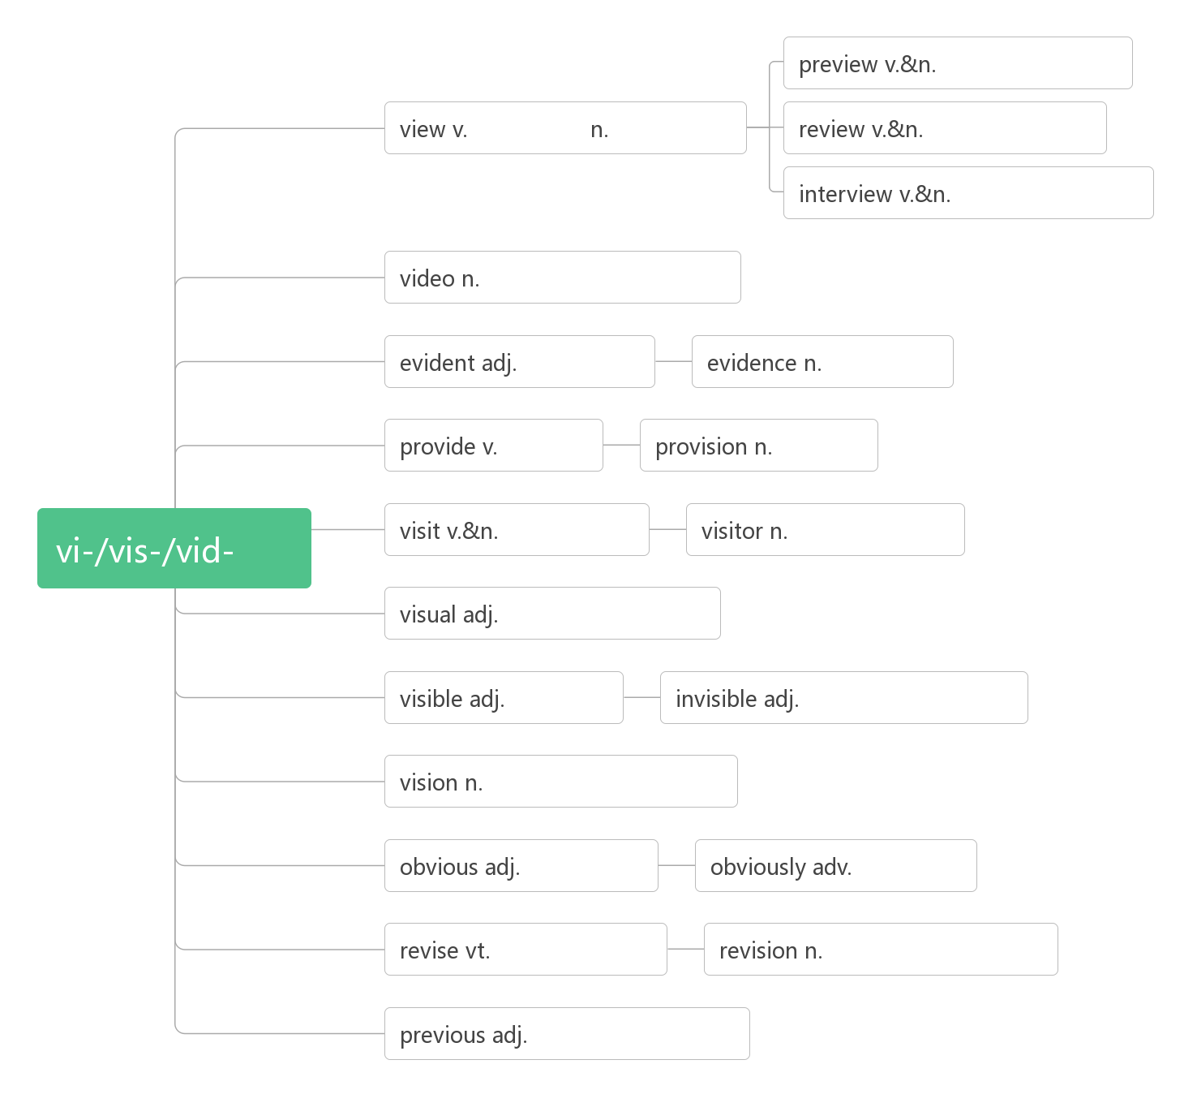
预习
看,看待
景象
复习;评论
采访;面试
视频, 录像
明显的
证据
提供
供应
看
参观, 拜访
游客;访客
视觉的;可见的
可见的
看不见的
视力; 幻像
明显的
明显地
修订; 复习
修订; 复习
先前的,前面的

