Slide 1
感恩遇见，相互成就，本课件资料仅供您个人参考、教学使用，严禁自行在网络传播，违者依知识产权法追究法律责任。
更多教学资源请关注
公众号：溯恩高中英语
知识产权声明

Slide 2
The Whole Book Reading
- Continuous Writing
Danger in the Sun

Slide 3
Lesson Objectives
The following presentation and collection of resources will focus on students developing the skills to achieve the following:
1
2
3
4
Provide an objective summary of the previous text
Analyze the development of plot over the course of the text
Identify two themes explored in the text
Refine your second piece of continuous writing based on the given context.

Slide 4
Previously on Our Story

Slide 5
Reading for Details
Q1. Jake turns to the police office for help, but the policeman seems _____.
A. helpful B. warm-hearted C. impatient D. reliable
Q2. “I clearly don’t look smart enough to be the kind of person who stays in such a good hotel.” Here “SMART” means _____.
A. brilliant B. rich C. fashionable D. pretty
Q3: What does this mean “He sounds as if this is most unlikely”?
He smiles, or at least his mouth smiles.
His eyes look cold
He looks irritated and rather bored.

Slide 6
Reading for Details
Q4. What is an ambassador?
Q5. I explain. Again. So what does Jake explain?
Q6. Who would you contact if you were in Jake’s situation and reasons?

Slide 7
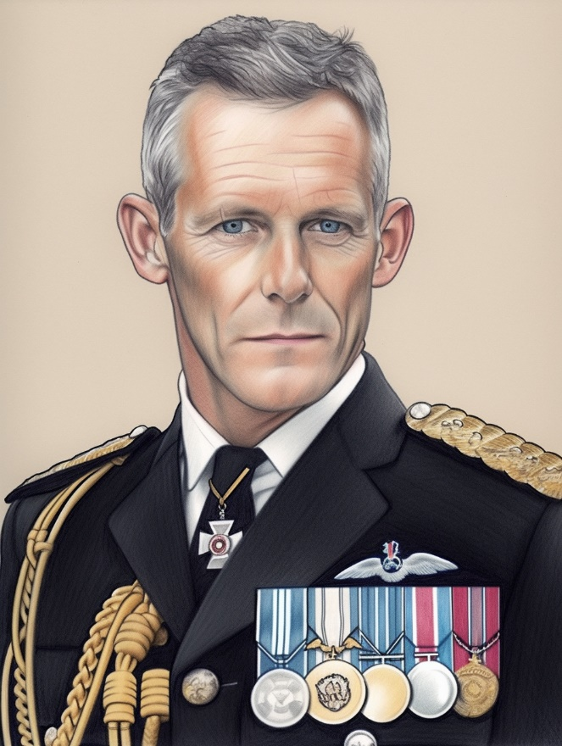
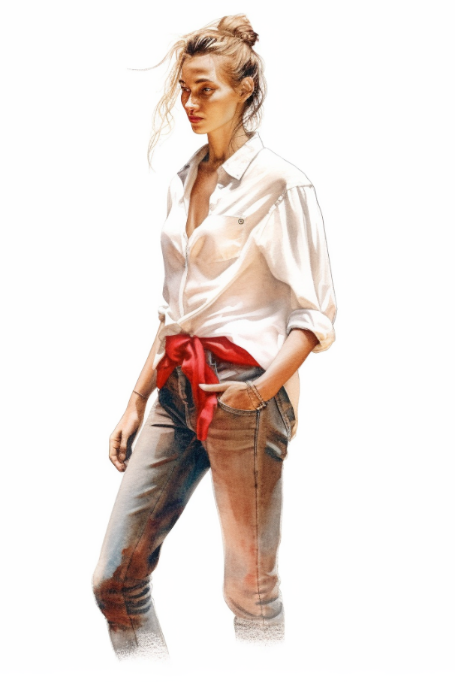
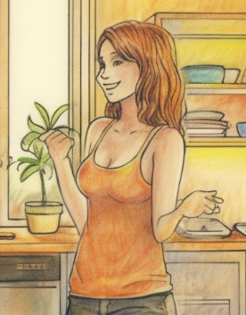
Reading for New Characters
Characters
John Parsons
Susie
Natalie

Slide 8
Reading for Themes
Human and Nature / Human and Society / Human and Self
Friendship
Family Love
This theme might be explored through characters who work together and support one another in pursuit of a common goal.
This theme can highlight the importance of forgiveness, understanding and emphasizes the idea that family members should always be there for each other, no matter what happens.

Slide 9
Reading for New Characters
Characters
John Parsons
Susie
Natalie
Appearance
Tall/ slim/ in a ponytail
with a pair of very grubby jeans
a huge white shirt covered in smears of red mud
Like a race horse walk into a paddock
Perfect/ beautiful/graceful
Not mentioned
Personality
Kind
Educated
Friendly
Snobby/ friendly?

Slide 10
Reading for Plot
Considering the plots can be quite complex, it's important to consider how they develop throughout a text.
Beginning
Rising
Climbing
Climax
Resolution
I imagine Natalie is smart and snobby and will hate me instantly.
I know I am going to really dislike Natalie.
I know that whatever else happens to me in my life, I want Natalie as a friend.
But I don’t say any of this to Nat, who I’m beginning to like a little less.
I sit back and think what it must be like to live in a family like this.
?
Befriend
?
admire
Dislike
Like a little less

Slide 11
Reading for Feelings
“Investigate yourself,” says Nat.
I’m wrong. She does have ideas. And she’s right.
PLOT
FEELINGS
1
2
3
Jake can’t speak Greek
Five years without seeing father
J: Astonished
N: Sorry
J: Hopeful
Nat offers help
N: Concerned
Then how?
Taxi company
J: Inspired
N: Confident

Slide 12
Reading for Language
1. “… ,” I say/ add/ reply/ tell/ continue/begin.
e.g. “Um…Natalie…” I begin.
2. “… ,” I say as I do.
e.g. “This is…,” Susie continues as she walks, “apart from…”
3. “… ,” I say, doing.
e.g. “Of course not,” I say, trying to sound keen and un-puddinglike.

Slide 13
Reading for language
4. This remark is shouted/yelled/screamed/howled “…”
e.g. This last remark is again shouted over her shoulder. “Ghosts and ghouls…”
5. “… ,” says a ADJ voice.
e.g. “Is that Jake?”, says a kind, educated voice. “John Parson here.”

Slide 14
Your Turn
Now, let's put these skills into practice by refining your draft. Good luck!

Slide 15
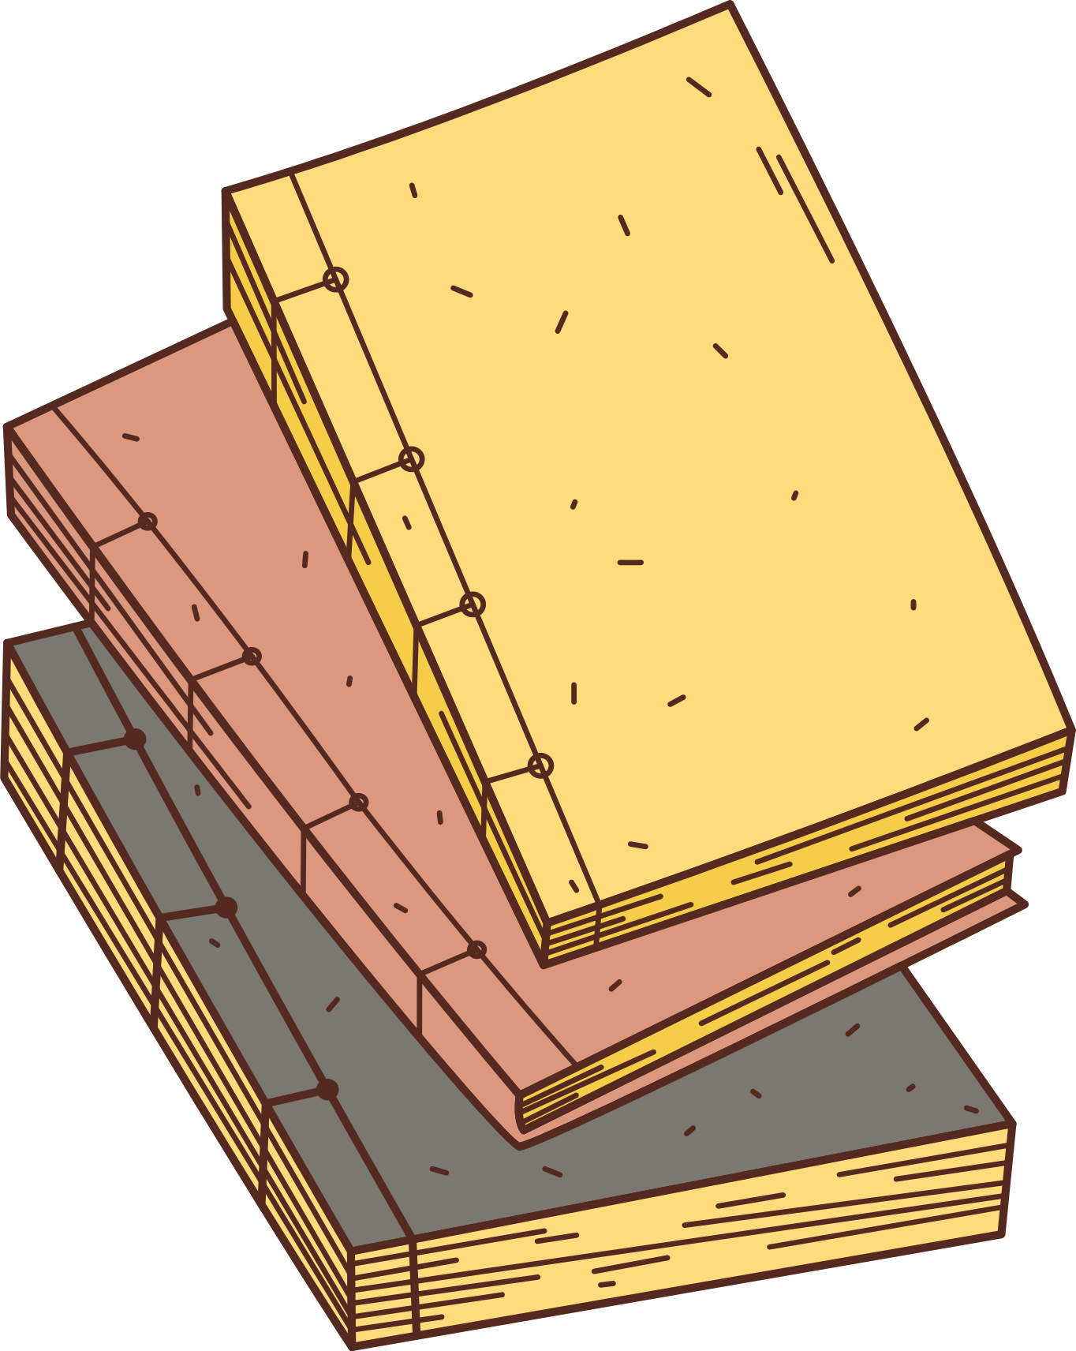
Thank you!

