Slide 1


感恩遇见，相互成就，本课件资料仅供您个人参考、教学使用，严禁自行在网络传播，违者依知识产权法追究法律责任。
更多教学资源请关注
公众号：溯恩英语
知识产权声明

Slide 2
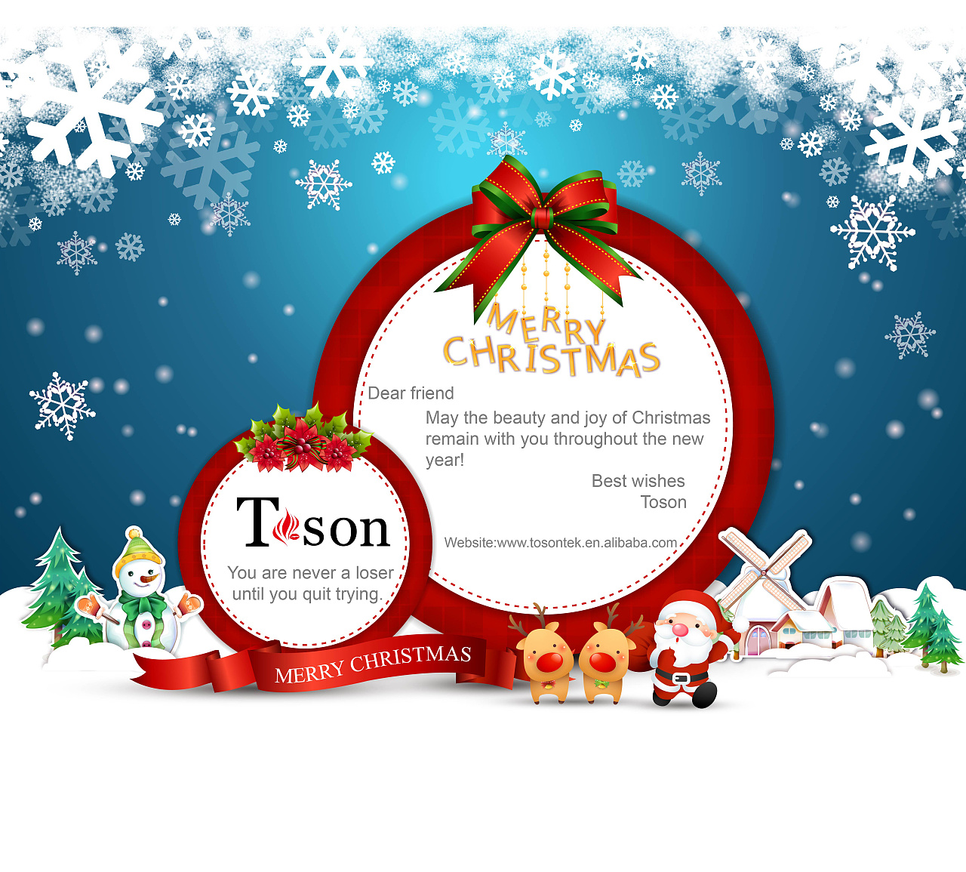
小小贺卡推销员
傅嘉

Slide 3


原文本
I faced a tight budget when I was nine. On November Ist, I used up most of the money I saved. With a small amount of pocket money left before Christmas I didn't have enough to buy presents for the family.
I was seriously considering going to my dad and asking for an advance on the next year's pocket money, so I could at least buy gifts for my family members. But then, one evening, I was sitting in my room reading advertisements in the back of a magazine. Several greeting-card companies were telling us how people could make money by selling their cards and stationery. Normally, I would have passed right over the ads, but this time my situation was so difficult that I felt I had nothing to lose.
The ad that attracted me most was one by a well-known greeting-card company in my nation, whose products were of high quality. With my parents' help, I contacted the company, although they preferred adults or older kids to advertise their products. After my sincere request, they agreed to give me, a nine-year-old boy, a chance.
My sales materials arrived within the week. I had expected something small and neat, but the package looked like a dinosaur's shoebox; it was close to three feet long and nearly a foot wide, full of stuff. There was a thick binder (活页夹)containing a complete selection of the cards and some writing paper, which I would be selling for around $3 per box.
Although my parents supported my try to make money by myself, they had little confidence in my success: after all, instead of an outgoing kid, I was somewhat shy. However, I was determined to have a try to challenge myself.

Slide 4
I faced a tight budget when I was nine. On November Ist, I used up most of the money I saved. With a small amount of pocket money left before Christmas I didn't have enough to buy presents for the family.
main idea
My tight budget & my problem

Slide 5
I was seriously considering going to my dad and asking for an advance on the next year's pocket money, so I could at least buy gifts for my family members. But then, one evening, I was sitting in my room reading advertisements in the back of a magazine. Several greeting-card companies were telling us how people could make money by selling their cards and stationery. Normally, I would have passed right over the ads, but this time my situation was so difficult that I felt I had nothing to lose.
main idea
Advertisements of greeting-card companies

Slide 6
The ad that attracted me most was one by a well-known greeting-card company in my nation, whose products were of high quality. With my parents' help, I contacted the company, although they preferred adults or older kids to advertise their products. After my sincere request, they agreed to give me, a nine-year-old boy, a chance.
main idea
the beginning of my job of selling cards

Slide 7
My sales materials arrived within the week. I had expected something small and neat, but the package looked like a dinosaur's shoebox; it was close to three feet long and nearly a foot wide, full of stuff. There was a thick binder (活页夹)containing a complete selection of the cards and some writing paper, which I would be selling for around $3 per box.
main idea
Brief introduction to a card box and its price

Slide 8
Although my parents supported my try to make money by myself, they had little confidence in my success: after all, instead of an outgoing kid, I was somewhat shy. However, I was determined to have a try to challenge myself.
main idea
my challenge & my determination

Slide 9

Read for hidden clues
Textual clues | Continuation echoes
With a small amount of pocket money left before Christmas I didn't have enough to buy presents for the family. | 1. Now with a big fortune, I had enough to buy presents/ gifts for my family.

Slide 10
Read for hidden clues
Textual clues | Continuation echoes
Several greeting-card companies were telling us how people could make money by selling their cards and stationery. Normally, I would have passed right over the ads, but this time my situation was so difficult that I felt I had nothing to lose. | 2. I did make money by selling its high-quality cards. Thanks to the ads on the back of the magazine, I found a great way to make my pocket money. 3. I lost nothing. Instead, I got something like confidence and being outgoing.

Slide 11
Read for hidden clues
Textual clues | Continuation echoes
With my parents' help, I contacted the company, although they preferred adults or older kids to advertise their products. After my sincere request, they agreed to give me, a nine-year-old boy, a chance. | 4. That week, I sold more products of the company than any other salesman who were more experienced than me. Giving me a chance meant to give themselves another opportunity to advertise their products.

Slide 12
Read for hidden clues
Textual clues | Continuation echoes
Although my parents supported my try to make money by myself, they had little confidence in my success: after all, instead of an outgoing kid, I was somewhat shy. However, I was determined to have a try to challenge myself. | 5. Seeing my rich profit from card sales, my parents just couldn’t believe their eyes. They took pride in my unexpected success as well as growth, grinning from ear to ear. 6. Though being shy, I didn’t let it stop me from advance towards my goal. The experience of selling card boxes that year made a big difference to my life--- it taught me how to face my challenge bravely.

Slide 13
Analysis of the story --- charater and plot
Key role： I, 9 years old, shy, but try to challenge myself
Minor role：1. my parents , support me , have little confidence
2. my family
3. a card company , give me a chance
Time： November before Christmas
Cause: have little money for Christmas presents
How: want to sell cards to make some money
Where: in my neighborhood
(要延伸也可以如neighboring / nearby neighborhood)
Result: I made money

Slide 14
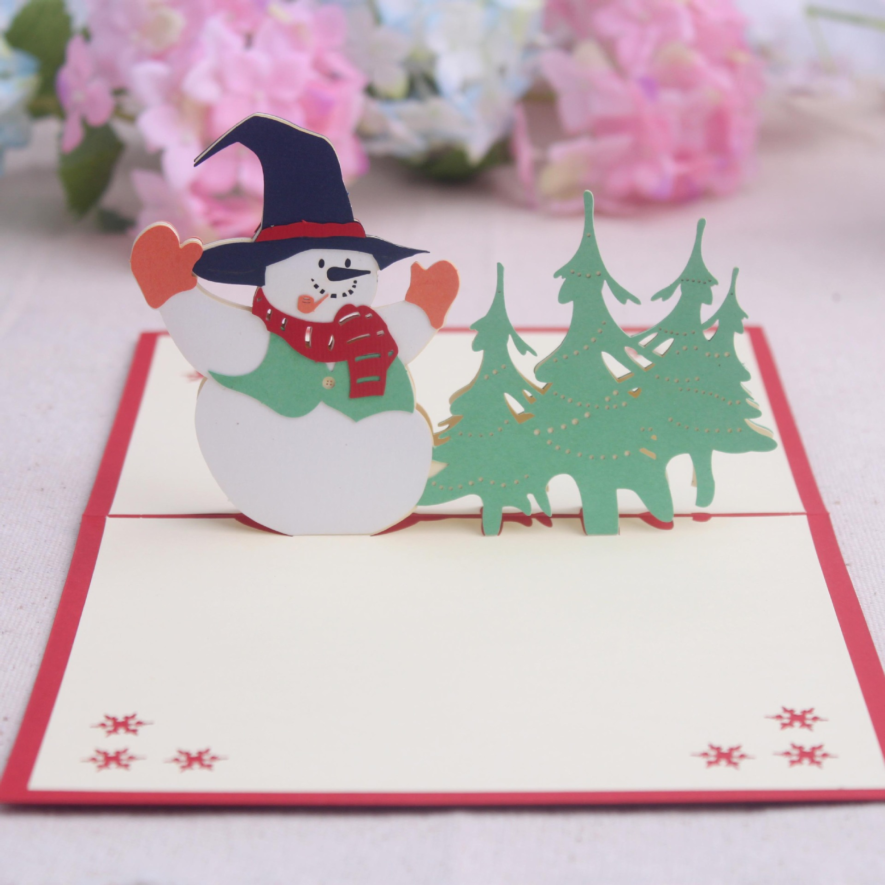
Design plots for each paragraph
Para1: Wasting no time, I set off and knocked on doors in my neighborhood.
第一段： 挨家挨户推销卡片。我9岁的小男孩，生性比较内向，一开始会遇到怎样的困难？会如何与顾客打交道？后来呢？有变化吗？

Slide 15
Design plots for each paragraph
Para2: Eventually, I earned over $20, a large sum of money for a 9-year-old kid in 1954.
赚钱了怎么花？可以回扣原文挣钱的动机。是否给家人买了礼物就可以结尾了呢？思考一下续写如果要有深度，一定要思考一下“我”为什么要写9岁时发生的事呢？是不是又什么特殊的意义？是否影响了我的人生？性格？等等。

Slide 16
三处衔接1、2处理
Although my parents supported my try to make money by myself, they had little confidence in my success: after all, instead of an outgoing kid, I was somewhat shy. However, I was determined to have a try to challenge myself.
Para1: Wasting no time, I set off and knocked on doors in my neighborhood.
Link1:
As the first door opened, I was so nervous that I could even sense my palms sweating.

Slide 17
三处衔接1、2处理
Para1: Wasting no time, I set off and knocked on doors in my neighborhood.
Para2: Eventually, I earned over $20, a large sum of money for a 9-year-old kid in 1954.
Link2:
Some people just turned my away politely, which kind of frustrated me. Others were stunned to see a shy ,smiling 9-year-old salesman trying hard to recommend exquisite greeting cards. Time ticking by, orders for cards came one after one! My efforts paid off!

Slide 18
衔接处3处理
Para2: Eventually, I earned over $20, a large sum of money for a 9-year-old kid in 1954.
Link3:
Now with a big fortune, I had enough to buy presents/ gifts for my family.

Slide 19
结尾句(句群）处理
Para2: Eventually, I earned over $20, a large sum of money for a 9-year-old kid in 1954.
Ending sentences:
Looking back, that experience taught me valuable lessons about perseverance, business communication skills, and the power of believing in oneself. Selling greeting cards in my neighborhood was a turning point in my young life, shaping the way I treated challenges and opportunities in the years to come.

Slide 20
各段句间主语平行或交叉进行叙事
Para1: Wasting no time, I set off and knocked on doors in my neighborhood.
（ 状语从句两个+情绪描写：紧张）
As the first door opened, I was so nervous that I could even sense my palms sweating.
2. （三连动：如何推销）
After sincere greetings , I stepped up, showed the card box in my hand and explained the high-quality greeting cards.

Slide 21
各段句间主语平行或交叉进行叙事
Para1: Wasting no time, I set off and knocked on doors in my neighborhood.
3. （呼应最后一段I was somewhat shy)
To tell you the truth, I did stutter quite badly in the beginning.
(迈出销售旅程的第一步）
Anyhow, this was my first step in my long selling journey and I made it.

Slide 22
5. （定从+邻居的反应）
Some people just turned my away politely, which kind of frustrated me.
6. （非谓语+邻居的不同的表现）
Others were stunned to see a shy ,smiling 9-year-old salesman trying hard to recommend exquisite greeting cards.

Slide 23
（独立主格结构+ 推销成果）
Time ticking by, orders for cards came one after one!
8. 或者 （with 结构+并列句：开始享受与邻居的各种互动）With each sale, my confidence grew and I began to enjoy the interaction with my neighbors.
9.（无灵主语句）
My efforts paid off!

Slide 24
各段句间主语平行或交叉进行叙事
Para2: Eventually, I earned over $20, a large sum of money for a 9-year-old kid in 1954.
1. （with 结构+我赚够了买礼物的钱）
Now with a big fortune, I had enough to buy presents/ gifts for my family.
2. (二连动：买礼物）
I decided to pause my card sales and conducted Christmas present purchases for every family member.

Slide 25
各段句间主语平行或交叉进行叙事
Para2: Eventually, I earned over $20, a large sum of money for a 9-year-old kid in 1954.
（夸张+ 家人得到礼物的喜悦）
The joyful laughter of opening my carefully-selected gifts was the most rewarding and the most ear-catching !
4. （强调句+ 反思）
It was my parents’ consistent support and my persistence as well as my bravery that made it!

Slide 26
5. （非谓语+ 反思） Looking back, I realized that experience taught me valuable lessons that I couldn’t learn from books.
6. （具体表现为恒心，商务沟通技能，强大的自信的力量）My short-lived salesman life taught me much about perseverance, business communication skills, and the power of believing in myself.
7. （定语从句 +人生转折点） Selling greeting cards in my neighborhood was a turning point in my young life, shaping the way I treated challenges and opportunities in the years to come.

Slide 27
习作欣赏
Para1: Wasting no time, I set off and knocked on doors in my neighborhood. As the first door opened, I was so nervous that I could even sense my palms sweating. After sincere greetings , I stepped up, showed my surprised neighbor the card box and explained the high-quality greeting cards. To tell you the truth, I did stutter quite badly in the beginning. Anyhow, this was my first step in my long selling journey and I made it. Some people just turned my away politely, which kind of frustrated me. Others were stunned to see a shy ,smiling 9-year-old salesman trying hard to recommend exquisite greeting cards. Time ticking by, orders for cards came one after one! My efforts paid off!

Slide 28
Para2: Eventually, I earned over $20, a large sum of money for a 9-year-old kid in 1954. Now with a big fortune, I had enough to buy presents/ gifts for my family. I decided to pause my card sales and conducted Christmas present purchases for every family member. The joyful laughter of opening my carefully-selected gifts was the most rewarding and the most ear-catching ! It was my parents’ consistent support and my persistence as well as my bravery that made it! Looking back, I realized that experience taught me valuable lessons that I couldn’t learn from books. My short-lived salesman life taught me much about perseverance, business communication skills, and the power of believing in myself. Selling greeting cards in my neighborhood was a turning point in my young life, shaping the way I treated challenges and opportunities in the years to come.

Slide 29
Para2: Eventually, I earned over $20, a large sum of money for a 9-year-old kid in 1954. I did make money by selling its high-quality cards. Thanks to the ads of the magazine, I found a great way to make my pocket money. I lost nothing. Instead, I got something like confidence and being outgoing. From that day to Christmas Eve, I sold more products of the company than any other salesman who were more experienced than me. Their products became a hit in Christmas market! Seeing my rich profit from card sales, my parents just couldn’t believe their eyes. They took pride in my unexpected success as well as growth, grinning from ear to ear. My shyness didn’t stop me from achieving my goal. The experience of selling card boxes made a big difference to my life--- it taught me how to face my challenge bravely.

Slide 30


