Slide 1
感恩遇见，相互成就，本课件资料仅供您个人参考、教学使用，严禁自行在网络传播，违者依知识产权法追究法律责任。
更多教学资源请关注
公众号：溯恩高中英语
知识产权声明

Slide 2
2020年11月衢州、湖州、丽水三地市
读后续写评析
Superhero with a Secret
浙江省衢州第一中学 徐荣仙

Slide 3
Superhero with a Secret
【写作背景】该篇读后续写是根据一个外刊的一篇原版文章改编而来的。原文总字数达1100多，考虑到字数多，故事情节比较复杂，词汇量偏大等综合原因，在不改变原版文章味道和故事情节构思的大致走向的前提下，对该故事进行了整合改编。故事大概描述的是作者被要求在一个生日晚会上扮演小丑蝙蝠侠的角色。但是作者一直有个想当filmmaker的情节，对于小丑这个角色心中有点抵触。所以那天明知道蝙蝠侠没有胡子，却偏偏把大胡子留着，扮演了蝙蝠侠小丑角色前往晚会的一系列经历和感触。

Slide 4
Superhero with a Secret
【心理动态剖析】本文考生需要读出故事的几个心理情绪：
作者对于扮演clown这个角色的心理情绪： struggle, ridiculous, confusing，have to, shameless, trash, more of
作者对于扮演Batman要不要留moustache的徘徊、纠结的心理
作者思考如何给kids一个surprise, 当作者还没决定该怎么办，就被发现了一个长有胡子的蝙蝠侠。此刻作者的尴尬和不知所措的心理

Slide 5
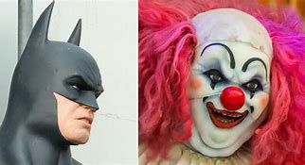
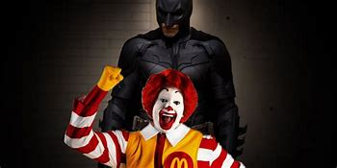
Further Reading for Implied Information

Slide 6
unwilling, hesitant, embarrassed, conflicted
My first year living in Los Angeles, I was a birthday-party clown（小丑）. I struggled a lot with my identity because, though I viewed myself as a filmmaker, everyone in my life viewed me as this ridiculous day job. To make matters more confusing, being a clown is itself an identity-masking job. You wear makeup to cover your features. Sometimes I’d have to wear a mask and completely cover my face.
For certain parties, I’d have to go as a specific character. The way that would work is someone from the company would drop off costumes for me the night before a party at an appointed spot. It was like a shameful deal.

Slide 7
make up his mind ; be determined to do...,; stick to his dream; not give way to; keep his original intention...
One night, they handed me my trash bag and said, “Tomorrow you’re going to be Batman.” Now, keep in mind that at the time I had a giant moustache. I know: a clown with a moustache—that’s a huge red flag for parents. But I hadn’t wanted to change my physical appearance for that job, because that would have been me subconsciously（下意识地）admitting I was more of a clown than an artist. So for the party, I chose not to shave.

Slide 8
unexpectedly; out of expectation; beyond expectation; contrary to what one expects
intend to make a surprise; plan to;
The next day, I went to the party. It was at this huge public park, and I had to leave my car parked far enough away so that the kids couldn’t see me getting off my car. So I was all the way on the edge of the park, and the only way for me to get to the party was to walk to it. Normally at these parties, all you have going for you is the element of surprise. You pop in through the front door: “Surprise! Batman’s here!” All the kids go crazy. Without the element of surprise, these visits are meaningless. So I thought, “Should I try to make an entrance（入场）for them?” Reflecting what to do next, I heard a scream, “Look, a Batman with a moustache!” Suddenly, the entire party broke out in laughter.
in a dilemma
what? how?

Slide 9
Analyze the Plots in the given Passage
struggle
ridiculous
confusing
batman
moustache
a huge red flag
park far enough
walk on the edge
make a surprise
before the party
one night
the next day
in a dilemma
not want to
not shave
be discovered
run back / go on
unwilling
climax
in a dilemma

Slide 10
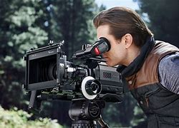
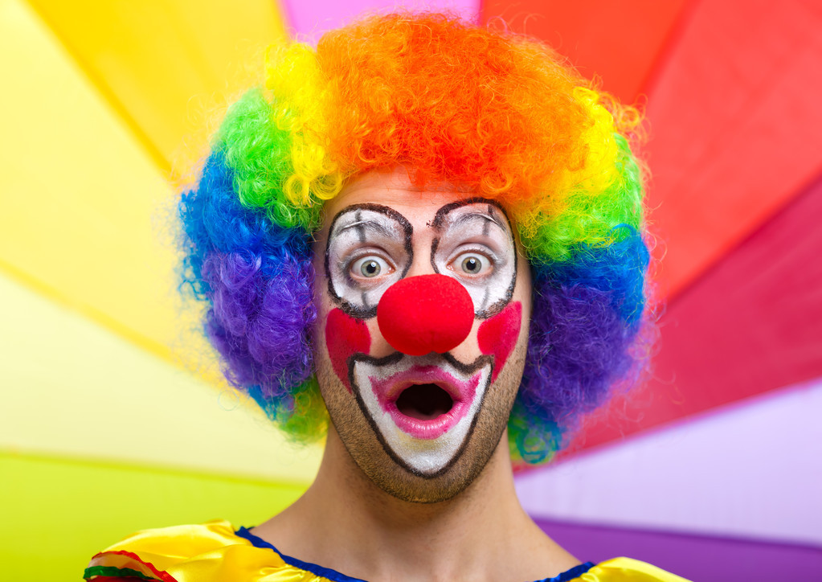
work out the plots
reasonable and appealing endings

Slide 11
Superhero with a Secret
【故事情节构思】
Paragraph1:
I was so embarrassed and wanted to run back.____________
Paragraph2:
I stared at the cake with a clown wearing a moustache in disbelief._________________________________________
抓住所给提示句的关键词，理出合理的构思线索。
心理描写
神态描写
动作描写
Paragraph1:
Why did the author feel embarrassed?
How did he react to the situation?
Who brought a cake with a moustache?

Slide 12
Superhero with a Secret
【故事情节构思】
Paragraph1:
I was so embarrassed and wanted to run back.____________
Paragraph2:
I stared at the cake with a clown wearing a moustache in disbelief._________________________________________
抓住所给提示句的关键词，理出合理的构思线索。
Paragraph2:
Why did the author feel unbelievable?
Why did the clown on the cake wear a moustache?
Why did they make such a cake?
What did the author learn from the birthday party？
心理描写
神态描写
动作描写

Slide 13
How to describe an embarrassing situation:
1. He smiled in an awkward almost apologetic way.
他笑得很尴尬，几乎象在道歉。
2. He laughed off an embarrassing situation.
他以笑来解除这种尴尬的处境。
3. An anguished look appeared on his face.
他面上浮现尴尬的表情。
4. At length these moments of constraint were removed.
这种尴尬的局面终于过去了
constraint n. 约束，强制，约束条件，对感情的压抑，虚情假意
5. Tipping over a chair put me in a tight spot.
被椅子绊倒,弄得我很尴尬。
in a tight spot adj. 处境困难

Slide 14
下水作文
I was so embarrassed and wanted to run back. I started to regret my choice to not shave, My face flushed as if I were sitting on pins and needles. How I wished I could find a hole to hide in it. But then the laughter kind of merged and changed into cheering and applause. Feeling kind of puzzled, I looked in the direction of the laughter. The birthday boy came towards me, pushing a dining cart with a huge birthday cake on it.

Slide 15
I stared at the cake with a clown wearing a moustache in disbelief. It's a thick black line drawn underneath his nose and curling around the side. It looks just like my moustache. It dawned on me that's why everyone was laughing so hard. Clearly, to save my face, someone made the magic clown. “Batman always has a mustache. He just shaves it for his movies.,” the birthday boy announced proudly. That year, I struggled a lot with my identity: was I a filmmaker or a clown? But that day, at least, there was no doubt in my mind what I was- a hero as a clown!

Slide 16
Some problems may occur in students' articles

Slide 17
三个衔接点：第一段、第二段首句与该段第二句的衔接，不要出现首句被孤立的情况；第一段段尾与第二段段首的呼应，第一段段尾按照情节发展应该是出现了cake, clown;
故事情节构建自然，不要出现一系列情绪或者环境描写的堆砌，重复，只是单纯为了呈现老师给与的背诵好句；
高三现阶段很多学生为了博取老师眼睛一亮，会使用很多生僻词、华丽词。注意这些生僻词华丽词使用语境的自然性、合理性。通篇文章的达意、语流顺畅更重要；
故事的结尾应该自然但是能拔高立意的，不要出现突兀性的哲理结尾或者矫揉造作的寓情于景式结尾；

