Slide 1
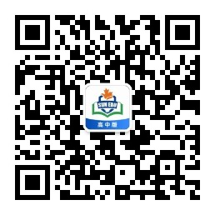
感恩遇见，相互成就，本课件资料仅供您个人参考、教学使用，严禁自行在网络传播，违者依知识产权法追究法律责任。
更多教学资源请关注
公众号：溯恩高中英语
知识产权声明

Slide 2

台州市2020年4月高三二模
应用文写作
A Letter of Information
Thinker, Tiantai High School

Slide 3
第一节应用文写作(满分15分)
假定你是李华，你校交换生 David有意加入学校阳光志愿者组织( Sunshine Club)，向你咨询相关情况，请你给他写一封回信，内容包括:
1.表示支持；
2.主要志愿活动；
3.申请方式。
注意:
1.词数80左右；
2.可适当增加细节，以使行文连贯。

Slide 4
假定你是李华，你校交换生 David有意加入学校阳光志愿者组织( Sunshine Club)，向你咨询相关情况，请你给他写一封回信，内容包括:
1.表示支持； 2.主要志愿活动； 3.申请方式。
1.文体：信件 （回复咨询+告知）
2.主题：支持加入组织+活动介绍
3.要点：写信目的、活动介绍、申请方式
4.格式：称呼、开头语、正文、尾句、署名
5. 字数与拼写：90字左右， 7-9句

Slide 5
Framework：
Para 1
Para 2
Para 3
1. 背景：交换生 David有意加入学校阳光志愿者组织+咨询相关情况
2.目的：支持加入+告知信息
1. 主要志愿活动
2. 申请方式
1. 期待加入
Tip: 为了段落平衡，可以把2.申请方式放到第3段。

Slide 6
Para 1:
1.问候
1. How is everything going with you?
2. How are things going with you?
3. How are you doing?
4. Hope this letter finds you fine.
5. Greetings from Li Hua!

Slide 7
Para 1:
2.背景+目的
1. I’m delighted/ thrilled to learn that you have a desire to join the school Sunshine Club. Here, I’d like to express my support for you and share with you some detailed information about the club.
2. Learning that you want/ desire/ would like to be a member of the school Sunshine Club, I’m writing to convey/ extend my support and inform you of relevant information about the club.
3. Delighted/Thrilled to learn that you are to join the school Sunshine Club, I’d like to show my eagerness to have you with us and briefly introduce the club to you.

Slide 8
Para 1:
2.背景+目的
4. Learning from your last letter that you desire/plan/intend to join the school Sunshine Club, I’m really delighted at that and would like to tell you some detailed information.
5. I’m really delighted to learn your desire to be admitted into the school Sunshine Club. Here, I’m writing to welcome /embrace you into this big family and have you informed of the relevant information in details.

Slide 9
Para 2:主要志愿者活动：
Tips（思维拓展）：
1.一般只写两个/项活动；
2.活动应该围绕“阳光”、“志愿者”、 “学生”来展开；
Possible events：
1. Beautify the campus
2. Help the students in need
3. Clean public places
4. Visit the old people in the nursing home
5. Advocate the environmental protection in a community
6 ….

Slide 10
Para 2:主要志愿者活动
Tips （表达拓展）
1.本段落建议采用“总-分”或者“总-分-总”结构, 用3-4句话完成。
2.用定语从句、非谓语动词做状语、状语从句等拓展句子结构的丰富性，从原因、目的、结果等角度来拓展表达的宽度和深度。

Slide 11
总：
(拓展：俱乐部活动的初衷)
1. Meant/Designed to help people in need, the club organizes various activities regularly.
2. To help out people in need as well as enrich our school life, the club organizes various voluntary activities.
3. To bring sunshine and comfort to the people in need, we organize different activities.
4. Aimed at raising our awareness of serving the public and helping the needy, the club offers many different activities.
5. Different activities are regularly organized.

Slide 12
具体活动：
1. The club holds various activities, such as visiting the nursing home and charity sale, which offer you a chance to enhance your problem-solving abilities.
2. Not only do we donate books and school supplies to the students, who would otherwise drop out, we also visit the nursing home, bringing sunshine and comfort to the old people there.
3. Sometimes we clean up the Center park, making our city a beautiful and tidy one. Besides, a visit to the old people’s home with some performances to cheer them up is also regularly paid.

Slide 13
Para 2/3:申请方式
1.To be a member, you need to send your application (form) to Students’ Center before May 10th.
2. Remember to submit your application at the school website no later than May 10th.
3. To be officially admitted, you are expected to fill in the application attached and send it to Miss Zhao, the teacher in charge before May 10th.
4. An application needs to be filled and sent to Miss Zhao for your admission.
5. If you have any further questions, feel free to ask me/ don’t hesitate to ask me.

Slide 14
改卷反馈：表达典型性错误
1. I’m delighted to learn that you are intended to participate in our school Sunshine Club.
2.I’m writing to express my sincere suppose to your decision.
3. Glad to learn that you’d like to join the Sunshine Club, so I’m writing to express my full support.
are intended to 改成intend to; participate in 改成join。
弄混淆intend to do和be intended to do之间的不同用法；还有表示“参加”的几个词的区别。
support改为suppose。
把support误当作suppose。
删掉so 。
前半部分不是完整的句子，不可以用连接词。

Slide 15
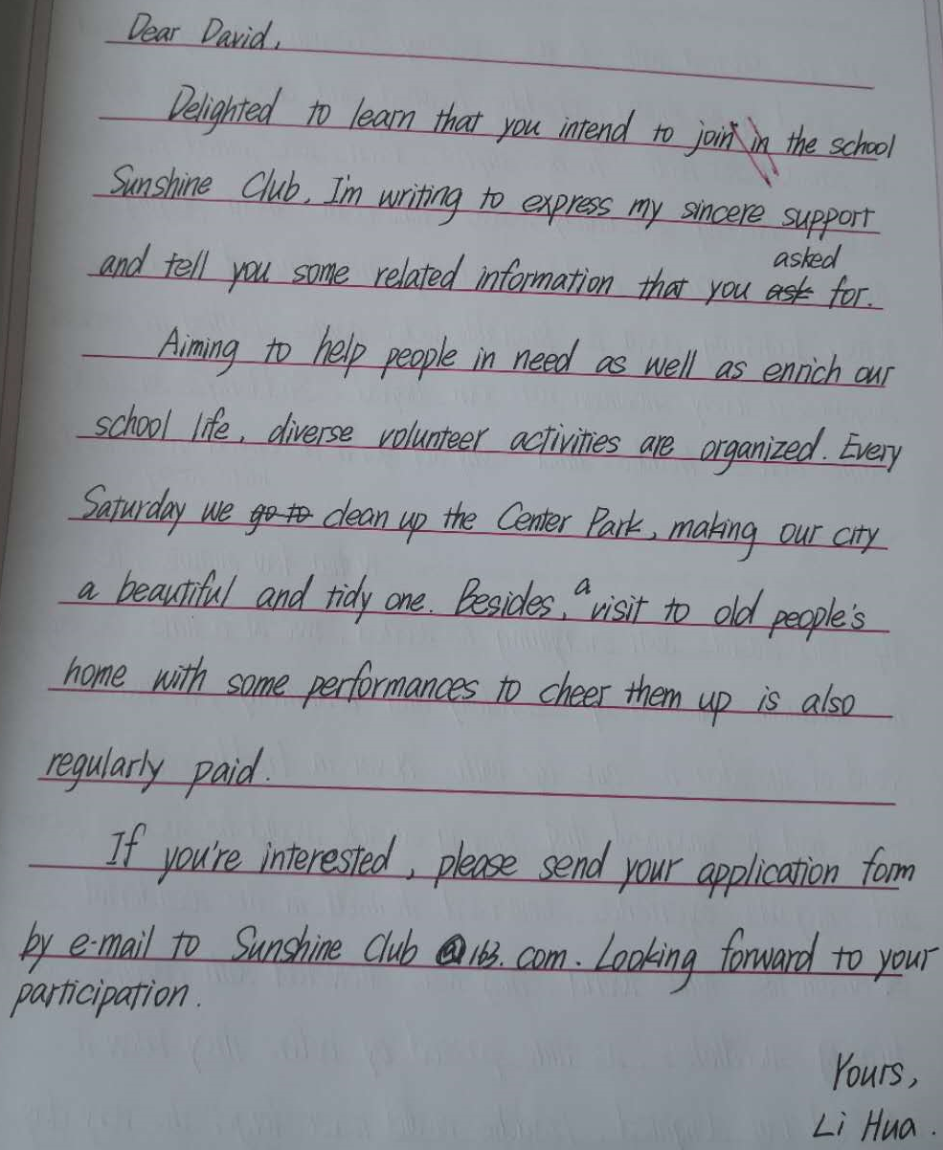
【考场作文】
点评：
本篇作文结构层次清晰，要点齐备，达到了organized的要求。应用了分词作状语、定语从句、被动语态、无灵主语句等多种语法结构，表达干脆而又多样化，达到了rich的要求。语言上运用了较多的高级词汇和复杂结构，有较强的语言驾驭能力。显性连接和隐形链接运用得体，文本读起来一气呵成。总体上，可以给这篇作文定位第五档。

Slide 16
【下水作文】
Dear David,
How’s everything going? Delighted to learn that you’d like to join the school Sunshine Club, I’m writing to express my support for you and share relevant information with you.
Meant to help people in need, the club organizes various activities regularly. We donate books and school supplies to the students, who would otherwise drop out. Sometimes, we also visit the nursing home, bringing sunshine and comfort to the old people there.
To be a member, you need to send your application (form) to Students’ Center before May 10th. Looking forward to your joining us.
Yours,
Li Hua (96)

Slide 17
【参考范文】
Dear David,
Glad to know your desire to be a volunteer of the Sunshine Club. As a member, I do regard it worthwhile to be engaged in volunteering and I’m writing to give you my full support.
As for major activities, regularly, we are committed to raising funds and donations for those in need. Sometimes, we hold events in the local community to promote people’s awareness of environmental protection.
Once you have decided, please fill in the application form attached and send it to me. Looking forward to your participation.
Yours,
Li Hua (93)

Slide 18
同类型作文巩固练：2019.9名校协作体
假如你是李华，下周瑞典某中学师生团将来你校进行访问。请你给你将接待的瑞典学生 Peterson写封电子邮件，内容包括：
1.表示热烈欢迎；
2.告知活动安排；
3.询问有何要求。
注意:
1.词数80词左右；
2.可适当增加细节，以使行文连贯。

Slide 19
【下水作文】
Dear Peterson,
I'm Li Hua, writing to express my heartfelt exhilaration to your coming and inform you of some detailed arrangements.
During your stay, you'll be accommodated at my home, and go to and from school with me everyday. At school you will attend our colorful optional classes ranging from calligraphy to martial arts, which will surely open up a whole new dimension in your understanding of Chines culture. Besides, we will go to the West Lake to appreciate its picturesque scenery and cultural relics before you leave. I believe you will get fully immersed in its ever-changing beauty.
If you have any others requirements, do not hesitate to e-mail me. Looking forward to your coming.
Yours,
Li Hua

Slide 20
【参考范文】
Dear Peterson,
How is everything going? I'm writing to express my great pleasure to host you during your stay in our school.
We have made colorful arrangements for you. You will visit our class, attend our English spelling competition and join us in doing sports. You will be shown around the West Lake, taste Hangzhou cuisine and visit the Song City, a theme park, where you can experience various ancient Chinese cultures. I'm fully convinced that it will add a brilliant touch to your stay here.
Don't hesitate to let me know if you have any requirements. I'm looking forward to meeting you soon.
Yours Sincerely,
Li Hua

