Slide 1
感恩遇见，相互成就，本课件资料仅供您个人参考、教学使用，严禁自行在网络传播，违者依知识产权法追究法律责任。
更多教学资源请关注
公众号：溯恩高中英语
知识产权声明

Slide 2
Learning goals
After this period, hopefully we will be able to:
analyze the structure of the passage
understand the logic of the writing
grasp the message of the author
form the positive attitude towards success
learn to be confident when meeting challenges in life
Complete a micro-writing with the language from the reading.

Slide 3
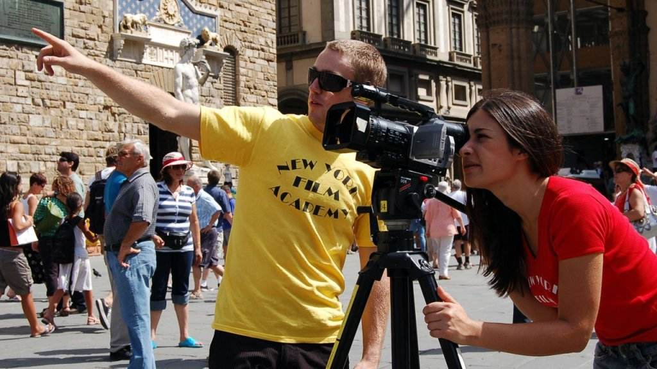
Expanding Reading
Senior 1
SUCCESS TAKES TIME

Slide 4
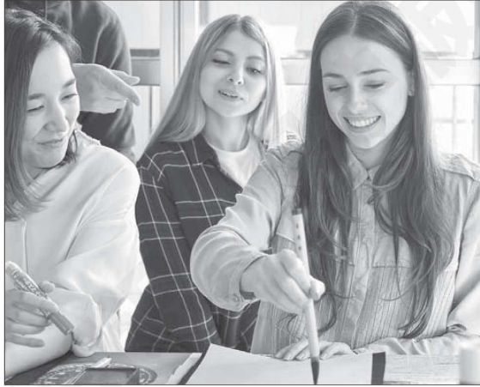
Pre-reading
Prediction
Success Takes Time
Q1: Can you share with us an experience with success in your life?
Q2: What will be talked about in
the passage according to the
title and picture ?

Slide 5
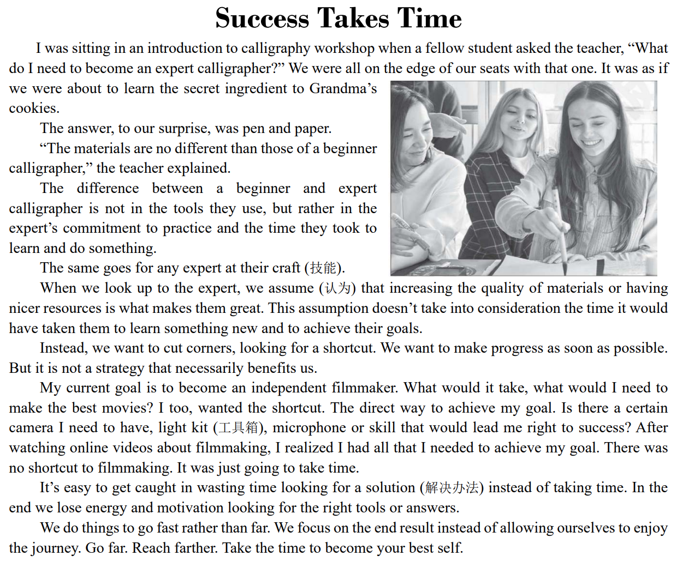
While-reading
Reading for the structure
Introduce the
the topic
Propose the view
Support the view
Draw a Conclusion

Slide 6
While-reading
Reading for the key information
A lesson from a calligraphy workshop
The commitment and the time spent on the goal
The author’s own experience
Enjoy the process

Slide 7
While-reading
Part 1
Reading for the details
on the edge of one’s seat: very excited and giving your full attention to something
极为激动；有浓厚兴趣
I was sitting in an introduction to calligraphy workshop when a fellow student asked the teacher, “What do I need to become an expert calligrapher?” We were all on the edge of our seats with that one. It was as if we were about to learn the secret ingredient to Grandma’s cookies.
The answer, to our surprise, was pen and paper.
“The materials are no different than those of a beginner calligrapher,” the teacher explained.
Where
Who
What
How
A workshop
I, fellow student and teacher
Interaction
(互动)
The student
The teacher
How to become an expert calligrapher
Just pen and paper
materials
excited, eager and surprised
Do you agree with the teacher’s answer? Why?

Slide 8
While-reading
Part 1
Reading for the details
The difference between a beginner and expert calligrapher is not in the tools they use, but rather in the expert’s commitment to practice and the time they took to learn and do something.
The commitment to practice
The expert
The time to learn and do sth.

Slide 9
While-reading
Part 2
Reading for the details
The same goes for any expert at their craft (技能).
When we look up to the expert, we assume (认为) that increasing the quality of materials or having nicer resources is what makes them great. This assumption doesn’t take into consideration the time it would have taken them to learn something new and to achieve their goals.
Instead, we want to cut corners, looking for a shortcut. We want to make progress as soon as possible. But it is not a strategy that necessarily benefits us.
A connecting sentence
Contrast(对比)
People’s assumption
Experts
*increase the quality of materials
*have nicer
resources
* want to cut
corners
* The time
To learn sth new
To achieve their
goals
Q: What’s the writer’s attitude to the shortcut?

Slide 10
While-reading
Part 3
Reading for the details
My current goal is to become an independent filmmaker. What would it take, what would I need to make the best movies? I too, wanted the shortcut. The direct way to achieve my goal. Is there a certain camera I need to have, light kit (工具箱), microphone or skill that would lead me right to success? After watching online videos about filmmaking, I realized I had all that I needed to achieve my goal. There was no shortcut to filmmaking. It was just going to take time.
●
Self-reflection
(内省)
No shortcut , just take time
An independent filmmaker
▏
Watching
videos
●
Looking for a direct way to achiever my goal
My goal

Slide 11
While-reading
Part 4
Reading for the details
It’s easy to get caught in wasting time looking for a solution (解决办法) instead of taking time. In the end we lose energy and motivation looking for the right tools or answers.
We do things to go fast rather than far. We focus on the end result instead of allowing ourselves to enjoy the journey. Go far. Reach farther. Take the time to become your best self.
Which circle can help us achieve our goals?
A) Look for the right tools or answers
B) Go far; Reach farther.
C) Enjoy the journey
A) Just spend time looking for a solution
B) Go fast
C) Focus on the end result
×
√
the process (过程)

Slide 12
After-reading
Group discussion
Topic | Success Takes Time
L What we have learned | S Share what we have learned

Slide 13
After-reading
Micro-writing
Translate the following sentences with the phrases given in the brackets and then form a short paragraph by adding proper transitional words.
1. 李教授在学校报告厅给我们做了一个如何实现目标的讲座。(achieve one’s goal)
2. 同学们都兴奋不已，(on the edge of one’s seat), 因为似乎会找到走捷径的方法(it was as if…., cut corners)。
3. 令我们感到惊讶的是，李教授告诉我们学习没有捷径可走的。(There is no shortcut to doing…)
4. 他解释说我们只有专注于功课(focus on)，才能取得进步。(make progress)
5. 我认识到我不能耽于(get caught in…)浪费时间寻找捷径，而是要花时间(take time)学习新的东西。

Slide 14
After-reading
Micro-writing
One possible version
In the lecture hall, Mr. Li gave us a lecture on how to achieve our goals. We were on the edge of our seats, because it was as if we would find a way to cut corners. However, to our surprise, Mr Li told us that there was no shortcut to learning. He explained that we could make progress if we focused on our schoolwork. Because of Mr Li’s lecture, I’ve realized that I should take time to learn new things, rather than get caught in wasting time looking for shortcuts.

