Slide 1


感恩遇见，相互成就，本课件资料仅供您个人参考、教学使用，严禁自行在网络传播，违者依知识产权法追究法律责任。
更多教学资源请关注
公众号：溯恩高中英语
知识产权声明

Slide 2
Module Two Unit Two
REC
HD
4K
25FPS
Wildlife Protection
嵊州市高级中学 尹 娟
MENU

Slide 3
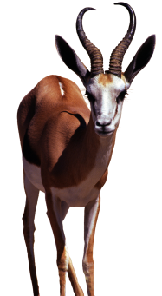
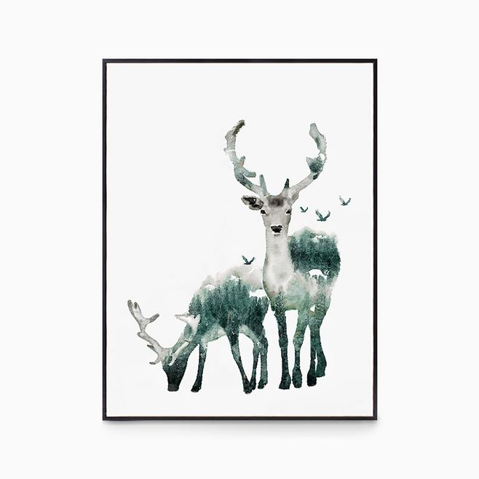
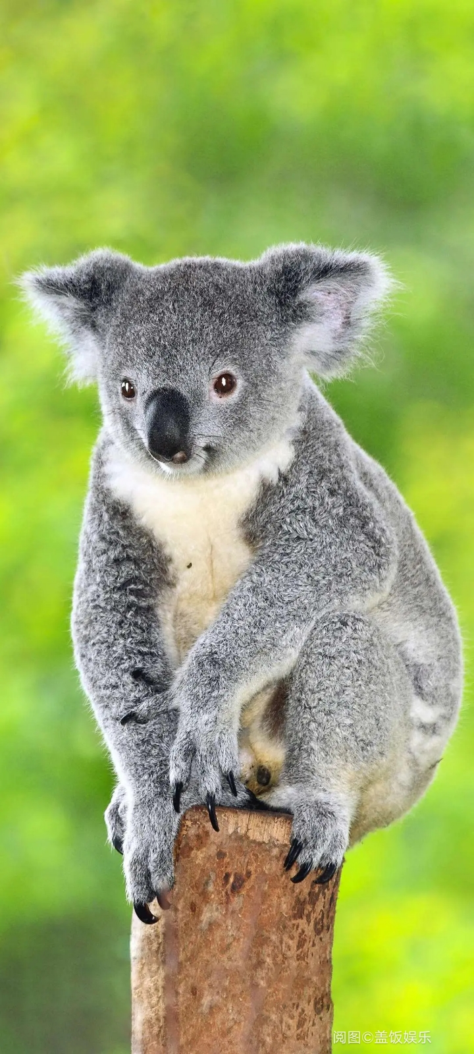
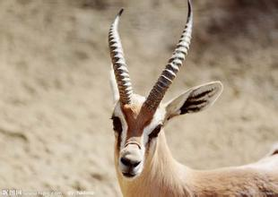
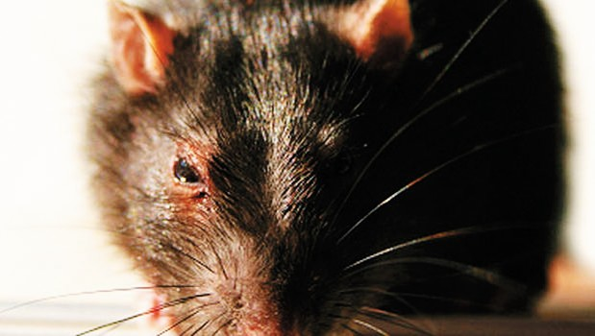
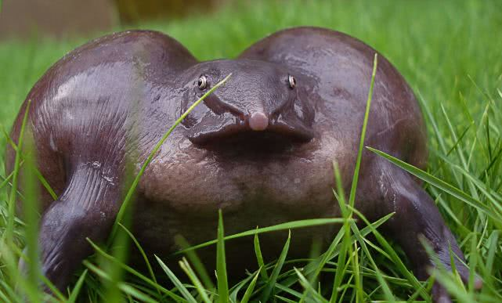
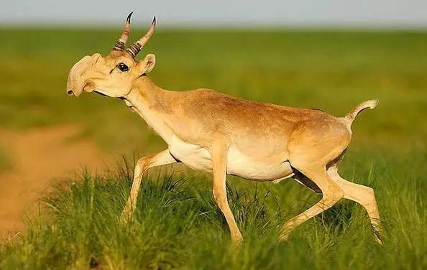
What do you think about the animals when you see these pictures?
Beautiful
Lovely
Graceful
(优雅的)
Attractive
Suppose you are asked to protect one of them, which one would you like to choose? And why?
Ugly
Terrible
Frightening
Unttractive

Slide 4

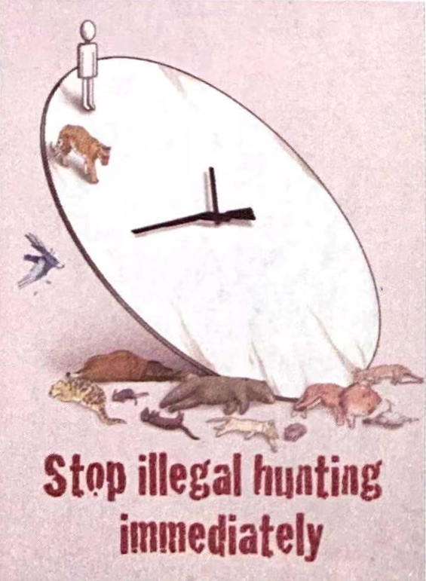
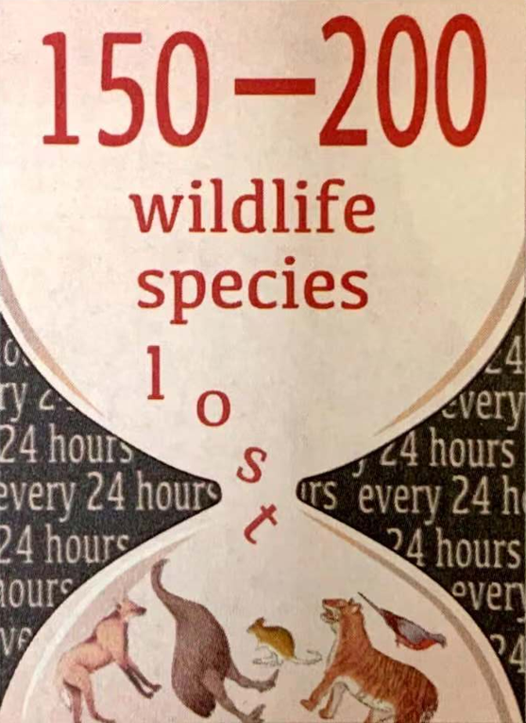
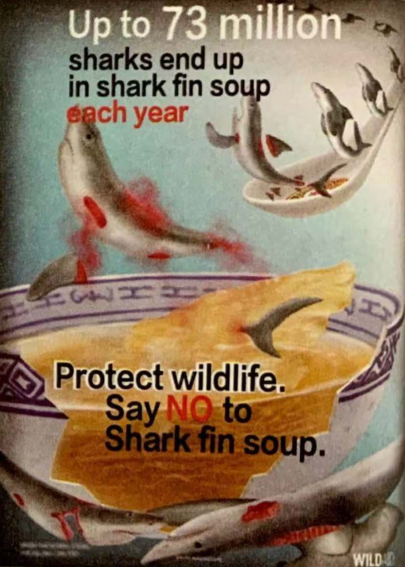
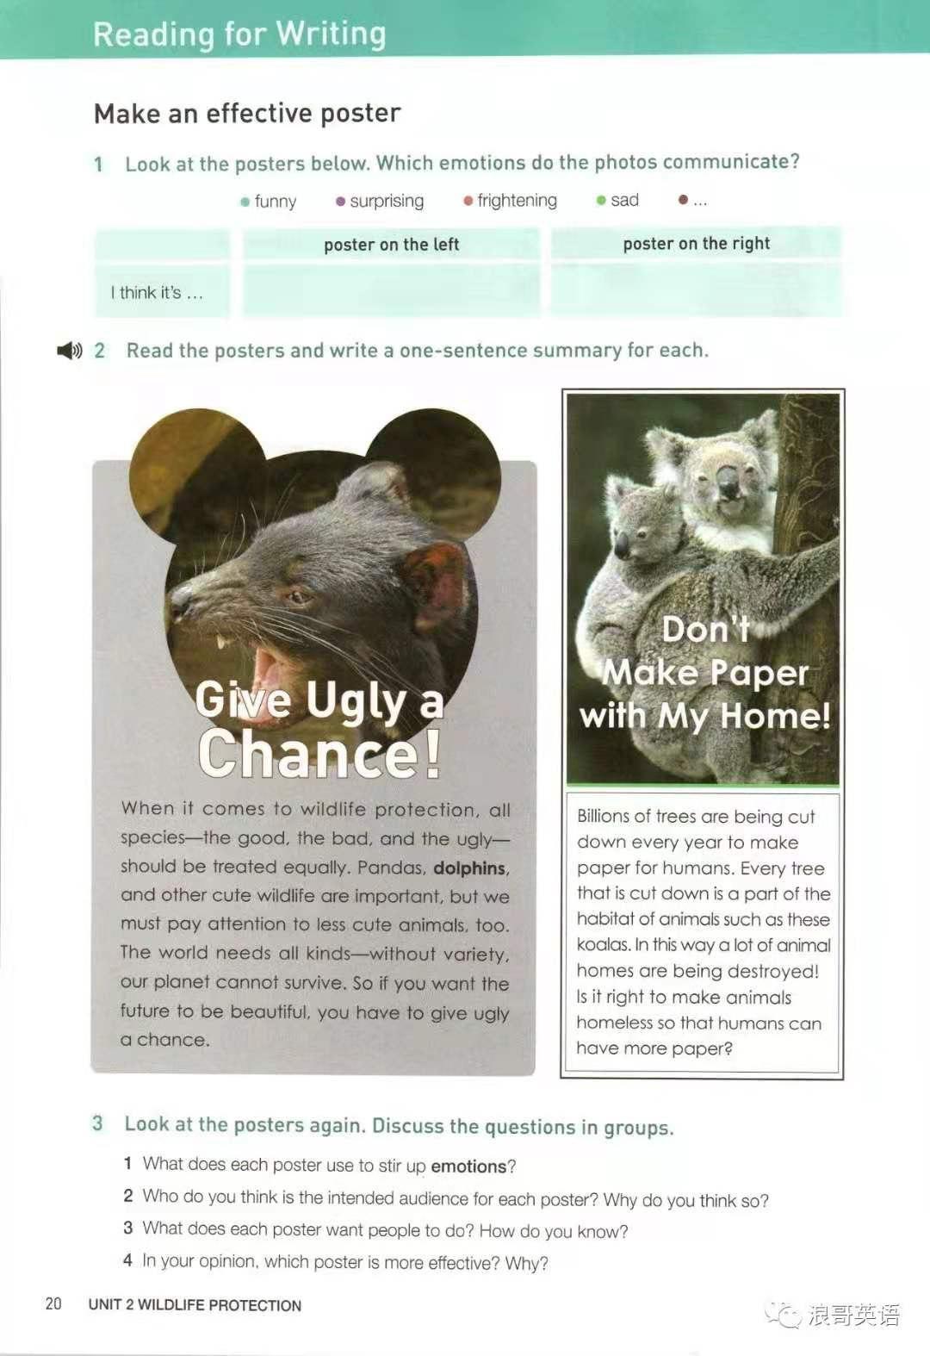
The alarming situation of wildlife
illegal hunting
unreasonable eating habit
habitat destruction
wildlife species loss
appearance prejudice
Our planet's wildlife is dying out at an alarming rate. Between 150 and 200 species are becoming extinct every day. This mass extinction is caused by hunting, habitat loss, and pollution. We must make people aware of the problem and help protect the endangered wildlife before it's too late.

Slide 5
Appreciate the poster: Give ugly a chance!
Questions:
1 What does this poster use to stir up emotions?
2 Who do you think is the intended audience for each poster? Why do you think so?
3 What does the poster want people to do?
An ugly picture framed by a Mickey Mouse outline to get a reaction from the reader.
All the people in the planet.
The world...our planet...the future...
Treat the “ugly” equally and be aware of the importance of them.

Slide 6
Appreciate the poster: Don't make paper with my home!
Questions:
1 What does this poster use to stir up emotions?
2 Who do you think is the intended audience for each poster? Why do you think so?
3 What does the poster want people to do? How do you know?
A cute picture and a headline in the tone of Koalas.
The humans.
Most all of the humans use paper in daily life.
Protect the natural habitat of animals and pay more attention to the paper consumption.

Slide 7
Analyse the language feature
When it comes to wildlife protection, all species...
the adverbial clause
All species—the good, the bad, and the ugly—should be treated equally.
the passive voice
the active voice
..., but we must pay attention to less cute animals, too.
So if you want the future to be beautiful, you have to give ugly a chance.
the adverbial clause
Billions of trees are being cut down ....
... homes are being destroyed
the present continuous passive voice
Every tree that is cut down is a part of the habitat of animals ...
the attributive clause
Is it right to make animals homeless so that humans can have more paper?
the rhetorical question

Slide 8
Analyse the characteristics of these posters
Image
Tempting and powerful images
Imperative sentences(祈使句) and exclamatory sentences(感叹句)
Title
Situation
Urgent problems and
detailed information
Language feature
Various sentence patterns and
appropriate tense and voice
Ending part
Specific and reasonable appeals

Slide 9
Make an effective poster
The steps to organise your poster:
Step 1: Write a title that is simple, interesting, and unusual, and
then collect the information you need.
Step 2: Write the name of the species and why it is endangered.
Step 3: Use a powerful image to attract the readers' attention
to the facts and problems.
Step 4: Use different sentence patterns and appropriate tense
and voice.
Step 5: Tell the readers what you want them to think and do.

Slide 10
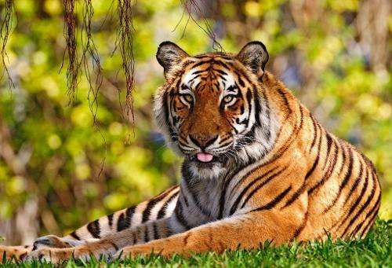
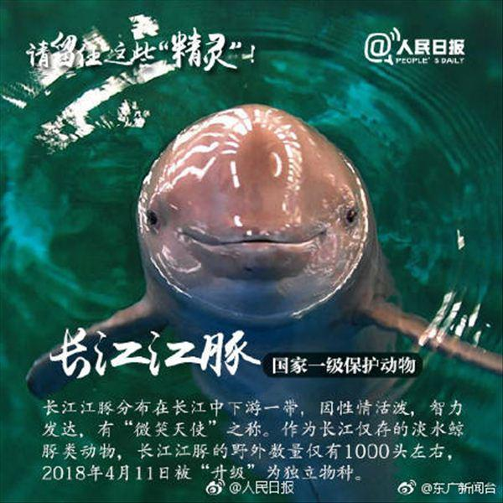
Make an effective poster
South China Tiger Why is it endangered? Hunted for its skin and fur
Population: 0 in the wild; 30-80 still living
What is being done? A plan is being carried out to
increase the number of wild tigers. What can we do? Do not buy fur or other tiger products!
Yangtze River Dolphin
Why is it endangered? Habitat loss and pollution
Population: 1,000—1,800
What is being done? The dolphins are being moved
to a clean and safe habitat.
What can we do? Clean up the rivers!

Slide 11
Sample Writing
Being called South China Tiger, this kind of animal now is considered to be precious and important. However, hunters were shooting them without mercy to make profits because of their skin and fur. As a consequence, there is no South China Tiger in the wild, and only 30-80 are still living in the zoo. Thanks to the increase of the awareness, a plan is being carried out to increase the number of wild tigers. If we hope our young generations can see this species in the wild, we shouldn't buy fur or other tiger products! When the buying stops, the killing can too.
Do not make us
become a memory!

Slide 12
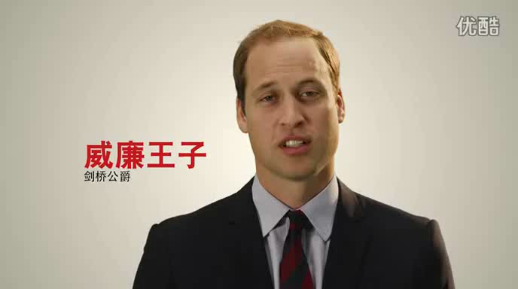

Slide 13
Thank you!

