Slide 1

感恩遇见，相互成就，本课件资料仅供您个人参考、教学使用，严禁自行在网络传播，违者依知识产权法追究法律责任。
更多教学资源请关注
公众号：溯恩高中英语
知识产权声明

Slide 2
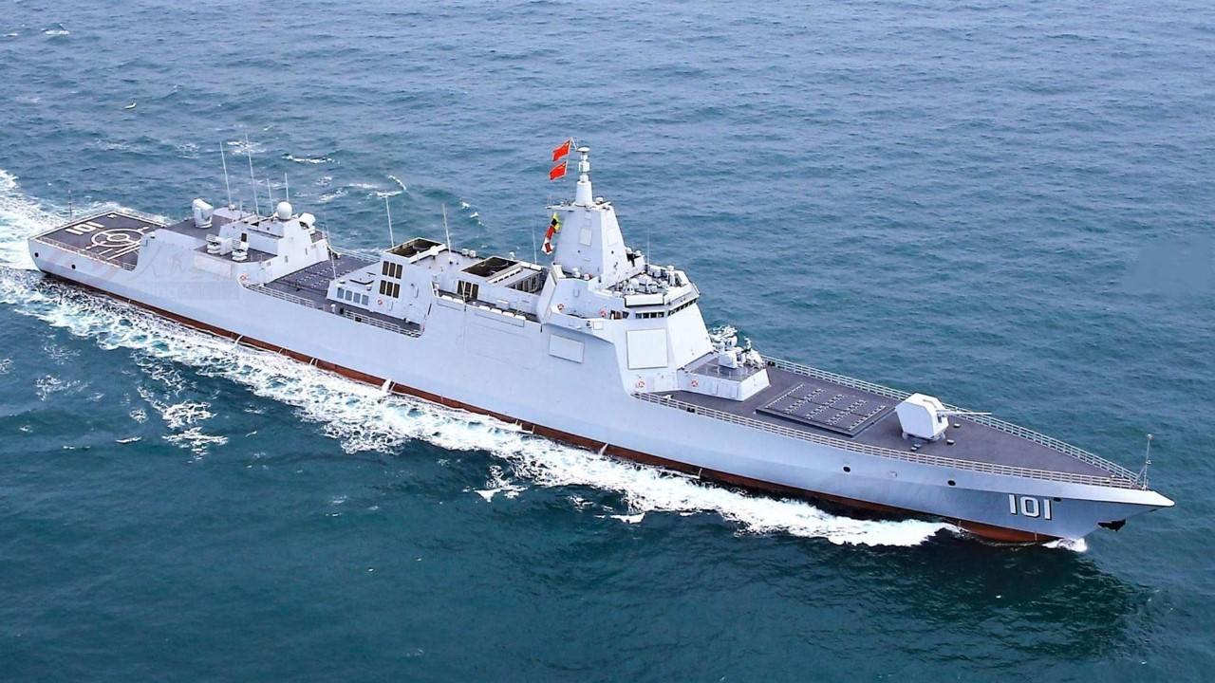
UNIT 3
Using Language (2)
Express your opinions on sea exploration

Slide 3
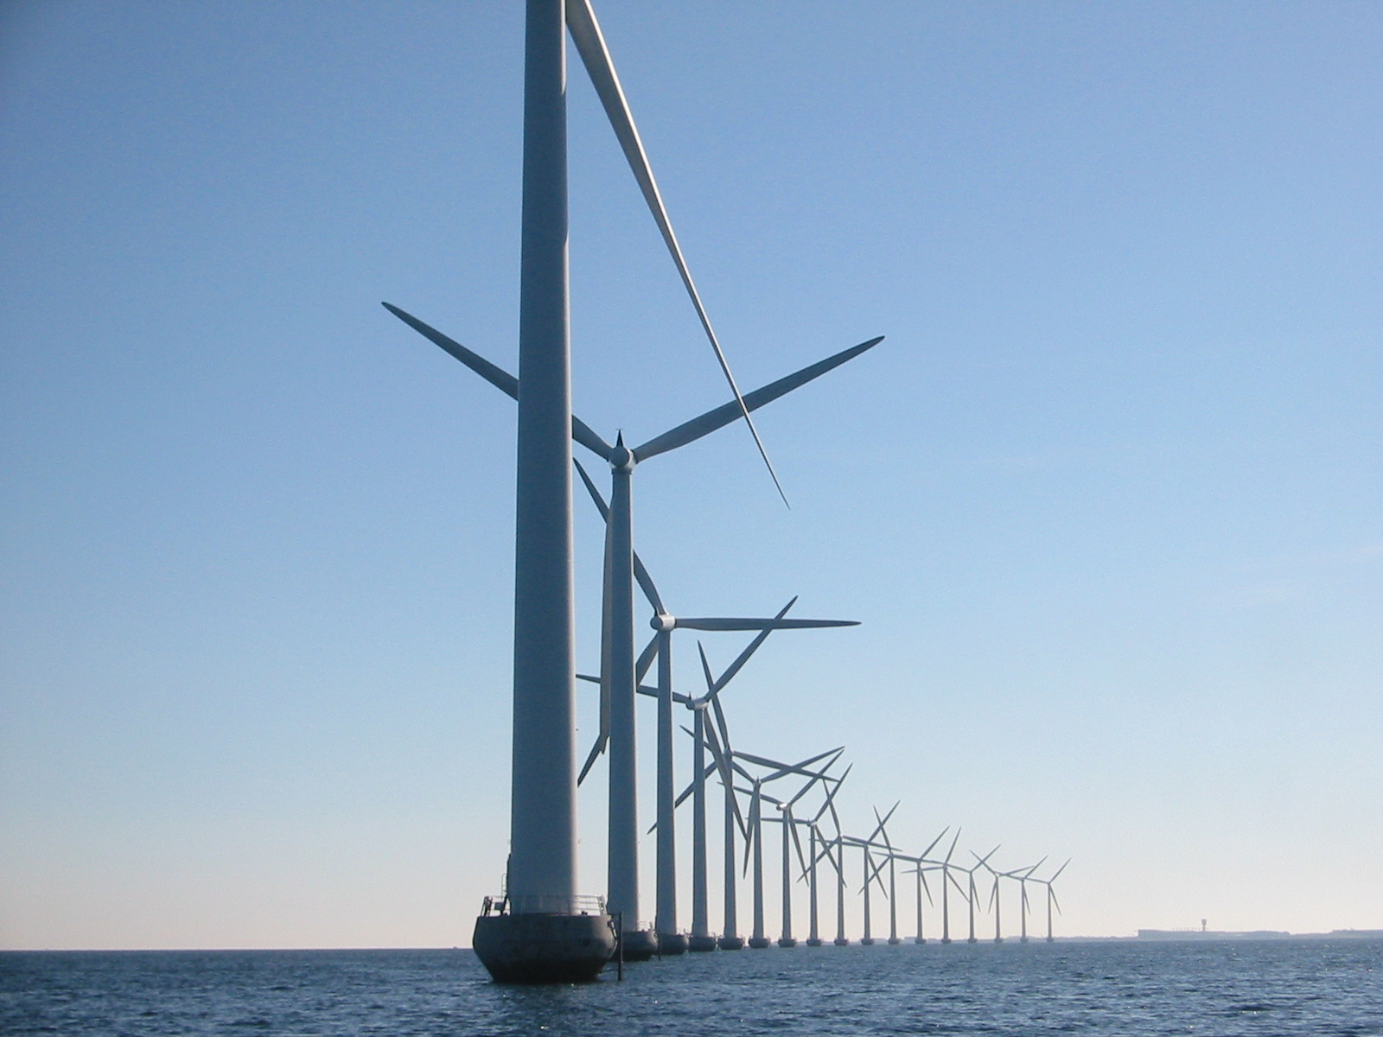
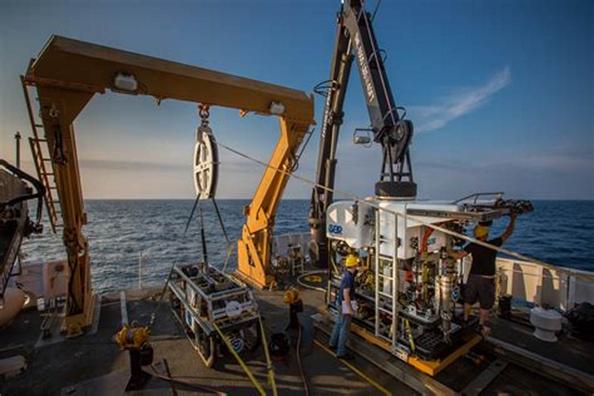
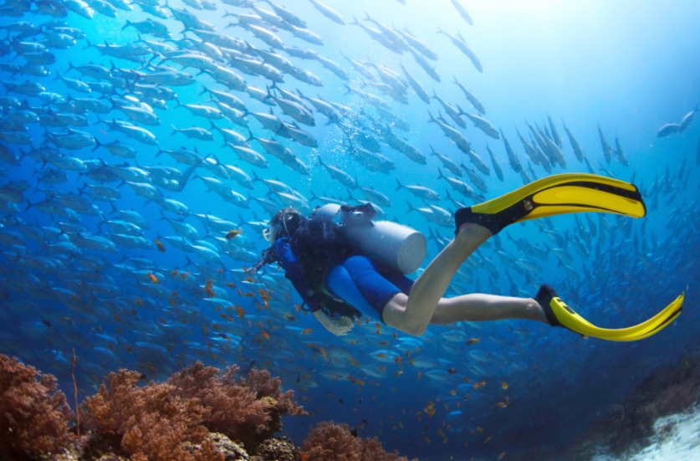

Pre-reading
Generate electricity
Exploit resources
discover new species
What did you know something about sea exploration?
What are the advantages/ disadvantages of sea exploration?

Slide 4
Pre-reading
What is the content of the two passages about?
They are mainly about the sea exploration.
1
2
What is the text type of the two passages?
Argumentative essay.
3
What are the three parts of an argumentative essay?
Argument, evidence, restatement/ recommendation/ a call to action.

Slide 5
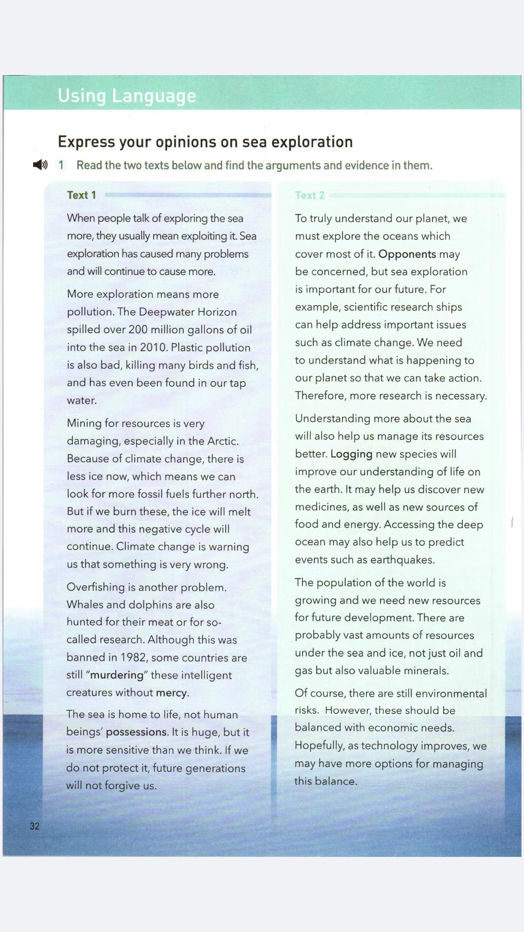
Pre-reading
1
Para 1
Para 2~3
Skim Text 1 and divide it into three parts.
Part 1: Para ________
Argument
2~3
Part 2: Para ________
Evidence
Part 3: Para ________
Restatement
4
Para 4

Slide 6
Pre-reading
Argument
Sea exploration caused problems
Pollution
Evidence
Mining
Overfishing
Restatement
Less exploration
& more protection

Slide 7

Pre-reading
How did the evidence prove the points?
What ways can be used to help evidence to prove the points?
The author cites examples and facts to prove the points
We can cite examples, facts, statistics, quotes, expert opinions, anecdotal evidence, personal experience…

Slide 8
While-reading
Skim Text 2 and find:
Argument
Sea exploration caused problems
Pollution
Fact:
Evidence
Cause & effect:
Mining
Examples:
Overfishing
Statistics:
Restatement
Less exploration
& more protection

Slide 9
While-reading
Skim Text 2 and find:
Argument
Sea exploration is important
Scientific research
Examples:
Evidence
Resource management
Effects:
The survival of mankind
Facts:
manage the balance between sea protection and economic needs
Recommendation

Slide 10
1. Plastic pollution is also bad…
2. Although this was banned in 1982, some countries are still "murdering" these…
3. For example, scientific research ships can help address important issues such as climate change.
4. Of course, there are still environmental risks.
5. Overfishing is another problem
While-reading
Read for Language Features
What words are used to help to explain the evidence?
What’s the tense of these two texts?
although/though, for example, further, of course, also, because, another, …
The future tense & the present tense.
1. Sea exploration has caused many problems and will continue to cause more.
2. The ice will melt more and this negative cycle will continue.
3. If we do not protect it, future generations will not forgive us.
4. Understanding more about the sea will also help us manage its resources better.
5. Of course, there are still environmental risks.

Slide 11
Post-reading
What other aspects of sea exploration are not mentioned?
Which argument do you agree with more? Why (not)?
Why is the sea more sensitive than we think?
How to make a good balance between sea protection and exploitation?

Slide 12
Post-reading
Point
Evidence
Explanation
Link
Add evidence
Add evidence
Use connectives
Writing Task
Based on your note, write an argumentative essay on sea exploration, expressing your opinions with supporting facts.

Slide 13
Post-reading
Brainstorm
1
2
3
4
What is the purpose of sea exploration?
How does sea exploration help us to protect the sea?
How does sea exploration cause damage to the sea?
Is there a good balance between protection and exploitation?

Slide 14
Write your draft and exchange it with a partner. Use the checklist to help each other revise the drafts.
Yes | No
1. Is the point clear enough?
2. Are there any examples or facts that support the argument strongly?
3. Is there any explanation on how the evidence supports the opinion?
4. Are there some connectives linking one point to another?

Slide 15
Sample
Although the oceans make up about 70% of the earth’s surface, more than 80% of the oceans remain unexplored. While some people say that we should not explore the oceans, their reasoning is not very sound. Exploring is not the same as exploiting. When we explore a place. We go just to see and understand what is there.
We should explore the ocean, first and foremost, because we do not know what we do not know. We thought we knew many about the ocean, but we were wrong. There could be life forms in the ocean, for example, that fit none of the neat categories we have for life while we have no clue that they even exist.
This brings up the second point. We already know many things about the ocean, but we need to learn more. A good example is ocean acidification.

Slide 16
We know that it is causing coral to die. We know that using less fossil fuel would cause the process to slow down. However, we need to learn more to find out how to stop it. We need more research to see what is going on, and to come up with plans and solutions.
Finally, to do this research, we have to enter an extreme environment not very friendly to humans. This requires the development of new technologies that can also benefit us in other areas. For example, in many ways, the deep ocean resembles outer space.
The technologies can benefit each other. For another instance, the technology of a mechanical arm to collect samples with has been used in factories and development of artificial limbs for humans.
All in all, there are many good reasons to explore the oceans. If we care about science, about protecting our oceans, and about developing new technologies, we need to do all we can to support ocean exploration.

Slide 17
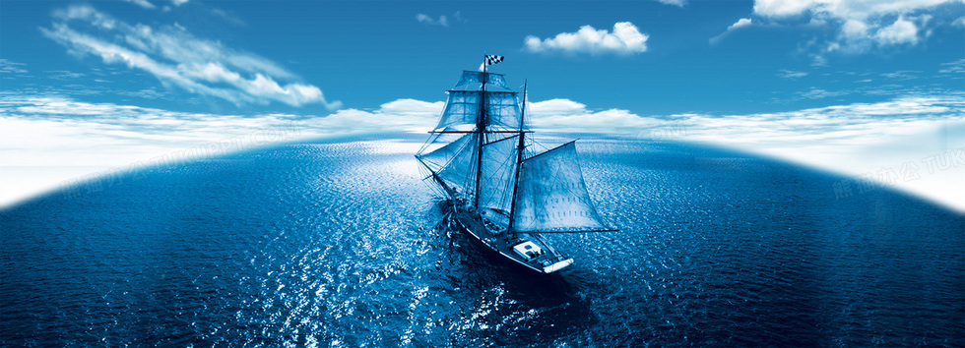
Homework
假定你是某校的宣传委员李华，应邀为学校网站英文版写一篇有关海洋生物保护的文章，请根据以下要点写一篇短文。
1. 海洋受污染的现状;
2. 保护海洋的重要性。
3.词数100左右;
4.注意使用连词以使文章连贯。

Slide 18
Sample
As we all know, there are varieties of resources under the sea. However, the past ten years has witnessed that some creatures have died out. Therefore, marine pollution has been greatly concerned by the whole world.
On the one hand, we must make people realize the importance of protecting the ocean. As a matter of fact, to protect the ocean is to protect human beings. On the other hand, the government should take immediate measures to keep the balance of nature. In no way should we abandon protecting the environment. Only by raising people’s awareness of protecting the environment and making great efforts to prevent pollution can the problem be solved.

Slide 19
THANK YOU

