Slide 1

感恩遇见，相互成就，本课件资料仅供您个人参考、教学使用，严禁自行在网络传播，违者依知识产权法追究法律责任。
更多教学资源请关注
公众号：溯恩高中英语
知识产权声明

Slide 2
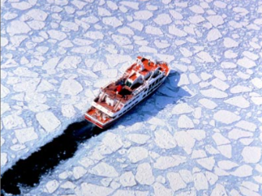
⁶²“How?” she asked. “It doesn't say anything about a supersaturated solution in the book, or about putting them in the fridge."
The Crystals 萨曼萨的晶体实验
Jacqueline Crompton Ottaway
(New Zealand)
Act10 The talk after dinner II

Slide 3
⁶³Thomas laughed, shook his curly mane浓密的头发 and leaned forward. “Don‘t believe everything you read. OK,” he added with authority一本正经地继续说道, “first we need a warm jar and some boiling water沸腾的水."
⁶⁴Samantha looked in the cupboard and found a clean jam jar. She ran冲洗 it under hot water until it was warm. Typical不出所料, she thought, Thomas is bossing me around对（某人）发号施令 so I do all the work.
⁶⁵Thomas came up behind her.
⁶⁶“Got the kettle boiling?”
⁶⁷Samantha switched the kettle on. Can‘t imagine how Mum can stand忍受 it, she thought.
⁶⁸"Pour in the water."
⁶⁹Samantha could see that Thomas was really enjoying himself.
⁷⁰“Now,” “said Thomas, grabbing the dog-eared翻旧了的 packet of copper sulphate,"we just keep adding as much copper sulphate as we can until no more will dissolve溶解."
⁷¹"I did that last time."
⁷²“Right,” added Thomas enthusiastically, ignoring her comment. “Now we have got a saturated solution, let‘s pop放置 it in the fridge."
⁷³With a dramatic戏剧性的 flourish夸张动作, Samantha held open the fridge door while Thomas placed the jar of blue liquid inside.
⁷⁴"You see, Sam..."
⁷⁵"Samantha," she corrected him.
⁷⁶"Yeah, well see, Samantha, when you lower the temperature, the solution becomes supersaturated and the extra copper sulphate turns into crystals.”
⁷⁷Thomas uttered说 the conclusions triumphantly得意洋洋地. “Is that clear?”
⁷⁸“Crystal clear清楚明白的,” replied Samantha dryly冷淡地. She stretched伸懒腰 and yawned打哈欠. “I think I'll go to bed now.”
⁷⁹Thomas started clearing up the kitchen counter厨房台面 "I'll wait up for Jodie and Jon and your mum."
⁸⁰Samantha paused at the kitchen door. She turned around. “Thanks, Thomas.” Thomas made a mock salute假装敬礼. "No sweat, Samantha.“
〇 Did Thomas treat Samantha with respect? Any expression here to prove your opinion? Try to circle these expressions.
In which way did Thomas speak, casually or formally?
Can you find an expression similar in meaning to “add with authority” in this part?
情境造句。参照蓝色字体句子，进行类似描述：
当小明拿出他的练习本时，我用一个戏剧性的夸张动作翻开我的物理书，
“你错了”，他 ______________ (一本正经地继续说道/得意洋洋的总结道/ 狂热的继续说道，完全无视我的评价)
⁶⁰“We could make a saturated solution and stick them in the fridge.
⁵⁷She looked at Thomas out of the corner of her eye. "My name's Samantha -- not Sam.”
⁵⁸“Well, Samantha, shall we …

Slide 4
⁶³Thomas laughed, shook his curly mane浓密的头发 and leaned forward. “Don‘t believe everything you read. OK,” he added with authority一本正经地继续说道, “first we need a warm jar and some boiling water沸腾的水."
⁶⁴Samantha looked in the cupboard and found a clean jam jar. She ran冲洗 it under hot water until it was warm. Typical不出所料, she thought, Thomas is bossing me around对（某人）发号施令 so I do all the work.
⁶⁵Thomas came up behind her.
⁶⁶“Got the kettle boiling?”
⁶⁷Samantha switched the kettle on. Can‘t imagine how Mum can stand忍受 it, she thought.
⁶⁸"Pour in the water."
⁶⁹Samantha could see that Thomas was really enjoying himself.
⁷⁰“Now,” “said Thomas, grabbing the dog-eared翻旧了的 packet of copper sulphate,"we just keep adding as much copper sulphate as we can until no more will dissolve溶解."
⁷¹"I did that last time."
⁷²“Right,” added Thomas enthusiastically, ignoring her comment. “Now we have got a saturated solution, let‘s pop放置 it in the fridge."
⁷³With a dramatic戏剧性的 flourish夸张动作, Samantha held open the fridge door while Thomas placed the jar of blue liquid inside.
⁷⁴"You see, Sam..."
⁷⁵"Samantha," she corrected him.
⁷⁶"Yeah, well see, Samantha, when you lower the temperature, the solution becomes supersaturated and the extra copper sulphate turns into crystals.”
⁷⁷Thomas uttered说 the conclusions triumphantly得意洋洋地. “Is that clear?”
⁷⁸“Crystal clear清楚明白的,” replied Samantha dryly冷淡地. She stretched伸懒腰 and yawned打哈欠. “I think I'll go to bed now.”
⁷⁹Thomas started clearing up the kitchen counter厨房台面 "I'll wait up for Jodie and Jon and your mum."
⁸⁰Samantha paused at the kitchen door. She turned around. “Thanks, Thomas.” Thomas made a mock salute假装敬礼. "No sweat, Samantha.“
〇 Did Thomas treat Samantha with respect? Any expression here to prove your opinion? Try to circle these expressions.
⁶⁰“We could make a saturated solution and stick them in the fridge.
⁵⁷She looked at Thomas out of the corner of her eye. "My name's Samantha -- not Sam.”
⁵⁸“Well, Samantha, shall we …
Yes, he did.

Slide 5
⁶³Thomas laughed, shook his curly mane浓密的头发 and leaned forward. “Don‘t believe everything you read. OK,” he added with authority一本正经地继续说道, “first we need a warm jar and some boiling water沸腾的水."
⁶⁴Samantha looked in the cupboard and found a clean jam jar. She ran冲洗 it under hot water until it was warm. Typical不出所料, she thought, Thomas is bossing me around对（某人）发号施令 so I do all the work.
⁶⁵Thomas came up behind her.
⁶⁶“Got the kettle boiling?”
⁶⁷Samantha switched the kettle on. Can‘t imagine how Mum can stand忍受 it, she thought.
⁶⁸"Pour in the water."
⁶⁹Samantha could see that Thomas was really enjoying himself.
⁷⁰“Now,” “said Thomas, grabbing the dog-eared翻旧了的 packet of copper sulphate,"we just keep adding as much copper sulphate as we can until no more will dissolve溶解."
⁷¹"I did that last time."
⁷²“Right,” added Thomas enthusiastically, ignoring her comment. “Now we have got a saturated solution, let‘s pop放置 it in the fridge."
⁷³With a dramatic戏剧性的 flourish夸张动作, Samantha held open the fridge door while Thomas placed the jar of blue liquid inside.
⁷⁴"You see, Sam..."
⁷⁵"Samantha," she corrected him.
⁷⁶"Yeah, well see, Samantha, when you lower the temperature, the solution becomes supersaturated and the extra copper sulphate turns into crystals.”
⁷⁷Thomas uttered说 the conclusions triumphantly得意洋洋地. “Is that clear?”
⁷⁸“Crystal clear清楚明白的,” replied Samantha dryly冷淡地. She stretched伸懒腰 and yawned打哈欠. “I think I'll go to bed now.”
⁷⁹Thomas started clearing up the kitchen counter厨房台面 "I'll wait up for Jodie and Jon and your mum."
⁸⁰Samantha paused at the kitchen door. She turned around. “Thanks, Thomas.” Thomas made a mock salute假装敬礼. "No sweat, Samantha.“
情境造句。参照蓝色字体句子，进行类似描述：
当小明拿出他的练习本时，我用一个戏剧性的夸张动作翻开我的物理书，
“你错了”，他 ______________ (一本正经地继续说道/得意洋洋的总结道/ 狂热的继续说道，完全无视我的评价)
With a dramatic flourish, I held open my physics book while Xiaoming took his exercise book out.
added with authority.
“You are wrong,” he
uttered the conclusion triumphantly.
added enthusiastically, totally ignoring my comment.

Slide 6
⁶³Thomas laughed, shook his curly mane浓密的头发 and leaned forward. “Don‘t believe everything you read. OK,” he added with authority一本正经地继续说道, “first we need a warm jar and some boiling water沸腾的水."
⁶⁴Samantha looked in the cupboard and found a clean jam jar. She ran冲洗 it under hot water until it was warm. Typical不出所料, she thought, Thomas is bossing me around对（某人）发号施令 so I do all the work.
⁶⁵Thomas came up behind her.
⁶⁶“Got the kettle boiling?”
⁶⁷Samantha switched the kettle on. Can‘t imagine how Mum can stand忍受 it, she thought.
⁶⁸"Pour in the water."
⁶⁹Samantha could see that Thomas was really enjoying himself.
⁷⁰“Now,” “said Thomas, grabbing the dog-eared翻旧了的 packet of copper sulphate,"we just keep adding as much copper sulphate as we can until no more will dissolve溶解."
⁷¹"I did that last time."
⁷²“Right,” added Thomas enthusiastically, ignoring her comment. “Now we have got a saturated solution, let‘s pop放置 it in the fridge."
⁷³With a dramatic戏剧性的 flourish夸张动作, Samantha held open the fridge door while Thomas placed the jar of blue liquid inside.
⁷⁴"You see, Sam..."
⁷⁵"Samantha," she corrected him.
⁷⁶"Yeah, well see, Samantha, when you lower the temperature, the solution becomes supersaturated and the extra copper sulphate turns into crystals.”
⁷⁷Thomas uttered说 the conclusions triumphantly得意洋洋地. “Is that clear?”
⁷⁸“Crystal clear清楚明白的,” replied Samantha dryly冷淡地. She stretched伸懒腰 and yawned打哈欠. “I think I'll go to bed now.”
⁷⁹Thomas started clearing up the kitchen counter厨房台面 "I'll wait up for Jodie and Jon and your mum."
⁸⁰Samantha paused at the kitchen door. She turned around. “Thanks, Thomas.” Thomas made a mock salute假装敬礼. "No sweat, Samantha.“
In which way did Thomas speak, casually or formally?
Can you find an expression similar in meaning to “add with authority” in this part?
⁶⁰“We could make a saturated solution and stick them in the fridge.
⁵⁷She looked at Thomas out of the corner of her eye. "My name's Samantha -- not Sam.”
⁵⁸“Well, Samantha, shall we …
Casually.
Uttered the conclusions triumphantly

Slide 7
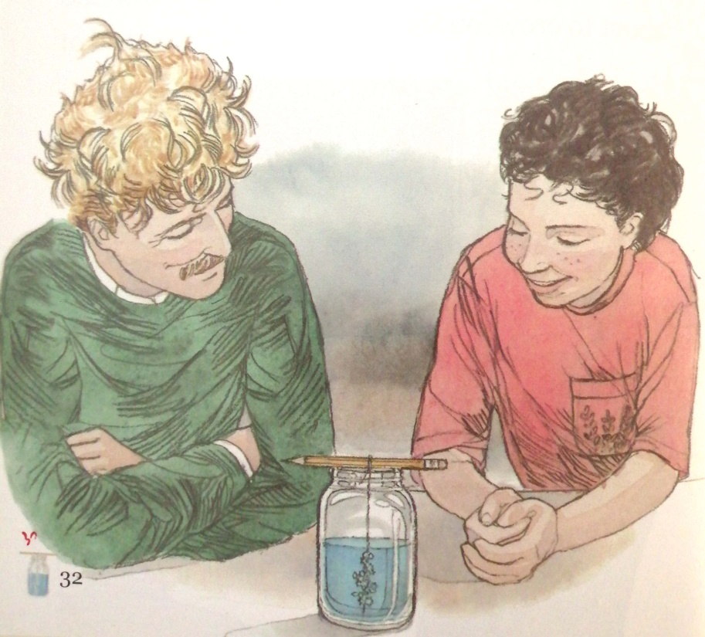
The Crystals 萨曼萨的晶体实验
Jacqueline Crompton Ottaway
(New Zealand)
Act 11 The next morning

Slide 8
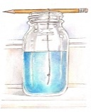
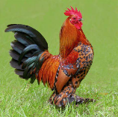
The next morning
11_____________________
⁸¹When Samantha woke the next morning, the sunlight was flooding across洒满 her bed. She was hungry. Silently, she walked down the stairs to the kitchen. Thomas was already there. His rumpled凌乱的 hair stood on end竖起来 as usual and he was holding a glass jar in his hand.
⁸²“Look at this, Sam!"
⁸³Samantha looked at the jar. Then she looked up at Thomas. He didn‘t look like a cockatoo this morning, she decided. More like a rooster公鸡 about to crow报晓 loudly.
⁸⁴The bright morning sunlight struck照在…上 the shimmering微微发亮的, translucent半透明的 blue crystals. Their shapes and patterns式样 were astounding惊人. Samantha looked at Thomas. He'd called her Sam again. Nothing had really changed.
⁸⁵But still she had some crystals -- that should impress Miss Newman. And it was a beautiful day outside. She might call Rebecca and ask her to go skateboarding溜滑板.
⁸⁶She smiled. Suddenly life didn't seem so bad.
〇 Could Samantha face Miss Newman with a project on copper sulphate crystals?
Was Samantha happy here?
Who was Rebecca?
Find out expressions to describe sunshine and “明亮的” and translate the sentence below:
清晨的阳光正倾洒在他的书桌上。
The morning sunshine is flooding across his desk.
²⁷Samantha turned around. ... She suppressed a giggle. His crisp, curly blond hair stood ruffled on end. He looked like a startled cockatoo.
²Everything seemed to be going wrong lately… ⁴Then she retreated upstairs to her bedroom.
Yes. She succeeded in doing it with the help of Thomas.

Slide 9
The next morning
11_____________________
⁸¹When Samantha woke the next morning, the sunlight was flooding across洒满 her bed. She was hungry. Silently, she walked down the stairs to the kitchen. Thomas was already there. His rumpled凌乱的 hair stood on end竖起来 as usual and he was holding a glass jar in his hand.
⁸²“Look at this, Sam!"
⁸³Samantha looked at the jar. Then she looked up at Thomas. He didn‘t look like a cockatoo this morning, she decided. More like a rooster公鸡 about to crow报晓 loudly.
⁸⁴The bright morning sunlight struck照在…上 the shimmering微微发亮的, translucent半透明的 blue crystals. Their shapes and patterns式样 were astounding惊人. Samantha looked at Thomas. He'd called her Sam again. Nothing had really changed.
⁸⁵But still she had some crystals -- that should impress Miss Newman. And it was a beautiful day outside. She might call Rebecca and ask her to go skateboarding溜滑板.
⁸⁶She smiled. Suddenly life didn't seem so bad.
Was Samantha happy here?
Who was Rebecca?
²⁷Samantha turned around. ... She suppressed a giggle. His crisp, curly blond hair stood ruffled on end. He looked like a startled cockatoo.
²Everything seemed to be going wrong lately… ⁴Then she retreated upstairs to her bedroom.
Yes, we can find it from the description the sunshine and her thought.
She must be her friend and they didn’t play together recently.

Slide 10
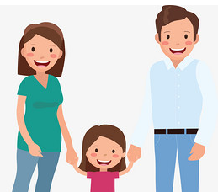
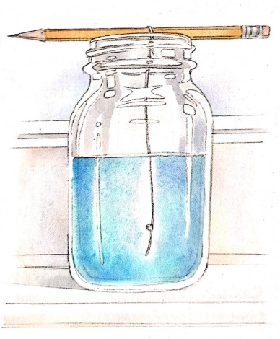
Can you find out
How did Samantha look at the others?
How did Thomas say to the others?
How did Mum treat Samantha and Thomas differently?

Slide 11

Could you change the story into a
play? Maybe you can play all the three roles because of the holiday or find some companions（同甘共苦的）伙伴?
1. Read the story another time.
2. Group the expressions.
3. Act it out in some way

