Slide 1
感恩遇见，相互成就，本课件资料仅供您个人参考、教学使用，严禁自行在网络传播，违者依知识产权法追究法律责任。
更多教学资源请关注
公众号：溯恩高中英语
知识产权声明

Slide 2
M4U4
Body language
New Words and Expressions

Slide 3
重点单词
1. ________ vt. 代表；象征
2. ________ vt. & vi. 接近；靠近 n. 接近；方法；途径
3. ________ vt. 保护；保卫
4. ________ adj. 可能的
5. ________ n. 安逸；舒适 vt. 减轻（痛苦；忧虑）
6. ________ n. 陈述；说明
7. ________ vi. & vt. 迎接；问候
8. ________ n. 宿舍
9. ________ n. 飞行；航班
10.________ adj. 好奇的
11. ________ adj. 主要的
12.________ vt. (____________, ____________) 误解
represent
approach
defend
likely
ease
statement
greet
dormitory
flight
curious
major
misunderstand
misunderstood
misunderstand

Slide 4
重点单词
13. ________ vi. 猛冲；突进
14. ________ n. 成人；成年人 adj. 成人的；成熟的
15. ________ adj. 口语的
16. ________ adj. 面部的
17. ________ n. 作用；功能；职能 vi. 起作用；运转
18. ________ adv. 真实地；真诚地；真正地
19. ________ adj. 错误的；假的
20. ________ n. 拳头
21. ________ vi. 打呵欠
22.________ adj. 主观的
23. ________ vi. & vt. 拥抱
24.________ n. 等级；军衔
dash
adult
spoken
facial
function
truly
false
fist
yawn
subjective
hug
rank

Slide 5
派生单词
statement
state
1.__________ n. 陈述；说明 _______ v. 说明；陈述
2.__________ vt. 代表；象征 _____________ n. 代表；销售代表
3. ________ n. 社团；联系；联想 _________ v. 交往；联想
4.________ adj. 好奇的 _________ n. 好奇心；求知欲
5._______ vt. 保护；保卫 ________ n. 防御；保卫
6. ______ adj. 主要的 _________ n. 大多数；大部分
7.______ adv. 真实地；真诚地 ______ adj. 符合事实的；确实的
8._________ n. 功能 vi. 起作用；运转 __________ adj. 实用的；作用的
9.______ adj. 面部的 ______ n. 脸；面孔
10. ______ adj. 可能的 _________ n. 可能性
represent
representative
association
associate
curious
curiosity
defend
defence
major
majority
truly
true
function
functional
facial
face
likely
likelihood

Slide 6
重点短语
defend against
1.________________ 保卫……以免受
2.________________ 很可能……；有希望……
3.________________ 总的来说；通常
4.________________ 舒适；快活；自由自在
5.________________ 丢脸
6.________________ 背对；背弃
be likely to
in general
at ease
lose face
turn one’s back to

Slide 7
词义释义
________________ situation in which a comment, an instruction, etc. is not understood correctly
____________ either side of the face below the eyes
____________ to open your mouth wide and breathe in deeply through it, usually because you are tired or bored
____________ a room for several people to sleep in, especially in a school or other institution
____________ a hand when it is tightly closed with the fingers bent into the palm
____________ a place where two roads meet and cross each other
____________ something that you say or write that gives information or an opinion
____________ a place where food and drink are served in a factory, a school, etc.
misunderstanding
cheek
yawn
dormitory
fist
crossroads
statement
canteen

Slide 8
话题词汇
Countries
Colombia, Jordan, Spain, Italy
approach, dash, frown, facial, anger, turn one’s back to, fist, yawn, hug, at ease, posture, unspoken, cheek
Body language

Slide 9
美句赏析
We keep moving forward, opening new doors, and doing new things, because we're _______ and curiosity keeps leading us down new paths. ---Walt Disney
Sadness is also a kind of _______. ---Ivo Andric
You always risk people _______________ you when you say anything. ---Phil Lord
The ________ word never does harm. ---Lajos Kossuth
Our world is at the __________. We have a choice, right and wrong. ---LL Cool J
History is so __________. The teller of it determines it. ---Lin-Manuel Miranda
curious
defence
misunderstanding
unspoken
crossroads
subjective

Slide 10
遣词造句
Group 1: greet; cheek; in general; misunderstanding
Group 2: approach; be likely to; defend possible
Group 3: adult; anger; lose face;
Group 4: at ease; facial; unspoken
Group 5: turn one's back to; yawn; misread
In general, you'd better not kiss on the cheek when you greet a Chinese, as it might lead to misunderstanding.
When a stranger approaches, we are likely to get nervous and defend against possible danger.
Many adults fail to contain anger when they lose face.
Unspoken language like facial expression can often tell whether a person is at ease or not.
Yawning and turning your back to others can often be misread when you do not mean it.

Slide 11
核心词汇
1. represent
v.
将例句中represent的意思与右侧意思相匹配。
Mr Smith was chosen to represent the company at the meeting.
This contract represents 20% of the company's yearly income.
The pictures represent a hunting scene.
They represented their concerns to the authorities.
正式提出
描绘
代表
相当于

Slide 12
Quiz
歌词翻译
You ask me how deep my love for you is.
How much I really love you...
My affection is real.
My love is real.
The moon represents my heart.
你问我爱你有多深
我爱你有几分
我的情也真
我的爱也真
月亮代表我的心

Slide 13
核心词汇
2. approach
v. & n.
根据例句写出approach的词性和意思。
As you approach the town, you'll see the college on the left.
It might be possible to approach the problem in a different way.
The school has decided to adopt a different approach to discipline.
Students should be able to approach teachers for advice.
It is a sign of the approach of middle age.
v. 靠近，接近
v. 对付，处理
n. 方式，方法
v. 请求，要求
n. 某事的来临

Slide 14
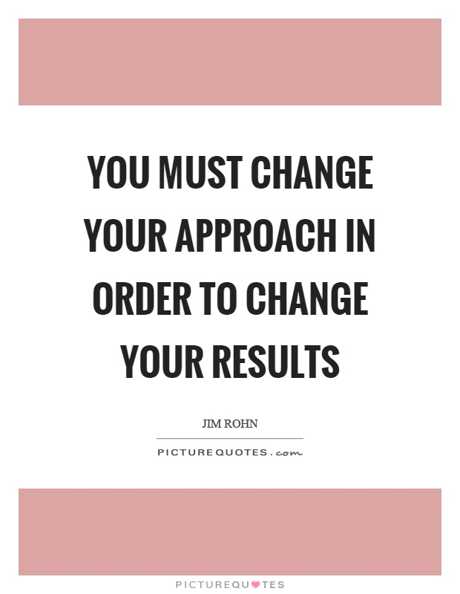
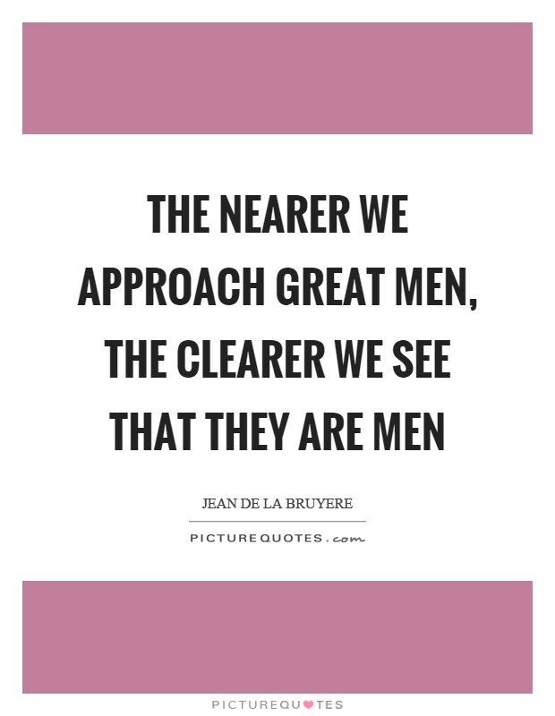
Quiz
名言翻译
要改变结果必须改变你的方式。
我们离伟人靠得越近，就愈发现他们也是人。

Slide 15
核心词汇
3. defend
v.
写出例句中defend相关表达的意思
It is impossible to defend against an all-out attack.
It is advice on how women can defend themselves from sex attackers.
How can you defend such behaviour?
He is defending champion.
防御，保护
保护自己免受...
为这种行为辩护
参加卫冕赛
派生词
defence n. 防御 in defence of

Slide 16
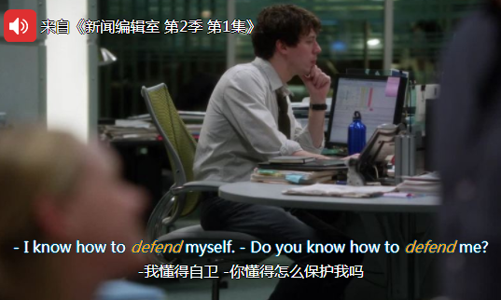
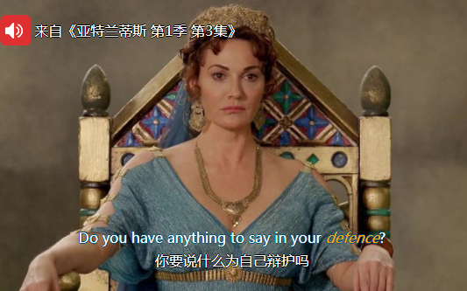
Quiz
台词翻译

Slide 17
核心词汇
4. ease
n. & v.
利用例句写出ease相关表达的意思
不费劲；轻易地
He passed the exam with ease.
I never feel completely at ease with him.
This should ease the pain.
The rain had eased off a bit.
舒适；自由自在
减轻痛苦
减轻

Slide 18
Quiz
翻译
他们轻松获胜。
They won with ease.
她和约翰在一起感觉很自在。
She felt completely at ease with John.
他会给你一些药镇痛。
He'll give you something to ease the pain.

Slide 19
核心词汇
5. likely
adj.
根据例句写出likely可能表达及相应的意思
Snow showers are likley tomorrow.
What are the likely effects of the law going to be?
Children who live in the country's rural areas are very likely to be poor.
One likely source of energy of enery is windpower.
be likely 可能发生的
likely effects可能的影响
be likely to 可能的
likely + n. 合适的...
派生词
unlikely adj. 不太可能的
likelihood n. 可能性

Slide 20
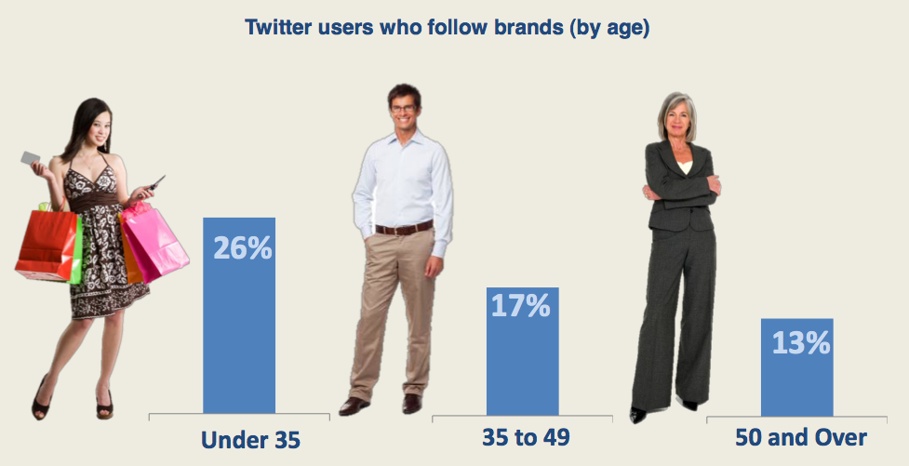
Quiz
看图写句子
Twitter user aged under 35 are more likely to follow brands according to the survey.

Slide 21
即学即用
Body language is the _________ part of communication that we use to show our true feelings and emotions, such as amusement, pleasure, _____, and boredom. It includes our posture, our _____ expressions, and our hand gestures. When we are able to "read" these signs, we can use it to our advantage. For example, if someone _________________ when you are talking, it __________ mean that he is bored and not interested in your speech. Being aware of these signs can help you to adjust what you say and how you say it, so you can make him feel more _______ and more interested in your talk. However, it should be noted that body language is not international. ________________ can happen if you make the same gesture in a different country.
unspoken
anger
facial
turns his back to you
is likely to
at ease
Misunderstandings

