Slide 1
感恩遇见，相互成就，本课件资料仅供您个人参考、教学使用，严禁自行在网络传播，违者依知识产权法追究法律责任。
更多教学资源请关注
公众号：溯恩英语
知识产权声明

Slide 2
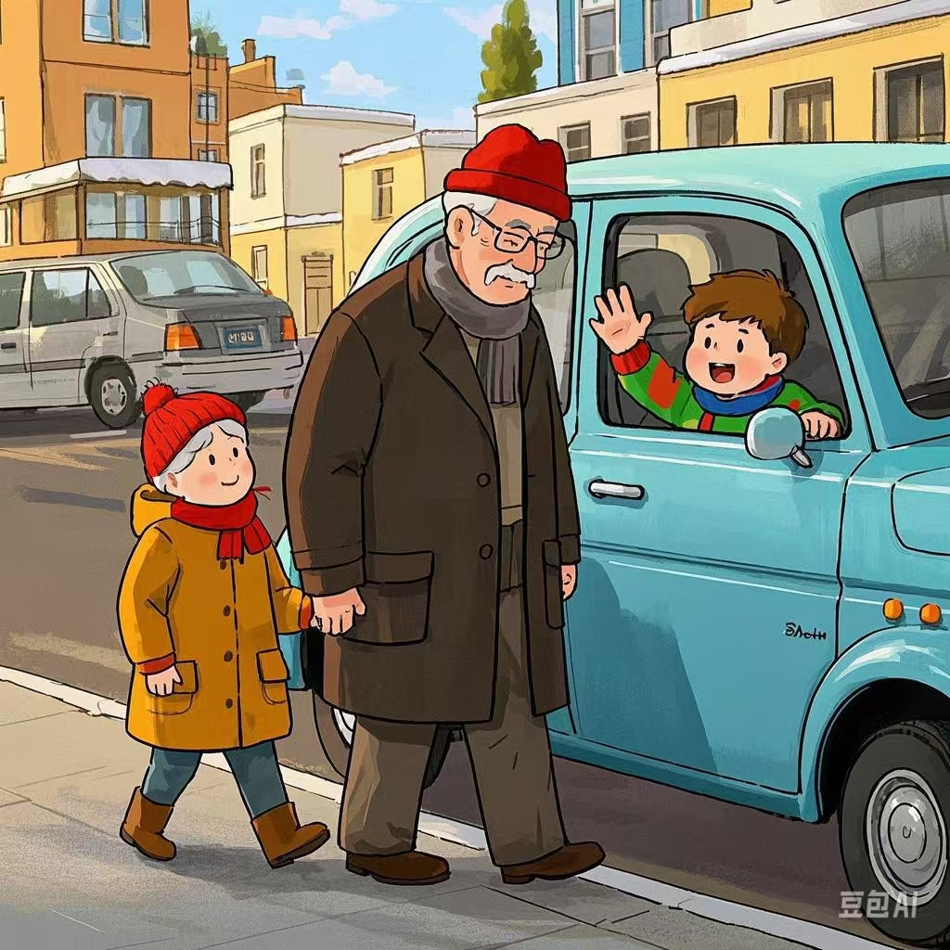
爷爷的红帽子
---2025届-12 五校联考
人与社会之邻里情
郑素红

Slide 3
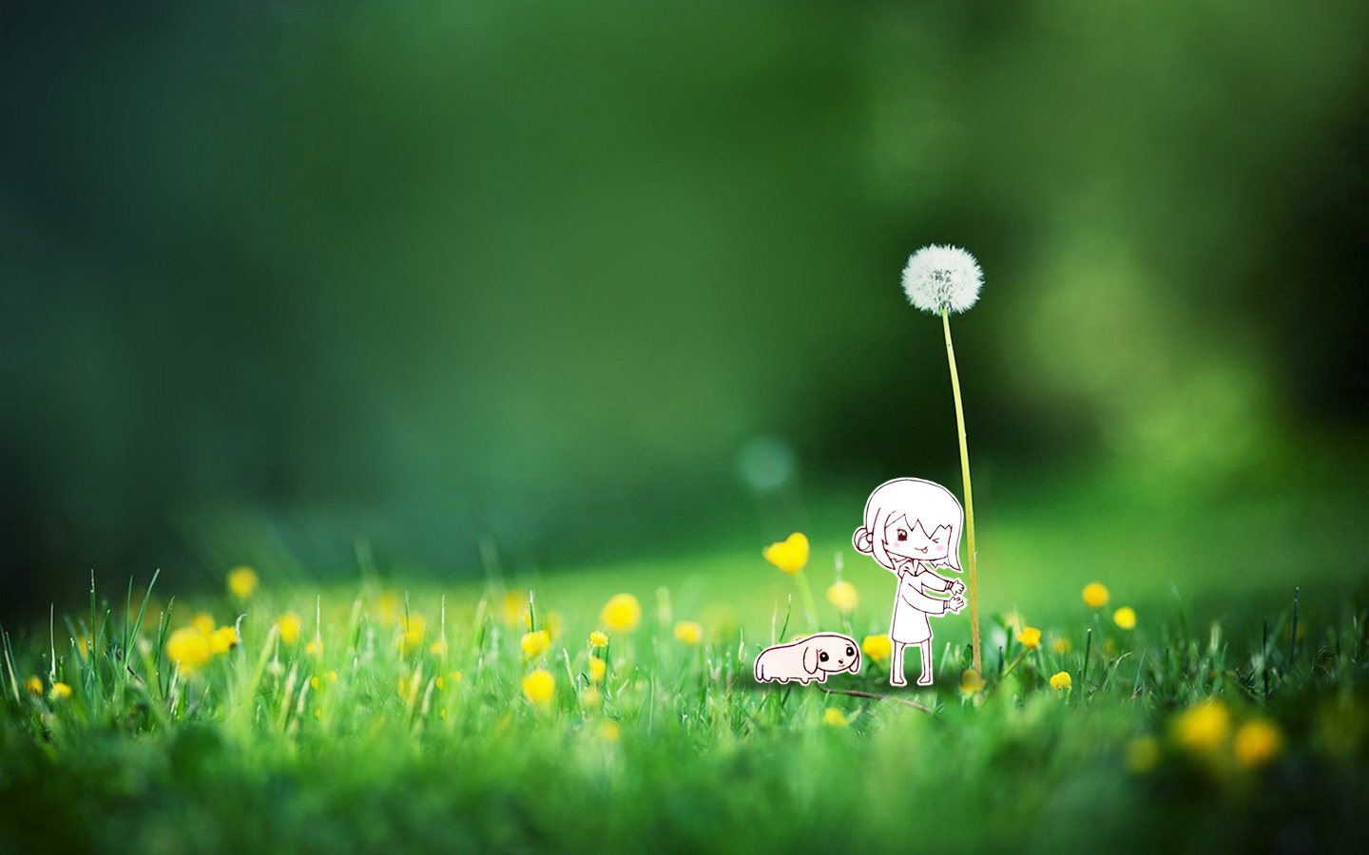
“Want to take a walk, Tyler?” Grandpa Charlie called from the front room. “In a minute, Grandpa,” Tyler called back, looking at his mom. “I thought Grandpa wasn’t feeling well, and it’s cold outside. Can he take a walk?”
“The fresh air will be good for him. And your grandpa doesn’t want to miss waving at people,” Mama said. “He knows it makes them happy, and when they wave back, it makes him happy, too.”
Tyler walked into the front room and saw Grandpa Charlie wrapping a gray scarf around his face and neck. “Hope I don’t look too much like a mummy(木乃伊),” Grandpa Charlie said, his eyes twinkling. He put on his red hat, and they stepped outside.
He waved to the first car that passed. A boy stuck his head out the window and yelled, “There’s the man in the red hat!” Grandpa Charlie waved to him and to the people in the next three cars. They all waved back.
Grandpa Charlie and Tyler turned a corner. An old man wearing a brown hat and a scarf walked toward them. He was frowning.
“Hi, Henry,” Grandpa Charlie said. “I don’t see you out much.”

Slide 4
“My doctor is making me take walks for my health, but I don’t like it,” Henry grumbled ( 抱怨 ) . “It’s supposed to be autumn, but it feels like the dead of winter.” He pulled his scarf up over his mouth and nose and walked past them.
“He’s bad-tempered!” Tyler said in a low voice. “Henry is just lonely. His wife died right after we lost your grandmother.”
Suddenly, a gust of wind blew off both men’s hats. The hats flew toward the duck pond, and Henry’s went in. Tyler ran down the hill and grabbed Grandpa Charlie’s hat off the grass and fished Henry’s out of the water. He ran back up the hill, holding out Henry’s hat. “It’s wet. Just throw it away. I’ll have to buy a new hat,” Henry said coldly, walking past Tyler.
A car went by, but no one beeped the horn or waved. Grandpa Charlie didn’t seem to notice for he was talking to a neighbor.
Para1: Tyler stared at his grandpa’s red hat and came up with a plan.
Para2: A car passed, and the people inside waved at Henry.

Slide 5
Read for elements
1.characters：
Main roles: Tyler (kind-hearted , thoughtful, caring and loving)
Henry ( cold-hearted, bad-tempered, depressed, lonely )
Minor role: Grandpa Charlie ( happy, caring and thoughtful)
2. narrative perspective: third -person
3. time：winter
place： in a street
Event : Tyler accompanied Grandpa for a walk and met an unhappy Grandpa called Henry. Tyler decided to do something.

Slide 6
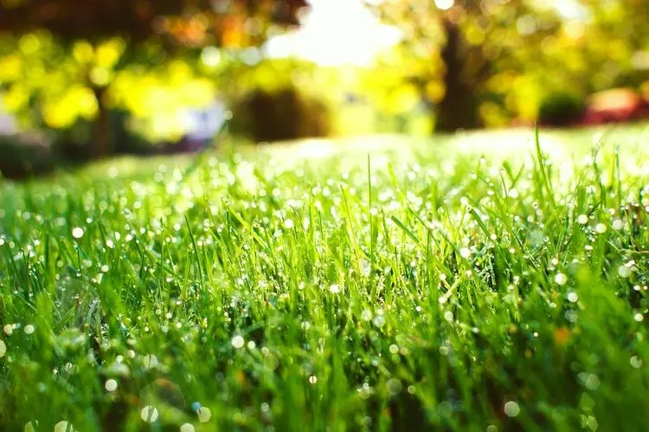
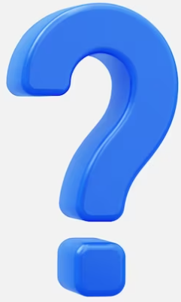
6.story line
Climax
A gust of wind blew away Charlie’s red hat as well as Henry’s brown hat. Tyler picked them back, but Henry’s brown hat was wet.
Para1: Tyler stared at his grandpa’s red hat and came up with a plan.
Tyler met a bad-tempered, lonely and cold Henry, whom Grandpa Charlie showed sympathy for.
With a hat on Grandpa Charlie’s head, passing cars beeped their horn or people in the cars waved at them to send their warmest greetings , which made Grandpa very happy.
Para2: A car passed, and the people inside waved at Henry.
.
Tyler was invited by his grandpa Charlie to walk in the outside in winter.
background
Ending
Beginning

Slide 7
Read for clues and echoes
hidden clues | echoes
“The fresh air will be good for him. And your grandpa doesn’t want to miss waving at people,” Mama said. “He knows it makes them happy, and when they wave back, it makes him happy, too.” | “ Mr, Henry, please put on the red hat and it will make your day!” Tyler said politely and enthusiastically, casting a warm look at the lonely, stubborn and unhappy old man.

Slide 8
Read for clues and echoes
hidden clues | echoes
He waved to the first car that passed. A boy stuck his head out the window and yelled, “There’s the man in the red hat!” Grandpa Charlie waved to him and to the people in the next three cars. They all waved back. | 2. Another car passing, a boy poked his head out, yelling, “There’s the man in the red hat!” Hearting that, Henry raised his hand, waving at him like an old acquaintance more naturally.

Slide 9
Read for clues and echoes
hidden clues | echoes
A car went by, but no one beeped the horn or waved. Grandpa Charlie didn’t seem to notice for he was talking to a neighbor. | 3. More cars passing and more people beeping the horn or waving, Henry’s face softened and lit up.

Slide 10
Read for clues and echoes
hidden clues | echoes
Grandpa Charlie and Tyler turned a corner. An old man wearing a brown hat and a scarf walked toward them. He was frowning. …. He ran back up the hill, holding out Henry’s hat. “It’s wet. Just throw it away. I’ll have to buy a new hat,” Henry said coldly, walking past Tyler. | 4. Tyler’s caring words melting the ice in his heart, Mr. Henry took it over from Tyler’s hand slowly and gently put it on, literally moved to tears. 或者 Henry’s previous depression gave way to gratitude due to the kindness from his new cross-age friend.

Slide 11
Read for clues and echoes
hidden clues | echoes
…. He ran back up the hill, holding out Henry’s hat. “It’s wet. Just throw it away. I’ll have to buy a new hat,” Henry said coldly, walking past Tyler. | 5. A radiant smile cracking across his wrinkled and weathered face, he bent down, hugged Tyler in his arms tightly and murmured thanks to the little angel for his gesture of kindness and his golden heart. Thanks to Tyler’s brilliant idea, Henry fell in love with the daily walk in the cold winter and resolved to purchase a red magic hat!

Slide 12
心理描写
神态描写
动作描写
外貌描写
环境描写
对话描写
语言
无灵主语
动作链
分词作状语
With 复合结构
独立主格
从句
倒装句
虚拟语气
强调句
长短句结合
考生构思情节的同时，要考虑合适的语言句式以及修辞

Slide 13
Plot the continuation story
Para1: Tyler stared at his grandpa’s red hat and came up with a plan.
Para2:A car passed, and the people inside waved at Henry.
Link1: What was Tyler’s plan? How did he feel?
Body: What did Tyler do? How did Charlie react and what did he do?
Link2: What did Tyler say to Henry? What did Henry do and how did he feel?
Link3: What did Henry do? How did he react?
Body: How did Henry learn to greet people in the passing cars? Ending: ① What changes happened to Henry?
② What lesson did Tyler learn from the experience?

Slide 14
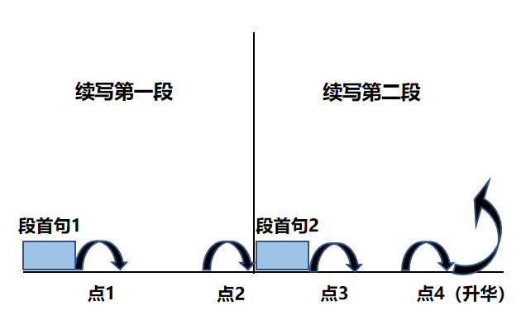
Plot Continuation
点1：位于续写第一段段首，流畅衔接前面的故事（常与原文最后一段呼应）和第一段段首语；
点2：位于续写第一段段尾，流畅衔接第二段段首句；
点3：位于续写第二段段首，续写衔接第二段段首语；
点4：文章结尾升华，给予读者正能量，揭示和强调主题。

Slide 15
Design link1
Para1: Tyler stared at his grandpa’s red hat and came up with a plan.
Link1A: (回扣所给首句 the plan ) “Why not let Mr. Henry wear Grandpa’s red hat?” Tyler blurted out. Puffing and panting, he dashed to Grandpa Charlie, whispered his plan to Grandpa and expected his affirmative response, eyes sparkling with anticipation.
Link1B: : ( Tyler与爷爷的互动：） Heart pounding with thrill, Tyler proposed, “Grandpa, can you lend Henry your red hat for a while?” Tyler had strong faith that the red hat boasted a mysterious appeal, which seemed to bring magic and joy to Grandpa Charlie and passengers in every passing car.

Slide 16
Design link1
Para1: Tyler stared at his grandpa’s red hat and came up with a plan.
Link1C: : ( Tyler与Henry的互动：） Determined and expectant, Tyler skipped to Grandpa Henry merrily, cautiously tugged Henry’s overcoat and readily offered to put the red hat on Henry’s head. Moved by Tyler’s innocence and pureness, Henry stroked Tyler’s head gently.

Slide 17
Design link2
Para1: Tyler stared at his grandpa’s red hat and came up with a plan.
Link2 A: (Tyler 关心Henry) “ Mr, Henry, please put on the red hat and it will make your day!” Tyler said politely and enthusiastically, casting a warm look at the lonely, stubborn and unhappy old man. Tyler’s caring words melting the ice in his heart, Mr. Henry took it over from Tyler’s hand slowly and gently put it on, almost moved to tears.
Link2B: ( Henry 被说服带上红帽子）“ Grandpa Henry, please try this red hat on,” Tyler said earnestly, sticking out the red hat. “It has a magic power.” Henry hesitated, his gaze drifting between Tyler’s eager face and the bright red hat. Determined to give it a try, Henry summoned up his courage, grabbed the commonplace red hat and placed it on his head, anxious to witness its magic.

Slide 18
Design link3
Para2: A car passed, and the people inside waved at Henry.
Link3A: ( 路过的车子里的人的问候给Henry带来的冲击）The unexpected greetings made Henry feel uneasy, hands rubbing pants awkwardly. Henry stole a look at Little Tyler, who waved back to the people inside merrily and naturally.
Link3B: ( Henry 的转变为感受美妙的感觉 ） Wearing an awkward and uneasy look on his face, Henry didn’t know how to respond to those hospitable people, palms sweating even in the cold air. What he never expected was that a warm current welled up inside him from nowhere.

Slide 19
Design ending
Para2: A car passed, and the people inside waved at Henry.
本文没有 教育读者领悟大道理，重在体会人与人之间的温情，孩童的金子般善良的心。不太适合用感悟式结尾，情景式结尾最佳。
Ending A: (情景式结尾从Henry以及Tyler 角度写) The walk done, Henry took off the red hat, gave it back to the angel Tyler, promised to buy a new red hat and invited Tyler and Grandpa Charlie to take a walk the next day. Exchanging an understanding look with Grandpa Charlie, Tyler accepted Henry’s invitation, heading back home together with his beloved grandpa in the twilight and heart overflowing with delight.

Slide 20
Design ending
Para2: A car passed, and the people inside waved at Henry.
Ending B: (情景式结尾 Henry 角度) A radiant smile cracking across his wrinkled and weathered face, he bent down, hugged Tyler in his arms tightly and murmured thanks to the little angel for his gesture of kindness and his golden heart. Thanks to Tyler’s brilliant idea, Henry fell in love with the daily walk in the cold winter and resolved to purchase a red magic hat!

Slide 21
Design ending
Para2: A car passed, and the people inside waved at Henry.
Ending C: (情景式结尾 Tyler 角度) Staring at Henry’s smiling wrinkled face, Tyler was overwhelmed with an enormous flood of pride blended with joy. Henry’s once-cold demeanor began to melt, and in that split moment, Tyler knew his plan did work pretty well, for it filled Henry’s heart with abundant warmth and love to dispel the harsh winter .

Slide 22
Design ending
Para2: A car passed, and the people inside waved at Henry.
Ending D: (情景式结尾 Grandpa Charlie角度) Seeing a long lost smile blossoming across Henry’s weathered face, Grandpa Charlie heaved a sigh of relief, proud of Tyler’s cleverness and giving a thumbs-up to his dearest grandson!

Slide 23
Para1: Tyler stared at his grandpa’s red hat and came up with a plan. “Why not let Mr. Henry wear Grandpa’s red hat?” Tyler blurted out. Puffing and panting, he dashed to Grandpa Charlie, whispered his plan to Grandpa and expected his affirmative response, eyes sparkling with anticipation. Looking astounded at what Tyler said, Grandpa Charlie nodded, a slight smile playing around the corner of his mouth. Hardly had Grandpa said yes to his grand idea when Tyler flew to Mr. Henry like an arrow, holding the red hat tightly as if fearing it would vanish from his hand. “ Mr, Henry, please put on the red hat and it will make your day!” Tyler said politely and enthusiastically, casting a warm look at the lonely, stubborn and unhappy old man. Tyler’s caring words melting the ice in his heart, Mr. Henry took it over from Tyler’s hand slowly and gently put it on, literally moved to tears.

Slide 24
Para2: A car passed, and the people inside waved at Henry. The unexpected greetings made Henry feel uneasy, hands rubbing pants awkwardly. Henry stole a look at Little Tyler, who waved back to the people inside merrily and naturally. Another car passing, a boy poked his head out, yelling, “There’s the man in the red hat!” Hearting that, Henry raised his hand, waving at him like an old acquaintance more naturally. Much to his delight, the boy waved back until the car vanished. More cars passing and more people beeping the horn or waving, Henry’s face softened and lit up. The walk done, Henry took off the red hat, gave it back to the angel Tyler, promised to buy a new red hat and invited Tyler and Grandpa Charlie to take a walk the next day. Exchanging an understanding look with Grandpa Charlie, Tyler accepted Henry’s invitation, heading back home together with his beloved grandpa in the twilight.

Slide 25
Para2: A car passed, and the people inside waved at Henry.
Wearing an awkward and uneasy look on his face, Henry didn’t know how to respond to those hospitable people, palms sweating even in the cold air. What he never expected was that a warm current welled up inside him from nowhere. More cars passing and more strangers waving at him with a bright smile, Henry waved back to them unskillfully with watery eyes. The connection with people felt like sunshine enveloping him in its warm hug, which deeply touched Henry. A radiant smile cracking across his wrinkled and weathered face, he bent down, hugged Tyler in his arms tightly and murmured thanks to the little angel for his gesture of kindness and his golden heart. Thanks to Tyler’s brilliant idea, Henry fell in love with the daily walk in the cold winter and resolved to purchase a red magic hat! (第二段版本2）

Slide 26
