Slide 1
感恩遇见，相互成就，本课件资料仅供您个人参考、教学使用，严禁自行在网络传播，违者依知识产权法追究法律责任。
更多教学资源请关注
公众号：溯恩高中英语
知识产权声明

Slide 2
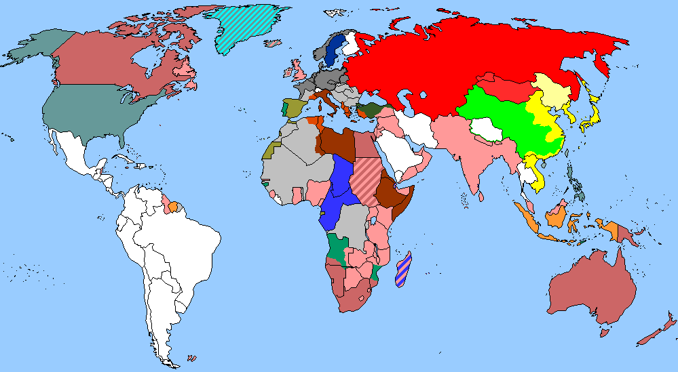
The World
September 16th-30th, 2022

Slide 3
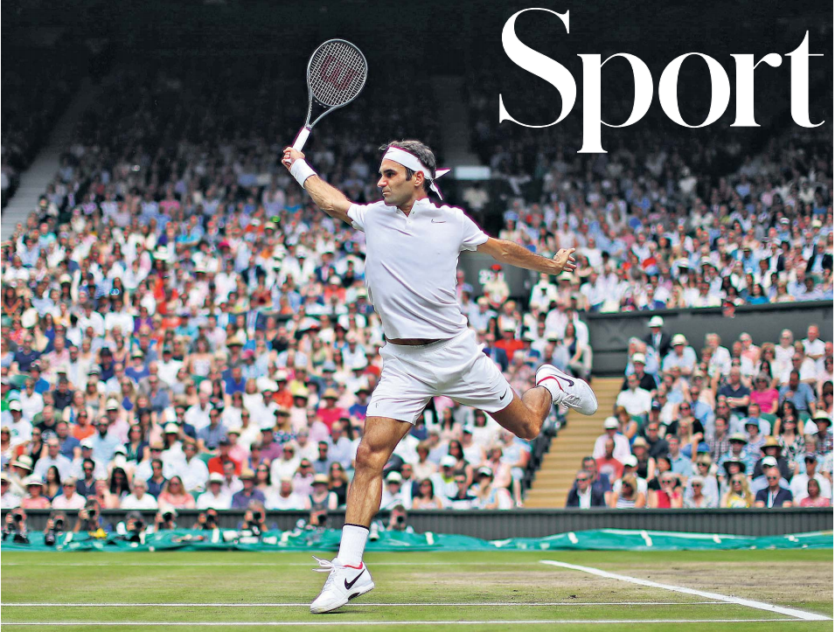
1. ‘My body told me to quit’ 费德勒宣布退役
Class act: Roger Federer shows his customary poise in beating Marin Cilic on Centre Court to win the Wimbledon men’s final in 2017, a record eighth singles triumph at SW19 for the Swiss, who announced his retirement yesterday.

Slide 4
语篇填空
（《每日电讯报》2022年9月16日 SPORT版面 1页）
Roger Federer has announced he is retiring at the age of 41, and ____ next week’s Laver Cup in London will be his final event.
Federer won 20 major ________ (trophy) and a record 103 ATP titles over his 24-year career, including eight Wimbledon championships, and established himself ___ one of the most successful players ever ____ (see). But he has spent the best part of the past two years on the sidelines and underwent triple knee surgery.
Federer had spells as the most dominant male ______ (play), including a record 237 consecutive weeks as world No 1 and 1,251 match wins.
He last played at a grand-slam event at Wimbledon last year, _____ he was beaten by Hubert Hurkacz in the quarter-finals, ______ (lose) the final set 6-0 – an irksome stain on his glittering record at the All England Club that he admitted ______ (help) drive him during long months of rehab.
At ___ ceremony at this year’s Wimbledon, he said he hoped he could play there “one more time”, and had earmarked next week’s Laver Cup team event as the start of his comeback. ___ the end though, the knee injury proved career-ending.
that
trophies
as
seen
player
when
losing
helped
a
In

Slide 5
词汇讲解
1. irksome: annoying or irritating 使人烦恼的；令人生气的
I hate some of the irksome regulations in our school.
我讨厌咱们学校的一些令人厌烦的规章条例。
2. earmark: ~sb/sth (for/as sb/sth) to decide that sth will be used for a particular purpose, or to state that sth will happen to sb/sth in the future 指定……的用途；预先安排，确定（未来发生的事情）
Their support meant that he was not forced to sell the business which was earmarked for disposal last year.
他们的支持意味着他不必被迫出售去年已决定要卖掉的公司。
翻译句子
我对那些限制感到很烦。
I found the restrictions irksome.
翻译句子
这家工厂已被指定关闭。
The factory has been earmarked for closure.

Slide 6
长难句分析
He last played at a grand-slam event at Wimbledon last year, when he was beaten by Hubert Hurkacz in the quarter-finals, losing the final set 6-0 – an irksome stain on his glittering record at the All England Club that he admitted helped drive him during long months of rehab.
分析：本句是一个复合句，“when he was beaten by Hubert Hurkacz in the quarter-finals”是____________________________，“losing the final set 6-0”是___________________；另外，定语从句“that he admitted helped drive him during long months of rehab”修饰先行词_______，其中“he admitted ”是________。
when引导的非限制性定语从句
现在分词作伴随状语
record
插入语
他上一次比赛是在去年的温布尔登大满贯赛事上，在四分之一决赛中被休伯特·赫卡茨击败，以6比0输掉了最后一盘——这给他在全英俱乐部的辉煌记录抹上了污点，他承认正是这辉煌记录帮助他支撑过慢长的康复期。
翻译

Slide 7
句子翻译
Federer won 20 major trophies and a record 103 ATP titles over his 24-year career, including eight Wimbledon championships, and established himself as one of the most successful players ever seen.
翻译
在他24年的职业生涯中，费德勒赢得了20个重要奖杯和创纪录的103个ATP冠军，其中包括8次温布尔登冠军，并确立了自己有史以来最成功的球员之一的地位。
At a ceremony at this year’s Wimbledon, he said he hoped he could play there “one more time”, and had earmarked next week’s Laver Cup team event as the start of his comeback.
翻译
在今年温布尔登网球公开赛的一个仪式上，他说他希望自己能在那里“再”比赛一次，并期望下周的拉沃尔杯团体比赛作为他复出的开始。

Slide 8
2.WORLD OF MEDICINE
医学界新发现

Slide 9
语篇填空1
（《读者文摘》 2022年9月刊 46页）
Why It’s OK to Forget Sometimes
Forgetting things can be frustrating or even worrying, but it might actually be good for our brains. ______ (base) on preclinical trials, researchers at Trinity College Dublin and the University of Toronto propose that forgetting is something the brain _____ (do) to prune clutter. On the flip side, their research suggests that buried memories could be brought back, even in people with amnesia. If further study supports these findings, more serious memory loss could be treated. Also, ___ new German study shows that cognitive processing speed generally begins to change after age 60. In the study, older participants took ______ (long) to settle on decisions, but ______ (main) because they were more careful to avoid making mistakes — which is, of course, a smart thing if you want to make better choices.
Based
does
a
longer
mainly

Slide 10
语篇填空2
（《读者文摘》 2022年9月版 46页）
Olive Oil Could Add Years To Your Life
A Mediterranean diet is known to be heart-healthy, and a new Harvard study found that __________ (consume) just a small amount of olive oil every day lowers your risk of dying from a _______ (various) of ailments. Researchers followed 90,000 Americans for 28 years and found those ____ consumed a half tablespoon of olive oil daily had a lower risk of death from cancer (by 17 percent), respiratory disease (by 18 percent), heart disease (by 19 percent), and neurodegenerative diseases such as dementia (by 29 percent). Whether taken straight from the bottle ___ used in cooking, olive oil has anti-inflammatory and antioxidant _________ (property) that contribute to over-all health, as does replacing other artery-clogging fats.
consuming
variety
who
or
properties

Slide 11
词汇讲解
1. cognitive: connected with mental processes of understanding 认知的
As children grow older, their cognitive processes become sharper. 随着孩子们长大，他们的认知过程也变得越来越敏锐了。
2. ailment: an illness that is not very serious 轻病；小恙
The pharmacist can assist you with the treatment of common ailments. 药剂师能帮助你治疗平常小病。
翻译句子
她的部分认知能力受到了损害。
Some of her cognitive functions have been impaired.
翻译句子
这男孩因为生病没去上学。
The boy didn’t go to school becuase of an ailment.

Slide 12
句子翻译
Based on preclinical trials, researchers at Trinity College Dublin and the University of Toronto propose that forgetting is something the brain does to prune clutter.
都柏林圣三一学院和多伦多大学的研究人员在临床前试验的基础上提出，遗忘是大脑为了清理杂乱而做的一件事。
翻译
Whether taken straight from the bottle or used in cooking, olive oil has anti-inflammatory and antioxidant properties that contribute to over-all health, as does replacing other artery-clogging fats.
无论是直接从瓶中取出还是在烹饪中使用，橄榄油具有抗炎和抗氧化的特性，有助于全面的健康，也可以替代其他阻塞动脉的脂肪。
翻译

Slide 13
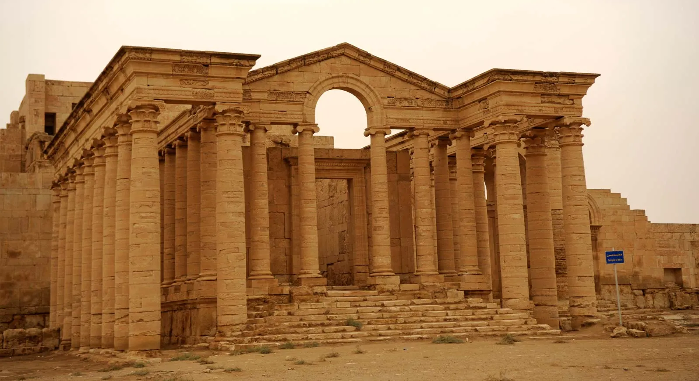
3.Ancient City is Open to Visitors
古城对游客开放

Slide 14
语篇填空
（《青少年周刊》 2022年9月17日刊 5页）
The ancient city of Hatra, in northern lraq, is open to visitors again after its temples and statues were attacked by the Islamic State (IS) five years ago. IS is an armed group _____ members hold extreme religious ______ (relief). The group tried to destroy ancient buildings and monuments before it was defeated in the region in 2019.
_____ (build) about 2,000 years ago, Hatra used to be an important religious and trading centre. Ancient temples (places of religious worship) are surrounded by a thick wall that once protected the city from attacks. A local museum now hopes to boost _______ (tour) in the area, and it ________ (recent) organised a tour that allowed 40 visitors to walk around Hatra as the Sun was setting. The tourists took selfies in front of old buildings and inspected parts of the city that ________________ (damage) by IS.
Luna Batota, from Belgium, said the city is like a window to ___ ancient civilisation. “A lot of history but at the same time a lot of __________ (fortunate) events took place here,” she said.
A sculpture and decorations from one of the temples were restored ______ (early) this year, and more tourists are expected to visit. The UK Government says it is too dangerous for people to travel to lraq, which is still recovering from years of war. _________, it is hoped that soon more people will be able to discover lraq’s rich history.
whose
beliefs
Built
tourism
recently
had been damaged
an
unfortunate
earlier
However

Slide 15
词汇讲解
1. monument: a building, column, statue, etc. built to remind people of a famous person or event 纪念碑（或馆、堂、像等）
A monument to him was erected in St Paul’s Cathedral. 在圣保罗大教堂为他修了一座纪念碑。
2. boost: to make sth increase, or become better or more successful 使增长；促进
Getting that job did a lot to boost his ego. 得到那份工作使他信心倍增。
翻译句子
广场上立着一座纪念战争中所有死难者的纪念碑。
In the square stands a monument to all the people killed in the war.
翻译句子
我们需要一个大的胜利来增强我们的自信心。
We need a big win to boost our confidence.

Slide 16
句子翻译
IS is an armed group whose members hold extreme religious beliefs. The group tried to destroy ancient buildings and monuments before it was defeated in the region in 2019.
IS是一个武装组织，其成员持有极端的宗教信仰。该组织2019年在该地区被击败之前，曾试图摧毁该地区的古代建筑和纪念碑。
翻译
A local museum now hopes to boost tourism in the area, and it recently organised a tour that allowed 40 visitors to walk around Hatra as the Sun was setting. The tourists took selfies in front of old buildings and inspected parts of the city that had been damaged by IS.
一家当地博物馆现在希望能促进该地区的旅游业，它最近组织了一场旅游活动，允许40名游客在太阳落山时游览哈特拉。游客们在老建筑前自拍，并视察了被IS破坏的城市部分地区。
翻译

Slide 17
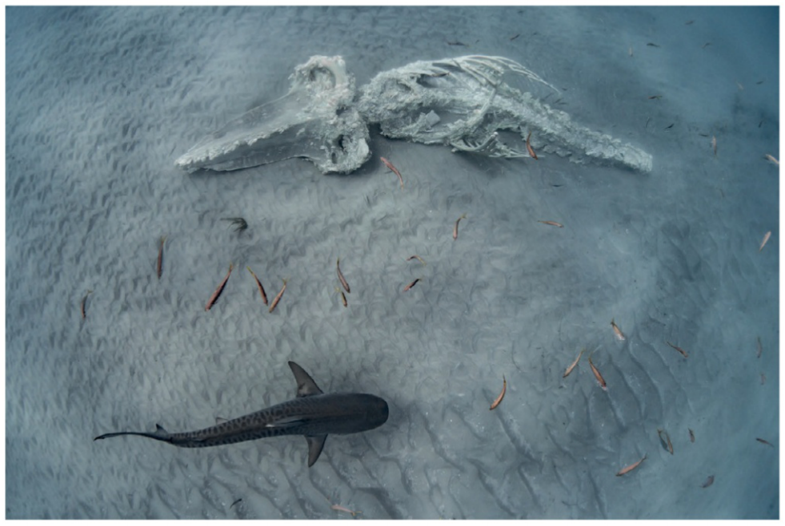
4.Winners’ Crowned In Australian Geographic Nature Photographer Of The Year
获奖者加冕为年度澳大利亚地理自然摄影师

Slide 18
语篇填空
（《澳大利亚摄影》 2022年10月1日刊 10页）
A
___ confronting photograph of a humpback whale carcass and circling sharks on the ocean floor in Coral Bay, Western Australia has won the Australian Geographic Nature Photographer of the Year ___________ (compete) for 2022. Nature’s Prey by Ashlee Jansen captures a harsh act of Mother Nature, but an important part of the natural ecosystem. Based in Western Australia, Ms Jansen captured her winning shot in July 2021 after a sub-adult whale died _____ making the annual migration north along the Ningaloo Reef.
“Tour boats had been watching the young whale for days as it ______ (slow) moved through the bay, _________ (appear) sicker and slower with more shark bites over its body day after day,” Jansen recalled. “This ____________ (forget) experience is a reminder of how harsh nature and the food chain can be, yet such an important part of the natural ecosystem. One animal’s sacrifice can provide so many nutrients ___ so many other species of wildlife for years to come,” she _________ (explain).
For her win, Jansen receives a cash prize of $10,000 along with a travel prize. The annual competition is open to images ________ (capture) in Australia, New Zealand, Antarctica and the New Guinea region, with more than 2,400 ______ (entry), the highest number in the competition’s history, entered this year.
competition
while
slowly
appearing
unforgettable
to
explained
captured
entries

Slide 19
词汇讲解
1. carcass: the dead body of an animal, especially of a large one or of one that is ready for cutting up as meat 动物尸体
A cluster of vultures crouched on the carcass of a dead buffalo. 一群秃鹫伏在一头水牛的尸体上啄食。
2. harsh: cruel, severe and unkind 残酷的；严酷的；严厉的
The minister received some harsh criticism . 部长受到了严厉的批评。
翻译句子
那是一具棕色动物的尸体。
It was the carcass of a brown animal.
翻译句子
我们迟早都得正视生活的严酷现实。
We had to face up to the harsh realities of life sooner or later.

Slide 20
句子翻译
Based in Western Australia, Ms Jansen captured her winning shot in July 2021 after a sub-adult whale died while making the annual migration north along the Ningaloo Reef.
Jansen女士住在西澳大利亚，她在2021年7月拍摄了这张获奖照片，当时一头亚成年鲸鱼在沿着宁格罗礁向北的年度迁徙途中死亡。
翻译
“This unforgettable experience is a reminder of how harsh nature and the food chain can be, yet such an important part of the natural ecosystem. One animal’s sacrifice can provide so many nutrients to so many other species of wildlife for years to come,” she explained.
“这段难忘的经历提醒我们，大自然和食物链是多么残酷，但它是自然生态系统如此重要的一部分。 一只动物的牺牲可以在未来几年为许多其他野生动物物种提供如此多的营养。” 她解释道。
翻译

Slide 21
5. BBC新闻听写填空 09/28/22

Slide 22
听力填空
Scientists have ___________ crashed a spacecraft into a distant asteroid aiming to push it _________. NASA described the mission as the first test of a planetary defence system to prevent a future asteroid collision with earth. A live camera relayed the final few seconds before the collision.
The UN’s special representative in Haiti has said an _________ crisis, a gang crisis, and a political crisis have converged into a humanitarian __________ in the country. The emergency meeting of the UN Security Council was called following two weeks of violence and attacks on ________ warehouses.
Hurricane Ian’s outer bands of strong wind and heavy rain are beginning _________ in western Cuba. Homes and _________ have been secured and evacuation plans prepared in advance of the storm’s landfall.
The head of the technology firm Apple has told the BBC there are no good excuses for the failure of the world’s Tech firms to employ more women. Tim Cook said that without ______________, technology would not fulfil its ________ to help humanity.
And a study says that more than a thousand species of palm trees are _________ extinction.
deliberately
off course
economic
catastrophe
food aid
to be felt
properties
better diversity
potential
at risk of

Slide 23
词汇讲解
1. relay: to broadcast television or radio signals
播放，转播（电视或广播讯号）
The satellite will be used mainly to relay television programmes.
这颗人造卫星主要用途是转播电视节目。
2. converge: ~ (on...) (of people or vehicles) to move towards a place from different directions and meet （人或车辆）汇集；聚集；集中
Hundreds of coaches will converge on the capital.
数百辆长途汽车将会在首都汇集。
翻译句子
这场比赛通过卫星向全世界的观众进行了转播。
The game was relayed by satellite to audiences all over the world.
翻译句子
成千上万的支持者从四面八方汇聚伦敦举行集会。
Thousands of supporters converged on London for the rally.

Slide 24
句子翻译
Scientists have deliberately crashed a spacecraft into a distant asteroid aiming to push it off course. NASA described the mission as the first test of a planetary defence system to prevent a future asteroid collision with earth.
科学家们故意将一艘航天器撞向一颗遥远的小行星，旨在使它偏离轨道。美国宇航局将这次任务描述为对行星防御系统的第一次测试，以防止未来小行星与地球发生碰撞。
翻译
The UN’s special representative in Haiti has said an economic crisis, a gang crisis, and a political crisis have converged into a humanitarian catastrophe in the country.
翻译
联合国驻海地特别代表表示，一场经济危机、一场帮派危机和一场政治危机已经在该国变成一场人道主义灾难。

