Slide 1
感恩遇见，相互成就，本课件资料仅供您个人参考、教学使用，严禁自行在网络传播，违者依知识产权法追究法律责任。
更多教学资源请关注
公众号：溯恩英语
知识产权声明

Slide 2
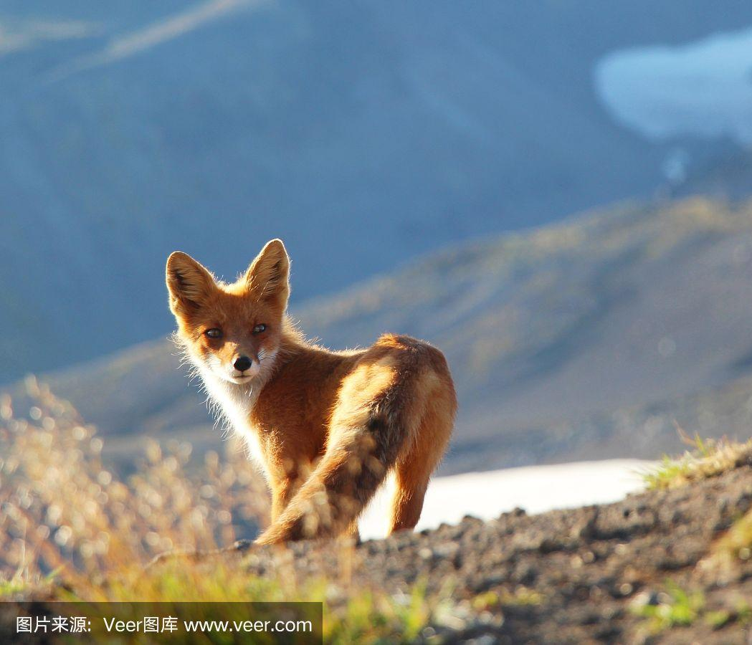
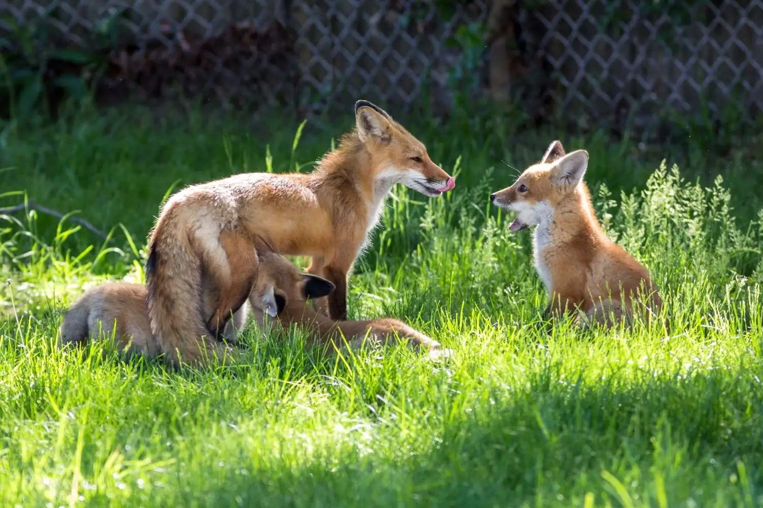
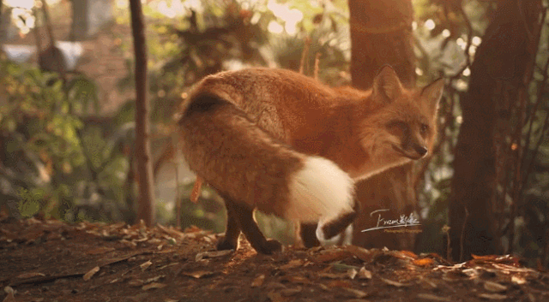
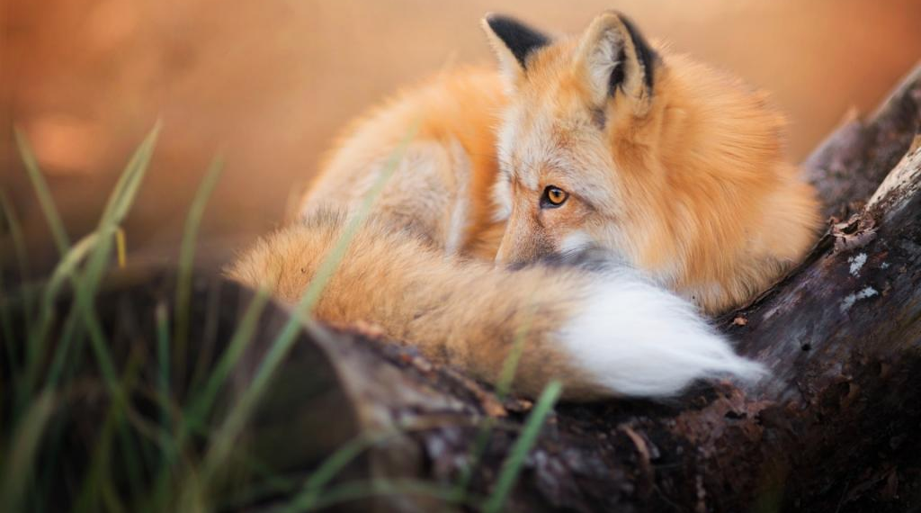
Tame a Fox
Sycophantic 狐媚的
Ms. Zhu Mar. 1, 2024

Slide 3
1. My story started one autumn morning, at the bend(转弯处) on a path.
2. I was 13 years old, and was on the way to school. It was the first time I had caught sight of a fox. Fascinated to the point that I forgot all fear, I dared to go up to it, I had never come so close to a wild animal. There was nobody else around, only me and the fox.
3. “Hey, fox!” I tried to greet it, though my voice was so weak it felt like I was saying hello to myself. It didn't hear me. It stayed there and I watched it. My heart was beating flat out. It was so cute. For a moment I thought I might be able to touch it.
4. Throughout the day at school, I could only think of the fox at the big beech (山毛榉) tree. At my return to the place where we met, I was sure I'd find it there.
5. And I did. This time I gathered a little bit more courage and called out to it, “Fox!” Of course it escaped. But that only made me long to meet it again. I decided that if I could find its kennel (洞) and catch it, I would try and tame (别服) it, making it my friend.
6. Thus, I spent most of my free time in the forests trying to find the fox during the following months. But I never saw it again before winter came. During the winter, I followed its footprints far across the fields. Suddenly I was alarmed by the howling of wolves near me. I ran away frightened, stumbled and hurt my ankle. It healed very slowly, so that I had to stay at home during the winter, reading a book about animals of the forest and foxes.
7. When spring arrived, I was free again. I looked for fox kennels and waited for my fox, To my amazement, it had got young ones but kept moving, because of my observations; therefore I decided to observe the fox from a longer distance.

Slide 4
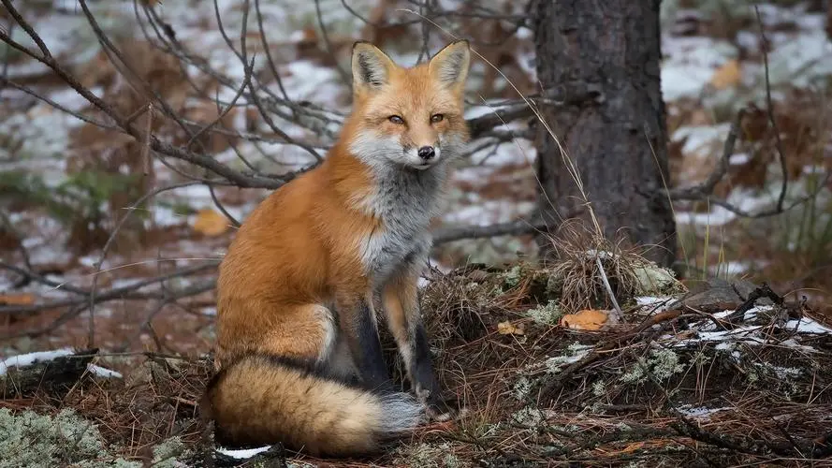
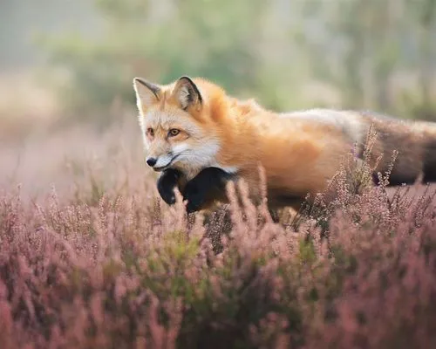
My story about a fox
I was 13 years old, and was on the way to school. It was the first time I had caught sight of a fox. Fascinated to the point that I forgot all fear, I dared to go up to it, I had never come so close to a wild animal.
“Hey, fox!” I tried to greet it, though my voice was so weak it felt like I was saying hello to myself. It didn't hear me. It stayed there and I watched it. My heart was beating flat out.
For a moment I thought I might be able to touch it.
Throughout the day at school, I could only think of the fox at the big beech (山毛榉) tree.
autumn
I was fascinated by the fox I encountered accidentally on the way to school.
It was so cute.
It stayed there.
This time I gathered a little bit more courage and called out to it, “Fox!” Of course it escaped. But that only made me long to meet it again. I decided that if I could find its kennel (洞) and catch it, I would try and tame (别服) it, making it my friend.
Thus, I spent most of my free time in the forests trying to find the fox during the following months.
I decided to catch the fox and tame it, making it my friend.
I decided to catch the fox and tame it, making it my friend.
During the winter, I followed its footprints far across the fields. Suddenly I was alarmed by the howling of wolves near me. I ran away frightened, stumbled and hurt my ankle. It healed very slowly, so that I had to stay at home during the winter, reading a book about animals of the forest and foxes.
It escaped!
winter
I got my ankle hurt, staying at home and reading a book about fox.
I was free again. I looked for fox kennels and waited for my fox.
I decided to observe the fox from a longer distance.
It had got young ones but kept moving.
spring

Slide 5
Major event
I decided to catch the fox and tame it, making it my friend.
From autumn to spring, the fox had grown to be a mother fox, could I tame it? How can I make friend with it ?
To tame the fox who had babies was inhuman, for its babies needed their mum and they preferred to live in the wild, therefore, I should befriend rather than tame.
Para. 1 Finally, it would let me get close.
Para. 2 To my surprise, the day after I took it home, it fled.
衔接 1 Scene 1. Overjoyed, I approached the fox.
衔接 1 Q. How did I feel when knowing that ? What did I do?
过渡 1 Scene 2 I touched the fur of the fox and also played with its babies. The idea to bring it home and tame it emerged in my mind again.
过渡 1 Q. What did I do next after approaching? The fox’s reaction ?
衔接 2 Scene 3 I brought the fox home cautiously while it was asleep. Being carefully attended but locked, it’s mournful.
衔接 2 Q. What did I do to take the fox home? The fox’s reaction?
衔接 3 Q. How did I feel when finding the fox fled? What would I do?
衔接 3 Scene 1 Amazed, I hurried to search for it from my house all the way to the wild.
过渡 2 Scene 2 Exhausted and relieved, I finally found the fox, together with the young ones, playing happily in the wild. The scene caused me to give up taming.
过渡 2 Q. Where did I go? What did I see? What would I then?
主题 1 Scene 3 I realized that making friends with the fox and letting it live in the wild was much better than taming it.
主题 1 Q. What lesson did I learn from this experience?

Slide 6
Useful sentence patterns to make up the sentences
前缀 + 主句 + 后缀
主句中 插入
倒装
名词性从句组合
It 句型
非谓语动词/独立主格/adj短语 + 主句 + 非限定性定语从句
主句 + 非限定性定语从句/非谓语动词/独立主格/同位语名词短语 + 主句其他部分
Not only…, but also…
Only + 状语置于句首；
So + adj…that… 虚拟里的倒装(Were I you, … )
Why … is that…
What… is that…
It is/was + adj /n. + for sb to do sth.
It is suggested/ convinced/ … that…
It is/was + 被强调的部分+ that …

Slide 7
sentence patterns + advanced and precise words
feelings + actions
Para. 1 Finally, it would let me get close.
衔接 1 Scene 1. Overjoyed, I approached the fox.
过渡 1 Scene 2 I touched the fur of the fox and also played with its babies. The idea to bring it home and tame it emerged in my mind again.
衔接 2 Scene 3 I took the fox home when it’s asleep, cautious. Being carefully attended but locked, it’s mournful.
An overwhelming surge of excitement coursing through my veins, my long-lasting dream of befriending the fox came true in time/became an undoubted reality/ was realized/ accomplished ultimately!
Months of patient observation and cautious approach eventually paid off and overwhelming joy and excitement filled my heart. [无灵主语]
Excited and touched by her trust, I reached out my hand, touched her smooth fur and played with them.[前缀+ 主句连动] Never in my wildest dream had I imagined that she did come to me, along with her babies. [主句倒装+后缀] It was at that time that the idea to bring it home and tame it emerged/began to bounce in my mind again. [强调句式]

Slide 8
sentence patterns + advanced and precise words
feelings + actions
衔接 2 Scene 3 I brought the fox home cautiously while it was asleep. Being carefully attended but locked, it’s mournful.
Moments later, the fox, with her babies, curled in my arms, falling asleep.[前缀+主句+后缀] Why not took them home then? [前缀+ 主句] With great caution, / Holing my breath tightly, /Gentle and cautious, I held it tightly and walked them to my home. [前缀+ 主句] Upon arrival, I laid them in the kennel that I had prepared months in advance and presented the food and drink alongside them, hoping they would settle down. [前缀+主句+定语从句+ 非谓语动词后缀] When night fell, it seemed everything was going well except for some noises from the kennel. [状语从句 + it 句式]

Slide 9
sentence patterns + advanced and precise words
feelings + actions
Para. 2 To my surprise, the day after I took it home, it fled.
衔接 3 Scene 1 Amazed, I hurried to search for it from my house all the way to the wild.
过渡 2 Scene 2 Exhausted and relived, I finally found the fox, together with the young ones, playing happily in the wild. The scene caused me to give up taming.
主题 1 Scene 3 I realized that making friends with the fox and let it live in the wild was much better than taming it.
When seeing the empty kennel, the “new house” for the fox, I couldn’t hold back my tears of sadness and burst out crying/ I was overwhelmed by a huge wave of loss. [非谓语+插入] But I knew what I should do right now was to find it. [名词性从句组合]
From my home to the wild, I searched for its footprints inch by inch, finally spotting it attending and playing with its young ones with great joy.[前缀+ 主句+ 后缀] Sometimes the fox hid itself in the woods; sometimes chased after the babies happily; sometimes “wrestled” with the babies in the mud. [排比]Only at that time did I realize what a ridiculous idea I ever bore.[倒装]
My journey of the encounter with the fox came to an end in an unexpected way, but fond memories of the special bond between us never faded.
There’s no denying that the best way to get close to animals is to be a friend of them rather than tame them.

Slide 10
Para. 1 Finally, it would let me get close. Months of patient observation and a cautious approach eventually paid off and overwhelming joy and excitement filled my heart. [无灵主语] Excited and touched by her trust, I reached out my hand, touched her smooth fur and played with them.[前缀+ 主句连动] Never in my wildest dream had I imagined that she would come to me, along with her babies. [主句倒装+后缀] It was at that time that the idea to bring it home and tame it emerged/began to bounce in my mind again. [强调句式] Moments later, the fox, with her babies, curled in my arms, falling asleep.[前缀+主句+后缀] Why not take it home then? [前缀+ 主句] With great caution/care, / Holding my breath tightly, /Gentle and cautious, I held it tightly and walked it to my home. [前缀+ 主句] Upon arrival, I laid them in the kennel that I had prepared months in advance and presented the food and drink alongside it, hoping they would settle down. [前缀+主句+定语从句+ 非谓语动词后缀] When night fell, it seemed everything was going well except for some noises from the kennel. [状语从句 + it 句式]

Slide 11
Para. 2 To my surprise, the day after I took it home, it fled. When seeing the empty kennel, the “new home” for the fox, I couldn’t hold back my tears of sadness and burst out crying/ I was overwhelmed by a huge wave of loss. [非谓语+插入] But I knew what I should do right now was to find it. [名词性从句组合] From my home to the wild, I searched for its footprints inch by inch, finally spotting it attending and playing with its young ones with great joy.[前缀+ 主句+ 后缀] Sometimes the fox hid itself in the woods; sometimes chased after the babies on the grassland; sometimes “wrestled” with the babies in the mud. [排比]Only at that time did I realize what a ridiculous idea I ever bore.[倒装] My journey of the encounter with the fox came to an end in an unexpected way, but fond memories of the special bond between us never faded./There’s no denying that the best way to get close to animals is to be a friend of them rather than tame them.

Slide 12
参考范文
Finally it would let me get close. One day, as I sat quietly under the shade of a tree, the fox cautiously approached, its bright and soft eyes fixed on me. I held my breath, not wanting to startle the little creature. As it came closer, I could see the trust in its eyes, and I knew that it had got accustomed to my presence and that our bond had deepened. Over time, I was able to bring it food and even stroke its fur and occasionally, it would huddle peacefully against me as we sat on the green grass, like two old friends. And just like what I’d do to an old friend who seemed to need help, I took it home—thinking I could better take care of it and we could better enjoy each other’s company.
To my surprise, the day after I took it home, it fled. It jumped out of an open window and in no time vanished into the woods. As I watched it slip away, with a nimbleness and grace that was a joy to behold, darting through the underbrush with a fluidity that spoke of its wild nature, I suddenly realized that perhaps the wild called to it more strongly than I ever could. I should never have tried to keep it as a tame pet, because wild creatures were supposed to be roaming in their own home, rather than being confined in mine. I didn’t see it then,—not even with the help of that book about foxes, but now, on looking back, I know that my self -acclaimed “love” for it was not love at all, but possession.

