Slide 1
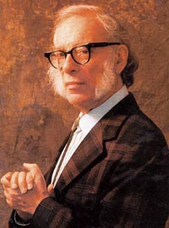
A biography of
Isaac Asimov
Unit2 Using language
Reading and Writing

Slide 2
感恩遇见，相互成就，本课件资料仅供您个人参考、教学使用，严禁自行在网络传播，违者依知识产权法追究法律责任。
更多教学资源请关注
公众号：溯恩高中英语
知识产权声明

Slide 3
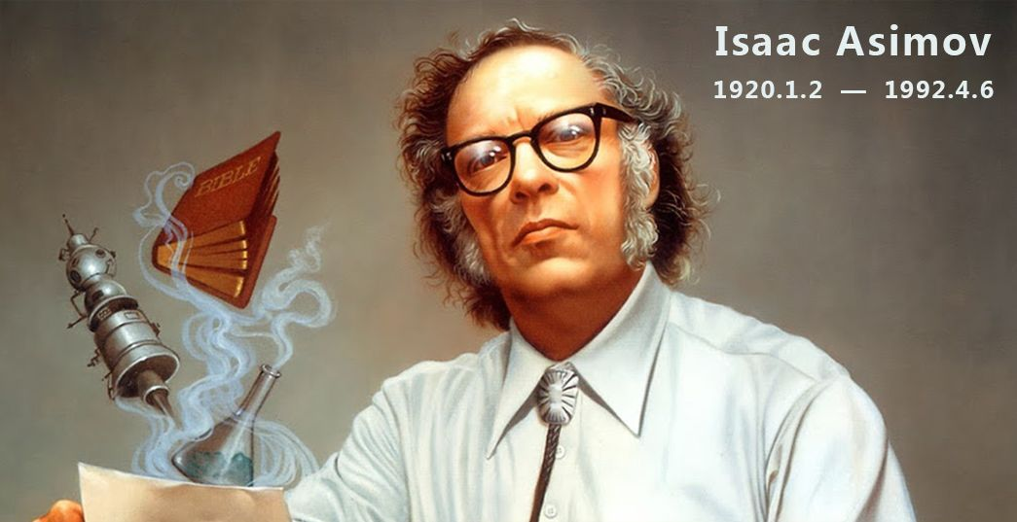
Lead-in
An American scientist and writer
快乐男声电影众筹详情:
A Russian-born American author and professor of biochemistry, a highly successful and exceptionally prolific writer best known for his works of science fiction and for his popular science books.
筹资金额巨大
参与人数众多
Know him in one minute
众多明星响应
¥5,075,980
29166人
特别录制宣传片

Slide 4
Content
01
Asimov’s biography
02
Tips of summarizing a bio.
03
Summary writing practice

Slide 5
过渡页
PART
ONE
Asimov’s biography

Slide 6
Fast-reading
1.
Which paragraph..
search
Which paragraph tells you when and where Asimov was born and died?
Which paragraph tells you about his education?
Which paragraph tells you about awards he received?
P2
P3
P5

Slide 7
2.
Read for information
Complete the timeline in Exercise1：
(get ready for the summary writing)
Date Event
born in Russia.
___________.
_________________________.
Parents bought a candy store.
___________________________.
Mother had her third child.
____ Started to take himself seriously as a writer.
________________________________
________________________________.
Sister born
Moved with family to New York
Started working in a candy store
1931
Began having stories published in science fiction magazines

Slide 8
2.
Read for information
Date Event
____ Gained Master’s degree in chemistry.
Finished working in the candy store.
________________.
1942-1945 ____________________________ ____________________________.
____ Got PhD in chemistry.
____ Became a biochemistry teacher, Boston
University School of Medicine.
Published his first novel.
__________________ . Developed three laws
for robots.
1941
Got married
Worked as junior chemist, Philadelphia Navy Yard
1948
1949
Published “I, Robot”

Slide 9
2.
Read for information
Date Event
1951-1953 Published “The Foundation Trilogy” and
won an award for it.
_____ Published first science book
_____ Became a full-time writer.
Divorced his first wife.
__________________________.
_____ Had a blood transfusion. Became infected
with HIV.
1992 ________________________.
1953
1958
Married for a second time
1983
Died in New York

Slide 10
3.
Comprehension
1.. What was Asimov best known for?
A. His mystery stories.
B. His science fiction stories.
C. His science and history books.
D. His books about the Bible and about Shakespeare.
B
2. Why could Isaac Asimov become a writer ?
A. A friend of his made him a writer
B. His parents wanted him to be a writer
C. He had the talent for writing
D. He had so many experiences in his life .
C

Slide 11
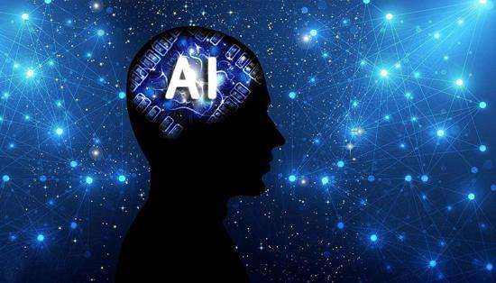
3.
Comprehension
3. What might happen in a world where there were robots if Asimov’s
three laws didn’t exist?
Maybe robots will harm or injure human beings.
Maybe robots will disobey human beings.
In order to protect their own existence, robots may injure human beings.

Slide 12
过渡页
PART
TWO
Tips of summarizing a biography.

Slide 13
感恩遇见，相互成就，本课件资料仅供您个人参考、教学使用，严禁自行在网络传播，违者依知识产权法追究法律责任。
更多教学资源请关注
公众号：溯恩高中英语
知识产权声明

Slide 14
1.
About a biography
*What is a biography?
A biography of someone is an account of their life, written by someone else.
Asimov’s writing career
*What is included in a biography?
Date and place of birth (and death, if applicable)
Education
Marriage
Work experience
Major achievements
√
√
√
√
His works
√
*How to summarize a biography?
Choose the focus
Knowing what points the author discussed will help you determine what information is most important.

Slide 15
Get ready for summary
Tip1
Collect necessary information
Pay attention to the change of living places.
Date Event
born in Russia.
___________.
___________________________.
parents bought a candy store.
___________________________.
Mother had her third child.
____ started to take himself seriously as a writer.
________________________________
________________________________.
sister born
eg:His family moved to the United Stated and settled in New York.
moved with family to New York
started working in a candy store
1931
began having stories published in science fiction magazines

Slide 16
Date Event
____ gained Master’s degree in chemistry.
finished working in the candy store.
________________.
1942-1945 ____________________________ ____________________________.
____ got PhD in chemistry.
____ became a biochemistry teacher, Boston
University School of Medicine.
published his first novel.
__________________ . Developed three laws
for robots.
Tip2
1941
Introduce his educational and occupational history .
got married
worked as junior chemist, Philadelphia Navy Yard
1948
1949
eg:He gained a master’s degree in chemistry and later his PhD.
He became a biochemistry teacher at…
published “I, Robot”

Slide 17
Tip3
Date Event
1951-1953 published “The Foundation Trilogy” and
won an award for it.
_____ published first science book
_____ became a full-time writer.
divorced his first wife.
__________________________.
_____ had a blood transfusion. Became infected
with HIV.
1992 ________________________.
End with his marriage & death in short
1953
1958
married for a second time
1983
eg: He had 2 marriages and 2 children.
He died in New York in 1992.
died in New York

Slide 18
Get ready for summary
Asimov’s writing career
1939 began having stories published
in science fiction magazines
1950 published his first novel.
1951-1953 published “The Foundation Trilogy” and
won an award for it.
1953 published first science book
1958 became a full-time writer.
Use your own sentences to organize the information.
Original comment of the author
Some of his ideas about robots later influenced other writers and even scientists researching into artificial intelligence.
Choose the focus

Slide 19
过渡页
PART
THREE
Summary writing practice

Slide 20
Prepare for writing
* Use the tense of past
* Write it in the order of time
* Add some transitional words/ expression if necessary
* Check your summary if the major points are left out
All-sided
object-ive
Fair & square
Linguistic feature

Slide 21
Write a summary
Write a short summary of Asimov’s life in 150-200 words. Follow the directions on Page 18.
All-sided
object-ive
Fair & square

Slide 22
Sample summary
⊿Isaac Asimov was a Russian-born American writer. His family immigrated to the United States when he was three years old and settled in New York. He gained a master’s degree in chemistry and later got his PhD. After he graduated, he became a biochemistry teacher at Boston University.
⊿He was talented in writing. When he realized it, he gave up teaching and became a professional writer. In 1939, he had storied published his first novel. He was famous for his fiction stories and received many awards. The Foundation trilogy and I, Robot are very popular with the young and adults. His works exercised great influence over other writers.
⊿Asimov had two marriages and two children. He died of AIDS in New York in 1992.
Begin by giving the assessment
Write according to the timeline
Focus on his writing career and his achievement
Comment objectively
End with his marriage & death

Slide 23
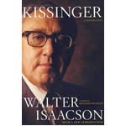
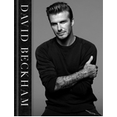
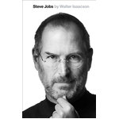
recommended reading

Slide 24
感恩遇见，相互成就，本课件资料仅供您个人参考、教学使用，严禁自行在网络传播，违者依知识产权法追究法律责任。
更多教学资源请关注
公众号：溯恩高中英语
知识产权声明

Slide 25
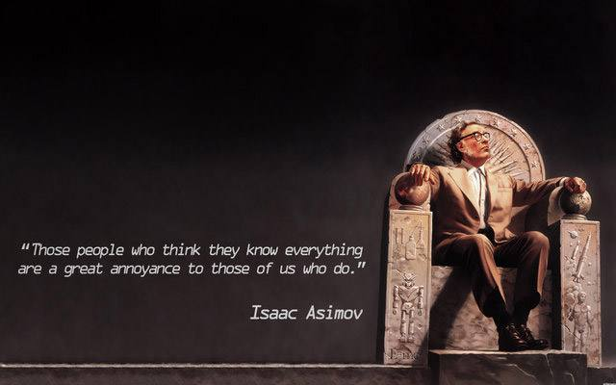
THANKS

