Slide 1
感恩遇见，相互成就，本课件资料仅供您个人参考、教学使用，严禁自行在网络传播，违者依知识产权法追究法律责任。
更多教学资源请关注
公众号：溯恩英语
知识产权声明

Slide 2
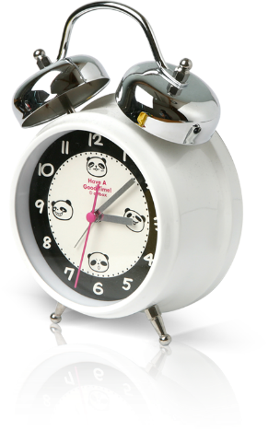
考前词汇头脑风暴,提升敏锐捕捉信息的解构和建构思维能力
语义场释义Paraphrase-1
Word bank for paraphrase
http://www.sunedu.com
浙江省常山一中 吴俊峰
06-05

Slide 3
What is paraphrase
英语在其发展中，不断吸收了各民族、各语言中的词汇，形成了极为丰富的同(近)义词词群。语义场理论是研究英语词汇中词与词之间特殊关系，语义场是一个大的词汇关系场域，在这一词汇关系场域中，每一个词汇都有着相应的关系, 或上下义关系，或同义关系和反义关系，或整体与局部关系，或组合关系等。
Paraphrase 的核心更在于建立一套能够让你有效paraphrase的体系，或者说是一种在脑海中系统搜寻paraphrase词汇的方法。利用这些方法，词汇与词汇之间通过衔接建立了一个贯穿语篇的语义链，而语篇的主题主要是由词汇衔接链的贯通而得到实现的。 基于词汇衔接理论，在理解语篇的基础上融入文体的品读，丰富词汇的内涵和外延，对文章语义语域的准确判断和逻辑脉络的宏观把握，听力、阅读、完形以及写作的谋篇布局和措词造句的能力和语言素养都会有根本提升和质的飞跃。 同义替换Paraphrase并不是说意思完全相等，能否替换另一个表达要根据语境来决定，可以通过看每个替换词的英文表达，比较不同的用法和使用场合。

Slide 4
How to paraphrase
change the part of speech (改变词法）
change words and phrases (替换字词)
Strategies
Change the voice (改变语态)
Change sentence patterns (改变句式）
Combine sentences（合并句子）

Slide 5
1. 发现，找到; 揭示 discover, find; known, appear
1.泄露秘密/披露详情/透露方法/揭露错误/流露感情/发现潜在安全问题
2.筷子揭示了中国的哲学和价值观，反映了中国文化和文明的特征。
3.新兴的“数码艺术摄影”
uncover 揭露，发现
unravel _{/ʌnˈrævl/} 解开；弄清，阐明
unveil _{/ˌʌnˈveɪl/}（首次）公开，揭示; 除去面纱
lift the veil 揭开面纱，揭露真相
reveal- revelation 揭示，透露
emerge_{/ɪ'mɜːdʒ/} 浮现；显露，知悉；形成，兴起
shed light on 阐明；使…清楚地显出
bring sth to light将……置于公众视野；揭露
1.reveal secrets/ details/ methods/ faults/ feelings /potential security issues
2.Chopsticks unravel Chinese philosophy and values and reflect the basic characteristics of Chinese culture and civilization.
3. emerging "digital arts photography"

Slide 6
2.修复；恢复 recover;renew; refresh
restore 恢复（情况或感受）；复原；修复
-restoration
renovate _{/ˈrenəveɪt/} 修复；使恢复活力
-renovation
revive _{/rɪˈvaɪv/}（使）复原，复苏；使复兴
-revival
revitalize _{/ˌriːˈvaɪtəlaɪz/} 使恢复生机，使复兴
- revitalization
restore _{/rɪˈstɔː/} 恢复；修复
-restoration
resurge _{/rɪˈsɜːdʒ/} 复活；再起
-resurgence
revert _{/rɪˈvɜːt/} 恢复（到原来状态、情况或做法）- -reversion
1.乡村振兴
2.这意味着将鲸鱼数量恢复到捕鲸前的数量可能是应对气候变化的重要工具。
3.他创立了合作社，振兴了衰落的产业，并带动了成千上万的村民。
4.语言的复兴，尤其是在年轻人当中的复兴，是民族认同感复苏的一部分。
1.revive rural areas/ rural revitalization
2.What this means is that restoring whale populations to their pre-whaling numbers could be an important tool in fighting climate change.
3.He founded the cooperative, revitalizing the declining industry and involving thousands of villiagers.
4.The revival of the language, particularly among young people, is part of a resurgence of national identity.

Slide 7
3.改变，变化 change；switch; reform
convert _{/kən'vɜːt/}v. 转变，变换；皈依
alter _{/'ɔːltə/} v. 改变，修改
shift _{/ʃɪft/} v. 转移；变换；换挡；轮班
reverse _{/rɪˈvɜːs/} v. 颠倒；反转；彻底改变
transform 改变; 转换
-transformation-transformable
revolution 彻底变革；革命
-revolutionary
evolve 进化，演化
- evolution - evolutionary
tipping points = critical transitions
引爆点=关键转变/拐点/临界点
1. 经历了非凡的转变
2. 找出两个主要的旋律革命
3.这些转折点标志着热门旋律的结构和复杂性的重大转变
4. .教科书式的关键转变=突破新领域=突破
5.扭转这一趋势
1.undergone a remarkable transformation
2.identify two major melodic revolutions
3.These turning points mark significant shifts in the structure and complexity of hit melodies
4. a textbook critical transition = broke new ground = breakthrough
5.reverse the trend

Slide 8
3.改变，变化 change；switch; reform
convert _{/kən'vɜːt/}v. 转变，变换；皈依
alter _{/'ɔːltə/} v. 改变，修改
shift _{/ʃɪft/} v. 转移；变换；换挡；轮班
reverse _{/rɪˈvɜːs/} v. 颠倒；反转；彻底改变
transform 改变; 转换
-transformation-transformable
revolution 彻底变革；革命
-revolutionary
evolve 进化，演化
- evolution - evolutionary
tipping points = critical transitions
引爆点=关键转变/拐点/临界点
6..变形以适应他们遇到的任何表面
7.任务切换
8.我已经从吃含糖饮料和零食转变为在饮食中加入更多的蔬菜和水果。
9.地貌彻底改变，严重损害了野生动物。
6.shape-shift to fit whatever surface they encounter
7.task-switching
8. I’ve transitioned from consuming sugary drinks and snacks to including more vegetables and fruits into my diet.
9.The landscape has been radically altered, severely damaging wildlife.

Slide 9
4.消除 remove; erase
1.把床上用品拿开，放一段时间。=脱掉被褥，让床垫透透气
2.最近的举措还未能根除就业歧视。
3. 放弃/踢除/避免/摆脱这种最不慷慨的情绪
4. 拔掉电视插头，制订计划到户外去玩耍。
5.即使消除了这些死亡原因，预期寿命也不会超过92岁。
6.消除误解/ 偏见 /负面情绪/ 让学生从疲劳和压力中解脱出来
eliminate _{/ɪ'lɪmɪneɪt/} vt. 消除；排除
exclude 把……排除在外；排除……的可能
abolish 废除，废止，取消
dispose of 处理掉; 除掉--get rid of
unplug _{[ʌn'plʌg]} vt. 去掉…的障碍物；拔去…的塞子或插头_{（unplugged /unplugging）}
strip 除去，剥去（一层）；剥夺
unwind ...from 解除从…
clear up/away 清除；整理，清理=declutter_{/diːˈklʌtə/} 清除，清理/minimalise
take away 减去,消除
smooth away 减轻（问题、困难等）；消除（问题、困难等）
1.Remove the bedding and leaving it for a while. = Strip the bedding, and let the mattress breathe for a bit.
2. Recent measures have not eliminated discrimination in employment.
3.quit/ kick/avoid/rid this most ungenerous emotion
4. Unplug your TV and plan to enjoy the great outdoor.
5.Even if those causes of death were eliminated, life expectancy would still not go much beyond 92 years.
6.eliminate/erase the misunderstanding / prejudice/ negative emotions //unwind students from fatigue and pressure

Slide 10
5. bad；harmful 坏的
1.不断恶化的天气/ 经济/ 健康状况
2.许多食物因所含的化学成分和添加剂被怀疑有害健康。
3.之前做过的动物实验显示，污染物质能对海洋生物产生有害作用。
4.这种依赖/过度依赖对我们的学习有害
deleterious _{/ˌdeləˈtɪəriəs/} adj. 有毒的，有害的
deteriorate _{/dɪ'tɪərɪəreɪt/} v. 恶化，变坏
--deteriorated adj. 恶化的；已变质的
--deteriorating adj. 日益恶化的
detrimental _{/,detrɪ'mentəl/} adj. 不利的；有害的
n. 有害的人（或物）
1. deteriorating weather conditions /economy /health
2. Many foods are suspected of being detrimental to health because of the chemicals and additives they contain.
3. Prior research on laboratory animals has shown that the pollutants can cause deleterious effects.
4.This dependency/ over-reliance is detrimental to our learning.

Slide 11
5. damage;ruin; endanger 危害、破坏
5.虽然人工智能可以在某些领域提供帮助，但过度依赖它会破坏学习的本质，损害学术诚信。
6高强度的音乐对我们的听力造成威胁，这会对我们的感觉细胞造成永久性的破坏，导致无法治愈的听力损失。
7.过度的咖啡因会削弱我们放松的能力，并且还回干扰你的日常睡眠状况。
8.环境破坏=对生态系统的破坏
undermine _{/ˌʌndəˈmaɪn/}
v.逐渐削弱；（尤指）从根基处损坏
compromise _{/ˈkɒmprəmaɪz/}
n.折中，妥协 v.妥协；危及，损害
devastate _{/'devəsteɪt/ (utterly destroy)}
毁坏，破坏；使极度震惊，使伤心欲绝
impair _{/ɪm'peə/} 损害，削弱
destroy- destruction-destructive
破坏性的，毁灭性的
cause/pose a threat to
对…造成威胁
put …at stake/ at risk/ in danger
使…处于危险/危险之中
5.While AI can assist in certain areas, overreliance on it undermines the essence of learning and compromise academic integrity.
6.Loud music can cause a threat to / endanger/ threaten our hearing // put our ears at stake/ at risk/ in danger, which can do permanent devastate to our sensory cells, resulting in incurable hearing loss.
7.Excessive caffeine can impair your ability to relax, and it can interfere with your usual sleep patterns, too.
8.environmental destruction = damage to the ecosystem

Slide 12
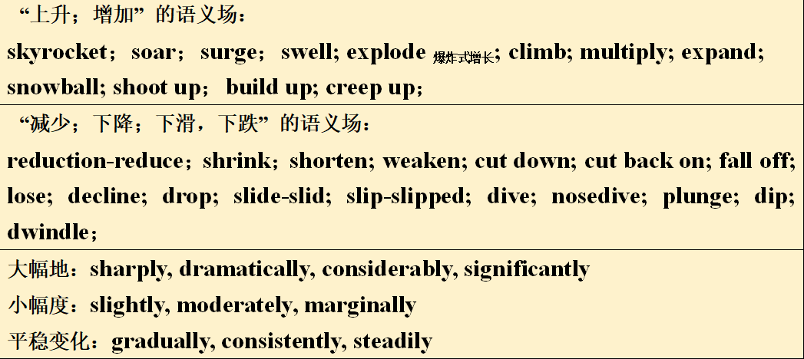
6. increase；rise; grow 增加 --decrease 减少
1.捕鲸从海洋中移除了一个巨大的有机碳泵，而这个有机碳泵本来会对海洋吸收碳的能力产生更大的倍增效应。
2.118个国家承诺将可再生能源增加两倍
3.我对中国文化的欣赏像滚雪球似地增长。
4.出生率的下降应该是值得庆祝的，因为这意味着性别平等的进步和地球负担的减轻。
1. Whaling has removed a huge organic carbon pump from the ocean that would have been having a much larger multiplying effect on the ocean's ability to absorb carbon.
2.with 118 countries promising to triple renewables
3.My appreciation for Chinese culture has snowballed.
4.Declining birth rates should be cause for celebration as they signify advances in gender equality and a reduced burden on Earth.
=Declining Birth Rates: A Hopeful Sign

Slide 13
7.mix; combine 整合;融合
1.为了优化运营，我们应该整合跨部门的资源。
2.通过广泛的实地调研，他整合了基层的声音，倡导政
策变革。
3.他把不同的物质调配成特效药。
4.在把各部分结合成一个连贯的整体方面几乎未作任何尝试。
1.To optimize our operations, we should consolidate/ integrate resources across departments.
integrate _{/ˈɪntɪɡreɪt/}合并，成为一体；（使）加入，融入群体
consolidate _{/kənˈsɒlɪdeɪt/}合并，统一
blend v.混合，调和；（使）协调，融合n.混合物；交融，融合
compound；mingle；fuse；merge；meld
2.Through extensive field research, he integrated grassroots voices to advocate for policy changes.
3.He compounded various substances into an effective medicine.
4. Little attempt was made to integrate/ combine the parts into a coherent whole.

Slide 14
7.mix; combine 整合;融合
5.在教育领域，AI的跨学科整合促进了个性化学习体验、自适应评估和互动教学工具，彻底改变了传统课堂环境。
6.我渴望融入当地的社会，扩展自己的能力去帮助他人，我发现这项工作正符合我的期望。
integrate _{/ˈɪntɪɡreɪt/}合并，成为一体；（使）加入，融入群体
consolidate _{/kənˈsɒlɪdeɪt/}合并，统一
blend v.混合，调和；（使）协调，融合n.混合物；交融，融合
compound；mingle；fuse；merge；meld
5.The interdisciplinary integration of AI facilitates personalized learning experiences, adaptive assessments, and interactive educational tools, revolutionizing the traditional classroom setting.
6.Yearning for melting/ blending/ integrating into local society and extending my abilities to help others, I find this work exactly caters to my expectations. l

Slide 15
8. promote 促进，推动；增强
1.自身利益推动了经济的竞争和增长。
2.提高阅读技巧/提高阅读理解能力
3.暴露在日光下会加快老化过程。
4.促进志趣相投、热爱汉语学习的同学间的相互友谊
5.语言技能的助推器
1.Self-interest is what drives competition and growth in economies. =Self-interest pushes the development of economies.
boost / enhance / fuel / drive / propel
facilitate _{/fəˈsɪlɪteɪt/} v.使便利；促进，推动
-- facility n.设施，设备
enhance _{/ɪn'hæns/} vt. 提高；加强；增加
accelerate _{/ækˈseləreɪt/} v. 加速；促进；增加
catalyst _{/ˈkætəlɪst/} 催化剂
booster起促进或激励作用的事物；助推器
2.sharpen reading skills/enhance reading comprehension
3.Exposure to the sun can accelerate the ageing process.
4.a catalyst for mutual friendship between like - minded peers sharing similar passion in Chinese learning
5.a booster for linguistic skills

Slide 16
9. explanation; prove 证明；示范，演示
1.展示互联网的前景
2.狗的自我保护本能表现在它的警觉性越来越高。
3.让我用一些非常简单的图表，阐明这个观点。
4.统计表明……
5.正如上面图画/图表/文中明显展示/陈述地那样……
interpretation _{/ɪnˌtɜːprəˈteɪʃn/} n.解释，理解；口译
elaborate _{/ɪˈlæbərət/}
v.详细说明，详尽阐述；精心制作
illustrate_{/ˈɪləstreɪt/} 加插图于；说明，阐明；证明
demonstrate _{/ˈdemənstreɪt/}证明；示范，演示
verify _{/'verɪfaɪ/} vt. 核实；查证
-- verifiable _{/'verə,faɪəbl/}adj. 可证实的
--verification _{/,verɪfɪ'keɪʃən/}n.查证；核实
indicate vt.指出；标示；表明；暗示
manifest _{/'mænɪfest/}
v. 表明，清楚显示_{（情感、态度或品质）}adj. 显然的
1.demonstrate the prospect of the Internet
2.A dog’s protective instincts are manifested in increased alertness.
3. Let me illustrate the point with some very simple graphs.
4. Statistics indicates that ...
5. As is apparently shown/stated in the picture /chart /passage above, ...

Slide 17
9. explanation; prove 证明；示范，演示
6.埃文打开笔记本电脑，翻看他在谷歌上搜索到的图片，他详细地说明，声音稳定而令人信服“你看，詹姆斯。海龟经常进入冬眠状态，以保存能量，保护自己免受严寒的影响。”
7.到目前为止这种做法证明在确保行业发展方面是有益的，成功的合作就是明证。
interpretation _{/ɪnˌtɜːprəˈteɪʃn/} n.解释，理解；口译
elaborate _{/ɪˈlæbərət/}
v.详细说明，详尽阐述；精心制作
illustrate_{/ˈɪləstreɪt/} 加插图于；说明，阐明；证明
demonstrate _{/ˈdemənstreɪt/}证明；示范，演示
verify _{/'verɪfaɪ/} vt. 核实；查证
-- verifiable _{/'verə,faɪəbl/}adj. 可证实的
--verification _{/,verɪfɪ'keɪʃən/}n.查证；核实
indicate vt.指出；标示；表明；暗示
manifest _{/'mænɪfest/}
v. 表明，清楚显示_{（情感、态度或品质）}adj. 显然的
6.Unfolding the laptop and scrolling through the pictures he had googled, Evan elaborated, his voice steady and convincing. “You see, James. Turtles often enter a state of hibernation to conserve energy and protect themselves from the freezing temperatures.”
7.This practice has proved to be beneficial in terms of ensuring the growth of the industry so far, evidenced by the successful cooperation.

Slide 18
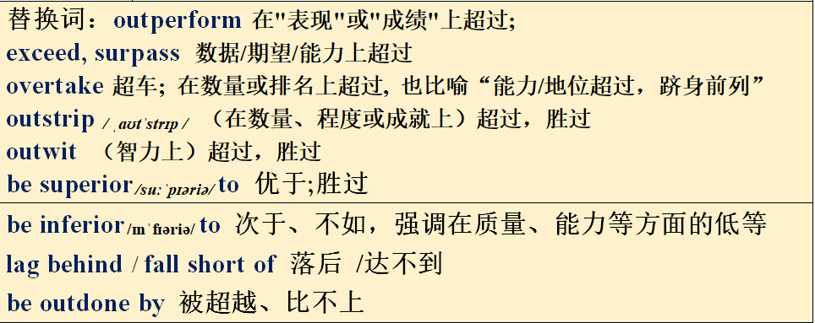
10.beyond 胜过，超出 --不如 not as good as
1.在学校，女生在语言和人文学科上的表现优于男生。
2.这位短跑运动员打破了此前比赛创下的所有记录。
3.这个产品的质量不如其竞争对手的。
4.我们公司在创新领域被竞争对手超越了。
1.In school, girls outperformed boys in language and humanity subjects.
2.The sprinter surpassed all previous records set at the games.
3.The quality of this product is inferior to its competitors'.
4.Our company was outdone by its rival in the innovation field.

Slide 19
http://www.sunedu.com
THANKS

