Slide 1
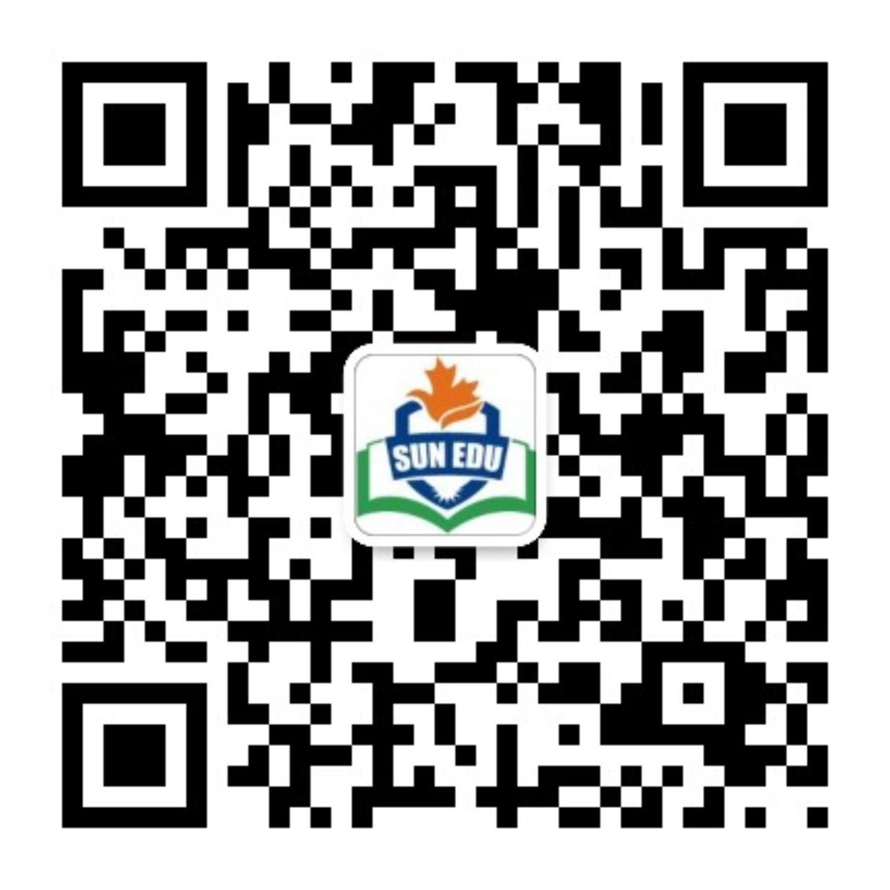
感恩遇见，相互成就，本课件资料仅供您个人参考、教学使用，严禁自行在网络传播，违者依知识产权法追究法律责任。
更多教学资源请关注
公众号：溯恩英语
知识产权声明

Slide 2
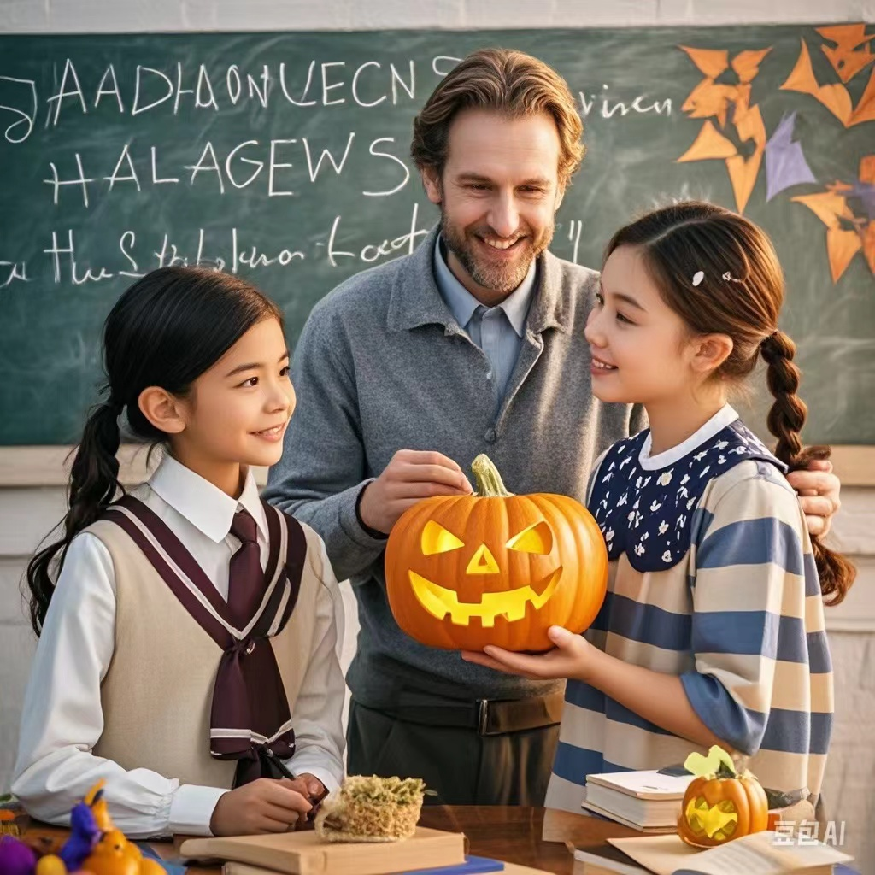
2024
高二名校协作体读后续写 外教的南瓜灯
基于续写微技能：眼神+前文取材+比喻
刘艳

Slide 3
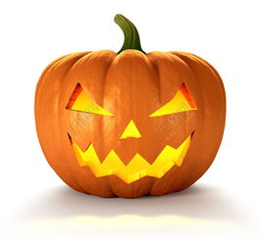
读原文 找出记叙文要素
“She wants a what?” barked the fruit seller. I was in one of the many street markets of Luzhou, a small city located in China’s Sichuan Province. Already, a crowd of curious on - lookers was gathering: white - haired grandmas, toothless old men, mothers holding infants. Everyone was waiting, wondering why the foreigner was causing such a fuss（大惊小怪）.
I took a deep breath. The crowd leaned in. “Do you have a pumpkin?” I asked as clearly as possible. A mother holding an infant explained there was no pumpkin here in English. I had to move on to yet another market in my search for Halloween.
As an American English teacher in China, the urge was strong to explain my country’s cultural traditions to my students. I’d had plenty of success in teaching the Chinese about significant United States holidays and events, Halloween being one of them. Yet I was now in a new teaching position, in a different region of the country which seems to have every kind of produce known to man except the one I wanted for Oct.31.
I had learned that in teaching about Halloween, there was no substitute （替代品）for a carved pumpkin. Descriptions produced blank stares. Drawings were misinterpreted. Pictures only puzzled.
Sure, I could give up showing a real jack-o’- lantern（南瓜灯） to my students. I could lecture on the history of this tradition, which had its origin in old beliefs about the return of the spirits of dead people. We could have a go at wearing masks, and role- play trick - or - treat.
But nothing could compare with the pumpkin. For that reason, I was willing to go through just about anything to find a pumpkin for my students.
In another section of the city, I headed to a big market. “Do you have a pumpkin?” I asked the seller I saw. “A what?” she seemed to be at a loss. However, I didn’t know how to make her understand what I wanted.
Suddenly, an idea occurred to me.
On Oct. 31, I brought the carefully - carved pumpkin into the class.

Slide 4
记叙文要素
Time | Before October 31 (Halloween)
Place | a large market in Luzhou, a small city in Sichuan Province, China.
Characters | "I": An American English teacher in China. Fruit vendor students
Contradiction | "I" strongly hope to show students the important element of Halloween, the pumpkin lantern. However, in this new area of China, it seems that pumpkins cannot be found in all markets. There is a contradiction between "I"'s teaching need and the difficulty in finding pumpkins.
Main plot | As an American English teacher in China, "I" want to introduce American Halloween cultural traditions to students in a new area. Especially, "I" want to teach through showing a real jack-o'-lantern. "I" search for pumpkins in the street markets and a large market in Luzhou but encounter difficulties everywhere. People don't understand what "I" want. Finally, "I" come up with an idea and bring a carefully carved pumpkin into the classroom on October 31.

Slide 5
读原文
“She wants a what?” barked the fruit seller. I was in one of the many street markets of Luzhou, a small city located in China’s Sichuan Province. Already, a crowd of curious on - lookers was gathering: white - haired grandmas, toothless old men, mothers holding infants. Everyone was waiting, wondering why the foreigner was causing such a fuss（大惊小怪）.
I took a deep breath. The crowd leaned in. “Do you have a pumpkin?” I asked as clearly as possible. A mother holding an infant explained there was no pumpkin here in English. I had to move on to yet another market in my search for Halloween.
As an American English teacher in China, the urge was strong to explain my country’s cultural traditions to my students. I’d had plenty of success in teaching the Chinese about significant United States holidays and events, Halloween being one of them. Yet I was now in a new teaching position, in a different region of the country which seems to have every kind of produce known to man except the one I wanted for Oct.31.
I had learned that in teaching about Halloween, there was no substitute （替代品）for a carved pumpkin. Descriptions produced blank stares. Drawings were misinterpreted. Pictures only puzzled.
Sure, I could give up showing a real jack-o’- lantern（南瓜灯） to my students. I could lecture on the history of this tradition, which had its origin in old beliefs about the return of the spirits of dead people. We could have a go at wearing masks, and role- play trick - or - treat.
But nothing could compare with the pumpkin. For that reason, I was willing to go through just about anything to find a pumpkin for my students.
In another section of the city, I headed to a big market. “Do you have a pumpkin?” I asked the seller I saw. “A what?” she seemed to be at a loss. However, I didn’t know how to make her understand what I wanted.
Suddenly, an idea occurred to me.
On Oct. 31, I brought the carefully - carved pumpkin into the class.
找出前文伏笔
1动词短语
2名词短语
3情节搭建的主要行为动作句式

Slide 6
P1：Suddenly, an idea occurred to me.
情节搭建
The specific content of my idea: How to make the supermarket salesperson understand what my mean (我的想法的具体内容:怎样让超市营业员理解我的意思)
The reactions and actions of salespeople(营业员的反应和动作)
I finally got the pumpkin I wanted(我终于买到了想要的南瓜)
carved and decorated the pumpkin carefully before class(我在课前精心地雕刻和装扮了这个南瓜)
P 2 ： On Oct. 31, I brought the carefully - carved pumpkin into the class.

Slide 7
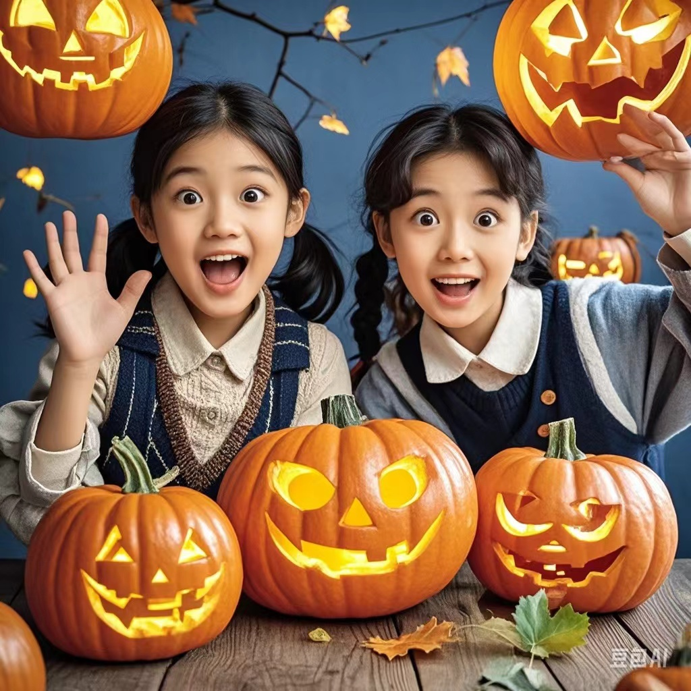
P 2 ： On Oct. 31, I brought the carefully - carved pumpkin into the class.
Students' reactions to seeing the pumpkin + describe the shape of the pumpkin specifically (学生们看到这个南瓜的反应+具体描述南瓜的造型)
I explained to them the traditions of Halloween in Western culture (我向他们讲解了西方文化中万圣节的传统)
The students‘ reaction to the lesson(学生们听课的反应）

Slide 8
P1：Suddenly, an idea occurred to me.
（创新点）
【我】的想法的具体内容:怎样让超市营业员理解我的意思
一、肢体语言
用手比画出南瓜的大致形状，圆圆的、大大的形状。（Use hands to draw the approximate shape of a pumpkin, a round and large shape.）
二、借助实物或图片
拿出手机，搜索南瓜的图片给售货员看。（Take out the mobile phone and search for pictures of pumpkins to show the salesperson.）
在纸上简单画一个南瓜。（Draw a simple pumpkin on paper.）
三、找翻译工具或他人帮忙
使用翻译软件，把 “我想买南瓜” 翻译成中文给售货员看。（Use translation software to translate "I want to buy pumpkins" into Chinese and show it to the salesperson.）
四 在市场里找懂英语的人帮忙翻译。（Look for someone who understands English in the market to help with translation.）

Slide 9
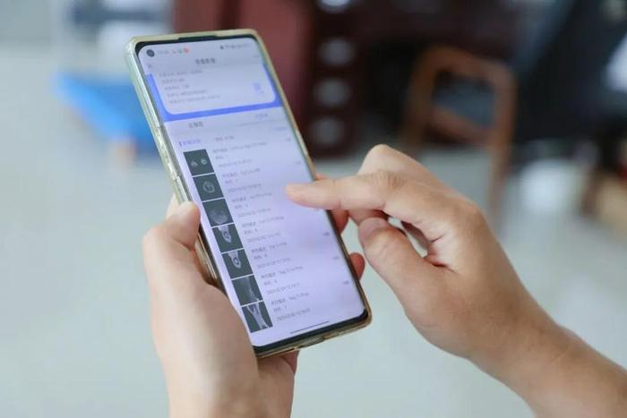
续写微技能：动作链+眼神+对话
我迅速拿出手机，手指飞快地在屏幕上搜索着南瓜的图片。我直视着卖家的眼睛，举起手机向摊贩展示。“看，这个。我要这个。”我用空闲的手比划着说道。
I quickly took out my phone. My fingers moved swiftly as I searched for an image of a pumpkin. Looking directly into the seller's eyes, I held up the phone to the vendor. "Look, this. I want this." I said, gesturing with my free hand.

Slide 10
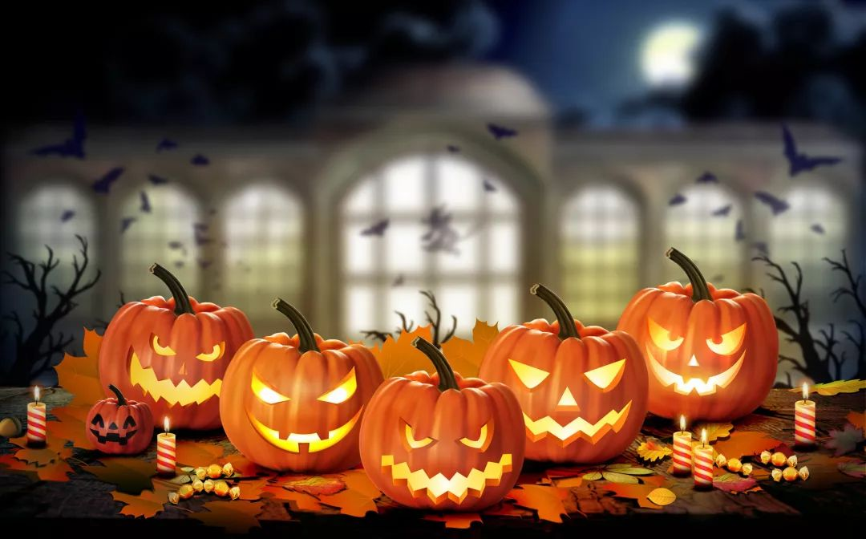
续写微技能：前文取材（呼应前文）+对此（结果）
感谢上帝，这一次我这个外国人没有引起太多的大惊小怪，我成功的买到了我想要的万圣节的南瓜。
Thank God. This time, the foreigner didn‘t cause too much fuss. I successfully bought the pumpkin I wanted for Halloween.

Slide 11
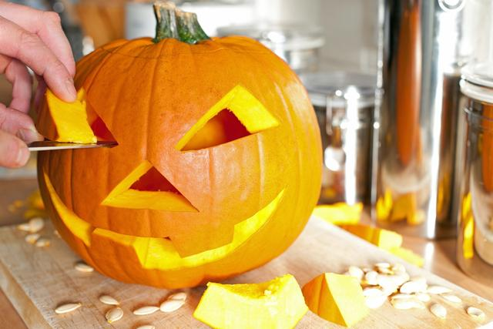
续写微技能：情绪+时间过渡+比喻+衔接二段首句
我怀抱南瓜，满心欢喜地走回家。就好像找到了一件失而复得的宝物一样。一进家门，我就迫不及待地开始雕刻南瓜了。
I walked back home with the pumpkin in my arms, beaming with joy. It was as if I had found a long-lost treasure. As I entered my house, I couldn't wait to start working on my pumpkin.

Slide 12
P2 ： On Oct. 31, I brought the carefully - carved pumpkin into the class
续写微技能：眼神+比喻+ 情绪+前文取材
孩子们看着我雕刻的南瓜灯，他们的反应就像一场兴奋的烟花表演。
The moment the kids laid eyes on my carved pumpkin lantern, their reactions exploded like a fireworks show of excitement.
我就知道雕刻的南瓜没有替代品(替代品)。
I just know that there was no substitute （替代品）for a carved pumpkin.

Slide 13
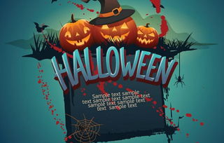
续写微技能：呼应前文+前文取材
我讲了万圣节的历史、传统和起源，特别是刻南瓜驱邪的习俗。
I lectured on the history, tradition and origin of Halloween , especially the custom of carving pumpkins to drive off evil spirits.

Slide 14
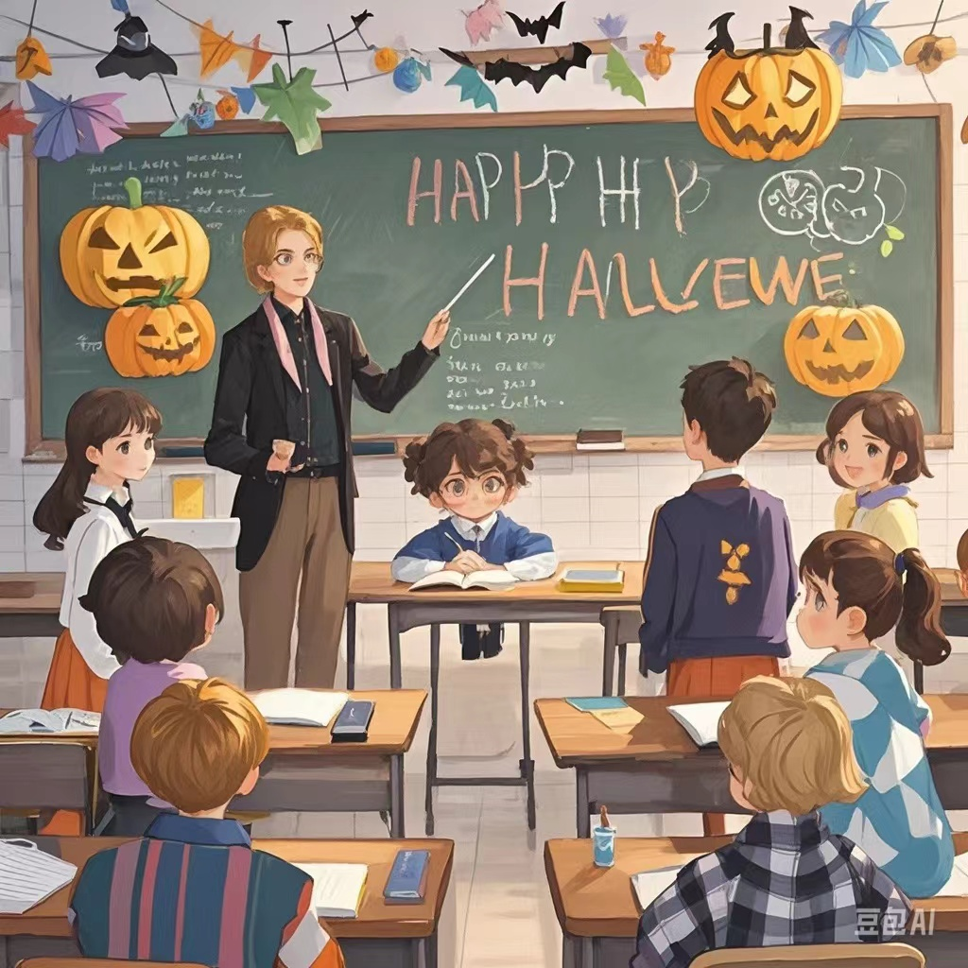
续写微技能：眼神+环境
学生们的眼里充满了好奇。空气中充满了笑声和急切的问题。这就是我想营造的愉快的学习氛围!
The students' eyes were filled with curiosity. Laughter and eager questions filled the air. It's a joyous learning the atmosphere I was trying to create!

Slide 15
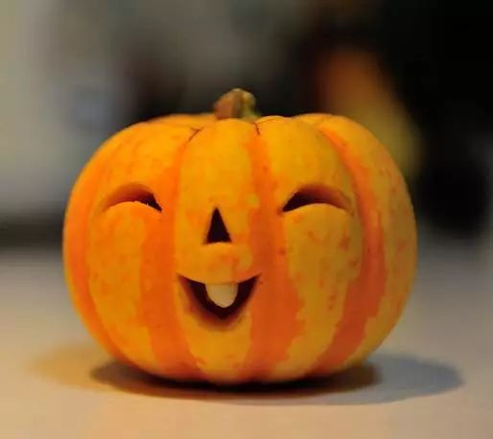
续写微技能：虚拟语气+ 前文取材
看着自己雕刻的这个南瓜，我觉得它好像在骄傲地对我说:“没有什么能和我相比!”
Looking at the carved pumpkin I made, I felt as if it were proudly telling me ,“Nothing can compare with me!”

Slide 16
Judy 下水作文
眼神
P1：Suddenly, an idea occurred to me. I quickly took out my phone. My fingers moved swiftly as I searched for an image of a pumpkin. Looking directly into the seller's eyes, I held up the phone to the vendor. "Look, this. I want this." I said, gesturing with my free hand. Thank God. This time, the foreigner didn‘t cause too much fuss. I successfully bought the pumpkin I wanted for Halloween. I walked back home with the pumpkin in my arms, beaming with joy. It was as if I had found a long-lost treasure. As I entered my house, I couldn't wait to start working on my pumpkin.
P2：On Oct. 31, I brought the carefully - carved pumpkin into the class. The moment the kids laid eyes on my carved pumpkin lantern, their reactions exploded like a fireworks show of excitement. I just know that there was no substitute （替代品）for a carved pumpkin. I lectured on the history, tradition and origin of Halloween , especially the custom of carving pumpkins to drive off evil spirits. The students‘ eyes were filled with curiosity. Laughter and eager questions filled the air. It’s a joyous learning the atmosphere I was trying to create! Looking at the carved pumpkin I made, I felt as if it were proudly telling me ,“Nothing can compare with me!”
呼应前文+前文取材
比喻

Slide 17
续写微技能：眼神描写
a raise of the eyebrow 眉毛一扬
wink at sb. 对某人眨眼
roll one’s eyes 翻白眼
blink one’s eyes 眨眼睛
avert one’s eyes 转移视线
rub one’s eyes 揉眼睛
raise/lift one’s eyes 抬眼
drop/lower one’s eyes 眼睛朝下看
squeeze one’s eyes shut 紧闭双眼
bat one’s eyes/eyelashes 挤眉弄眼
squint/narrow/widen one’s eyes 眯起/眯起/睁大眼睛
eyes fall on sth. 目光落在……
one’s eyes water 某人的眼睛流泪
look/gaze into one’s eyes 看着/凝视某人的眼睛
give sb. a dirty look 给某人一个白眼；厌恶地瞪某人一眼one’s eyes sparkle/glitter/glow/twinkle 眼睛闪闪发光

Slide 18
续写微技能：比喻的句型
1. 介词：like 等；
2. 连词：as, as if, as though, as...so, what等；
3. 动词：seem, compare...to, liken...to, bear a resemblance to 等；4. 名词：comparison, resemblance 等；
5. 形容词：akin to, similar to, be analogous to 等
6. 短语： as it were, no more...than, be something of, be something like等；
7. 句式：As…, so…; As A is to B, so C is to D; A is to B as [what] C is to D等。

Slide 19
官方范文
Suddenly, an idea occurred to me. I could bridge the language gap with visuals! I drew a simple sketch of a pumpkin, complete with a stem on top and the characteristic ridges（纹路）. “I need something like this,” I said, showing my drawing to the seller. She studied the sketch with curiosity, then looked up at me, understanding dawning on her face. After a moment, she disappeared behind a pile of produce and soon returned with a round, orange pumpkin. “That’s it!” I exclaimed, my face lit up with joy. Immediately I rushed back home, starting to carve my beautiful pumpkin.
On Oct. 31, I brought the carefully- carved pumpkin into the class. The students gathered around, their eyes wide with curiosity as they observed the delicately carved face with a flickering candle inside. It was indeed a traditional jack-o’- lantern, and it captured the essence of the holiday. As the light cast shadows around the room, I began to tell them about the origins of Halloween, the legends of spirits and the custom of carving pumpkins to drive off evil spirits. They listened attentively, eyes fixed on me. We were all connected through the universal language of celebration and tradition despite the cultural differences.

Slide 20
感谢聆听

