Slide 1

感恩遇见，相互成就，本课件资料仅供您个人参考、教学使用，严禁自行在网络传播，违者依知识产权法追究法律责任。
更多教学资源请关注
公众号：溯恩高中英语
知识产权声明

Slide 2
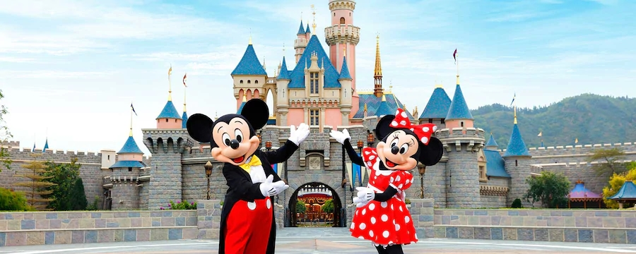
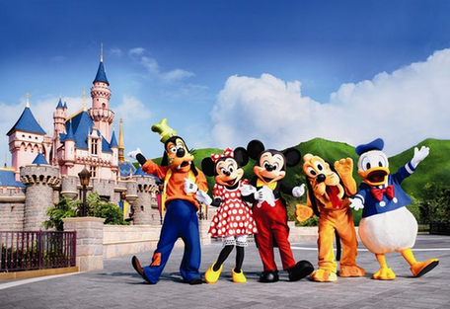
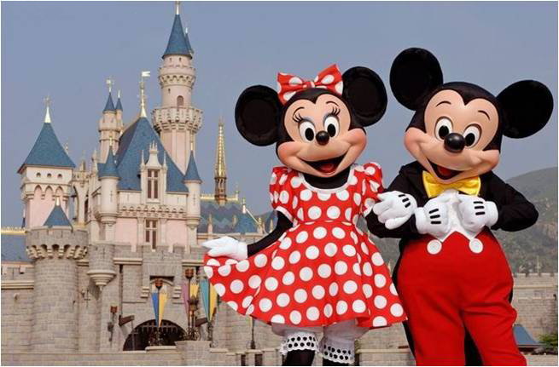
M4U5 Theme Parks
——Fun and More Than Fun
LongQuan No.1 High School
Lan Jianzhen

Slide 3
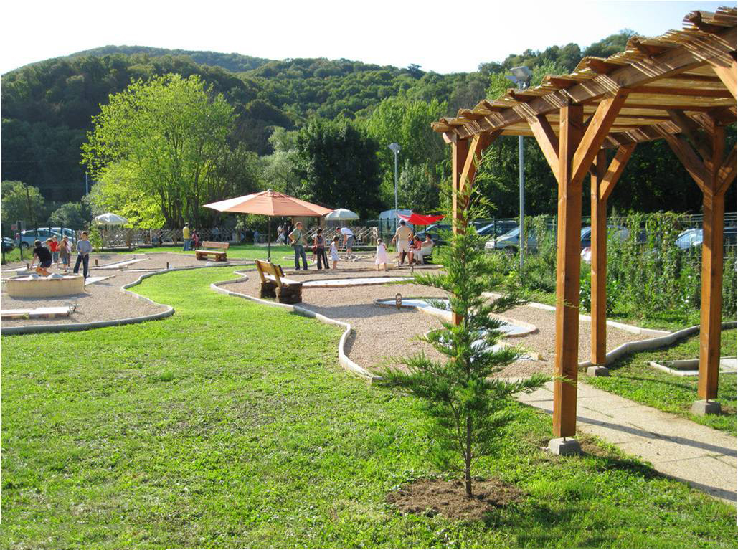
an ordinary park
run,walk, dance, sit chatting,play chess,play games, listen to birds’ singing or just relax a bit…

Slide 4
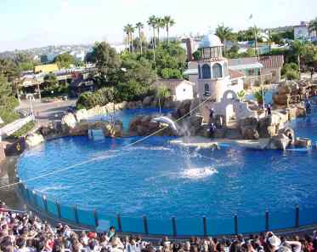
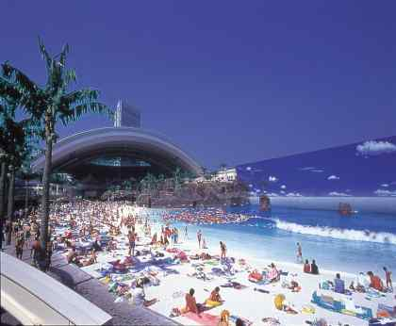
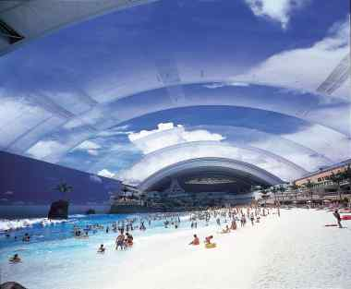
water
The World Water Park (in Canada)
theme
a theme park

Slide 5
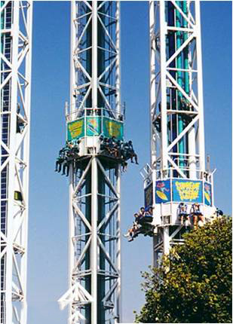
free-fall drops

Slide 6
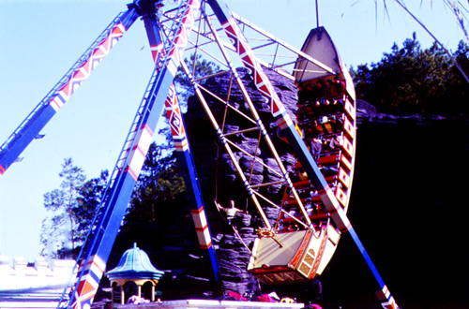
pirate ship/ swinging ship

Slide 7
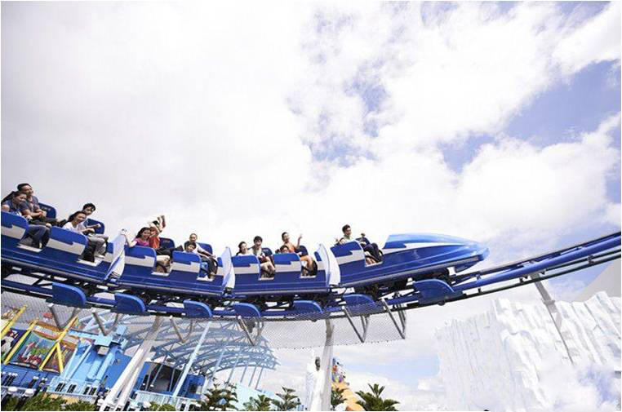
roller-coasters

Slide 8
Para.1
What question does the author raise in the first paragraph?
And what answer does he give?
Q: Which theme park would you like to visit?
food, culture, science, cartoons, movies, history…
various
theme
parks
Some…roller coasters
others…sights and sounds of a culture
…
A: Whichever and whatever you like, there is a theme park for you.

Slide 9
Please find out the name and the theme of each theme park.
Theme parks——Fun And More Than Fun
paragraph
Para.2
Para.3
Para.4
name
theme
Disneyland
fairy tales or Disney
cartoon characters
Dollywood
America’s traditional
southeastern culture
Camelot Park
England’s ancient history

Slide 10
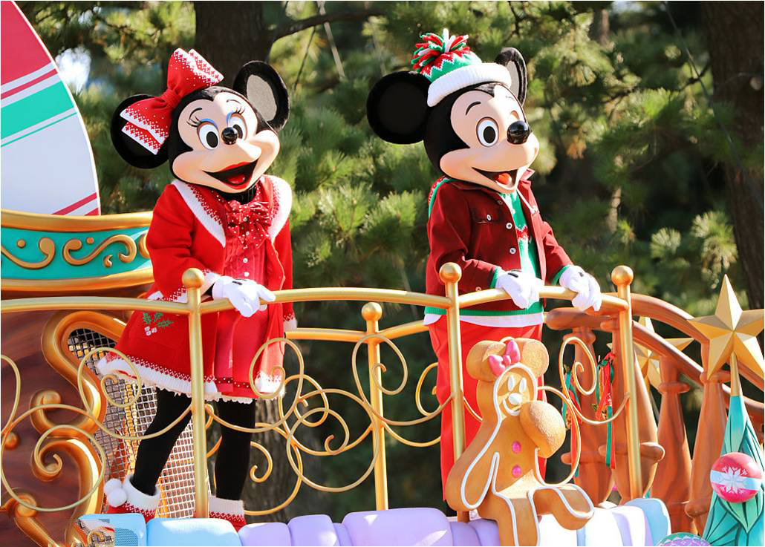
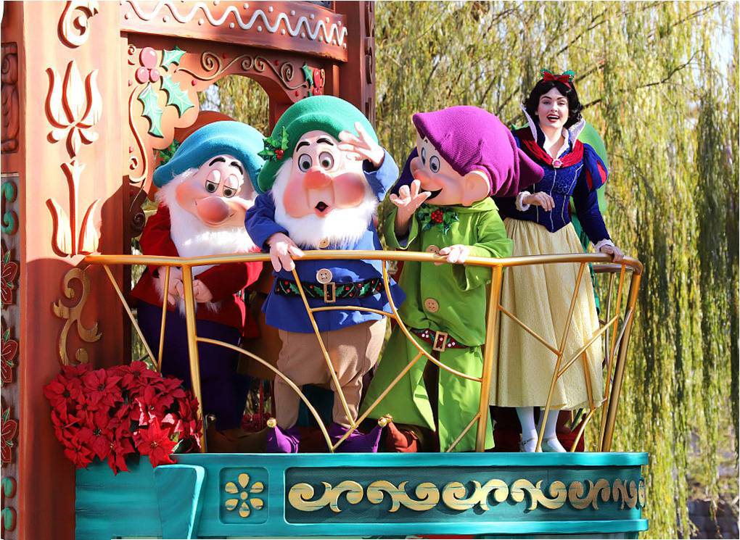
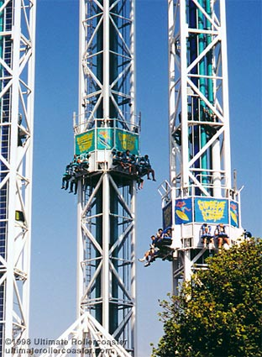
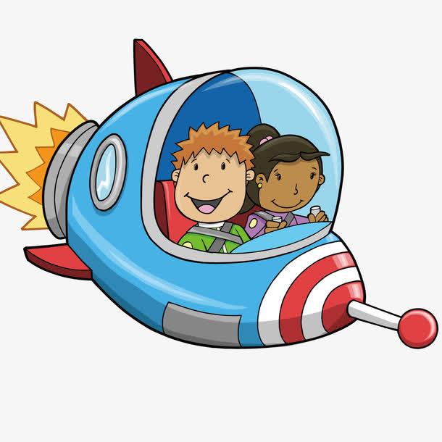
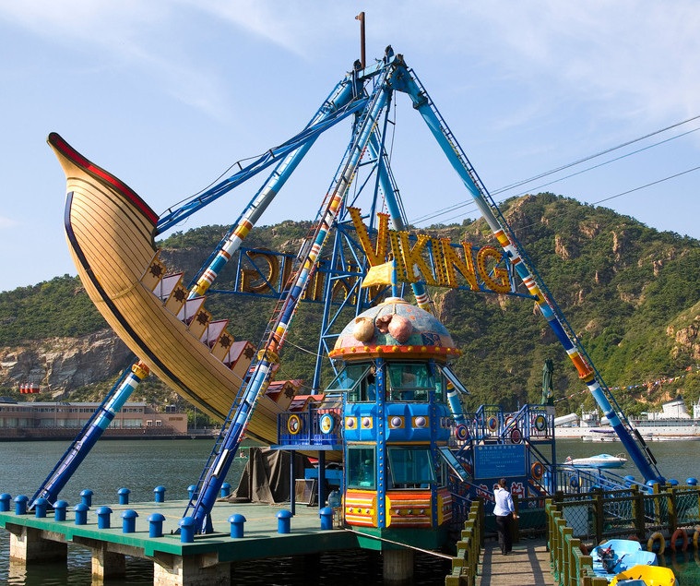
Para.2 Disneyland
▲ The theme park you are most familiar with is …
★ whether…or…, it’ll bring you into a …world and make your
dreams come true.
Activities?
★ As you wander around…, you may see…
★ It also has…, from…to…
Promotion: If you want to have fun and more than fun, come to Disneyland!

Slide 11
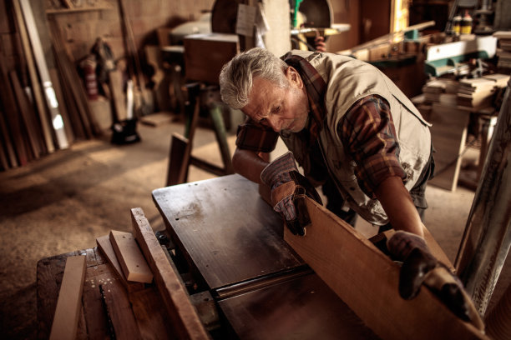
Para.3 Dollywood
▲ Dollywood is one of the most…, which shows…
Activities?
country
★ 1…listen to…perform famous ________music …
2. People come from all over…to see _________ and other craftsmen make things in the __________ way.
3. Visit the old _________ shop to try…
4. Or ride on a ______ ________ train
5. You can even see bald eagles in the _________.
6. And for those who like…, Dollywood has one of the best…and
_____ _____ _____ having the most length in the smallest space.
listen to perform
come from to see
carpenters
old-fashioned
Visit
candy
to
Or ride
steam engine
You can even see
preserve
is world-famous for
Promotion: Come to Dollywood to have fun learning all about America’s historiacal southeastern culture!

Slide 12
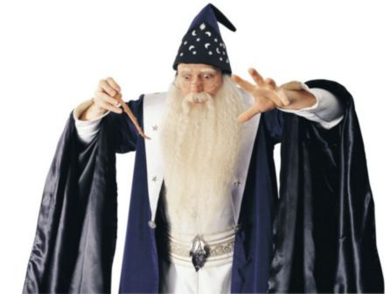
Para.4 Camelot Park
If you want to experience the ancient days and great deeds of English knights and ladies, princes and queens, then England’s Camelot Park is the place for you. Every area of the park is modelled after life in the days of King Arthur and the Knights of the Round Table. In one place, you can watch magic shows with Merlin the Wizard. If you want to see fighting with swords or on horseback, then the jousting area is a good place to visit. If you do well there, King Arthur may choose you to fight in the big jousting tournament. Do you like animals? Then visit
the farm area, and learn how people in ancient England ran their farms and took care of their animals. To enter a world of fantasy about ancient England, come to Camelot Park!
▲ If you want to…, then …is the place for you.
★ If you want to…, (then) …
★Do you like…? Then …
Promotion: To enter a world of fantasy about ancient England, come to Camelot Park!

Slide 13

Critical thinking
How do you understand the title
“Theme Park –—Fun and more than fun”?

Slide 14
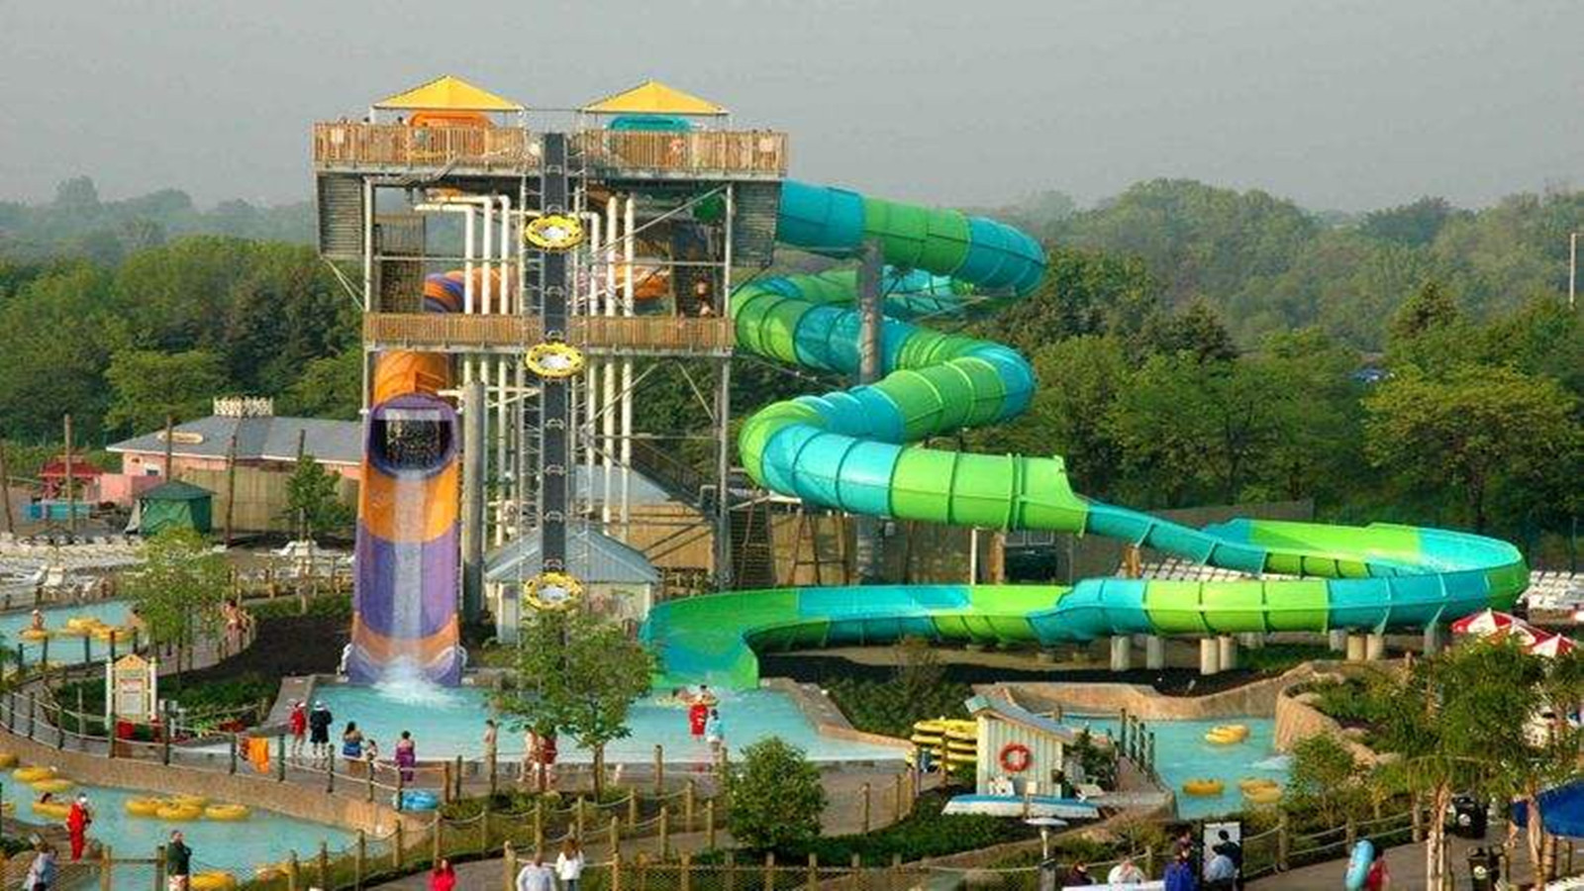
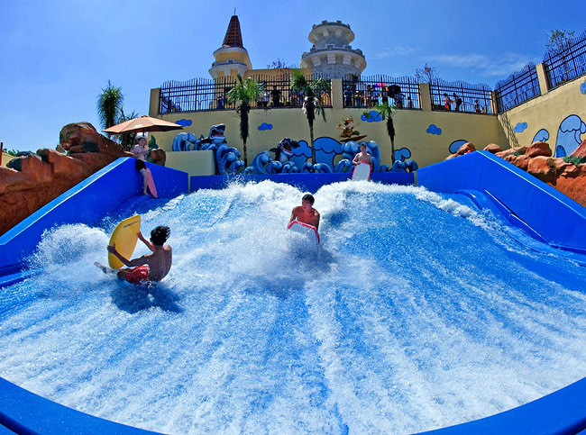
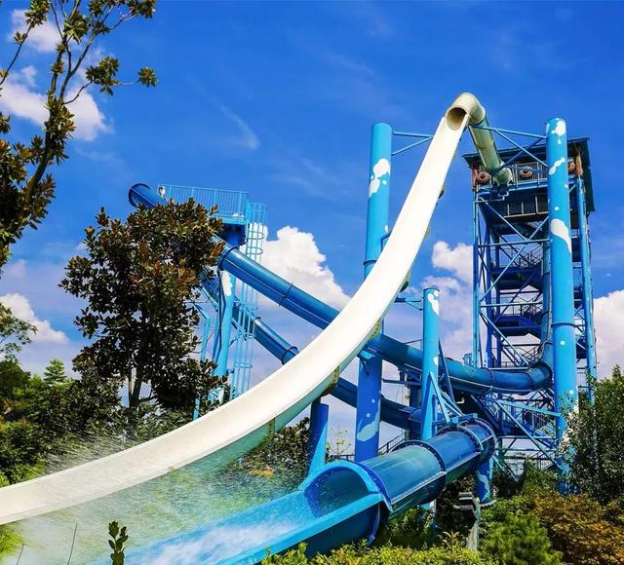
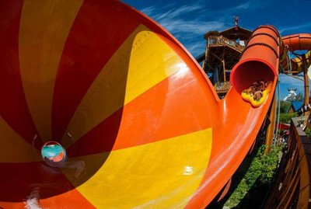
Lishui Adventure Island Water Park （丽水冒险岛水上乐园）
go surfing
slide

Slide 15
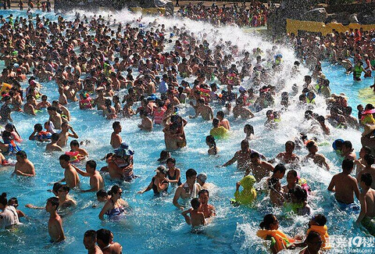
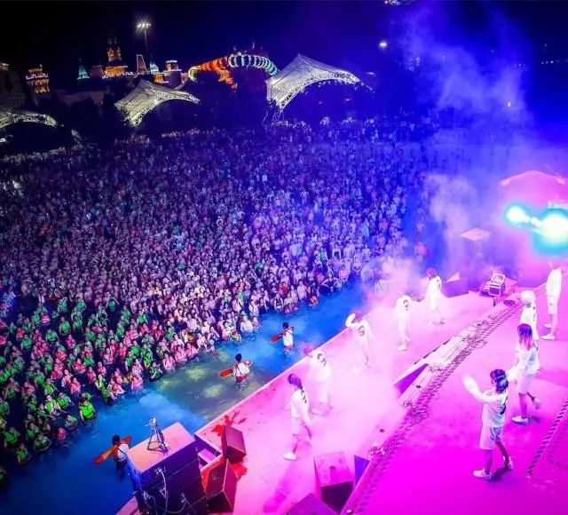
experience the
man-made(人工的) waves
enjoy the music

Slide 16
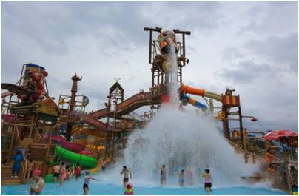
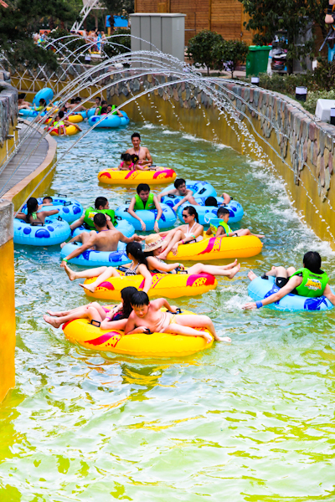
go drifting

Slide 17
Assignment
Write one more paragraph about another theme park. The writing structure and language should be modelled after (模仿)that of the three theme parks like “theme park—activities—promotion”.

Slide 18
Lishui Adventure Island Water Park （丽水冒险岛水上乐园）
Lishui Adventure Island Water Park （丽水冒险岛水上乐园）
experience the
man-made(人工的) waves
Slide
enjoy the music
go surfing
slide
go drifting

Slide 19
Possible version:
The theme park you are most familiar with in Lishui is Lishui Adventure Island Water Park. Whether you are going surfing or sliding, it will bring you into a fantastic world and make your dream come true. And experiencing the man-made waves is one of the most terrific activities here, which will enable you to enjoy some amazing music as well as wonderful performances. If you want to relax and get refreshed, it is a good palce for you. What’s more, the park’s main attraction is water amusement, so as you wander around, you may also see many travellers drifting along the river, which you certainly cannot miss. If you want to have fun and more than fun, come to Lishui Adventure Island Water Park!

Slide 20
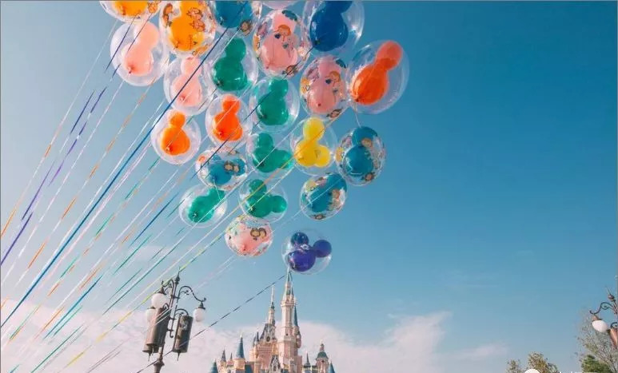
Thank you!

