Slide 1
感恩遇见，相互成就，本课件资料仅供您个人参考、教学使用，严禁自行在网络传播，违者依知识产权法追究法律责任。
更多教学资源请关注
公众号：溯恩高中英语
知识产权声明

Slide 2
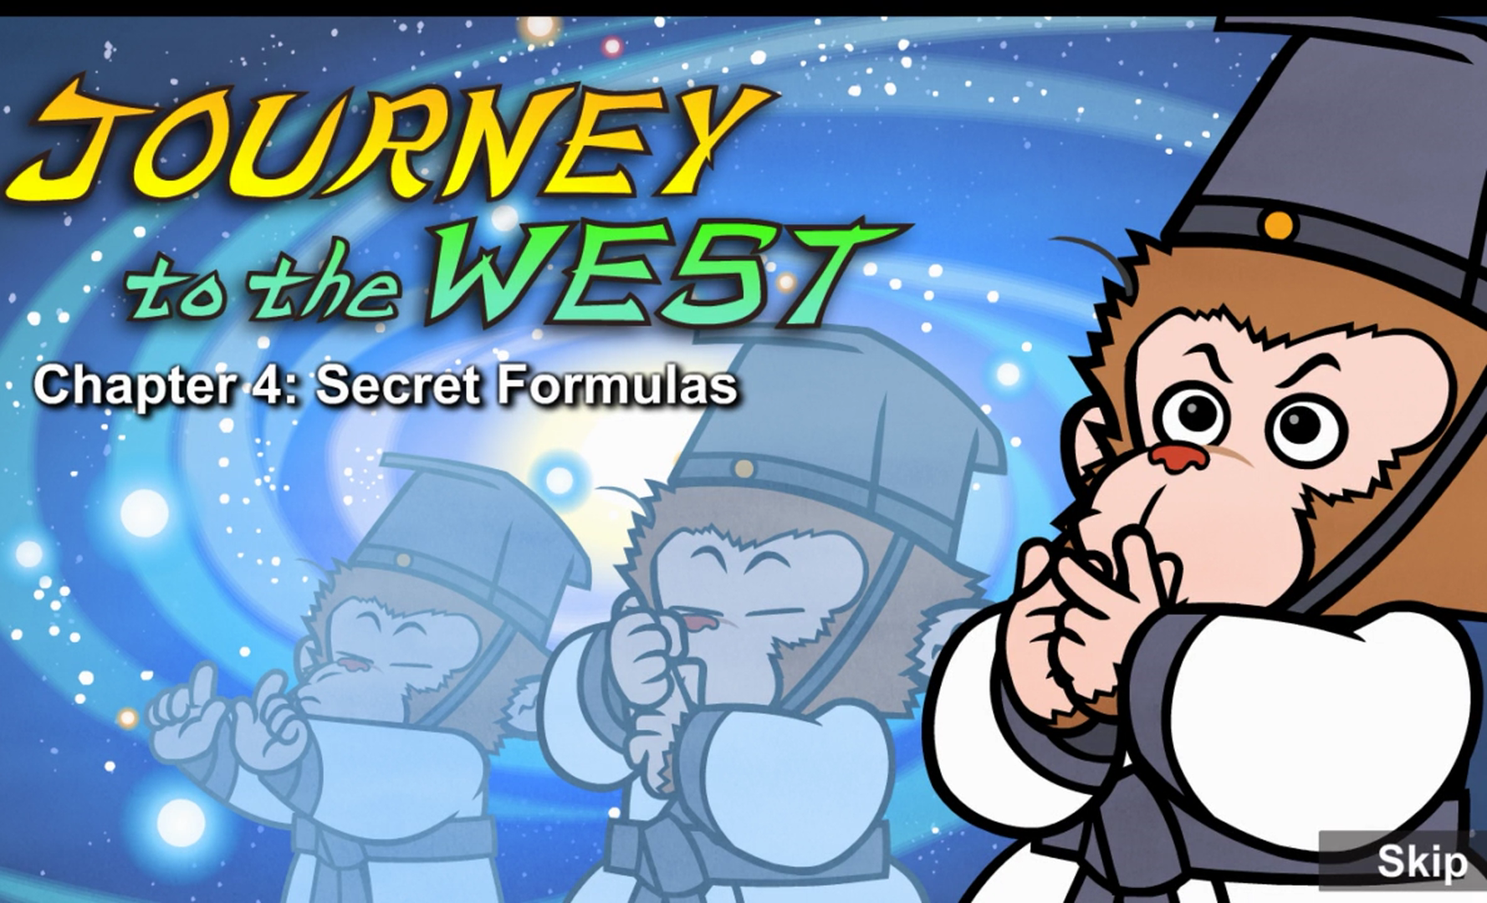
Episode 4 Secret Formulas

Slide 3
Part 1 quiz
1. How did Wukong learn to live forever?
A. Subodhi whispered formulas into his ear.
B. Subodhi turned himself into a tree.
C. Wukong learned by himself.
2. What did Wukong do while the other students slept?
A. He did powerful exercises.
B. He studied old books.
C. He practiced secret formulas.
3. What did Wukong show the other students he could do?
A. turn into a tree B. ride on a cloud C. change into a bird
4. Why did Wukong have to leave?
A. He learned everything. B. He wasn't safe. C. He had to return home.
5. Where did Wukong arrive?
A. the Fruit and Flower Mountain B. the ocean C. the temple
Keys: ACABA

Slide 4
Part 2 vocabulary
1.formula(可达到特定的)方式，方法
The sage whispered prayers as well as secret formulas about the universe and nature.
2.secret formula秘诀
The sage whispered prayers as well as secret formulas about the universe and nature.
3.crept 蹑⼿蹑脚地⾛，缓慢地⾏进 (creep-crept)
At three o'clock in the morning, he crept quietly through the dark temple.
4.worthy1. 有价值的，很好的，(2. 值得的，⾜以……的，配得上的)
I knew you were a worthy student.
5.prayer祷告
The sage whispered prayers as well as secret formulas about the universe and nature.
6.universe宇宙，太空
The sage whispered prayers as well as secret formulas about the universe and nature.
7.nature自然
The sage whispered prayers as well as secret formulas about the universe and nature.
8.meditate冥想，沉思
For the next few years, Sun Wukong meditated and practiced the secret formulas.
9.mind 1. 精神，心，2. 介意
Soon his mind and body were powerful, and he could change shape or size.

Slide 5
10.shape形状，样Soon his mind and body were powerful, and he could change shape or size.
11.soar飞，往上飞舞He could turn into other animals and soar through the sky on clouds.
12.lately最近You have been busy lately.
13.interested 感兴趣的Everyone looked very interested.
14.enormous 巨⼤的，庞⼤的An enormous pine tree stood in his place.
15.amazing 惊⼈的，令⼈吃惊的That's amazing!
16.truly真实地，真正地The monkey is truly powerful!
17.noise声响，喧闹声The noise disturbed Subodhi.
18.disturb妨碍，打乱The noise disturbed Subodhi.
19.flash闪光，闪烁Subodhi's eyes flashed with anger.
20.taught讲授，教 (teach-taught)
I taught you the secret formulas so you could live forever.
21.show off卖弄，炫耀Not so you could show off!
22.harm损伤，损害If you don't tell them, they might harm you.
23.repay1. 报答，报恩， (2. 还(钱))I must repay you first.
24.stay out of trouble 不惹是生非⾮，避开麻烦Just try to stay out of trouble.
25.evil 邪恶的，坏的I can see that you will do evil things someday.
26.someday将来有⼀天I can see that you will do evil things someday.
27.hang one's head 把头垂下Wukong hung his head.

Slide 6
Part 3 sentences
1. At three o'clock in the morning, he crept quietly through the dark temple.
2. I knew you were a worthy student.
3. They leaned in closer to WuKong
4. Subodhi's eyes flashed with anger.
5. I must repay you first.

