Slide 1
感恩遇见，相互成就，本课件资料仅供您个人参考、教学使用，严禁自行在网络传播，违者依知识产权法追究法律责任。
更多教学资源请关注
公众号：溯恩高中英语
知识产权声明

Slide 2
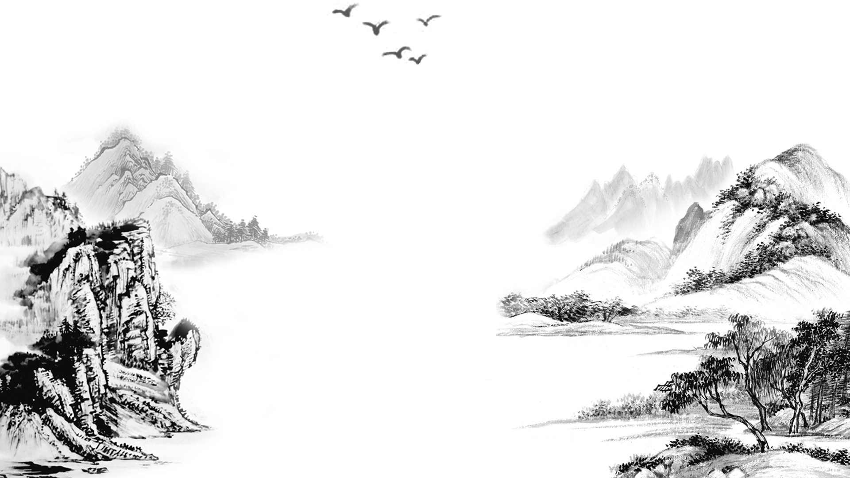
The Chinese Writing System:
Connecting the Past and the Present
Notes:
版权声明：精品模板商业授权，请联系【设计】:https://，专业PPT老师为你解决所有PPT问题！

Slide 3
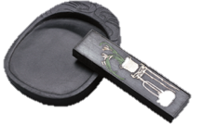
A short film that was shown in New York’s Times Square
What is the topic of the video?
Chinese characters.

Slide 4
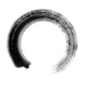
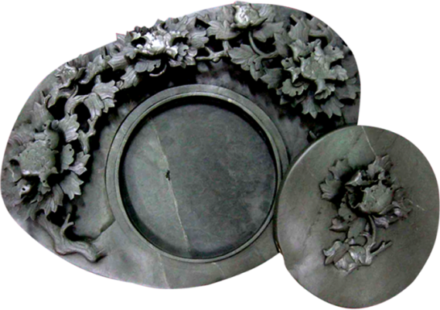
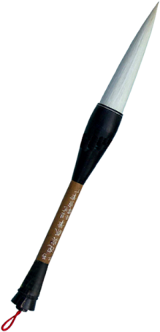
The Chinese Writing System:
Connecting the Past and the Present
What will the text talk about?
The development of the Chinese writing system.
The importance of the Chinese writing system.

Slide 5
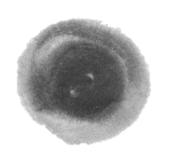
Divide the text into 3 parts and find the main idea.
China’s ancient civilisation and the Chinese writing system.
1
Part 1 (Para. 1)
Part 2 (Para.2-4)
The Chinese Writing System:
Connecting the Past and the Present
topic
Part 3 (Para. 4-6)
development
importance
2
What is the writing style?
3
A. Narration（记叙文）
B. Argument（议论文）
C. Exposition（说明文）
C. Exposition（说明文）

Slide 6
How does the Chinese writing system develop from ancient times to today?
picture-based
well-developed
Development
at the beginning
by the Shang Dynasty
Para.2-4
one direction
the Qin Dynasty
several thousand years ago
today
over the years
jiaguwen
different forms
part of Chinese culture
Time order

Slide 7
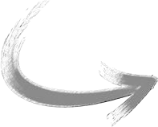
The Chinese Writing System:
Connecting the Past and the Present
Para. 1
China is widely known for its ancient civilisation which has continued all the way through into modern times, despite the many ups and downs in its history.
Para. 2
It dates back several thousand years to the use of longgu—animal bones and shells on which symbols were carved by ancient Chinese people. Some of the ancient symbols can still be seen in today’s hanzi.
the past
the present
Para.4
Even today, no matter where Chinese people live or what dialect they speak, they can all still communicate in writing.
What other functions does the Chinese writing system have?

Slide 8
What other functions does the Chinese writing system have?
Para. 4
That writing system was of great importance in uniting the Chinese people and culture.
connect
People
Culture
Para. 5
The high regard for the Chinese writing system can be seen in the development of Chinese characters as an art form, known as Chinese calligraphy, which has become an important part of Chinese culture.
connect
Language
Art
Para.6
As China plays a greater role in global affairs, an increasing number of international students are beginning to appreciate China’s culture and history through this amazing language.
the present
connect
China
World

Slide 9
Why does the author emphasize the “connecting” functions of the Chinese writing system?
importance
connect China with the world
connect language with art
connect people with culture
connect the past and the present

Slide 10
Can you find some sentences showing importance of the Chinese writing system directly?
The high regard for the Chinese writing system can be seen in the development of Chinese characters as an art form, known as Chinese calligraphy, which has become an important part of Chinese culture.
The Chinese writing system is one of the main factors that have made the continuation of China’s ancient civilisation possible.
That writing system was of great importance in uniting the Chinese people and culture.
Importance
Written Chinese has also become an important means by which China’s present is connected with its past.
Today, the Chinese writing system is still an important part of Chinese culture.
What do you think are some other factors?

Slide 11
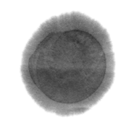
What do you think are some other factors?
1
2
3
...
...
Food
Art
Festivals
Hot Pot
dumpling
china
Beijing duck
architecture
Mid-Autumn Festival
soya-bean milk
Shu embroidery
Dragon Boat Festival
mooncake
Beijing opera
Lantern Festival
wine
Tomb Sweeping Day
Chinese painting
…
tea
paper-cutting
…
…

Slide 12
Do you think the Chinese language might become a global language like English in the future? Why?
the present

Slide 13
Summary
What
The Chinese Writing System:
Connecting the Past and the Present
How
Why

Slide 14
Homework
Read the passage carefully and write a summary of it in no more than 120 words.
Our school will receive exchange students from British. Please design a poster in English to introduce the development and importance of Chinese characters to British friends.

Slide 15
Example
There are many factors contributing to the popularity of the Chinese civilization, of which the Chinese calligraphy plays a significant role. Being a picture-based language, it was carved on different materials and it had many variations, thus making it not united until Emperor Qingshihuang took actions to stop this situation. Ever since then, the Chinese calligraph functions successfully by means of connecting China and the world, connecting language and art, connecting people with culture and connecting the past and the present. It is beyond doubt that the Chinese calligraphy will become more and more popular in the future and it will be appreciated by people both home and abroad.
the present

Slide 16
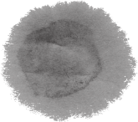
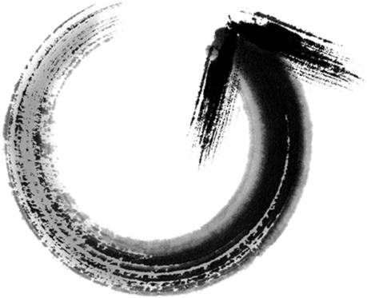
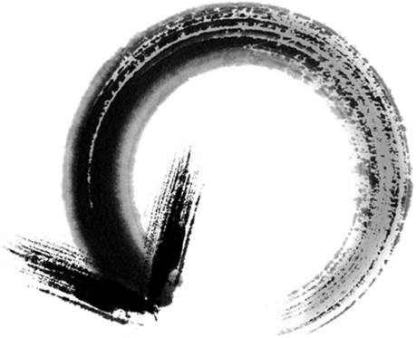
1
2
It accounts for the popularity of the Chinese civilization.
It dates back to several thousand years and it wasn’t united until Emperor Qingshihuang.
Importance
Development
3
4
connecting China and the world ;
connecting language and art;
connecting people with culture;
connecting the past and the present.
Functions
Potentials
It will become more and more popular in the future.
The Chinese Calligraphy

Slide 17
Thanks for your listening.

