Slide 1
感恩遇见，相互成就，本课件资料仅供您个人参考、教学使用，严禁自行在网络传播，违者依知识产权法追究法律责任。
更多教学资源请关注
公众号：溯恩高中英语
知识产权声明

Slide 2
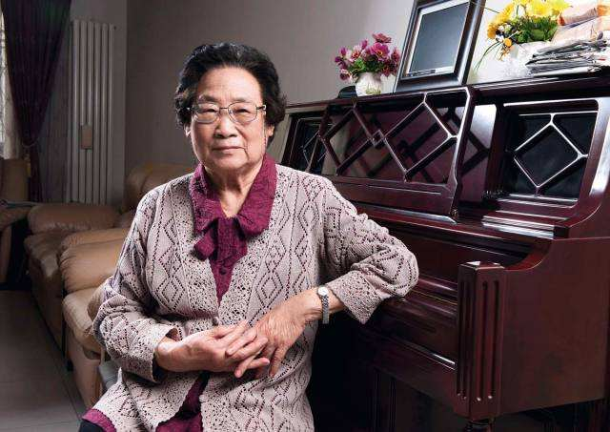
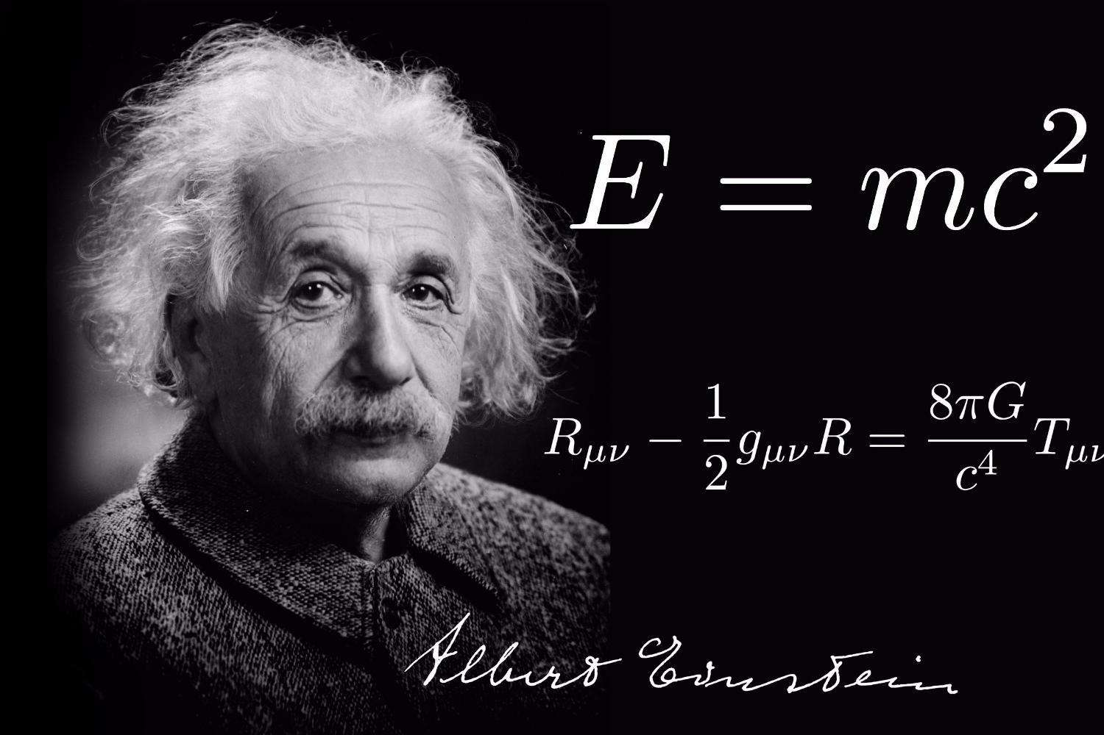
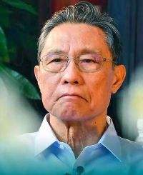
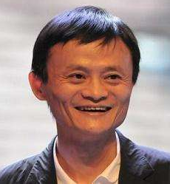
People of Achievement
Unit 1
Try to become not a man of success, but try rather to become a man of value.
——Albert Einstein

Slide 3
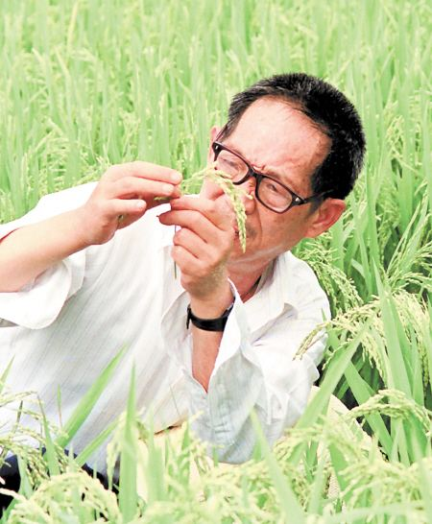
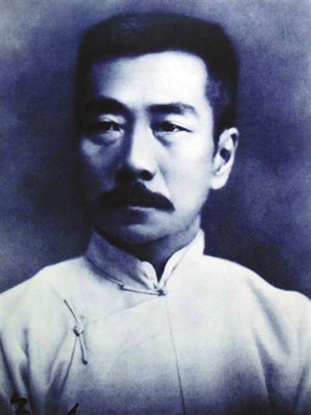
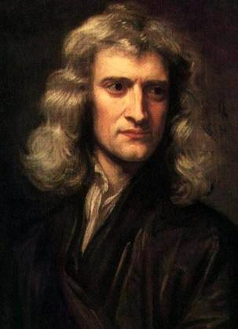
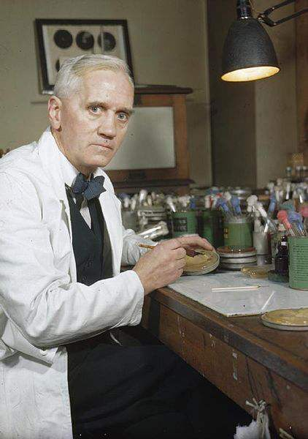
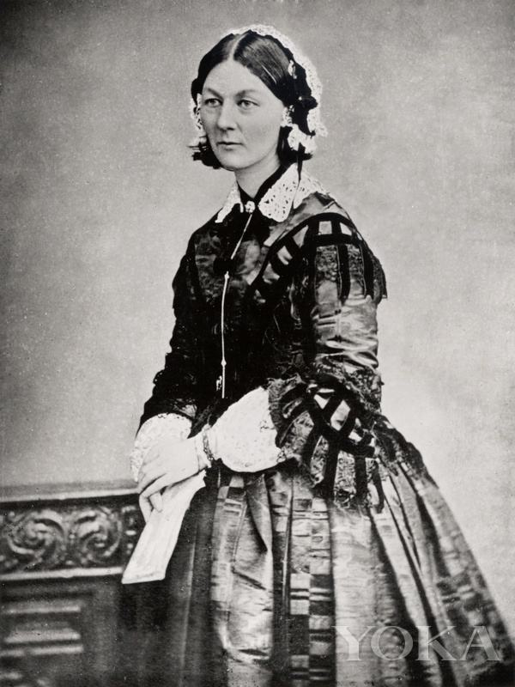
I. Discussion
1. Do you know the following
people in the picture?
2. Why are these people called
great people?
Florence Nightingale
♦making great contributions...
Alexander
Fleming
♦blaze a trail in...
♦cast a new light on...
Isaac Newton
♦bring enlightenment to...
Lu Xun
the act of enlightening or the state of being enlightened
Yuan Longping

Slide 4
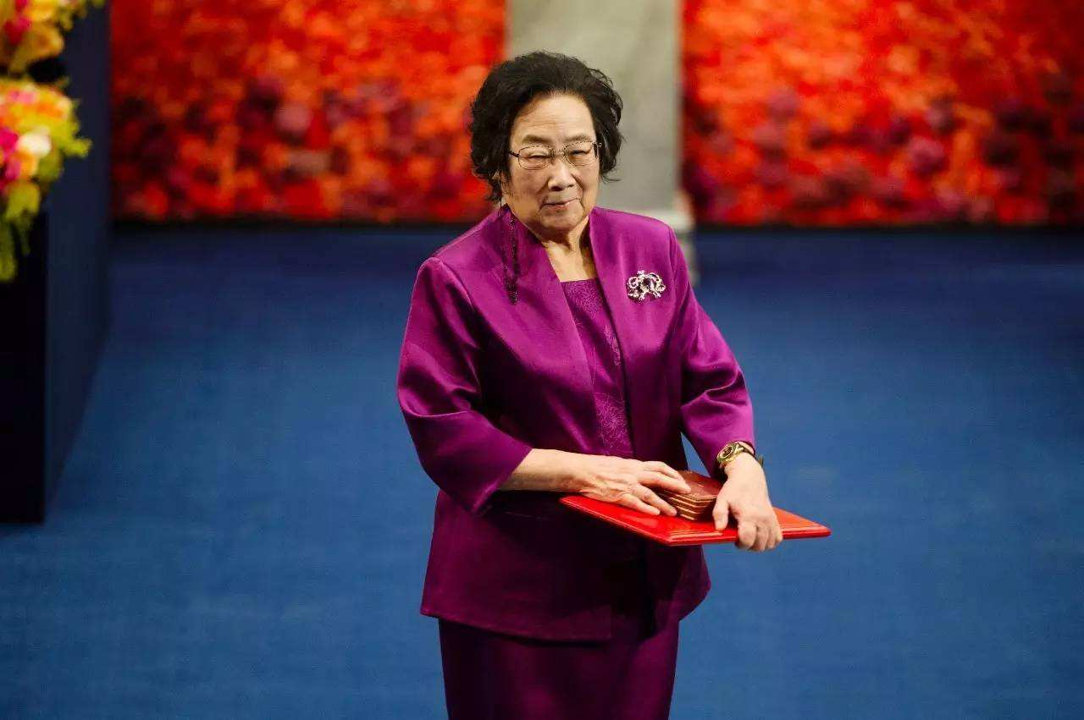
Tu Youyou Awarded Nobel Prize

Slide 5
II. Reading
1. According to the title and text, can you tell what text type this passage
belongs to? Why do you say so?
title
Tu Youyou Awarded Nobel Prize
News story
time line
6th October 2015
This year's Nobel Prize for Physiology or Medicine has been awarded to Tu Youyou (co-winner), whose research led to the discovery of artemisinin, a crucial new treatment for malaria.
Lead
According to the lead, what do you want to know about this incident?

Slide 6
Questions Raised by You
1. Why is the discovery of artemisinin so important that Tu Youyou was
awarded Nobel Prize?
2. Why did Tu Youyou begin to study the treatment of malaria?
3. What role did Tu Youyou play in the research of artemisinin in the
beginning and later?
4. How was the research led by Tu Youyou different from the previous
one?
5. How was artemisinin discovered? (Draw a flow chart)
6. How did Tu Youyou react to her winning the Nobel Prize? How do
you understand what she said?

Slide 7
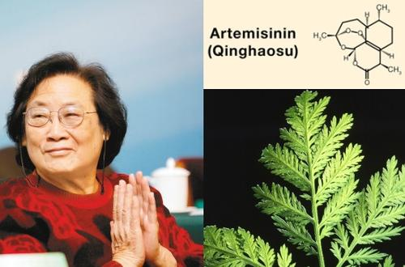
2. Why is the discovery of artemisinin so important that Tu Youyou was
awarded Nobel Prize?
Over 200 million people get malaria each year worldwide;
Artemisinin has saved hundreds of thousands of lives
(100,000 lives in Africa aloe);
About 600,000 die from malaria each year.
Artemisinin has improved health for millions of lives;
What does these number suggest?
harmful impact
great healing effect
The . of malaria on people
The . of malaria on people
What kind of effect does these numbers create in a news report?
♦making the writing convincing and accurate
♦making the writing reader-friendly

Slide 8
3. Why did Tu Youyou begin to study the treatment of malaria?
In 1967, the Chinese government formed a team of scientists with the objective of discovering a new treatment for malaria, and Tu Youyou was among the first researchers chosen.
What does the word “chosen” imply?
♦Scientists should work for the country's
needs and interest;
♦The national interest is above all else.
4. What role did Tu Youyou play in the research of artemisinin in the
beginning and later?
a researcher
a leading researcher

Slide 9
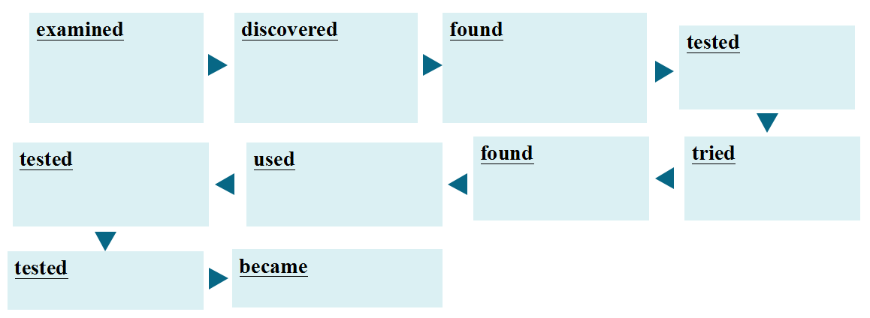
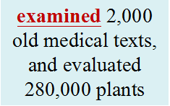
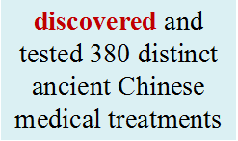
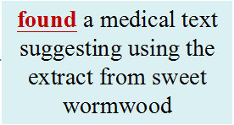
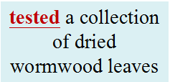
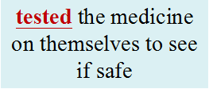
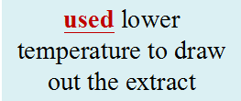
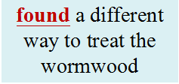
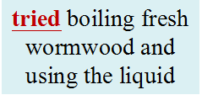
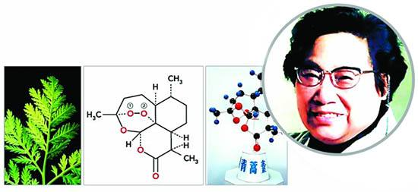
5. How was the research led by Tu Youyou different from the previous one?
They decided to review ancient Chinese medical texts to find traditional botanical treatments for malaria.
wisdom from ancestors
How was
artemisinin
discovered?

Slide 10
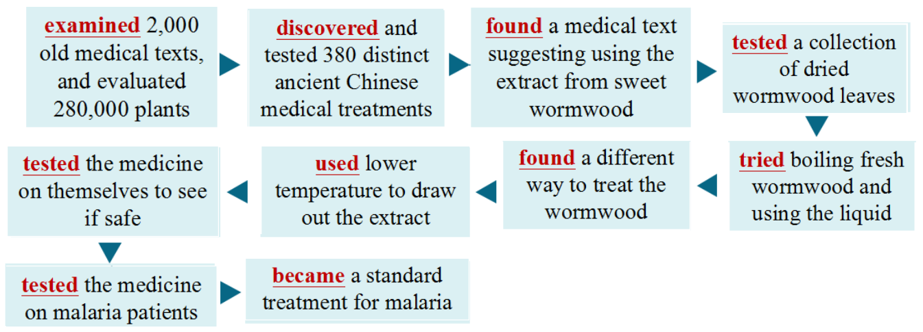
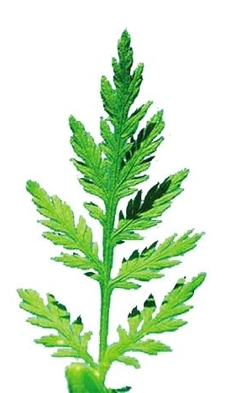
What was the key to getting a good extract from the wormwood?
temperature
What does the verbs in red imply?
♦The process of discovering artemisinin was a repetition of , which tells us the road to scientific
discovery is yet in the end.
How are paragraph 2 and 3 developed?
failure
frustrating
worthwhile
How does the writer describe Tu Youyou in the research? Give examples.
committed
By time and process
patient

Slide 11
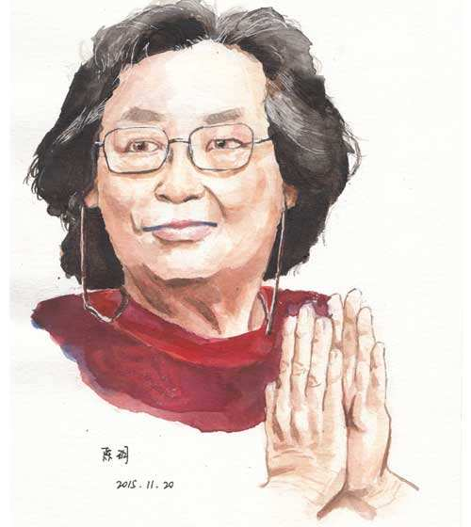
6. How did Tu Youyou react to her winning the Nobel Prize? How do you
understand what she said?
“The honour is not just mine. There is a team behind me, and all the people of my country. This success proves the great value of traditional Chinese medicine. It is indeed an honour for China's scientific research and Chinese medicine to be spread around the world.”
1. Team efforts and the support of my country plays a crucial role in the discovery.
2. Traditional Chinese medicine and the wisdom of ancestors help a lot.
3. It's a great opportunity to introduce Chinese scientific research worldwide.

Slide 12
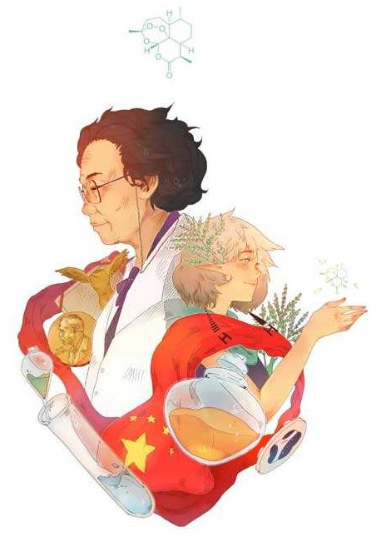
7. According to your understanding, what's the significance of the discovery
of artemisinin?
♦Many lives of malaria patients were saved worldwide. (Direct )
♦Tu Youyou was awarded the Nobel Prize for Physiology or Medicine,
which is a breakthrough in Chinese research work. (Direct)
♦Chinese traditional medicine and scientific research are introduced to
the whole world, which will help them get recognized worldwide. (Indirect)
8. What kind of qualities does Tu Youyou have according to the text? Give
support details in the text.
patient
determined
confident
adventurous
creative
devoted
persistent
committed
courageous
modest

Slide 13
9. Figure out the structure of the news report.
Title
Tu Youyou Awarded Nobel Prize
key information
Time line
6th October 2015
This year's Nobel Prize for Physiology or Medicine has been awarded to Tu Youyou...
Lead
main idea
News
report
The basic information of Tu Youyou
Body
The reason why Tu Youyou begin study the treatment of malaria
details
The process of discovering artemisinin
The honour is not just mine. There is a team behind me, and all the people of my country...
quote
significance

Slide 14
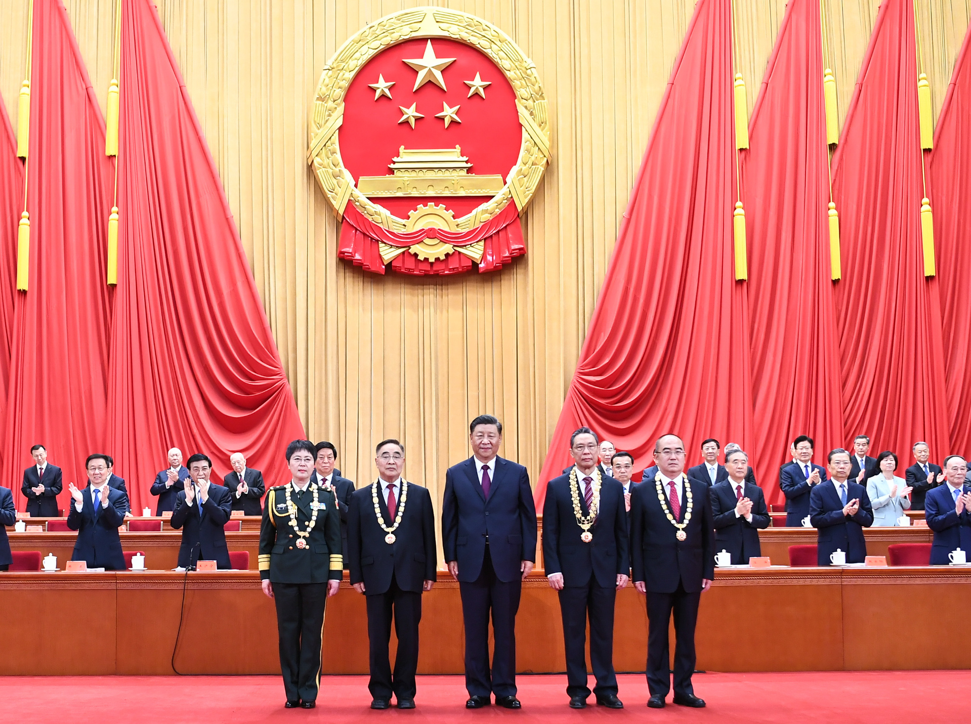
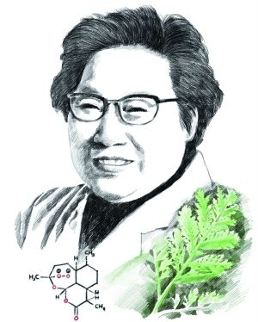
10. What are the features of the title of a news story/report?
♦short sentence/phrase
♦short; objective
♦key information of the incident
11. Why is passive voice often used in a news report?
♦To be more objective and convincing

Slide 15
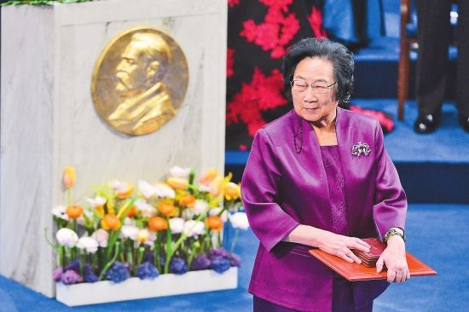
III. Activity
1. If you were Tu Youyou, try to introduce how artemisinin was discovered.
2. As to the discovery of artemisinin, which do you believe is more important,
talent or effort? Or something else?
3. Here comes the news that Tu Youyou, Albert Einstein, Mar Curie, and Alan
Turing were nominated “the Greatest Scientists of the 20th Century”. What
would be the reasons for Tu Youyou's nomination?
4. Do you want to be a person like Tu Youyou? Why
or why not? If yes, in which aspect would you like
to be? What preparations are you going to make?

