Slide 1
感恩遇见，相互成就，本课件资料仅供您个人参考、教学使用，严禁自行在网络传播，违者依知识产权法追究法律责任。
更多教学资源请关注
公众号：溯恩高中英语
知识产权声明

Slide 2
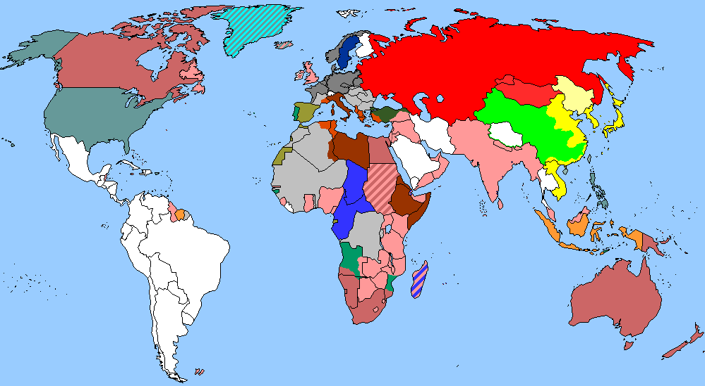
The Week
Feb 12th-18th, 2022

Slide 3
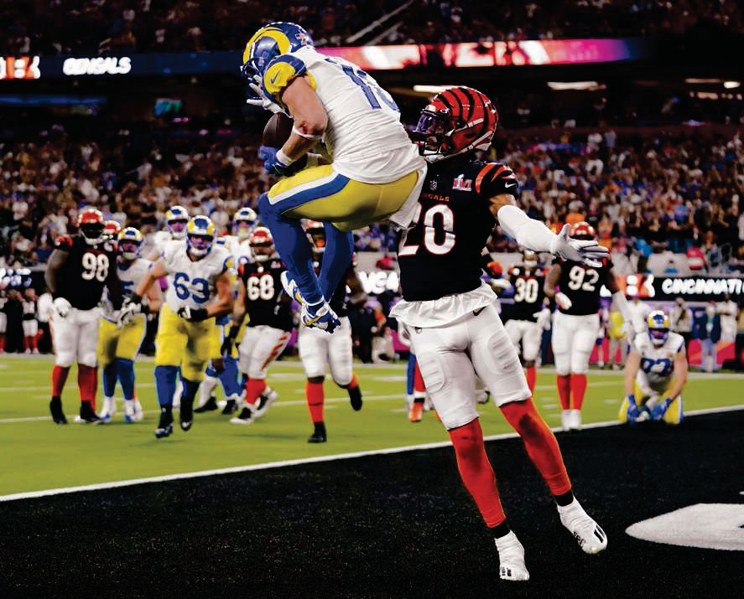
1. Rams Defeat Bengals 23-20 to Win Super Bowl
公羊队23-20击败孟加拉虎队赢得超级碗
Cooper Kupp leaps in front of Eli Apple to catch the winning touchdown late in the fourth quarter, giving the Rams their second Super Bowl title.

Slide 4
语篇填空
（《波士顿环球报》2022年2月14日 C1&C2版面）
In a venue built for champions, the Los Angeles Rams ________ (carry) off the crown jewel: a Super Bowl trophy on February 14, 2022.
It took a precise 79-yard drive ________ (cap) by Cooper Kupp’s 1-yard touch-down reception(接球) with 1:25 remaining for a 23-20 victory Sunday over the Cincinnati Bengals _______ (give) the Rams their first NFL title since the 1999 season — and their first representing Los Angeles since 1951.
“The ______ (guy) just did a great job,” coach Sean McVay said. “They took over that game.” They did so in their home, the $5 billion SoFi Stadium, ________ (make) the Rams the second consecutive host to win the championship after Tampa Bay a year ago.
_____ the championship drive, Kupp had four receptions for 39 yards, and a 7-yard run on fourth and 1 from the Rams’ 30. The winning series, during _______ game MVP Kupp’s 4-yard touchdown reception from Matthew Stafford ____________ (negate) by offsetting penalties(点球), ended soon after with the NFL Offensive Player of the Year _______ (easy) beating Eli Apple in the right corner of the end zone for ____ winning score.
carried
capped
to give
guys
making
On
which
was negated
easily
the

Slide 5
词汇讲解
1. carry off: to perform or manage successfully 成功应对
No other country has carried off two European titles in a row.
没有任何一支球队曾成功蝉联欧洲杯王者之座。
2. negate: to stop sth from having any effect 取消；使无效
Alcohol negates the effects of the drug. 酒精能使药物失效。
翻译句子
他的经验和威望足以成事。
He’s got the experience and the authority to carry it off.
翻译句子
这些缺点抹杀了他本来开明态度。
These weaknesses negated his otherwise progressive attitude.

Slide 6
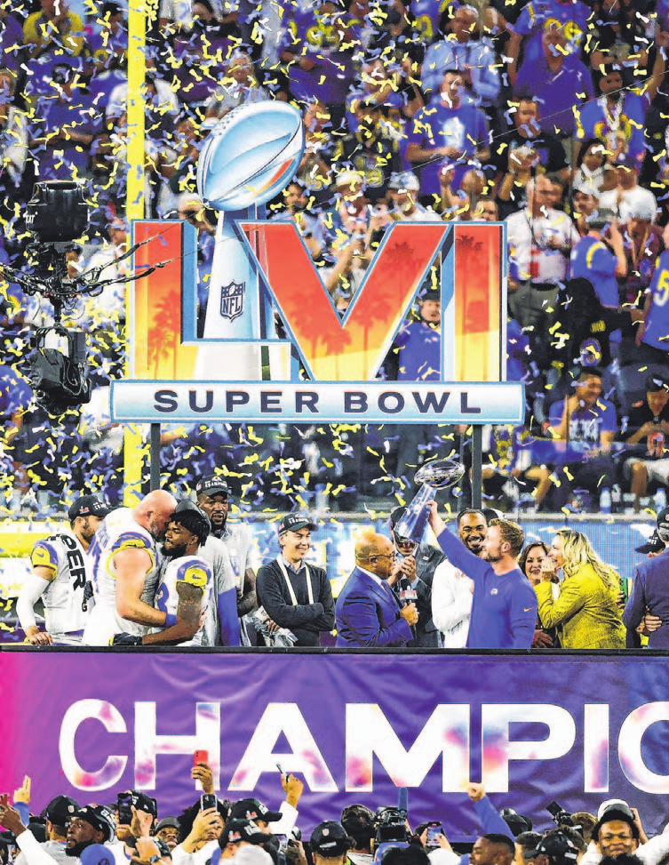
美式橄榄球中英对照
chain 链尺
corner post 角杆
march 持续进攻
mark 接球地点
marking 标志线
dangerous zone 危险区
helmet 头盔
knee pad 护膝
face guard 面罩
air attack 传球进攻
blind pass 跨下向后传球
blocked kick 被阻挡的踢球
catch a high ball 拾高球
grounding ball 压球触地
half back 飞扑传球
back-up 线后防守的队员
back field 守卫队员
back judge 防守对后方的裁判员
ball carrier 持球前进的队员

Slide 7
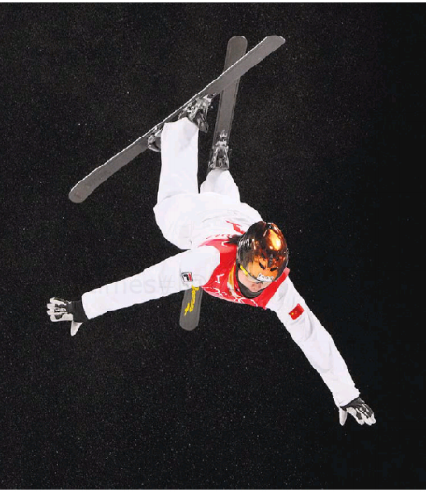
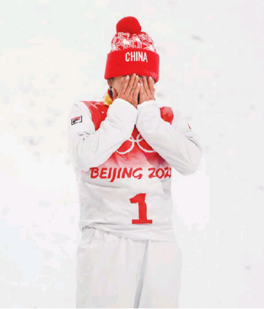
2. Winner and the No. 4 Finisher Celebrate a Triumph in Aerials
四届坚守，徐梦桃空中技巧终夺金！
With the temperature below zero, Xu Mentgao of China won in women’s freestyle sking aerials.

Slide 8
语篇填空
（《纽约时报》2022年2月15日 B12版面）
but
Australia has a habit of dominating freestyle skiing aerials, ___ China came to Genting Snow Park on a bitingly cold night hoping ______ (win) medals for the home country. And China delivered.
____ the evening temperature at minus-10 degrees Fahrenheit, Xu Mengtao won the gold medal with a back-full-full-full effort executed to near _________ (perfect). Hanna Huskova, the defending gold medalist from Belarus, earned silver, and Megan Nick of the United States got bronze. Laura Peel of Australia, __ two-time world champion and one of the favorites to win a medal, came in fifth after a hard fall.
Xu’s winning trick brought the few Chinese fans in the grand-stands to their feet and caused them to cheer, breaking the pandemic-era decorum __________ asks fans to not yell. Her score of 108.61 put her in ____ (one) place.
That left Ashley Caldwell of the United States, ________ (jump) last. She did the same trick, ______ (land) a bit on her backside and finished fourth. Afterward, she swallowed Xu in a long embrace, the winner overcome with ____ (tear). Xu then danced with the Chinese flag draped over her shoulders.
to win
With
perfection
a
which / that
first
jumping
landed
tears

Slide 9
词汇讲解
1. execute: to successfully perform a skilful action or movement 成功地完成
The whole play was executed with great precision.
这出戏从头到尾表演得丝丝入扣，有板有眼。
2. drape: to hang clothes, materials, etc. loosely on sb/sth 将……披挂于
She took the coat and draped it over her shoulders. 她拿起外套，披在肩上。
He draped his coat over the back of the chair. 他把外衣搭在座椅背上。
翻译句子
滑冰运动员们的动作完成得很完美。
The skaters’ routine was perfectly executed.
翻译句子
她肩上披着一条围巾。
She had a shawl draped around her shoulders.

Slide 10
熟词生义
1. deliver: 常见义 → v.递送；发表；接生
生义 → to achieve or produce something that has been promised 兑现
She always delivers on her promises. 她总是信守诺言。
2. overcome: 常见义 → v.克服
生义 → to be extremely strongly affected by sth 受到…的极大影响
She was overcome with grief at the funeral. 在葬礼上她悲痛欲绝。
翻译句子
政府没有兑现（承诺）。
The government has failed to deliver (what it promised).
翻译句子
考试的前一晚我被恐惧困扰着。
The night before the test I was overcome by fear.

Slide 11
句子翻译
Xu’s winning trick brought the few Chinese fans in the grand-stands to their feet and caused them to cheer, breaking the pandemic-era decorum that asks fans to not yell.
许梦桃的制胜一跳让看台上为数不多的中国球迷起立欢呼，打破了疫情时期要求球迷不要大喊大叫的礼仪。
翻译
With the evening temperature at minus-10 degrees Fahrenheit, Xu Mengtao won the gold medal with a back-full-full-full effort executed to near perfection.
翻译
在零下10华氏度的夜晚，徐梦涛以近乎完美的状态完成back-full-full-full难度的一跳夺得金牌。

Slide 12
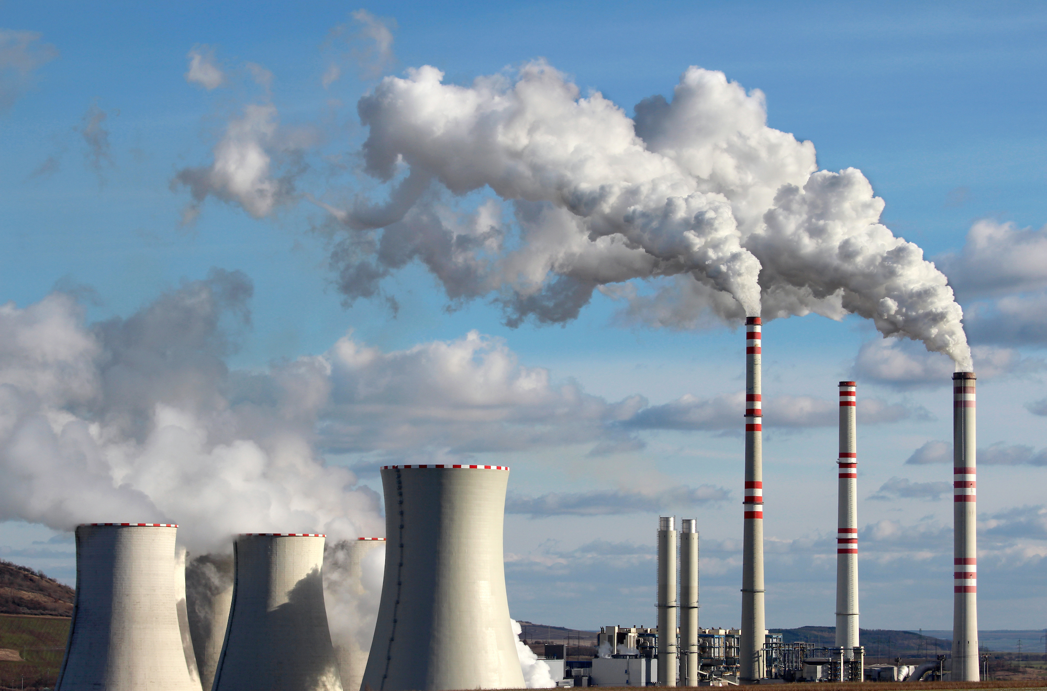
3. Time to Be Honest About Fossil Fuels
关于化石燃料的真相

Slide 13
语篇填空
（《外交政策》2022年冬季刊 29-30页）
The global energy crisis has hit U.S. shores: Fuel prices are rising, and a global supply _______ (short) of natural gas is driving up the cost of heat and electricity ___ winter approaches. The United States needs a ____________ (fundamental) new energy policy that will deliver reliable energy supplies at _________ (afford) prices with low impact on the environment and climate.
Any energy policy will have to start by __________ (consider) several inconvenient but incontrovertible facts. First, no matter ____ quickly the administration wants to raise the share of energy from renewable sources, U.S. energy security will require continued domestic oil and natural gas production ___ transportation, heating, industry, and electricity generation.
Second, ___ current generation of renewables—hydropower, wind, and solar—cannot deliver electricity or heat without reliable baseload energy generation, most often from natural gas.
Third, the current set of renewable energy ______ (source) cannot deliver the energy the United States _____ (need) due to their low energy output and efficiency, no matter how much money Washington throws at them.
shortage
as
fundamentally
affordable
considering
how
for
the
sources
needs

Slide 14
词汇讲解
1. incontrovertible: that is true and cannot be disagreed with or denied
无可争辩的；不能否认的；无可置疑的
We have incontrovertible evidence of what took place.
我们有确凿无疑的证据证明到底发生了什么。
2. renewable: that is replaced naturally or controlled carefully and can therefore be used without the risk of finishing it all 可更新的；可再生的；可恢复的
Renewable energy such as solar energy is theoretically inexhaustible.
太阳能等可再生能源在理论上是取之不尽用之不竭的。
翻译句子
2021年3月提供了无可辩驳的证据。
March 2021 delivered the incontrovertible evidence.
翻译句子
森林是可再生的自然资源，但必须谨慎对待它们。
Forests are renewable natural resources, but they must be treated with care.

Slide 15
句子翻译
The United States needs a fundamentally new energy policy that will deliver reliable energy supplies at affordable prices with low impact on the environment and climate.
美国需要一项全新的能源政策，以可承受的价格提供可靠的能源供应，同时对环境和气候的影响很小。
翻译
No matter how quickly the administration wants to raise the share of energy from renewable sources, U.S. energy security will require continued domestic oil and natural gas production for transportation, heating, industry, and electricity generation.
无论政府希望以多快的速度提高可再生能源的份额，美国的能源安全都需要继续在国内生产用于运输、供暖、工业和发电的石油和天然气。
翻译
The current set of renewable energy sources cannot deliver the energy the United States needs due to their low energy output and efficiency, no matter how much money Washington throws at them.
当前的可再生能源无法提供美国所需的能源，因为无论华盛顿在这方面投入多少资金，它们的能源输出和效率低。
翻译

Slide 16
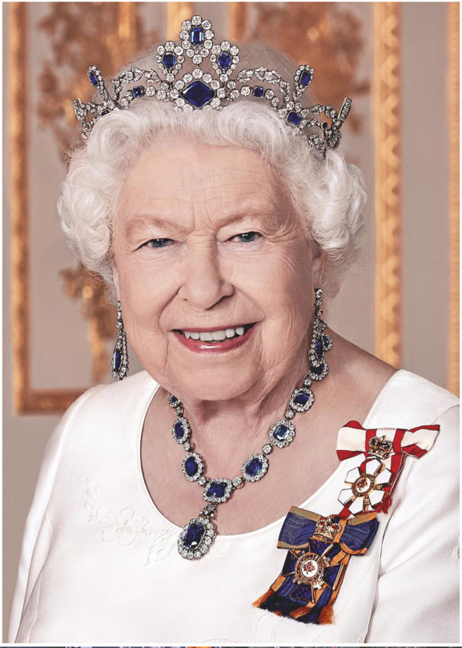
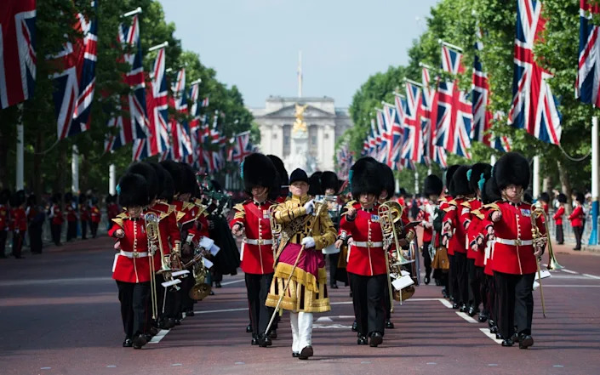
4. The Queen’s Platinum Jubilee Celebrations
女王白金周年庆典

Slide 17
语篇填空
（《Hello!》2022年1月24日刊 55页）
It will be a summer of celebrations in 2022, as the Queen becomes the first British monarch to ____________ (reign) for 70 years. With spectacular displays, a star-studded concert and major community events and exhibitions all ____ the calendar, the milestone _____________ (mark) in style across the UK.
The anniversary of Her Majesty’s accession to the throne falls on 6 February and she traditionally spends the day _________ (private). However, the following months will see several key occasions _______ (pay) tribute (表示敬意) to her seven decades of duty, culminating in a four-day bank holiday weekend.
June will be ___ time of celebration, with the Queen’s Birthday Parade ________ (kick) off a four-day bank holiday weekend. Trooping the Colour will see the 1st Battalion, Irish Guards, taking part, as well as hundreds of musicians and horses. They’ll be joined by _________ (member) of the royal family in a carriage procession down The Mall _______ they return to Buckingham Palace to watch a military fly past from the balcony. Making this even ____________ (special) is the fact it will be the first Queen’s Birthday Parade to take place in central London since 2019.
have reigned
in
will be marked
privately
to pay
a
kicking
members
before
more special

Slide 18
词汇讲解1
1. reign: hold royal office; rule as king or queen 为王，为君；统治
The Lord will reign for ever and ever.
耶和华必作王，直到永永远远！
2. culminate: to end with a particular result, or at a particular point （以某种结果）告终；（在某一点）结束
Months of hard work culminated in success.
几个月的艰辛工作终于取得了成功。
翻译句子
双方都没有发动战争的真实动机。因此，和平将会到来。
Neither side would have a real incentive to start a war. So, peace would reign.
翻译句子
在伦敦举行的一场精彩的音乐会将为他们夏季巡回演出画上句号。
Their summer tour will culminate at a spectacular concert in London.

Slide 19
词汇讲解2
3. kick off: (informal) to start 开始做
Tom will kick off with a few comments. 汤姆讲话时要先发表几点意见。
4. procession: a line of people or vehicles that move along slowly, especially as part of a ceremony （人或车辆的）队列，行列；列队行进
The procession made its way down the hill. 队伍走下山了。
翻译句子
展览从10月24日开始。
The shows kick off on October 24th.
翻译句子
许多失业群众列队向首都进发。
Many unemployed people marched in procession to the capital.

Slide 20
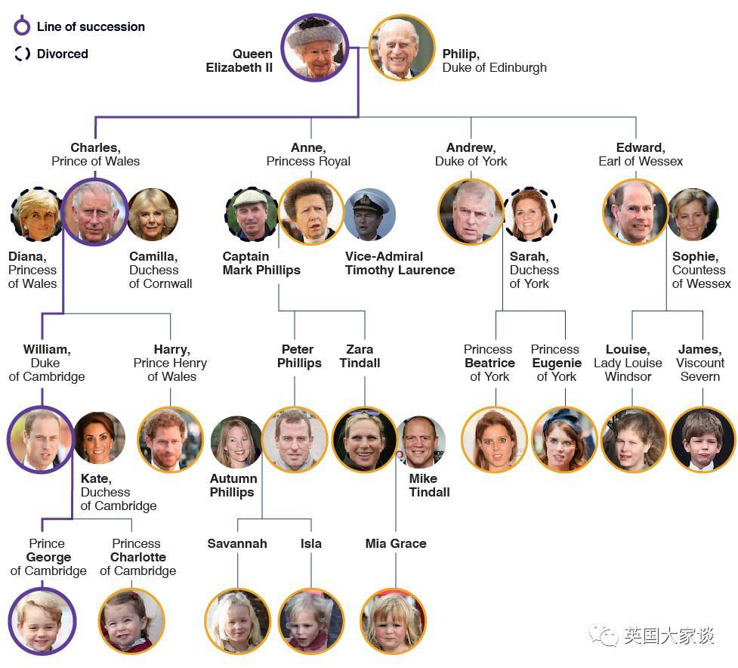
英
国
王
室
成
员
关
系
图
Tonga
Fiji
Vanuatu

Slide 21
5. VOA News 洛杉矶机场提供小狗为乘客解压

Slide 22
听写 Part I
These dogs are not at the Los Angeles International Airport to ______ a plane. They work here. Sergio, Klaus and Monti, are therapy dogs here at the airport. Animal lover and rescuer Heidi Huebner started the Pets on Stressing Passengers Program in 2013 to help people _____________ at airports. In the nine years since its _________, hundreds of volunteers and dogs have made thousands of passengers feel ______.
“You just don’t really know what to expect when you’re coming to travel. So, when we have the therapy dogs here, it’s just that warm and friendly, like, I can ______ and just feel happy.” Passengers love this _________. “Oh, it’s such a good idea, because we are, like, on the plane and tired and moody, and then we get off, and get to see dogs.” “I love dogs, it always makes me happy, so I definitely __________ that, yeah.” “The few of us that get ____________, any entertainment is wonderful and, you know, pets make everybody smile.”
The Los Angeles Airport _________ are equally happy to pet the therapy dogs, even pilots find it hard to resist the _________. “You want to smell my dogs, yeah?” “I love it. It ________ everybody. They really do. They bring _______. I wish it can be parked by my desk all day.” “He is so cute.”
hop on
feeling anxious
foundation
calmer
breathe
innovation
believe into
delayed flights
employees
temptation
distresses
comfort

Slide 23
听写 Part II
Volunteers also love _______________. During the _____ pandemic times, they say it’s nice to see they can make people smile, ______ for a few seconds. “It’s usually, ‘oh my God, I can pet them. It says ‘pet me’. Is that real?’ Yeah, it’s real. Come at him, come say hi.” “It means a lot to be able to get somebody to ____ a little and feel a little happier. You know, even if we can just _______________ a little bit in their day, that's wonderful.” “It's my joy, it's my favorite thing I do in my life, really, because my dog can provide, you know, comfort for other people.”
Therapy dog owners say their pets _________ when they see their bright __________. Anyone can become a volunteer and work with Huebner. The main and only ________ is everyone should enjoy it, both the people and the dogs of course.
Angelina Bagdasaryan in Los Angeles, Anna Rice, VOA News.
what they’re doing
tough
if only
relax
make a difference
get excited
red uniform
condition

Slide 24
词汇讲解
1. resist: to refuse to accept sth and try to stop it from happening 抵制；阻挡
They resisted our attempts to modernize the distribution of books.
他们反对我们采用现代化方式发行图书。
2. if only: used to say that you wish sth was true or that sth had happened
但愿；要是……就好了
If only I knew her name. 我要是知道她的名字就好了。
翻译句子
他们决心顶住要求改革法律的压力。
They are determined to resist pressure to change the law.
翻译句子
要是他没忘记发那封信就好了。
If only he had remembered to send that letter.

