Slide 1
感恩遇见，相互成就，本课件资料仅供您个人参考、教学使用，严禁自行在网络传播，违者依知识产权法追究法律责任。
更多教学资源请关注
公众号：溯恩高中英语
知识产权声明

Slide 2
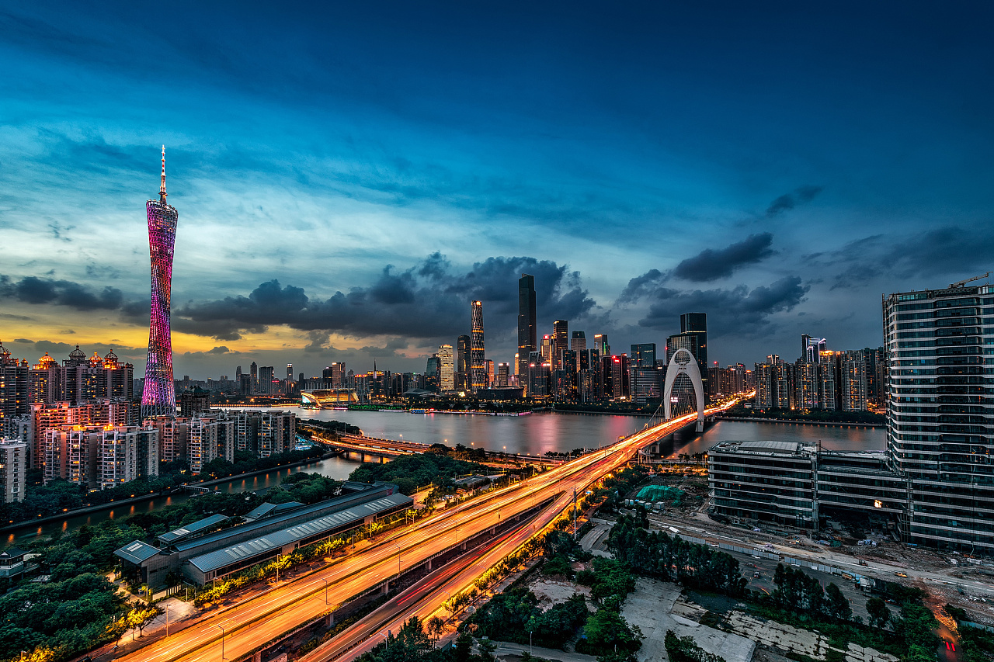
2024年3月天域全国名校协作体联考
英语试卷客观题讲评课件
傅嘉

Slide 3
PART 1
阅读理解

Slide 4
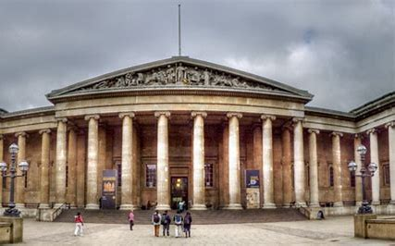
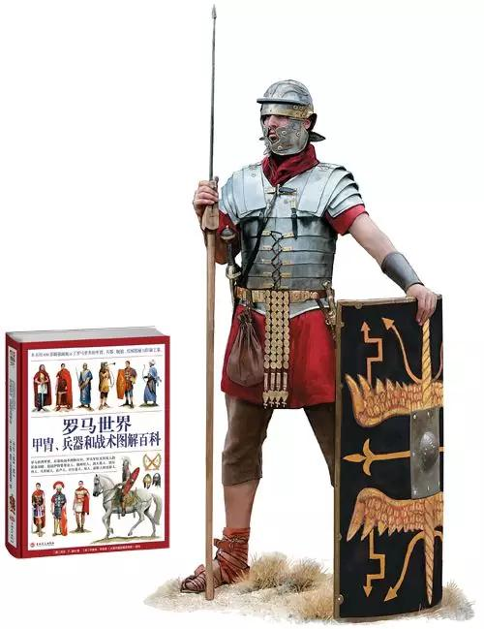
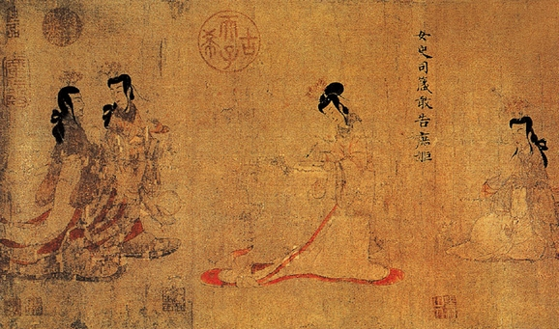
A 篇
介绍大英博物馆2024年举办的四个展览

Slide 5
主题语境--人与社会
A 篇：应用文
Experience Rome's war machine through the people who knew it best.
Expansive yet deeply personal, this exhibition transports you through the life and service of a real Roman soldier, Claudius Terentianus, from enlistment and campaigns to enforcing occupation then finally retirement. Objects include letters written on papyri and the Vindolanda tablets, revealing first-hand what daily life was like for soldiers and the women, children and enslaved people who accompanied them.
细节理解题
21. What can be learnt from Legion life in the Roman army?
A. The rise and fall of the Roman empire.
B. The function of machines in the war.
C. Daily objects used by Roman civilians.
D. Life records of a retired Roman soldier.

Slide 6
This masterpiece is considered a milestone in Chinese painting history.
Traditionally attributed to Gu Kaizhi （about AD345-406）, it probably dates to between AD 400 and700. Due to conservation precautions, it can only be displayed for six weeks a year. The Admonitions Scroll depicts a poetic text composed by an official Zhang Hua（about AD 232-300）aimed at correcting the behaviour of an empress. The Scroll carries inscriptions（题词） by later collectors including the Qianlong emperor.
Bear 多义性( bear bore born/ borne) be born 诞生；出生
The female bear is bearing a baby. （孕育）
His wife can’t bear having cats in the house. （忍受）
3. The ice is too thin to bear your weight. （承受）
4. These mango trees will bear fruit next year. （结果子）
5. Our hard work will bear fruit. (结果实—有成效）
6. Bear in mind that children need to be exposed to the sun. （bear…in mind 牢记…）
He visited the new parents, bearing gifts for the newly-born baby. （携带）
The houses bear the marks of bullet holes. (带有（标记、印痕、字迹）
细节理解题
22. What can we know about The Admonitions Scroll from the passage?
A. It is on display every 6 weeks. B. It changes the course of painting.
C. It bears Qianlong's handwriting on it. D. It was created by official Zhang Hua.

Slide 7
Gesture and line 5 October 2023-1 April 2024
Free
Explore the work of four artists who spearheaded（引领） the practice of drawing in the post-war years.
From the 1960s drawing assumed a prominent position among a rising generation of post-war artists in Germany and Austria. This exhibition examines works on paper by four of these artists, who are still comparatively little known in the UK.
Tip： B 、C、 D 均与古代展览内容有关，排除法亦可解题
23. Which exhibition would a person interested in contemporary art choose?
A. Gesture and line.
B. Around the world in 90.
C. Legion life in the Roman army.
D. Admonitions of the instructress to the court ladies.
细节理解题

Slide 8
Gesture and line 5 October 2023-1 April 2024
Free
Explore the work of four artists who spearheaded（引领） the practice of drawing in the post-war years.
From the 1960s drawing assumed a prominent position among a rising generation of post-war artists in Germany and Austria. This exhibition examines works on paper by four of these artists, who are still comparatively little known in the UK.
Tip： B 、C、 D 均与古代展览内容有关，排除法亦可解题
23. Which exhibition would a person interested in contemporary art choose?
A. Gesture and line.
B. Around the world in 90.
C. Legion life in the Roman army.
D. Admonitions of the instructress to the court ladies.
细节理解题

Slide 9
A 篇语料库
first-hand adj/ adv. 第一手的；直接地
enslave sb 使sb 成为奴隶；奴役sb
enlist sb 使sb 参军、入伍 // enlist sth 利用sth; 谋求sth
be attributed to … 归因于… （本文中指：女史箴图为顾恺之所作）
depict a poetic text 描绘了一首诗歌
assume a prominent position 占据显著位置
（assume vt. 假定；假设；认为；//生义：呈现；具有）
comparatively adv. 比较地；相对地 = relatively
knowledgeable adj. 知识渊博的
empress n. 女皇帝
instructress n. 女教员

Slide 10
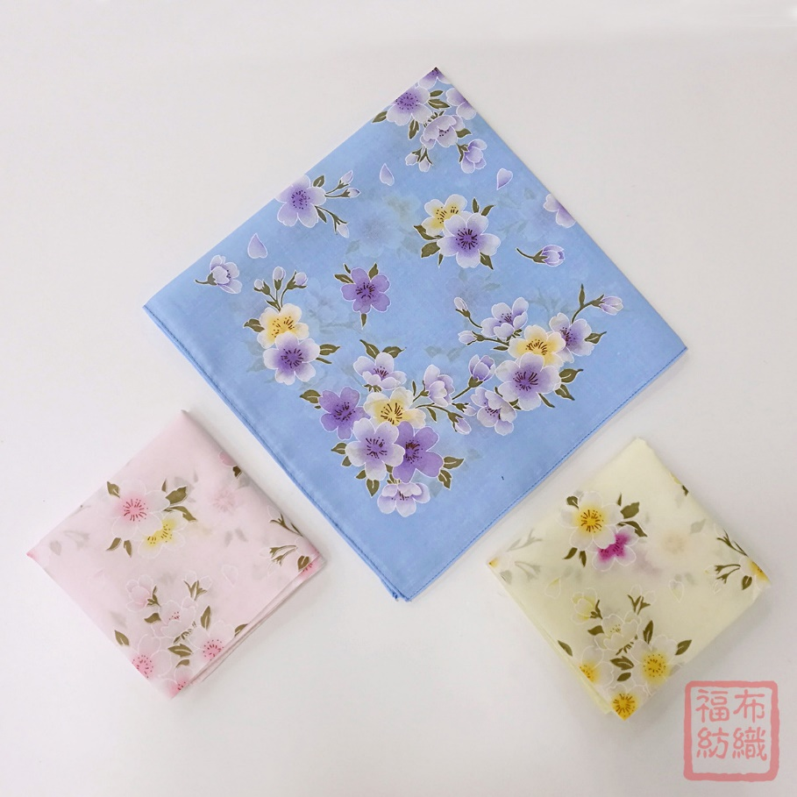
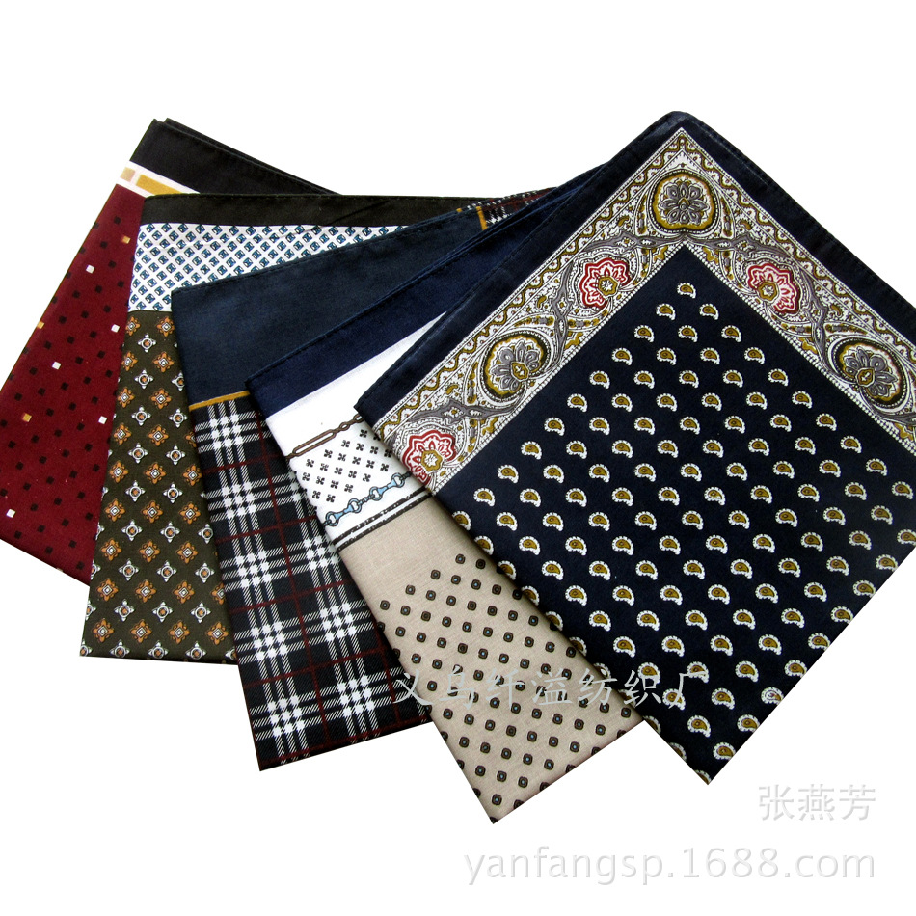
B 篇
本文是夹叙夹议的体裁， 主题语境是“人与社会” ， 借作者使用手帕的故事描述手帕在新时代下的作用更迭。

Slide 11
主题语境--人与自我
B 篇：记叙文
(Para. 1) The text from my son said it all: "Dad, there's an article you were born to write that the world is finally ready for: Bring Back the Handkerchief!" As my son knows, there's no "bring back" for me. For me, the handkerchief never left.
24. What kind of person is the author in the eye of his son?
A. His father is a born writer.
B. His father lost his handkerchief long ago.
C. His father will bring back the handkerchief.
D. His father has a habit of using handkerchief.
推理判断题

Slide 12
(Para.3) I am sure this habit has sometimes struck friends but in polite company nobody comments on somebody else's business. Children like my kids think of my hankie ridiculously old-fashioned and they have their arguments. If you have to be prepared every day for allergies or a cold, why not choose a little packet of tissues, which saves you from that disgusting business of blowing your nose in the thing and then stuffing it back in your pants?
strike 多义性：
The staff at the hospital went on strike. (n. 罢工
The tower clock was striking 12:00. (vt. 敲打；）
The boy struck his brother with his fist. (vt. 击中，击打)
A typhoon will strike our city this weekend. (vt.（灾难等）袭击）
A brilliant idea struck / hit/ occurred to Amy. (vt. 使…突然想到）
He struck me as a very serious but friendly person. (vt. 给sb 留下深刻印象）
She was struck by his simple, spellbinding eloquence. （vt. 被打动）
His behavior struck the audience. (vt. 使…吃惊）
25. How do the younger generation like the handkerchief?
A. They adore it very much.
B. They regard it as fashionable.
C. They consider it inconvenient.
D. They desire to have their own someday.
推理判断题

Slide 13
(Para.6) Yet not even my mother could have anticipated the hankie's new role as an Essential Public Health Appliance. All of us have learnt how hard it is to follow advice from medical experts about not touching your face. Here is an answer. Use your hankie. In case of emergency, your handkerchief can become a makeshift DIY mask that can be pulled over your lower face like a robber entering a bank.
Tip： 该段首句是Topic sentence , 后面的示例都说明手帕的new role.
细节判断题
26. What can be learned from the passage?
A. The function of handkerchiefs has been updated.
B. Handkerchiefs will be taken over by tissues sooner or later.
C. The author's wife feels embarrassed to give him a handkerchief.
D.The author was ridiculed by his friends for his use of handkerchiefs.

Slide 14
(Para.5) …In case of emergency, your handkerchief can become a makeshift DIY mask that can be pulled over your lower face like a robber entering a bank.
And it will certainly give me the chance to lift my chin and look at my adult children through one eye, asking in her good-hearted way, "What do you have to say now, smarty-pants?"
推理判断题
27. What's the tone of the author in the passage?
A. Bossy B. Humorous C. Pessimistic D. Critical

Slide 15
B 篇语料库
This habit has sometimes struck friends… （熟词生义：使…吃惊）
in polite company 在礼貌的（社交）场合
a little packet of tissues 一小袋餐巾纸；小包餐巾纸
save sb from sth 让sb 免去了（做）sth 的麻烦
smarty-pants 自作聪明的人
durable adj 经久耐用的； = lasting

Slide 16
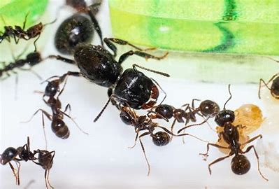
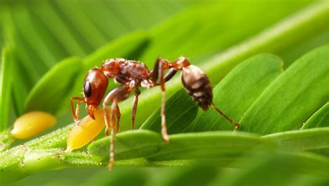
C 篇
本文的语篇类型是说明文， 主题语境是“人与自然” ， 主要介绍了因外来蚂蚁入侵而引发生态系统的一系列连锁反应。

Slide 17
主题语境--人与自然
C 篇：夹叙夹议文
(Para. 1) "THE ANT AND THE ZEBRA "sounds like the title of a Aesop's fable. Like all good fables, this one has a moral, which is that tinkering with nature has unpredictable consequences. Unlike the Greek originals, though, this fable is real.
和所有优秀的寓言故事一样， 这则寓言也蕴含着一个寓意， 那就是对大自然...会带来不可预测的后果。 可以得知这句话是在总起全文这个故事的寓意， 因此本题不同于单纯词义猜测题， 同时也是一个上下文推断题， 必须看完下文的故事才能得出结论。 根据后文中“外来蚂蚁入侵” 引发了一些列后续的反应， 可知一开始的起因是“改变自然”
28. What does the underlined phrase "tinkering with" probably mean in the 1st paragraph?
A. making changes to B. paying attention to
C. finding fault with D. showing respect for
词义猜测题

Slide 18
(Para.2) The story plays out in Laikipia county, Kenya. The characters include big-headed ants, an in-vasive（入侵） species, the native acacia ants these invasive ants have gradually been replacing, the whistling-thorn trees where both sorts of ants live, a cast of elephants, lions, zebras and buffalo, and Douglas Kamaru, a Kenyan biologist in the University of Wyoming. As Mr Kamaru reports this week in Science, the ant invasion has set off a complicated chain of consequences which has helped zebras at the expense of buffalo -thus illustrating a phenomenon called "trophic cascade".
推理判断题
29. The "trophic cascade" in the passage happened when ___.
A. animal habitat in a specific area was preserved
B. an invasive species suffered a lack of food supply
C. certain plants were affected by human activities
D. a particular species in the food chain was replaced

Slide 19
(P.4) Acacia ants' habitat are thickly carpeted with whistling-thorns. Big-headed ants, however, are not good at keeping the elephants at bay. The elephants move in and bite the trees, removing much of the area's cover. That upsets the local lions, which often use this cover to hide when hunting zebra. To compensate, the lions switch to hunting buffalo, which are more dangerous, but less fleet of foot.
推理判断题
30. Why did the lions change their targets of attack when hunting?
A. Because it becomes less risky to hunt the buffalo.
B. Because greater visibility makes it hard to hunt zebra.
C. Because they are not good at keeping the elephants away.
D. Because they are upset by the presence of big-headed ants.

Slide 20
(Para. 1) "THE ANT AND THE ZEBRA "sounds like the title of a Aesop's fable. Like all good fables, this one has a moral, which is that tinkering with nature has unpredictable consequences. Unlike the Greek originals, though, this fable is real.
根据全文所描述的自然现象主要脉络： 入侵蚂蚁取代当地蚂蚁， 使得与当地蚂蚁共生的哨刺树失去保护， 大象趁虚而入啃食哨刺树， 而因失去哨刺树的掩护捕猎斑马变得不易， 狮子最终转而捕猎速度更慢不费脚程的水牛， 可知是因为外来蚂蚁的入侵 最终促使狮子捕猎水牛。 因此 D 项 How ants persuaded lions to eat buffalo 合适。 因为文章是把此故事类比寓言故事的， 因此使用 persuade 这样的拟人手法是符合的。
31. Which of the following is probably the best title for the passage?
A. How ants and buffalo defeated lions.
B. How elephants landed zebra in trouble.
C. How trees changed lions' dinner menu.
D. How ants persuaded lions to eat buffalo.
主旨大意题

Slide 21
(P.4) Acacia ants' habitat are thickly carpeted with whistling-thorns. Big-headed ants, however, are not good at keeping the elephants at bay. The elephants move in and bite the trees, removing much of the area's cover. That upsets the local lions, which often use this cover to hide when hunting zebra. To compensate, the lions switch to hunting buffalo, which are more dangerous, but less fleet of foot.
推理判断题

Slide 22
长难句分析；
The characters include big-headed ants, an invasive（入侵）
species, the native acacia ants these invasive ants have gradually been replacing, the whistling-thorn trees where both sorts of ants live, a cast of elephants, lions, zebras and buffalo, and Douglas Kamaru, a Kenyan biologist in the University of Wyoming.
主语
谓语
宾语1
宾语1的同位语
宾语2
宾语2的定语从句
宾语3
宾语3的定语从句
宾语4
宾语5
宾语5的同位语
a cast of …一群…

Slide 23
C 篇语料库
unpredictable consequence 无法预料的后果
fable n. 寓言、寓言故事
unlike the Greek originals (不像…)
The story plays out in … (在…上演）
set off a complicated chain of consequences (引发了一连串复杂的结果）
at the expense of buffalo ( 以牺牲水牛为代价）（at the cost of…)
co-evolve with … (与…同步进化）
in the form of …以…形式
keep… at bay (使…无法接近）
remove much of the area’s cover 除去了该地区很多的覆盖物/遮蔽物
switch to hunting buffalo （ turn to doing sth :转向做sth )
blame the ants for their misfortune （ 把不幸归咎于蚂蚁）
visibility n. 可视性；能见度

Slide 24
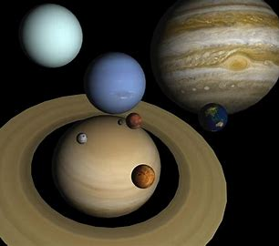
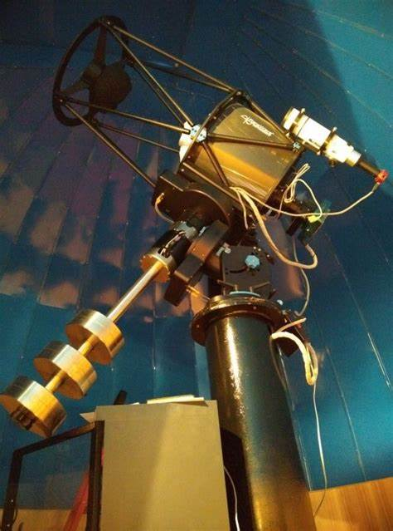
D 篇
本文的语篇类型是说明文， 主题语境是“人与自然” ， 主要介绍了天文学家寻找类地行星的方法和目标。 他们使用望远镜、 多普勒技术和监测恒星光度变化等方法来寻找类地行星。

Slide 25
D 篇：说明文
主题语境--人与自然
(Para. 2) The most direct approach is to take a picture of it with a telescope. However, a more effective way is to use "the Doppler technique". This involves analyzing starlight for evidence that the star's movement is affected by the gravitational pull of a planet. Nowadays, astronomers can tell when a planet is pulling its star by only one meter a second-about human walking speed. That's enough to detect a giant planet in a big orbit, or a small planet if it's close to its star.
32. According to paragraph two, astronomers analyze starlight with the aim of finding ____.
A. where we can detect a giant orbit
B. why a small planet is close to its stars
C. whether the motion of the stars is changed
D. how strong the power of the gravitational pull is
细节判断题

Slide 26
D 篇：说明文
主题语境--人与自然
(Para. 3) Another approach is to watch a star for a slight dip in its brightness. This occurs when an orbiting planet passes in front of the star and blocks part of its light. At most, a tenth of all planetary systems are oriented so that these mini-eclipses （日食, 月食）—called transits （凌日）—are visible from Earth. So, astronomers have to monitor a lot of stars to capture just a few transits.
33. Why do astronomers have to monitor a lot of stars to capture transits?
A. Transits last a very short period of time.
B. Most planetary systems don't have transits.
C. Transits only occur for a small number of stars.
D. No more than 10% planetary systems have visible transits from Earth.
细节理解题

Slide 27
D 篇：说明文
主题语境--人与自然
(Para. 5) The best places to look may be dwarf stars. Smaller than the sun, dwarf stars are plentiful; seven of the ten stars nearest to Earth are dwarf stars. They also provide a steady supply of sunlight to any life-bearing planets within their habitable zone. Additionally, dwarf stars are dim, so the habitable zone lies closer in. If the planet is closer to the star, it's easier for astronomers to detect a transit observation. A close-in planet also has a stronger pull on its star. That makes it easier to detect with the Doppler method.
34. Dwarf stars may be good places to spot Earth-like planets because
A. dwarf stars are limited in number
B. their planets are close to the Earth
C. the closeness of the habitable zone to dwarf stars aids detection
D. the brightness of dwarf stars to Earth improves their visibility
推理判断题

Slide 28
D 篇：说明文
主题语境--人与自然
(Para. 1) With the fast development of astronomy, astronomers are eager to find a hint of the familiar: planets that resemble Earth. By pushing technology to the limits, astronomers are rapidly approaching the day when they can find another Earth.
35. What is the author's attitude to the discovery of Earth-like planets?
Confident. B. Suspicious.
C. Ambiguous. D. Unconcerned.
推理判断题

Slide 29
D 篇语料库
resemble vt. look like 看起来像…
involve analyzing starlight （vt. 涉及；需要）（需要分析星光）
gravitational pull of a planet 行星的重力
detect a giant planet in a big orbit 在大轨道上探测一颗巨大的行星
a slight dip 轻微下降 （ a light drop)
blocks part of its light 阻挡一部分的光
monitor a lot of stars （监控； ）
capture just a few transits. （捕捉）
a promising residence for life 有前景的终身居所
dwarf star 矮星：比普通恒星小的恒星，通常具有较低的亮度和温度。
life-bearing planets : 能承载生命的行星
suspicious adj. 怀疑的 skeptical
ambiguous adj. 模棱两可的；
unconcerned adj. 不关心的； 不担忧的

Slide 30
PART 2
七选五
本文的语篇类型是说明文， 主题语境是“人与社会”。 介绍了在视频通话中如何给别人留下良好的第一印象的四个建议。

Slide 31
首先观察选项设置的特点：
A. Lighting makes the difference.
B. Do put on make-up on your face.
C. Instead, obtain a phone stand to hold it.
D. The ideal position for your camera is at your eye-level.
E. What can you do to ensure a successful business meeting?
F. So it's worth spending the money on a dedicated external microphone.
G. So what can you do to make sure your video calls project the right image?
化妆品
选项特点：
1. 有逻辑副词的选项大概率是备选的正确的选项 如：CFG
2. 疑问句 句式一致 如; E G 可能二选一，注意甄别
3. 注意选项中的名词，是否与原段落的信息关联
4. C选项末尾的it 是代词；说明空格前有其指代的单数名词
但F 项中, it 是形式主语，考生要注意辨别！

Slide 32
If you want to make a good first impression in that important business meeting, it is no longer about wearing the sharpest suit or the firmest handshake but about making sure that the little Zoom window with your face in it projects professionalism. But this isn't always easy. 36 Here are some tips.
解析：选 G。考查全文主旨。根据设空后 Here are some tips 是对选项 G. What can you do to make sure your video calls project the right image? （ 你能做些什么来确保你的视频通话投射出正确的图像?） 的回答。且有多处关键词加持。
A. Lighting makes the difference.
B. Do put on make-up on your face.
C. Instead, obtain a phone stand to hold it.
D. The ideal position for your camera is at your eye-level.
E. What can you do to ensure a successful business meeting?
F. So it's worth spending the money on a dedicated external microphone.
G. So what can you do to make sure your video calls project the right image?

Slide 33
• Don't hold your phone.
If you absolutely must join the meeting on your phone, then don't hold it in your hand. 37 Your colleagues won't see your picture swinging about wildly. And the camera won't suddenly look up your nose when you naturally pull your phone closer to your face.
A. Lighting makes the difference.
B. Do put on make-up on your face.
C. Instead, obtain a phone stand to hold it.
D. The ideal position for your camera is at your eye-level.
E. What can you do to ensure a successful business meeting?
F. So it's worth spending the money on a dedicated external microphone.
G. So what can you do to make sure your video calls project the right image?
解析：选 C。 考查句际转折关系。 根据上文 don’t hold it in your hand。 （相反， 买一个手机支架来固定它） 符合语境。Instead 前面必然有一个否定句。

Slide 34
• 38
How the light falls on our faces counts. So make sure that you don't have a big, direct source of light behind you, because all it will do is make your face dark and hard to see-and that's the most important part!
A. Lighting makes the difference.
B. Do put on make-up on your face.
C. Instead, obtain a phone stand to hold it.
D. The ideal position for your camera is at your eye-level.
E. What can you do to ensure a successful business meeting?
F. So it's worth spending the money on a dedicated external microphone.
G. So what can you do to make sure your video calls project the right image?
解析：选A ，考查小标题。 根据小标题下面段落尤其是首句 How the light falls on our faces
counts.可知选项 A. Lighting makes the difference 符合语境。 期中 counts 和 makes the
differences 意思一致

Slide 35
• A professional microphone makes up for bad video.
The built-in microphones inside our computers can be pretty good, but they're never truly great. 39 What matters is that people should be able to hear what you're saying.
解析：选 F。考查句际因果关系。根据 The built-in microphones inside our computers can be pretty good, but they’re never truly great.可知“虽然内置的麦克风可能很好…” ， 下文应继续谈论麦 克 风 的 问 题。
A. Lighting makes the difference.
B. Do put on make-up on your face.
C. Instead, obtain a phone stand to hold it.
D. The ideal position for your camera is at your eye-level.
E. What can you do to ensure a successful business meeting?
F. So it's worth spending the money on a dedicated external microphone.
G. So what can you do to make sure your video calls project the right image?

Slide 36
• Don't rely on the default（默认） camera.
40 This could help create the illusion of eye contact. However, this isn't always easy, especially if you're using a laptop and are sitting at a desk, towering above it. It might be worth get-ting an external camera you can put on top of a monitor.
A. Lighting makes the difference.
B. Do put on make-up on your face.
C. Instead, obtain a phone stand to hold it.
D. The ideal position for your camera is at your eye-level.
E. What can you do to ensure a successful business meeting?
F. So it's worth spending the money on a dedicated external microphone.
G. So what can you do to make sure your video calls project the right image?
解析：选 D。 考查句际顺承关系。 根据后文 This could help create the illusion of eye contact. 可知， “this” 指代指代 D选项整句话。

Slide 37
七选五语料积累：
1.同义表达count --- make the difference ----(matter) 很重要
2. project professionalism 投射专业的形象
3. built-in microphone 内置麦克风
4. make up for 弥补 = compensate (C 篇倒数第二段最后一句）
5. illusion n. 错觉；幻觉
6. tower above the desk 高耸于桌子上方

Slide 38
PART 3
完形填空

Slide 39
Every Friday night the Chevron gas station food mart offers a discount on the leftover food. To ensure the best selection, my mother and I pile into our old car and 41 in front of the mart at five p. m. sharp, ready to get our 42 .
41.A. settle down B. pull up C. hang about D. show off
42.A. award B. share C. change D. credit
41 B. pull up 根据句意，周五晚上，我和妈妈驾驶着旧车， 准时在下午五点到达加油站的食品店前，准备购物。 "pull up" 意为 "停车"， 与句意相符。 42 B. share 根据上下文，“...ready to get our share.” 表示准备好去获取我们的份额，意思是他们准备购物， “share”表示他们要去购物的份额。

Slide 40
Chevron shopping 43 like this: One day my mother suddenly realized that she had maxed out（透支） almost every credit card except the Chevron card and we needed groceries for the week. Since our first 44 there, I‘ve learned to believe in flexibility. …
43.A. continued B. started C. ran D. worked
44.A. encounter B. match C. inspection D. visit
43 B. started 根据上下文， 描述的是购物流程， 因此应该是加油站的购物开始的样子。"started" 表示开始， 符合句意。
44 D. visit 根据句意， 描述的是第一次去加油站的购物经历。 "visit" 意为访问， 符合句意。

Slide 41
….In my life, it has become necessary to 45 the idea of grocery shopping. My mother and I can no longer shop at real grocery stores, 46 we still get the necessities.
45.A. dismiss B. develop C. bend D. accept
46.A. but B. so C. when D. unless
45 C. bend 在这个上下文中， 主人公描述了他们的母亲意识到她必须接受在超市购物的观念， 因为他们无法再使用其他信用卡， 只能使用 Chevron 卡购物。 因此， 他们不得不适应在超市购物的观念。 选项 C. bend 表示适应或屈从于新的情况或观念。
46 A. but 前后句子表达的是尽管不能在真正的杂货店购物， 但他们仍然能够得到必需品。"but" 表示转折， 连接了两个相反的情况。

Slide 42
Grocery shopping at Chevron has its 47 . The worst is when we have so many items that it takes the cashier what seems like hours to ring up everything. A line of 48 customers formed behind us.
47.A. purposes B. drawbacks C. features D. grounds
48.A. excited B. guilty C. grateful D. anxious
47 B. drawbacks 根据上下文 the worst…， 描述的是在加油站购物的不利之处。 "drawbacks"表示缺点， 符合句意。
48 D. anxious 根据句意， 描述的是当购物时间过长时， 排在他们后面的顾客显得很焦虑。"anxious" 意为焦虑的， 符合句意。

Slide 43
…It's that line that 49 the most---the way they look at us. My mother never notices---or maybe she 50 not to.
49.A. declines B. suffers C. hurts D. struggles
50.A. threatens B. promises C. agrees D. pretends
49 C. hurts 根据上下文， 排在后面的顾客对他们的态度让主人公感到最痛苦。 "hurts" 表示伤害， 符合句意。
50 D. pretends 根据上下文， 母亲可能是故意不去注意排在后面顾客的态度。 "pretends" 表示假装， 符合句意

Slide 44
I'm 51 to shop there, and I'm afraid of running into someone I know. I once expressed my fear of being seen shopping at Chevron to my mother, and her eyes shone with disappointment. I know that I hurt her feelings when I try to 52 our weekly shopping trips.
51.A. shocked B. confused C. embarrassed D. bored
52.A. avoid B. join C. arrange D. cancel
51 C. embarrassed 根据上下文， 主人公对在加油站购物感到尴尬。 "embarrassed" 意为尴尬的， 符合句意。
52 A. avoid 根据上下文， 主人公曾试图避免每周的购物之旅。 "avoid" 意为避免符合句意。

Slide 45
And that is why I hold on to the idea of 53 so tightly. Whenever I feel the 54 rise to my face, I remind myself at this point in my life I am struggling does not mean that I will always struggle. I know that whatever happens, we will always 55 a way to survive.
53.A. simplicity B. generosity C. integrity D. flexibility
54.A. pride B. bitterness C. heat D. sweat
55.A. figure out B. wait for C. agree on D. break off
53 D. flexibility 根据上下文， 主人公认为保持灵活性的概念很重要。 "flexibility" 意为灵活性， 符合句意。
54 C. heat “Whenever I feel the heat rise to my face” 表示当主人公感到尴尬时， 他感到脸上发热， 这是一个常见的表达方式， 意味着主人公感到尴尬或者不舒服。 因此， 正确的选项是 C. heat， 表示主人公感到尴尬时脸上的热度。55 A. figure out 根据上下文， 主人公认为无论发生什么事情， 他们总会找到一种方法生存下去。 "figure out" 意为找出解决办法， 符合句意。。

Slide 46
完形填空语料积累：
1. offer a discount on the leftover food
2. pull up
3. need groceries
4. get necessities
5. cashier
6. ring up everything
7. run into sb = come across sb = encounter sb
8. hold on to sth

Slide 47
PART 4
语法填空

Slide 48
主题语境：人与自然
主旨大意：
China's Harbin International Ice and Snow Sculpture Festival
设空类型：有提示词7，无提示词3

Slide 49
56. 考查非谓语 表目的
to visit
Visitors have flocked from far and wide 56 （visit） the world's largest ice and snow festival dubbed （称为） "Disneyland on ice" recently. This is China's Harbin International Ice and Snow Sculpture Festival - a family friendly, fun-filled dream land 57 （fill） with intricately designed ice sculptures.
filled
57.考查非谓语作后置定语

Slide 50
58.考查介词 treat sb to sth 的被动语态be treated to sth ，此处译为：游客可以欣赏sth
to
Although visitors are treated 58 masses of ice sculptures throughout Harbin City, Sun Island and Ice and Snow World, are the two main areas. Ice and Snow World area is largely open at night, and 59 （feature）illuminated ice skyscrapers.
features
59.考查谓语 feature 此处是动词，feature sth 意为：具有某种特点

Slide 51
60.考查定语从句关系副词 ，修饰先行词Ferris wheel
61. 考查名词作宾语。这里描述了游客可以从空中欣赏这个令人印象深刻的冬季仙境。 "completeness"是名词，用来描述这个仙境的完整性或完整程度
This year, they‘ve also added such a towering snowflake Ferris wheel （摩天轮） 60 visitors can take in the 61 （complete）of this impressive winter wonderland from the air. The festival has established
62 （it）as one of the best winter celebrations worldwide, and has been pulling in an estimated 28. 7 billion yuan （£ 3. 2 billion）per year.
where
completeness
itself
62. 考查反身代词，指节日本身。

Slide 52
63.考查冠词 have a difficult time with sth
64. 考查副词,此处physically 意为：身体方面；身体方面对寒冷作出反应
a
One travel guide said: "I've always had 63 difficult time with winter, or at least the idea of it. I've associated winter with misery, irrespective of how I 64 （physical）react to the cold, and have gone to great 65 （length）to deny its very existence. Exploring China's Harbin Ice and Snow Festival brought me indescribable joy. "
physically
lengths
65. 考查名词复数+词组：go to great lengths to do sth 不遗余力，竭尽全力去做某事

Slide 53
语法填空长难句解析1.
This is China's Harbin International Ice and Snow Sculpture Festival - a family friendly, fun-filled dream land 57 （fill） with intricately designed ice sculptures.
1.主语：This
2.系+表：is China's Harbin International Ice and Snow Sculpture Festival
3. 同位语- a family friendly, fun-filled dream land
4.同位语的后置定语： filled （fill） with intricately designed ice sculptures.

Slide 54
语法填空长难句解析2.
The festival has established 62 （it）as one of the best winter celebrations worldwide, and has been pulling in an estimated 28. 7 billion yuan （£ 3. 2 billion）per year.
1.主语：The festival
2.谓语： and 连结的两个并列谓语

Slide 55
语法填空长难句解析3.
Ice and Snow World area is largely open at night, and 59 （feature）illuminated ice skyscrapers.
1.主语：Ice and Snow World area
2.谓语： and 连结的两个并列谓语

Slide 56
语法填空长难句解析4.
I've associated winter with misery, irrespective of how I 64 （physical）react to the cold, and have gone to great 65 （length）to deny its very existence.
1.主语：I
2.谓语： and 连结的两个并列谓语
3. 形容词作伴随状语：irrespective of … （不管，不顾sth)
of 介词后面是how 引导的宾语从句；
4. 非谓语动词作状语表目的：to deny its very existence

Slide 57
语法填空合成词、派生词
1. fun-filled dream land 充满快乐的
2. irrespective of … 不顾… 不考虑…
3. indescribable joy 无法描述的快乐
4. associate winter with misery 把冬天和悲惨联系起来
5. be treated to sth 享用sth；享受sth
6. take in 吸收；领略
7. pull in (money)= bring in (money)
8. go to great lengths to do sth
9. establish A as B

Slide 58
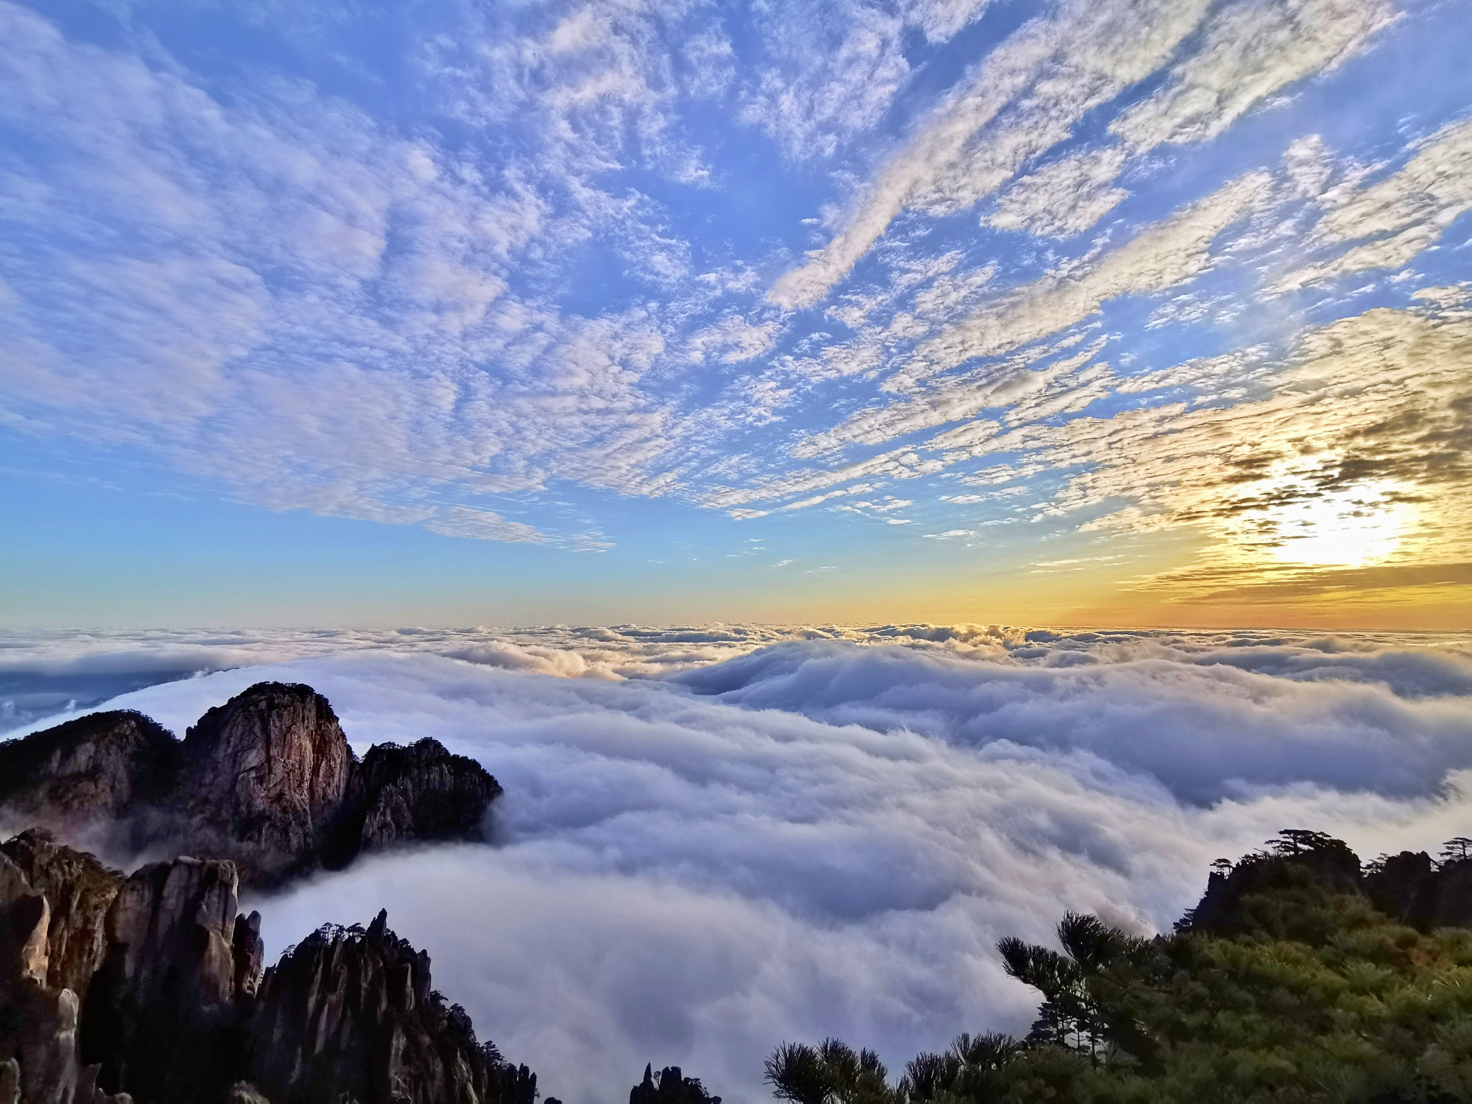
谢谢观看！
PPT作者：傅嘉

