Slide 1
感恩遇见，相互成就，本课件资料仅供您个人参考、教学使用，严禁自行在网络传播，违者依知识产权法追究法律责任。
更多教学资源请关注
公众号：溯恩高中英语
知识产权声明

Slide 2
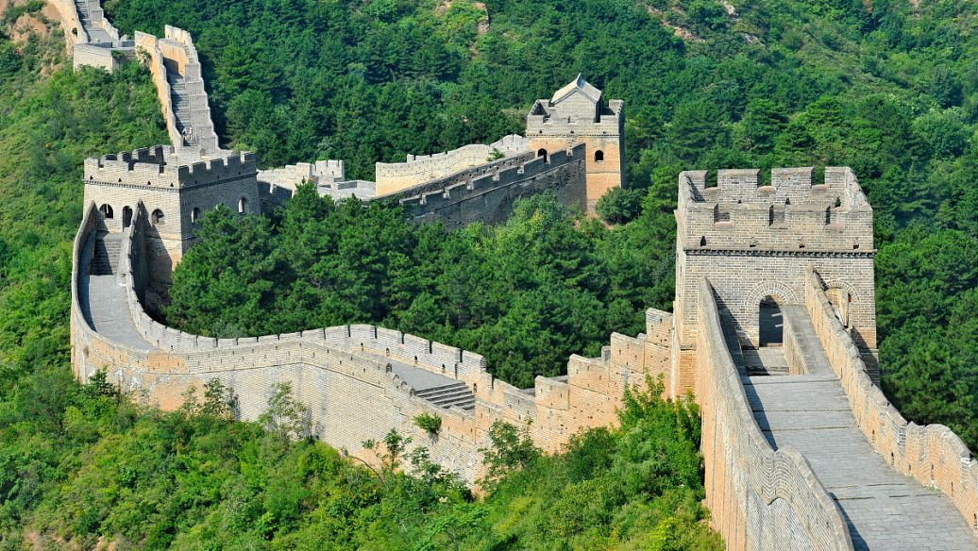
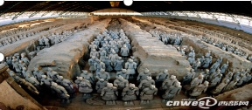
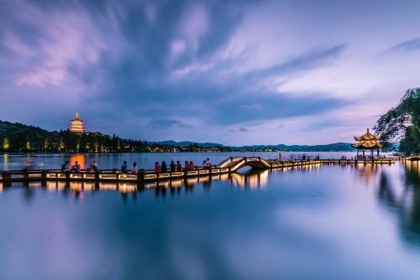
Reading
workbook on P80

Slide 3
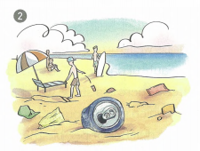
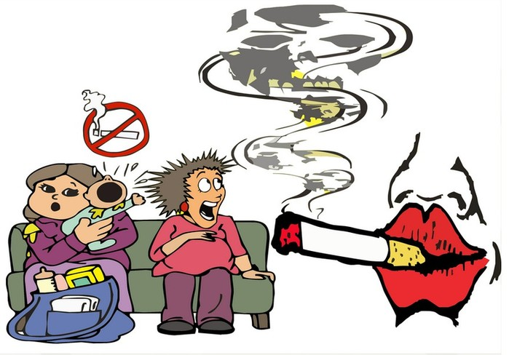
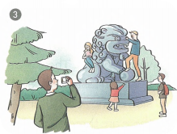
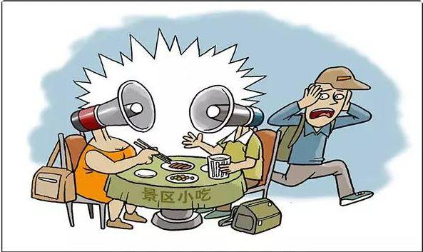
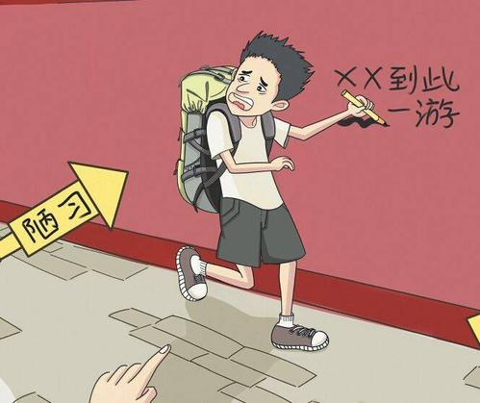
terrible tourists
make loud noises
smoke
climb randomly（随意地）
litter randomly
These behaviors will
d___________ the
tourist sites.
write on the wall
estroy
leave ugly marks

Slide 4
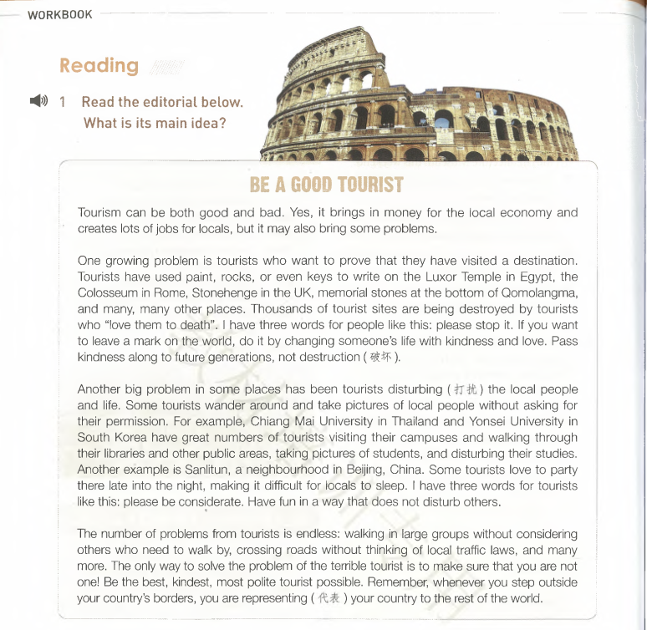
editorial
社评文
a news article in which the editor gives their opinion on an issue in the news
topic
Structure:
Main idea:
____________________________________________________________
2 problems
Tourism brings many problems and we should be a good tourist.
Is this problem parallel to （与…并列）the above two?
conclusion

Slide 5
Be a Good Tourist
topic
Tourism can be both good and bad. Yes, it brings in money for the local economy and creates jobs for locals, but it may also bring some problems.
good
bad
but
benefits
bring in money
create jobs
problems
Tell in one sentence:
Phenomenon: ____________________________________________
__________________________________________________________
Although tourism has many benefits, it also brings some problems.
Tip: Signal words like “however, but ”are always followed by important information.

Slide 6
Para2&3
Q: How does the editor develop the two paragraphs?
A. By making comparisons(对比）.
B. By giving examples.

Slide 7
1. What is happening to the tourist sites?
2. How are the tourist sites being destroyed?
3. Why do those tourists do that?
4. How to solve the problem?
Read and find out some examples
One growing problem is tourists who want to prove that they have visited a destination. Tourists have used paint, rocks, or even keys to write on the Luxor Temple in Egypt,the Colosseum in Rome, Stonehenge in the UK, memorial stones at the bottom of Qomolangma, and many, many other places. Thousands of tourist sites are being destroyed by tourists who “love them to death.”I have three words for people like this: please stop it. If you want to leave a mark on the world, do it by changing someone's life with kindness and love. Pass kindness along to future generations, not destruction.
problems | behaviors | solutions
destroy tourist sites
use paint, rocks, or even keys to leave ugly marks
?
be kind and love
to prove their presence
Tell in one sentence:
lack the sense of social morality(公德意识)
To prove their presence, some tourists are destroying the
Problem1: _______________________________________________
_________________________________________________________
tourist sites by using paint,rocks or even keys to leave some marks.

Slide 8
3. How to solve the problem?
Read and find out some examples
1. What do those tourists do?
2. What’s the problem?
Another big problem in some places has been tourists disturbing (打扰) the local people and life. Some tourists wander around and take pictures of local people without asking for their permission. For example, Chiang Mai University in Thailand and Yonsei University in South Korea have great numbers of tourists visiting their campuses and walking through their libraries and other public areas, taking pictures of students, and disturbing their studies. Another example is Sanlitun, a neighbourhood in Beijing, China. Some tourists love to party there late into the night, making it difficult for locals to sleep. I have three words for tourists like this: please be considerate. Have fun in a way that does not disturb others.
example
example
problems | behaviors | solutions
?
wander around
take pictures of…
party late into night
be considerate
disturb the locals
lack consideration
Tell in one sentence:
Problem2: _______________________________________________
_________________________________________________________
Some tourists wander around and take pictures without asking
permission and even party late into the night, which disturbs the locals.

Slide 9
1. What conclusion can we draw from this paragraph?
2. How to be a good tourist?
conclusion
The number of problems from tourists is endless: walking in large groups without considering others who need to walk by, crossing roads without thinking of local traffic laws, and many more. The only way to solve the problem of the terrible tourist is to make sure that you are not one!Be the best, kindest, most polite tourist possible. Remember, whenever you stop outside your country’s borders, you are representing(代表) your country to the rest of the world.
The number of problems from tourists is endless: walking in large groups without considering others who need to walk by, crossing roads without thinking of local traffic laws, and many more. The only way to solve the problem of the terrible tourist is to make sure that you are not one! Be the best, kindest, most polite tourist possible. Remember, whenever you stop outside your country’s borders, you are representing(代表) your country to the rest of the world.
The number of problems from tourists is endless: walking in large groups without considering others who need to walk by, crossing roads without thinking of local traffic laws, and many more. The only way to solve the problem of the terrible tourist is to make sure that you are not one! Be the best, kindest, most polite tourist possible. Remember, whenever you stop outside your country’s borders, you are representing(代表) your country to the rest of the world.
the terrible tourist
be a good tourist: be the best, kindest, most polite tourist
be responsible for your country
take action right now
join our efforts
Meanwhile，what should we do?
In a word, we should improve our a_____________.
wareness
Tip: Punctuation mark(标点符号)such as colon (冒号)“:”is always followed by some examples or explanations.

Slide 10
Thinking
Q: What’s the purpose for writing this editorial?
To call on readers to be good tourists.
With what we have learnt from the editorial, write a speech.

Slide 11
Writing
假定你是李华，你校将举行主题为“Be a good tourist”的英语演讲比赛。请你写一篇参赛演讲稿，内容包括：
1.做好游客的原因；
2.如何去做好游客。
注意：1.词数80左右
2.可适当增加细节，以使行文连贯。

Slide 12
Writing
假定你是李华，你校将举行主题为“Be a good tourist”的英语演讲比赛。请你写一篇参赛演讲稿，内容包括：
1.做好游客的原因； 2.如何去做好游客。
审题
structure
Introduction: Para1:
Main body: Para2:
Conclusion: Para3:
打招呼，自我介绍，说明演讲的主题。
演讲稿
题材：
时态：
人称：
主题：
一般现在时
陈述演讲内容
第一人称
致谢听众
做个好游客（be a good tourist）

Slide 13
Possible version
Respected teachers, my fellow students,
I feel honored to give you a speech, whose topic is“Be a good tourist”.
As we all know, tourism can bring many benefits, but it has also caused many problems. For example, to prove their presence, some tourists destroy the tourist sites by using paint and rocks to leave ugly marks. What’s worse, some tourists wander around randomly and even party late into the night, thus disturbing the locals greatly. Therefore, it’s high time that we should be the best, kindest, most polite tourists. Let's take action immediately and make a difference!
Thanks for listening！

Slide 14
Thanks!
Notes:
本PPT模板部分元素使用了幻灯片母版制作。如果需要修改，点击-视图-幻灯片母版-修改；完成后关闭编辑母版即可。

