Slide 1
感恩遇见，相互成就，本课件资料仅供您个人参考、教学使用，严禁自行在网络传播，违者依知识产权法追究法律责任。
更多教学资源请关注
公众号：溯恩高中英语
知识产权声明

Slide 2
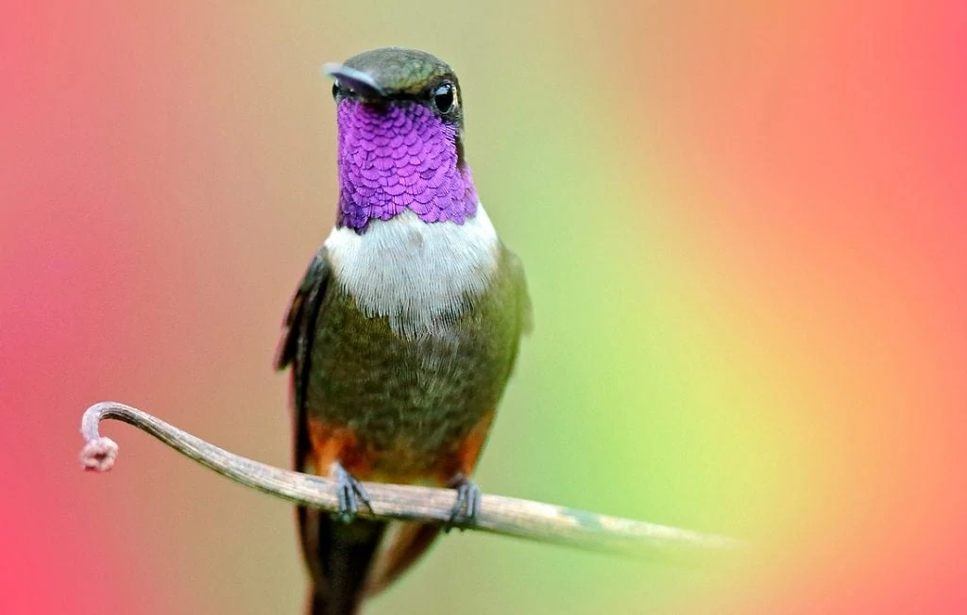
2023年1月浙江 首考读后续写

Slide 3
Labov’s overall structure of narrative
Evaluation
six elements of the narrative | meaning
abstract | What was this story about?
orientation | Who, when, where, what?
complicating action | Then, what happened?
evaluation | Character’s thoughts, feelings or views.
result or resolution | What finally happened?
coda | Memory, wish, theme…
Complicating action
Result or resolution
Orientation
Coda
abstract*

Slide 4
2023年1月浙江首考读后续写原文
Application of Labov’s overall structure of narrative
I was invited to a cookout on an old friend’s farm in western Washington. I parked my car outside the farm and walked past a milking house which had apparently not been used in many years. A noise at a window caught my attention, so I entered it. It was a hummingbird (蜂鸟), desperately trying to escape. She was covered in spider-webs (蛛网) and was barely able to move her wings. She ceased her struggle the instant I picked her up.
With the bird in my cupped hand, I looked around to see how she had gotten in. The broken window glass was the likely answer. I stuffed a piece of cloth into the hole and took her outside, closing the door securely behind me.
When I opened my hand, the bird did not fly away; she sat looking at me with her bright eyes. I removed the sticky spider-webs that covered her head and wings. Still, she made no attempt to fly. Perhaps she had been struggling against the window too long and was too tired? Or too thirsty?
As I carried her up the blackberry-lined path toward my car where I kept a water bottle, she began to move. I stopped, and she soon took wing but did not immediately fly away. Hovering (悬停), she approached within six inches of my face. For a very long moment, this tiny creature looked into my eyes, turning her head from side to side. Then she flew quickly out of sight.
During the cookout, I told my host the hummingbird incident. They promised to fix the window. As I was departing, my friends walked me to my cars. I was standing by the car when a hummingbird flew to the center of our group and began hovering. She turned from person to person until she came to me. She again looked directly into my eyes, then let out a squeaking call and was gone. For a moment, all were speechless. Then someone said, “She must have come to say good-bye.”
Para.1 A few weeks later, I went to the farm again.
Para.2 I was just about to leave when the hummingbird appeared.

Slide 5
Orientation: Who, when, where, what
I was invited to a cookout on an old friend’s farm in western Washington. I parked my car outside the farm and walked past a milking house which had apparently not been used in many years. A noise at a window caught my attention, so I entered it. It was a hummingbird (蜂鸟), desperately trying to escape. She was covered in spider-webs (蛛网) and was barely able to move her wings. She ceased her struggle the instant I picked her up.
I
was invited to a cookout
an old friend’s farm
a milking house
a hummingbird
She was covered in spider-
webs (蛛网) and was barely able to move her wings. She
ceased her struggle the instant I picked her up.
Notes:
Abstract orientation complicating action evaluation resolution coda

Slide 6
I was invited to a cookout on an old friend’s farm in western Washington. I parked my car outside the farm and walked past a milking house which had apparently not been used in many years. A noise at a window caught my attention, so I entered it. It was a hummingbird (蜂鸟), desperately trying to escape. She was covered in spider-webs (蛛网) and was barely able to move her wings. She ceased her struggle the instant I picked her up.
With the bird in my cupped hand, I looked around to see how she had gotten in. The broken window glass was the likely answer. I stuffed a piece of cloth into the hole and took her outside, closing the door securely behind me.
When I opened my hand, the bird did not fly away; she sat looking at me with her bright eyes. I removed the sticky spider-webs that covered her head and wings. Still, she made no attempt to fly. Perhaps she had been struggling against the window too long and was too tired? Or too thirsty?
As I carried her up the blackberry-lined path toward my car where I kept a water bottle, she began to move. I stopped, and she soon took wing but did not immediately fly away. Hovering (悬停), she approached within six inches of my face. For a very long moment, this tiny creature looked into my eyes, turning her head from side to side. Then she flew quickly out of sight.
During the cookout, I told my host the hummingbird incident. They promised to fix the window. As I was departing, my friends walked me to my cars. I was standing by the car when a hummingbird flew to the center of our group and began hovering. She turned from person to person until she came to me. She again looked directly into my eyes, then let out a squeaking call and was gone. For a moment, all were speechless. Then someone said, “She must have come to say good-bye.”
Para.1 A few weeks later, I went to the farm again.
Para.2 I was just about to leave when the hummingbird appeared.
1. Predict what would happen next?

Slide 7
Complicating Action & Evaluation
② With the bird in my cupped hand, I looked around to see how she had gotten in. ( )The broken window glass was the likely answer. ( ) I stuffed a piece of cloth into the hole and took her outside, closing the door securely behind me ( ).
cupped
looked around
Action
Evaluation
stuffed a piece of
cloth into the hole and took her outside, closing the door
securely behind me
Action
What kind of person was I according to my action?
I was a kind-hearted nature lover.

Slide 8
Complicating Action & Evaluation
③ When I opened my hand, the bird did not fly away; she sat looking at me with her bright eyes. ( ) I removed the sticky spider-webs that covered her head and wings. ( ) Still, she made no attempt to fly. ( ) Perhaps she had been struggling against the window too long and was too tired? Or too thirsty? ( )
Action
Action
Action
Evaluation
What kind of person was I according to my evaluation?
I was a considerate and empathetic person.

Slide 9
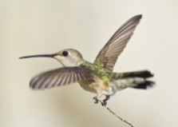
Complicating Action
④ As I carried her up the blackberry-lined path toward my car where I kept a water bottle, she began to move. I stopped, and she soon took wing but did not immediately fly away. Hovering (悬停), she approached within six inches of my face. For a very long moment, this tiny creature looked into my eyes, turning her head from side to side. Then she flew quickly out of sight.
Background Information About the Hummingbird
When it comes to having a good memory, elephants tend to top the tables, with goldfish always coming last. But what most people don’t realize is that hummingbirds also have stellar(优秀的) memories.
Now, the latest research suggests the tiny birds may have what might be called an episodic memory(情景记忆) – a trait previously thought unique to humans.
Episodic memory is a type of memory for specific events and experiences. So, as well as your overall recall of what happened, episodic memory also involves remembering where and when. This means you remember events in their original context.
took wing
did not immediately
fly away.
Hovering
approached within six
inches of my face.
looked into my eyes, turning her head from side to
side.
flew quickly out of sight.
Highlight the vivid actions of the hummingbird.
What’s the meaning of these actions?
To show that the hummingbird was grateful to me so that she tried to bear in mind my features.

Slide 10
I was invited to a cookout on an old friend’s farm in western Washington. I parked my car outside the farm and walked past a milking house which had apparently not been used in many years. A noise at a window caught my attention, so I entered it. It was a hummingbird (蜂鸟), desperately trying to escape. She was covered in spider-webs (蛛网) and was barely able to move her wings. She ceased her struggle the instant I picked her up.
With the bird in my cupped hand, I looked around to see how she had gotten in. The broken window glass was the likely answer. I stuffed a piece of cloth into the hole and took her outside, closing the door securely behind me.
When I opened my hand, the bird did not fly away; she sat looking at me with her bright eyes. I removed the sticky spider-webs that covered her head and wings. Still, she made no attempt to fly. Perhaps she had been struggling against the window too long and was too tired? Or too thirsty?
As I carried her up the blackberry-lined path toward my car where I kept a water bottle, she began to move. I stopped, and she soon took wing but did not immediately fly away. Hovering (悬停), she approached within six inches of my face. For a very long moment, this tiny creature looked into my eyes, turning her head from side to side. Then she flew quickly out of sight.
During the cookout, I told my host the hummingbird incident. They promised to fix the window. As I was departing, my friends walked me to my cars. I was standing by the car when a hummingbird flew to the center of our group and began hovering. She turned from person to person until she came to me. She again looked directly into my eyes, then let out a squeaking call and was gone. For a moment, all were speechless. Then someone said, “She must have come to say good-bye.”
Para.1 A few weeks later, I went to the farm again.
Para.2 I was just about to leave when the hummingbird appeared.
1. Predict what would happen next?
2. Why did the author write this article?

Slide 11
Complicating Action
MOVE
LOOK
CALL
Highlight the vivid actions of the hummingbird.
⑤ During the cookout, I told my host the hummingbird incident. They promised to fix the window. As I was departing, my friends walked me to my cars. I was standing by the car when a hummingbird flew to the center of our group and began hovering. She turned from person to person until she came to me. She again looked directly into my eyes, then let out a squeaking call and was gone. For a moment, all were speechless. Then someone said, “She must have come to say good-bye.”
flew to the center of our
group and began hovering.
turned from person to
person until she came to me.
again looked directly into
my eyes,
then let out a squeaking call

Slide 12
I was invited to a cookout on an old friend’s farm in western Washington. I parked my car outside the farm and walked past a milking house which had apparently not been used in many years. A noise at a window caught my attention, so I entered it. It was a hummingbird (蜂鸟), desperately trying to escape. She was covered in spider-webs (蛛网) and was barely able to move her wings. She ceased her struggle the instant I picked her up.
With the bird in my cupped hand, I looked around to see how she had gotten in. The broken window glass was the likely answer. I stuffed a piece of cloth into the hole and took her outside, closing the door securely behind me.
When I opened my hand, the bird did not fly away; she sat looking at me with her bright eyes. I removed the sticky spider-webs that covered her head and wings. Still, she made no attempt to fly. Perhaps she had been struggling against the window too long and was too tired? Or too thirsty?
As I carried her up the blackberry-lined path toward my car where I kept a water bottle, she began to move. I stopped, and she soon took wing but did not immediately fly away. Hovering (悬停), she approached within six inches of my face. For a very long moment, this tiny creature looked into my eyes, turning her head from side to side. Then she flew quickly out of sight.
During the cookout, I told my host the hummingbird incident. They promised to fix the window. As I was departing, my friends walked me to my cars. I was standing by the car when a hummingbird flew to the center of our group and began hovering. She turned from person to person until she came to me. She again looked directly into my eyes, then let out a squeaking call and was gone. For a moment, all were speechless. Then someone said, “She must have come to say good-bye.”
Para.1 A few weeks later, I went to the farm again.
Para.2 I was just about to leave when the hummingbird appeared.
1. Predict what would happen next?
2. Why did the author write this article?
3.
How will you describe the hummingbird?
MOVE+LOOK+CALL
How to mention the hummingbird before it appeared?
Evaluation: my thoughts, feelings or views of the hummingbird.

Slide 13
Para.1 A few weeks later, I went to the farm again.
Para.2 I was just about to leave when the hummingbird appeared.
① Why did I go to the farm?
② What did I think of then?
③ I expected to meet the hummingbird but she was no where to be found, so I departed.
① What did the hummingbird do?
② How did I feel?
③ What did I do?
④ What did I realize?

Slide 14
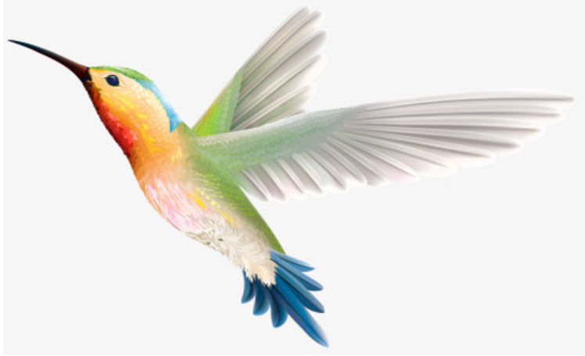
A few weeks later, I went to the farm again. When I happened to pass the milking house, I decided to check out the window there. To my relief, the broken window had already been fixed. Yet, the sight of the scene immediately reminded me of the hummingbird. Where was the hummingbird? Was she in good shape? Hoping she wouldn’t get herself into another sticky situation anymore! Thoughts like these just kept flooding in on me. To be honest, I was so eager to meet her again, even though I knew it was like a mission impossible to find such a tiny hummingbird in such a big world. With a mixture of relief and disillusionment, I paced my way towards my car for departure.
Notes:
Enjoy their presence I saw the first Hummingbird of spring on the 27th and was thrilled.
It is nice to have the little hummers.

Slide 15
I was just about to leave when the hummingbird appeared. She swooped down to my eye level, hovering real close to me, gazing at me with her sparkling eyes. Then she emitted a squeaky sound as if she had realized that it was I who had rescued her from the sticky spider-webs. “Hey! Little hummer, it’s you!” So exhilarated was I that I couldn’t help exclaiming. Watching her flapping wings rapidly and making the humming sound, I couldn’t help but reach out my hand, unexpectedly, this time, she stopped hovering but perched on my cupped hand, with no caution at all. My heart lurched, then a surge of warm current flooded into my heart. For the first time in my life, I started to believe there really existed a spiritual bond between we human beings and other animals in the world.

Slide 16
(相似续写1)
In 2000, when I was around seven years old, all my family were coming back from a T-ball game, which was our usual weekend adventure, but unlike every other weekend, a surprise was waiting for us in our driveway—two adult geese and a small goose. Obviously startled by our return, the adults flew away in panic, with their baby, too young to fly, left in place, tiny and delicate.
Hours passed one after another, and night eventually fell. However, with it also came a deep chill and a fear of watchful animals. It was apparent that the gosling needed protection, warmth, and food to make it to the morning, so we had to help it, and we brought him onto our back yard.

Slide 17
We all pretty much slept with one eye open till morning came. And then another morning. And still another. Each morning, we would try to drive the goose away to his parents, who kept coming back to our yard. He wouldn’t go to them, though, and neither would they come close enough to claim him. We kept this up for five days, but no luck. Realizing the young goose had clearly decided we were his family by then, we had to give him a name, calling the little guy Peeper, because he would often follow us around the yard making a peeping(唧唧叫) noise, nonstop. Besides, we decided that Peeper was a boy. I don’t know why; it just felt right.

Slide 18
A year passed and we settled into a routine. Peeper slept on our back yard each night and, in typical goose fashion, used it as a latrine(公共厕所). My dad would spray off all the goose droppings daily. Part of this ceremony included Dad throwing Peeper up into the air so he could flap its wings and flew a loop(圈) around the house, and then came back again once the porch was clean.
Days turned into weeks, and weeks turned into months.

Slide 19
Before we knew it, the little thing had grown into a big bird with two powerful wings. __________________________________________________________
__________________________________________________________
__________________________________________________________
__________________________________________________________
__________________________________________________________
It came as a total surprise to me when, in 2019, an adult goose made his way back to my family home.
__________________________________________________________
__________________________________________________________
__________________________________________________________
__________________________________________________________
__________________________________________________________

Slide 20
细节描写
“It must be YOU!” So thrilled was I that I couldn’t help exclaiming.
“肯定是你！”我是如此激动，情不自禁地大喊。[激动情绪/倒装句]
2. Never in my wildest dream did I imagine the adorable creature could come back 20 years later.
我做梦都不敢想这只可爱的生物20年后会再回来。 [倒装句]
3. I watched her flying gracefully high in the sky and smiled with relief.
我看着她优雅地在空中飞翔，欣慰地笑了笑.
4. live in harmony with.
和……和谐共处[结尾感悟]
5. It was a truly heart-warming moment and one that would never vanish .
这是一个真正温暖且永恒的时刻。 [结尾感叹]
6. The days with him is a unique gift that needs to be appreciated and treasured.
跟他在一起的日子是一份独特的礼物，需要欣赏和珍惜。[结尾感叹]
7. At that moment, merriness and touch mingled, welling up into my heart, tears rolling down my cheeks.
在那个时候，愉快和感动交织，涌入我的内心，我的眼泪从我脸颊滑落。[结尾/情绪渲染/画面定格]

Slide 21
Before we knew it, the little thing had grown into a big bird with two powerful wings. One day, when Dad threw Peeper into the air, he just flew away and didn’t come back. With night falling, all of us became increasingly nervous. We searched everywhere for him, called his name and even peeped like him, anxiously expecting his return. But the special buddy never appeared again. Suddenly losing the special companion, everyone felt like drifting in the ocean of sadness. It took quite a long time before we accepted the fact that he was thoroughly missing. Meanwhile, we could only pray he found his parents and went off on his natural way. Twenty years passed, and Peeper turned into a fond memory for my family.

Slide 22
It came as a total surprise to me when, in 2019, an adult goose made his way back to my family home. He did all of the same things Peeper used to do in Peeper’s old ways, and much to my astonishment, he even responded to the name Peeper. “It must be YOU!” So thrilled was I that I couldn’t help exclaiming. Never in my wildest dream did I imagine the adorable creature could come back 20 years later. This experience has been much more meaningful to me than numerous things in my life. Beyond our reach high in the sky, birds also have feelings like our human beings, so do many other living things. We human beings should learn to get along well with them. We need each other’s care and protection.

Slide 23
(相似续写2)
In late December, the cow path near our house in Tennessee was still covered with leaves, but I knew snow would be falling soon enough. My younger brother, Buddy Earl, and I were on an important mission: Go to Uncle Tommie’s place and get a goose(鹅). The hiking over Little Mountain and getting there would be worth it. Uncle Tommie raised the best geese around, and he’d offered to give us one for Christmas dinner.

Slide 24
Uncle Tommie met us at the door. “I’m not rushing you boys,” he said, “but as light snow started, you’d better get the goose and head home.” It didn’t take me long to pick up a goose from his yard. Buddy and I said a quick thank you and goodbye. The snow came down harder, wind blowing every way.
“I’m as cold as ice. How about you?” asked Buddy.
I tapped the goose’s head. “I wish we had feathers to keep us warm like you,” I said. “Or heavier coats.”

Slide 25
“Doug, I’m freezing,” Buddy said. I could hardly hear him over the wind and my own chattering teeth. “I think we should go back.” The idea was attractive, but we were closer to home than to Uncle Tommie’s house. We had to push on.
I held the goose closer to my chest. The bird was the only warm thing about me. I stepped in front of my brother. “Buddy, open your coat!” “Are you crazy?” He asked. “I’ll lose the little warmth I have.” When he saw I was serious, he slowly unzipped (拉开……的拉链) his coat and opened it. I placed the warm goose inside his coat and zipped it back up. “Make sure you keep the goose’s head out so it can breathe.” Buddy sighed happily. My plan was working.

Slide 26
“Doug, it is time for you to open your coat. ”
__________________________________________________________
__________________________________________________________
__________________________________________________________
__________________________________________________________
__________________________________________________________
Hearing our surviving experience, my parents hesitated about what to do with the goose.
__________________________________________________________
__________________________________________________________
__________________________________________________________
__________________________________________________________
__________________________________________________________

Slide 27
细节描写
Buddy’s words floated into my ears.
Buddy的话飘进我的耳朵。[无灵；听觉]
2. A warm current of energy permeated my heart.
一股暖流洋溢心房。[无灵；身体内部]
3. Fierce wind was blowing.
猛烈的风吹着。[环境]
4. gently stroke(d) its fine white feathers
轻轻地抚摸它上好的白色羽毛 [动作；动物]
5. The goose, as if knowing what had happened, lifted its head proudly, letting out a long, loud and emotional cackle.
这只鹅好像知道发生了什么一般，骄傲地抬起头，发出一长串响亮而情绪激动的咯咯叫。[比喻；动物动作]
6. The goose narrowly escaped being delicious food on the table.
这只鹅侥幸逃过一劫，没有变成餐桌美食。[What a narrow escape! 好险啊！]
7. Laughter and chat were echoing in our home while snowflakes was dancing out of the window.
欢笑和闲聊在家里回荡而雪花在窗外飞舞。[环境；画面定格]

Slide 28
“Doug, it is time for you to open your coat. ” Buddy handed the goose to me. Its feathered body was as warm as angel feathers inside my coat. Putting my freezing hands on its body, I felt a rush of warmth sweeping over me. We passed the goose back and forth between us all the way home, battling biting cold. After what seemed like ages, we got home. Upon arrival, we couldn’t wait to explain to our parents how the goose had kept us from freezing.
Hearing our surviving experience, my parents hesitated about what to do with the goose. “What should we have for Christmas dinner?” They looked at us with a concerned look. “Anything but the goose. He has saved our lives.” Buddy and I exclaimed. Shifting gazes between us and the goose which was honking as if he were pleading too. “Fine. Then we’ll do without it,” my parents announced. “Hooray!” we sprang to our feet. That Christmas, we didn’t have a grand feast, but came upon a hero in our life.

Slide 29
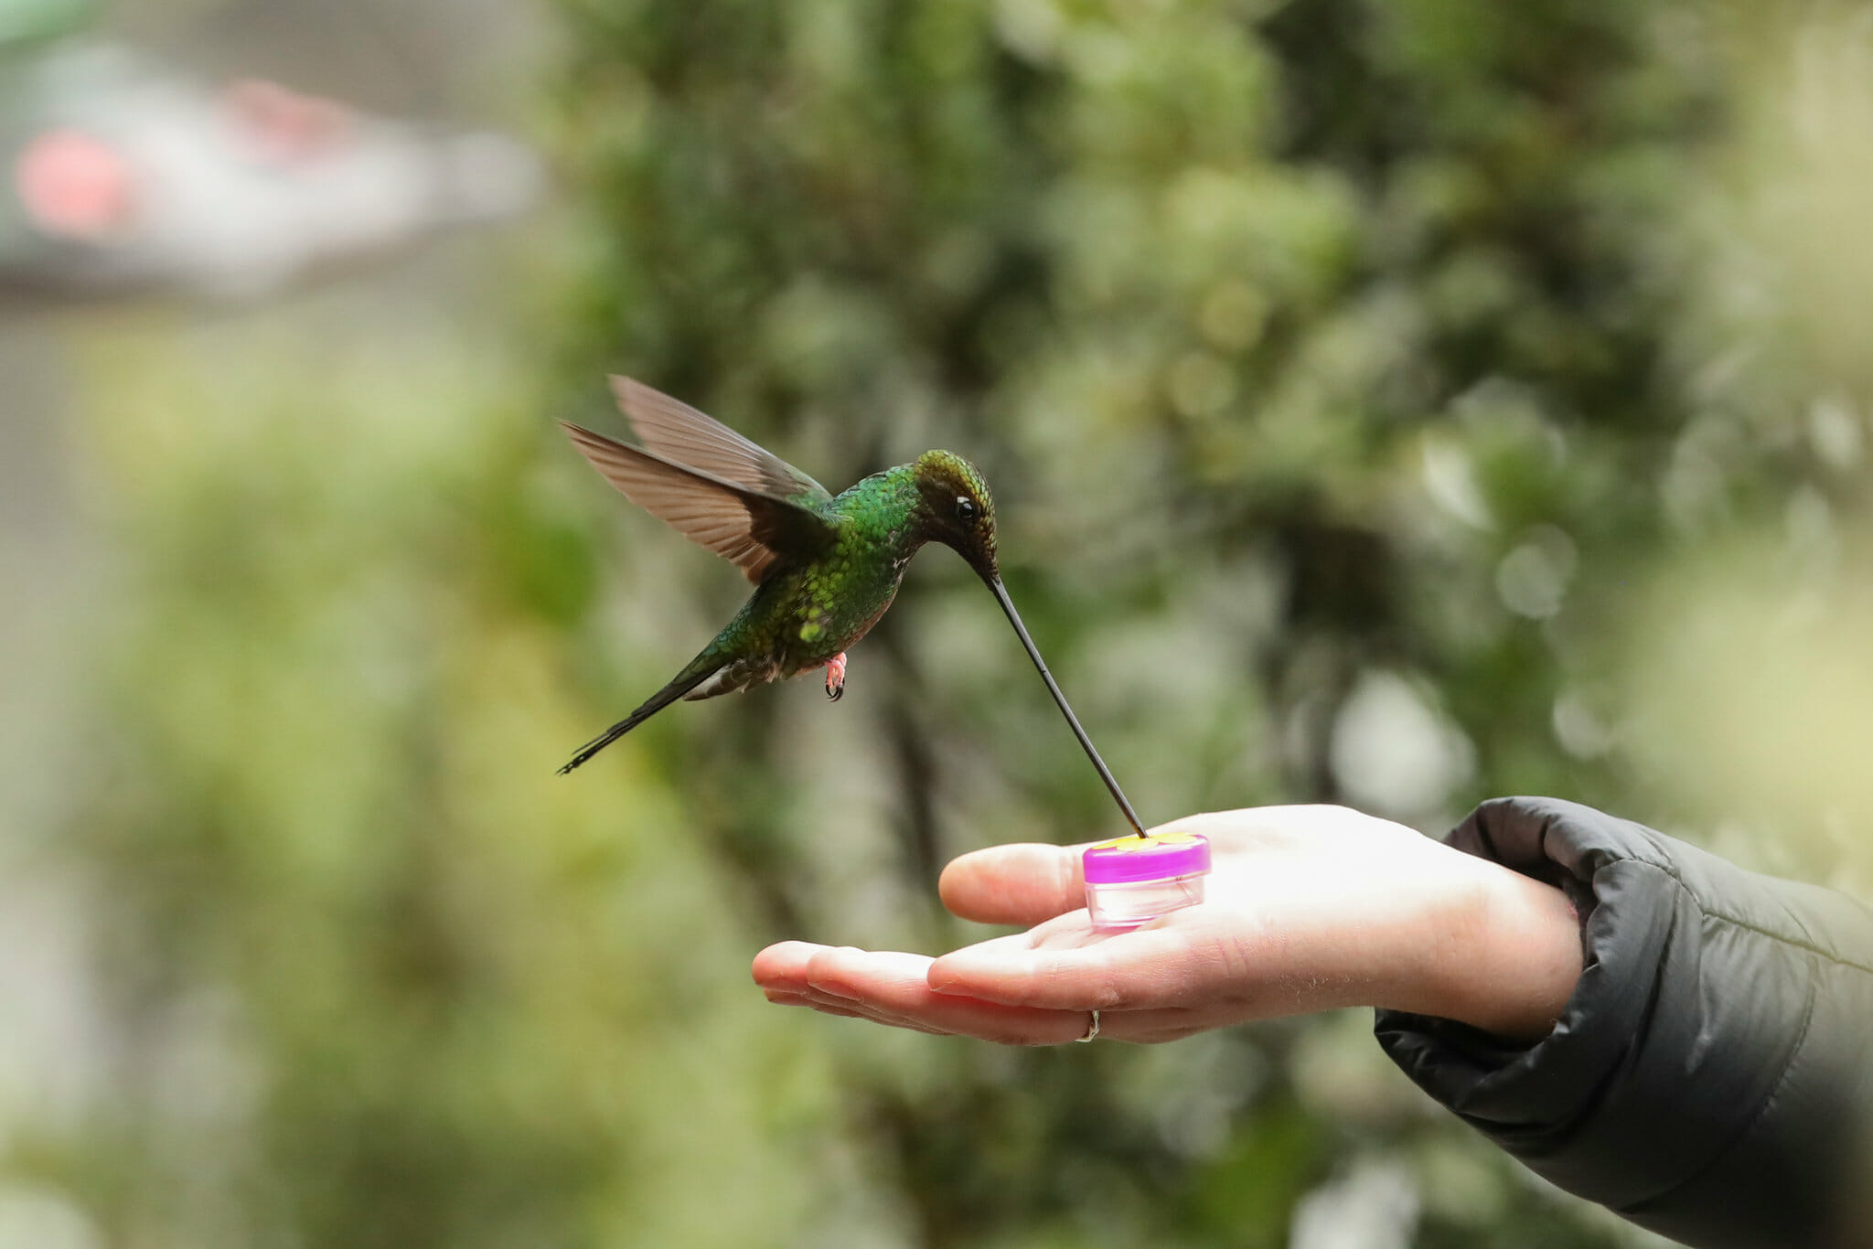
Thanks!

