Slide 1
感恩遇见，相互成就，本课件资料仅供您个人参考、教学使用，严禁自行在网络传播，违者依知识产权法追究法律责任。
更多教学资源请关注
公众号：溯恩高中英语
知识产权声明

Slide 2
Reading and Thinking
Unit 3 Environmental Protection
CLIMATE CHANGE REQUIRES THE WORLD’S ATTENTION
人教版 选择性必修三

Slide 3
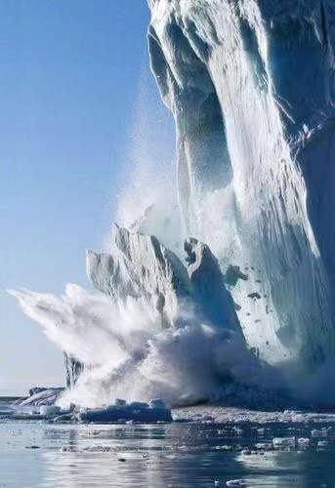
Lead-in
What can you see in the picture?
What will happen if glaciers are melting faster than before?

Slide 4
Vast quantities of water are locked up as ice in Greenland’s giant sheets, yet these sheets are melting at increasing rates. In the past decade 3.5 trillion tons of ice has melted on the island. That’s enough melted ice to cover the entire United Kingdom in 15 metres of water.
Greenland’s melting glaciers

Slide 5
What other consequences may global warming bring about?
wildfires
natural disasters
the rise of the sea level
Global Warming
extreme weather
insect outbreaks
economic losses
threaten ecosystems
coastal cities submerged

Slide 6
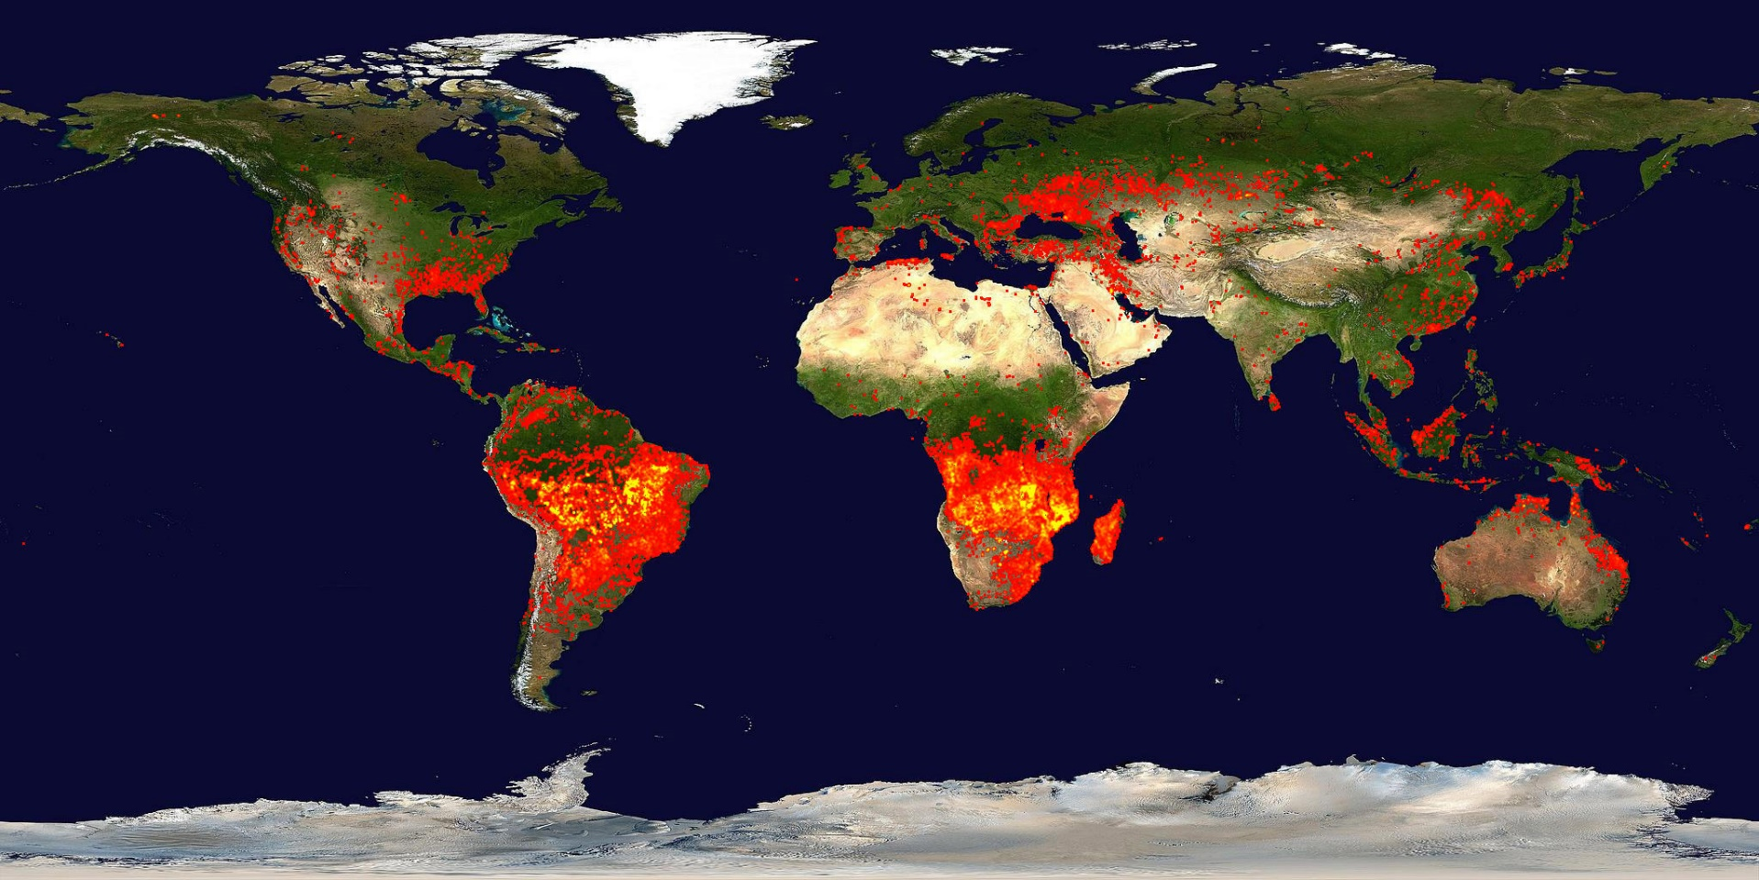
Wildfires
NASA's Terra satellite shows fires around the world

Slide 7
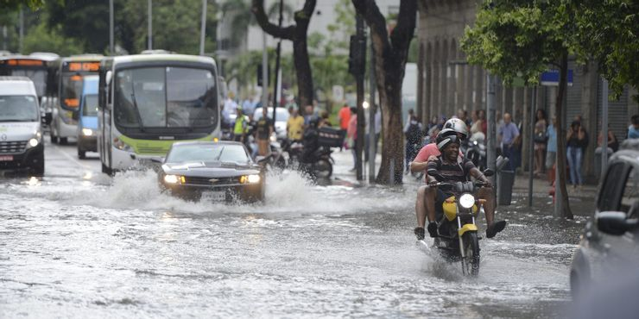
Coastal cities submerged
Brazil's capital city of Rio De Janeiro is one of the cities in real danger of getting swallowed up by the rising waters, and the population of 1.8 million knows it. Research says that just an increase of 3 degrees Celsius could flood and envelop the Copacabana Beach, even the Barra de Tijuca town nearby and the place's airport.

Slide 8
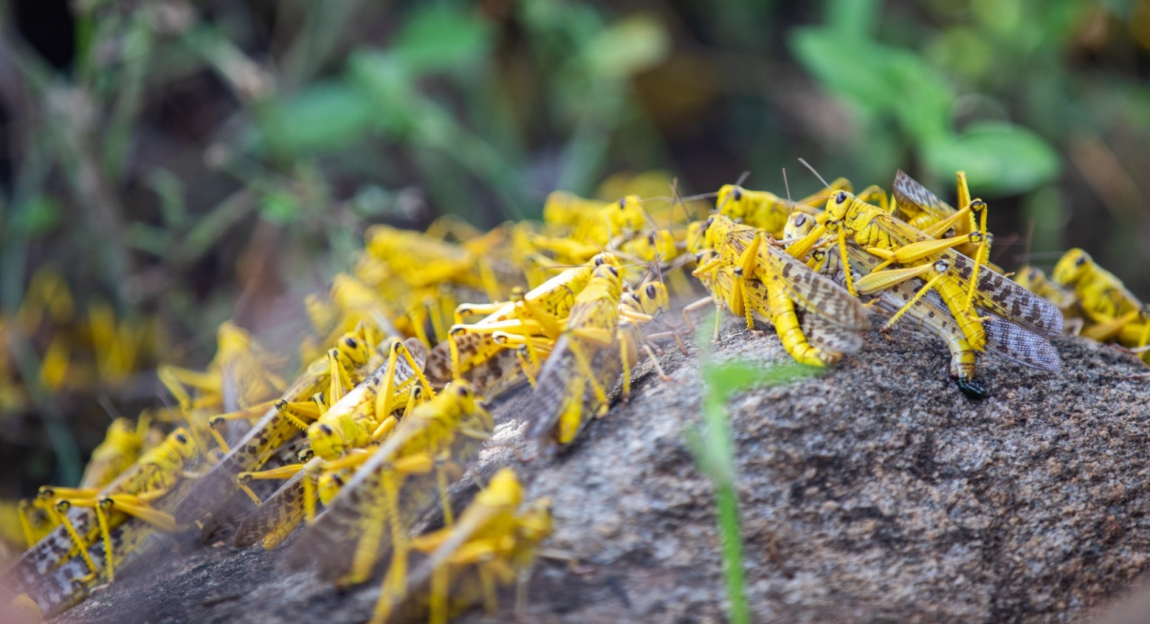
Insect outbreaks
Insects spread because of increased rainfall and elevated temperatures – perfect conditions for them to breed and grow quickly.

Slide 9
CLIMATE CHANGE REQUIRES THE WORLD’S ATTENTION
What is the writing style?
A. Exposition
B. Narration
C. Argumentation
D. A news report
Exposition: a full explanation of a theory, plan, etc.

Slide 10
Read for the main ideas
problem/ phenomenon/ present situation
Para.1 The ________:
The earth is getting ____________________.
Climate change requires the world’s attention
Part 1. The problem
warmer and warmer
Para.2 A(n) _____________:
A polar bear starved to _______ because of hunting no seals.
case/ example
death
Para.3 The _______:
The “_____________________”.
reasons/ causes
Part 2. The causes
greenhouse effect
consequences/ danger/ impacts
Para.4 The _________:
More extreme weather and natural _______ worldwide.
Part 3. The consequences
disasters
solutions/ measures
Para.5 The ________:
The global climate change requires the _________ of people all over the world.
Part 4. The solutions
attention

Slide 11
Read for details
Part 1 (Para.1-2) The problem
What evidence of climate change can you find in the first paragraph?
◆a warming ocean and atmosphere
◆melting ice
◆rising sea levels

Slide 12
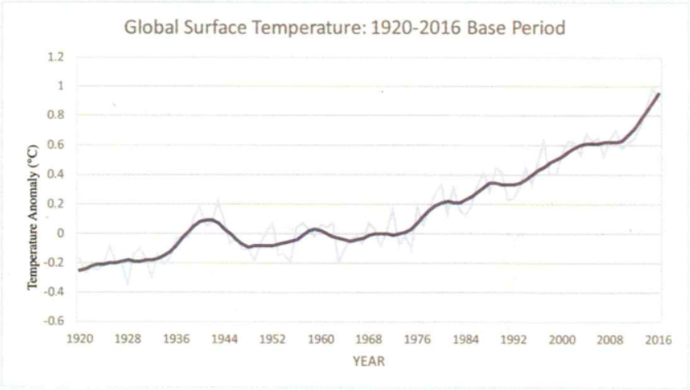
anomaly n. /əˈnɒməli/ a thing, situation, etc. that is different from what is normal or expected
What is the graph about? What information can you get from it?
increase sharply
increase gradually/ steadily
The graph shows the changes of global surface temperature over the period from 1920 to 2016.

Slide 13
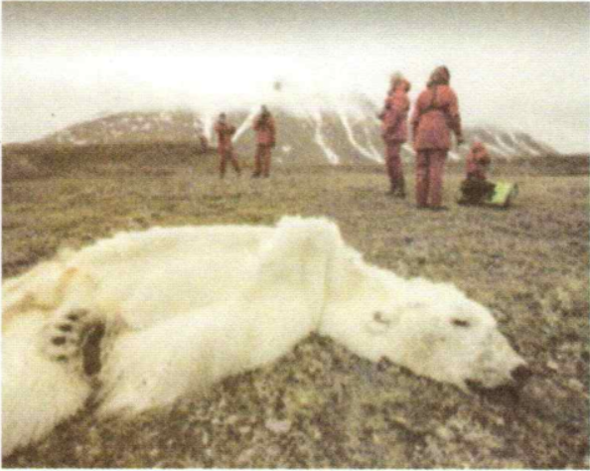
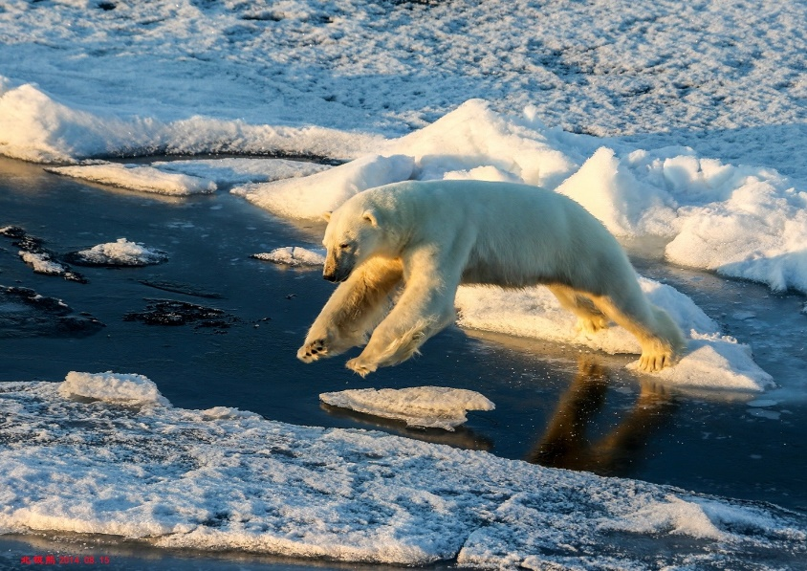
What happened to the polar bear in the photo?
The polar bear died of starvation.
Why did the writer write about it?
The writer wrote about it because it showed one of the effects of rising temperature due to climate change.
Can you use your own words to describe how climate change has influenced the polar bear’s life?

Slide 14
Put them in order.
Cause and effect
climate change
its dead body found
bears couldn't hunt
had to travel greater distances to find food
low sea-ice levels
starved to death

Slide 15
Part 2 (Para.3) The causes
natural greenhouse effect
important
keep Earth’s climate warm and habitable, sustain life
Greenhouse effect
man-made greenhouse effect
causing earth’s surface temperature to rise quickly if too much heat energy is trapped
A big problem

Slide 16
The greenhouse effect

Slide 17
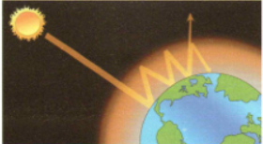
Draw a diagram describing how the greenhouse effect works.
Heat released back into space
Heat reflected back to Earth’s surface
Sunlight
Reflected sunlight
Atmosphere
Earth
What are the benefits of using diagrams?
Visualise the problem more clearly.
Demonstrate your creative thinking and problem-solving.

Slide 18
Part 3 (Para.4) The consequences
What are the consequences of the global temperature rise?
extreme rainstorms , heatwaves
examples
extreme weather/ natural disasters
The rise in temperature
led to
results
serious damage,
costing human lives, deaths and economic losses

Slide 19
Why did the author mention the climate scientists’ warning?
Because global warming needs everyone’s attention and it is essential that we take appropriate actions.

Slide 20
Part 4 (Para. 5) The solutions
Governments
Individuals
◆Make policies
◆Reduce our carbon footprint by restricting the amount of carbon dioxide our lifestyles produce
◆Take appropriate actions and measures
◆Educate everyone about global warming, along with its causes and impacts
What is a question left at the end?

Slide 21
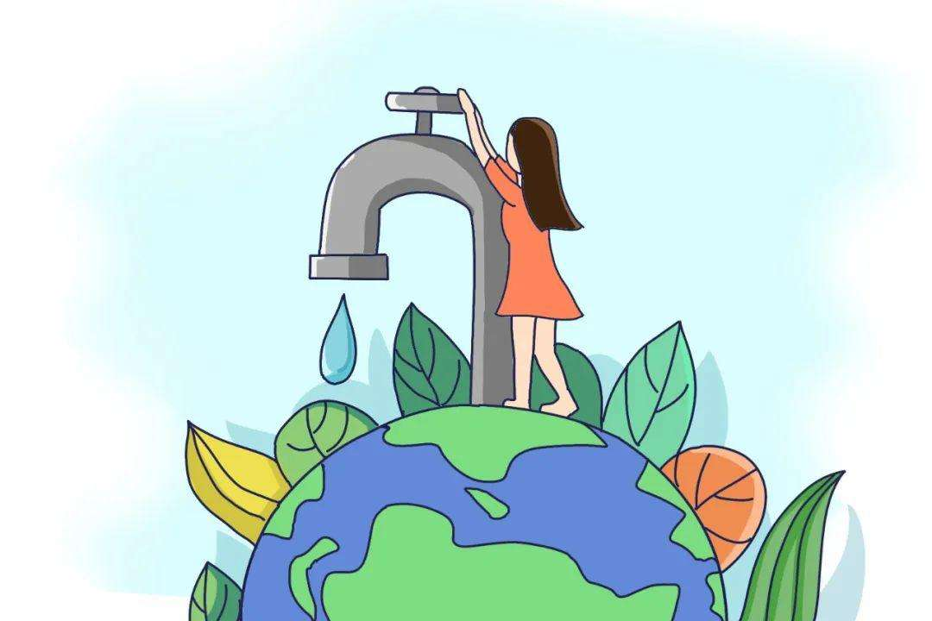
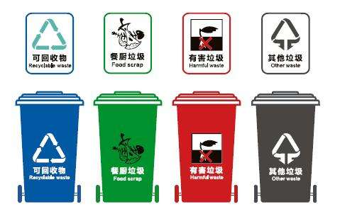
Discussion
What will you do to help?
◆ Reduce, reuse and recycle
◆ Sort the garbage
◆ Plant more trees
◆ Take public transport …

Slide 22
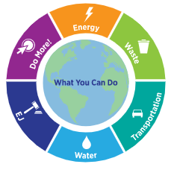
Choose energy-efficient products.
Reduce your food waste.
Share your knowledge!
Buy products made with recycled content.
Plant more trees wherever you can.
Continue to use greener transportation.
We all contribute to climate change and can make a difference by changing our own behaviors.
Get involved.
Use water efficiently.
Take shorter showers.

Slide 23
Read for language features
What writing techniques does the author use in the passage?

Slide 24
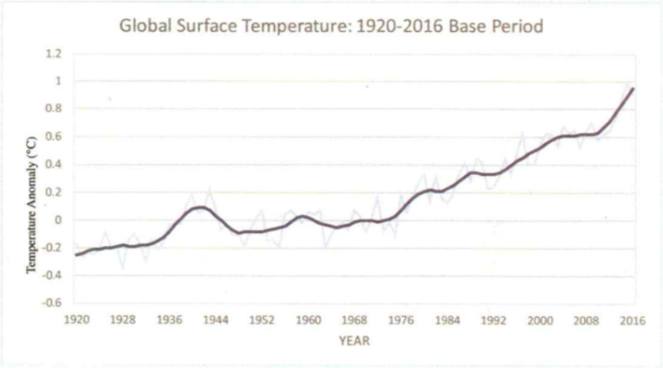
The “natural greenhouse effect” refers to … Without this process, earth could not sustain life. However, the “man-made greenhouse effect” has now become a big problem…
explanation, comparison
a graph
According to the scientists who found …
An expert who has studied polar bears …said that…
Experts claim that…
Climate scientists have warned that if we…
a photo
scientists’ and experts’ quotes

Slide 25
Governments need to consider making policies and taking appropriate actions and measures … We as individuals can also reduce our “carbon footprint” by ….
Writing purposes: To inform readers of global warming, convince and inspire them to do whatever they can do to deal with this problem.
examples
So what will you do to help?
raise a question at the end of the article for readers to think about

Slide 26
Global Warming

Slide 27
Critical thinking
Earth provides enough to satisfy every man’s needs, but not every man’s greed.
— Mohandas K. Gandhi
What is the difference between “needs” and “greed”? How do you understand the quote?
To satisfy their greed, some people overexploit natural resources, hunt varieties of animals, occupy more land to build factories and extend cities unlimitedly, resulting in environmental destruction, ecological unbalance and resource exhaustion. Ultimately, we human beings will pay a terrible price.
Nature has evolved to provide enough to satisfy the basic needs of all living things. However, nature cannot provide enough to satisfy everyone’s greed, because greed is a desire that can never be satisfied.

Slide 28
An interview
A journalist from England is visiting Li Hua’s community. He/She is now interviewing Li Hua, a senior high school student. They are talking about the environmental problems in the community.
The journalist : I am …from England. May I ask you some questions about the state of the environment in your community?
Li Hua: Of course…
The journalist : What environmental problems does your community have?
Li Hua: …
The journalist : What have residents done to solve the problem?
Li Hua: …
The journalist : Who do you think should take responsibility for dealing with the problem? What can you do to protect the environment?
Li Hua: …
The journalist : Do you think climate change is the result of human activities? Give your reasons.
…

Slide 29
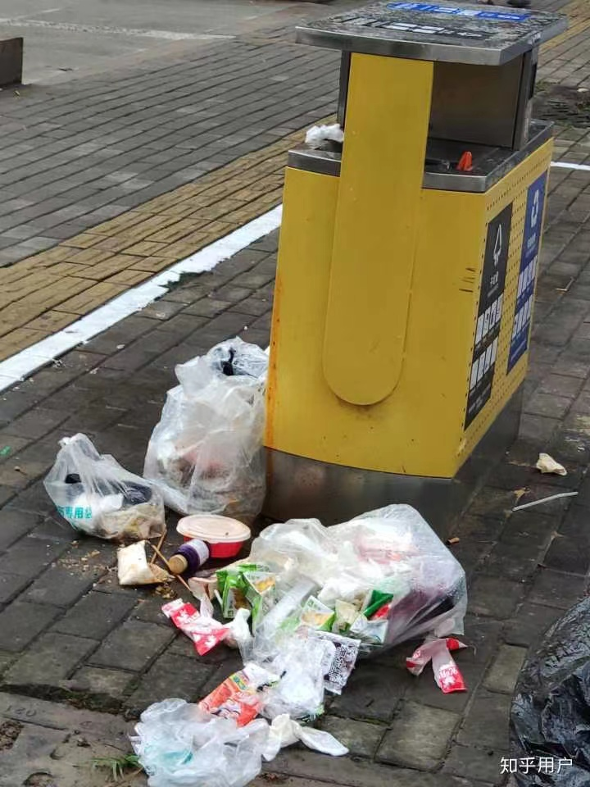
Situation 1 (with example answers):
The journalist : I am …from England. May I ask you some questions about the state of the environment in your community?
Li Hua: Of course…
The journalist : What environmental problems does your community have?
Li Hua:
一些居民经常随地扔垃圾。这种情况是如此的可怕，以至于很多人都无法忍受。
Some residents frequently drop garbage everywhere. The situation is so terrible that dozens of people can't tolerate it.
The journalist : What have residents done to solve the problem?
Li Hua:
一些居民强烈建议安装高清摄像头。 那些乱扔垃圾的人应该被罚款。有必要采取严格的措施和执行一些规定。
Some residents strongly recommend that high definition camera should be installed. Those caught throwing garbage about should be fined. It's necessary to take strict measures and carry out some regulations.

Slide 30
The journalist : Who do you think should take responsibility for dealing with the problem? What can you do to protect the environment?
Li Hua:
The journalist : Do you think climate change is the result of human activities? Give your reasons.
Li Hua:
The journalist: Thank you so much.
每个人都应该对自己的行为负责。就我个人而言，我更喜欢购买可回收的产品。
Every person should be responsible for their own behaviour. Personally, I prefer to buy the recycled products.
I do think that climate change is the result of human activities because the majority of scientists also think so, and also because global temperatures have followed the rise in global emissions and population.
我确实认为气候变化是人类活动的结果，因为大多数科学家也这么认为，而且全球气温随着全球排放和人口的增加而上升。

Slide 31
Thank you!

