Slide 1
感恩遇见，相互成就，本课件资料仅供您个人参考、教学使用，严禁自行在网络传播，违者依知识产权法追究法律责任。
更多教学资源请关注
公众号：溯恩高中英语
知识产权声明

Slide 2
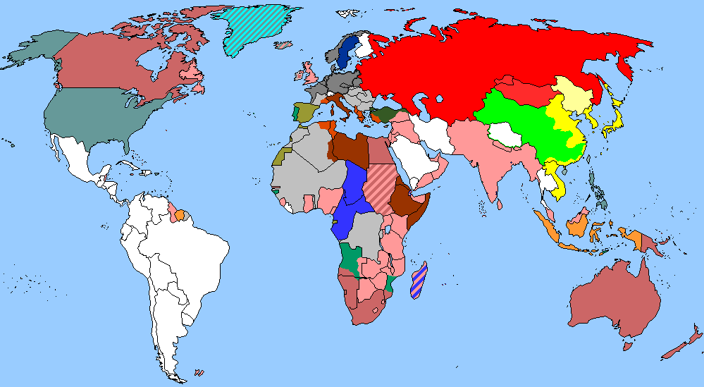
The World
January 1st-15th, 2024

Slide 3
1. UK cancer rates among worst of wealthy countries
英国癌症发病率在富裕国家中情况堪忧

Slide 4
Text Completion
The Times (4th January 2024 P4 )
comparably
Survival rates in the UK for several common cancers are among the worst in ___________ (comparabe) wealthy countries.
Researchers analysed six types of cancer with ___ average five-year survival rate in Britain of just 16 per cent —lung, liver, brain, oesophageal, pancreatic and stomach. More than 90,000 people ________________ (diagnose) with these conditions in the UK each year, and they account for more than 67,000 deaths annually — about 40 per cent of UK cancer rates among worst of wealthy countries all cancer deaths. ___ 33 countries with roughly comparable wealth and income levels, the UK _____ (rank) as low as 28th for five-year survival for both stomach and lung cancer, according to the Less Survivable Cancers Taskforce.
The countries with the highest five-year survival rates for the six cancers included South Korea, Belgium, the US and Australia. The report found that ___ survival rates in the UK equalled ______ of these countries, more than 8,000 lives would be saved annually.
The poor performance is likely ________ (reflect) delayed diagnoses and slow access to treatment, the task force said.
Many patients with a _____________ (survivable) cancer will be diagnosed only after an emergency admission to hospital or an urgent GP referral after ___________ (symptom) have become severe. For instance, seven out of ten patients in the UK receive no treatment at all for pancreatic cancer and of the 10,000 people diagnosed annually, just 10 per cent receive surgery, the only potential cure.
an
will be diagnosed
Of
ranks
if
those
to reflect
less survivable
symptoms

Slide 5
Vocabulary
1. admission: the act of accepting sb into an institution, organization, etc.; the right to enter a place or to join an institution or organization 准许加入，加入权，进入权
Hospital admissions for asthma attacks have doubled. 哮喘发作入院人次已成倍增加。
2. referral: the act of sending sb who needs professional help to a person or place that can provide it 送交，转送（到能提供专门帮助的人或地方那里）
Legal Aid can often provide referral to other types of agencies. 法律援助机构能经常提供向其他类型机构的移交。
Translation
她未获自己选择的大学录取。
She failed to gain admission to the university of her choice.
Translation
12月23日，他们被送往一所转诊医疗。
On 23 December they were moved to a referral hospital.

Slide 6
Translation
More than 90,000 people will be diagnosed with these conditions in the UK each year, and they account for more than 67,000 deaths annually — about 40 per cent of UK cancer rates among worst of wealthy countries all cancer deaths.
在英国，每年将有超过9万人被诊断出患有这些疾病，每年有超过6.7万人死于这些疾病——约占英国癌症发病率的40%，是所有癌症死亡率最高的富裕国家之一。
For instance, seven out of ten patients in the UK receive no treatment at all for pancreatic cancer and of the 10,000 people diagnosed annually, just 10 per cent receive surgery, the only potential cure.
例如，在英国，十分之七的胰腺癌患者根本没有接受任何治疗，每年确诊的1万名患者中，只有10%接受了唯一可能治愈的手术。

Slide 7
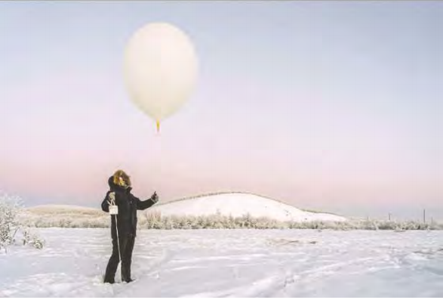
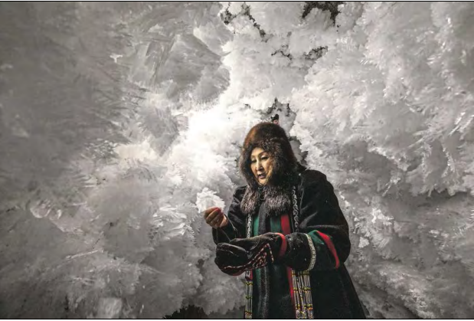
2. Siberia’s ice is melting, revealing its past and endangering its future
融化的西伯利亚，暴露了它的过去，也危及了它的未来

Slide 8
Text Completion
The Wall Street Journal (4th January 2024 A8 )
sticky
Nikita Zimov walked through the _______ (stick) brown muck of Siberia, just above the Arctic Circle. Zimov is tracking the effects of the melting and working on a plan to ___________ （potential）mitigate it.
As permafrost ______ (melt), microbes feed on the carbon trapped in the ice, ___________ (release) carbon dioxide and methane, a more potent greenhouse gas, into the atmosphere. The gas is apparent even in small streams. When Zimov pierced the ground with ____ long fishing rod, bubbles of gas floated to the surface.
The employees at the park monitor the methane _________ (emission). The ground is releasing more greenhouses gases each year than some large countries emit annually.
Zimov collects data on the depth of the permafrost to measure how much is disappearing in villages ______ the Arctic Circle.He hopes that in the next 25 years, the park will be free of human interference. “The goal of our work is ________ (create) a self-sustaining system,” he said. But the daunting aspects of the mission are not lost on him.
“The main criticism of our project is _____ it’s too much of a task, and there is just not enough time,” he said. “Maybe yes, it is too hard of task. But that doesn’t mean we shouldn’t be trying.”
People dress in fur from head to toe so that they can live in the freezing temperatures. It’s a matter of _________ (survive), but it’s also a way of life that is now in danger.
potentially
melts
releasing
a
emissions
above
to create
that
survival

Slide 9
Vocabulary
1. mitigate: to make sth less harmful, serious, etc.减轻；缓和
Some measures can mitigate the urban heat island. 有一些方法可以减轻城市热岛效应。
2. pierce: to make a small hole in sth, or to go through sth, with a sharp object 扎；刺破；穿透
The arrow pierced his shoulder. 箭头射入他的肩膀。
Translation
植树造林减轻了土壤侵蚀。
Soil erosion was mitigated by the planting of trees.
Translation
他用刀子在皮腰带上又扎了一个洞。
He pierced another hole in his belt with his knife.

Slide 10
Translation
As permafrost melts, microbes feed on the carbon trapped in the ice, releasing carbon dioxide and methane, a more potent greenhouse gas, into the atmosphere.
随着永久冻土融化，微生物以冰中的碳为食，将二氧化碳和甲烷(一种更强的温室气体)释放到大气中。
“The main criticism of our project is that it’s too much of a task, and there is just not enough time,” he said. “Maybe yes, it is too hard of task. But that doesn’t mean we shouldn’t be trying.”
他说:“对我们这个项目的主要批评是任务太多，而且时间不够。”“也许是的，这任务太难了。但这并不意味着我们不应该尝试。”

Slide 11
3. Ticketek spam tactics prove costly
Ticketek垃圾邮件策略代价高昂

Slide 12
Text Completion
Choice ( December 2023–January 2024 Page 6)
In 2019, the ACMA issued a formal warning to Ticketek ________ (cease) and desist breaching the Spam Act. But it seems the market-dominating ticketing business didn’t take the warning to heart. In October this year, Ticketek paid __ $515,040 fine to the ACMA after the regulator found it ________ (send) around 41,000 marketing texts and emails without the consent of recipients, and around 57,000 texts and emails to people ________ had previously unsubscribed.
Ticketek claimed that some of the emails were exempt from the Spam Act ________ they contained event information for ticket holders, but the ACMA’s ___________ (investigate) found they also contained advertising and ___________ (promotion) material for upcoming events, ________ (mean) the Spam Act applied.
“Australians are fed up with these types of intrusions ___ their privacy and Ticketek has no excuses given it was on notice after our previous action,” says the ACMA Chair Nerida O’Loughlin. “It is also _________ (incredible) frustrating for people to take the time to unsubscribe only for those requests to not be actioned. Businesses must have working systems in place to comply with consumer choice and consent.”
to cease
a
had sent
who / that
because
investigation
promotional
meaning
on
incredibly

Slide 13
Reading Comprehension
Which of the following can replace the underlined word “breaching” in Paragraph 1?
A. breaking B.obeying
C. establishing D.abolishing

Slide 14
Vocabulary
1. consent: permission to do sth, especially given by sb in authority同意；准许
Children under 16 cannot give consent to medical treatment. 16岁以下的儿童不得自行同意接受治疗。
2. exempt: ~ (from sth) if sb/sth is exempt from sth, they are not affected by it, do not have to do it, pay it, etc.免除（责任、付款等）；获豁免
The interest on the money is exempt from tax.这笔钱的利息免税。
Translation
他因未征得车主的同意自行开走车而受到指控。
He is charged with taking a car without the owner’s consent .
Translation
有的学生可免除某些考试。
Some students are exempt from certain exams.

Slide 15
Translation
In 2019, the ACMA issued a formal warning to Ticketek to cease and desist breaching the Spam Act. But it seems the market-dominating ticketing business didn’t take the warning to heart.
2019年，ACMA向Ticketek发出正式警告，要求其停止违反《垃圾邮件法》。 但这个占据市场主导地位的票务行业似乎并没有把这一警告放在心上。
Ticketek claimed that some of the emails were exempt from the Spam Act because they contained event information for ticket holders, but the ACMA’s investigation found they also contained advertising and promotional material for upcoming events, meaning the Spam Act applied.
Ticketek声称，其中一些电子邮件不受垃圾邮件法的约束，因为它们包含门票持有者的活动信息，但ACMA的调查发现，它们还包含即将举行的活动的广告和宣传材料，这意味着垃圾邮件法可以适用。

Slide 16
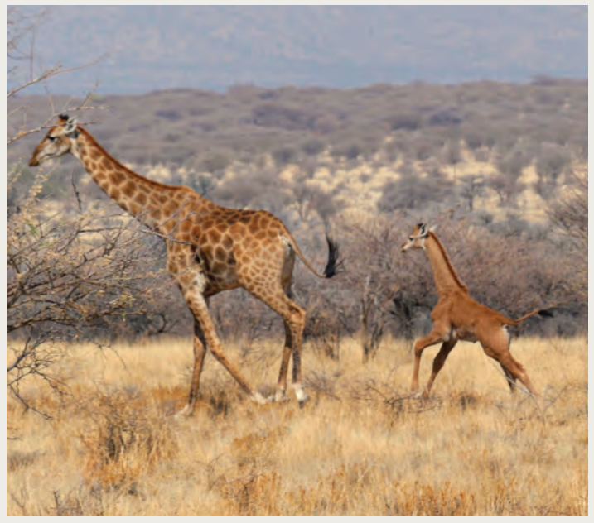
4. On the Coat Tales 没有斑点的长颈鹿

Slide 17
Text Completion
National Geographic (January 2024 BREAKTHROUGHS)
We all know the characteristic _______ (feature) of a giraffe: long neck, hornlike head protuberances, spotted coat. Well, not always. A giraffe _______ (miss) spots was recently photographed ___ the first time in the wild. The unprecedented sighting, at a private game reserve in Namibia, _______ (occur) just weeks after another animal with similar coloring was born at a Tennessee zoo. No data suggest that a solid-brown coat is appearing more ________ (frequent) than in the past, but it’s a surprising coincidence, says Sara Ferguson, a wildlife veterinarian and __________ (conserve) health coordinator at the Giraffe Conservation Foundation. The last _______ (report) all-brown giraffe sighting was in 1972, at a Tokyo zoo. Genetic mutations are the likely cause, ___ the animals don’t seem to be at a disadvantage, says Derek Lee, __ biologist at Penn State University who co-authored a 2018 study __________ found some aspects of giraffe markings are passed down from mother to calf. Are the all-brown giraffes truly spotless? Technically, Lee says, they’re “one-spot-all-over giraffes.”
features
missing
for
occurred
frequently
conservation
reported
but
a
that / which

Slide 18
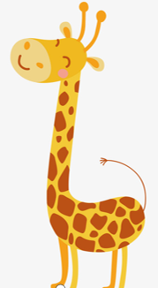
Reading Comprehension
Which of the following statements is correct?
A. Giraffes missing spots are rare both in the wild and at zoos.
B. There has been a sharp rise in the number of spotless giraffes.
C. The first ever spotless giraffe was discovered in 1972.
D. The all-brown feature is an unfavorable one for giraffes.

Slide 19
Vocabulary
1. unprecedented: that has never happened, been done or been known before
前所未有的；空前的；没有先例的
Such a move is rare, but not unprecedented.
这种做法很罕见，但也不是没有先例的。
2. mutation: the way in which genes change and produce permanent differences
（生物物种的）变异，突变
Mutations known to cause disease have been identified in about 1000 genes.
已知导致疾病的突变已在大约1000个基因中被确定。
Translation
这种情况在现代还没有出现过。
The situation is unprecedented in modern times.
Translation
众所周知，辐射会引起突变。
It is well known that radiation can cause mutation.

Slide 20
Translation
A giraffe missing spots was recently photographed for the first time in the wild. The unprecedented sighting, at a private game reserve in Namibia, occurred just weeks after another animal with similar coloring was born at a Tennessee zoo.
最近，一只没有斑点的长颈鹿首次在野外被拍到。这一史无前例的发现发生在纳米比亚的一个私人野生动物保护区，就在几周前，田纳西州的一家动物园里出生了一只性状相似的动物。
Genetic mutations are the likely cause, but the animals don’t seem to be at a disadvantage, says Derek Lee, a biologist at Penn State University who co-authored a 2018 study that found some aspects of giraffe markings are passed down from mother to calf.
宾夕法尼亚州立大学的生物学家Derek Lee说，基因突变是可能的原因，但这些动物似乎并不处于劣势。他与人合著了2018年的一项研究，该研究发现长颈鹿标记的某些方面是由母牛遗传给小牛的。

Slide 21
5. BBC News 01/04/2024

Slide 22
Dictation
The Ukrainian air force says its air defense systems have _______ 35 drones launched in Russia’s latest attacks. The military has now ______ air alerts nationwide warning of missile ______ from Russian bombers. The mayor of the capital Kiev says debris from missiles has fallen on different parts of the city. The ________________ in the capital are still collecting bodies for a Russian aerial attack on Friday.
The government of Panama has said that half a million people risked their lives crossing the Darien Gap last year as they ________________ the US-Mexico border, the number more than _______ from the previous year. The _________ is the only link between South and Central America. Migrants pay thousands of dollars to criminal gangs to guide them through tropical rivers and steep mountains.
The British government says it’s fulfilled a _______ by the prime minister Rishi Sunak to clear a big backlog of outstanding asylum ______. Tens of thousands of migrants have been _____ in the system.
downed
raised
strikes
emergency services
attempted to reach
doubled
jungle area
promise
claims
stuck

Slide 23
Vocabulary
1. debris: pieces of wood, metal, brick, etc. that are left after sth has been destroyed 残骸；碎片；破片
A number of people were killed by flying debris.
有数人被飞射的碎片击中身亡。
2. backlog: a quantity of work that should have been done already, but has not yet been done 积压的工作
There is a backlog of repairs and maintenance in schools.
对各学校的修缮和维护工作积压了一堆。
Translation
救援人员正在清理残骸。
The rescue workers are clearing the debris.
Translation
我有一大堆积压的工作要做。
I’ve got a huge backlog of work to do.

Slide 24
Translation
The government of Panama has said that half a million people risked their lives crossing the Darien Gap last year as they attempted to reach the US-Mexico border, the number more than doubled from the previous year. The jungle area is the only link between South and Central America.
巴拿马政府表示，去年有50万人冒着生命危险穿越达连隘口，试图到达美墨边境，这一数字比前一年增加了一倍多。丛林地区是连接南美洲和中美洲的唯一通道。
The British government says it’s fulfilled a promise by the prime minister Rishi Sunak to clear a big backlog of outstanding asylum claims. Tens of thousands of migrants have been stuck in the system.
英国政府表示，已履行首相苏纳克的承诺，清理大量积压的未处理庇护申请。成千上万的移民被困在这个体系中。

