Slide 1

感恩遇见，相互成就，本课件资料仅供您个人参考、教学使用，严禁自行在网络传播，违者依知识产权法追究法律责任。
更多教学资源请关注
公众号：溯恩高中英语
知识产权声明

Slide 2




My Clever, Curious, Caring Cat
读后续写讲评
聚焦衔接（情节＋语言）
浙江丽水龙泉一中 兰建珍
Notes:
更多模板亮亮图文旗舰店：https://liangliangtuwen.tmall.com

Slide 3

StepⅠAnalyse: 分析前文，总结大意
1. 5W (who, when, where, what, why)＋1H (how)
阅读下面材料，根据其内容和所给段落开头语续写两段，使之构成一篇完整的短文。
1 The Christmas holidays were fast approaching, and we had ordered many gifts online. So, when the doorbell rang, I was sure some of the packages had arrived. I ran to the door and swung it open, but no one was there. I sensed something and looked down, only to find a beautiful calico kitten (杂色猫) sitting there, looking up at me with big, intelligent eyes. There was no way that she could have rung the doorbell by herself, was there?
2 We figured that someone had found the kitten somewhere and left her there, and then rang the doorbell and ran away. They accurately guessed we would welcome an additional family member and take care of her.
3 My husband called her our little angel, so we named her accordingly. She had a calm aura (气质) about her as she walked straight into our home and hearts, fitting in perfectly. It seemed as if she was always meant to be in this big house with us. She was an old soul and turned out to be the perfect companion. Always by my side, she was more like a puppy than a kitten. Wise beyond her years, she enjoyed wandering through the tunnels and mysterious rooms as much as I did, but with much less fear. Angelica the calico was courageous.
4 So, I took a page from her book and decided to be brave, too. There was an underground stone cellar (地窖) I had been eager to explore. The only way in was down a rickety (摇晃的) ladder to its murky(阴暗的，难以理解的) depths. I guessed it was an old root cellar, probably twelve feet deep.
5 I had promised my husband that I wouldn’t explore dangerous areas unless he or someone else was around. Though I knew I was stretching it, I figured that Angelica would count as my companion. I was ready to explore this cellar, and so was she.
6 I equipped myself with a good flashlight and warm clothes, and carefully started down the rickety ladder while Angelica was looking down at me from above. Faint crack and sudden crash were what I could remember.
注意：1. 续写词数应为 150 个左右； 2. 请按如下格式在答题卡的相应位置作答。
I woke up with pieces of the rotting, broken ladder lying around me on the stone cellar floor. ____________________________
It seemed my companion, Angelica, was my last hope. ___________________________________________________________
Setting: how the calico kitten became a member of my family
calm, wise, curious & courageous
Angelica was .
4. main character(s) characteristics
“I”: curious; decided to be brave and ready to try...
2.problem
my adventure in the cellar
5. theme
(echo)
3.solution?

Slide 4
StepⅡ Plot: 情节的衔接
...Faint crack and sudden crash were what I could remember.
Para.1: I woke up with pieces of the rotting, broken ladder lying around me
on the stone cellar floor. ______________
Para.2: It seemed my companion, Angelica, was my last hope. _____

Slide 5
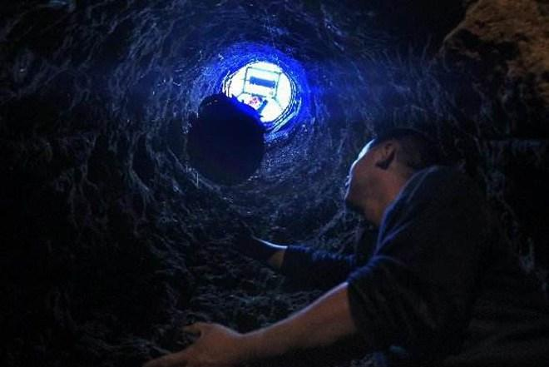
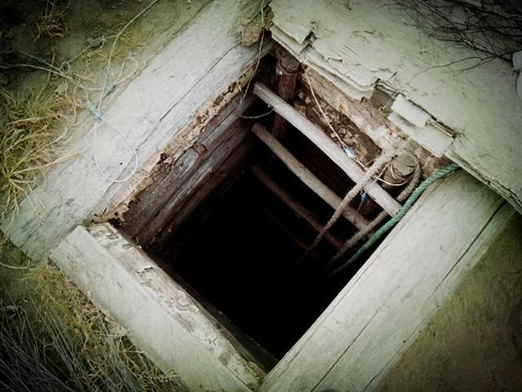
StepⅡ Plot: 情节的衔接
...Faint crack and sudden crash were what I could remember.
Para.1: I woke up with pieces of the rotting, broken ladder lying around me
on the stone cellar floor. ______________
coherence 1
Scene 1:
my situation (my body; feeling, saying, doing, thinking;)
Scene 2:
self-rescue (cry for help; cell phone;flashlight...); ＋failed
coherence 3
Scene 3:
notice Angelica (sound/meow;see/hear...;...)
coherence 2
Para.2: It seemed my companion, Angelica, was my last hope. _____
coherence 4
hatch
Scene 1:
got Angelica to help me out
coherence 5
Scene 2:
my anxiety and finally got help
coherence 6
Scene 3:
happy ending: got saved (theme: angel & perfect companion;
gift, miracle)
underground stone cellar
with murky depths

Slide 6
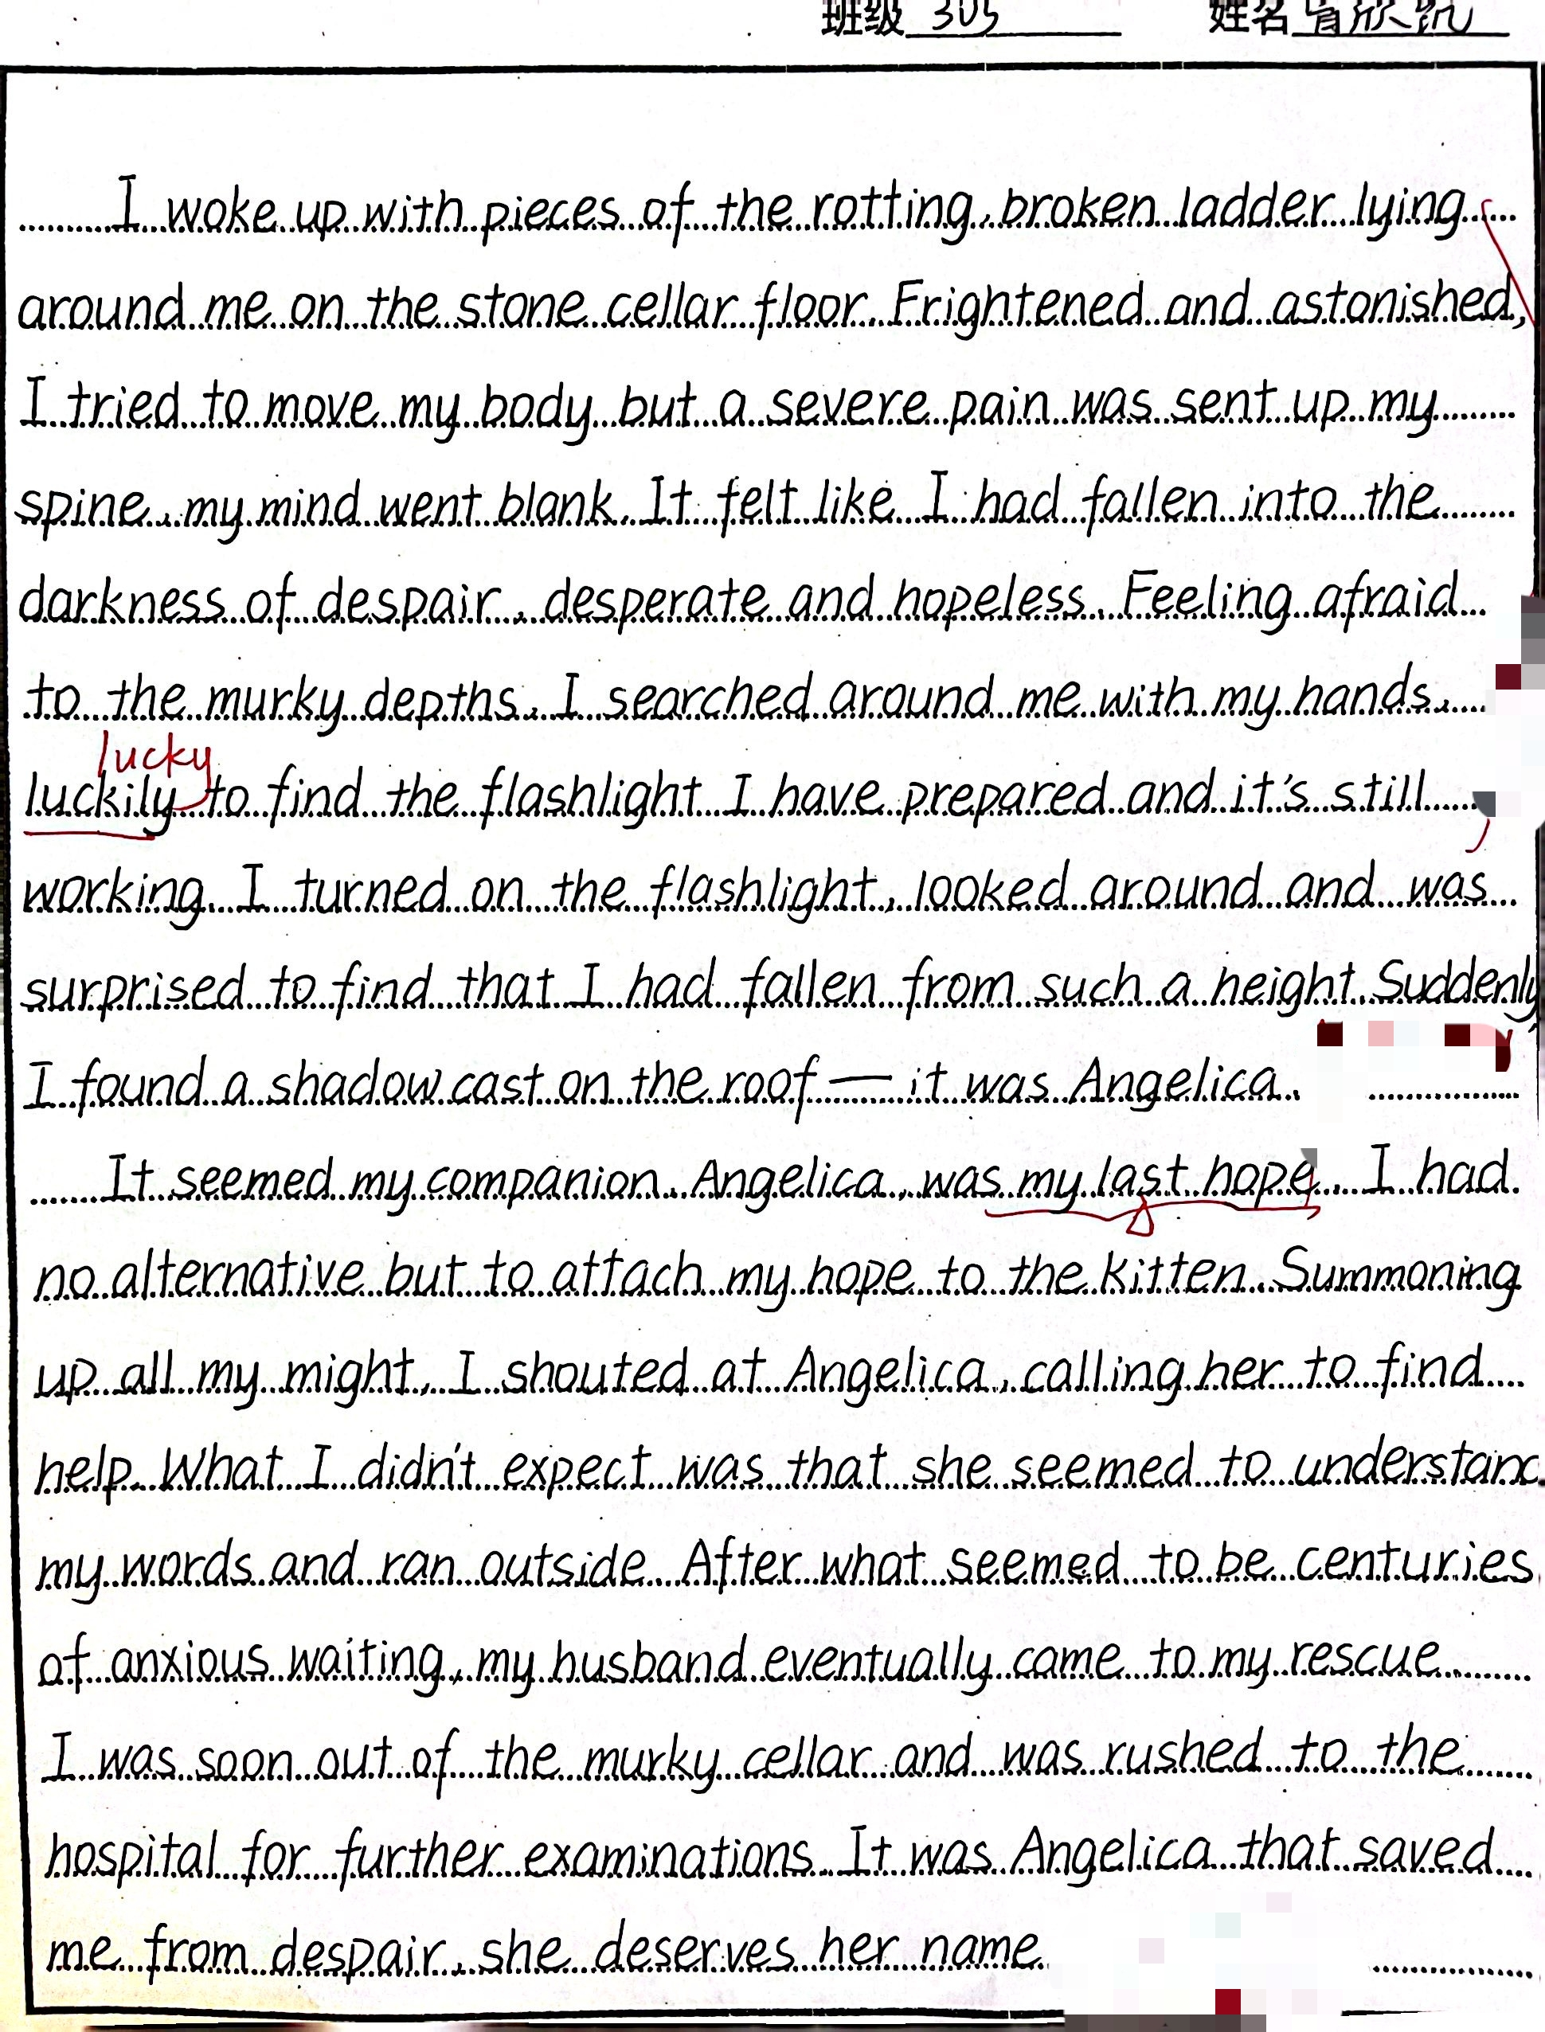
StepⅡ Polish: 情节＋语言的衔接
①②...desperate and hopeless.
③Feeling afraid of the murky depths, I plucked up my courage to search around, hoping to find a possible way out, but in vain.
④Later, I was lucky enough to find my flashlight I prepared before, considering it as a good tool to attract the attention of people outside. However, no response/no luck! / this did not work either.
⑤I was getting into an abyss of desperation when suddenly a shadow cast on the wall popped into my eyes — it was Angelica.
Your comment:
＊hand-writing 5’
Passage
A:
＊a coherent & logical plot 10’
＊Language 10’ (accurate & rich):
1. picture the scene vividly;
2. abundant fantastic expressions;
3. diverse sentence patterns;
4. saying, doing, feeling & thinking
several attempts but failed
Coherence:
plot & language！！！
got Angelica to help me out
How to correct it?
my anxiety and finally get help
happy ending: got saved (theme: angel)

Slide 7
I woke up with pieces of the rotting, broken ladder lying around me on the stone cellar floor. Aching and confused, I struggled up and wiped the dirt off my clothes, scanning around, only to be greeted with a dreadful darkness. I turned on my flashlight, faint glow dispelling the darkness as well as my fear. Cocooned 包围in the rotten odour / ˈəʊdə(r)/ 臭味, I frowned and covered my mouth, striving to find my way out, but in vain. The freezing air went through my collar and my slight footsteps terrified me again. I had to admit I was not as courageous as Angelica. Searching up and down, I still couldn’t hatch an idea to extricate 使...逃离myself. At this crucial juncture 紧要关头, the constant meows of Angelica caught my attention.
It seemed my companion, Angelica, was my last hope. She seemed to sense my dilemma and was anxious to help me out. Angelica circled around nervously as she let out loud meows to arrest passers-by’s attention. No luck! Then she suddenly ran away, leaving me in a desperate situation. “Does she give up on me?”I murmured to myself. It seemed that the last ray of light in my world had dimmed. Maybe I would end up there. Just as I was about to give up, Angelica appeared with one of our neighbors, who helped me out successfully. It turned out that Angelica was running away for someone to come to my rescue. I held Angelica tightly in my arms as I shed grateful tears uncontrolably. I knew deeply in my heart that Angelica was a true angel of our family, also a perfect companion.

Slide 8
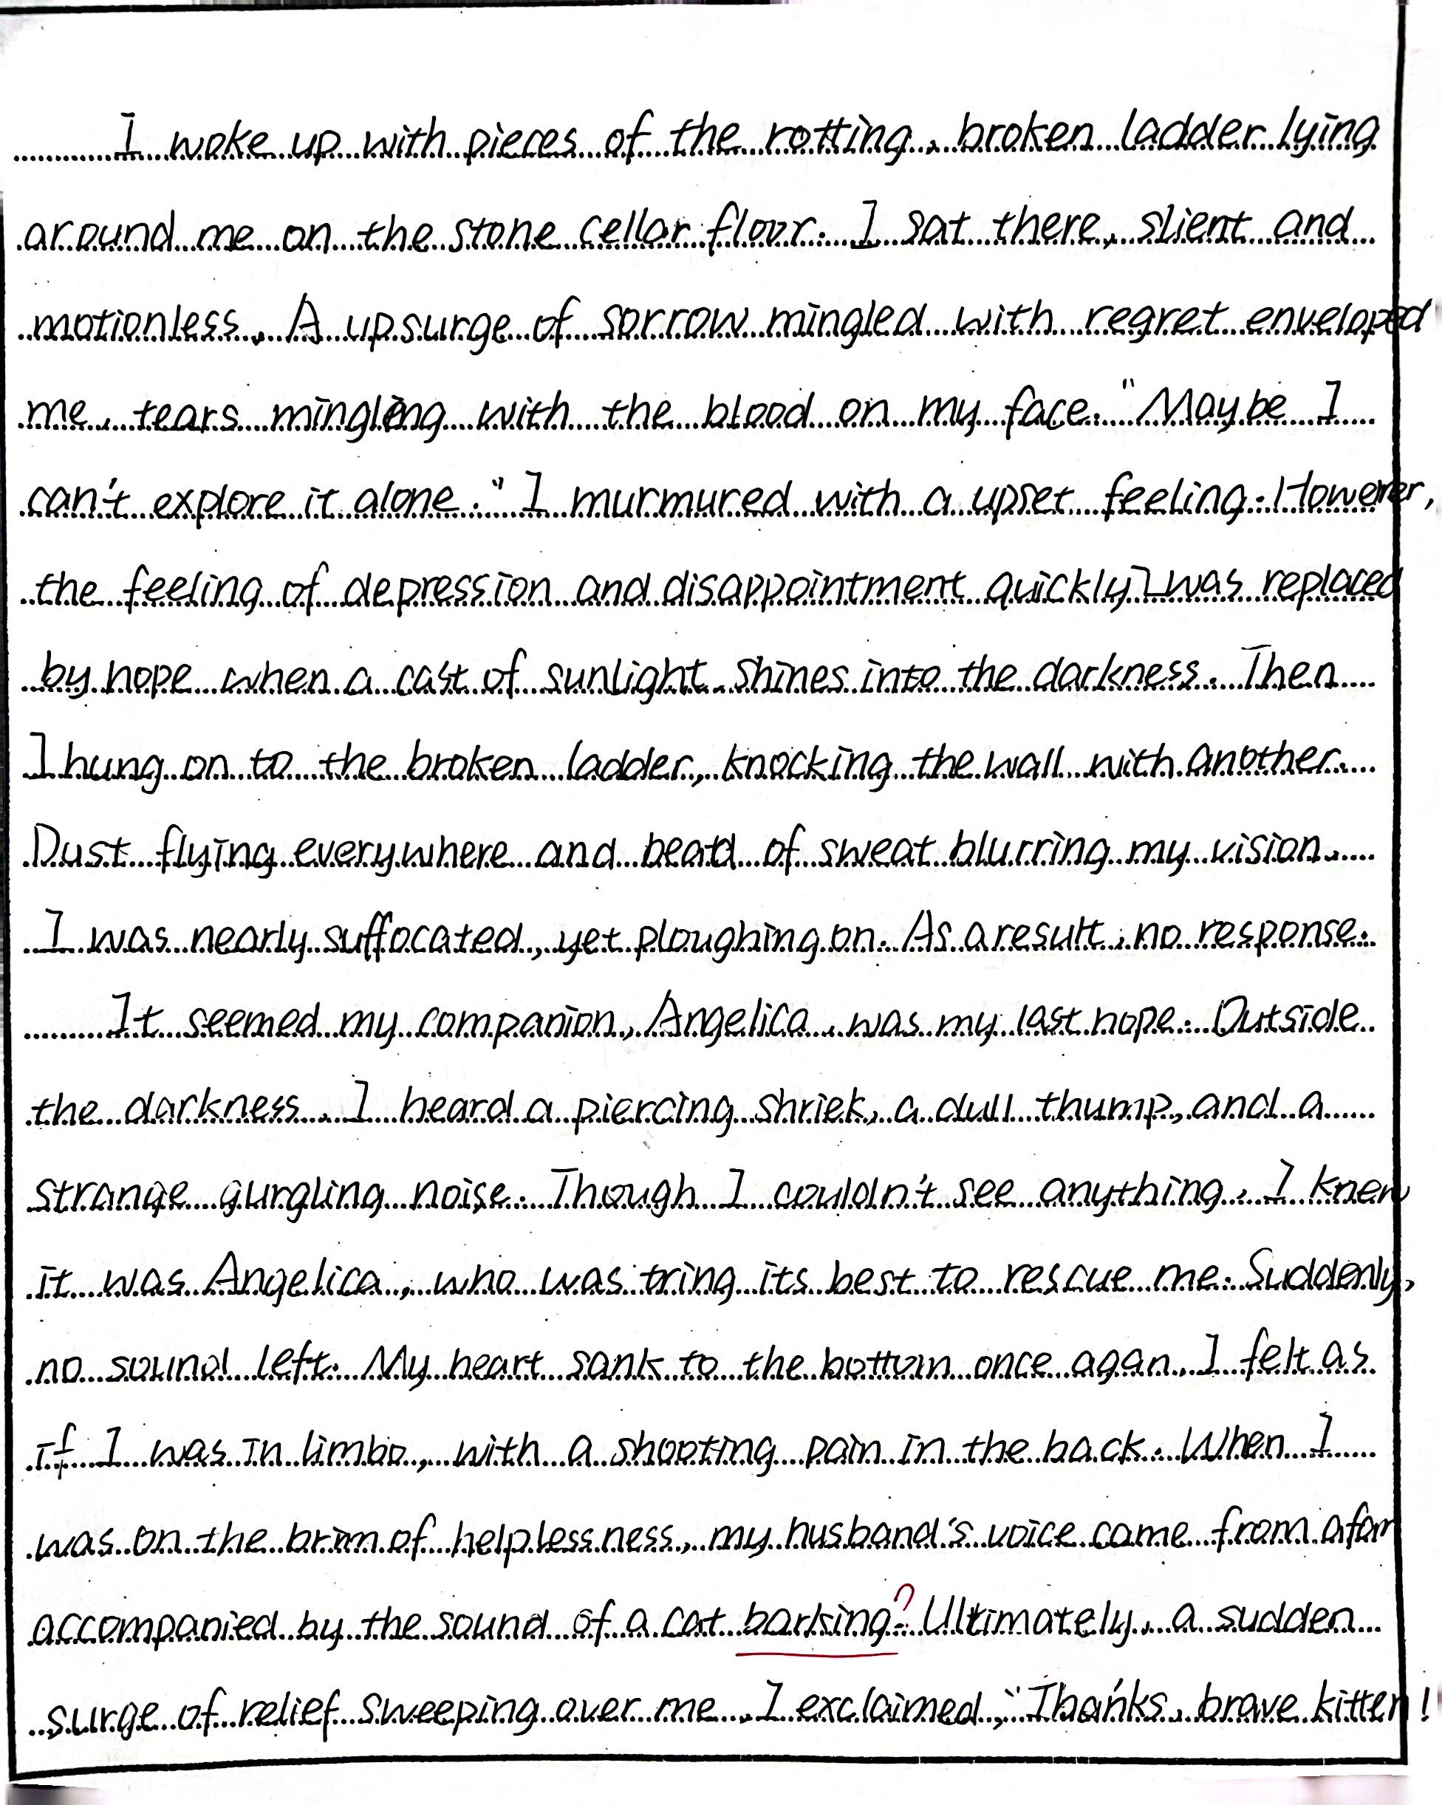
1. Aching and confused, I struggled up and wiped the dirt off my clothes, scanning around, only to be greeted with a dreadful darkness.
feeling
2. “If only I hadn’t explored the cellar alone...” I murmured. Suddenly, I remembered I’d brought my cell phone with me. Reaching into my pocket, I pulled out a shattered phone. Sadly, however, I wasn’t getting any signal down in this pit.
self rescue & failed
4. However, my disappointment was replaced by hope when a cast of sunlight slanted into the darkness. Squinting, I could make out a fuzzy and round object, which turned out to be Angelica, who was always there caring about me .
3. Then I tried to knock at the wall with a broken piece of ladder, trying to arrest others’ attention, but it didn’t work, either.
self rescue & failed again
from disappointment to hope

Slide 9
I tried calling Angelica, which was answered with her worried meows. She wandered around anxiously, meowing repeatedly, hoping to arrest the attention of the people passing by. No luck!
The next moment, before I could figure out what I should do, Angelica ran away, which put me in a desperate situation. “Will she give up on me?” I wondered. But just before I had time to come up with another way out, there came Angelica and my husband, who somehow learned my situation from Angelica and came to my rescue.
happy ending: got saved (theme: angel & perfect companion; gift, miracle)
got Angelica to help me out
Once out of the dark cellar, I held Angelica tightly, and deep down at heart I knew that she was meant to be our angel, our perfect companion!
my anxiety and finally got help

Slide 10
Sharpening your axe will not delay your job of chopping wood.
磨刀不误砍柴工！

Slide 11
Homework
1. Rewrite , evaluate and polish your writing;
2. Mark (评分) your partner’s writing and hand in all your works.

Slide 12
Thank you

