Slide 1

感恩遇见，相互成就，本课件资料仅供您个人参考、教学使用，严禁自行在网络传播，违者依知识产权法追究法律责任。
更多教学资源请关注
公众号：溯恩高中英语
知识产权声明

Slide 2
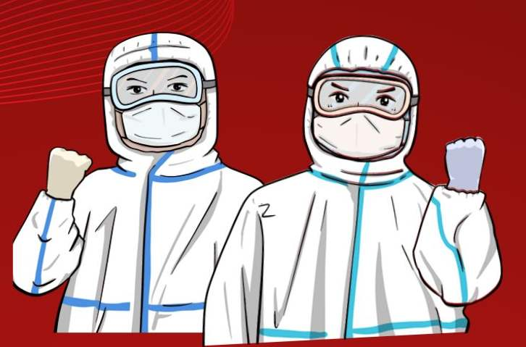
Emphatic “it”structure

Slide 3

Focus on the structure
Hello virus from Wuhan
Another problem's here again
Because you see the contagion creeping
And the virus is indeed spreading
And the memory of SARS planted in my brain still remains
We stand and fight the virus
We hear of theories how it grew
From snakes and bats became a flu
Passing the sickness from man to man
Now it's growing, getting out of hand
_________________________________
_________________________________
We have to fight the virus...
Listen to the song and complete the lyrics.
It's a virus that has travelled near and far Corona

Slide 4
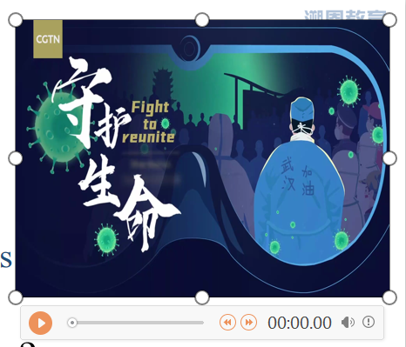
Millions of moving stories happened during the way to fight against COVID-19...
Watch the video and answer the questions.
What happened to Han and his father?
Where did Han go after being tested positive?
What did Temporary Hospitals transform from?
Who tended Han and danced with the patients to ease their anxiety?
It was ____________ that ________ Han and his father. And both of them were infected.
COVID-19
struck
It was __________________ that ___________after being tested positive.
a Temporary Hospital
Han went to
It was _______________ that temporary hospitals were transformed from.
the city's venues
It was________________who/ that tended Han and danced with the patients to ease their anxiety.
the medical staff

Slide 5


Emphatic “it”structure:
It is /was +被强调的部分+that (who)+其他
当被强调的部分是人的时候可用who、that

Slide 6
Han lost contact with his father after being tested positive in Wuhan.
It was Han that /who lost contact with his father after being tested positive in Wuhan.
强调主语
It was his father that/who Han lost contact with after being tested positive in Wuhan.
强调宾语
It was after being tested positive that Han lost contact with his father in Wuhan.
强调时间状语
It was in Wuhan that Han lost contact with his father after being tested positive.
强调地点状语

Slide 7
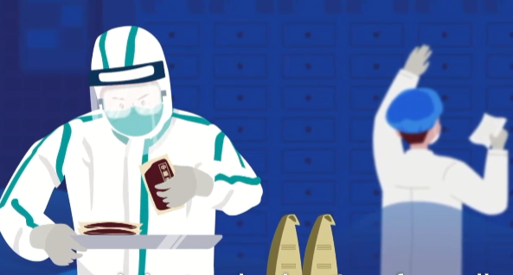
It was traditional Chinese medicine that helped many of them alleviate(减轻) symptoms.
________________________________________________________________________(改为一般疑问句)?
Was it traditional Chinese medicine that helped many of them alleviate(减轻) symptoms.
____________________________________________________________________________________
(改为特殊疑问句)?
How was it that traditional Chinese medicine helped many of them alleviate(减轻) symptoms.
强调句型的一般疑问句式：
Is /Was+it+被强调的部分+that/who+其他
强调句型的特殊疑问句式：
特殊疑问词+it is/was+that+其他成分

Slide 8
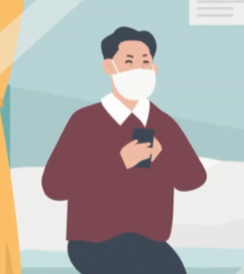
Han's father didn't get a full recovery until 15 days later.
___________________________________________ (改为强调时间状语的强调句)?
It was not until 15 days later that Han's father get a full recovery.
在not...until结构中，强调由until 引导的短语或从句表示的时间状语时，要用固定的强调句型 It is/was not until...that...

Slide 9
Focus on the function
Why do we use it?
Contrast
Version A | Version B
Han lost contact with his his father and tried to recontact him. | It was Han's father that he lost contact with and tried to recontact.
The medical staffs ' selfless commitment and hard work saved Han and his father. | It was the medical staff' selfless commitment and hard work that saved Han and his father.
Function1:
to emphasize key information
Function2:
to stress the mood/attitude/emotion of the speaker

Slide 10
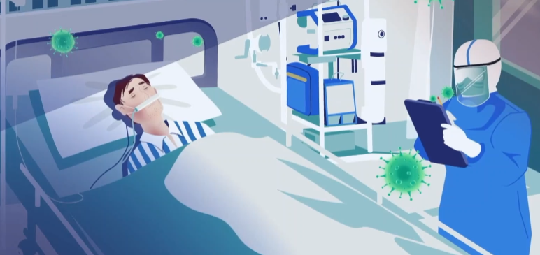
Focus on the rules
是医生们冒着生命危险24小时照顾病人。
It was the doctors that risk their lives to give the patients close monitoring and 24-hour care.
强调主语时，that/who后面的谓语动词的形式要与前面被强调的主语一致；
强调句中It 不能更换为其他代词, is/was 数的形式不受被强调部分单复数影响

Slide 11
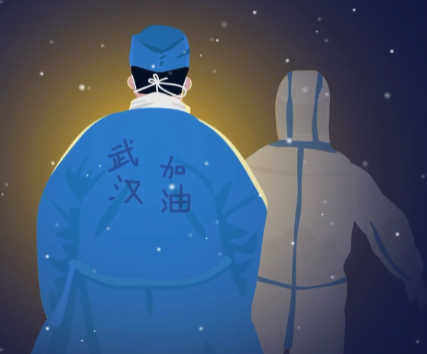
Which one is a sentence with emphatic structure?
Their heroic deeds that President Xi spoke highly of in his speech really deserve our sincere appreciation.
It was their heroic deeds that President Xi spoke highly of in his speech.
定从
强调句
判断方法：将it is/was...that (who)去掉，适当调整语序，句子依然完整那就是强调句。

Slide 12
It is /was +被强调的部分+that (who)+其他
结构
疑问句式
特殊句式
1. 对重要信息进行强调
强调句
功能
2. 对说话者的语气/情感/态度进行强调
that/who后谓语动词的单复数
注意事项
is/was 数的形式
强调句的判断

Slide 13
Focus on application
回归课本
强调句
考试应用

Slide 14
回归课本
我不知道这是不是因为我长久无法出门的缘故，我变得对一切与大自然有关的事物都无比狂热。(M1U1)
I wonder if it's because I haven't been able to be outdoors for so long that I've grown so crazy about everything to do with nature. (M1U1)
强调原因状语
首先想到要沿整条湄公河从源头到终点骑车旅行的正是我的姐姐。(M1U3)
It was my sister who first had the idea to cycle along the entire Mekong River from where it begins to where it ends. (M1U3)
强调主语

Slide 15
回归课本
是在夏季奥运会上有赛跑、游泳、帆船运动和所有的团体项目。(M2U2)
It's in the Summer Olympics that you have the running races, together with swimming, sailing and all the team sports. (M2U2)
强调地点状语
进一步阅读使我了解到是苦干、决心和善良的天性使她走进了医学院的大门。(M4U1)
Further reading made me realize that it was hard work and determination as well as her gentle nature that got her into medical school. (M4U1)
强调主语

Slide 16
回归课本
正是约翰迅速的动作和急救知识挽救了斯莱德女士的性命。(M5U5)
It was John's quick action and knowledge of first aid that saved Ms Slade's life. (M5U5)
强调主语
事实上，是精神上的瘾而不是身体上的影响使得戒烟非常困难。(M6U3)
In fact, it is the mental addiction rather than the physical effects that makes it really hard to quit smoking. (M6U3)
强调主语

Slide 17
回归课本
地球变暖正是人类活动导致的，并非一种随意的自然现象。(M6U4)
It is human activity that has caused this global warming rather than a random but natural phenomenon. (M6U4)
强调主语
是一名叫查尔斯肯林的科学家八57-1997年期间大气层中二氧化碳的含量作了精确的统计。(M6U4)
It was a scientist called Charles Keeling, who made accurate measurements of the amount of carbon dioxide in the atmosphere from 1957 to 1997. (M6U4)
强调主语

Slide 18
回归课本
正是越来越多的化石燃料的燃烧导致了二氧化碳的增加。(M6U4)
It is the burning of more and more fossil fuels that has resulted in this increase in carbon dioxide. (M6U4)
强调主语

Slide 19

考试应用
A letter of thanks
假如你是韩，在你爸爸住院期间他所在的同济医院的医护人员对他悉心照料，现在你爸爸已经出院回家。你决定替爸爸写一封英文感谢信给医护人员，内容包括：
1. 对同济医院的医护人员的悉心照料表示感谢；
2. 描述医护人员对你爸爸住院期间的帮助；
3. 再次表达感谢。
注意：
1. 词数80左右；
2. 可以适当增加细节，以使行文连贯；

Slide 20
Dear medical workers, On behalf of my father, I would like to express my sincere thanks to you when he was in your hospital. Earlier in February, my father was severely infected and was sent to your hospital. 是你们不顾感染的危险日夜照顾他；是你们的不断鼓励逐渐消除了他的不安和害怕；最重要的是，是因为你们的及时的救助,专业的技能以及精心的治疗挽救了他的生命，让他恢复了健康。
Our thankfulness to you is beyond words. Thank you again!
Yours sincerely, Li Hua

Slide 21
A sample version:
Dear medical workers, On behalf of my father, I'd like to express my sincere thanks to you when he was in your hospital. Earlier in February, my father was severely infected and was sent to your hospital. It is you who, regardless of the potential risk of infection, tended him day after night. It is also your continuous encouragement that soothed his anxiety and fear. Most importantly, it was because of your timely aid, professional skills as well as careful treatment that saved him and helped him recover from COVID-19.
Our thankfulness to you is beyond words. Thank you again!
Yours sincerely, Li Hua

Slide 22

Consolidation
Lyrics Blank Filling
Suppose you were Han. You are composing a song to highlight the arduous efforts of the front-line medical staff .
It Was You
It was you
Who ___________________
I always knew
That you'd stand beside me
And it was you
Who ___________________
When the skies were dead grey
And it was you
Who ___________________
Since the day I went there
It was you
Who ____________________
With your hands that are warm
I know I can count on you
_________________________
Because the faith I had in you
_________________________
It was you
That I really__________
It was you
That I deeply _________

Slide 23
It Was You
It was you
Who showed me a friend I can see
I always knew
That you'd stand beside me
And it was you
Who stuck with me on the way
When the skies were dead grey
And it was you
Who tended me with care
Since the day I went there
It was you
Who helped me out of the storm
With your hands that are warm
I know I can count on you
Whenever life is blue
Because the faith I had in you
Helps me through
It was you
That I really appreciated
It was you
That I deeply admired
...

Slide 24
Homework
1. Go over the emphatic structure.
2. Finish the given exercise.

Slide 25

The end

