Slide 1
感恩遇见，相互成就，本课件资料仅供您个人参考、教学使用，严禁自行在网络传播，违者依知识产权法追究法律责任。
更多教学资源请关注
公众号：溯恩英语
知识产权声明

Slide 2
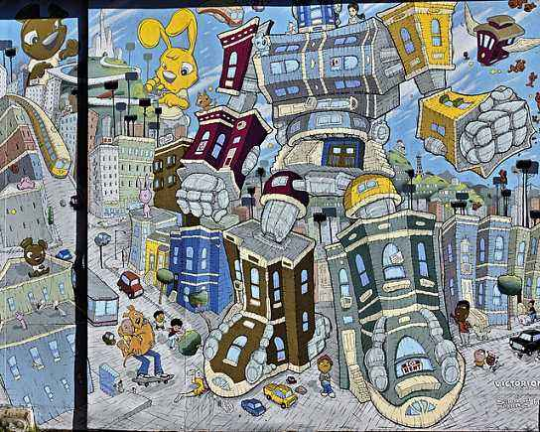
B3U3 Diverse Cultures
Reading and thinking
Language study

Slide 3
Para 1.
1. I have to admit that it definitely feels good to be back in the city again.
it 形式主语，真正的主语是动词不定式短语
to be back in the city again
admitted, admitted
feel link.v to give you a particular feeling or impression
给…感觉；有印象；感受到
The desk feels smooth.
2)我回到母校有一种生疏的感觉。
It felt strange to be back in my old school.

Slide 4
permit sb to do sth.
to allow somebody to do something or to allow something to happen
允许；准许某人做…
admit sb/ (in) to +n
to allow somebody/something to enter a place 准许…进入（某处）
to allow somebody to become a member of a club, a school or an organization
准许…加入（俱乐部、组织）；接收（入学）
1) 铃响后不许进入考场。
You will not be admitted to the examination room after the bell rings.
2) 去年她被北京大学录取。
Last year, she was admitted into Peking University.
admit
v.

Slide 5
admit sb/ (in) to +n
to allow somebody/something to enter a place 准许…进入（某处）
to allow somebody to become a member of a club, a school or an organization
准许…加入（俱乐部、组织）；接收（入学）
admit (to) (doing) sth.
to agree, often unwillingly, that something is true（常指勉强）承认
admit
v.
She admitted the mistakes.
She admitted to being strict with her children.
What's the admission?
门票多少钱？
admission n.
1) 承认;供认
2) the amount of money that you pay to go into a building or to an event入场费；门票费

Slide 6
2. What a city—a city that was able to rebuild itself after the earthquake _________ (occur) in 1906.
occurred
同位语，补充说明前文的city，再带一个that引导的定语从句，说明这座城市的了不起的原因。
occur vi. --occurred—occurred
Describe a place/a person using the structure:
What a(n)+n --- a(n) +n that/which/who…
1) to happen
发生；出现
2) be found
被发现，想起/到
发生了一件出乎意料的事。
Something unexpected occurred.
某人突然想到：
It occurred to sb that…
It struck sb that…
It hit sb that…
我突然想到门没有锁上。
It occurred to me that I had left the door unlocked.

Slide 7
3. There are so many beautiful old buildings – many _______ (sit) on top of big hills, ________ (offer) great views of the city, the ocean, and the Golden Gate bridges.
sitting
offering
独立主格结构，补充说明buildings
现在分词短语，充当结果状语
After a while, a group of women came along, each balancing a pot of water on her head. (B3U2 p 20)
这里有众多美丽的古建筑– 不少坐落于大山之巅，城市、大海和金门大桥美景尽收眼底。

Slide 8
Para 3
headed to
1. In the afternoon, I _______ ______ (前往) a local museum that showed the historical changes in California.
head v. to move in a particular direction 朝（某方向）行进
She stood up and headed to/toward/for the exit.
2. Over 300,000 people came from all over the world to seek their fortune.
seek one’s fortune:
to try to find a way to become rich, especially by going to another place
外出寻找发财机会；外出闯荡；闯世界
seek—sought—sought v. to look for something/somebody寻找

Slide 9
seek for sb/sth寻找某人/某物
They are seeking for solutions to the problems.
seek
v.
seek to do sth
试图做某事
They are seeking to solve the problem.
seek sth from sb
向某人请求、寻求
She managed to calm him down and seek help from a neighbour.

Slide 10
a large amount of money 大笔的钱；巨款
make a fortune 发财
Nowadays many young people dream of making a fortune in big cities.
fortune n.
a person’s fate or future 命运，前途
她可凭看手纹替你算命。
She can tell your fortune by looking at the lines on your hand.
fortunate adj.
fortunately adv.

Slide 11
3. To earn a living, some opened up shops and restaurants in Chinatown.
make a living
谋生
He made/earned a living by selling newspapers when he was young.
to get money for work that you do
挣得；赚得
She must have earned a fortune.
earn v.
earn sb. sth.
(a reputation /respect)
某人赢得名声/尊敬
Your efforts will earn you a good reputation.

Slide 12
Activity 6 P 29
1. occurred, downtown, District
2. definitely, admit, region

Slide 13
Activity 6 P 29
1. Over 3,000 lives were claimed in the 1906 San Francisco earthquake and the series of fire that occurred after it.
claim v.1) (of a disaster, an accident, etc.灾难、事故等)
to cause somebody’s death 夺走，夺去（生命）
那次撞车事故导致三人死亡。
The car crash claimed three lives.
2) to say that something is true although it has not been proved and other people may not believe it 宣称；声称；断言
1) 我不敢自称为专家。
I don't claim to be an expert.
2) 据说有些医生每周工作 80 小时。
It was claimed that some doctors were working 80 hours a week.

Slide 14
2. It is the best region of China to escape the cold winter.
escape (from)…
to get away from a place where you have been kept as a prisoner or not allowed to leave（从监禁或管制中）逃跑，逃走，逃出
to get away from or avoid something unpleasant or dangerous
避开，避免（不愉快或危险的事物）
They escaped from the castle at last.
She was lucky to escape punishment.
3) She escaped ________________(punish).
escape n.
死里逃生
What a narrow escape！
2） (防火)太平门[梯]
fire escape
being punished
escape sth./doing /being done

