Slide 1
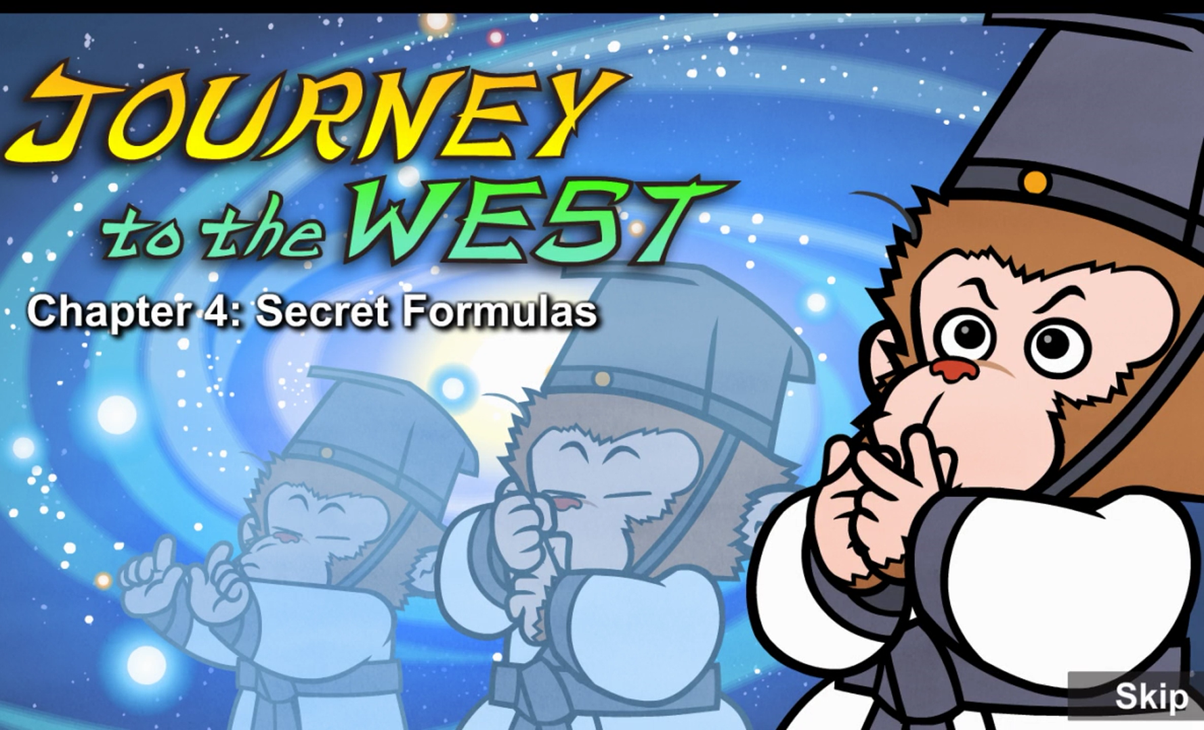
Episode 4 Secret Formulas

Slide 2
Part 1 quiz
1. How did Wukong learn to live forever?
A. Subodhi whispered formulas into his ear.
B. Subodhi turned himself into a tree.
C. Wukong learned by himself.
2. What did Wukong do while the other students slept?
A. He did powerful exercises.
B. He studied old books.
C. He practiced secret formulas.
3. What did Wukong show the other students he could do?
A. turn into a tree B. ride on a cloud C. change into a bird
4. Why did Wukong have to leave?
A. He learned everything. B. He wasn't safe. C. He had to return home.
5. Where did Wukong arrive?
A. the Fruit and Flower Mountain B. the ocean C. the temple
Keys: ACABA

Slide 3
Part 2 vocabulary
1. formula [ˈfɔːmjələ] n. (可达到特定⽬的的)⽅式，⽅法
The sage whispered prayers as well as secret formulas about the universe and nature.
2.secret formula秘诀
The sage whispered prayers as well as secret formulas about the universe and nature.
3.crept[krept] v. 蹑⼿蹑脚地⾛，缓慢地⾏进 (creep-crept)
At three o'clock in the morning, he crept quietly through the dark temple.
4.prayer [preə(r)] v.祷告
The sage whispered prayers as well as secret formulas about the universe and nature.
5.meditate [ˈmedɪteɪt] v.冥想，沉思
For the next few years, Sun Wukong meditated and practiced the secret formulas.

Slide 4
6.soar [sɔː(r)] v.⾼飞，往上飞舞
He could turn into other animals and soar through the sky on clouds.
7.enormous [ɪˈnɔːməs] adj.巨⼤的，庞⼤的 An enormous pine tree stood in his place. 8.flash [flæʃ] vi.闪光，闪烁 Subodhi's eyes flashed with anger. 9.show off 卖弄，炫耀 Not so you could show off! 10.repay [rɪˈpeɪ] v. 1. 报答，报恩， (2. 还(钱)) I must repay you first. 11.stay out of trouble 不惹是⾮，避开⿇烦 Just try to stay out of trouble. 12.evil[ˈiːvl] adj.邪恶的，坏的 I can see that you will do evil things someday. 13.hang one's head 把头垂下 Wukong hung his head.

Slide 5
10.shape形状，样Soon his mind and body were powerful, and he could change shape or size.
11.soar飞，往上飞舞He could turn into other animals and soar through the sky on clouds.
12.lately最近You have been busy lately.
13.interested 感兴趣的Everyone looked very interested.
14.enormous 巨⼤的，庞⼤的An enormous pine tree stood in his place.
15.amazing 惊⼈的，令⼈吃惊的That's amazing!
16.truly真实地，真正地The monkey is truly powerful!
17.noise声响，喧闹声The noise disturbed Subodhi.
18.disturb妨碍，打乱The noise disturbed Subodhi.
19.flash闪光，闪烁Subodhi's eyes flashed with anger.
20.taught讲授，教 (teach-taught)
I taught you the secret formulas so you could live forever.
21.show off卖弄，炫耀Not so you could show off!
22.harm损伤，损害If you don't tell them, they might harm you.
23.repay1. 报答，报恩， (2. 还(钱))I must repay you first.
24.stay out of trouble 不惹是生非⾮，避开麻烦Just try to stay out of trouble.
25.evil 邪恶的，坏的I can see that you will do evil things someday.
26.someday将来有⼀天I can see that you will do evil things someday.
27.hang one's head 把头垂下Wukong hung his head.

Slide 6
Part 3 sentences
1. At three o'clock in the morning, he crept quietly through the dark temple.
2. I knew you were a worthy student.
3. They leaned in closer to WuKong
4. Subodhi's eyes flashed with anger.
5. I must repay you first.

